Slide 1
CHAPTER 6
Risk and Return

Slide 2
Topics in Chapter
Read sections 1, 2, 5, 6a, 7acd.
Basic return and risk concepts
Stand-alone risk
Risk in a Portfolio Context
Risk and return: CAPM/SML
Market equilibrium and market efficiency
Notes:
1

Slide 3
Determinants of Intrinsic Value: The Cost of Equity
Net operating
profit after taxes
Required investments
in operating capital
−
Free cash flow
(FCF)
=
FCF₁
FCF₂
FCF∞
Value = + + +
(1 + WACC)¹
(1 + WACC)²
...
(1 + WACC)∞
Weighted average
cost of capital
(WACC)
Market interest rates
Cost of debt
Cost of equity
Firm’s debt/equity mix
Market risk aversion
Firm’s business risk

Slide 4
Overview
Two behavioral assumptions about investors:
Non-satiation: prefer high return;
Risk aversion: don’t like risk.
Therefore there is a trade-off relationship between Risk and Return.
In this chapter, we define and measure risk, and examine the relationship between Risk and Return in a quantitative way.

Slide 5
6-1 Investment Returns and Risk 6-1a Returns on Investments
Investment returns measure the financial performance of an investment.
Returns may be historical (realized) or prospective (expected).
Returns can be expressed in:
Dollar terms.
Percentage terms.

Slide 6
An investment costs $1,000 and is sold after 1 year for $1,100.
Dollar return:
$ Received - $ Invested
$1,100 - $1,000 = $100
Percentage return:
$ Return/$ Invested
$100/$1,000 = 0.10 = 10%
The rate of return (percentage return) “standardizes” the return calculation in terms of accounting for the scale of investments and the timing of cash flows by considering the periodic return per unit of investment.
Notes:
2

Slide 7
6-1b Stand-Alone Risk versus Portfolio Risk
Investment risk is exposure to the chance of earning less than expected.
The greater the chance of a return far below the expected return, the greater the risk.
An asset’s risk can be analyzed in two ways: (i) on a stand-alone basis; (ii) on a portfolio basis. We start with stand-alone risk, then examine the asset’s risk in a portfolio context.
Notes:
2

Slide 8
6-2 Measuring (Stand-Alone) Risk for Discrete Distributions 6-2a Probability Distributions for Discrete Outcomes
(Discrete) Probability distribution: a listing of all possible outcomes, with a probability (chance of occurrence) assigned to each outcome.
Notes:
2

Slide 9
Example: Scenarios and Returns for a Stock Over the Next Year
Scenario | Probability | Return
Worst Case | 0.10 | −14%
Poor Case | 0.20 | −4%
Most Likely | 0.40 | 6%
Good Case | 0.20 | 16%
Best Case | 0.10 | 26%
 | 1.00

Slide 10
Discrete Probability Distribution for Scenarios

Slide 11
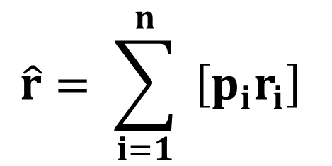
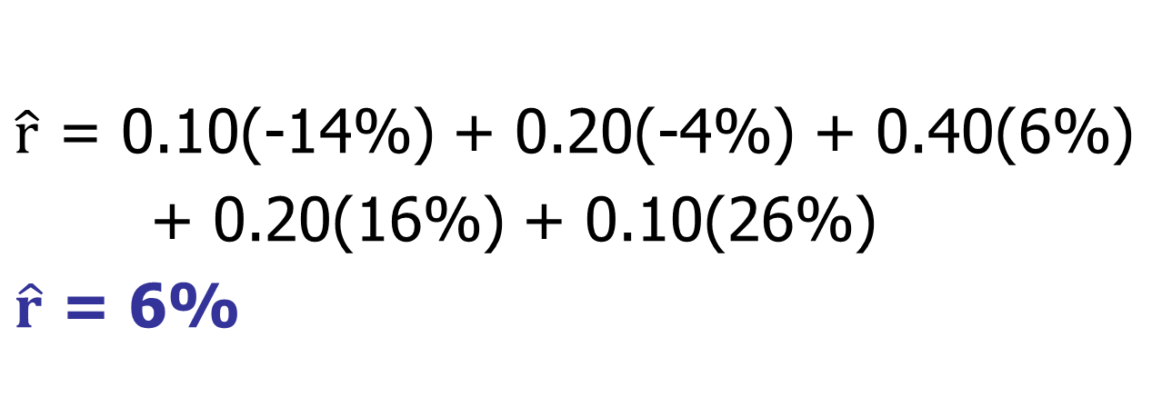
6-2b Expected Rate of Return for Discrete Distributions

Slide 12
Use Excel to Calculate the Expected Value of a Discrete Distribution
SUMPRODUCT:
Multiplies each value in the first array (the range of cells with probabilities) by its corresponding value in the second array (the range of cells with returns).
Sums the products.
This is identical to the formula on the previous slide.

Slide 13
6-2c Measuring Stand-Alone Risk: The Standard Deviation of a Discrete Distribution
Stand-alone risk is the risk of each asset held in isolation.
Standard deviation measures the dispersion of possible outcomes around the mean.
For a single asset:
Stand-alone risk = Standard deviation

Slide 14
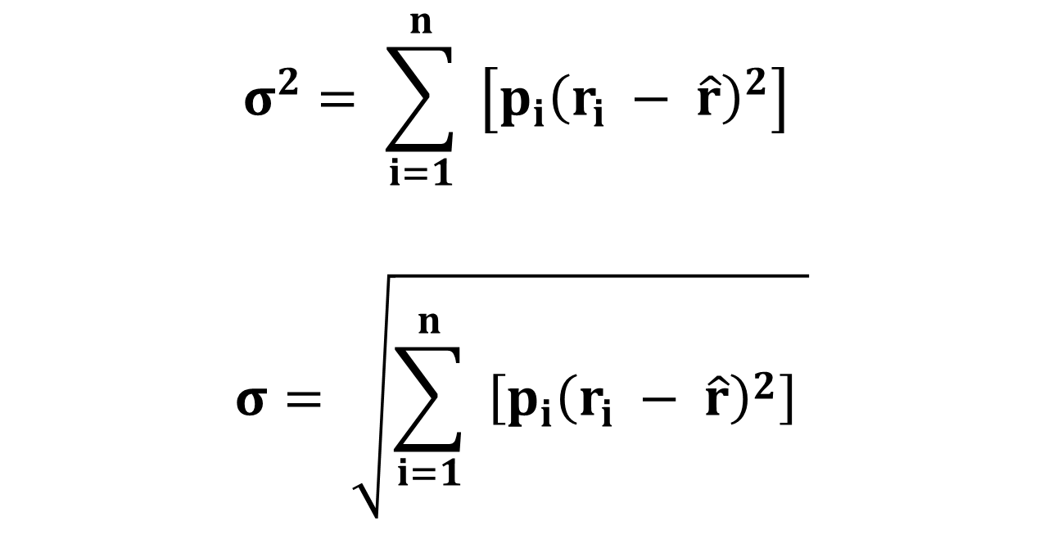
Variance (σ²) and Standard Deviation (σ) for Discrete Probabilities

Slide 15
Example Continued: Standard Deviation of the Stock’s Return During the Next Year
σ² = 0.10 (-0.14 – 0.06)²
+ 0.20 (-0.04 – 0.06)²
+ 0.40 ( 0.06 – 0.06)²
+ 0.20 ( 0.16 – 0.06)²
+ 0.10 ( 0.26 – 0.06)²
σ² = 0.0120
Notes:
11

Slide 16
Use Excel to Calculate the Variance and Standard Deviation of a Discrete Distribution
SUMPRODUCT:
Multiplies each value in the first array (the range of cells with probabilities) by its corresponding value in the second array (the range of cells with returns less the expected return) and by the third array (which is identical to the second array).
Sums the products; the result is variance.
Take the square root of the variance to get the standard deviation.

Slide 17
Standard Deviation in Comparing Investments
Investments with bigger standard deviations have more risk.
High risk doesn’t mean you should reject the investment, but:
You should know the risk before investing
You should expect a higher return as compensation for bearing the risk.

Slide 18
6-5 Risk in a Portfolio Context 6-5a Creating a Portfolio: Portfolio Return
The percentage of a portfolio’s value that is invested in Stock i is denoted by the “weight” w_{i}. Notice that the sum of all the weights must equal 1.
With n stocks in the portfolio, its expected return each year will be:

Slide 19
Example: 2-Stock Portfolio
Form a portfolio by investing 75% in SnailDrive which has an expected annual return of 8.6% and 25% in MicroDrive which has a 14.6% return.
The expected portfolio return will be:

Slide 20
6-5b Correlation Coefficient (ρ_{i,j}) and Risk for a Two-Stock Portfolio
Loosely speaking, the correlation (ρ) coefficient measures the tendency of two variables to move together.
Estimating ρ_{i,j} with historical data is tedious:
Notes:
21

Slide 21
Excel Functions to Estimate the Correlation Coefficient (ρ_{i,j})
“Stock_{i}” and “Stock_{j}” are the cell ranges with historical returns for Stocks i and j.
Est. ρ_{i,j} = Correl(Stock_{i},Stock_{j})
Correlation between SnailDrive and MicroDrive (G):
Est. ρ_{S,M} = -0.10

Slide 22
2-Stock Portfolio: the Role of ρ on Portfolio Standard Deviation
ρ = −1
2 stocks can be combined to form a riskless portfolio: σ_{p} = 0.
ρ = +1
Risk is not “reduced”.
σ_{p} is just the weighted average of the 2 stocks’ standard deviations.
−1 < ρ < +1
Risk is reduced but not eliminated.
Notes:
22

Slide 23
The Important Implication:
Since the correlation between most pairs of stocks is in the range of 0.2 to 0.3, and the perfect correlation (+1) is rare:
Diversification lowers risk.
(Don’t put all your eggs in one basket.)

Slide 24
6-5c Adding Stocks to a Portfolio: Diversification and Multi-Stock Portfolios
What would happen to the risk of an average 1-stock portfolio as more randomly selected stocks were added?
σ_{p} would decrease because the added stocks would not be perfectly correlated with the existing portfolio.
Notes:
25

Slide 25
Portfolio Risk vs. Number of Stocks in Portfolio
σ_{p}
Company Specific (Diversifiable) Risk
35%
Total Portfolio Risk, σ_{p}
20%
0
Market Risk
10 20 30 40 2,000 stocks
Notes:
27

Slide 26
Conclusions
As more stocks are added, each new stock has a smaller risk-reducing impact on the portfolio.
σ_{p} falls very slowly after about 40 stocks are included. The lower limit for σ_{p} is about 20% = σ_{M} (M: market portfolio).
By forming well-diversified portfolios, investors can eliminate about half the risk of owning a single stock.
Notes:
31

Slide 27
A Security’s Stand-alone Risk = its Market Risk/Systematic Risk/Non-diversifiable Risk + Firm-specific Risk/Unsystematic Risk/Diversifiable Risk
Market risk is that part of a security’s stand-alone risk that cannot be eliminated by diversification.
Firm-specific, or diversifiable, risk is that part of a security’s stand-alone risk that can be eliminated by diversification.
Notes:
29

Slide 28
6-6 The Relevant Risk of a Stock: the Capital Asset Pricing Model (CAPM)
How should the risk of an individual stock be measured?
Nobel laureate in economics Harry Markowitz and William Sharpe developed the Capital Asset Pricing Model (CAPM) to answer this question.
And the answer is…
Notes:
34

Slide 29
6-6a Contribution to Market Risk: Beta
Define:
w_{i} is the percent of the portfolio invested in Stock i.
σ_{M} is the standard deviation of the market index.
ρ_{i,M} is the correlation between Stock i and the market.
Notes:
34

Slide 30
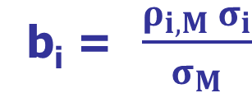
Contribution to Market Risk: Beta (Continued)
The beta of Stock i (b_{i}) is defined:
The contribution of Stock i to the standard deviation of a well-diversified portfolio (σ_{p}) is:
Given the standard deviation of the market portfolio and the percent of the portfolio invested in Stock i, beta measures the impact of Stock i on σ_{p}. In other words, beta measures a stock’s contribution to the risk of a well-diversified portfolio.
We assume investors hold well-diversified portfolios. Therefore, beta is the proper measure of a stock’s relevant risk.
Notes:
34

Slide 31
Websites for Beta: A Lot of Financial Websites
http://finance.yahoo.com
Enter the ticker symbol such as FB or AAPL in the “Quote Lookup” box, then click to search.
When the quote comes up, you can find beta on the top panel.
http://www.google.com/finance
Enter a ticker symbol at the top of the page.
Most stocks have betas in the range of 0.4 to 1.6.

Slide 32
6-7 The Relationship Between Risk and Return in the CAPM
Investors require a return for time (for tying their funds up in the investment: chapter 4 Time Value of Money):
r_{RF}, the risk-free rate.
Investors require a return for risk, which is the extra return above the risk-free rate that investors require to induce them to invest in Stock i:
RP_{i}, the risk premium of Stock i.
Notes:
43

Slide 33
6-7a The Security Market Line (SML) a graphical representation of the capital asset pricing model (CAPM)
RP_{M} is the market risk premium. It is the extra return above the risk-free rate that that investors require to invest in the stock market (the slope of SML):
RP_{M} = r_{M} − r_{RF}.
The CAPM defines the risk premium for Stock i as:
RP_{i} = b_{i} (RP_{M}).
Notes:
43

Slide 34
The SML/CAPM: the Formula
The Security Market Line (SML) is the graphical representation of the CAPM: showing how to determine the return required for bearing a stock’s risk:
CAPM/SML: r_{i} = r_{RF} + (RP_{M})b_{i}
Notes:
43

Slide 35
The Security Market Line: Relating Risk and Required Return
Risk depends on beta:
The part of σ_{p} due to Stock i = w_{i} σ_{M} b_{i}
Required return depends on beta:
r_{i} = r_{RF} + (RP_{M}) b_{i}
Notes:
43

Slide 36
Example: Use CAPM/SML to Calculate a Stock’s Required Return
Inputs:
r_{RF} = 6% (given)
R_{PM} = 5% (given)
Stock L: b = 0.50 (given)
r_{i} = r_{RF} + b_{i} (RP_{M})
r_{i} = 6% + 0.50(5%) = 8.5%
Notes:
43

Slide 37
Comparing Risk and Return for Different Stocks on SML: Figure 6-9 on P266
The beta of an average stock is 1.0; Stock H’s beta is 2. How do their required returns compare with the previous example (Stock L)?
r_{Avg_stock} = 6%+ 1.0 (5%) = 11%
r_{H} = 6%+ 2* (5%) = 16%
r_{L} = 6%+ 0.5* (5%) = 8.5%
Stock L contributes less risk to a well-diversified portfolio than do Stock H or the average stock, so Stock L’s investors require a lower rate of return.

Slide 38
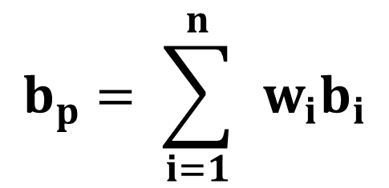
6-7c Portfolio Returns and Portfolio Performance Evaluation: CAPM/SML is not only applicable to individual stocks, but also to portfolios.
Example: Calculate the weights for a portfolio with $1.4 million in Stock H and $0.6 million in Stock L.
Find the weights:
w_{H} = $1.4/($1.4+$0.6) = 70%
w_{L} = $0.6/($1.4+$0.6) = 30%
The portfolio beta is the weighted average of the stocks’ betas:
Notes:
47

Slide 39
Calculate the portfolio beta:
b_{p} = 0.7(b_{H}) + 0.3(b_{L})
= 0.7(2) + 0.3(0.5)
= 1.55.
Notes:
47

Slide 40
What is the Required Return on the Portfolio?
(1) Use CAPM/SML:
r_{p} = r_{RF} + b_{p} (RP_{M})
= 6.0% + 1.55(5%) = 13.75%.
Double Check:
(2)Use fact that r_{p}=
r_{p}= 0.7(16%) + 0.3(8.5%)
= 13.75%.
Notes:
48

Slide 41
Portfolio Performance Evaluation Relative to SML: Example: Assuming the following data, which portfolio manager, JJ or CC, has performed better accounting for the risk?
 | Portfolio Manager
 | JJ | CC
Portfolio beta | 0.7 | 1.4
Risk-free rate | 4% | 4%
Market risk premium | 5% | 5%
Portfolio required return | 7.5% | 11.0%
Portfolio actual return | 8.5% | 9.5%
Over/under performance | +1.0% | −1.5%

Slide 42
Performance Relative to the Security Market Line

Slide 43
6-7d Required Return versus Expected Returns: Market Equilibrium
In chapter 1, managers should seek to maximize the intrinsic value/fundamental price of their firms’ stocks. But only market price is observable. What’s the difference between market price and intrinsic value?
Intrinsic value incorporates all relevant available information about expected cash flows and risk;
In contrast to intrinsic value, market prices are based on investors’ selection and interpretation of information.
To the extent that investors don’t select all relevant information and don’t interpret it correctly, market prices can deviate from intrinsic value: see next slide (Figure 6-12 on P270) for an illustration.
Notes:
25

Slide 44
Intrinsic Values and Market Prices
The Company, the Economic
Environment, and the Political Climate
All Relevant Available Information
Selected Information and Its Interpretation
Unbiased Expected Future Cash Flows
Unbiased Risk
“Perceived” Future Cash Flows
“Perceived” Risk
Equal?
Intrinsic Value
Market Price

Slide 45
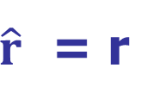
But Market Forces will be at work until market reaches Equilibrium, then in market equilibrium:
The market price of a security must equal the security’s intrinsic value (intrinsic value reflects the size, timing, and risk of the future cash flows).
Market price = Intrinsic value
The expected return a security must equal its required return (which reflects the security’s risk).
Notes:
25

Slide 46
How is equilibrium established?
If the market price is below the intrinsic value (or if the expected return is above the required return), then the security is a “bargain.”
Buy orders will exceed sell orders, bidding up the market price (which also drives down the expected return, given no change in the asset’s cash flows).
“Profitable” trading (i.e., earning a return greater than justified by risk) will continue until the market price is equal to the intrinsic value.
The opposite occurs if the market price is above the intrinsic value.
Notes:
25

Slide 47
Is the Market Usually in Equilibrium?
Stocks are normally in equilibrium.
One cannot “beat the market” by consistently earning a return higher than is justified by a stock’s risk.
Market Efficiency: market prices incorporate all relevant available information. It’s a necessary condition for market equilibrium.
Notes:
28

Slide 48
Market Bubbles and Market Efficiency
Market bubbles:
Prices climb rapidly to heights that would have been considered extremely unlikely before the run-up.
Trading volume is unusually high.
Many new investors (or speculators?) eagerly enter the market.
Prices suddenly fall precipitously.
What does this imply about the market efficiency?

Slide 49
Bubbles are hard to puncture
If there is a bubble, why don’t traders take positions that make big profits when the bubble bursts?
It is hard to recognize a bubble until after it bursts—then it seems obvious!
Trading strategies expose traders to possible big negative cash flows if the bubble is slow to burst.

Slide 50
Market Efficiency: The Bottom Line
For most stocks, for most of the time, it is generally safe to assume that the market is reasonably efficient.
Many investors have given up trying to beat the market, which helps explain the popularity of index funds.
However, bubbles do occur infrequently.
Notes:
32

Slide 51
Summary: CAPM/SML
Empirical tests of CAPM have statistical problems that make empirical verification or rejection virtually impossible.
Most corporations use the CAPM to determine their stock’s required return for capital budgeting decisions (chapters 9 & 10).
Regulatory commissions use the expected return-beta relationship along with forecasts of the market index return as one factor in determining the cost of capital for regulated firms.
Court rulings on torts cases sometimes use the expected return-beta relationship to determine discount rates to evaluate claims of lost future income.

Slide 52
Homework Problems
Questions on P284:
1(a, b, d, f, g, h, i, j, k, l, m), 3;
Problems on P286:
1, 2, 3, 5, 10.
Notes:
53

