Slide 1
Overview of Financial Management and the Financial Environment
CHAPTER 1
© 2020 Cengage Learning. All Rights Reserved. May not be copied, scanned, or duplicated, in whole or in part, except for use as permitted in a license distributed with a certain product or service or otherwise on a password-protected website for classroom use.

Slide 2
Topics in Chapter
Forms of business organization
Objective of the firm: Maximize wealth
Determinants of fundamental value
Financial securities, markets and institutions

Slide 3
Why is corporate finance important to all managers?
Corporate finance provides the skills managers need to:
  Identify and select the corporate strategies and individual projects that add value to their firm.
  Forecast the funding requirements of their company, and devise strategies for acquiring those funds.

Slide 4
Business Organization from Start-up to a Major Corporation
Sole proprietorship
Partnership
Corporation

Slide 5
Starting as a Proprietorship
Advantages:
  Ease of formation
  Subject to few regulations
  No corporate income taxes
Disadvantages:
  Limited life
  Unlimited liability
  Difficult to raise capital to support growth

Slide 6
Starting as or Growing into a Partnership
A partnership has roughly the same advantages and disadvantages as a sole proprietorship.

Slide 7
Becoming a Corporation
A corporation is a legal entity separate from its owners and managers.
File papers of incorporation with state.
  Charter
  Bylaws

Slide 8
Advantages and Disadvantages of a Corporation
Advantages:
  Unlimited life
  Easy transfer of ownership
  Limited liability
  Ease of raising capital
Disadvantages:
  Double taxation
  Cost of set-up and report filing

Slide 9
Becoming a Public Corporation and Growing Afterwards
Initial Public Offering (IPO) of Stock
  Raises cash
  Allows founders and pre-IPO investors to “harvest” some of their wealth
Subsequent issues of debt and equity

Slide 10
Agency Problems and Corporate Governance
Agency problem: managers may act in their own interests and not on behalf of owners (stockholders)
Corporate governance is the set of rules that control a company’s behavior towards its directors, managers, employees, shareholders, creditors, customers, competitors, and community.
Corporate governance can help control agency problems.

Slide 11
What should be management’s primary objective?
The primary objective should be shareholder wealth maximization, which translates to maximizing the fundamental stock price.
  Should firms behave ethically? YES!
  Do firms have any responsibilities to society at large? YES! Shareholders are also members of society.

Slide 12
Is maximizing stock price good for society, employees, and customers? (1 of 2)
Employment growth is higher in firms that try to maximize stock price. On average, employment goes up in:
  firms that make managers into owners (such as LBO firms)
  firms that were owned by the government but that have been sold to private investors

Slide 13
Is maximizing stock price good for society, employees, and customers? (2 of 2)
Consumer welfare is higher in capitalist free market economies than in communist or socialist economies.
Fortune lists the most admired firms. In addition to high stock returns, these firms have:
  high quality from customers’ view
  employees who like working there

Slide 14
What three aspects of cash flows affect an investment’s value?
Amount of expected cash flows (bigger is better)
Timing of the cash flow stream (sooner is better)
Risk of the cash flows (less risk is better)

Slide 15
Free Cash Flows (FCF)
Free cash flows are the cash flows that are available (or free) for distribution to all investors (stockholders and creditors).
FCF = sales revenues - operating costs - operating taxes - required investments in operating capital.

Slide 16
What is the weighted average cost of capital (WACC)?
WACC is the average rate of return required by all of the company’s investors.
WACC is affected by:
  Capital structure (the firm’s relative use of debt and equity as sources of financing)
  Interest rates
  Risk of the firm
  Investors’ overall attitude toward risk

Slide 17
What determines a firm’s fundamental, or intrinsic, value?
Intrinsic value is the sum of all the future expected free cash flows when converted into today’s dollars:
See “big picture” diagram on next slide.

Slide 18
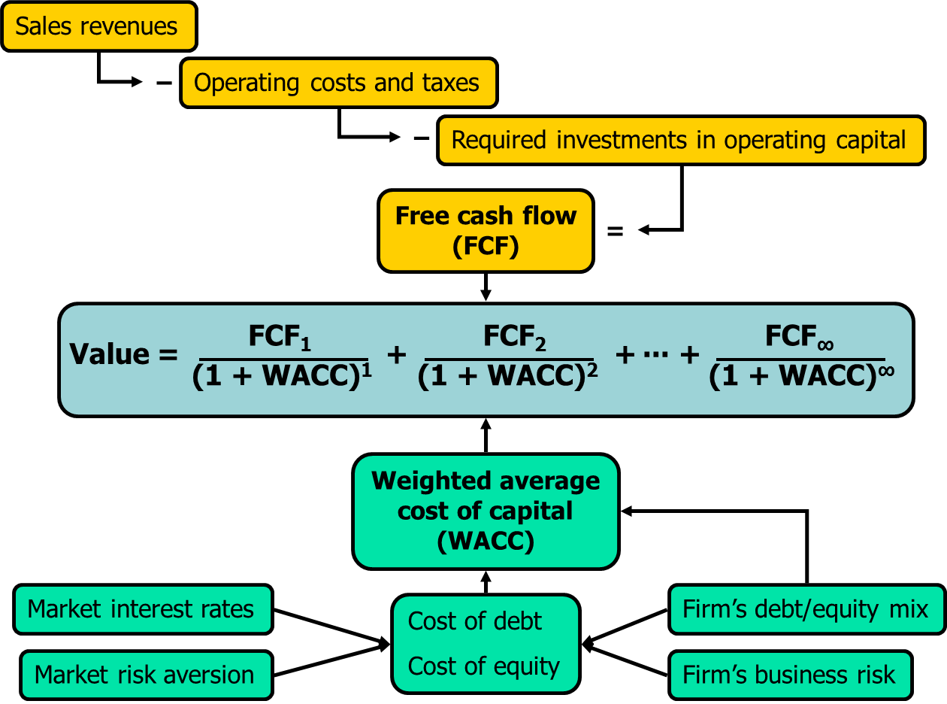
Determinants of Intrinsic Value: The Big Picture

Slide 19
Who are the providers (savers) and users (borrowers) of capital?
Households: Net savers
Non-financial corporations: Net users (borrowers)
Governments: U.S. governments are net borrowers, some foreign governments are net savers
Financial corporations: Slightly net borrowers, but almost breakeven

Slide 20
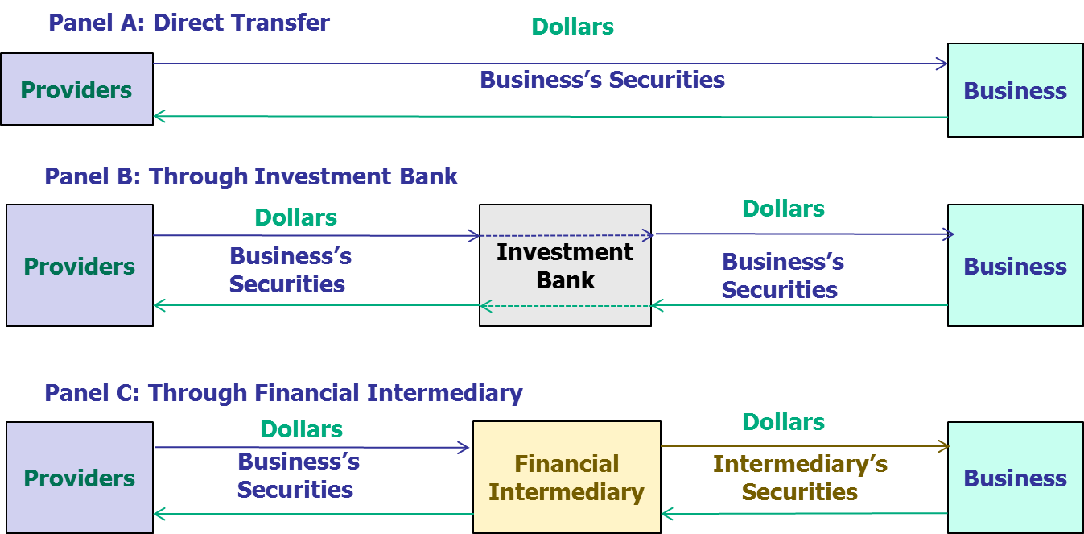
The Capital Allocation Process

Slide 21
Transfer of Capital from Savers to Borrowers
Direct transfer
  Example: A corporation issues commercial paper to an insurance company.
Through an investment banking house
  Example: In an IPO, seasoned equity offering, or debt placement, company sells security to investment banking house, which then sells security to investor.
Through a financial intermediary
  Example: An individual deposits money in bank and gets certificate of deposit, bank makes commercial loan to a company (bank gets note from company).

Slide 22
Cost of Money
What do we call the price, or cost, of debt capital?
  The interest rate
What do we call the price, or cost, of equity capital?
  Cost of equity = Required return = dividend yield + capital gain

Slide 23
What four factors affect the cost of money?
Production opportunities
Time preferences for consumption
Risk
Expected inflation

Slide 24
What economic conditions affect the cost of money?
Federal Reserve policies
Budget deficits/surpluses
Level of business activity (recession or boom)
International trade deficits/surpluses

Slide 25
Financial Securities
 | Debt | Equity | Derivatives
Money Market | T-Bills CD’s Eurodollars Fed Funds |  | Options Futures Forward contract
Capital Market | T-Bonds Agency bonds Municipals Corporate bonds | Common stock Preferred stock | LEAPS Swaps

Slide 26
What are some financial institutions?
Commercial banks
Investment banks
Savings & Loans, mutual savings banks, and credit unions
Life insurance companies
Mutual funds
  Exchanged Traded Funds (ETFs)
Pension funds
Hedge funds and private equity funds

Slide 27
What are some types of markets?
A market is a method of exchanging one asset (usually cash) for another asset.
Physical assets vs. financial assets
Spot versus future markets
Money versus capital markets
Primary versus secondary markets

Slide 28
Primary vs. Secondary Security Sales
Primary
  New issue (IPO or seasoned)
  Key factor: issuer receives the proceeds from the sale.
Secondary
  Existing owner sells to another party.
  Issuing firm doesn’t receive proceeds and is not directly involved.

Slide 29
Along what two dimensions can we classify trading procedures??
By “location”
  Physical location exchanges where trading is face-to-face
  Computer/telephone networks
By the way that orders from buyers and sellers are matched
  Open outcry auction with face-to-face trading
  Dealers (i.e., market makers) buy from and sell to clients from an inventory of stocks. Orders are not always automatically matched by computers.
  Automated trading platforms match orders and execute trades automatically.

Slide 30
Types of Orders
Instructions on how a transaction is to be completed
  Market Order– Transact as quickly as possible at current price
  Limit Order– Transact only if specific situation occurs. For example, buy if price drops to $50 or below during the next two hours.

Slide 31
Broker-Dealer Networks
Registered with the SEC, but less regulated than alternative trading systems (ATS) and registered stock exchanges.
Broker-dealer purchases stock being offered for sale by a client and then immediately sells it to another client who wished to buy the stock.
Broker-dealer is the counterparty to each of the clients. Called internalization.
Broker-dealer must report the transactions, but not any information prior to the trade.
Trades in broker-dealer networks are called “off exchange” or over-the-counter (OTC).
Trades can be with individuals (called retail trades) or with institutions. Large trades (10,000 shares or more) are called block trades and are sometimes called “upstairs” trades.

Slide 32
Alternative Trading System (ATS)
A broker-dealer than registers with the SEC as an ATS.
ATS usually has an automated trading platform to match orders from clients.
  Owner of the ATS is not always the counterparty, in contrast to a broker-dealer network.
The ATS must report trades, but not any pre-trade information.
  Therefore, an ATS is often called a dark pool

Slide 33
Registered Stock Exchange
Stocks can only be listed at a registered stock exchange
  May be traded elsewhere
Must comply with more regulations than an ATS.
Must report:
  Trades
  Pre-trade information regarding bids and quotes

Slide 34
NYSE versus NASDAQ
The NYSE is the oldest U.S. registered stock exchange.
The NASDAQ Stock Market has the most listings because it is willing to list smaller corporations than the NYSE.
NYSE’s listings have a much bigger market value than NASDAQ’s listed stocks.

Slide 35
Stock Exchange Listings (1 of 2)
Exchange | Number of Listings | Market Value of Listings (Trillions)
NYSE | 3,131 | $27.9
NASDAQ | 3,274 | 11.3
NYSE MKT | 362 | 0.2
 | 6,767 | $39.4
Source: www.nasdaq.com/screening/company-list.aspx, November, 2017.

Slide 36
Stock Exchange Listings (2 of 2)
Owner of Trading Venue | % of Dollar Volume
Cboe Global Markets | 18%
NASDAQ OMX | 22%
Intercontinental Exchange: (includes NYSE) | 22%
Others | 3%
Total trading on all exchanges: | 65%
Dark pools (ATS): 34 | 13%
Broker-dealer networks: Over 250
Retail trades | 8%
Institutional trades | 14%
Total broker-dealer trades: | 22%
Total trading off-exchange: | 35%

Slide 37
Home Mortgages Before S&Ls
The problems if an individual investor tried to lend money to an aspiring homeowner:
  Individual investor might not have enough money to fund an entire home
  Individual investor might not be in a good position to evaluate the risk of the potential homeowner
  Individual investor might have difficulty collecting mortgage payments

Slide 38
S&Ls Before Securitization
Savings and loan associations (S&Ls) solved the problems faced by individual investors
  S&Ls pooled deposits from many investors
  S&Ls developed expertise in evaluating the risk of borrowers
  S&Ls had legal resources to collect payments from borrowers

Slide 39
Problems faced by S&Ls Before Securitization
S&Ls were limited in the amount of mortgages they could fund by the amount of deposits they could raise
S&Ls were raising money through short-term floating-rate deposits, but making loans in the form of long-term fixed-rate mortgages
When interest rates increased, S&Ls faced crisis because they had to pay more to depositors than they collected from mortgagees

Slide 40
Taxpayers to the Rescue
Many S&Ls went bankrupt when interest rates rose in the 1980s.
Because deposits are insured, taxpayers ended up paying hundreds of billions of dollars.

Slide 41
Securitization in the Home Mortgage Industry
After crisis in 1980s, S&Ls now put their mortgages into “pools” and sell the pools to other organizations, such as Fannie Mae.
After selling a pool, the S&Ls have funds to make new home loans
Risk is shifted to Fannie Mae

Slide 42
Fannie Mae Shifts Risk to Its Investors
Risk hasn’t disappeared, it has been shifted to Fannie Mae.
But Fannie Mae doesn’t keep the mortgages:
  Puts mortgages in pools, sells shares of these pools to investors
  Risk is shifted to investors.
  But investors get a rate of return close to the mortgage rate, which is higher than the rate S&Ls pay their depositor.
  Investors have more risk, but more return
This is called securitization, since new securities have been created based on original securities (mortgages in this example)

Slide 43
Collateralized Debt Obligations (CDOs)
Fannie Mae and others, such as investment banks, can also split mortgage pools into “special” securities
  Some securities might pay investors only the mortgage interest, others might pay only the mortgage principal.
  Some securities might mature quickly, others might mature later.
  Some securities are “senior” and get paid before other securities from the pool get paid.
  Rating agencies give different
Risk of basic mortgage is parceled out to those investors who want that type of risk (and the potential return that goes with it).

Slide 44
Other Assets Can be Securitized
Car loans
Student loans
Credit card balances

Slide 45
The Dark Side of Securitization (1 of 2)
Homeowners wanted better homes than they could afford.
Mortgage brokers encouraged homeowners to take mortgages even thought they would reset to payments that the borrowers might not be able to pay because the brokers got a commission for closing the deal.
Appraisers thought the real estate boom would continue and over-appraised house values, getting paid at the time of the appraisal.
Originating institutions (like Countrywide) quickly sold the mortgages to investment banks and other institutions.

Slide 46
The Dark Side of Securitization (2 of 2)
Investment banks created CDOs and got rating agencies to help design and then rate the new CDOs, with rating agencies making big profits despite conflicts of interest.
Financial engineers used unrealistic inputs to generate high values for the CDOs.
Investment banks sold the CDOs to investors and made big profits.
Investors bought the CDOs but either didn’t understand or care about the risk.
Some investors bought “insurance” via credit default swaps.

Slide 47
The Collapse
When mortgages reset and borrowers defaulted, the values of CDOs plummeted.
Many of the credit default swaps failed to provide insurance because the counterparty failed.
Many originators and securitizers still owned sub-prime securities, which led to many bankruptcies, government takeovers, and fire sales, including:
  New Century, Countrywide, IndyMac, Northern Rock, Fannie Mae, Freddie Mac, Bear Stearns, Lehman Brothers, and Merrill Lynch.

