Slide 1
Financial Statements, Cash Flow, and Taxes
CHAPTER 2
© 2020 Cengage Learning. All Rights Reserved. May not be copied, scanned, or duplicated, in whole or in part, except for use as permitted in a license distributed with a certain product or service or otherwise on a password-protected website for classroom use.

Slide 2
Topics in Chapter
Income statement
Balance sheet
Statement of cash flows
Free cash flow
Performance measures
Corporate taxes
Personal taxes

Slide 3
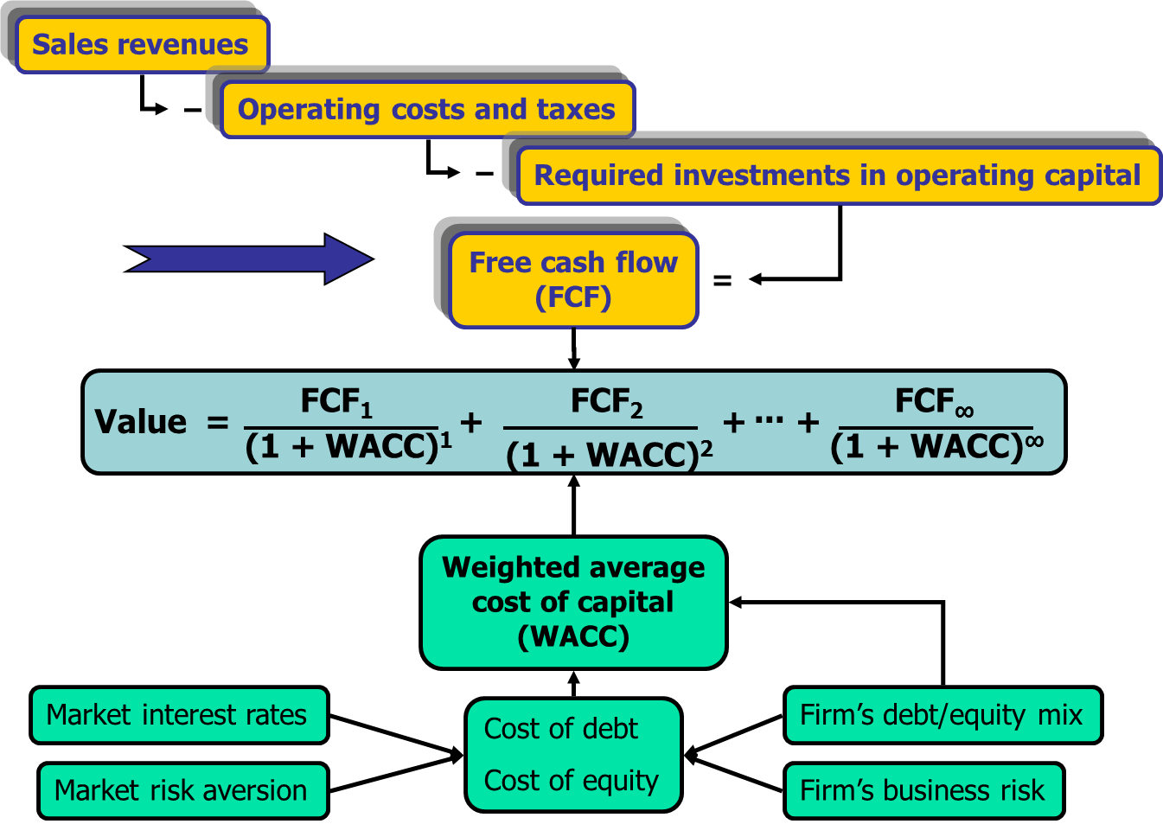
Determinants of Intrinsic Value: Calculating FCF

Slide 4
Computron Inc.
Computron expanded operations in 2019. Following slides show key information and financial statements to evaluate the expansions.
 | 2018 | 2019
Stock price | $50.00 | $30.00
Shares outstanding (millions) | 100 | 100
Common dividends (millions) | $90 | $84
Tax rate | 25% | 25%
Cost of capital (WACC) | 10.00% | 10.00%

Slide 5
Income Statement (Millions of Dollars)
 | 2018 | 2019
Sales | $ 5,500 | $ 6,000
COGS | 4,300 | 4,800
Deprec. | 290 | 320
Other expenses | 350 | 420
Tot. op. costs | $ 4,940 | $ 5,540
EBIT | $ 560 | $ 460
Int. expense | 68 | 108
Pre-tax earnings | $ 492 | $ 352
Taxes (25%) | 123 | 88
Net income | $ 369 | $ 264

Slide 6
What happened to sales and net income?
Sales increased by $500 million (9% growth).
59% increase in interest payments.
Net income fell by $105 million.

Slide 7
Balance Sheet: Assets (Millions of Dollars)
 | 2018 | 2019
Cash | $ 60 | $ 50
S-T invest. | 100 | 10
AR | 400 | 520
Inventories | 620 | 820
Total CA | $ 1,180 | $ 1,400
Gross FA | $ 3,900 | $ 4,820
Less: Depr. | 1,000 | 1,320
Net FA | $ 2,900 | $ 3,500
Total assets | $ 4,080 | $ 4,900

Slide 8
Effect of Expansion on Assets
Current assets and net fixed assets each grew by over 20%, much more than sales grew.
AR and inventory almost doubled.
  Taking longer to collect
  Unsold products (or unused raw materials) in warehouses
Cash and short-term investments fell.

Slide 9
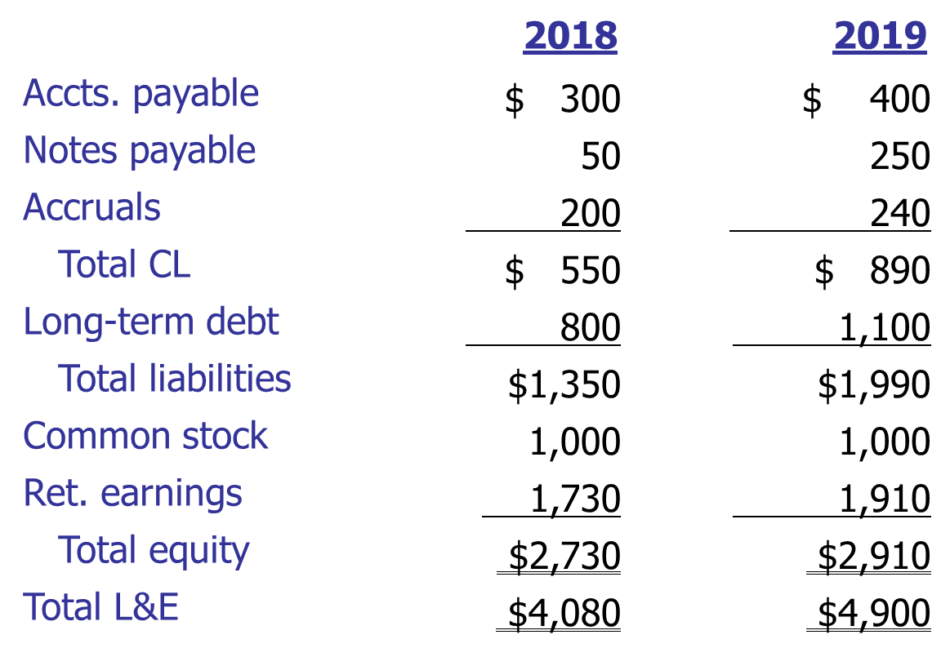
Balance Sheet: Liabilities & Equity
(Millions of Dollars)

Slide 10
What effect did the expansion have on liabilities & equity?
Debt increased to help finance the expansion.
The company didn’t issue any stock.

Slide 11
Statement of Cash Flows for 2019: Operating Activities (Millions of Dollars)
Operating Activities
Net Income | $ 264
Adjustments:
Depreciation | 320
Change in AR | (120)
Change in inventories | (200)
Change in AP | 100
Change in accruals | 40
Net cash provided (used) by ops. | $ 404

Slide 12
Statement of Cash Flows: Investing Activities (Millions of Dollars)
Investing Activities
Cash used to acquire FA | $ (920)
Change in S-T invest. | 90
Net cash prov. (used) by inv. act. | $ (830)

Slide 13
Statement of Cash Flows: Financing Activities (Millions of Dollars)
Financing Activities | 2020
Change in notes payable | $ 200
Change in long-term debt | 300
Payment of cash dividends | (84)
Net cash provided (used) by fin. act. | $ 416

Slide 14
Statement of Cash Flows: Summary
(Millions of Dollars)
Net cash provided (used) by ops. | $ 404
Net cash prov. (used) by inv. act. | (830)
Net cash prov. (used) by fin. act. | 416
Net change in cash | (10)
Cash at beginning of year | 60
Cash at end of year | $ 50

Slide 15
What can you conclude from the statement of cash flows?
Positive net CF from operations:
  Dragged down by big net increase in working capital.
Negative net CF from investing:
  Small increase due to selling ST investments
  Bigger decrease due to large FA expenditures.
Net CF from financing:
  Big increase in borrowing.
Even after borrowing, the cash account fell.

Slide 16
What is free cash flow (FCF)? Why is it important?
FCF is the amount of cash available from operations for distribution to all investors (including stockholders and debtholders) after making the necessary investments to support operations.
A company’s value depends on the amount of FCF it can generate.

Slide 17
What are the five uses of FCF?
1. Pay interest on debt.
2. Pay back principal on debt.
3. Pay dividends.
4. Buy back stock.
5. Buy nonoperating assets (e.g., marketable securities, investments in other companies, etc.)

Slide 18
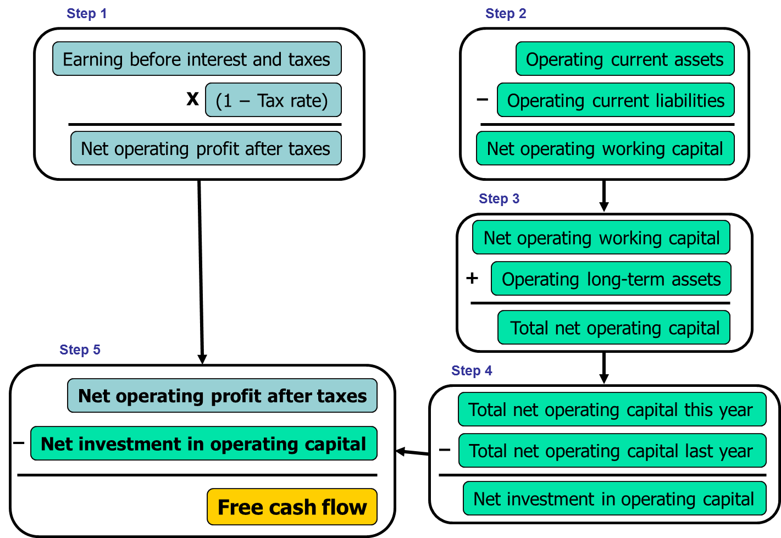
Calculating Free Cash Flow in 5 Easy Steps

Slide 19
Net Operating Profit after Taxes (NOPAT)

Slide 20
What are operating current assets?
Operating current assets are the CA needed to support operations.
  Op CA include: cash, inventory, receivables.
  Op CA exclude: short-term investments, because these are not a part of operations.

Slide 21
What are operating current liabilities?
Operating current liabilities are the CL resulting as a normal part of operations.
  Op CL include: accounts payable and accruals.
  Op CL exclude: notes payable, because this is a source of financing, not a part of operations.

Slide 22
Net Operating Working Capital (NOWC)

Slide 23
Total net operating capital
(also called operating capital)
Operating Capital= NOWC + Net fixed assets.
Operating Capital 2019:
OpCap₁₉ = $750 + $3,500
= $4,250.
Operating Capital 2018:
OpCap₁₈ = $3,480.

Slide 24
Free Cash Flow (FCF) for 2019
FCF NOPAT - Net investment in operating capital
How do you suppose investors reacted?

Slide 25
Uses of FCF
After-tax interest payment | $81
Reduction (increase) in debt | −$500
Payment of dividends | $84
Repurchase (Issue) stock | $0
Purch. (Sale) of ST investments | −$90
Total uses of FCF | −$425

