Slide 1
Analysis of Financial Statements
CHAPTER 3
© 2020 Cengage Learning. All Rights Reserved. May not be copied, scanned, or duplicated, in whole or in part, except for use as permitted in a license distributed with a certain product or service or otherwise on a password-protected website for classroom use.

Slide 2
Topics in Chapter
Ratio analysis
  Ratios
  Common size statements
  Percent change statement
DuPont equation
Limitations of ratio analysis
Qualitative factors

Slide 3
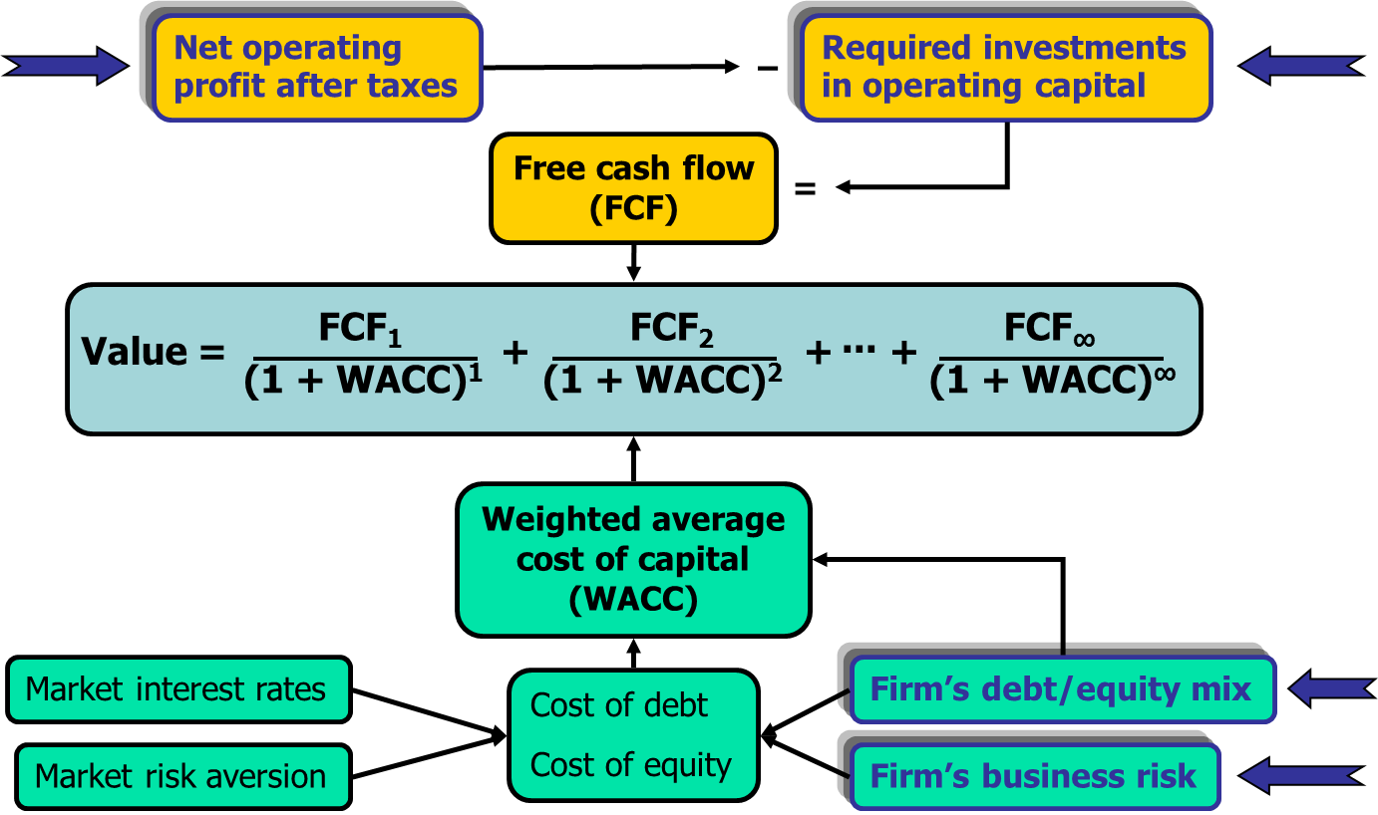
Determinants of Intrinsic Value: Using Ratio Analysis

Slide 4
Overview
Ratios facilitate comparison of:
  One company over time
  One company versus other companies
Ratios are used by:
  Lenders to determine creditworthiness
  Stockholders to estimate future cash flows and risk
  Managers to identify areas of weakness and strength

Slide 5
Income Statement
 | 2019 | 2020E
Sales | $6,000 | $6,600
COGS except depr. | 4,800 | 5,210
Other expenses | 320 | 370
Deprec. | 420 | 400
EBIT | $ 460 | $ 620
Int. expense | 108 | 100
EBT | $ 352 | $ 520
Taxes (40%) | 88 | 130
Net income | $ 264 | $ 390

Slide 6
Balance Sheets: Assets
 | 2019 | 2020E
Cash | $ 50 | $ 60
S-T invest. | 10 | 50
AR | 520 | 530
Inventories | 820 | 660
Total CA | $1,400 | $1,300
Net FA | 3,500 | 3,700
Total assets | $4,900 | $5,000

Slide 7
Balance Sheets: Liabilities & Equity
 | 2019 | 2020E
Accts. payable | $ 400 | $ 330
Notes payable | 250 | 100
Accruals | 240 | 270
Total CL | $ 890 | $ 700
Long-term debt | 1,100 | 1,100
Total liabilities | $1,990 | $1,800
Common stock | 1,000 | 1,000
Ret. earnings | 1,910 | 2,200
Total equity | $2,910 | $3,200
Total L&E | $4,900 | $5,000

Slide 8
Other Data
 | 2019 | 2020E
EPS | $2.64 | $3.90
DPS | $0.84 | $1.00
Book value per share | $29.10 | $32.00
Dividends | $84 | $100
Number of shares | 100 | 100
Year-end stock price | $30.00 | $49.00
Lease payments | $20 | $20
Tax rate | 25% | 25%

Slide 9
Profitability Ratios
What is the company’s rate of return on sales?
  Profit margin
  Operating profit margin
What is the company’s rate of return on assets?
  Basic earning power
  Return on assets
  Return on equity

Slide 10
Profit Margin
Net profit margin (PM):
 | 2018 | 2019 | 2020E | Ind.
Profit Margin | 6.7% | 4.4% | 5.9% | 7.2%

Slide 11
Operating Profit Margin
Operating profit margin:
 | 2018 | 2019 | 2020E | Ind.
Profit Margin | 10.2% | 7.7% | 9.4% | 10.4%

Slide 12
Basic Earning Power (BEP)

Slide 13
Basic Earning Power vs. Industry Average
BEP removes effect of taxes and financial leverage. Useful for comparison.
Projected to be below average.
Room for improvement.
 | 2018 | 2019 | 2020E | Ind.
Basic Earning Power | 13.7% | 9.4% | 12.4% | 15.6%

Slide 14
Return on Assets (ROA) and Return on Equity (ROE) (1 of 2)

Slide 15
Return on Assets (ROA) and Return on Equity (ROE) (2 of 2)

Slide 16
ROA and ROE vs. Industry Averages
 | 2018 | 2019 | 2020 | Industry
ROA | 9.0% | 5.4% | 7.8% | 10.8%
ROE | 13.5% | 9.1% | 12.2% | 15.4%
Both below industry average but improving.

Slide 17
Effects of Debt on ROA and ROE
ROA is lowered by debt--interest expense lowers net income, which also lowers ROA.
However, the use of debt lowers equity, and if equity is lowered more than net income, ROE would increase.

Slide 18
Asset Management Ratios
How efficiently does the firm use its assets?
How much does the firm have tied up in assets for each dollar of sales?

Slide 19
Inventory Turnover Ratio vs. Industry Average
 | 2018 | 2019 | 2020E | Ind.
Inventory turnover | 7.4 | 6.2 | 8.5 | 9.0

Slide 20
Comments on Inventory Turnover
Inventory turnover:
  Improved from previous year
  Below industry average

Slide 21
DSO: average number of days from sale until cash received.

Slide 22
Appraisal of DSO
Higher than 2018, but a little lower than industry.
 | 2018 | 2019 | 2020E | Ind.
Days Sales Outstanding | 26.5 | 31.6 | 29.3 | 28.0

Slide 23
Fixed Assets and Total Assets Turnover Ratios
(1 of 2)

Slide 24
Fixed Assets and Total Assets Turnover Ratios
(2 of 2)
Better than previous year.
Not up to industry average. Caused by high fixed assets relative to sales.
 | 2018 | 2019 | 2020E | Ind.
Fixed Asset Turnover | 1.9 | 1.7 | 1.8 | 3.0
Total Asset Turnover | 1.348 | 1.224 | 1.320 | 1.5

Slide 25
Liquidity Ratios
Can the company meet its short-term obligations using the resources it currently has on hand?

Slide 26
Forecasted Current and Quick Ratios

Slide 27
Comments on Current and Quick Ratios
 | 2018 | 2019 | 2020E | Ind.
Current | 2.1 | 1.6 | 1.9 | 2.5
Quick | 1.0 | 0.7 | 0.9 | 1.9
Expected to improve but still below the industry average.
Liquidity position is weak.

Slide 28
Debt Management Ratios
Does the company have too much debt?
Can the company’s earnings meet its debt servicing requirements?

Slide 29
Leverage Ratios: Debt Ratio

Slide 30
Leverage Ratios: Debt-to-Equity Ratio

Slide 31
Leverage Ratios: Liabilities-to-Assets Ratio

Slide 32
Leverage Ratios: Equity Multiplier
Equity multiplier = Total Assets
Common Equity
= $5,000
$3,200 = 1.5625

Slide 33
Times Interest Earned Ratio

Slide 34
EBITDA Coverage (EC)

Slide 35
Debt Management Ratios vs. Industry Averages
 | 2018 | 2019 | 2020E | Industry
Debt Ratio | 20.8% | 27.6% | 24.0% | 15.0%
Debt-to-equity | 0.31 | 0.46 | 0.38 | 0.22
Liabilities-to-assets | 33.1% | 40.6% | 36.0% | 32.0%
Earnings Multiplier | 1.49 | 1.68 | 1.56 | 1.47
Times Interest Earned | 8.2 | 4.3 | 6.2 | 13.0
EBITDA Coverage Ratio | 9.9 | 6.3 | 8.4 | 17.2
Improved, but more debt than industry
More risk than industry

Slide 36
Market Value Ratios
Market value ratios incorporate the:
  High current levels of earnings and cash flow increase market value ratios
  High expected growth in earnings and cash flow increases market value ratios
  High risk of expected growth in earnings and cash flow decreases market value ratios

Slide 37
Calculate and appraise the Price/Earnings (P/E) ratio.
Price per share (P) = $49.00
Earnings per share (EPS) = $3.90
P/E = P/E = $49.00/$3.90 = 16.8
P/E: How much investors will pay for $1 of earnings. Higher is better.

Slide 38
Calculate and appraise the M/B ratio.
BVPS = Equity/ # Shares
= $3,200/100 = $32.00.
M/B = P/BVPS
M/B = $49.00/$32.00 = 1.53
M/B: How much paid for $1 of book value. Higher is better.

Slide 39
Comparison with Industry Averages
 | 2018 | 2019 | 2020E | Ind.
Price-to Earnings | 13.6 | 11.4 | 12.6 | 16.8
Market-to-Book | 1.8 | 1.0 | 1.5 | 2.7
The P/E ratio and the M/B ratio indicate that the market doesn’t value the company as highly as it does the average firm in industry.

Slide 40
Common Size Balance Sheets: Divide all items by Total Assets
Assets | 2018 | 2019 | 2020E | Ind.
Cash | 1.5% | 1.0% | 1.2% | 1.5%
ST Inv. | 2.5% | 0.2% | 1.0% | 7.6%
AR | 9.8% | 10.6% | 10.6% | 13.2%
Invent. | 15.2% | 16.7% | 13.2% | 17.8%
Total CA | 28.9% | 28.6% | 26.0% | 40.0%
Net FA | 71.1% | 71.4% | 74.0% | 60.0%
TA | 100.0% | 100.0% | 100.0% | 100.0%

Slide 41
Divide all items by Total Liabilities & Equity
Liab. & Eq. | 2018 | 2019 | 2020E | Ind.
AP | 7.4% | 8.2% | 6.6% | 6.8%
Notes pay. | 1.2% | 5.1% | 2.0% | 3.0%
Accruals | 4.9% | 4.9% | 5.4% | 10.2%
Total CL | 13.5% | 18.2% | 14.0% | 20.0%
LT Debt | 19.6% | 22.4% | 22.0% | 12.0%
Total Liab. | 33.1% | 40.6% | 36.0% | 32.0%
Total eq. | 66.9% | 59.4% | 64.0% | 68.0%
Total L&E | 100.0% | 100.0% | 100.0% | 100.0%

Slide 42
Analysis of Common Size Balance Sheets
Computron has higher proportion of net fixed assets than the industry.
Computron’s total debt is 24% (the combined percentages of notes payable and long-term bonds) of its assets, which is higher than the industry’s combined debt percentage of 20%.

Slide 43
Common Size Income Statement: Divide all items by Sales
2018 | 2019 | 2020E | Ind.
100.0% | 100.0% | 100.0% | 100.0%
78.2% | 80.0% | 78.9% | 69.0%
5.3% | 5.3% | 5.6% | 3.3%
6.4% | 7.0% | 6.1% | 17.3%
10.2% | 7.7% | 9.4% | 10.4%
1.2% | 1.8% | 1.5% | 0.8%
8.9% | 5.9% | 7.9% | 9.6%
2.2% | 1.5% | 2.0% | 2.4%
6.7% | 4.4% | 5.9% | 7.2%
Sales
COGS
Depr.
Other exp.
EBIT
Int. Exp.
Pre-tax earn.
Taxes (25%)
NI

Slide 44
Analysis of Common Size Income Statements
Computron’s profit margin is less than the industry ratio
  Computron has lower Other Costs.
  But… it has much higher costs of goods sold

Slide 45
Percentage Change Analysis: Cumulative Change from First Year (2018)
Income St. | 2018 | 2019 | 2020E
Sales | 0.0% | 9.1% | 20.0%
COGS | 0.0% | 11.6% | 21.2%
Depr. | 0.0% | 10.3% | 27.6%
Other exp. | 0.0% | 20.0% | 14.3%
EBIT | 0.0% | -17.9% | 10.7%
Int. Exp. | 0.0% | 58.8% | 47.1%
EBT | 0.0% | -28.5% | 5.7%
Taxes | 0.0% | -28.5% | 5.7%
NI | 0.0% | -28.5% | 5.7%

Slide 46
Analysis of Percent Change Income Statement
For 2019:
  Sales grew by 9% in 2019.
  Net income fell by 28.5%!
For 2020 projections:
  Cumulative sales growth is 20%.
  Cumulative net income growth is 5.7%
    Improvement, but more work is needed

Slide 47
Cumulative Percentage Change: Assets
Assets | 2018 | 2019 | 2020E
Cash | 0.0% | -16.7% | 0.0%
ST Invest. | 0.0% | -90.0% | -50.0%
AR | 0.0% | 30.0% | 32.5%
Invent. | 0.0% | 32.3% | 6.5%
Total CA | 0.0% | 18.6% | 10.2%
Net FA | 0.0% | 20.7% | 27.6%
TA | 0.0% | 20.1% | 22.5%

Slide 48
Cumulative Percentage Change: Liabilities & Equity
Liab. & Eq. | 2018 | 2019 | 2020E
AP | 0.0% | 33.3% | 10.0%
Notes pay. | 0.0% | 400.0% | 100.0%
Accruals | 0.0% | 20.0% | 35.0%
Total CL | 0.0% | 61.8% | 27.3%
LT Debt | 0.0% | 37.5% | 37.5%
Total eq. | 0.0% | 6.6% | 17.2%
Total L&E | 0.0% | 20.1% | 22.5%

Slide 49
Analysis of Percent Change Balance Sheets: 2019
Assets grew by 20.1% even though net income fell.
Much of the asset growth was in accounts receivable and inventories.
  Not collecting on credit sales
  Unsold product is piling up.
Growth was funded with big increase in debt.

Slide 50
Analysis of Percent Change Balance Sheets: Projections Compared with 2019
Small cumulative increase in 2020E total assets (22.5%) compared with 2019 change in total assets (20.1%)
  But big reduction in cumulative inventory growth (6.5% in 2020E vs. 32.3% in 2019)
Big drop in cumulative notes payable growth in 2020E relative to notes payable growth in 2019.

Slide 51
Explain the Extended DuPont Equation
The DuPont equation focuses on:
  Expense control (Profit margin, PM)
  Asset utilization (Total asset turnover,TAT)
  Debt utilization (Equity multiplier, EM)
It shows how these factors combine to determine the return on equity (ROE).

Slide 52
The Simple Version of the DuPont Equation

Slide 53
The Extended DuPont Equation

Slide 54
ROE: (Profit margin)(TA turnover)(EM)
ROE₂₀₁₈ = (6.7%)(1.348)(1.495) = 13.5%
ROE₂₀₁₉ = (4.4%)(1.224)(1.684) = 9.1%
ROE_{2020E} = (5.9%)(1.320)(1.563) = 12.2%
ROE_{Ind} = (7.2%)(1.5)(1.47) = 15.9%

Slide 55
Potential Problems and Limitations of Ratio Analysis
Comparison with industry averages is difficult if the firm operates many different divisions.
Seasonal factors can distort ratios.
Window dressing techniques can make statements and ratios look better.
Different accounting and operating practices can distort comparisons.

Slide 56
Qualitative Factors
There is greater risk if:
  revenues tied to a single customer
  revenues tied to a single product
  reliance on a single supplier?
  High percentage of business is generated overseas?
What is the competitive situation?
What products are in the pipeline?
What are the legal and regulatory issues?

