Slide 1
Time Value of Money
CHAPTER 4
© 2020 Cengage Learning. All Rights Reserved. May not be copied, scanned, or duplicated, in whole or in part, except for use as permitted in a license distributed with a certain product or service or otherwise on a password-protected website for classroom use.

Slide 2
Time Value Topics
Future value
Present value
Rates of return
Amortization

Slide 3
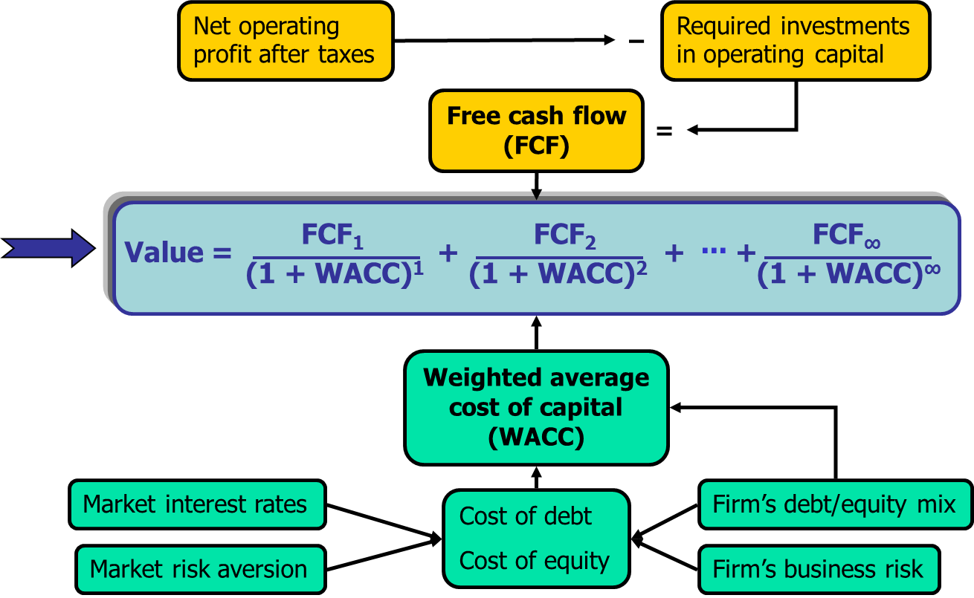
Determinants of Intrinsic Value: The Present Value Equation

Slide 4
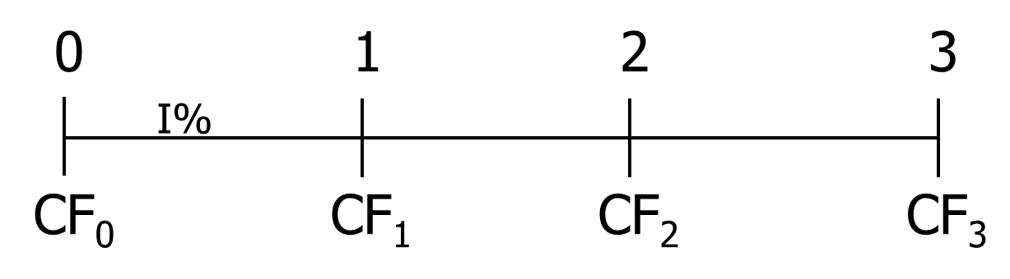
Time lines show timing of cash flows.
Tick marks at ends of periods, so Time 0 is today; Time 1 is the end of Period 1; or the beginning of Period 2.

Slide 5
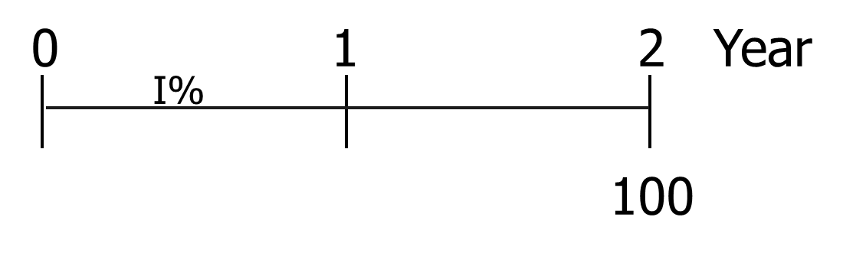
Time line for a $100 lump sum due at the end of Year 2.

Slide 6
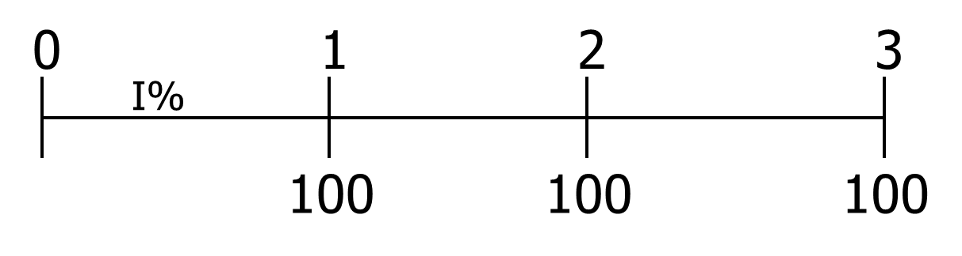
Time line for an ordinary annuity of $100 for 3 years

Slide 7
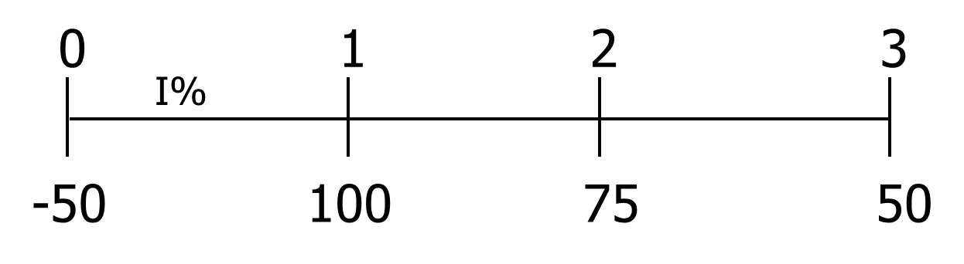
Time line for uneven CFs

Slide 8
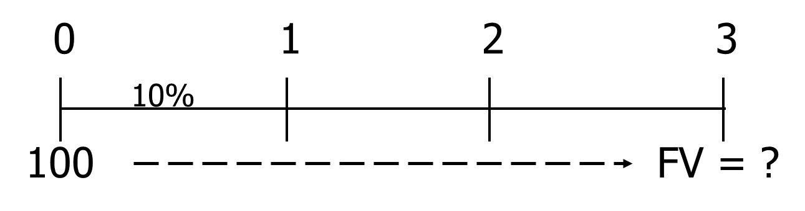
FV of an initial $100 after 3 years (I = 10%)
Finding FVs (moving to the right
on a time line) is called compounding.

Slide 9
After 1 year
FV₁ = PV + INT₁ = PV + PV (I)
= PV(1 + I)
= $100(1.10)
= $110.00

Slide 10
After 2 years
FV₂ = FV₁(1+I)
= $110(1.10)
= $121.00
Or
FV₂ = PV(1 + I)(1+I)
= PV(1+I)²
= $100(1.10)²
= $121.00

Slide 11
After 3 years
FV₃ = FV₂(1+I)
= $121.00(1.10)
= $133.10
Or
FV₃ = FV₂(1+I)=PV(1 + I)²(1+I)
= PV(1+I)³
= $100(1.10)³
= $133.10

Slide 12
Using the General Formula: FV_{N}= PV(1 + I)^{N}
Generalizing the approach from previous slides:
FV_{N} = PV(1 + I)^{N}
FV₃ = $100(1.10)³
= $133.10

Slide 13
Four Ways to Find FVs
Step-by-step approach using time line (as shown in previous slides).
Solve the equation with a regular calculator (formula approach).
Use a financial calculator.
Use a spreadsheet.

Slide 14
Financial calculator: HP 10bII+ (1 of 4)
Adjust display brightness: hold down ON and push + or –.
Set number of decimal places to display: Orange Shift key, then DISP key (in orange), then desired decimal places (e.g., 3).
To temporarily show all digits, hit Orange Shift key, then DISP, then =.

Slide 15
Financial calculator: HP 10bII+ (2 of 4)
To permanently show all digits, hit ORANGE shift, then DISP, then . (period key).
Set decimal mode: Hit ORANGE shift, then ./, key. Note: many non-US countries reverse the US use of decimals and commas when writing a number.

Slide 16
HP 10bII+: Set Time Value Parameters
To set END (for cash flows occurring at the end of the year), hit ORANGE shift key, then BEG/END.
To set 1 payment per period, hit 1, then ORANGE shift key, then P/YR.

Slide 17
Financial calculator: BAII+
Set number of decimal places to display: 2nd Format; use the up and down arrows to display DEC=; press 9; press ENTER
Set AOS calculation; 2nd Format; down arrow 4 times until you see Chn (if you see AOS then just stop and hit CE/C, you are done); 2nd SET (AOS should display); CE/C you are done.

Slide 18
BAII +: Set Time Value Parameters
To set END (for cash flows occurring at the end of the year), hit 2nd BGN; 2nd SET will toggle between cash flows at the beginning of the year (BGN) and end of the year (END). Leave it as END.
To set 1 payment per period, hit 2nd P/Y 1 ENTER.

Slide 19
BAII+
To reset TVM calculations; 2nd CLR TVM.
To reset cash flow register; CF; 2nd CLR Work.

Slide 20
Financial Calculator Solution (1 of 3)
Financial calculators solve this equation:
FV_{N} + PV (1+I)^{N} = 0.
There are 4 variables. If 3 are known, the calculator will solve for the 4th.

Slide 21
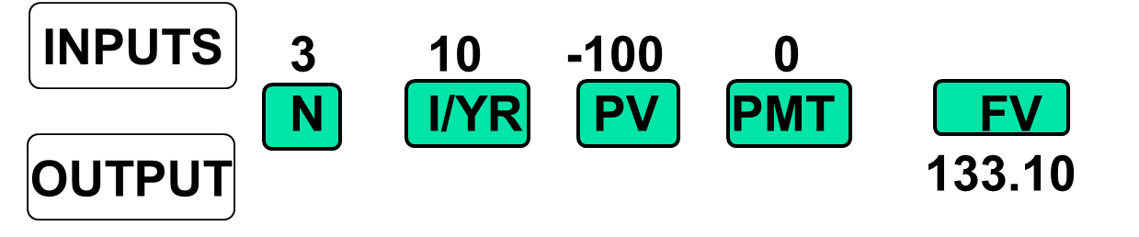
Here’s the setup to find FV
Clearing automatically sets everything to 0, but for safety enter PMT = 0.
Set: P/YR = 1, END.

Slide 22
Spreadsheet Solution (1 of 6)
Use the FV function: see spreadsheet in Ch04 Mini Case.xls
FV_{N} = FV(I, N, PMT, PV)
FV_{N} = FV(0.10, 3, 0, -100) = 133.10

Slide 23
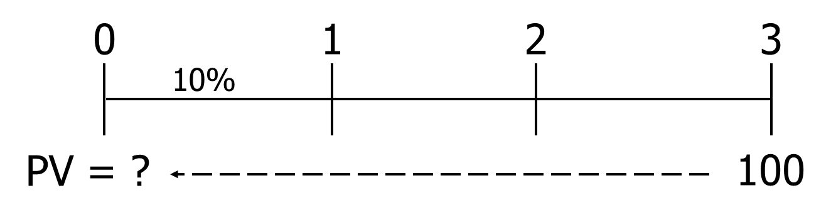
What’s the PV of $100 due in 3 years if I/YR = 10%?
Finding PVs is discounting, and it’s the reverse of compounding.

Slide 24
Formula Solution
FV_{N} = PV(1 + I)^{N}
Solve for PV:

Slide 25
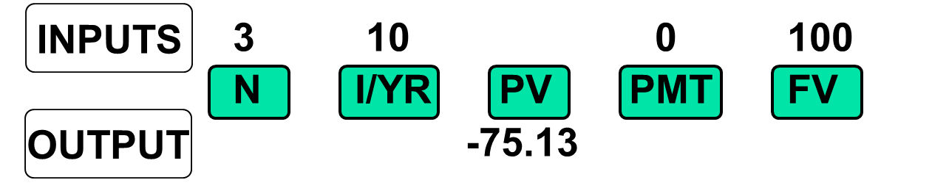
Financial Calculator Solution (1 of 2)
Either PV or FV must be negative. Here
PV = -75.13. Put in $75.13 today, take
out $100 after 3 years.

Slide 26
Spreadsheet Solution (2 of 6)
Use the PV function: see spreadsheet in Ch04 Mini Case.xls
PV = PV(I, N, PMT, FV)
PV = PV(0.10, 3, 0, 100) = -75.13

Slide 27
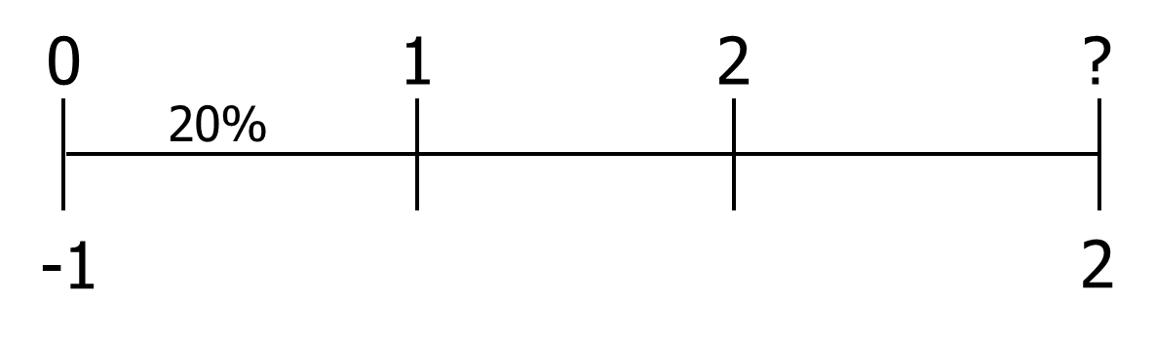
Finding the Time to Double (1 of 2)
FV_{N} = PV(1 + I)^{N}
Continued on next slide

Slide 28
Finding the Time to Double (2 of 2)

Slide 29
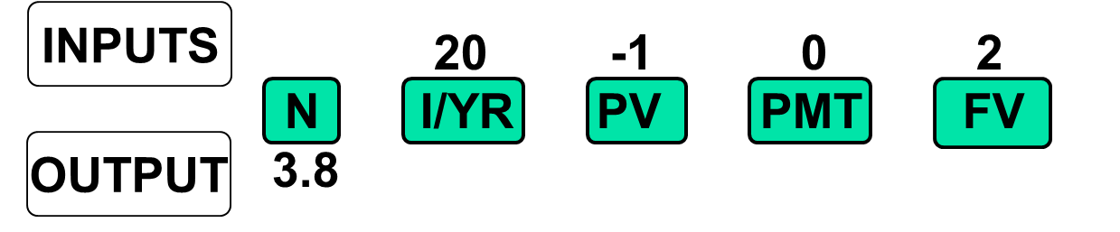
Financial Calculator Solution (2 of 2)

Slide 30
Spreadsheet Solution (3 of 6)
Use the NPER function: see spreadsheet in Ch04 Mini Case.xls
N = NPER(I, PMT, PV, FV)
N = NPER(0.10, 0, -1, 2) = 3.8

Slide 31
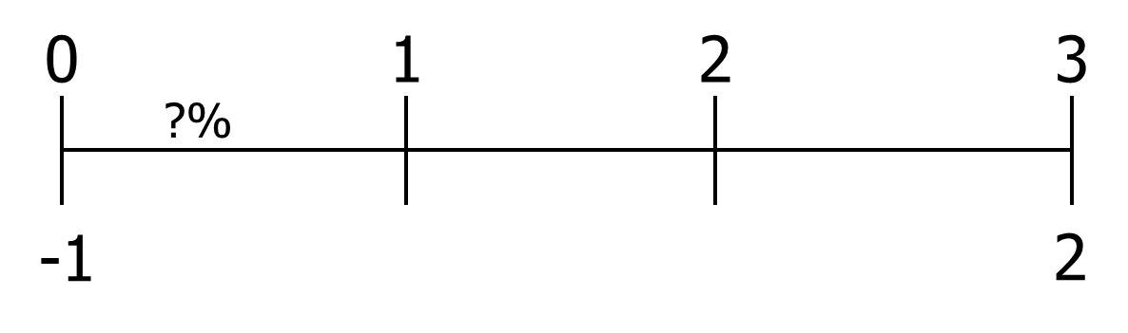
Finding the Interest Rate

Slide 32
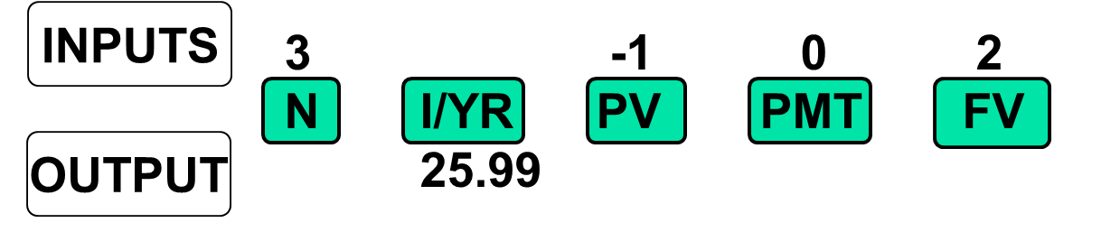
Financial Calculator

Slide 33
Spreadsheet Solution (4 of 6)
Use the RATE function: see spreadsheet in Ch04 Mini Case.xls
I = RATE(N, PMT, PV, FV)
I = RATE(3, 0, -1, 2) = 0.2599

Slide 34
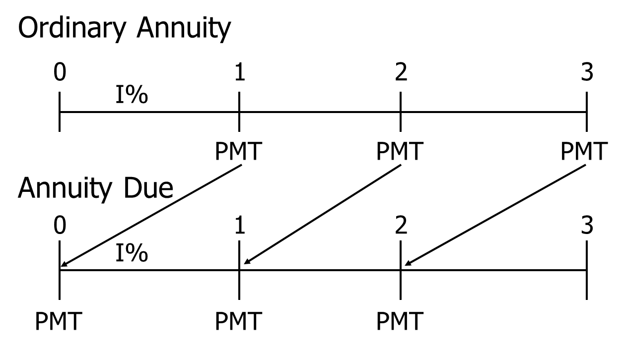
Ordinary Annuity vs. Annuity Due

Slide 35
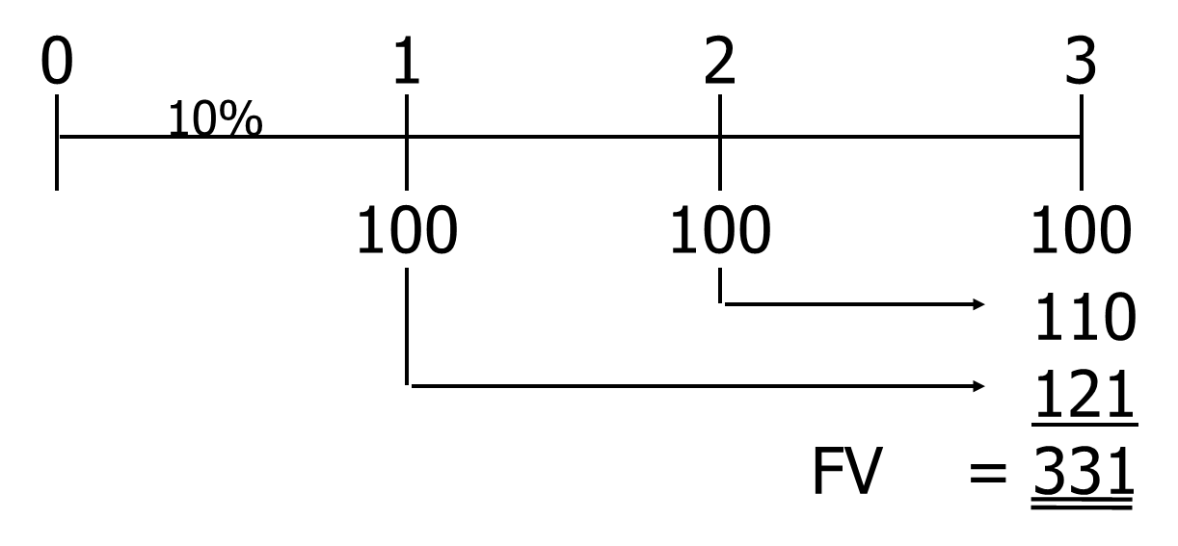
What’s the FV of a 3-year ordinary annuity of $100 at 10%?

Slide 36
FV Annuity Formula
The future value of an annuity with N periods and an interest rate of I can be found with the following formula:

Slide 37
Financial Calculator Formula for Annuities
Financial calculators solve this equation:
There are 5 variables. If 4 are known, the calculator will solve for the 5th.

Slide 38
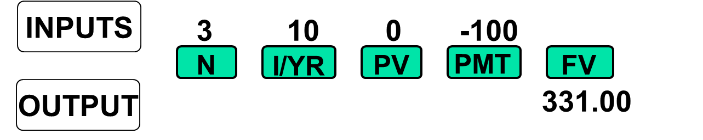
Financial Calculator Solution (2 of 3)
Have payments but no lump sum PV, so enter 0 for present value.

Slide 39
Spreadsheet Solution (5 of 6)
Use the FV function: see spreadsheet in Ch04 Mini Case.xls.
FV_{N} = FV(I, N, PMT, PV)
FV_{N} = FV(0.10, 3, -100, 0) = 331.00

Slide 40
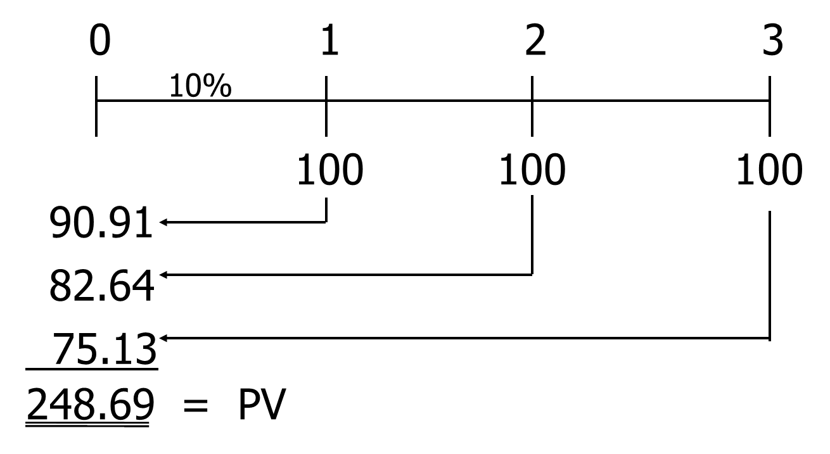
What’s the PV of this ordinary annuity?

Slide 41
PV Annuity Formula
The present value of an annuity with N periods and an interest rate of I can be found with the following formula:

Slide 42
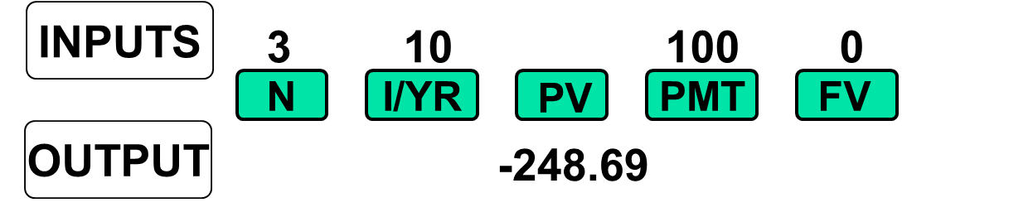
Financial Calculator Solution (3 of 3)
Have payments but no lump sum FV, so enter 0 for future value.

Slide 43
Spreadsheet Solution (6 of 6)
Use the PV function: see spreadsheet in Ch04 Mini Case.xls.
PV = PV(I, N, PMT, FV)
PV = PV(0.10, 3, 100, 0) = -248.69

Slide 44
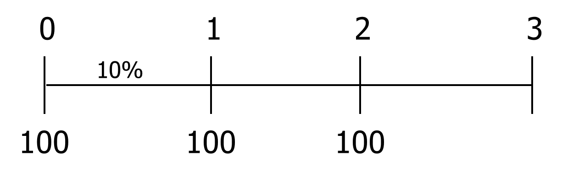
Find the FV and PV if the annuity were an annuity due.

Slide 45
PV and FV of Annuity Due vs. Ordinary Annuity
PV of annuity due:
= (PV of ordinary annuity) (1+I)
= ($248.69) (1+ 0.10) = $273.56
FV of annuity due:
= (FV of ordinary annuity) (1+I)
= ($331.00) (1+ 0.10) = $364.10

Slide 46
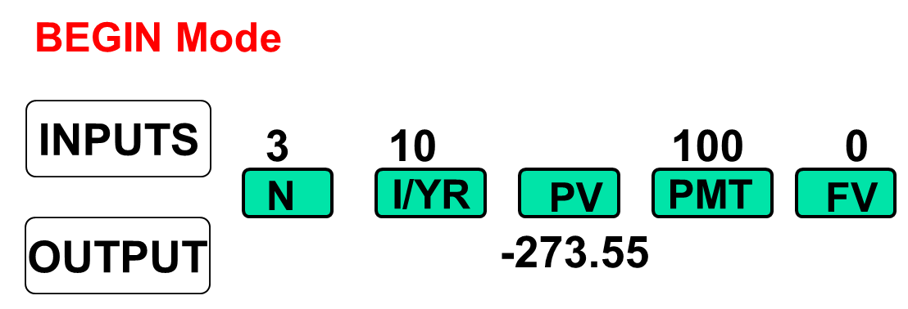
PV of Annuity Due: Switch from “End” to “Begin”

Slide 47
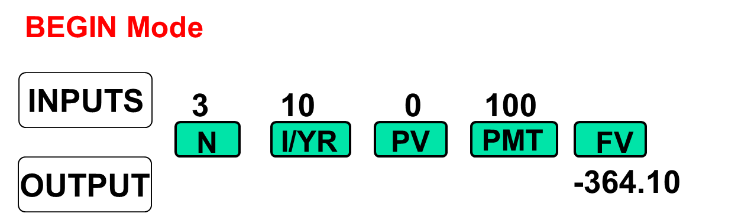
FV of Annuity Due: Switch from “End” to “Begin”

Slide 48
Excel Function for Annuities Due
Change the formula to:
=PV(0.10,3,-100,0,1)
The fourth term (0) tells the function there are no other cash flows. The fifth term (1) tells the function that it is an annuity due. A similar function gives the future value of an annuity due:
=FV(0.10,3,-100,0,1)

Slide 49
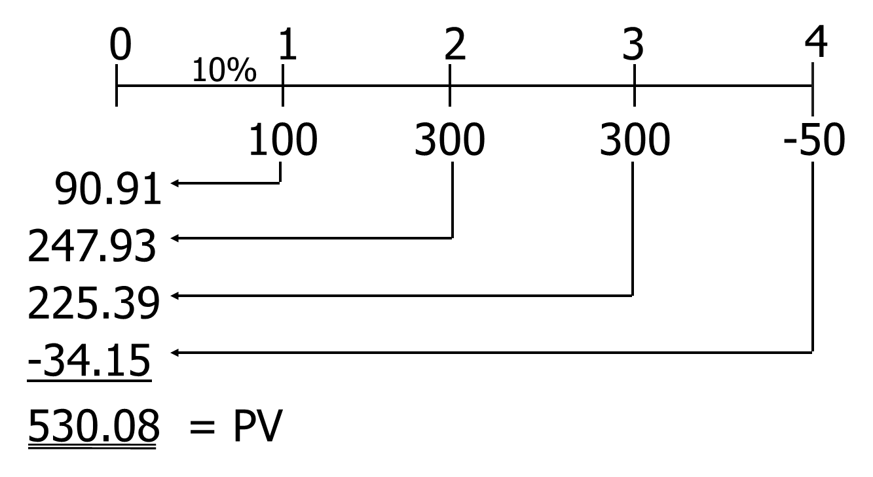
What is the PV of this uneven cash flow stream?

Slide 50
Financial calculator: HP 10bII+ (3 of 4)
Clear all: Orange Shift key, then C All key (in orange).
Enter number, then hit the CFj key.
Repeat for all cash flows, in order.
To find NPV: Enter interest rate (I/YR). Then Orange Shift key, then NPV key (in orange).

Slide 51
Financial calculator: HP 10bII+ (4 of 4)
To see current cash flow in list, hit RCL CFj CFj
To see previous CF, hit RCL CFj –
To see subsequent CF, hit RCL CFj +
To see CF 0-9, hit RCL CFj 1 (to see CF 1). To see CF 10-14, hit RCL CFj . (period) 1 (to see CF 11).

Slide 52
Financial calculator: BAII + (1 of 4)
Clear all cash flows: CF; 2nd CLR Work.
CF0 displayed. Enter number, then hit the ENTER key.
Hit the down arrow to display C01. Enter number, hit ENTER.
F01 displayed. Usually just hit 1 ENTER. If you have several cash flows that are all the same, then use F01 to say how many you have.

Slide 53
Financial calculator: BAII + (2 of 4)
Repeat for all cash flows, in order.
To find NPV: Hit NPV; I = will display. Enter interest rate (as a percentage, so enter 10 for 10%) ENTER; Down Arrow; Displays NPV =; hit CPT and the NPV will display.

Slide 54
Financial calculator: BAII + (3 of 4)
To see current cash flow in list, hit CF
Scroll up or down using the up and down arrows.

Slide 55
Financial calculator: BAII + (4 of 4)
Input in “CFLO” register:
  CF0 = 0
  CF1 = 100
  CF2 = 300
  CF3 = 300
  CF4 = -50
Enter I/YR = 10, then press NPV button to get NPV = 530.09. (Here NPV = PV.)

Slide 56
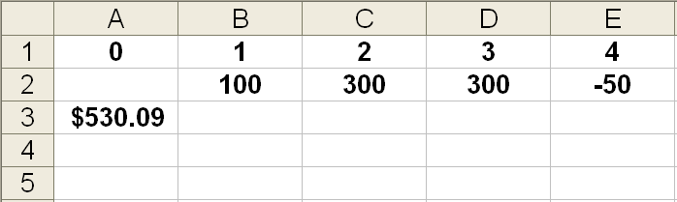
Excel Formula in cell A3: = NPV(10%,B2:E2)

Slide 57
Nominal rate (I_{NOM})
Stated in contracts, and quoted by banks and brokers.
Not used in calculations or shown on time lines
Periods per year (M) must be given.
Examples:
  8%; Quarterly
  8%, Daily interest (365 days)

Slide 58
Periodic rate (I_{PER} )
I_{PER} = I_{NOM}/M, where M is number of compounding periods per year. M = 4 for quarterly, 12 for monthly, and 360 or 365 for daily compounding.
Used in calculations, shown on time lines.
Examples:
  8% quarterly: I_{PER} = 8%/4 = 2%.
  8% daily (365): I_{PER} = 8%/365 = 0.021918%.

Slide 59
The Impact of Compounding
Will the FV of a lump sum be larger or smaller if we compound more often, holding the stated I% constant?
Why?

Slide 60
The Impact of Compounding (Answer)
LARGER!
If compounding is more frequent than once a year--for example, semiannually, quarterly, or daily--interest is earned on interest more often.

Slide 61
FV Formula with Different Compounding Periods

Slide 62
$100 at a 12% nominal rate with semiannual compounding for 5 years

Slide 63
FV of $100 at a 12% nominal rate for 5 years with different compounding
FV(Ann.) | = $100(1.12)⁵ | = $176.23
FV(Semi.) | = $100(1.06)¹⁰ | = $179.08
FV(Quar.) | = $100(1.03)²⁰ | = $180.61
FV(Mon.) | = $100(1.01)⁶⁰ | = $181.67
FV(Daily) | = $100(1+(0.12/365))^{(5x365)} | = $182.19

Slide 64
Effective Annual Rate
The effective annual rate (EAR or EFF%) is the annual rate that causes PV to grow to the same FV as under multi-period compounding.

Slide 65
Effective Annual Rate Example
Example: Invest $1 for one year at 12%, semiannual:
EFF% = 12.36%, because $1 invested for one year at 12% semiannual compounding would grow to the same value as $1 invested for one year at 12.36% annual compounding.

Slide 66
Comparing Rates
An investment with monthly payments is different from one with quarterly payments. Must put on EFF% basis to compare rates of return. Use EFF% only for comparisons.
Banks say “interest paid daily.” Same as compounded daily.

Slide 67
EFF% for a nominal rate of 12%, compounded semiannually

Slide 68
Finding EFF with HP10BII
Type in nominal rate, then Orange Shift key, then NOM% key (in orange).
Type in number of periods, then Orange Shift key, then P/YR key (in orange).
To find effective rate, hit Orange Shift key, then EFF% key (in orange).

Slide 69
EAR (or EFF%) for a Nominal Rate of of 12%

Slide 70
Can the effective rate ever be equal to the nominal rate?
Yes, but only if annual compounding is used, i.e., if M = 1.
If M > 1, EFF% will always be greater than the nominal rate.

Slide 71
When is each rate used? (1 of 3)
I_{NOM}: Written into contracts, quoted by banks and brokers. Not used in calculations or shown on time lines.

Slide 72
When is each rate used? (2 of 3)
I_{PER}: Used in calculations, shown on time lines.
If I_{NOM} has annual compounding,
then I_{PER} = I_{NOM}/1 = I_{NOM}.

Slide 73
When is each rate used? (3 of 3)
EAR (or EFF%): Used to compare returns on investments with different payments per year.
Used for calculations if and only if dealing with annuities where payments don’t match interest compounding periods.

Slide 74
Amortization (1 of 2)
Construct an amortization schedule for a $1,000, 10% annual rate loan with 3 equal payments.

Slide 75
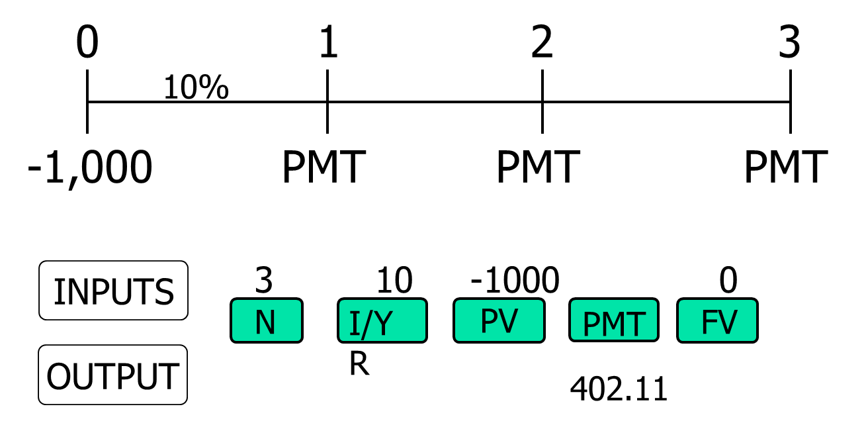
Step 1: Find the required payments.

Slide 76
Step 2: Find interest charge for Year 1.
INT_{t} = Beg bal_{t} (I)
INT₁ = $1,000(0.10) = $100

Slide 77
Step 3: Find repayment of principal in Year 1.

Slide 78
Step 4: Find ending balance after Year 1.
Repeat these steps for Years 2 and 3
to complete the amortization table.

Slide 79
Amortization Table
YEAR | BEG BAL | PMT | INT | PRIN PMT | END BAL
1 | $1,000 | $402 | $100 | $302 | $698
2 | 698 | 402 | 70 | 332 | 366
3 | 366 | 402 | 37 | 366 | 0
TOT |  | 1,206.34 | 206.34 | 1,000

Slide 80
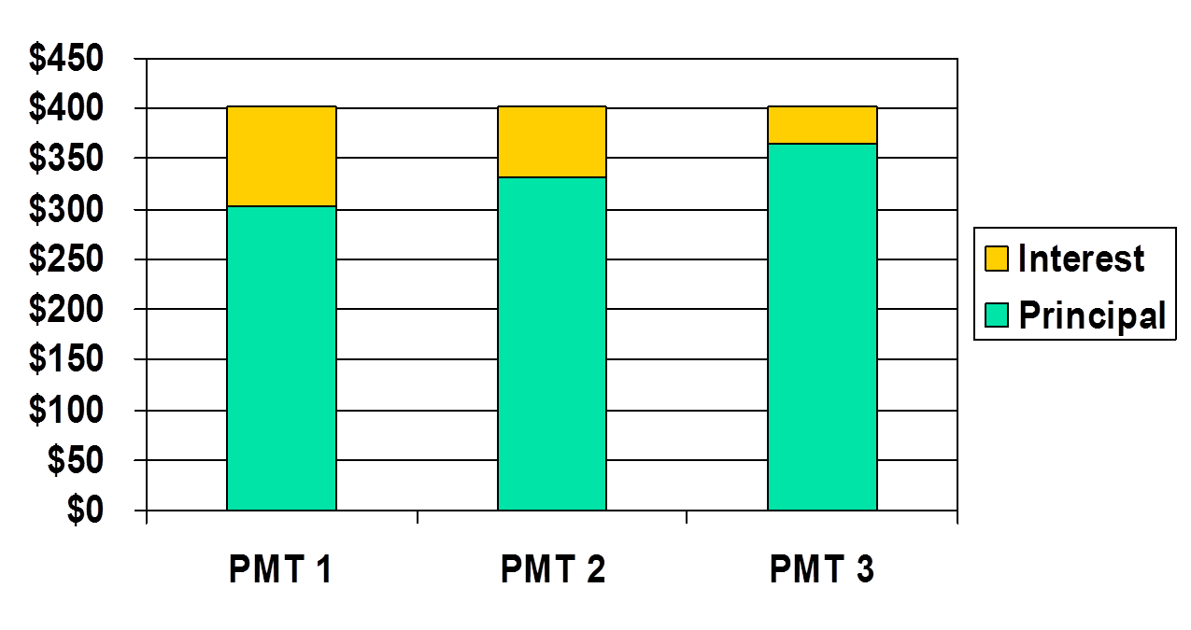
Interest declines because outstanding balance declines.

Slide 81
Amortization (2 of 2)
Amortization tables are widely used--for home mortgages, auto loans, business loans, retirement plans, and more. They are very important!
Financial calculators (and spreadsheets) are great for setting up amortization tables.

Slide 82
Fractional Time Periods
On January 1 you deposit $100 in an account that pays a nominal interest rate of 11.33463%, with daily compounding (365 days).
How much will you have on October 1, or after 9 months (273 days)? (Days given.)

Slide 83
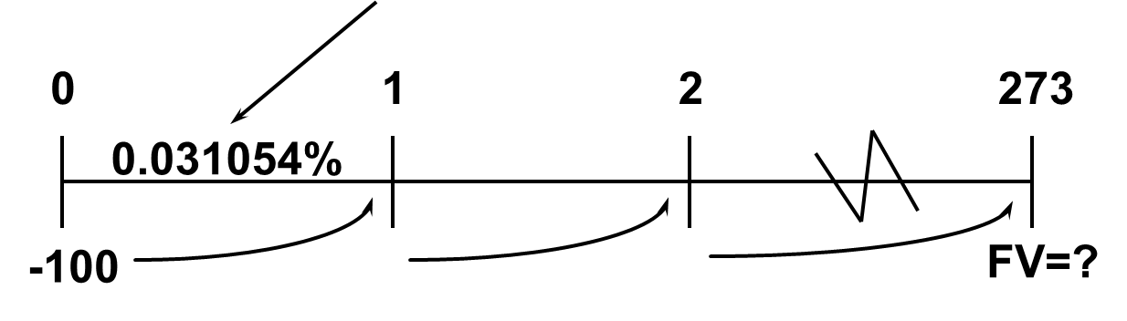
Convert interest to daily rate

Slide 84
Find FV

Slide 85
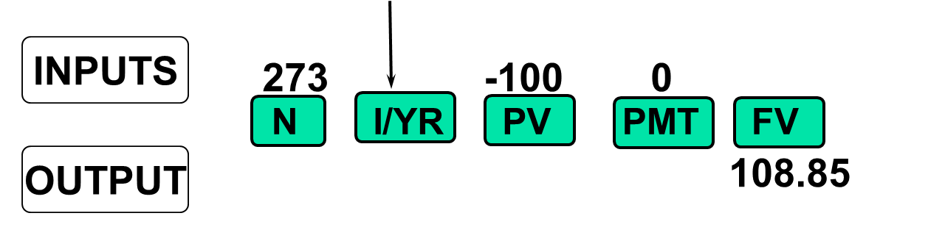
Calculator Solution (1 of 2)

Slide 86
Non-matching rates and periods (1 of 2)
What’s the value at the end of Year 3 of the following CF stream if the quoted interest rate is 10%, compounded semiannually?

Slide 87
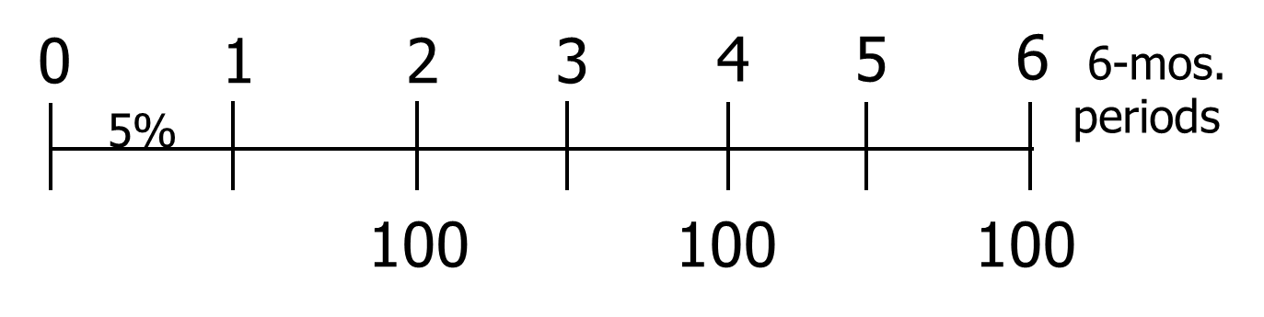
Time line for non-matching rates and periods

Slide 88
Non-matching rates and periods (2 of 2)
Payments occur annually, but compounding occurs each 6 months.
So we can’t use normal annuity valuation techniques.

Slide 89
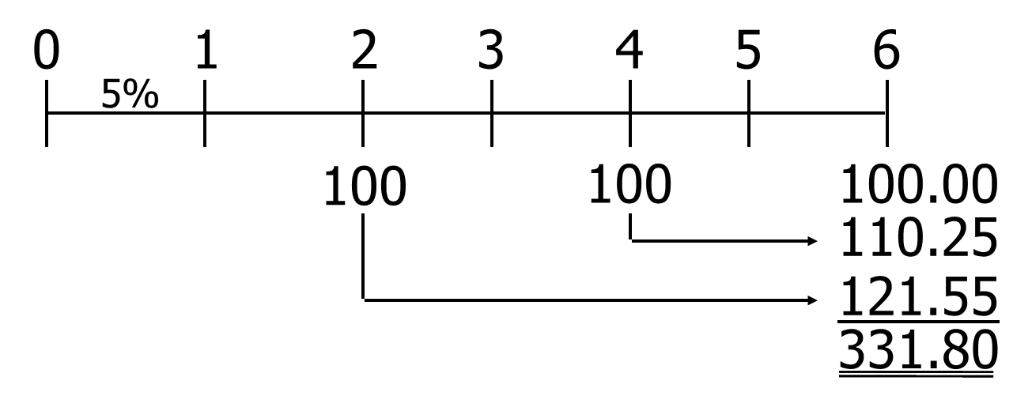
1st Method: Compound Each CF

Slide 90
2nd Method: Treat as an annuity, use financial calculator
Find the EFF% (EAR) for the quoted rate:

Slide 91
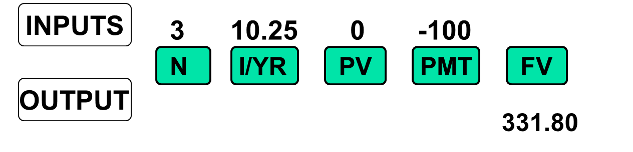
Use EAR = 10.25% as the annual rate in calculator.

Slide 92
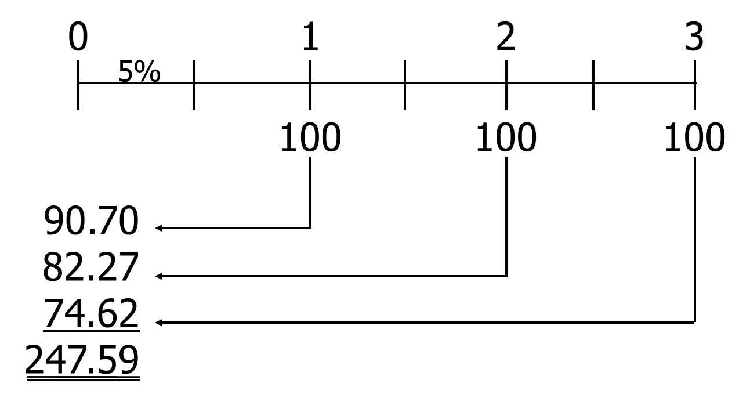
What’s the PV of this stream?

Slide 93
Comparing Investments
You are offered a note that pays $1,000 in 15 months (or 456 days) for $850. You have $850 in a bank that pays a 6.76649% nominal rate, with 365 daily compounding, which is a daily rate of 0.018538% and an EAR of 7.0%. You plan to leave the money in the bank if you don’t buy the note. The note is riskless.
Should you buy it?

Slide 94
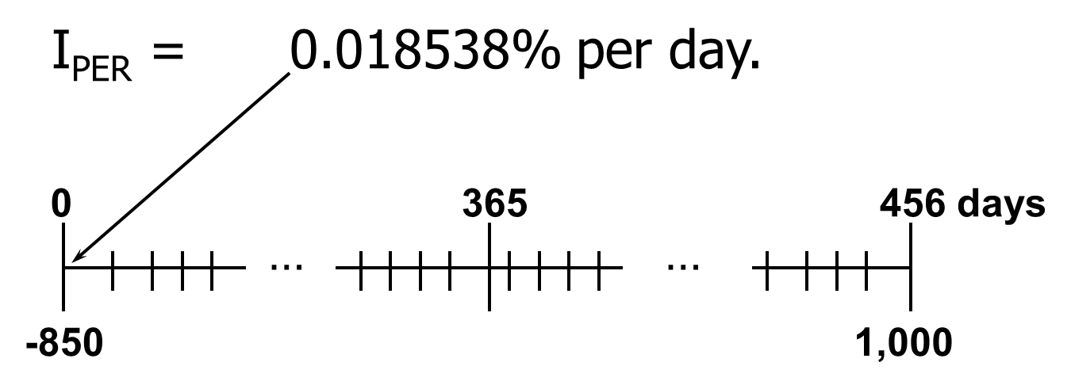
Daily time line

Slide 95
Three solution methods
1. Greatest future wealth: FV
2. Greatest wealth today: PV
3. Highest rate of return: EFF%

Slide 96
1. Greatest Future Wealth
Find FV of $850 left in bank for
15 months and compare with
note’s FV = $1,000.
FV_{Bank} = $850(1.00018538)⁴⁵⁶
= $924.97 in bank.
Buy the note: $1,000 > $924.97.

Slide 97
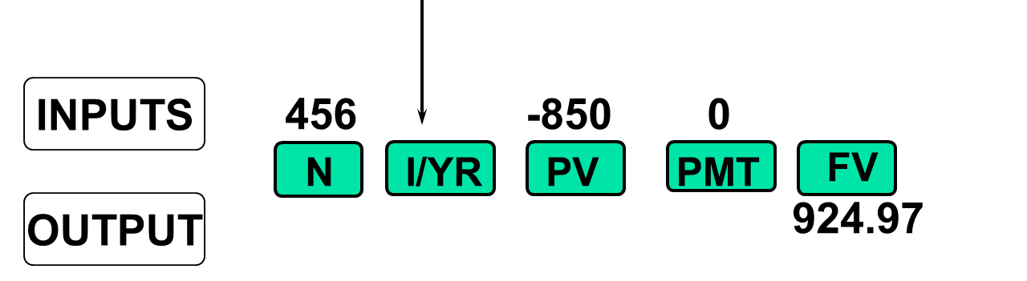
Calculator Solution to FV

Slide 98
2. Greatest Present Wealth
Find PV of note, and compare
with its $850 cost:
PV = $1,000/(1.00018538)⁴⁵⁶
= $918.95
Buy the note: $918.95 > $850

Slide 99
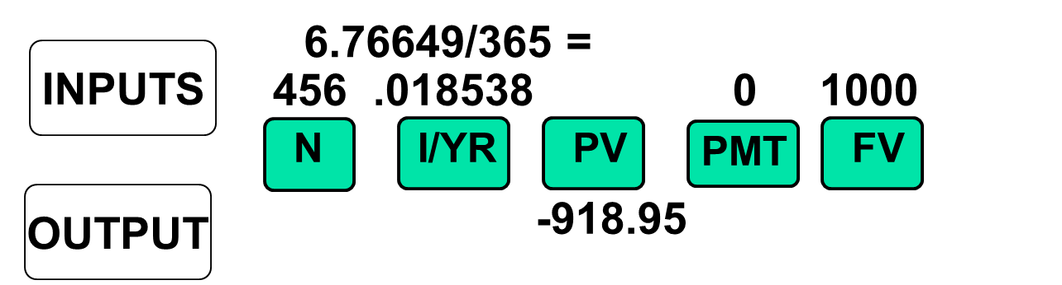
Financial Calculator Solution
PV of note is greater than its $850 cost, so buy the note. Raises your wealth.

Slide 100
3. Rate of Return
Find the EFF% on note and compare with 7.0% bank pays, which is your opportunity cost of capital:
FV_{N} = PV(1 + I)^{N}
$1,000 = $850(1 + I)⁴⁵⁶
Now we must solve for I.

Slide 101
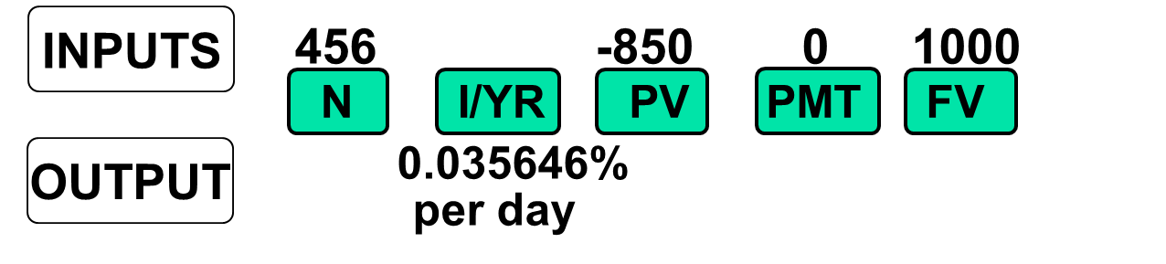
Calculator Solution (2 of 2)
Convert % to decimal:
Decimal = 0.035646/100 = 0.00035646.
EAR = EFF% = (1.00035646)³⁶⁵ - 1
= 13.89%.

Slide 102
Using interest conversion
P/YR = 365
NOM% = 0.035646(365) = 13.01
EFF% = 13.89
Since 13.89% > 7.0% opportunity cost,
buy the note.

