Slide 1
Bonds, Bond Valuation, and Interest Rates
CHAPTER 5
© 2020 Cengage Learning. All Rights Reserved. May not be copied, scanned, or duplicated, in whole or in part, except for use as permitted in a license distributed with a certain product or service or otherwise on a password-protected website for classroom use.

Slide 2
Topics in Chapter
Key features of bonds
Bond valuation
Measuring yield
Assessing risk

Slide 3
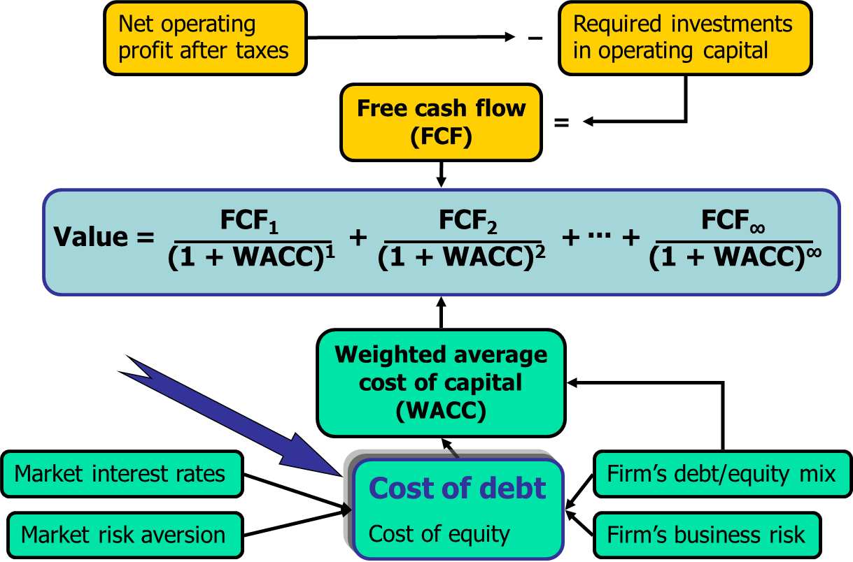
Determinants of Intrinsic Value: The Cost of Debt

Slide 4
Key Features of a Bond (1 of 2)
Par value: Face amount; paid at maturity. Assume $1,000.
Coupon interest rate: Stated interest rate. Multiply by par value to get dollars of interest. Generally fixed.

Slide 5
Key Features of a Bond (2 of 2)
Maturity: Years until bond must be repaid. Declines.
Issue date: Date when bond was issued.
Default risk: Risk that issuer will not make interest or principal payments.

Slide 6
Call Provision
Issuer can refund if rates decline. That helps the issuer but hurts the investor.
Therefore, borrowers are willing to pay more, and lenders require more, on callable bonds.
Most bonds have a deferred call and a declining call premium.

Slide 7
What’s a sinking fund?
Provision to pay off a loan over its life rather than all at maturity.
Similar to amortization on a term loan.
Reduces risk to investor, shortens average maturity.
But not good for investors if rates decline after issuance.

Slide 8
Sinking funds are generally handled in 2 ways
Call x% at par per year for sinking
fund purposes.
  Call if r_{d} is below the coupon rate and bond sells at a premium.
Buy bonds on open market.
  Use open market purchase if r_{d} is above coupon rate and bond sells at a discount.

Slide 9
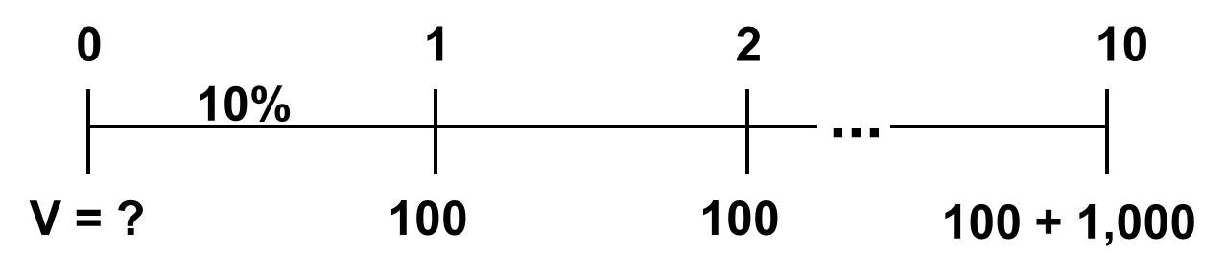
Value of a 10-year, 10% coupon bond if r_{d} = 10%

Slide 10
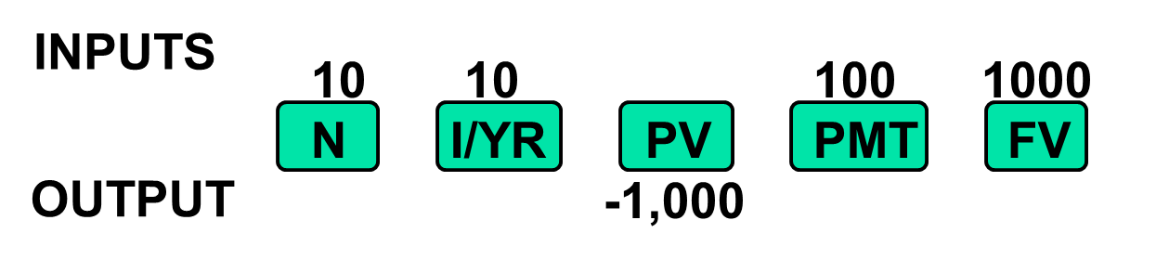
The bond consists of a 10-year, 10% annuity of $100/year plus a $1,000 lump sum at t = 10:
PV annuity | = $614.46
PV maturity value | = 385.54
Value of bond | = $1,000.00

Slide 11
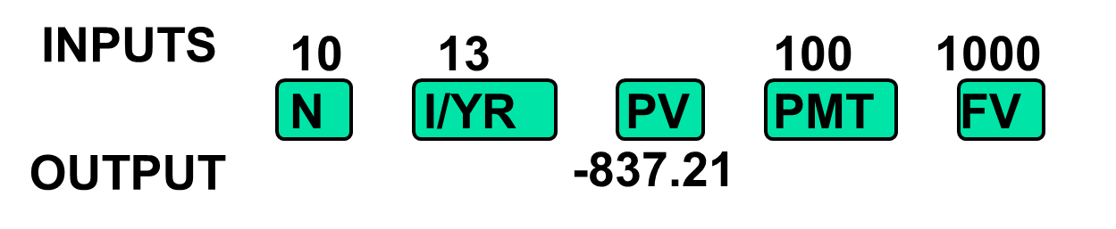
What would happen if expected inflation rose by 3%, causing r = 13%?
When r_{d} rises, above the coupon rate, the bond’s value falls below par, so it sells at a discount.

Slide 12
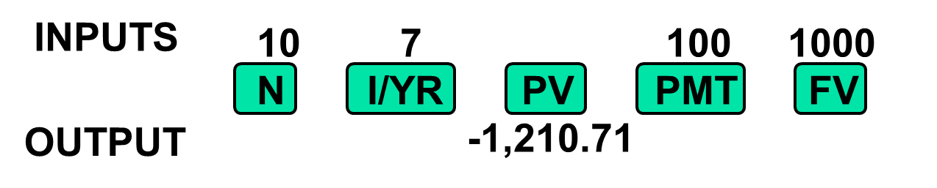
What would happen if inflation fell, and r_{d} declined to 7%?
If coupon rate > r_{d}, price rises above par, and bond sells at a premium.

Slide 13
Bond Value ($) vs. Years remaining to Maturity
(1 of 2)
Suppose the bond was issued 20 years ago and now has 10 years to maturity. What would happen to its value over time if the required rate of return remained at 10%, or at 13%, or at 7%?
See next slide.

Slide 14
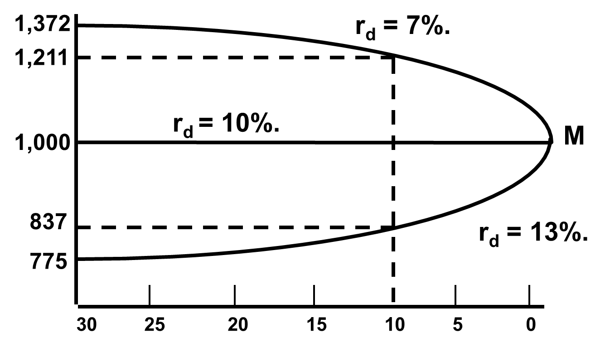
Bond Value ($) vs. Years remaining to Maturity
(2 of 2)

Slide 15
Bond Value ($) vs. Years remaining to Maturity
(2 of 3)
At maturity, the value of any bond must equal its par value.
The value of a premium bond would decrease to $1,000.
The value of a discount bond would increase to $1,000.
A par bond stays at $1,000 if r_{d} remains constant.

Slide 16
What’s “yield to maturity”?
YTM is the rate of return earned on a bond held to maturity. Also called “promised yield.”
It assumes the bond will not default.

Slide 17
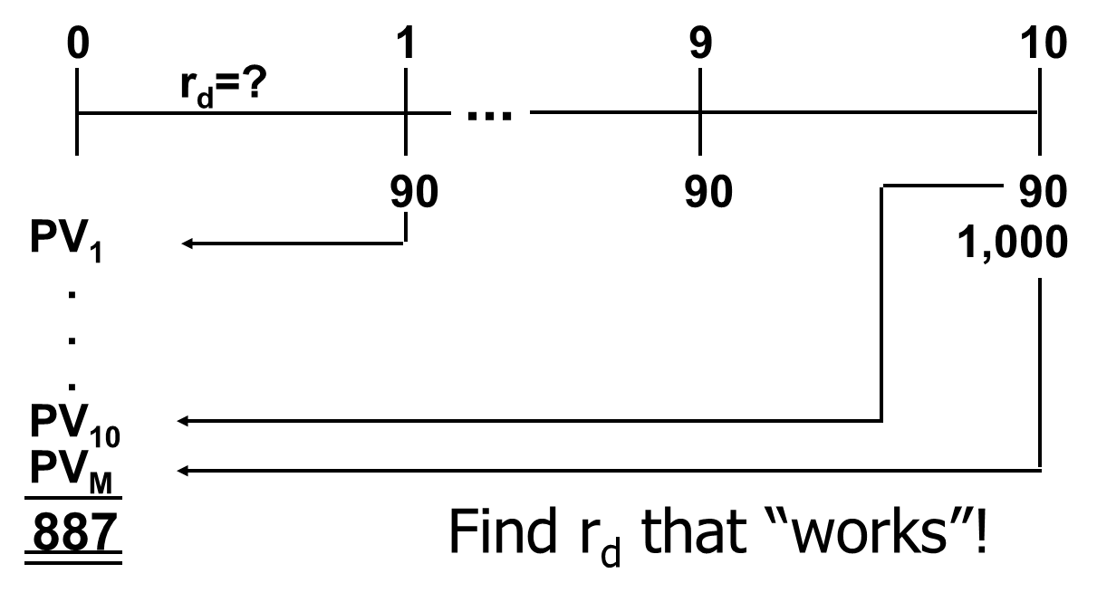
YTM on a 10-year, 9% annual coupon, $1,000 par value bond selling for $887

Slide 18
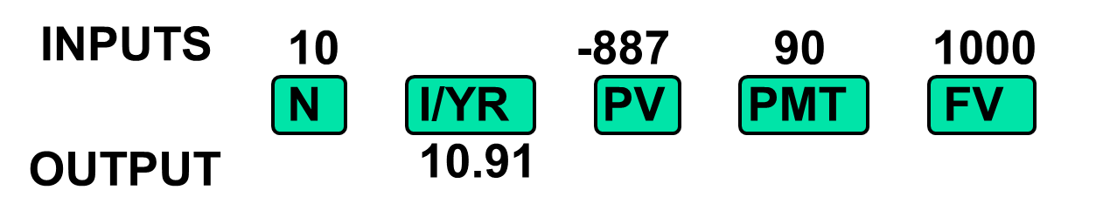
Find r_{d}

Slide 19
If coupon rate < r_{d}, bond sells at a discount.
If coupon rate = r_{d}, bond sells at its par value.
If coupon rate > r_{d}, bond sells at a premium.
If r_{d} rises, price falls.
Price = par at maturity.

Slide 20
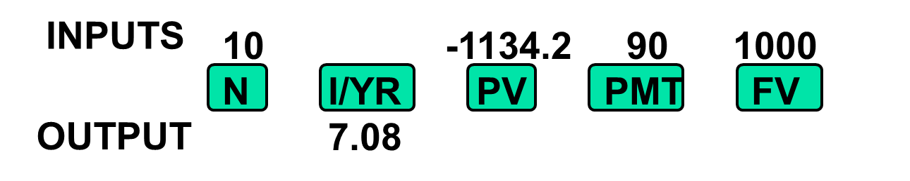
Find YTM if price were $1,134.20.
Sells at a premium.
Because coupon = 9% > r_{d} = 7.08%,
bond’s value > par.

Slide 21
Definitions

Slide 22
9% coupon, 10-year bond, P = $887, and YTM = 10.91%

Slide 23
YTM = Current yield + Capital gains yield.
Could also find values in Years 1 and 2,
get difference, and divide by value in
Year 1. Same answer.

Slide 24
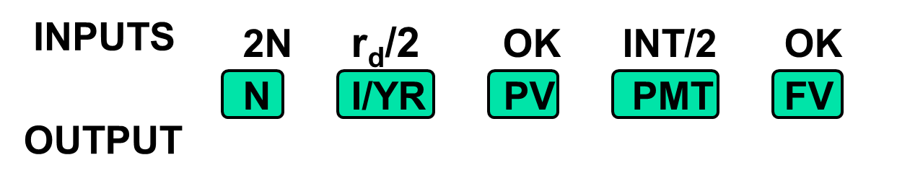
Semiannual Bonds
1. Multiply years by 2 to get periods = 2N.
2. Divide nominal rate by 2 to get periodic rate = r_{d}/2.
3. Divide annual INT by 2 to get PMT = INT/2.

Slide 25
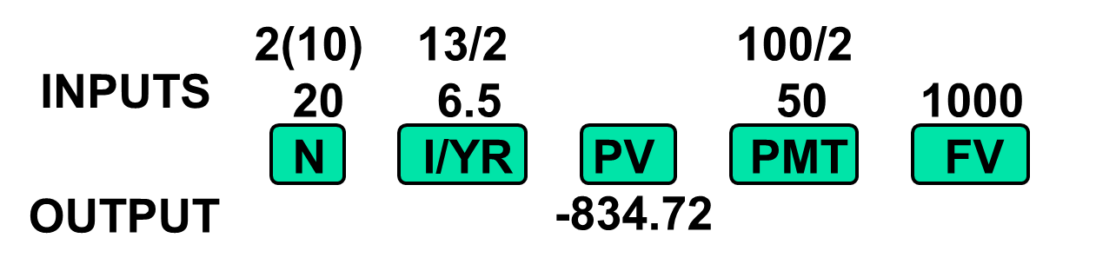
Value of 10-year, 10% coupon, semiannual bond if r_{d} = 13%.

Slide 26
Spreadsheet Functions for Bond Valuation
See Ch04 Mini Case.xls for details.
  PRICE
  YIELD

Slide 27
Callable Bonds and Yield to Call
A 10-year, 10% semiannual coupon,
$1,000 par value bond is selling for
$1,135.90 with an 8% yield to maturity.
It can be called after 5 years at $1,050.

Slide 28
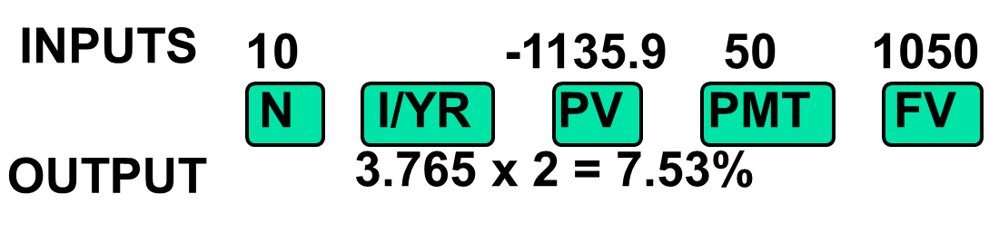
Nominal Yield to Call (YTC)

Slide 29
If you bought bonds, would you be more likely to earn YTM or YTC?
Coupon rate = 10% vs. YTC = r_{d} = 7.53%. Could raise money by selling new bonds which pay 7.53%.
Could thus replace bonds which pay $100/year with bonds that pay only $75.30/year.
Investors should expect a call, hence YTC = 7.5%, not YTM = 8%.

Slide 30
In general, if a bond sells at a premium, then coupon > r_{d}, so a call is likely.
So, expect to earn:
  YTC on premium bonds.
  YTM on par & discount bonds.

Slide 31
r_{d} = r* + IP + MRP + DRP + LP.

Slide 32
What is the real risk-free rate (r*)?
Rate that a hypothetical riskless security pays each moment if zero inflation were expected.
r* changes over time depending on economic conditions.
r* can be approximated by rate on short-term Treasury Inflation-Protected Securities (TIPS).

Slide 33
What is the nominal risk-free rate (r_{RF})?
The rate on a U.S. Treasury security
  Short-term security: T-bill
  Long-term security: T-bond

Slide 34
Estimating IP
Treasury Inflation-Protected Securities (TIPS) are indexed to inflation.
The IP for a particular length maturity can be approximated as the difference between the yield on a non-indexed Treasury security of that maturity minus the yield on a TIPS of that maturity.

Slide 35
Bond Spreads, the DRP, and the LP
A “bond spread” is often calculated as the difference between a corporate bond’s yield and a Treasury security’s yield of the same maturity. Therefore:
  Spread = DRP + LP.
Bond’s of large, strong companies often have very small LPs. Bond’s of small companies often have LPs as high as 2%.

Slide 36
Bond Ratings
Bond Ratings |  |  | % defaulting within:
S&P and Fitch | Moody’s | 1 yr. | 5 yrs.
Investment grade bonds:
AAA | Aaa | 0.13 | 0.68
AA | Aa | 0.00 | 0.00
A | A | 0.09 | 0.96
BBB | Baa | 0.07 | 1.72
Junk bonds:
BB | Ba | 0.62 | 6.35
B | B | 2.06 | 11.68
CCC | Caa | 21.36 | 35.38

Slide 37
Bond Ratings and Bond Spreads (October 2016)
Long-term Bonds | Yield (%) | Spread (%)
10-Year T-bond | 1.72
AAA | 2.21 | 0.49
AA | 2.27 | 0.55
A | 2.42 | 0.70
BBB | 3.46 | 1.74
BB | 5.16 | 3.44
B | 6.58 | 4.86
CCC | 8.37 | 6.65

Slide 38
What factors affect default risk and bond ratings?
Financial ratios
  Debt ratio
  Coverage ratios, such as interest coverage ratio or EBITDA coverage ratio
  Profitability ratios
  Current ratios

Slide 39
Bond Ratings Median Ratios (S&P)
 | Return on capital | Debt to capital
AAA | 27.6% | 12.4%
AA | 27.0% | 28.3%
A | 17.5% | 37.5%
BBB | 13.4% | 42.5%
BB | 11.3% | 53.7%
B | 8.7% | 75.9%
CCC | 3.2% | 113.5%

Slide 40
Other Factors that Affect Bond Ratings (1 of 2)
Provisions in the bond contract
  Secured versus unsecured debt
  Senior versus subordinated debt
  Guarantee provisions
  Sinking fund provisions
  Debt maturity

Slide 41
Other Factors that Affect Bond Ratings (2 of 2)
Other factors
  Earnings stability
  Regulatory environment
  Potential product liability
  Accounting policies

Slide 42
Interest rate (or price) risk for 1-year and 10-year 10% bonds
Interest rate risk:
Rising r_{d} causes bond prices to fall
 | 1-Year | 1-Year | 10-Year | 10-Year
r_{d} | Price | Change | Price | Change
5.0% | $1,048 |  | $1,386
 |  | 4.8% |  | 38.6%
10.0% | $1,000 |  | $1,000
 |  | 4.5% |  | 33.5%
15.0% | $957 |  | $749

Slide 43
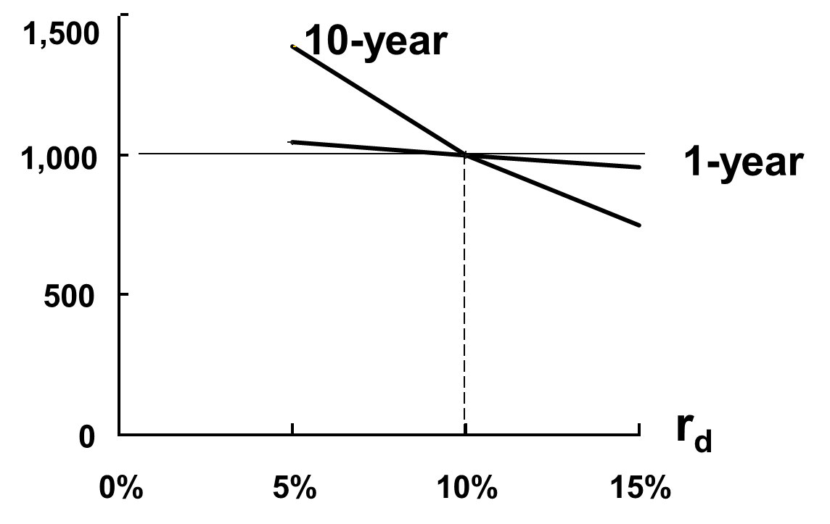
Value

Slide 44
What is reinvestment rate risk? (1 of 2)
The risk that CFs will have to be reinvested in the future at lower rates, reducing income.
Illustration: Suppose you just won $500,000 playing the lottery. You’ll invest the money and live off the interest. You buy a 1-year bond with a YTM of 10%.

Slide 45
What is reinvestment rate risk? (2 of 2)
Year 1 income = $50,000. At year-end get back $500,000 to reinvest.
If rates fall to 3%, income will drop from $50,000 to $15,000. Had you bought 30-year bonds, income would have remained constant.

Slide 46
The Maturity Risk Premium
Long-term bonds: High interest rate risk, low reinvestment rate risk.
Short-term bonds: Low interest rate risk, high reinvestment rate risk.
Nothing is riskless!
Yields on longer term bonds usually are greater than on shorter term bonds, so the MRP is more affected by interest rate risk than by reinvestment rate risk.

Slide 47
Term Structure Yield Curve
Term structure of interest rates: the relationship between interest rates (or yields) and maturities.
A graph of the term structure is called the yield curve.

Slide 48
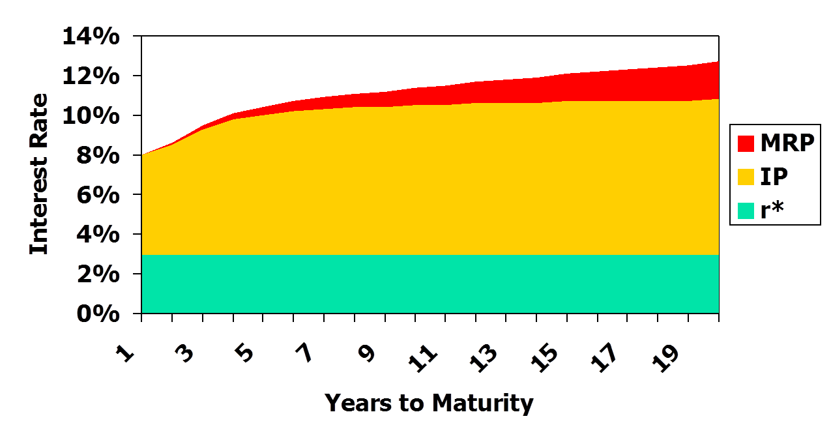
Hypothetical Treasury Yield Curve

Slide 49
Bankruptcy (1 of 4)
Two main chapters of Federal Bankruptcy Act:
  Chapter 11, Reorganization
  Chapter 7, Liquidation
Typically, company wants Chapter 11, creditors may prefer Chapter 7.

Slide 50
Bankruptcy (2 of 4)
If company can’t meet its obligations, it files under Chapter 11. That stops creditors from foreclosing, taking assets, and shutting down the business.
Company has 120 days to file a reorganization plan.
  Court appoints a “trustee” to supervise reorganization.
  Management usually stays in control.

Slide 51
Bankruptcy (3 of 4)
Company must demonstrate in its reorganization plan that it is “worth more alive than dead.”
Otherwise, judge will order liquidation under Chapter 7.

Slide 52
If the company is liquidated, here’s the payment priority:
Past due property taxes
Secured creditors from sales of secured assets.
Trustee’s costs
Expenses incurred after bankruptcy filing
Wages and unpaid benefit contributions, subject to limits
Unsecured customer deposits, subject to limits
Taxes
Unfunded pension liabilities
Unsecured creditors
Preferred stock
Common stock

Slide 53
Bankruptcy (4 of 4)
In a liquidation, unsecured creditors generally get zero. This makes them more willing to participate in reorganization even though their claims are greatly scaled back.
Various groups of creditors vote on the reorganization plan. If both the majority of the creditors and the judge approve, company “emerges” from bankruptcy with lower debts, reduced interest charges, and a chance for success.

