Slide 1
Risk and Return
CHAPTER 6
© 2020 Cengage Learning. All Rights Reserved. May not be copied, scanned, or duplicated, in whole or in part, except for use as permitted in a license distributed with a certain product or service or otherwise on a password-protected website for classroom use.

Slide 2
Topics in Chapter
Basic return and risk concepts
Stand-alone risk
Portfolio (market) risk
Risk and return: CAPM/SML
Market equilibrium and market efficiency

Slide 3
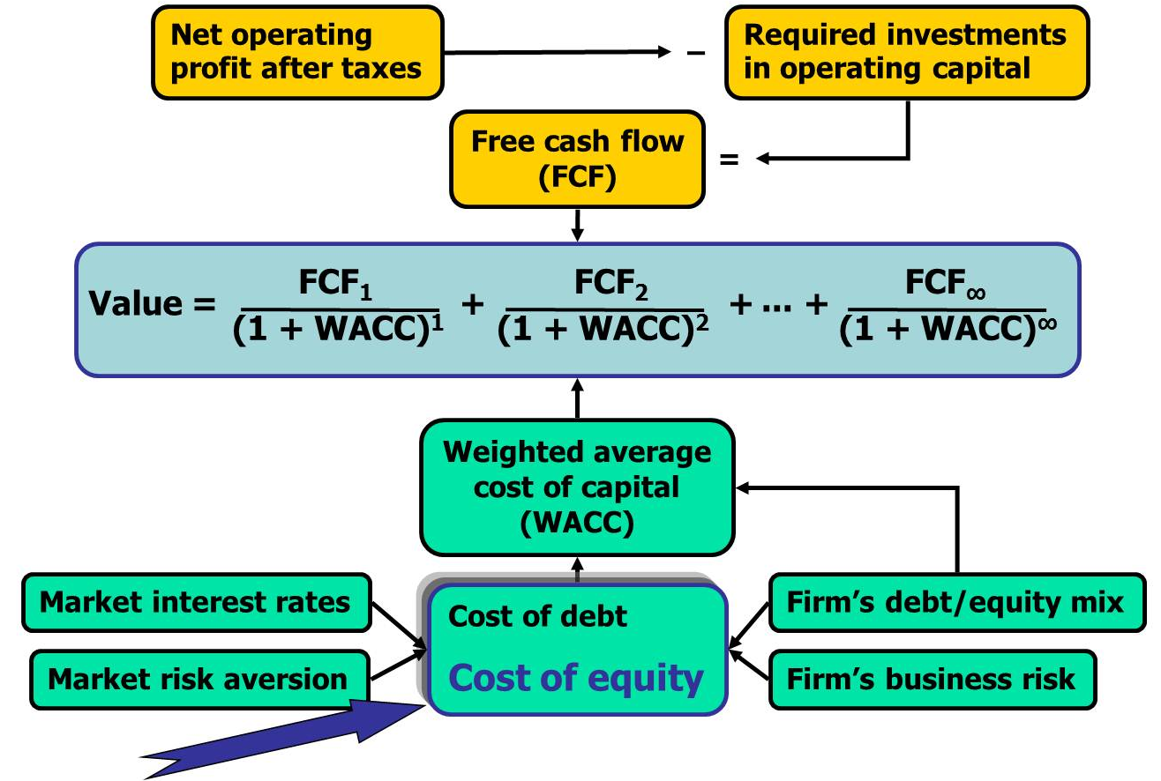
Determinants of Intrinsic Value: The Cost of Equity

Slide 4
What are investment returns?
Investment returns measure the financial results of an investment.
Returns may be historical or prospective (anticipated).
Returns can be expressed in:
  Dollar terms.
  Percentage terms.

Slide 5
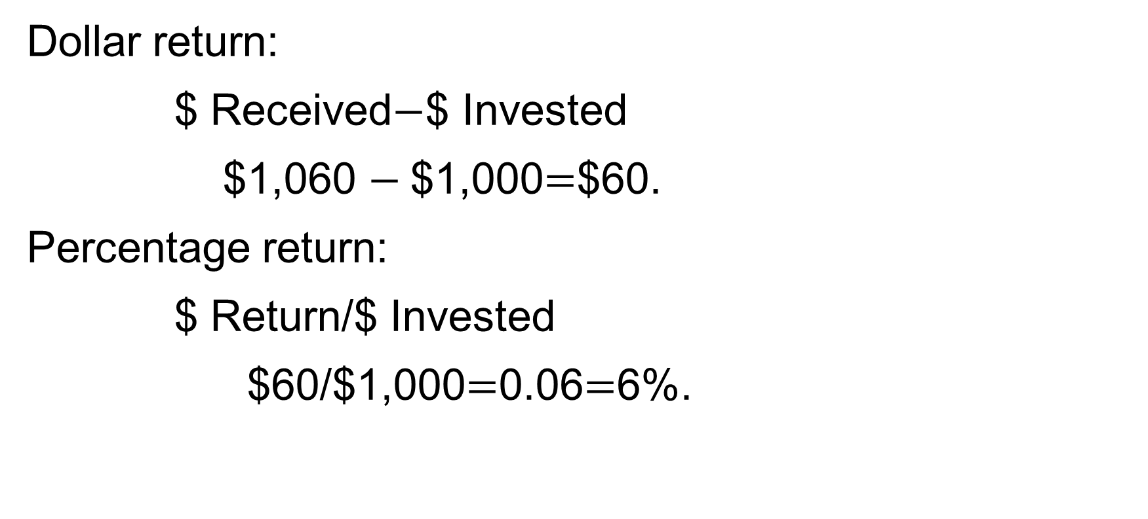
An investment costs $1,000 and is sold after
1 year for $1,060.
Dollar return:
$ Received$−$$ Invested
$1,060 $−$$1,000$=$$60.
Percentage return:
$ Return/$ Invested
$60/$1,000$=$0.06$=$6%.

Slide 6
What is investment risk?
Investment risk is exposure to the chance of earning less than expected.
The greater the chance of a return far below the expected return, the greater the risk.

Slide 7
Scenarios and Returns for the 10-Year Zero Coupon T-bond Over the Next Year
Scenario | Probability | Return
Worst Case | 0.10 | −14%
Poor Case | 0.20 | −4%
Most Likely | 0.40 | 6%
Good Case | 0.20 | 16%
Best Case | 0.10 | 26%
 | 1.00

Slide 8
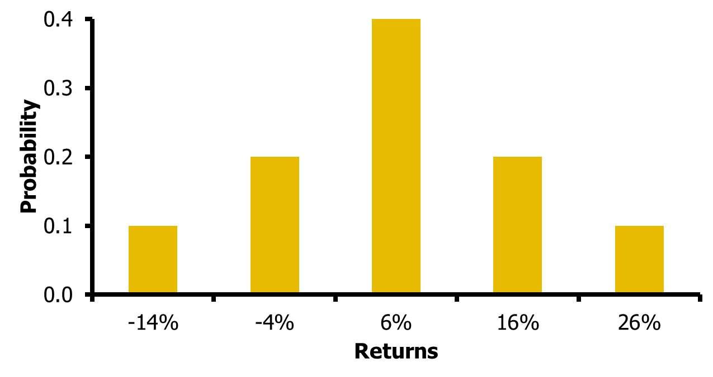
Discrete Probability Distribution for Scenarios

Slide 9
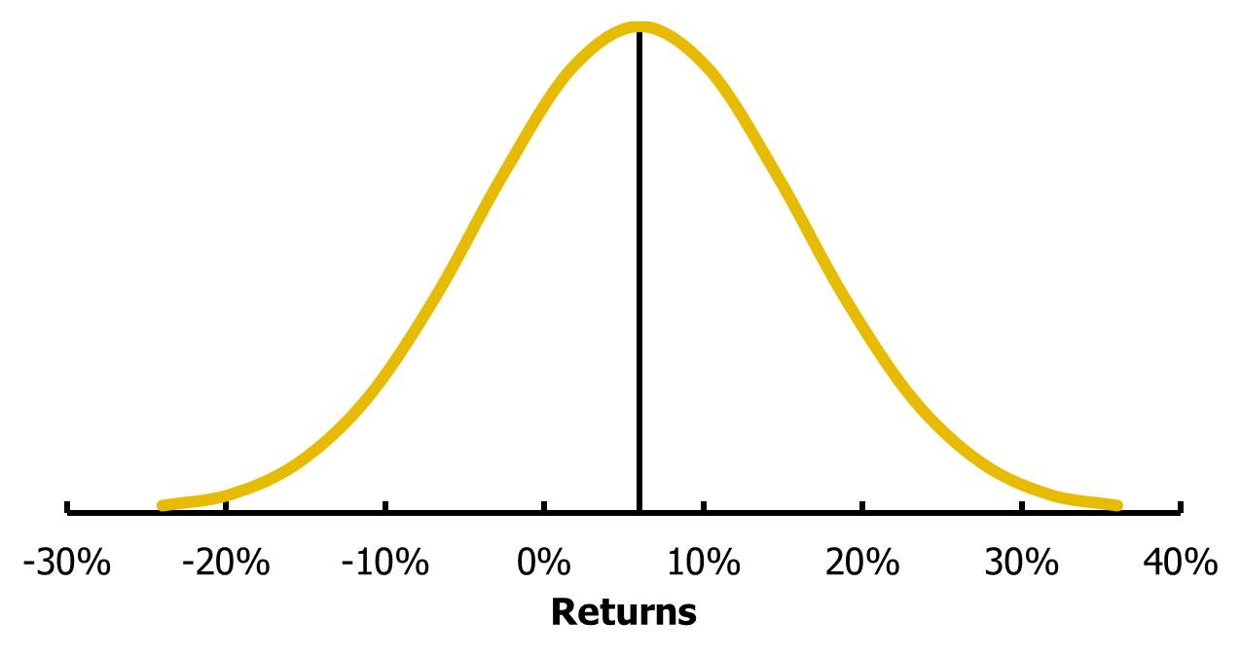
Example of a Continuous Probability Distribution

Slide 10
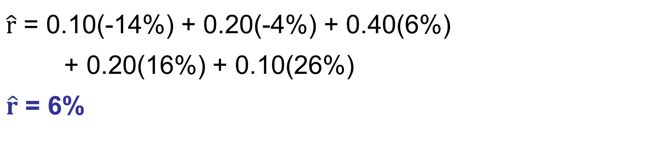
Calculate the expected rate of return (r ̂ ) on the bond for the next year.
$\hat{r}$ = 0.10(-14%) + 0.20(-4%) + 0.40(6%)
+ 0.20(16%) + 0.10(26%)
$\hat{r}$ = 6%

Slide 11
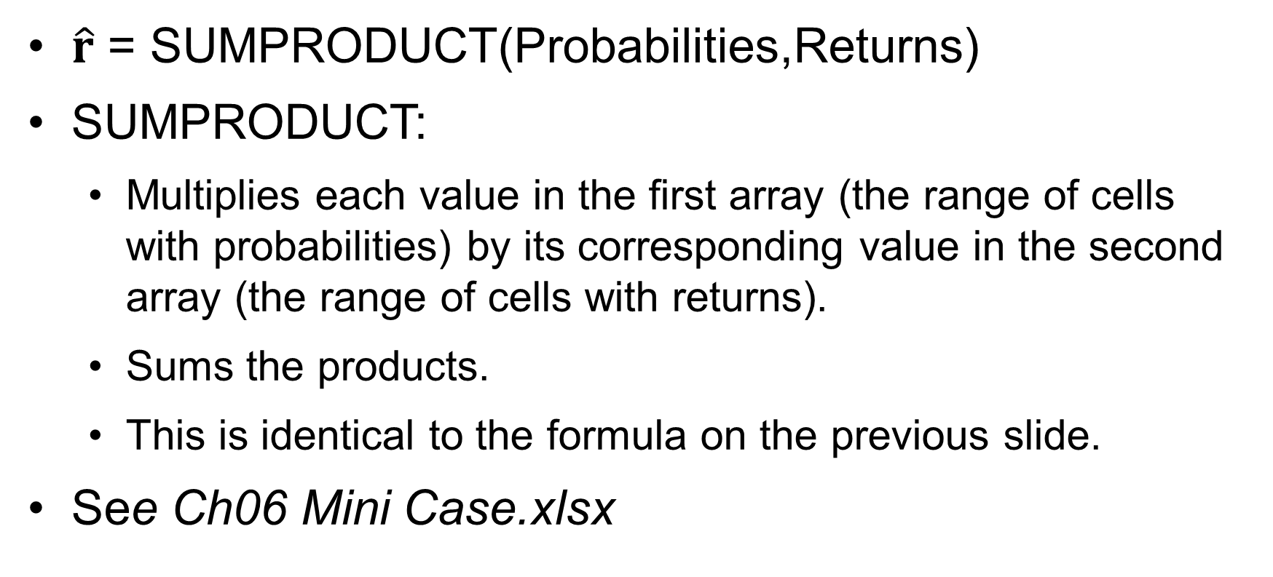
Use Excel to Calculate the Expected Value of a Discrete Distribution
$\hat{r}$ = SUMPRODUCT(Probabilities,Returns)
SUMPRODUCT:
  Multiplies each value in the first array (the range of cells with probabilities) by its corresponding value in the second array (the range of cells with returns).
  Sums the products.
  This is identical to the formula on the previous slide.
See Ch06 Mini Case.xlsx

Slide 12
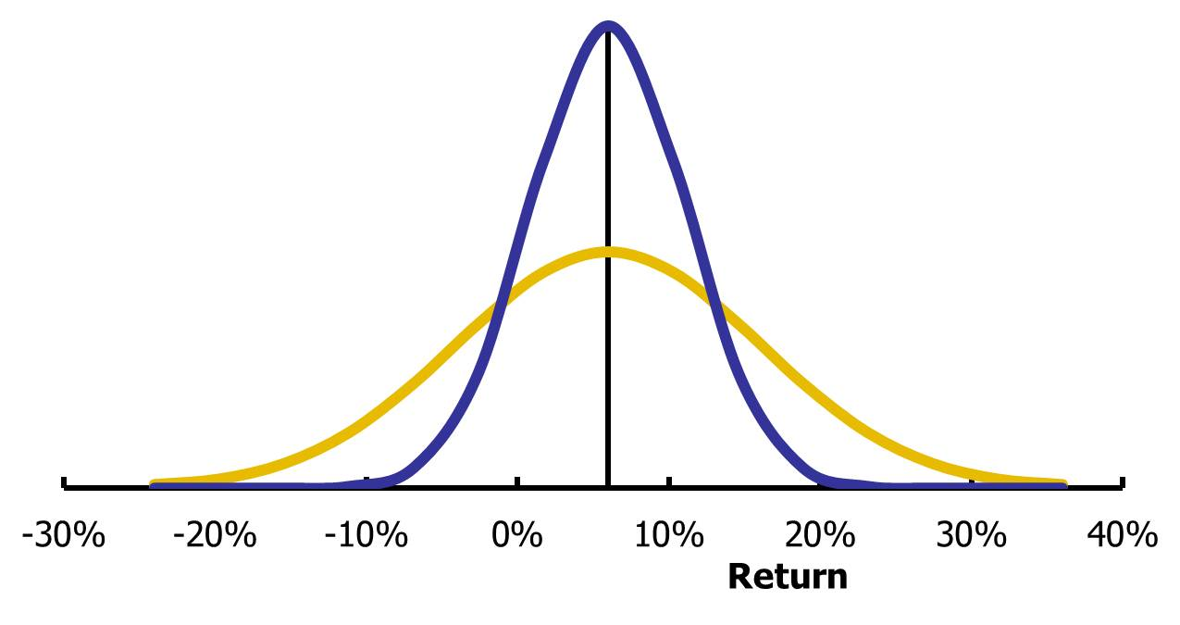
Consider these probability distributions for two investments. Which riskier? Why?

Slide 13
Stand-Alone Risk: Standard Deviation
Stand-alone risk is the risk of each asset held by itself.
Standard deviation measures the dispersion of possible outcomes.
For a single asset:
  Stand-alone risk = Standard deviation

Slide 14
Variance (σ²) and Standard Deviation (σ) for Discrete Probabilities

Slide 15

Standard Deviation of the Bond’s Return During the Next Year
σ² = 0.10 (-0.14 – 0.06)²
+ 0.20 (-0.04 – 0.06)²
+ 0.40 (0.06 – 0.06)²
+ 0.20 (0.16 – 0.06)²
+ 0.10 (0.26 – 0.06)²
σ² = 0.0120
σ = $\sqrt{σ^{2}}=\sqrt{.0120}$
σ = 0.1095 = 10.95%

Slide 16
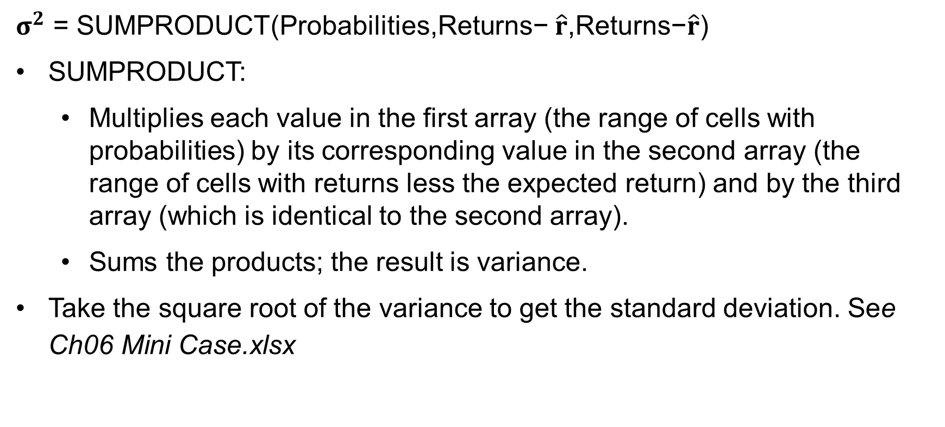
Use Excel to Calculate the Variance and Standard Deviation of a Discrete Distribution
$σ^{2}$ = SUMPRODUCT(Probabilities,Returns− $\hat{r}$,Returns−$\hat{r}$)
SUMPRODUCT:
  Multiplies each value in the first array (the range of cells with probabilities) by its corresponding value in the second array (the range of cells with returns less the expected return) and by the third array (which is identical to the second array).
  Sums the products; the result is variance.
Take the square root of the variance to get the standard deviation. See Ch06 Mini Case.xlsx

Slide 17
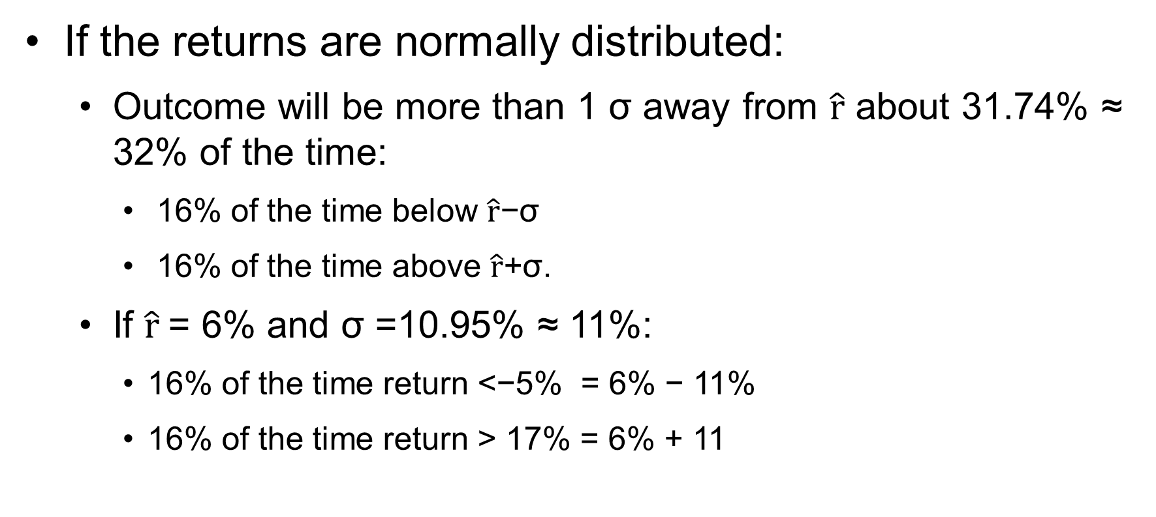
Understanding the Standard Deviation
If the returns are normally distributed:
  Outcome will be more than 1 σ away from $\hat{r}$ about 31.74% ≈ 32% of the time:
    16% of the time below $\hat{r}$−σ
    16% of the time above $\hat{r}$+σ.
  If $\hat{r}$= 6% and σ =10.95% ≈ 11%:
    16% of the time return <−5% = 6% − 11%
    16% of the time return > 17% = 6% + 11

Slide 18
Useful in Comparing Investments
Investments with bigger standard deviations have more risk.
High risk doesn’t mean you should reject the investment, but:
  You should know the risk before investing
  You should expect a higher return as compensation for bearing the risk.

Slide 19
Using Historical Data to Estimate Risk
Analysts often use discrete outcomes to analyze risk for projects; see Chapter 11.
But for investments, most analysts normally use historical data rather than discrete forecasts to estimate an investment’s risk unless it is a very special situation.
Most analysts use:
  48 to 60 months of monthly data, or
  52 weeks of weekly data, or
  Shorter period using daily data.
Use annual returns here for sake of simplicity.

Slide 20
Formulas for a Sample of T Historical Returns
Tedious to calculate by hand, easy in Excel. See next slide.

Slide 21
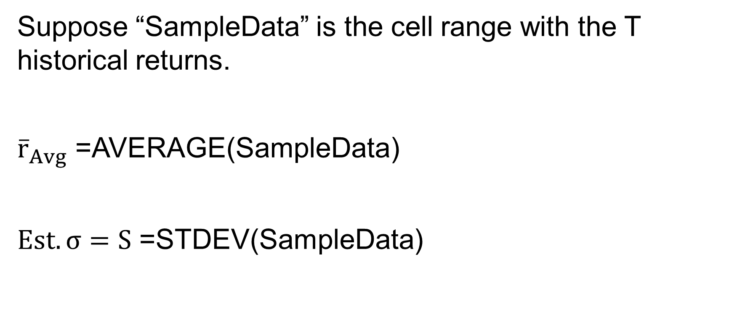
Excel Functions a Sample of T Historical Returns
Suppose “SampleData” is the cell range with the T historical returns.
${\overline{r}}_{Avg}$ =AVERAGE(SampleData)
$Est. σ=S$ =STDEV(SampleData)

Slide 22
Historical Data for Stock Returns
Year | Market | Blandy | Gourmange
1 | 30% | 26% | 47%
2 | 7 | 15 | −54
3 | 18 | −14 | 15
4 | −22 | −15 | 7
5 | −14 | 2 | −28
6 | 10 | −18 | 40
7 | 26 | 42 | 17
8 | −10 | 30 | −23
9 | −3 | −32 | −4
10 | 38 | 28 | 75

Slide 23
Average and Standard Deviations for
Stand-Alone Investments
Use formulas shown previously (tedious) or use Excel (easy)
What is Blandy’s stand-alone risk?
Note: analysts often use past risk as a predictor of future risk, but past returns are not a good prediction of future returns.
 | Market | Blandy | Gourmange
Average return | 8.0% | 6.4% | 9.2%
Standard deviation | 20.1% | 25.2% | 38.6%

Slide 24
How risky is Blandy stock?
Assumptions:
  Returns are normally distributed.
  σ is 25.2%
  Expected return is about 6.4%.
16% of the time (approximately), return will be:
  < −18.8% (6.4%−25.2% = −18.8)
  > 32.6% (6.4%+25.2% = 32.6)
Stocks are very risky!

Slide 25
Portfolio Returns
The percentage of a portfolio’s value that is invested in Stock i is denoted by the “weight” w_{i}. Notice that the sum of all the weights must equal 1.
With n stocks in the portfolio, its return each year will be:

Slide 26
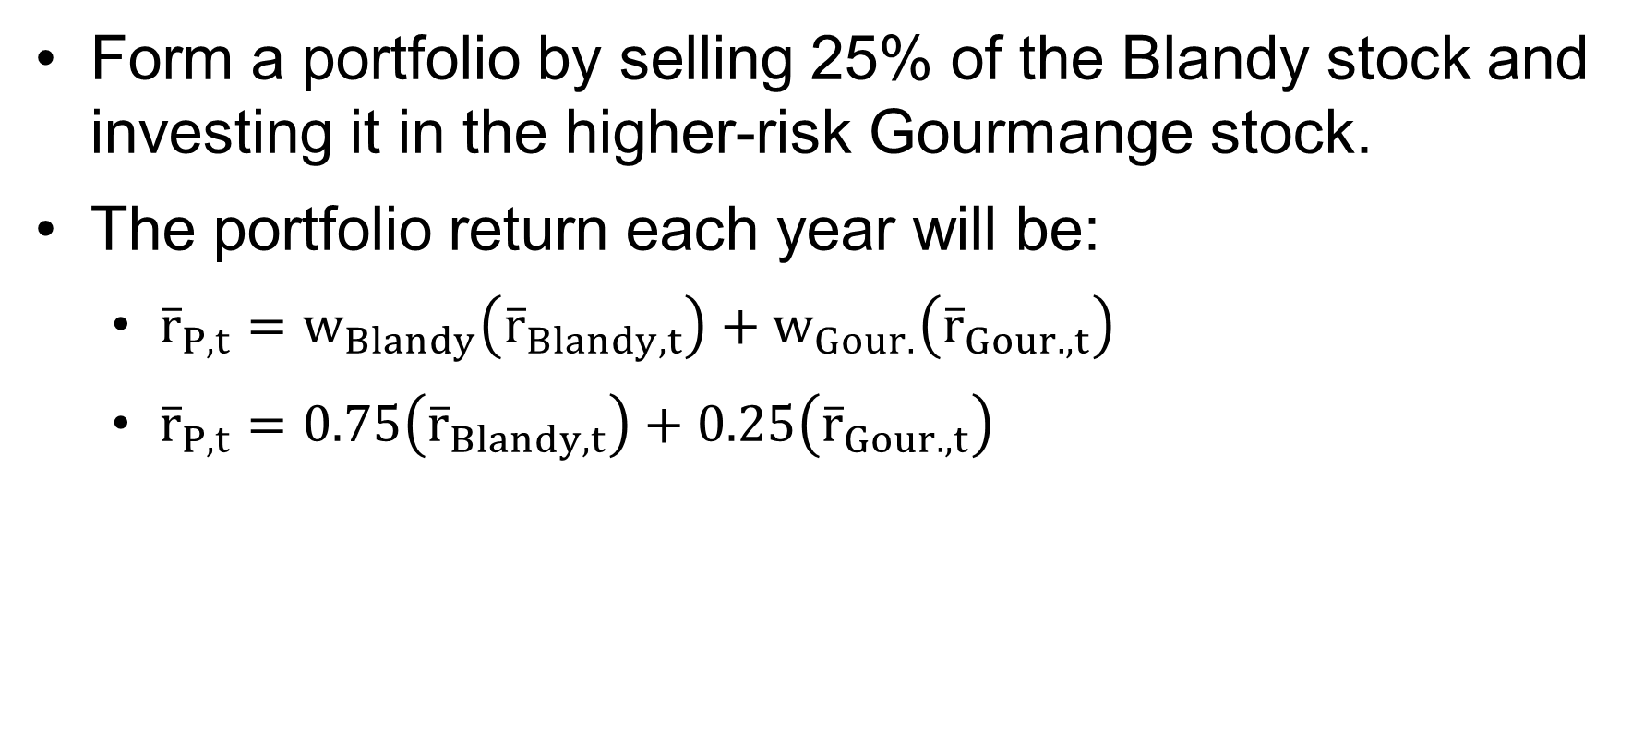
Example: 2-Stock Portfolio
Form a portfolio by selling 25% of the Blandy stock and investing it in the higher-risk Gourmange stock.
The portfolio return each year will be:
  ${\overline{r}}_{P,t}=w_{Blandy}\left({\overline{r}}_{Blandy,t}\right)+w_{Gour.}\left({\overline{r}}_{Gour.,t}\right)$
  ${\overline{r}}_{P,t}=0.75\left({\overline{r}}_{Blandy,t}\right)+0.25\left({\overline{r}}_{Gour.,t}\right)$

Slide 27
Historical Data for Stocks and Portfolio Returns
Year | Blandy | Gourmange | Portfolio of Blandy and Gourmange
1 | 26% | 47% | 31.3%
2 | 15 | −54 | −2.3
3 | −14 | 15 | −6.8
4 | −15 | 7 | −9.5
5 | 2 | −28 | −5.5
6 | −18 | 40 | −3.5
7 | 42 | 17 | 35.8
8 | 30 | −23 | 16.8
9 | −32 | −4 | −25.0
10 | 28 | 75 | 39.8

Slide 28
Portfolio Historical Average and
Standard Deviation
The portfolio’s average return is the weighted average of the stocks’ average returns.
The portfolio’s standard deviation is less than either stock’s σ!
What explains this?
 | Blandy | Gourmange | Portfolio
Average return | 6.4% | 9.2% | 7.1%
Standard deviation | 25.2% | 38.6% | 22.2%

Slide 29
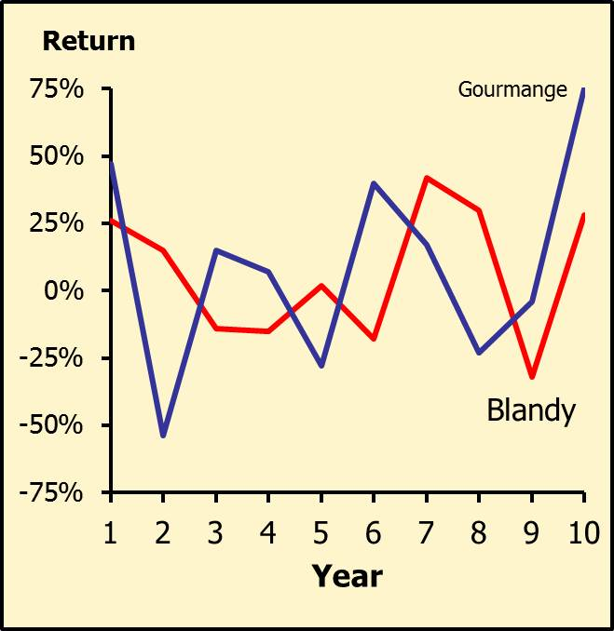
How closely do the returns follow one another?
Notice that the returns don’t move in perfect lock-step: Sometimes one is up and the other is down.

Slide 30
Correlation Coefficient (ρ_{i,j})
Loosely speaking, the correlation (ρ) coefficient measures the tendency of two variables to move together.
Estimating ρ_{i,j} with historical data is tedious:

Slide 31
Excel Functions to Estimate the Correlation Coefficient (ρi,j)
“Stock_{i}” and “Stock_{j}” are the cell ranges with historical returns for Stocks i and j.
Est. ρ_{i,j} = R_{ij} =Correl(Stock_{i},Stock_{j})
Correlation between Blandy (B) and Gourmange (G):
Est. ρ_{B,G} = 0.11

Slide 32
2-Stock Portfolios
ρ = −1
  2 stocks can be combined to form a riskless portfolio: σ_{p} = 0.
ρ = +1
  Risk is not “reduced”
  σ_{p} is just the weighted average of the 2 stocks’ standard deviations.
−1 < ρ < −1
  Risk is reduced but not eliminated.

Slide 33
Adding Stocks to a Portfolio
What would happen to the risk of an average 1-stock portfolio as more randomly selected stocks were added?
σ_{p} would decrease because the added stocks would not be perfectly correlated.

Slide 34
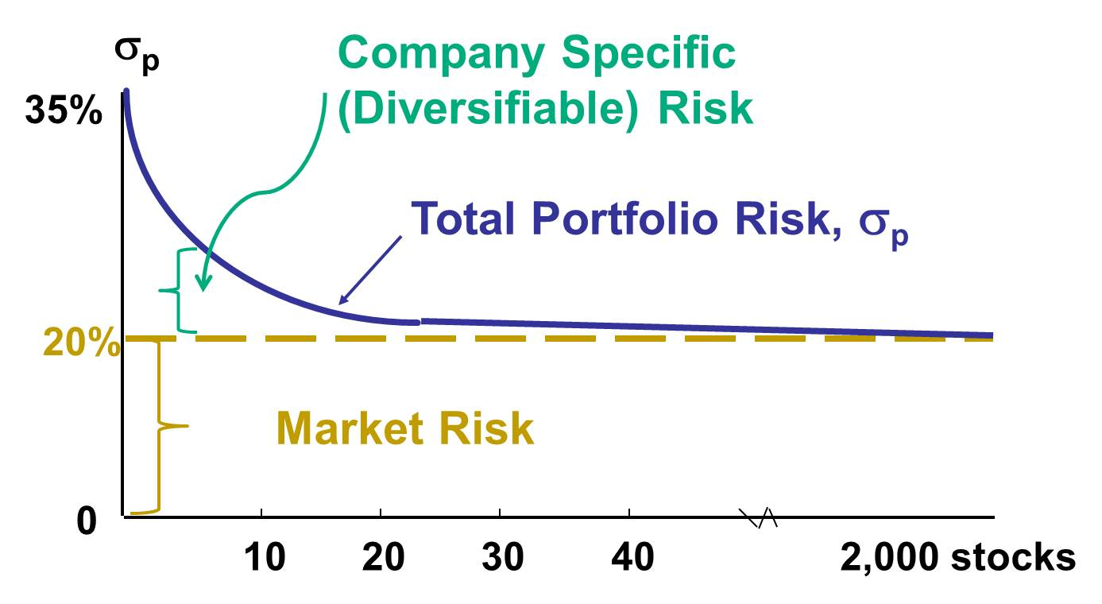
Risk vs. Number of Stocks in Portfolio

Slide 35
Stand-alone risk = Market risk + Diversifiable risk
Market risk is that part of a security’s stand-alone risk that cannot be eliminated by diversification.
Firm-specific, or diversifiable, risk is that part of a security’s stand-alone risk that can be eliminated by diversification.

Slide 36
Conclusions
As more stocks are added, each new stock has a smaller risk-reducing impact on the portfolio.
σ_{p} falls very slowly after about 40 stocks are included. The lower limit for σ_{p} is about 20% = σ_{M} .
By forming well-diversified portfolios, investors can eliminate about half the risk of owning a single stock.

Slide 37
Can an investor holding one stock earn a return commensurate with its risk?
No. Rational investors will minimize risk by holding portfolios.
Investors bear only market risk, so prices and returns reflect the amount of market risk an individual stock brings to a portfolio, not the stand-alone risk of individual stock.

Slide 38
Market Risk Due to an Individual Stock
How do you measure the amount of market risk that an individual stock brings to a well-diversified portfolio?
William Sharpe developed the Capital Asset Pricing Model (CAPM) to answer this question.
And the answer is….. See next slide.

Slide 39
Market Risk as Defined by the CAPM
Define:
  w_{i} is the percent of the portfolio invested in Stock i.
  σ_{M} is the standard deviation of the market index.
  ρ_{i,M} is the correlation between Stock i and the market.
The contribution of Stock i to the standard deviation of a well-diversified portfolio (σ_{p}) is:

Slide 40
Market Risk and Beta (1 of 2)
The beta of Stock i (b_{i}) is defined:
The contribution of Stock i to the standard deviation of a well-diversified portfolio (σ_{p}) is:
Given the standard deviation of the market and the percent of the portfolio invested in Stock i, beta measures the impact of Stock i on σ_{p}.

Slide 41
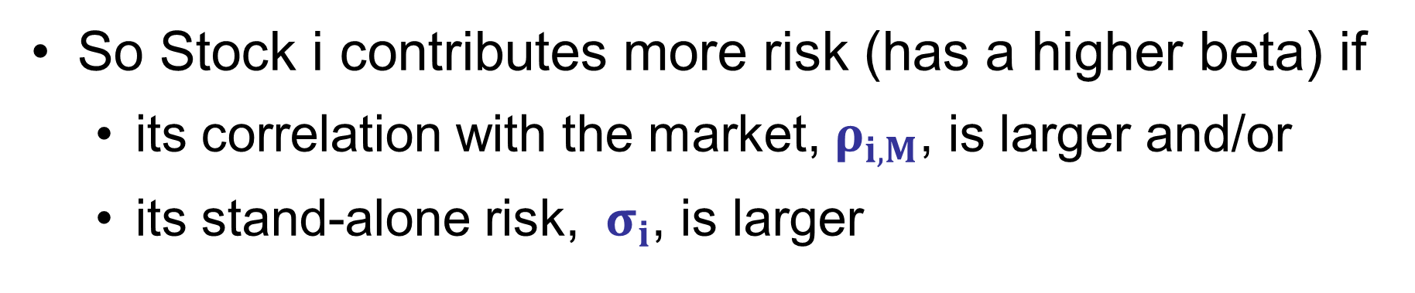
Market Risk and Beta (2 of 2)
So Stock i contributes more risk (has a higher beta) if
  its correlation with the market, $ρ_{i,M}$, is larger and/or
  its stand-alone risk, ${ σ}_{i}$, is larger

Slide 42
Required Return and Risk: General Concept
Investors require a return for time (for tying their funds up in the investment).
  r_{RF}, the risk-free rate
Investors require a return for risk, which is the extra return above the risk-free rate that investors require to induce them to invest in Stock i.
  RP_{i}, the risk premium of Stock i.

Slide 43
Required Return and Risk: The CAPM
RP_{M} is the market risk premium. It is the extra return above the risk-free rate that that investors require to invest in the overall stock market:
  RP_{M} = r_{M} − r_{RF}.
The CAPM defines the risk premium for Stock i as:
  RP_{i} = b_{i} (RP_{M})

Slide 44
The Security Market Line: Relating Risk and Required Return (1 of 2)
The Security Market Line (SML) puts the pieces together, showing how to determine the return required for bearing a stock’s risk:
SML: r_{i} = r_{RF} + (RP_{M})b_{i}

Slide 45
The Security Market Line: Relating Risk and Required Return
Risk depends on beta:
The part of σ_{p} due to Stock i = w_{i} σ_{M} b_{i}
Required return depends on beta:
r_{i} = r_{RF} + (RP_{M}) b_{i}

Slide 46
Correlation Between Blandy and the Market
Using the formula for correlation or the Excel function =CORREL, Blandy’s correlation with the market (ρ_{B,M}) is:
  ρ_{B,M} = 0.481

Slide 47
Beta for Blandy
Use the previously calculated standard deviations for Blandy and the market to estimate Blandy’s beta:
  b = ρ_{B,M} (σ_{B}/σ_{M})
  b = 0.481(.252/.201) = 0.60
The average beta is equal to 1.0, so Blandy’s stock contributes less risk to a well-diversified portfolio than does the average stock.

Slide 48
Required Return for Blandy
Inputs:
  r_{RF} = 4% (given)
  R_{PM} = 5%(given)
  b = 0.60 (estimated)
r_{i} = r_{RF} + b_{i} (RP_{M})
r_{i} = 4% + 0.60(5%) = 7%

Slide 49
Comparing Risk and Return for Different Stocks
The beta of an average stock is 1.0; Gourmange’s beta is 1.3. How do their required returns compare with Blandy’s?
r_{Avg_company} = 4%+ 1.0 (5%) = 9%
r_{G} = 4%+ 1.3 (5%) = 10.5%
r_{B} = 4%+ 0.6 (5%) = 7%
Blandy’s stock contributes less risk to a well-diversified portfolio than do Gourmange or the average stock, so Blandy’s investors require a lower rate of return.

Slide 50
Using a Regression to Estimate Beta
Run a regression with returns on the stock plotted on the Y-axis and returns on the market portfolio plotted on the X-axis.
The slope of the regression line is equal to the stock’s beta coefficient.

Slide 51
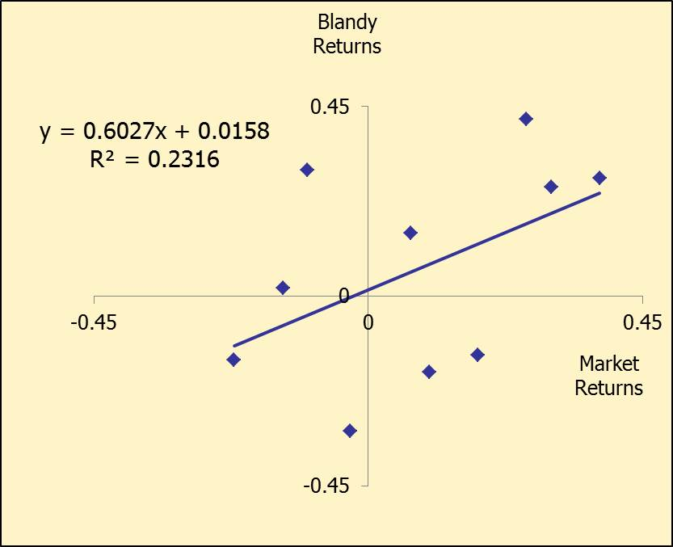
Excel: Plot Trendline Right on Chart

Slide 52
Estimated Beta from Regression
The trendline is plotted on the previous slide, including the regression equation.
  y = 0.6027x + 0.0158
  b = Slope = 0.6027 (same as before)
Easier way—use the Excel SLOPE function.
  b =SLOPE(y_values,x_values)

Slide 53
Web Sites for Beta
http://finance.yahoo.com
  Enter the ticker symbol for a “Stock Quote”, such as IBM or Dell, then click GO.
  When the quote comes up, select Key Statistics from panel on left.
www.valueline.com
  Enter a ticker symbol at the top of the page (registration is free).
Most stocks have betas in the range of 0.5 to 1.5.

Slide 54
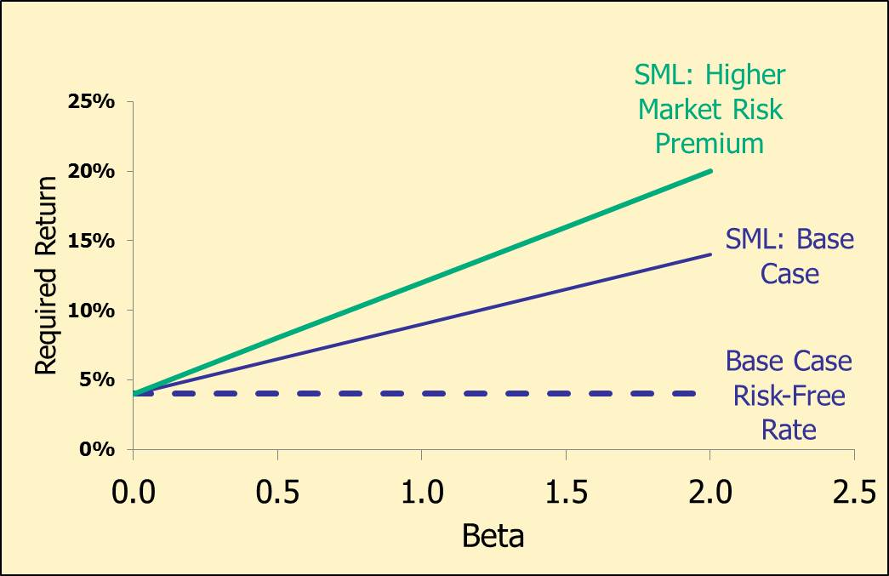
Impact on SML of Increase in Risk-Free Rate

Slide 55
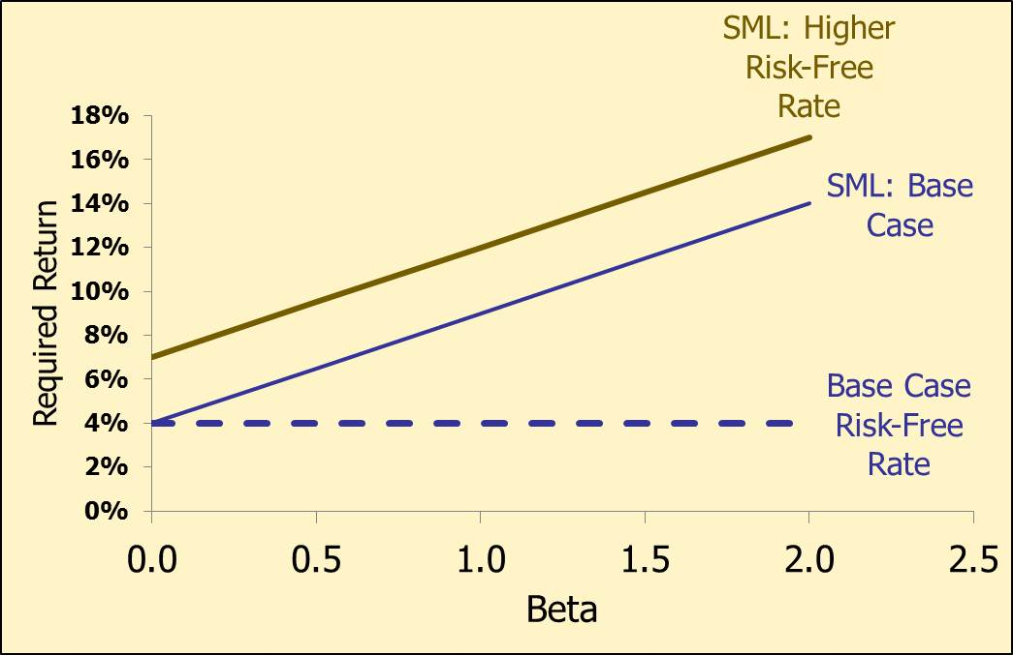
Impact on SML of Increase in Risk Aversion

Slide 56
Calculate the weights for a portfolio with $1.4 million in Blandy and $0.6 million in Gourmange.
Find the weights:
  w_{B} = $1.4/($1.4+$0.6) = 70%
  w_{G} = $0.6/($1.4+$0.6) = 30%
The portfolio beta is the weighted average of the stocks’ betas:

Slide 57
Calculate the portfolio beta.
b_{p} = 0.7(b_{Blandy}) + 0.3(b_{Gour.})
= 0.7(0.60) + 0.3(1.30)
= 0.81.

Slide 58
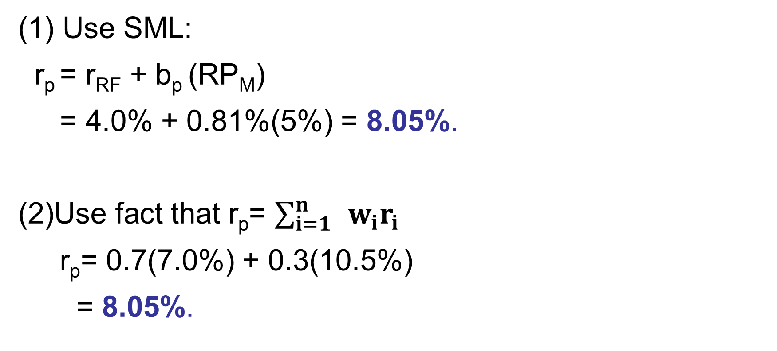
What is the Required Return on the Portfolio?
(1) Use SML:
r_{p} = r_{RF} + b_{p} (RP_{M})
= 4.0% + 0.81%(5%) = 8.05%.
(2)Use fact that r_{p} = $\sum_{i=1}^{n}{ }w_{i}r_{i}$
r_{p}= 0.7(7.0%) + 0.3(10.5%)
= 8.05%.

Slide 59
Portfolio Performance Evaluation
Relative to SML (1 of 2)
 | Portfolio Manager | Portfolio Manager
 | JJ | CC
Portfolio beta | 0.7 | 1.4
Risk-free rate | 4% | 4%
Market risk premium | 5% | 5%
Portfolio required return | 7.5% | 11.0%
Portfolio actual return | 8.5% | 9.5%
Over/under performance | +1.0% | -1.5%

Slide 60
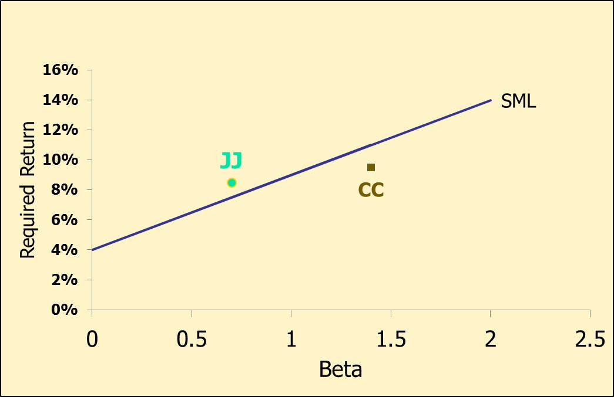
Portfolio Performance Evaluation
Relative to SML (2 of 2)

Slide 61
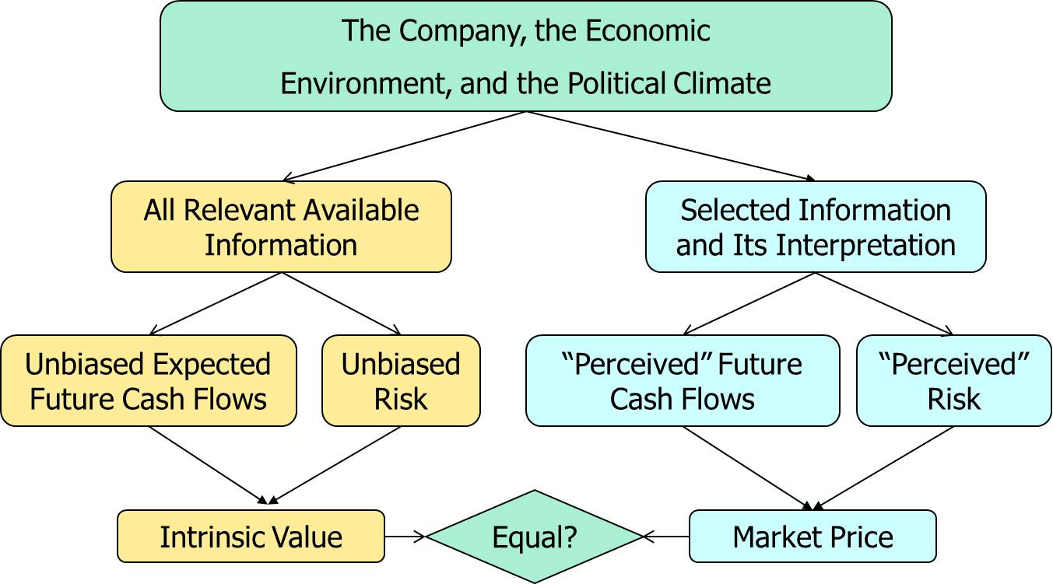
Intrinsic Values and Market Prices

Slide 62
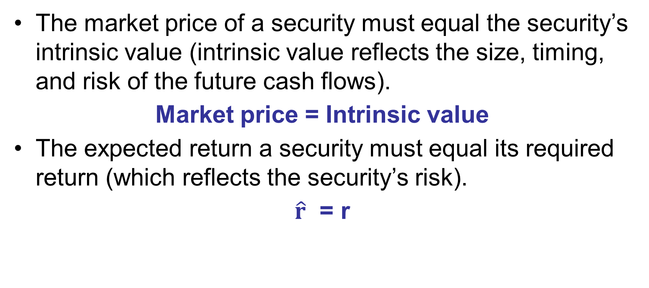
What is required for the market to be in equilibrium?
The market price of a security must equal the security’s intrinsic value (intrinsic value reflects the size, timing, and risk of the future cash flows).
Market price = Intrinsic value
The expected return a security must equal its required return (which reflects the security’s risk).
$\hat{r}$ = r

Slide 63
How is equilibrium established?
If the market price is below the intrinsic value (or if the expected return is above the required return), then the security is a “bargain.”
Buy orders will exceed sell orders, bidding up the market price (which also drives down the expected return, given no change in the asset’s cash flows).
“Profitable” trading (i.e., earning a return greater than justified by risk) will continue until the market price is equal to the intrinsic value.
The opposite occurs if the market price is above the intrinsic value.

Slide 64
Efficient Market Hypothesis (EMH):
It’s all about the info.
The EMH asserts that when new information arrives, prices move to the new equilibrium price very, very quickly because:
  There are many really smart analysts looking for mispriced securities.
  New information is available to most professional traders almost instantly.
  When mispricing occurs (due to new info or inefficient markets), analysts have billions of dollars to use in taking advantage of the mispricing– which then quickly eliminates the mispricing.

Slide 65
Implications of Efficient Market Hypothesis (EMH)
Stocks are normally in equilibrium.
One cannot “beat the market” by consistently earning a return higher than is justified by a stock’s risk.

Slide 66
Testing the EMH
Choose a trading strategy and implement it over a large sample.
Pick an asset pricing model, like the CAPM, and measure the required return of the strategy’s investments.
Measure the actual return.
  Actual > required? Reject EMH.
Notice that this is a “joint” test of the EMH and the particular asset model– if the test rejects the EMH, it could be that the asset pricing model is wrong.

Slide 67
Weak-form EMH
Current prices already reflect all the information “contained” in past prices, so you cannot earn excess returns with strategies based on past prices.
Example strategy: Invest in stocks that have declined below their previous 52-week low.
This is a type of “technical” analysis.

Slide 68
Weak-form EMH: Empirical Evidence
Most empirical evidence supports weak-form EMH because very few trading strategies consistently earn in excess of the CAPM prediction.
Two exceptions with small excess returns:
  Short-term momentum
  Long-term reversals

Slide 69
Semistrong-form EMH
Current prices already reflect all publicly available information, so you cannot earn excess returns with strategies based on information from financial statements or other public sources.
Example strategy: Invest in stocks with past 3-year annual earnings growth greater than 10% and a ratio of R&D to sales greater than 10%.
This is a type of “fundamental” analysis.

Slide 70
Semistrong-form EMH: Empirical Evidence
Most empirical evidence supports the semistrong-form EMH.
  In fact, the vast majority of portfolio managers do not consistently have returns in excess of CAPM predictions.
Two exceptions that earn excess returns:
  Small companies
  Companies with high book-to-market ratios

Slide 71
Strong-form EMH
All information, even inside information, is embedded in stock prices so you cannot earn excess returns ever.
Not true—excess returns can be gained by trading on the basis of insider information.
  Illegal! Go to jail now!

Slide 72
Market Bubbles and Market Efficiency
Market bubbles:
  Prices climb rapidly to heights that would have been considered extremely unlikely before the run-up.
  Trading volume is unusually high.
  Many new investors (or speculators?) eagerly enter the market.
  Prices suddenly fall precipitously.
What does this imply about the EMH?

Slide 73
Bubbles are hard to puncture.
If there is a bubble, why don’t traders take positions that make big profits when the bubble bursts?
  It is hard to recognize a bubble until after it bursts—then it seems obvious!
  Trading strategies expose traders to possible big negative cash flows if the bubble is slow to burst.

Slide 74
Market Efficiency: The Bottom Line
For most stocks, for most of the time, it is generally safe to assume that the market is reasonably efficient.
Many investors have given up trying to beat the market, which helps explain the popularity of index funds.
However, bubbles do occur infrequently.

Slide 75
The CAPM: The Bottom Line
Empirical tests of CAPM have statistical problems that make empirical verification or rejection virtually impossible.
Most corporations use the CAPM to determine their stock’s required return.
Most researchers use multi-factor models to identify the portion of a stock’s return that remains unexplained after accounting for the model’s factors.

Slide 76
Has the CAPM been completely confirmed or refuted?
No. The statistical tests have problems that make empirical verification or rejection virtually impossible.
  Investors’ required returns are based on future risk, but betas are calculated with historical data.
  Investors may be concerned about both stand-alone and market risk.

