Slide 1
Corporate Valuation and Stock Valuation
CHAPTER 7
© 2020 Cengage Learning. All Rights Reserved. May not be copied, scanned, or duplicated, in whole or in part, except for use as permitted in a license distributed with a certain product or service or otherwise on a password-protected website for classroom use.

Slide 2
Topics in Chapter
Features of common stock
Valuing common stock
  Dividend growth model
  Free cash flow valuation model
  Market multiples
Preferred stock

Slide 3
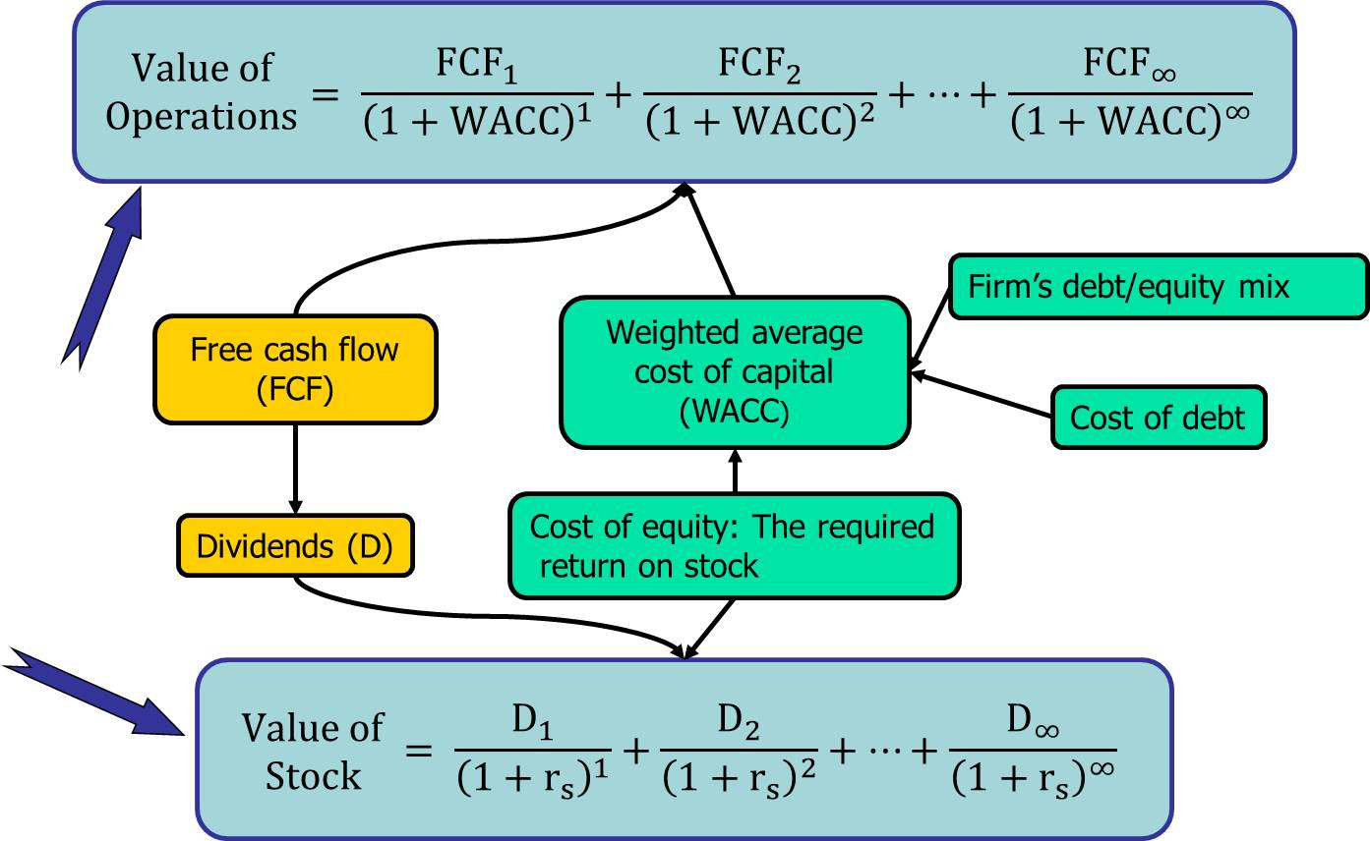
Corporate Valuation and Stock Valuation

Slide 4
Common Stock: Owners, Directors, and Managers
Represents ownership.
Ownership implies control.
Stockholders elect directors.
Directors hire management.
Since managers are “agents” of shareholders, their goal should be: Maximize stock price.

Slide 5
Classified Stock
Classified stock has special provisions for each class, usually involving voting rights and dividend rights.
Usually named Class A, Class B, etc.
New shares in IPO sometimes have voting restrictions but full dividend rights.
Founders’ shares usually have voting rights but dividend restrictions.
Standard & Poor’s no longer allows new additions to its indices to have classified stock.

Slide 6
Tracking Stock
The dividends of tracking stock are tied to a particular division, rather than the company as a whole.
  Investors can separately value the divisions.
  Its easier to compensate division managers with the tracking stock.
But tracking stock usually has no voting rights, and the financial disclosure for the division is not as regulated as for the company.
Very few companies have tracking stock.

Slide 7
Different Approaches for Valuing Common Stock
Free cash flow model
  Constant growth
  Nonconstant growth
Dividend growth model
  Constant growth
  Nonconstant growth
Using the multiples of comparable firms

Slide 8
The Free Cash Flow Valuation Model: FCF and WACC
Free cash flow (FCF) is:
  The cash flow available for distribution to all of a company’s investors.
  Generated by a company’s operations.
The weighted average cost of capital (WACC) is:
  The overall rate of return required by all of the company’s investors.

Slide 9
Value of Operations (V_{op})
The PV of expected future FCF, discounted at the WACC, is the value of a company’s operations (V_{op}):

Slide 10
Sources of Value
Value of operations
Nonoperating assets
  Short-term investments and other marketable securities
  Ownership of non-controlling interest in another company
  Value of nonoperating assets usually is very close to figure that is reported on balance sheets.

Slide 11
Claims on Corporate Value
Debtholders have first claim.
Preferred stockholders have the next claim.
Any remaining value belongs to stockholders.

Slide 12
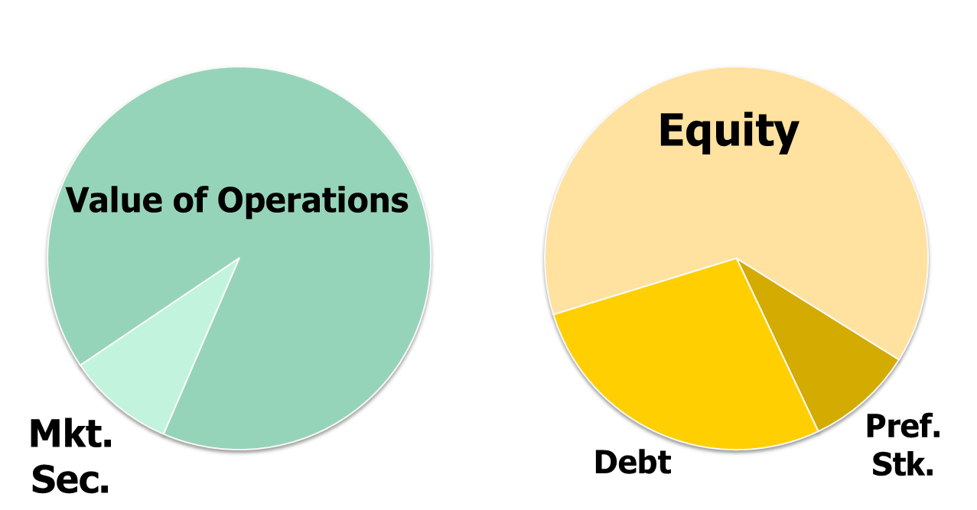
Total Corporate Value: Sources and Claims

Slide 13
Value of operations= PV of FCF discounted at WACC
Conceptually correct, but how do you find the present value of an infinite stream?

Slide 14
Suppose FCFs are expected to grow at a constant rate, g_{L}, starting at t=1, and continue forever. What happens to FCF?
What is the value of operations if FCFs grow at a constant rate? See next slide.

Slide 15
Value of operations in terms of FCF₁ and g_{L}:
We can multiply and divide by (1+g_{L}), for a reason that will soon be clear, as shown on the next slide.

Slide 16
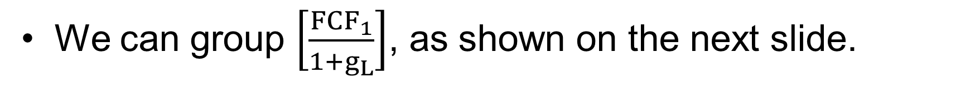
Rewritten value of operations:
We can group $\left[\frac{{FCF}_{1}}{1+g_{L}}\right]$, as shown on the next slide.

Slide 17
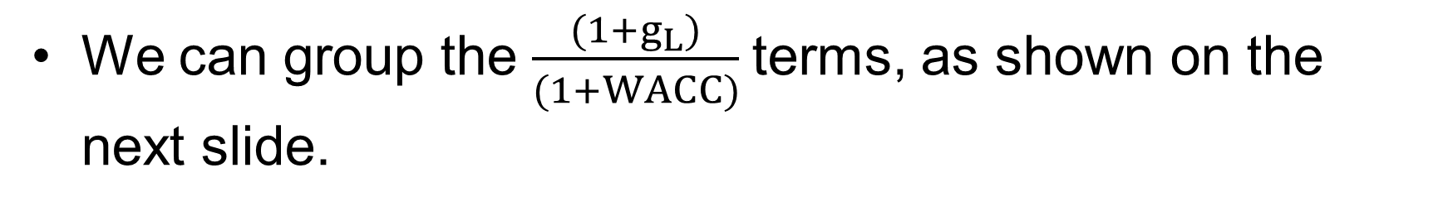
Value of operations with grouped terms:
We can group the $\frac{(1+g_{L})}{(1+WACC)}$terms, as shown on the next slide.

Slide 18
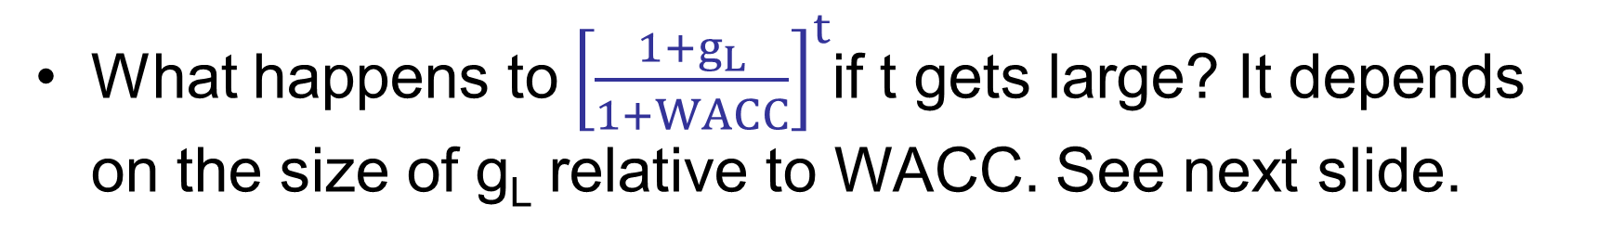
Value of operations if FCF grows at a constant rate:
What happens to${ \left[\frac{1+g_{L}}{1+WACC}\right]}^{t}$if t gets large? It depends on the size of g_{L} relative to WACC. See next slide.

Slide 19
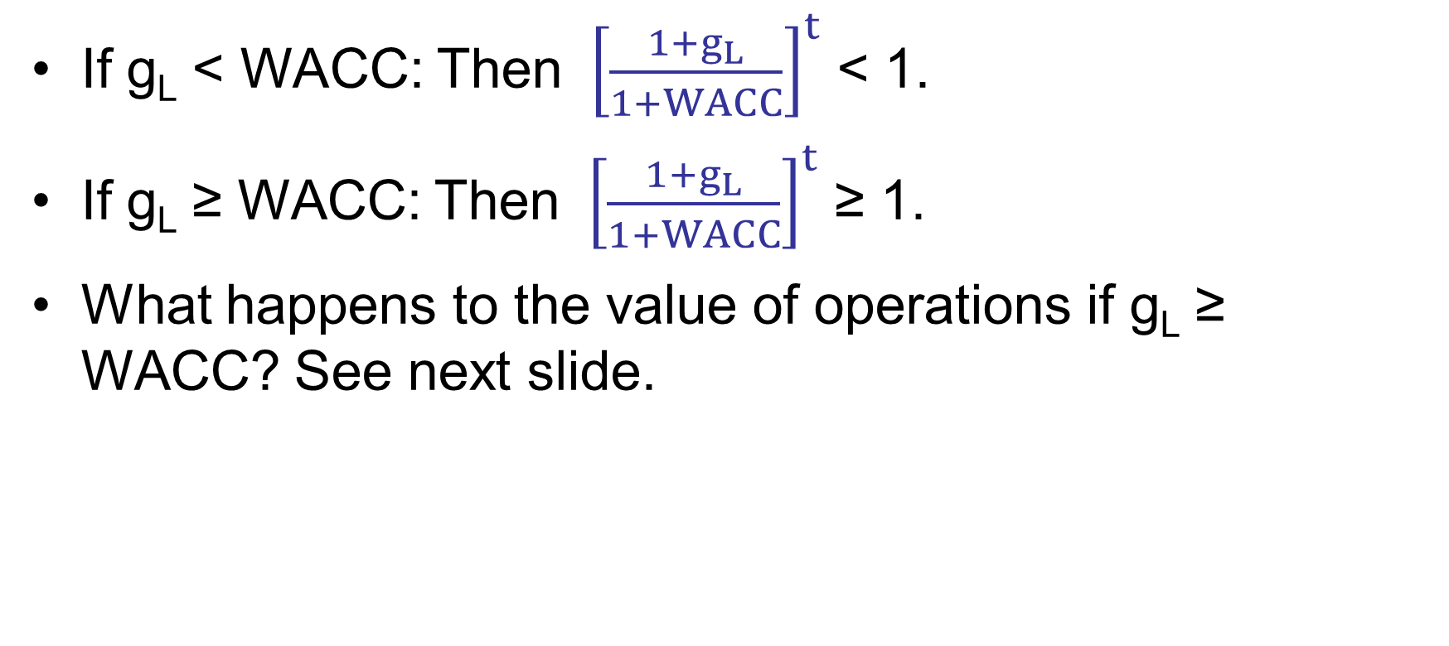
What happens to ${ \left[\frac{1+g_{L}}{1+WACC}\right]}^{t}$ as t gets large?
If g_{L} < WACC: Then ${ \left[\frac{1+g_{L}}{1+WACC}\right]}^{t}$ < 1.
If g_{L} ≥ WACC: Then ${ \left[\frac{1+g_{L}}{1+WACC}\right]}^{t}$ ≥ 1.
What happens to the value of operations if g_{L} ≥ WACC? See next slide.

Slide 20
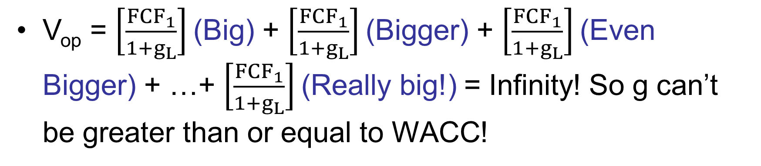
What happens to the value of operations if g_{L} ≥ WACC?
V_{op} = $\left[\frac{{FCF}_{1}}{1+g_{L}}\right]$ (Big) + $\left[\frac{{FCF}_{1}}{1+g_{L}}\right]$ (Bigger) + $\left[\frac{{FCF}_{1}}{1+g_{L}}\right]$ (Even Bigger) + …+ $\left[\frac{{FCF}_{1}}{1+g_{L}}\right]$ (Really big!) = Infinity! So g can’t be greater than or equal to WACC!

Slide 21
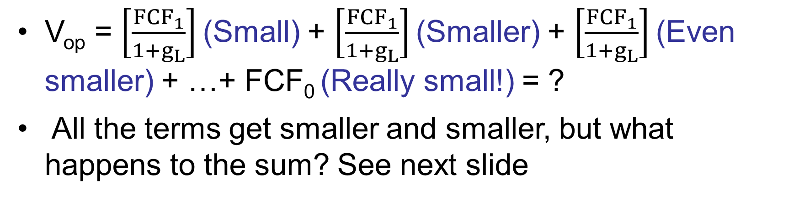
What happens to the value of operations if g_{L} ≤ WACC?
V_{op} = $\left[\frac{{FCF}_{1}}{1+g_{L}}\right]$ (Small) + $\left[\frac{{FCF}_{1}}{1+g_{L}}\right]$ (Smaller) + $\left[\frac{{FCF}_{1}}{1+g_{L}}\right]$ (Even smaller) + …+ FCF₀ (Really small!) = ?
All the terms get smaller and smaller, but what happens to the sum? See next slide

Slide 22
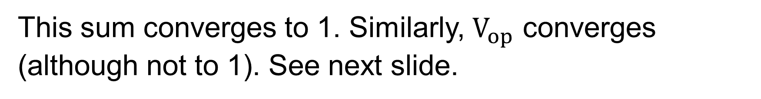
What is the sum of an infinite number of factors that get smaller at a geometric rate?
Consider this example. The first row is t. The second row is a number that is less than 1 that is compounded to the power of t. The third row is the cumulative sum.
t | 1 | 2 | 3 | 4 | . . . ∞
(1/2)^{t} | 1/2 | 1/4 | 1/8 | 1/16 | 1/∞ ≈ 0
Σ(1/2)^{t} | 1/2 | 3/4 | 7/8 | 15/16 | ≈ 1
This sum converges to 1. Similarly, $V_{op}$ converges (although not to 1). See next slide.

Slide 23
Constant Growth Formula for Value of Operations: g_{L} begins at Time 1
If FCF are expected to grow at a constant rate of g_{L} from Time 1 and afterwards, and g_{L}<WACC:
This is the PV of all FCF from Time 1 through infinity, when discounted at WACC.

Slide 24
Constant Growth Formula for Value of Operations: g_{L} begins at Time 0
If FCF are expected to grow at a constant rate of g_{L} from Time 0 and afterwards, and g_{L}<WACC:
This is still the PV of all FCF from Time 1 through infinity, when discounted at WACC.

Slide 25
Data for FCF Valuation
FCF₀ = $24 million
WACC = 11%
FCF is expected to grow at a constant rate of g_{L} = 5%
Short-term investments = $100 million
Debt = $200 million
Preferred stock = $50 million
Number of shares =n = 10 million

Slide 26
Find Value of Operations

Slide 27
Total Value of Company (V_{Total})

Slide 28
Estimated Intrinsic Value of Equity (V_{Equity})
V_{operations} | $420.00
+ ST Inv. | 100.00
V_{Total} | $520.00
−Debt | 200.00
− Preferred Stk. | 50.00
V_{Equity} | $270.00

Slide 29

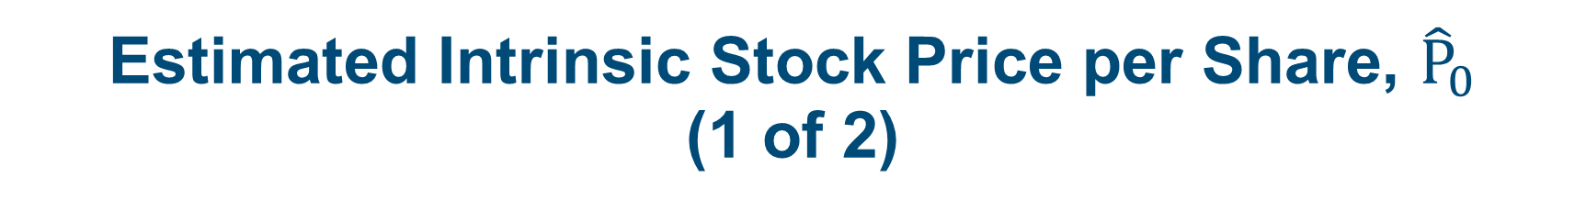
Estimated Intrinsic Stock Price per Share, ${\hat{P}}_{0}$
(1 of 2)
V_{operations`} | $420.00
+ ST Inv. | 100.00
V_{Total} | $520.00
−Debt | 200.00
− Preferred Stk. | 50.00
V_{Equity} | $270.00
÷ n | 10
 | $27.00
$${\hat{P}}_{0}$$

Slide 30
Expansion Plan: Nonconstant Growth
Finance expansion financed by owners.
Projected free cash flows (FCF):
  Year 1 FCF = −$10 million.
  Year 2 FCF = $20 million.
  Year 3 FCF = $35 million
  FCF grows at constant rate of 5% after year 3.
No change in WACC, marketable securities, debt, preferred stock, or number of shares of stock.

Slide 31
Estimating the Value of Operations
Free cash flows are forecast for three years in this example, so the forecast horizon is three years.
Growth in free cash flows is not constant during the forecast, so we can’t use the constant growth formula to find the value of operations at time 0.

Slide 32
Time Line of FCF
Year | 0 | 1 | 2 | 3 | 4 | 5 | … t
FCF |  | −$10 | $20 | $35 | FCF₃(1+g_{L}) | FCF₄(1+g_{L}) | FCF_{t}(1+g_{L})
Free cash flows are forecast for three years in this example, so the forecast horizon is three years.
Growth in free cash flows is not constant during the forecast, so we can’t use the constant growth formula to find the value of operations at time 0.

Slide 33
Horizon Value
Year | 0 | 1 | 2 | 3 | 4 | 5 | … t
FCF |  |  |  |  | FCF₃(1+g_{L}) | FCF₄(1+g_{L}) | FCF_{t}(1+g_{L})
 |  |  |  | HV₃ | ← ↵ | ← ↵ | ← ↵
Horizon value is also called terminal value, or continuing value.

Slide 34
Horizon Value Application
(FCF₃ = $35, WACC = 11%, g_{L} = 5%)
This is the value of FCF from Year 4 and beyond discounted back to Year 3.

Slide 35
Value of Operations at t=0: PV of FCF₁ through FCF₃ plus PV of HV₃
Year | 0 | 1 | 2 | 3 | 4 | 5 | … t
FCF |  | FCF₁ | FCF₂ | FCF₃
 | PV of FCF in explicit forecast | ← ↵ | ← ↵ | ← ↵ | FCF₃(1+g_{L}) | FCF₄(1+g_{L}) | FCF_{t}(1+g_{L})
 | + |  |  | HV₃ | ← ↵ | ← ↵ | ← ↵
 | PV of HV | ← ↵ | ← ↵ | ← ↵
 | = Value of operations Time 0
PV of HV is the PV of FCF beyond the explicit forecast. So PV of HV plus PV of FCF in explicit forecast is the PV of all future FCFs.

Slide 36
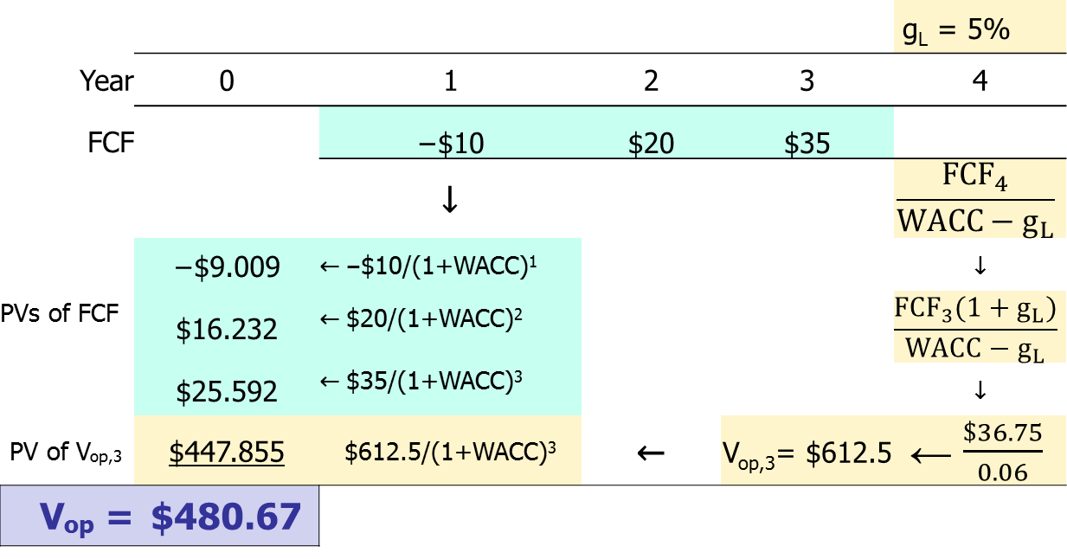
Application: Current Value of Operations (Nonconstant g in FCF until after Year 3; g_{L} = 5%; WACC = 11%)

Slide 37
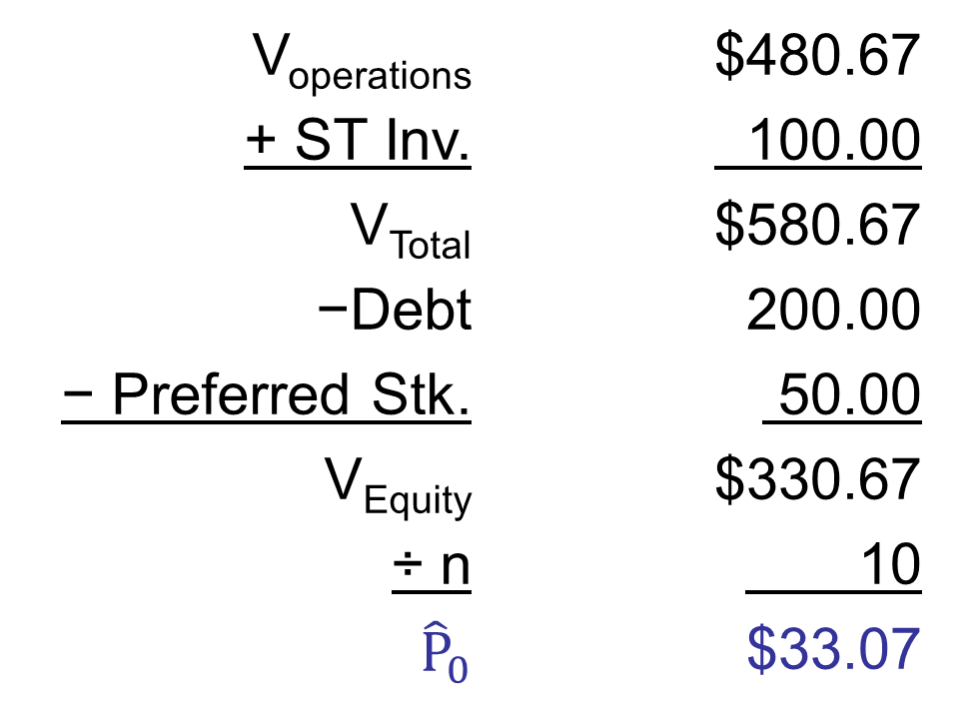
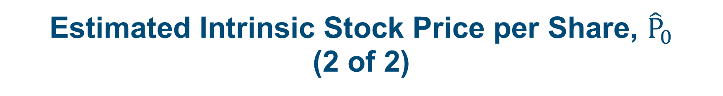
Estimated Intrinsic Stock Price per Share, ${\hat{P}}_{0}$
(2 of 2)
V_{operations} | $480.67
+ ST Inv. | 100.00
V_{Total} | $580.67
−Debt | 200.00
− Preferred Stk. | 50.00
V_{Equity} | $330.67
÷ n | 10
${\hat{P}}_{0}$ | $33.07

Slide 38
How much of the value of operations is based on cash flows from Year 4 and beyond?
The horizon value is the value of all FCF from Year 4 and beyond, discounted back to Year 3.
The present value of HV₃ is the present value of all FCF from Year 4 and beyond.
The PV of HV₃ is the percent of total value due to long-term cash flows.

Slide 39
Value of Operations and Present Value of Horizon Value
Value of operations: V_{op} = $480.67
Horizon value: HV₃ = $612.5
PV of HV₃ = $612.5/(1 + 0.11)³
= $447.855

Slide 40
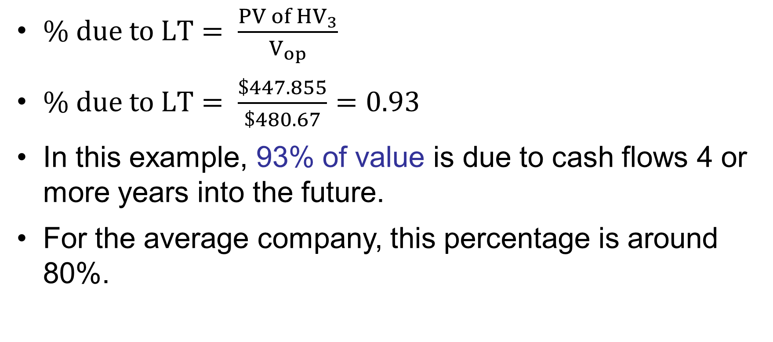
Percent of Value Due to Long-Term Cash Flows
$\% due to LT= \frac{PV of {HV}_{3}}{V_{op}}$
$\% due to LT= \frac{\$447.855}{\$480.67}=0.93$
In this example, 93% of value is due to cash flows 4 or more years into the future.
For the average company, this percentage is around 80%.

Slide 41
Long-term versus Short-term Focus
Why focus on quarterly earnings if most value is from longer-term cash flows?
  Changes in quarterly earnings can signal changes future in cash flows. This would affect the current stock price.
  Managers often have bonuses tied to quarterly earnings, so they have incentive to manage earnings.

Slide 42
Forecasting Free Cash Flows: A Simple Approach
Forecast sales to grow at chosen growth rates.
Forecast net operating profit after taxes (NOPAT) and total net operating capital (OpCap) as a percent of sales.

Slide 43
Current Situation (in millions)
Most recent data:
  Sales of $2,000
  Total net operating capital, OpCap = $1,120
  Operating profitability ratio
    OP = NOPAT/Sales = 4.5%
  Capital requirement ratio
    CR = OpCap/Sales = 56%.
The target weighted average cost of capital (WACC) is 9%.

Slide 44
Initial Operating Assumptions for the No Change Scenario
Operating ratios remain unchanged from values in most recent year.
Sales will grow by 10%, 8%, 5%, and 5% for the next four years.
The long-term growth rate in sales is 5%.
The target weighted average cost of capital (WACC) is 9%.

Slide 45
Assumptions
 | Actual | Forecast
Inputs | 0 | 1 | 2 | 3 | 4
WACC | 9.0%
Sales | $2,000
OpCap | $1,120
Sales growth rate |  | 10% | 8% | 5% | 5%
NOPAT/Sales | 4.5% | 4.5% | 4.5% | 4.5% | 4.5%
OpCAP/Sales | 56.0% | 56.0% | 56.0% | 56.0% | 56.0%

Slide 46
Examples of Forecasting Items
Sales₁ = $2,000(1+0.10) = $2,200
NOPAT₁ = $2,200(0.045) = $99
OpCap₁ = $2,200(0.56) = $1,232
FCF_{t} = NOPAT_{t} − (OpCap_{t} − OpCap_{t-1})
ROIC_{t} = NOPAT_{t}/OpCap_{t}

Slide 47
Forecasted FCF: No changes in operating ratios
Scenario: No Change | Actual | Forecast
 | 0 | 1 | 2 | 3 | 4
Sales | $2,000 | $2,200 | $2,376 | $2,495 | $2,620
NOPAT |  | $99 | $107 | $112 | $117.879
OpCap | $1,120 | $1,232 | $1,331 | $1,397.088 | $1,466.942
FCF |  | −$13 | $8.36 | $45.738 | $48.025
Growth in FCF |  |  | -164% | 447.1% | 5.0%
ROIC | 8.0% | 8.0% | 8.0% | 8.0% | 8.0%
FCF is negative in Year 1.
ROIC of 8% is less than WACC of 9%--not good!
Note: There is no rounding in intermediate calculations.

Slide 48
Estimated Intrinsic Value (1 of 2)

Slide 49
Estimated Intrinsic Value (2 of 2)
Scenario: No Change
Horizon Value:
HV₄ = | $1,260.65
Value of Operations:
Present value of HV | $893.08
+ Present value of FCF | $64.45
Value of operations ≈ | $958

Slide 50
The Value of Operations versus the Total Net Operating Capital
The ROIC (8%) is too low compared to the WACC (9%).
The capital is not earning enough to meet investors’ required return, so:
  Horizon value ($958) is less than the total net operating capital at the horizon ($1,467).
  Current value of operations ($958) is less than the current total net operating capital ($1,120).
ROIC must be greater than WACC/(1+g_{L}) for horizon value to be greater than the total net operating capital at the horizon.

Slide 51
Value Drivers
The ROIC (8%) is too low compared to the WACC (9%).
The capital is not earning enough to meet investors’ required return, so:
  Horizon value ($958) is less than the total net operating capital at the horizon ($1,467).
  Current value of operations ($958) is less than the current total net operating capital ($1,120).
ROIC must be greater than WACC/(1+g_{L}) for horizon value to be greater than the total net operating capital at the horizon.

Slide 52
Impact of Higher Growth Rates
 | No Change | Improve Growth
g_{0,1} | 10% | 11%
g_{1,2} | 8% | 9%
g_{2,3} | 5% | 6%
g_{3,4} | 5% | 6%
g_{L} | 5% | 6%
OP | 4.5% | 4.5%
CR | 56.0% | 56.0%
ROIC | 8.0% | 8.0%
V_{op,0} | $958 | $933
WACC | 9.00% | 9.00%
Higher growth causes V_{op,0} to fall.
ROIC must be greater than WACC/(1+WACC) for growth to add value.
WACC/(1+WACC) = 8.26%

Slide 53
Impact of Higher Operating Profitability
 | No Change | Improve OP
g_{0,1} | 10% | 10%
g_{1,2} | 8% | 8%
g_{2,3} | 5% | 5%
g_{3,4} | 5% | 5%
g_{L} | 5% | 5%
OP | 4.5% | 5.5%
CR | 56.0% | 56.0%
ROIC | 8.0% | 9.8%
V_{op,0} | $958 | $1,523
WACC | 9.00% | 9.00%
Higher operating profitability increases the ROIC.
ROIC of 9.8% > 8.26%
The higher ROIC causes a big increase in V_{op,0}.

Slide 54
Impact of Lower Capital Requirements
 | No Change | Improve CR
g_{0,1} | 10% | 10%
g_{1,2} | 8% | 8%
g_{2,3} | 5% | 5%
g_{3,4} | 5% | 5%
g_{L} | 5% | 5%
OP | 4.5% | 4.5%
CR | 56.0% | 51.0%
ROIC | 8.0% | 8.8%
V_{op,0} | $958 | $1,191
WACC | 9.00% | 9.00%
Lower capital requirements increases the ROIC.
ROIC of 8.8% > 8.26%
The higher ROIC causes an increase in V_{op,0}.

Slide 55
Impact of Simultaneous Improvements in OP and CR
 | No Change | Improve OP and CR
g_{0,1} | 10% | 10%
g_{1,2} | 8% | 8%
g_{2,3} | 5% | 5%
g_{3,4} | 5% | 5%
g_{L} | 5% | 5%
OP | 4.5% | 5.5%
CR | 56.0% | 51.0%
ROIC | 8.0% | 10.8%
V_{op,0} | $958 | $1,756
WACC | 9.00% | 9.00%
The ROIC is much higher due to the improvements in operations.

Slide 56
Impact of Simultaneous Improvements in Growth, OP, and CR
 | No Change | Improve All
g_{0,1} | 10% | 11%
g_{1,2} | 8% | 9%
g_{2,3} | 5% | 6%
g_{3,4} | 5% | 6%
g_{L} | 5% | 6%
OP | 4.5% | 5.5%
CR | 56.0% | 51.0%
ROIC | 8.0% | 10.8%
V_{op,0} | $958 | $2,008
WACC | 9.00% | 9.00%
The ROIC is much higher due to the improvements in operations.
With a higher ROIC, growth adds substantial value.

Slide 57
Summary: Value of operations for previous combinations of ROIC and g_{L}
 | ROIC | ROIC | ROIC | ROIC | ROIC
 |  | 8.0% | 8.8% | 9.8% | 10.8%
g_{L} | 5% | $958 | $1,191 | $1,523 | $1,756
g_{L} | 6% | $933 | $1,247 | $1,694 | $2,008
The ROIC is much higher due to the improvements in operations.
With a higher ROIC, growth adds substantial value.

Slide 58
Are volatile stock prices consistent with rational pricing?
The previous slide shows that small changes in ROIC and growth cause large changes in value.
Similarly, small changes in the cost of capital (WACC), perhaps due to changes in risk or interest rates, cause large changes in value.
As new information arrives, investors continually update their estimates of operating profitability, capital requirements, growth, risk, and interest rates.
If stock prices aren’t volatile, then this means there isn’t a good flow of information.

Slide 59
Value of dividend-paying stock = PV of dividends discounted at required return
Conceptually correct, but how do you find the present value of an infinite stream?

Slide 60
Suppose dividends are expected to grow at a constant rate, g_{L}, forever.
D₁ = D₀(1 + g_{L})¹
D₂ = D₀(1 + g_{L})²
D_{t} = D₀(1 + g_{L})^{t}
What is the present value of a constant growth D_{t} when discounted at the stock’s required return, r_{s}? See next slide.

Slide 61
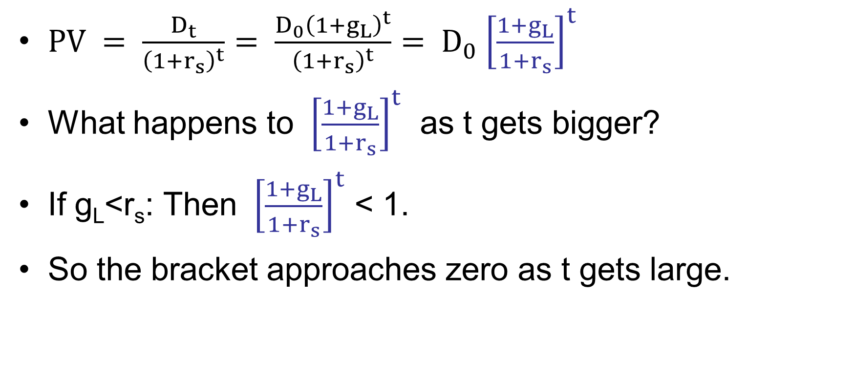
Present Value of a Constant Growth Dividend
$PV = \frac{D_{t}}{{\left(1+r_{s}\right)}^{t}}$ $= \frac{D_{0}{\left(1+g_{L}\right)}^{t}}{{\left(1+r_{s}\right)}^{t}}= D_{0}{ \left[\frac{1+g_{L}}{1+r_{s}}\right]}^{t}$
What happens to ${ \left[\frac{1+g_{L}}{1+r_{s}}\right]}^{t}$ as t gets bigger?
If g_{L}<r_{s}: Then ${ \left[\frac{1+g_{L}}{1+r_{s}}\right]}^{t}$ < 1.
So the bracket approaches zero as t gets large.

Slide 62
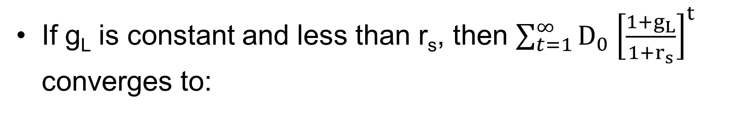
Constant Dividend Growth Model (g_{L}<r_{s})
If g_{L} is constant and less than r_{s}, then $\sum_{t=1}^{∞}{D_{0}{ \left[\frac{1+g_{L}}{1+r_{s}}\right]}^{t}}$ converges to:

Slide 63
What happens if g_{L} > r_{s}?
So g_{L} must be less than r_{s} for the constant growth model to be applicable!!

Slide 64
Required rate of return: beta = 1.2, r_{RF} = 7%, and RP_{M} = 5%.
Use the SML to calculate r_{s}:

Slide 65
Estimated Intrinsic Stock Value:
D₀ = $2.00, r_{s} = 13%, g_{L} = 6%

Slide 66
Expected Stock Price in 1 Year

Slide 67
Expected Dividend Yield and Capital
Gains Yield (Year 1)

Slide 68
Total Year 1 Return
Total return = Dividend yield + Capital gains yield.
Total return = 7% + 6% = 13%.
Total return = 13% = r_{s}.
For constant growth stock:
  Capital gains yield = 6% = g_{L}.

Slide 69
Rearrange model to rate of return form:

Slide 70
Nonconstant Growth Stock
Nonconstant growth of 30% for Year 0 to Year 1, 25% for Year 1 to Year 2, 15% for Year 2 to Year 3, and then long-run constant g_{L} = 6%.
Can no longer use constant growth model.
However, growth becomes constant after 3 years.

Slide 71
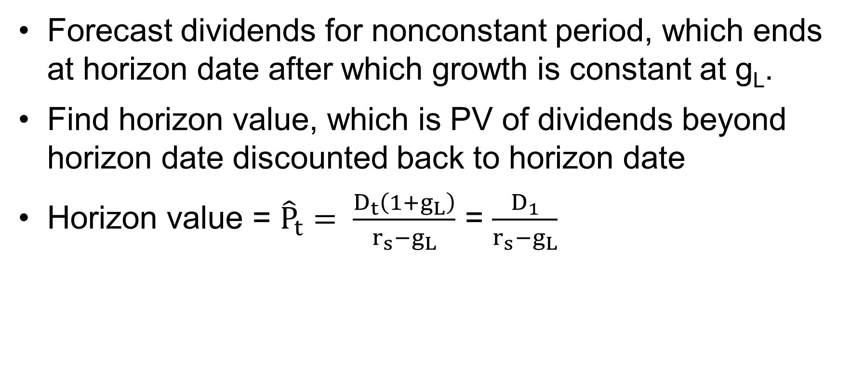
Steps to Estimate Current Stock Value
Forecast dividends for nonconstant period, which ends at horizon date after which growth is constant at g_{L}.
Find horizon value, which is PV of dividends beyond horizon date discounted back to horizon date
Horizon value = ${\hat{P}}_{t}= \frac{D_{t}\left(1+g_{L}\right)}{r_{s}−g_{L}}$ = $\frac{D_{1}}{r_{s}−g_{L}}$

Slide 72
Steps to Estimate Current Stock Price (Continued)
Find PV of each dividend in the forecast period.
Find PV of horizon value.
Sum PV of dividends and PV of horizon value.
Result is estimated current stock value.

Slide 73
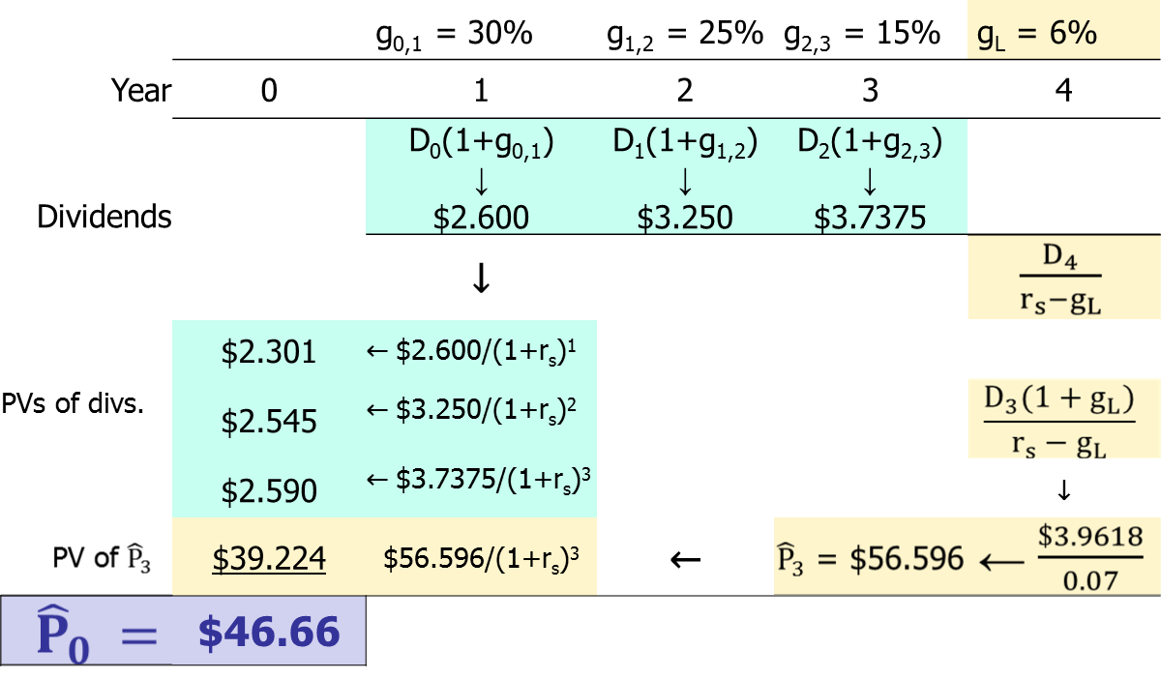
Example of Estimating Current Stock Value (D₀ = $2.00, r_{s} = 13%)

Slide 74
Expected Dividend Yield and Capital
Gains Yield (t = 0)

Slide 75
Expected Dividend Yield and Capital Gains Yield (after t = 3)
During nonconstant growth, dividend yield and capital gains yield are not constant.
If current growth is greater than g, current capital gains yield is greater than g.
After t = 3, g_{L} = constant = 6%, so the
capital gains yield = 6%.
Because r_{s} = 13%, after t = 3 dividend
yield = 13% – 6% = 7%.

Slide 76
Using Stock Price Multiples to Estimate
Stock Price
Analysts often use the P/E multiple (the price per share divided by the earnings per share).
Example:
  Estimate the average P/E ratio of comparable firms. This is the P/E multiple.
  Multiply this average P/E ratio by the expected earnings of the company to estimate its stock price.

Slide 77
Using Entity Multiples
The entity value (V) is:
  the market value of equity (# shares of stock multiplied by the price per share)
  plus the value of debt.
Pick a measure, such as EBITDA, Sales, Customers, Eyeballs, etc.
Calculate the average entity ratio for a sample of comparable firms. For example,
  V/EBITDA
  V/Customers

Slide 78
Using Entity Multiples (Continued)
Find the entity value of the firm in question. For example,
  Multiply the firm’s sales by the V/Sales multiple.
  Multiply the firm’s # of customers by the V/Customers ratio
The result is the firm’s total value.
Subtract the firm’s debt to get the total value of its equity.
Divide by the number of shares to calculate the price per share.

Slide 79
Problems with Market Multiple Methods
It is often hard to find comparable firms.
The average ratio for the sample of comparable firms often has a wide range.
  For example, the average P/E ratio might be 20, but the range could be from 10 to 50. How do you know whether your firm should be compared to the low, average, or high performers?

Slide 80
Comparing the FCF Model and Dividend
Growth Model
Can apply FCF model in more situations:
  Privately held companies
  Divisions of companies
  Companies that pay zero (or very low) dividends
FCF model requires forecasted financial statements to estimate FCF
  Takes more effort than just forecasting dividends, but…
  Provides more insights into value drivers.

Slide 81
Preferred Stock
Hybrid security.
Similar to bonds in that preferred stockholders receive a fixed dividend which must be paid before dividends can be paid on common stock.
However, unlike bonds, preferred stock dividends can be omitted without fear of pushing the firm into bankruptcy.

Slide 82
Value of Preferred Stock
(Dividend = $2.10; r_{ps} = 7%)

