Slide 1
Distributions to Shareholders:
Dividends and Repurchases
CHAPTER 14
© 2020 Cengage Learning. All Rights Reserved. May not be copied, scanned, or duplicated, in whole or in part, except for use as permitted in a license distributed with a certain product or service or otherwise on a password-protected website for classroom use.

Slide 2
Topics in Chapter
Theories of investor preferences
Signaling effects
Residual model
Stock repurchases
Stock dividends and stock splits
Dividend reinvestment plans

Slide 3
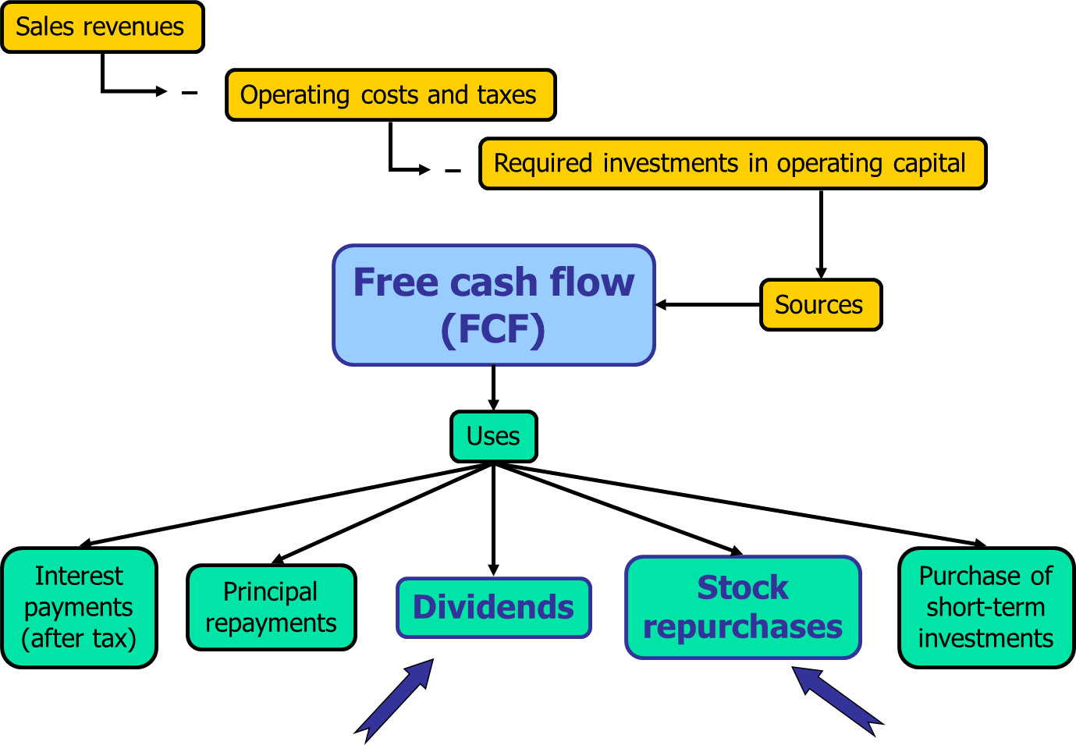
Free Cash Flow: Distributions to Shareholders

Slide 4
What is “distribution policy”?
The distribution policy defines:
  The level of cash distributions to shareholders
  The form of the distribution (dividend vs. stock repurchase)
  The stability of the distribution

Slide 5
Distributions Patterns Over Time (1 of 2)
Percentage of cash distributions relative to net income:
  Around 27% until the early 2000’s
  Exceeded 90% since 2012
  Net income is not cash flow!
Since 1998, repurchases have exceeded dividends. In 2017, the average
  Dividend yield = 1.84%
  Repurchase yield = 2.28%
  Total yield = 4.12%.

Slide 6
Distributions Patterns Over Time (2 of 2)
Percentage of companies paying a dividend has changed over time. The number of NYSE, AMEX, and NASDAQ firms paying a dividend has changed:
  66.5% in 1978
  20.8% in 1999 (lots of IPOs that didn’t pay dividends)
  46% in 2017
There are now fewer, but larger, publicly traded companies due to.
  Mergers
  Acquisition by private equity funds of small start-up firms that would have had an IPO.

Slide 7
Dividend Yields and Payout Ratios for
Selected Industries
Industry | Dividend Yield | Payout ratio
Electric Utilities | 3.01 | 25.7
Computer Hardware | 2.90 | 73.5
Oil & Gas Refining and Marketing | 2.74 | 30.1
Aluminium | 2.49 | 23.6
Banks | 2.46 | 35.4
Wireless Telecommunications | 1.57 | 38.3
AERO/DEF | 1.27 | 20.6
Drug Retailers | 1.18 | 17.5
Healthcare Facilities & Services | 0.93 | 25.3
Restaurants & Bars | 0.91 | 24.9

Slide 8
Do investors prefer high or low payouts?
There are three dividend theories:
  Dividends are irrelevant: Investors don’t care about payout.
  Dividend preference, or bird-in-the-hand: Investors prefer a high payout.
  Tax effect: Investors prefer a low payout.

Slide 9
Dividend Irrelevance Theory
Investors are indifferent between dividends and retention-generated capital gains. If they want cash, they can sell stock. If they don’t want cash, they can use dividends to buy stock.
Modigliani-Miller support irrelevance.
Implies payout policy has no effect on stock value or the required return on stock.
Theory is based on unrealistic assumptions (no taxes or brokerage costs).

Slide 10
Dividend Preference (Bird-in-the-Hand) Theory
Investors might think dividends (i.e., the-bird-in-the-hand) are less risky than potential future capital gains.
Also, high payouts help reduce agency costs by depriving managers of cash to waste and causing managers to have more scrutiny by going to the external capital markets more often.
Therefore, investors would value high payout firms more highly and would require a lower return to induce them to buy its stock.

Slide 11
Tax Effect Theory
Low payouts mean higher capital gains. Capital gains taxes are deferred until they are realized, so they are taxed at a lower effective rate than dividends.
This could cause investors to require a higher pre-tax return to induce them to buy a high payout stock, which would result in a lower stock price.

Slide 12
Empirical Tests: Dividends and Required Returns
Research shows that investors require higher pre-tax returns on stock in high payout companies.
But taxes alone can’t explain the difference in required returns between high-payout companies and low-payout companies.
These finding support the tax effect hypothesis, but are not conclusive.

Slide 13
Empirical Tests: International Evidence on Taxes and Payouts
Different countries have different tax laws, with some countries taxing dividends more heavily than capital gains.
This “dividend tax penalty” can be measured for different countries.
Research shows that in countries with relatively low dividend tax penalties:
  More companies pay dividends
  Dividend payments are larger
In countries with relatively high dividend tax penalties:
  More companies repurchase stock
This evidence doesn’t directly support the tax effect hypothesis, but it does show that taxes affect payout policies.

Slide 14
Empirical Tests: Changes in Tax Codes
In 2005, Congress reduced the tax rate on dividends to be equal to the tax rate on capital gains.
  But law was temporary and was set to expire at end of 2010
In mid-December 2010, Congress extended the tax treatment temporarily for two more years.
  Set to expire at end of 2012.
January 2013, Congress enacted law to “permanently” tax dividends and capital gains at 20% for high-income investors.*
Lots of uncertainty in late 2010 and 2012, making them excellent periods to study dividend changes. See next slide for more.
*This is the essence of the tax law, but the actual tax law is a bit more complicated.

Slide 15
Empirical Tests: Uncertainty about tax laws leads to changes in dividends.
2010 and 2012: Fear of tax increases on dividends.
Comparing late 2010 and 2012 (great uncertainty) with late 2009 and 2011:
  Additional special dividends of over $7 billion.
  176 companies moved up payment dates from beginning of next year to late in 2010 and 2012 before rates changed.
    Over $12 billion in sooner-than-normal regular dividend payments.
  Companies with higher insider ownership were more likely to pay special dividends or accelerate payment dates.
This evidence doesn’t directly support the tax effect hypothesis, but it does show that taxes affect payout policies.

Slide 16
Empirical Tests: Tax Effects versus Agency Costs
Some countries have legal system with poor investor protection.
  Agency costs, such as perquisite consumption and wasteful acquisitions, are harder for investors to to prevent.
  Low dividend payouts make more cash available for these activities.
Research shows that in countries with poor investor protection (where agency costs are most severe), high payout companies are valued more highly than low payout companies.

Slide 17
Summary of Empirical Tests
Taxes certainly affect dividend policies chosen by companies.
Evidence that investors prefer to avoid taxation.
Some evidence that investors require higher pre-tax returns on stocks with big dividend payouts.

Slide 18
What’s the “clientele effect”?
Different groups of investors, or clienteles, prefer different dividend policies.
Firm’s past dividend policy determines its current clientele of investors.
Clientele effects impede changing dividend policy. Taxes & brokerage costs hurt investors who have to switch companies due to a change in payout policy.

Slide 19
The Signaling Hypothesis
(also called the information content hypothesis)
Investors view dividend changes as signals of management’s view of the future. Managers hate to cut dividends, so won’t raise dividends unless they think raise is sustainable.
Therefore, a stock price increase at time of a dividend increase could reflect higher expectations for future EPS, not a desire for dividends.

Slide 20
What’s the “residual distribution model”?
Find the reinvested earnings needed for the capital budget.
Pay out any leftover earnings (the residual) as either dividends or stock repurchases.
This policy minimizes flotation and equity signaling costs, hence minimizes the WACC.

Slide 21
Using the Residual Model to Calculate Distributions Paid

Slide 22
Application of the Residual Distribution Approach: Data for IWT
Capital budget: $112.5 million.
Target capital structure: 20% debt, 80% equity. Want to maintain.
Forecasted net income: $140 million.
Number of shares: 100 million.

Slide 23
Application of the Residual Distribution Approach
Number of shares | 100 | 100 | 100
Equity ratio (w_{s}) | 80% | 80% | 80%
Capital budget | $112.5 | $112.5 | $112.5
Net income | $140.0 | $90.0 | $160.0
Req. equ.: (w_{s} X Cap. Bgt.) | $90.0 | $90.0 | $90.0
Dist. paid: (NI – Req. equity) | $50.0 | $0.0 | $70.0
Payout ratio (Dividend/NI) | 35.7% | 0.0% | 43.8%
Dividend per share | $0.50 | $0.00 | $0.70

Slide 24
Investment Opportunities and Residual Dividends
Fewer good investments would lead to smaller capital budget, hence to a higher dividend payout.
More good investments would lead to a lower dividend payout.

Slide 25
Advantages and Disadvantages of the
Residual Dividend Policy
Advantages: Minimizes new stock issues and
flotation costs.
Disadvantages: Results in variable dividends, sends conflicting signals, increases risk, and doesn’t appeal to any specific clientele.
Conclusion: Consider residual policy when setting target payout, but don’t follow it rigidly.

Slide 26
The Procedures of a Dividend
Payment: An Example
November 21: Board declares a quarterly dividend of $0.50 per share to holders of record as of December 15, payable on January 5.
November 21, 2019: | Declaration date
December 17, 2019: | Dividend goes with stock (owner on this day will get dividend)
December 18, 2019: | Ex-dividend date (purchaser on or after this date doesn't get dividend)
December 19, 2019:
December 20, 2019: | Holder-of-record date
January 10, 2020: | Payment date

Slide 27
Stock Repurchases
Repurchases: Buying own stock back from stockholders.
Reasons for repurchases:
  As an alternative to distributing cash as dividends.
  To dispose of one-time cash from an asset sale.
  To make a large capital structure change.
  To use when employees exercise stock options.

Slide 28
The Procedures of a Repurchase
Firm announces intent to repurchase stock.
Three ways to purchase:
  Have broker/trustee purchase on open market over period of time.
  Make a tender offer to shareholders.
  Make a block (targeted) repurchase.
Firm doesn’t have to complete its announced intent to repurchase.

Slide 29
IWT Before a Distribution: Inputs (Millions)
Value of operations | $1,937.50
Short-term investments | $50.00
Debt | $387.50
Number of shares | 100.00

Slide 30
Intrinsic Value Before Distribution
V_{op} | $1,937.50
+ ST Inv. | 50.00
V_{Total} | $1,987.50
− Debt | 387.50
S | $1,600.00
÷n | 100.00
P | $16.00

Slide 31
Intrinsic Value After a $50 Million
Dividend Distribution
 | Before | After Dividend
V_{op} | $1,937.50 | $1,937.50
+ ST Inv. | 50.00 | 0.00
V_{Total} | $1,987.50 | $1,937.50
− Debt | 387.50 | 387.50
S | $1,600.00 | $1,550.00
÷n | 100.00 | 100.00
P | $16.00 | $15.50
DPS |  | $0.50

Slide 32
Drop in Price with Dividend Distribution
Note that stock price drops by dividend per share in model.
  If it didn’t there would be arbitrage opportunity (assuming no taxes).
In real world, stock price drops on average by about 90% of dividend.

Slide 33
A repurchase has no effect on stock price!
The announcement of an intended repurchase might send a signal that affects stock price, and the previous events that led to cash available for a distribution affect stock price, but the actual repurchase has no impact on stock price because:
  If investors thought that the repurchase would increase the stock price, they would all purchase stock the day before, which would drive up its price.
  If investors thought that the repurchase would decrease the stock price, they would all sell short the stock the day before, which would drive down the stock price.

Slide 34
Remaining Number of Shares After
Repurchase (1 of 2)
# shares repurchased = n_{Prior} − n_{Post}
# shares repurchased =Cash_{Rep}/P_{Prior}
n_{Prior} − n_{Post} = Cash_{Rep}/P_{Prior}
n_{Post} = n_{Prior} − (Cash_{Rep}/P_{Prior})

Slide 35
Remaining Number of Shares After
Repurchase (2 of 2)
n_{Post} = n_{Prior} − (Cash_{Rep}/P_{Prior})
n_{Post} = 100 − ($50/$16)
n_{Post} = 100 − 3.125 = 96.875

Slide 36
Intrinsic Value After a $50 Million Repurchase
 | Before | After Repurchase
V_{op} | $1,937.50 | $1,937.50
+ ST Inv. | 50.00 | 0.00
V_{Total} | $1,987.50 | $1,937.50
− Debt | 387.50 | 387.50
S | $1,600.00 | $1,550.00
÷n | 100.00 | 96.875
P | $16.00 | $16.00
Shares rep. |  | 3.125

Slide 37
Key Points
ST investments fall because they are used to repurchase stock.
Stock price is unchanged by actual repurchase.
Value of equity falls from $1,600 to $1,550 because firm no longer owns the ST investments.
Wealth of shareholders remains at $1,600 because shareholders now directly own the $50 that was previously held by firm in ST investments.

Slide 38
Repurchase vs. Dividends
Repurchase
Stock price doesn’t fall at time of repurchase
Number of shares falls
Dividend distribution
Stock price falls by amount of dividend at time of payment
Number of shares doesn’t change

Slide 39
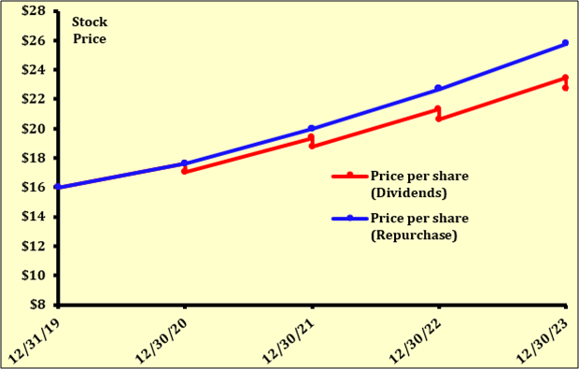
Repurchase vs. Dividends Over Time

Slide 40
Advantages of Repurchases
Stockholders can choose to sell or not.
Helps avoid setting a high dividend that cannot be maintained.
Income received is capital gains rather than higher-taxed dividends.
Stockholders may take as a positive signal--management thinks stock is undervalued.

Slide 41
Disadvantages of Repurchases
May be viewed as a negative signal (firm has poor investment opportunities).
IRS could impose penalties if repurchases were primarily to avoid taxes on dividends.

Slide 42
Setting Dividend Policy
Forecast capital needs over a planning horizon, often 5 years.
Set a target capital structure.
Estimate annual equity needs.
Set target payout based on the residual model.
Generally, some dividend growth rate emerges. Maintain target growth rate if possible, varying capital structure somewhat if necessary.

Slide 43
Stock Dividends vs. Stock
Splits (1 of 2)
Stock dividend: Firm issues new shares in lieu of paying a cash dividend. If 10%, get 10 shares for each 100 shares owned.
Stock split: Firm increases the number of shares outstanding, say 2:1. Sends shareholders more shares.

Slide 44
Stock Dividends vs. Stock
Splits (2 of 2)
Both stock dividends and stock splits increase the number of shares outstanding, so “the pie is divided into smaller pieces.”
Unless the stock dividend or split conveys information, or is accompanied by another event like higher dividends, the stock price falls so as to keep each investor’s wealth unchanged.
But splits/stock dividends may get us to an “optimal price range.”

Slide 45
When should a firm consider splitting its stock?
There’s a widespread belief that the optimal price range for stocks is $20 to $80.
Stock splits can be used to keep the price in the optimal range.
Stock splits generally occur when management is confident, so are interpreted as positive signals.

Slide 46
What’s a “dividend reinvestment plan (DRIP)”?
Shareholders can automatically reinvest their dividends in shares of the company’s common stock. Get more stock than cash.
There are two types of plans:
  Open market
  New stock

Slide 47
Open Market Purchase Plan
Dollars to be reinvested are turned over to trustee, who buys shares on the open market.
Brokerage costs are reduced by volume purchases.
Convenient, easy way to invest, thus useful for investors.

Slide 48
New Stock Plan (1 of 2)
Firm issues new stock to DRIP enrollees, keeps money and uses it to buy assets.
No fees are charged, plus sells stock at discount of 5% from market price, which is about equal to flotation costs of underwritten stock offering.

Slide 49
New Stock Plan (2 of 2)
Optional investments sometimes possible, up to $150,000 or so.
Firms that need new equity capital use new stock plans.
Firms with no need for new equity capital use open market purchase plans.
Most NYSE listed companies have a DRIP. Useful for investors.

