Slide 1

Applied Statistics and Probability for Engineers
Seventh Edition
Douglas C. Montgomery George C. Runger
Chapter 15
Statistical Quality Control
Chapter 15 Title Slide

Slide 2
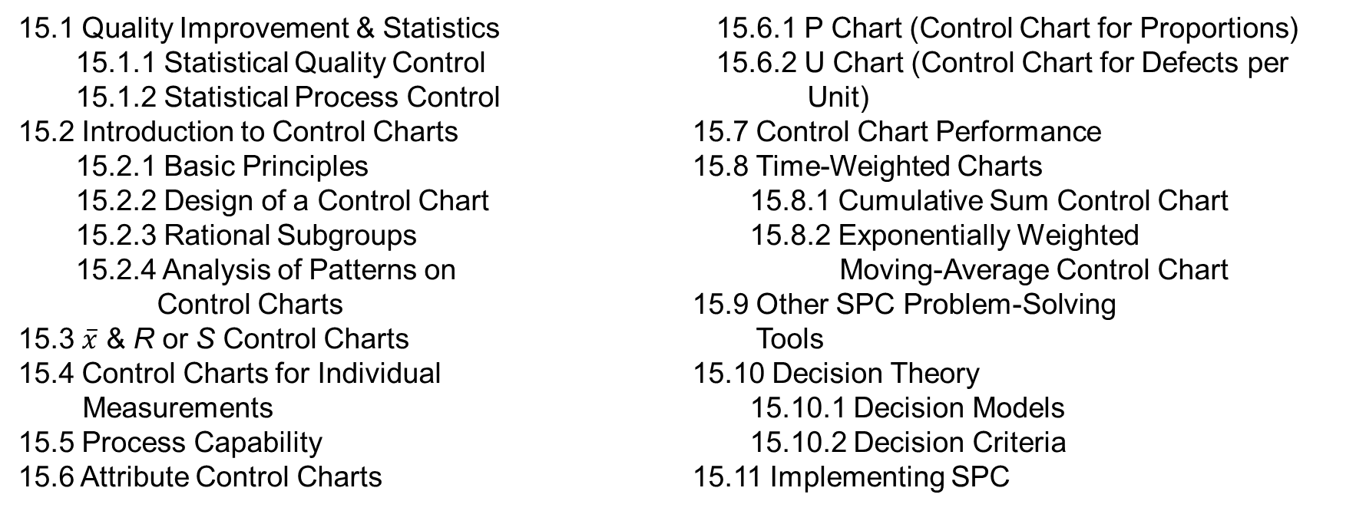
15
Statistical Quality Control
CHAPTER OUTLINE
15.1 Quality Improvement & Statistics
15.1.1 Statistical Quality Control
15.1.2 Statistical Process Control
15.2 Introduction to Control Charts
15.2.1 Basic Principles
15.2.2 Design of a Control Chart
15.2.3 Rational Subgroups
15.2.4 Analysis of Patterns on
Control Charts
15.3 $\overline{x}$ & R or S Control Charts
15.4 Control Charts for Individual
Measurements
15.5 Process Capability
15.6 Attribute Control Charts
15.6.1 P Chart (Control Chart for Proportions)
15.6.2 U Chart (Control Chart for Defects per Unit)
15.7 Control Chart Performance
15.8 Time-Weighted Charts
15.8.1 Cumulative Sum Control Chart
15.8.2 Exponentially Weighted
Moving-Average Control Chart
15.9 Other SPC Problem-Solving
Tools
15.10 Decision Theory
15.10.1 Decision Models
15.10.2 Decision Criteria
15.11 Implementing SPC
Chapter 15 Contents

Slide 3
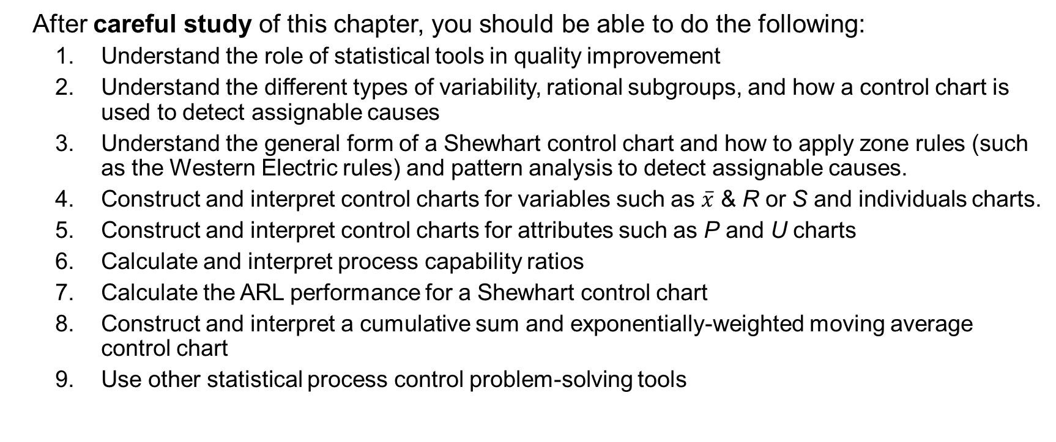
Learning Objectives for Chapter 15
After careful study of this chapter, you should be able to do the following:
Understand the role of statistical tools in quality improvement
Understand the different types of variability, rational subgroups, and how a control chart is used to detect assignable causes
Understand the general form of a Shewhart control chart and how to apply zone rules (such as the Western Electric rules) and pattern analysis to detect assignable causes.
Construct and interpret control charts for variables such as $\overline{x}$ & R or S and individuals charts.
Construct and interpret control charts for attributes such as P and U charts
Calculate and interpret process capability ratios
Calculate the ARL performance for a Shewhart control chart
Construct and interpret a cumulative sum and exponentially-weighted moving average control chart
Use other statistical process control problem-solving tools
Chapter 15 Learning Objectives

Slide 4
Quality Improvement and Statistics
Definitions of Quality
Quality means fitness for use
quality of design
quality of conformance
Quality is inversely proportional to variability.
Sec 15.1 Quality Improvement and Statistics

Slide 5
Quality Improvement and Statistics
Quality Improvement
Quality improvement is the reduction of variability in processes and products.
Alternatively, quality improvement is also seen as “waste reduction”.
Sec 15.1 Quality Improvement and Statistics

Slide 6
Statistical Quality Control
Statistical quality control is a collection of tools that are essential in quality improvement activities
The use of those statistical and engineering methods in measuring, monitoring, controlling, and improving quality
Much of the interest focuses on statistical process control and experimental design
Sec 15.1.1 Statistical Quality Control

Slide 7
Statistical Process Control (SPC)
A set of problem-solving tools that may be applied to any process
The 7 major tools of SPC are:
Histogram
Pareto chart
Cause-and-effect diagram
Defect concentration diagram
Control chart
Scatter diagram
Check sheet
Sec 15.1.2 Statistical Process Control

Slide 8
Basic Principles of Control Charts
A process that is operating with only chance causes of variation present is said to be in statistical control.
A process that is operating in the presence of assignable causes is said to be out of control.
The eventual goal of SPC is the elimination of variability in the process.
Sec 15.2.1 Basic Principles

Slide 9
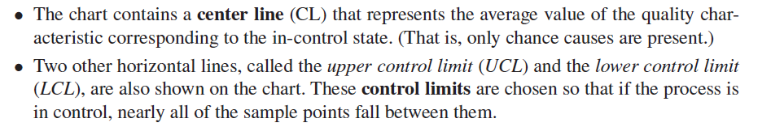
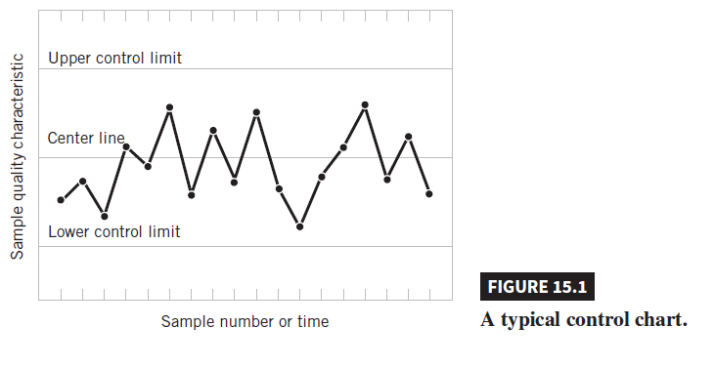
Basic Principles of Control Charts
Sec 15.2.1 Basic Principles

Slide 10
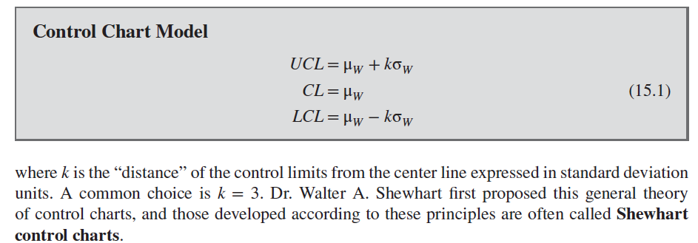
Basic Principles of Control Charts
Sec 15.2.1 Basic Principles

Slide 11
Types of Control Charts
Variables Control Charts
These charts are applied to data that follow a continuous distribution.
Attributes Control Charts
These charts are applied to data that follow a discrete distribution.
Sec 15.2.1 Basic Principles

Slide 12

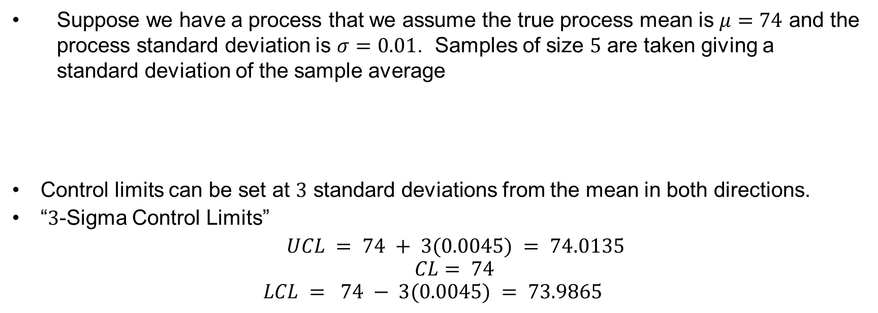
Design of a Control Chart
Suppose we have a process that we assume the true process mean is $μ=74$ and the process standard deviation is $σ=0.01$. Samples of size $5$ are taken giving a standard deviation of the sample average
Control limits can be set at $3$ standard deviations from the mean in both directions.
“$3$-Sigma Control Limits”
$UCL = 74 + 3(0.0045) = 74.0135$
$$CL= 74$$
$$LCL = 74 − 3(0.0045) = 73.9865$$
Sec 15.2.2 Design of a Control Chart

Slide 13
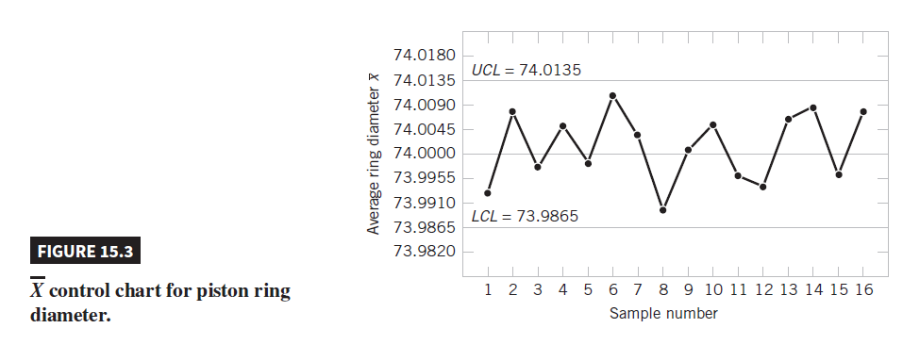
Design of a Control Chart
Sec 15.2.2 Design of a Control Chart

Slide 14
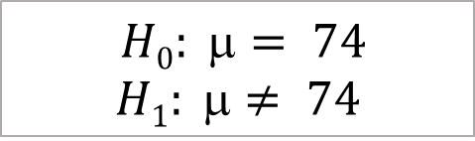
Design of a Control Chart
Choosing the control limits is equivalent to setting up the critical region for hypothesis testing
$$H0: = 74$$
$$H1: ≠ 74$$
Sec 15.2.2 Design of a Control Chart

Slide 15
Rational Subgroups
Subgroups or samples should be selected so that if assignable causes are present, the chance for differences between subgroups will be maximized, while the chance for differences due to these assignable causes within a subgroup will be minimized.
Constructing Rational Subgroups
Select consecutive units of production.
Provides a “snapshot” of the process.
Good at detecting process shifts
Select a random sample over the entire sampling interval.
Good at detecting if a mean has shifted out-of-control and then back in-control.
Sec 15.2.3 Rational Subgroups

Slide 16
Analysis of Patterns in a Control Chart
Look for “runs” - this is a sequence of observations of the same type (all above the center line, or all below the center line)
Runs of say 8 observations or more could indicate an out-of-control situation.
Run up: a series of observations are increasing
Run down: a series of observations are decreasing
Sec 15.2.4 Analysis of Patterns in a Control Chart

Slide 17
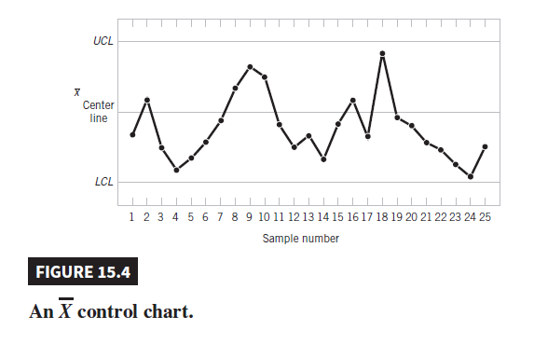
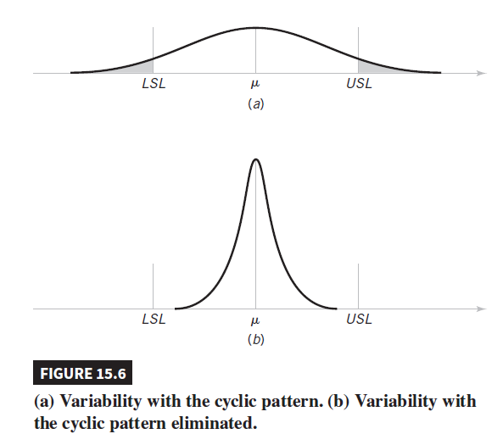
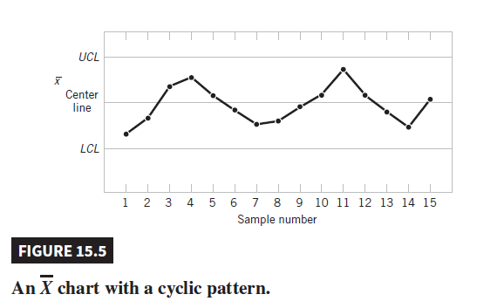
Analysis of Patterns in a Control Chart
Sec 15.2.4 Analysis of Patterns in a Control Chart

Slide 18
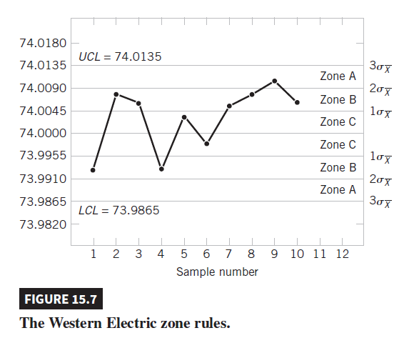
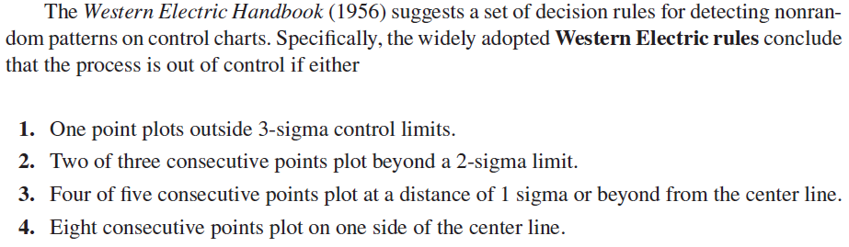
Western Electric Rules
Sec 15.2.4 Analysis of Patterns in a Control Chart

Slide 19


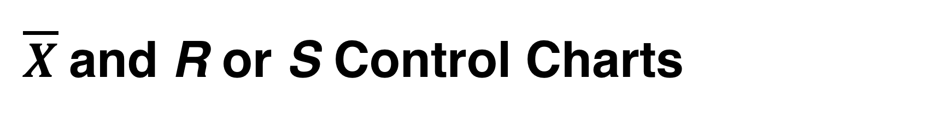
$\overline{X}$and R or S Control Charts
The grand mean:
The average range:
Sec 15.3 $\overline{X}$and R or S Control Charts

Slide 20
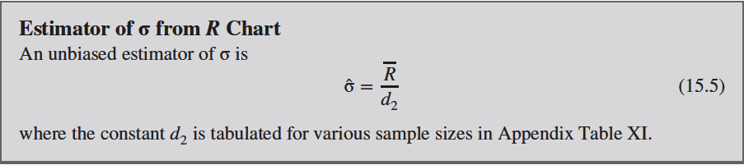
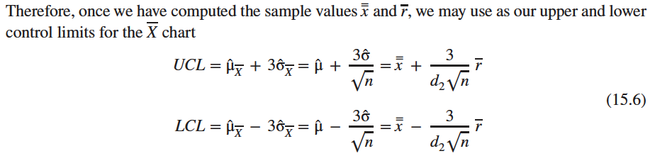
$\overline{X}$and R or S Control Charts
Sec 15.3 $\overline{X}$and R or S Control Charts

Slide 21
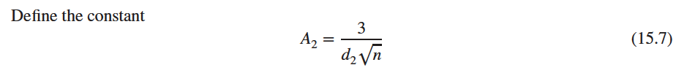
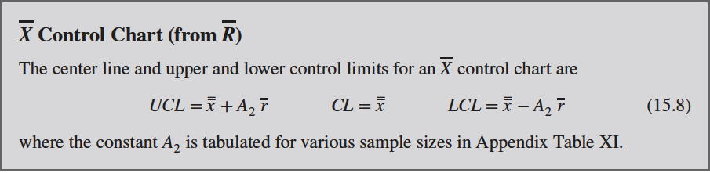
$\overline{X}$and R or S Control Charts
Sec 15.3 $\overline{X}$and R or S Control Charts

Slide 22
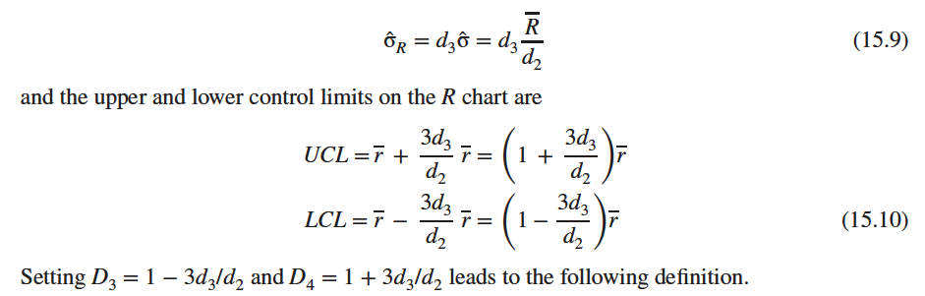
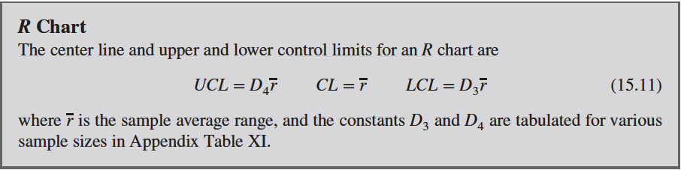
$\overline{X}$and R or S Control Charts
Sec 15.3 $\overline{X}$and R or S Control Charts

Slide 23

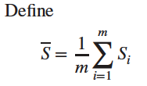
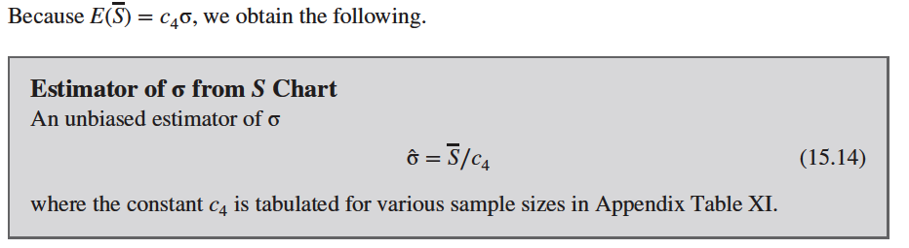
$\overline{X}$and R or S Control Charts
Sec 15.3 $\overline{X}$and R or S Control Charts

Slide 24
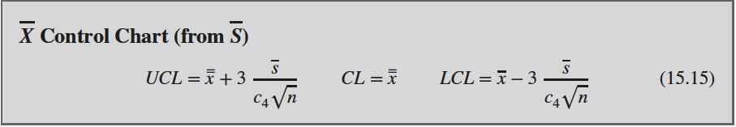
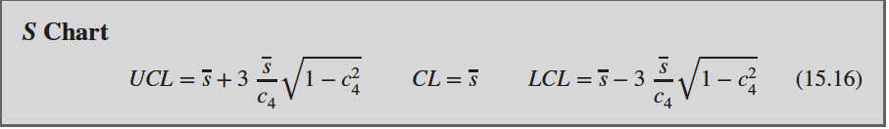
$\overline{X}$and R or S Control Charts
Sec 15.3 $\overline{X}$and R or S Control Charts

Slide 25
Example 15.1 | Vane Opening
A component part for a jet aircraft engine is manufactured by an investment casting process. The values given in the table have been coded by using the last three digits of the dimension; that is, 31.6 indicates 0.50316 inch.
The value of A₂ for samples of size 5 is A₂ = 0.577. Then the trial control limits for the chart are
or
UCL = 36.67 LCL = 29.97
Sec 15.3 $\overline{X}$and R or S Control Charts

Slide 26
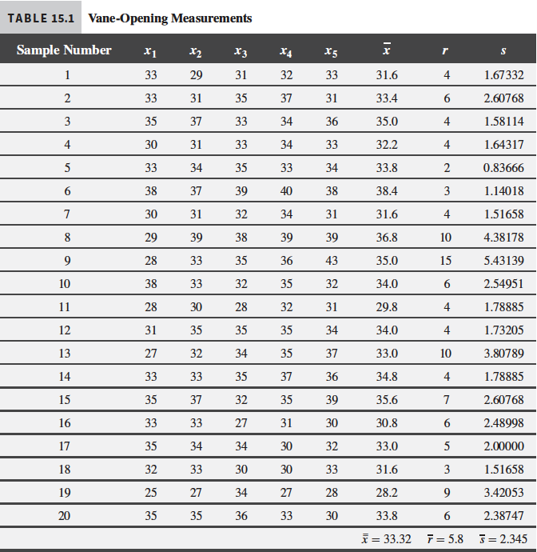
Example 15.1b | Vane Opening
Sec 15.3 $\overline{X}$and R or S Control Charts

Slide 27
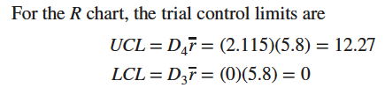
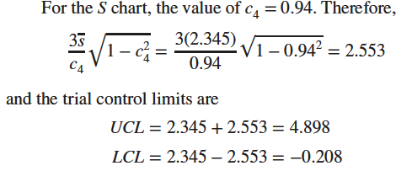
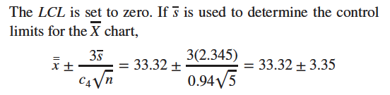

Example 15.1c | Vane Opening
Sec 15.3 $\overline{X}$and R or S Control Charts

Slide 28
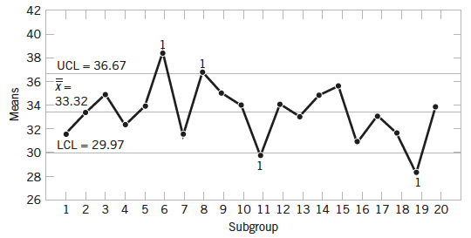
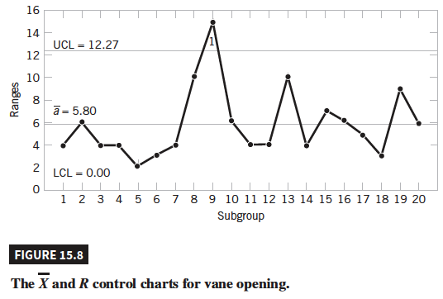
Example 15.1d | Vane Opening
Sec 15.3 $\overline{X}$and R or S Control Charts

Slide 29

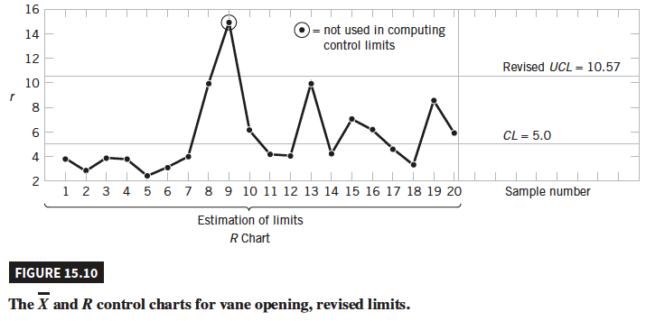
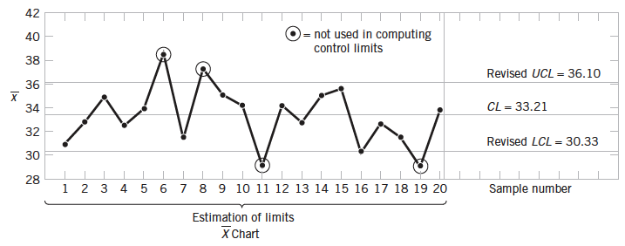
Example 15.1e | Vane Opening
Sec 15.3 $\overline{X}$and R or S Control Charts

Slide 30
Control Charts for Individual Measurements
In many situations, the sample size used for process control is n =1; that is, the sample consists of an individual unit. Examples:
Automated inspection and measurement technology is used, and every unit manufactured is analyzed.
The production rate is very slow, and it is inconvenient to allow samples sizes of n > 1 to accumulate before analysis
Repeat measurements on the process differ only because of laboratory or analysis error, as in many chemical processes.
In process plants, measurements on some parameters such as coating thickness across the roll differ very little and produce a standard deviation that is much too small if the objective is to control coating thickness along the roll
Sec 15.4 Control Charts for Individual Measures

Slide 31


Control Charts for Individual Measurements
The individual control charts (X chart) are useful
The control chart for individuals uses the moving range of two successive observations to estimate the process variability
Moving range:
Sec 15.4 Control Charts for Individual Measures

Slide 32
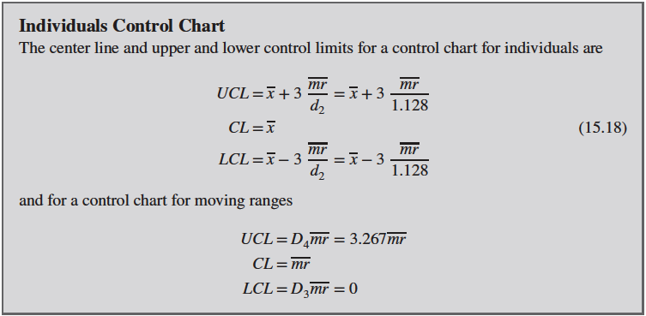
Individuals Control chart
Sec 15.4 Control Charts for Individual Measures

Slide 33
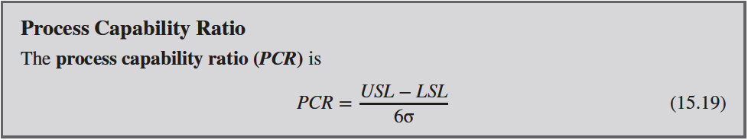
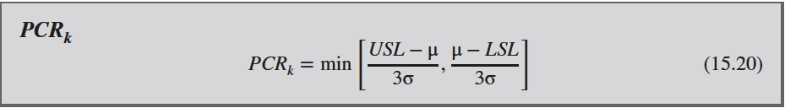
Process Capability
Process capability is the performance of the process when it is operating in control
Two graphical tools, the tolerance chart and the histogram, are helpful in assessing process capability
Sec 15.5 Process Capability

Slide 34
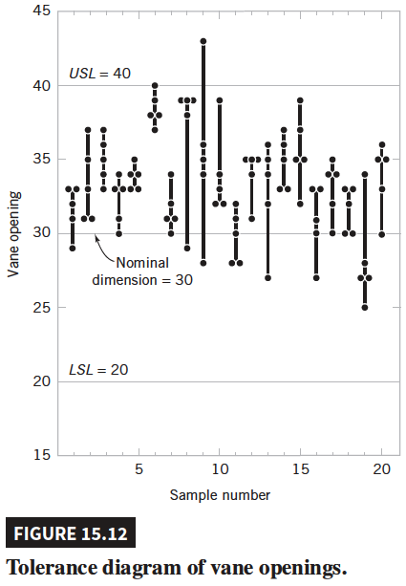
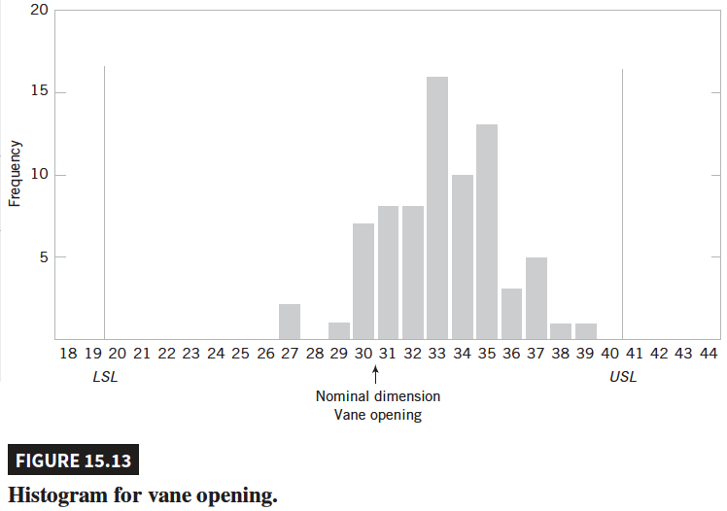
Process Capability
Sec 15.5 Process Capability

Slide 35
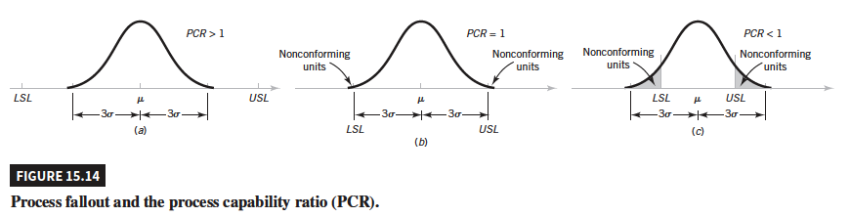
Process Capability
Sec 15.5 Process Capability

Slide 36
Example 15.3 | Electrical Current
For an electronic manufacturing process a current has specifications of 100 ± 10 milliamperes. The process mean μ and standard deviation σ are 107.0 and 1.5, respectively. The process mean is nearer to the USL. Consequently,
And
The small PCR_{k} indicates that the process is likely to produce currents outside of the specification limits. From the normal distribution in Appendix Table II,
P(X < LSL) = P(Z < (90 - 107)/1.5)
= P(Z < -11.33) ≅ 0
P(X > USL) = P(Z > (110 - 107)/1.5)
= P(Z > 2) = 0.023
Sec 15.5 Process Capability

Slide 37
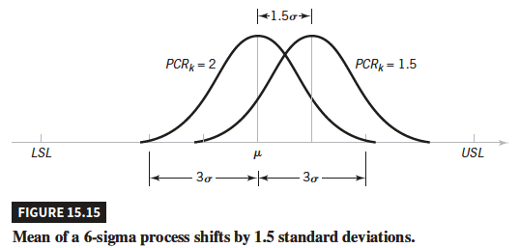
Process Capability
Sec 15.5 Process Capability

Slide 38
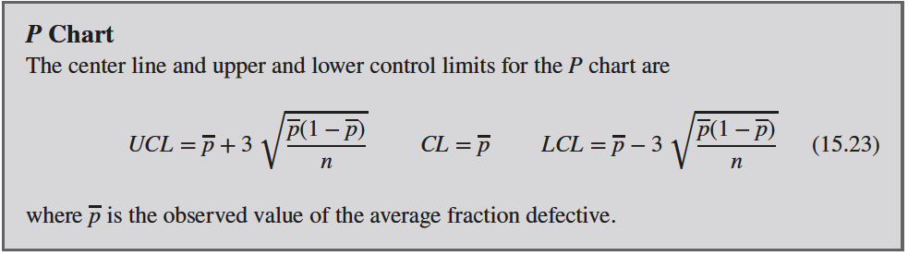
P Chart (Control Chart for Proportions)
Sec 15.6.1 P Chart (Control Chart for Proportions)

Slide 39
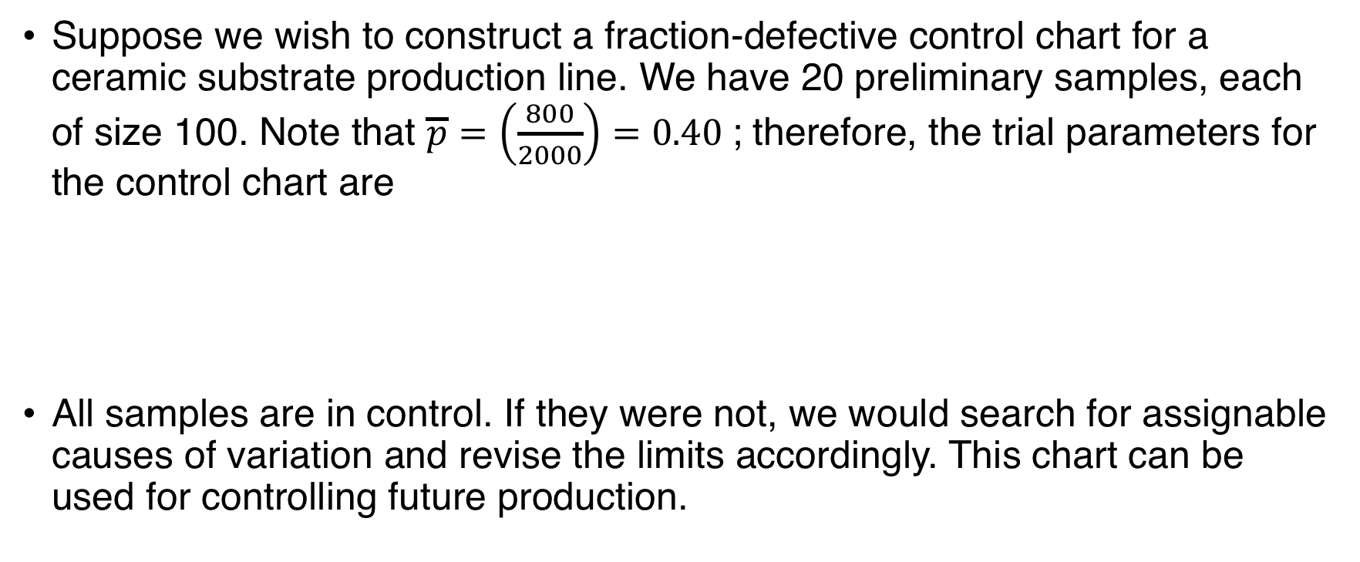
Example 15.4 | Ceramic Substrate
Suppose we wish to construct a fraction-defective control chart for a ceramic substrate production line. We have 20 preliminary samples, each of size 100. Note that $\overline{p}=\left(\frac{800}{2000}\right)=0.40$; therefore, the trial parameters for the control chart are
All samples are in control. If they were not, we would search for assignable causes of variation and revise the limits accordingly. This chart can be used for controlling future production.
Sec 15.6.1 P Chart (Control Chart for Proportions)

Slide 40
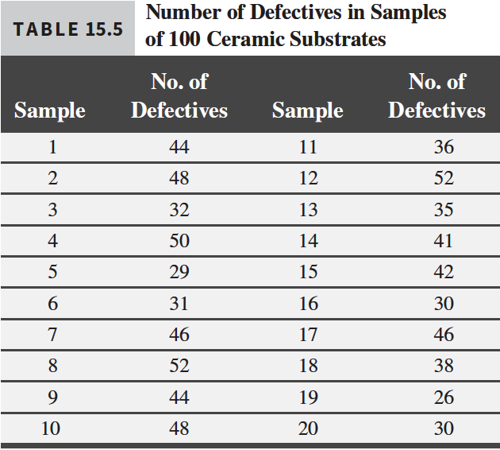
Example 15.4b | Ceramic Substrate
Sec 15.6.1 P Chart (Control Chart for Proportions)

Slide 41
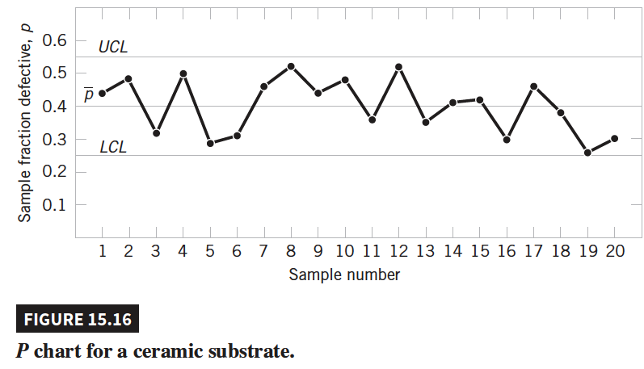
Example 15.4c | Ceramic Substrate
Sec 15.6.1 P Chart (Control Chart for Proportions)

Slide 42
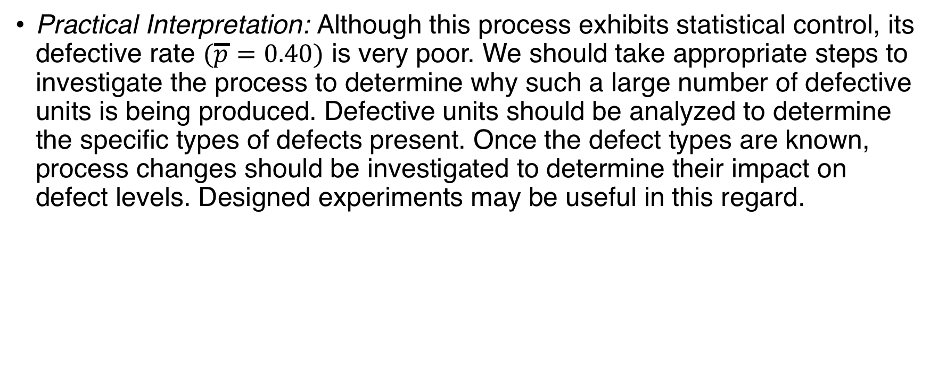
Example 15.4d | Ceramic Substrate
Practical Interpretation: Although this process exhibits statistical control, its defective rate $(\overline{p}=0.40)$ is very poor. We should take appropriate steps to investigate the process to determine why such a large number of defective units is being produced. Defective units should be analyzed to determine the specific types of defects present. Once the defect types are known, process changes should be investigated to determine their impact on defect levels. Designed experiments may be useful in this regard.
Sec 15.6.1 P Chart (Control Chart for Proportions)

Slide 43
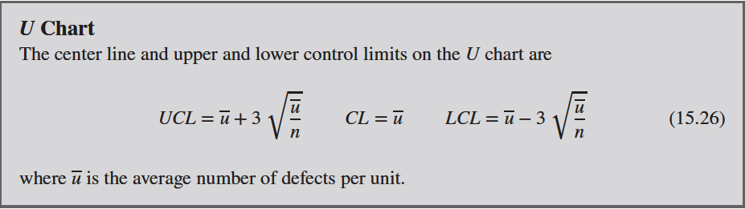
U chart (Control Chart for Defects per Unit
Sec 15.6.2 U Chart (Control Chart for Defects per Unit)

Slide 44
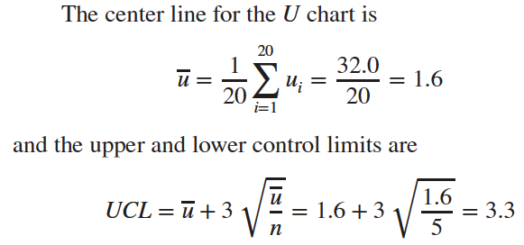
Example 15.5 | Printed Circuit Boards
Printed circuit boards are assembled by a combination of manual assembly and automation. Every hour, five boards are selected and inspected for process-control purposes. The number of defects in each sample of five boards is noted.
Sec 15.6.2 U Chart (Control Chart for Defects per Unit)

Slide 45
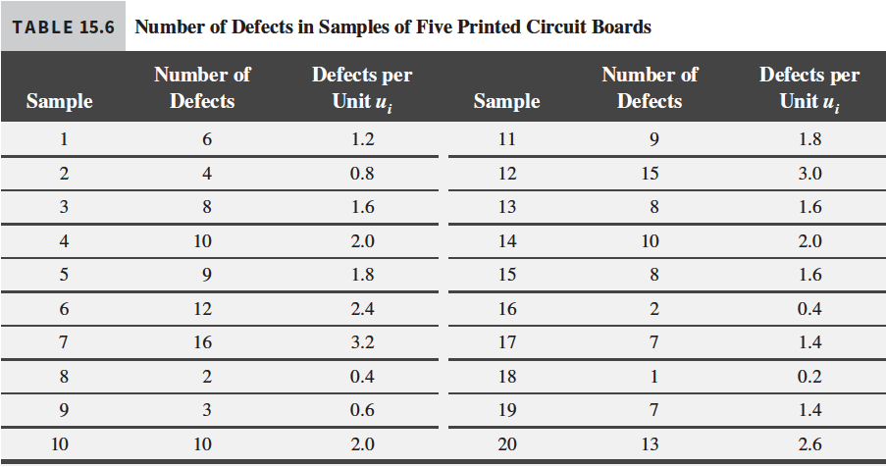
Example 15.5b | Printed Circuit Boards
Sec 15.6.2 U Chart (Control Chart for Defects per Unit)

Slide 46
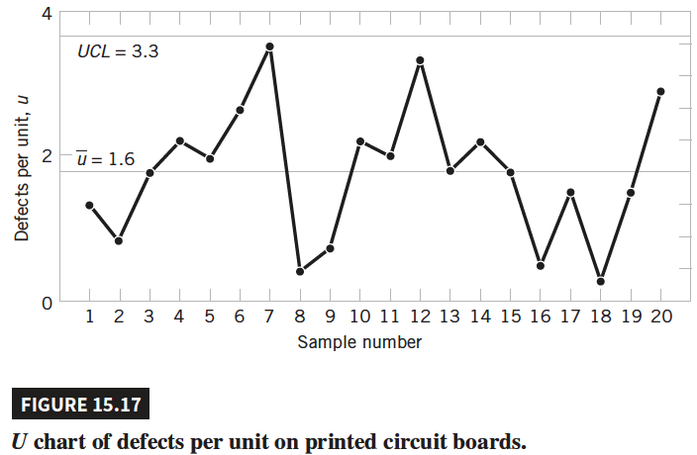
Example 15.5c | Printed Circuit Boards
Practical Interpretation: Eight defects per group of five circuit boards are too many (about 8/5 = 1.6 defects/board), and the process needs improvement. An investigation needs to be made of the specific types of defects found on the printed circuit boards. This will usually suggest potential avenues for process improvement.
Sec 15.6.2 U Chart (Control Chart for Defects per Unit)

Slide 47
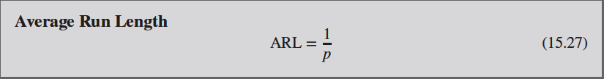
Control Chart Performance
The average run length (ARL) is a way to evaluate decisions regarding sample size and sampling frequency
Sec 15.7 Control Chart Performance

Slide 48
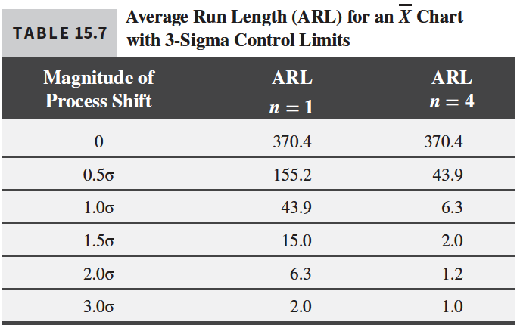

Control Chart Performance
Sec 15.7 Control Chart Performance

Slide 49

Time-Weighted Charts
A major disadvantage of any Shewhart control chart is that it is relatively insensitive to small shifts in the process ($1.5σ$ or less)
This is because Shewhart charts ignore information about sequences of (past) points and only uses information about the current point
Time-weighted charts are an effective alternative because they integrate data over several time periods, improving the ARL performance to detect small shifts and manage the in-control ARL
Sec 15.8 Time-Weighted Charts

Slide 50


Exponentially Weighted Moving-Average Control Chart
At time, t, the average of the last four measurements can be written as
This average places weight on ¼ on each of the most recent observations and zero weight on older observations. It is called a moving average and in this case, a window of size 4 is used.
The exponentially weighted moving-average (EWMA) is
Sec 15.8.1 Exponentially Weighted Moving-Average Control Charge

Slide 51

Example 15.6 | Chemical Process Concentration EWMA
Sec 15.8.1 Exponentially Weighted Moving-Average Control Charge

Slide 52

Example 15.6b | Chemical Process Concentration EWMA
Sec 15.8.1 Exponentially Weighted Moving-Average Control Charge

Slide 53


Example 15.6c | Chemical Process Concentration EWMA
Consider the concentration data shown in Table 15.3. Construct an EWMA control chart with λ = 0.2 with n = 1. It was determined that $\overline{x}=99.1$ and $\overline{mr}=2.59.$ Therefore, ${\overline{μ}}_{0}=99.1$ and $\hat{σ}=\frac{2.59}{1.128}=2.30$. The control limits for z₁ are
The first few values of z_{t} along with the corresponding control limits are
Sec 15.8.1 Exponentially Weighted
Moving-Average Control Charge

Slide 54

Example 15.6d | Chemical Process Concentration EWMA
Sec 15.8.1 Exponentially Weighted
Moving-Average Control Charge

Slide 55

Cumulative Sum Control Chart
Another alternative to the Shewhart control chart is the cumulative sum control chart (CUSUM)
If μ₀ is the target for the process mean, the cumulative sum control chart is formed by plotting the quantity
Sec 15.8.2 Cumulative Sum Control Chart

Slide 56

Cumulative Sum Control Chart
Sec 15.8.2 Cumulative Sum Control Chart

Slide 57

Cumulative Sum Control Chart
Sec 15.8.2 Cumulative Sum Control Chart

Slide 58

Cumulative Sum Control Chart
Sec 15.8.2 Cumulative Sum Control Chart

Slide 59

Cumulative Sum Control Chart
Sec 15.8.2 Cumulative Sum Control Chart

Slide 60
Example 15.7 | Chemical Process Concentration Tabular CUSUM
We will illustrate the tabular CUSUM by applying it to the chemical process concentration data in Table 15.9. The process target is μ₀ = 99, and we will use K = 1 as the reference value and H = 10 as the decision interval. The reasons for these choices will be explained later.
Table 15.10 shows the tabular CUSUM scheme for the chemical process concentration data. To illustrate the calculations, note that
s_{H}(i) = max[0, x_{i} - (μ₀ + K) + s_{H}(i - 1)]
= max[0, x_{i} - (99 + 1) + s_{H}(i - 1)]
= max[0, x_{i} - 100 + s_{H}(i - 1)]
s_{L}(i) = max[0, (μ₀ - K) - x_{i} + s_{L}(i - 1)]
= max[0, (99 - 1) - x_{i} + s_{L}(i - 1)]
= max[0, 98 - x_{i} + s_{L}(i - 1)]
Sec 15.8.2 Cumulative Sum Control Chart

Slide 61

Example 15.7b | Chemical Process Concentration Tabular CUSUM
Sec 15.8.2 Cumulative Sum Control Chart

Slide 62

Example 15.7c | Chemical Process Concentration Tabular CUSUM
Next steps: The limits for the CUSUM charts may be used to continue to operate the chart in order to monitor future productions.
Sec 15.8.2 Cumulative Sum Control Chart

Slide 63

Example 15.7d | Chemical Process Concentration Tabular CUSUM
Sec 15.8.2 Cumulative Sum Control Chart

Slide 64

Other SPC Problem-Solving Tools
Sec 15.9 Other SPC Problem-Solving Tools

Slide 65

Cause-and-Effect Diagram
Sec 15.9 Other SPC Problem-Solving Tools

Slide 66

Defect Concentration Diagram
Sec 15.9 Other SPC Problem-Solving Tools

Slide 67
Decision Theory
Decision theory is the study of mathematical models for decision making
It is a framework to characterize the decision problem in terms of actions, possible states, and associated probabilities to quantitatively compare alternatives
Sec 15.10 Decision Theory

Slide 68


Decision Models
Sec 15.10.1 Decision Models

Slide 69



Decision Criteria
Sec 15.10.2 Decision Criteria

Slide 70
Implementing SPC
Deming’s 14 points
Create a constancy of purpose focused on the improvement of products and services
Adopt a new philosophy of rejecting poor workmanship, defective products, or bad service
Do not rely on mass inspection to “control quality”
Do not award business to suppliers on the basis of price alone, but consider quality
Focus on continuous improvement
Practice modern training methods and invest in training for all employees
Practice modern supervision methods
Sec 15.11 Implementing SPC

Slide 71
Implementing SPC
8. Drive out fear.
9. Break down the barriers between functional areas of the business.
10. Eliminate targets, slogans, and numerical goals for the workforce.
11. Eliminate numerical quotas and work standards.
12. Remove the barriers that discourage employees from doing their jobs.
13. Institute an ongoing program of training and education for all employees.
14. Create a structure in top management that vigorously advocates first 13 points.
Sec 15.11 Implementing SPC

Slide 72

Important Terms and Concepts
Chapter 15 Important Terms and Concepts

