Slide 1
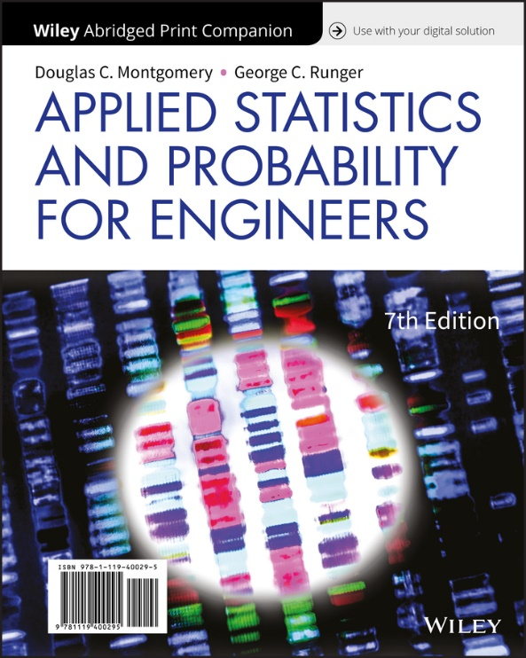
Applied Statistics and Probability for Engineers
Seventh Edition
Douglas C. Montgomery George C. Runger
Chapter 3
Discrete Random Variables & Probability Distributions
Chapter 3 Title Slide

Slide 2
3
Discrete Random Variables and
Probability Distributions
CHAPTER OUTLINE
3.1 Probability Distributions and
Probability Mass Functions
3.2 Cumulative Distribution
Functions
3.3 Mean and Variance of a
Discrete Random Variable
3.4 Discrete Uniform Distribution
3.5 Binomial Distribution
3.6 Geometric and Negative
Binomial Distributions
3.7 Hypergeometric Distribution
3.8 Poisson Distribution
Chapter 3 Contents

Slide 3
Learning Objectives for Chapter 3
After careful study of this chapter, you should be able to do the following:
Determine probabilities from probability mass functions and the reverse.
Determine probabilities and probability mass functions from cumulative distribution functions and the reverse.
Calculate means and variances for discrete random variables.
Understand the assumptions for discrete probability distributions.
Select an appropriate discrete probability distribution to calculate probabilities.
Calculate probabilities and determine means and variances for some common discrete probability distributions.
Chapter 3 Learning Objectives

Slide 4
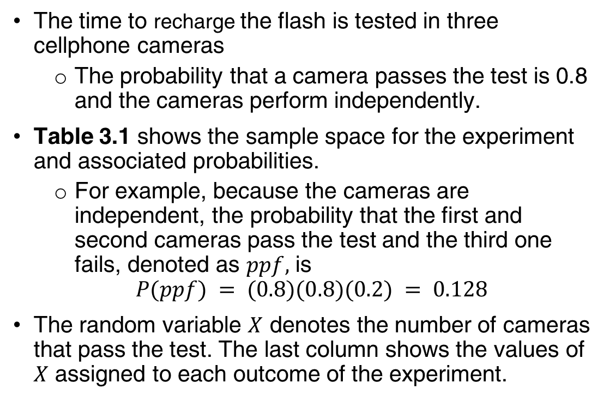
Example 3.1 | Flash Recharge Time
The time to recharge the flash is tested in three cellphone cameras
The probability that a camera passes the test is 0.8 and the cameras perform independently.
Table 3.1 shows the sample space for the experiment and associated probabilities.
For example, because the cameras are independent, the probability that the first and second cameras pass the test and the third one fails, denoted as $ppf,$ is
$$P(ppf) = (0.8)(0.8)(0.2) = 0.128$$
The random variable $X$ denotes the number of cameras that pass the test. The last column shows the values of $X$ assigned to each outcome of the experiment.
Sec 3.1 Probability Distributions and Mass Functions

Slide 5
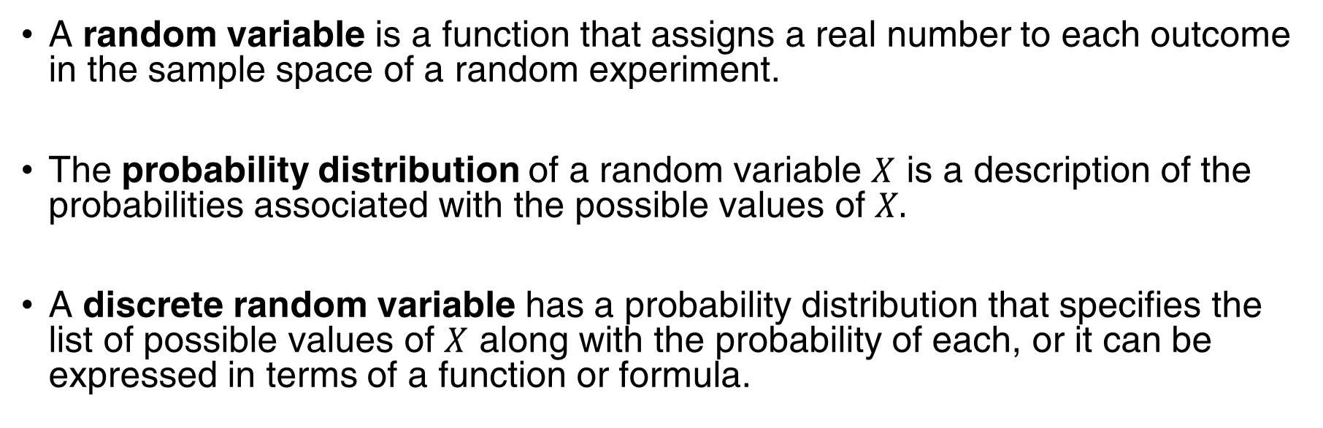
Probability Distributions
A random variable is a function that assigns a real number to each outcome in the sample space of a random experiment.
The probability distribution of a random variable $X$ is a description of the probabilities associated with the possible values of $X.$
A discrete random variable has a probability distribution that specifies the list of possible values of $X$ along with the probability of each, or it can be expressed in terms of a function or formula.
Sec 3.1 Probability Distributions and Mass Functions

Slide 6
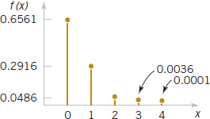
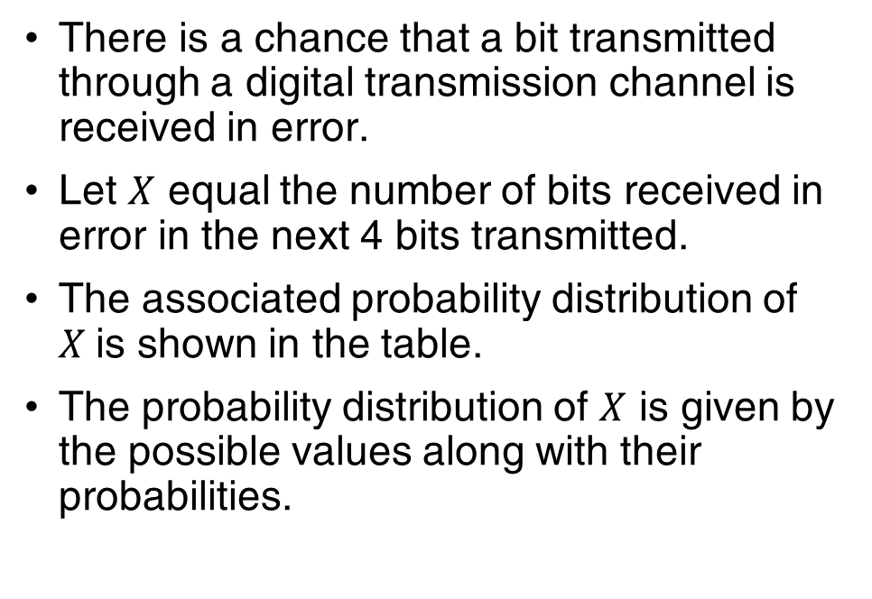
Example 3.3 | Digital Channel
There is a chance that a bit transmitted through a digital transmission channel is received in error.
Let $X$ equal the number of bits received in error in the next 4 bits transmitted.
The associated probability distribution of $X$is shown in the table.
The probability distribution of $X$ is given by the possible values along with their probabilities.
Figure 3.1 Probability distribution for bits in error.
Sec 3.1 Probability Distributions and Mass Functions

Slide 7
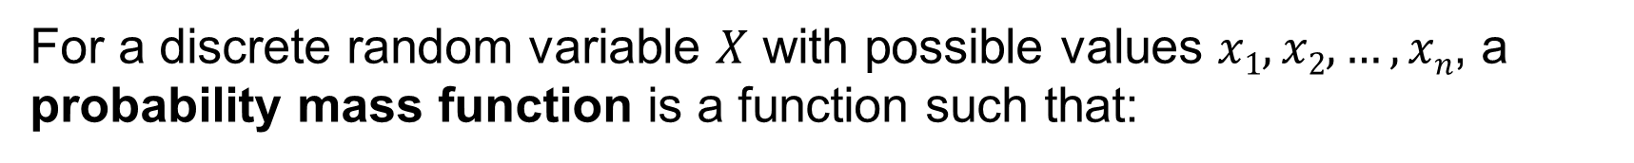
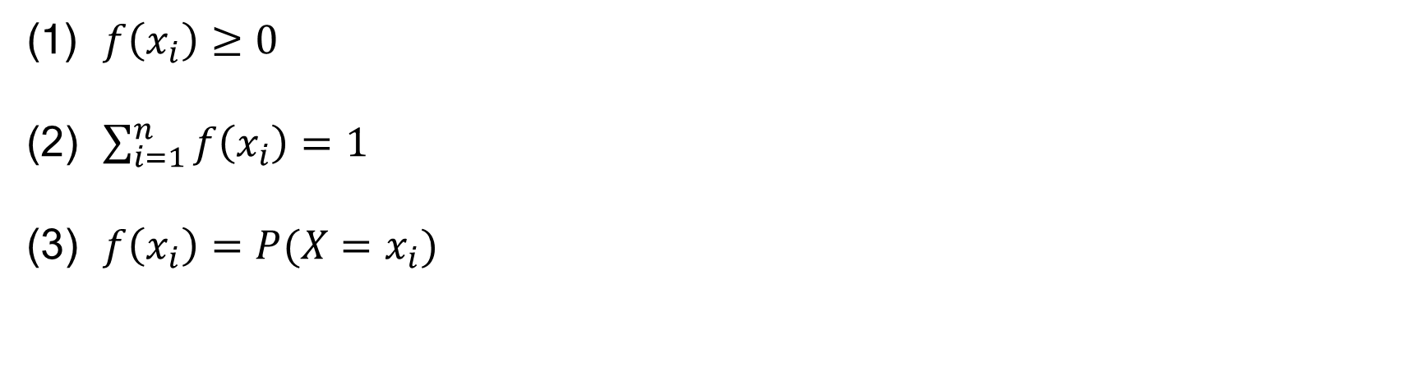
Probability Mass Function
For a discrete random variable $X$ with possible values $x1, x2, …, xn$, a probability mass function is a function such that:
(1) $f\left(x_{i}\right)≥0$
(2) $\sum_{i=1}^{n}{f\left(x_{i}\right)=1 }$
(3) $f\left(x_{i}\right)=P(X=x_{i})$
Sec 3.1 Probability Distributions and Mass Functions

Slide 8
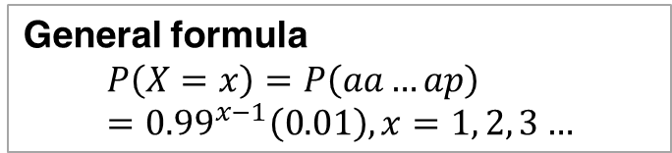
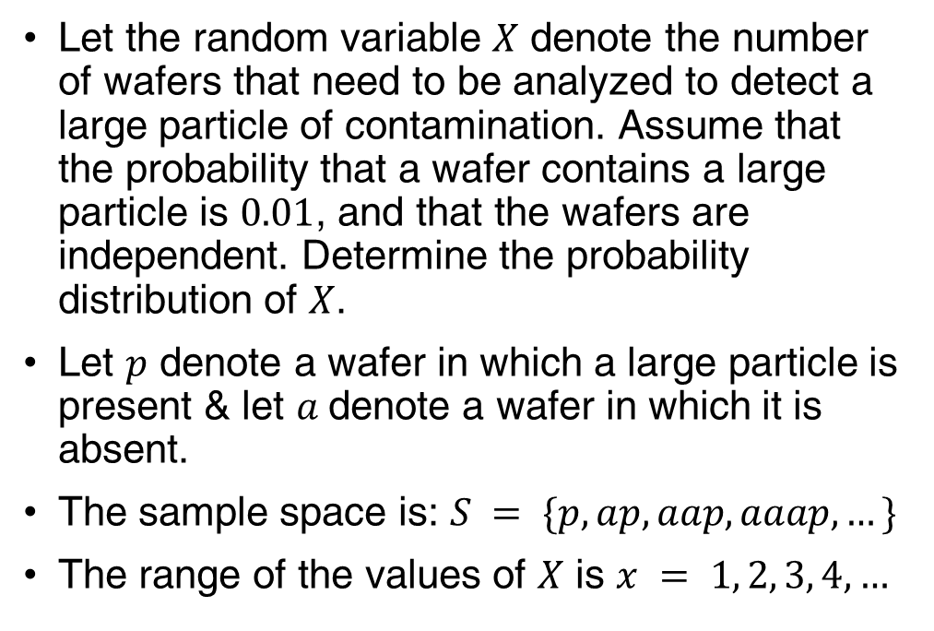
Example 3.4 | Wafer Contamination
Let the random variable $X$ denote the number of wafers that need to be analyzed to detect a large particle of contamination. Assume that the probability that a wafer contains a large particle is $0.01$, and that the wafers are independent. Determine the probability distribution of $X$.
Let $p$ denote a wafer in which a large particle is present & let $a$denote a wafer in which it is absent.
The sample space is: $S = \{p, ap, aap, aaap, …\}$
The range of the values of $X$ is $x = 1, 2, 3, 4, …$
General formula
$$P\left(X=x\right)=P\left(aa…ap\right)={0.99}^{x−1}\left(0.01\right), x=1, 2, 3…$$
Sec 3.1 Probability Distributions and Mass Functions

Slide 9

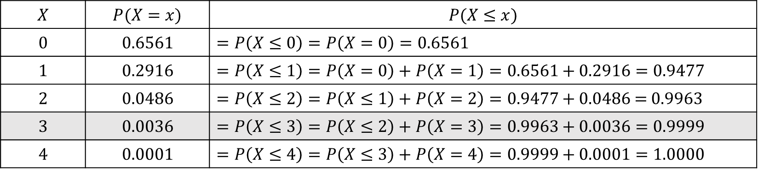
Cumulative Distribution Functions
Example 3.5 | Consider the probability distribution for the digital channel example. The last column shows the cumulative probabilities of getting an error $x$ or less.
Find the probability of three or fewer bits in error.
The event $(X ≤ 3)$is the total of the events: $(X = 0), (X = 1), (X = 2), and (X = 3).$
For the probability calculation, see the shaded row in the table.
$$X$$ | $$P(X=x)$$ | $$P(X≤x)$$
$$0$$ | $$0.6561$$ | $$=P\left(X≤0\right)=P\left(X=0\right)=0.6561$$
$$1$$ | $$0.2916$$ | $=P\left(X≤1\right)=P\left(X=0\right)+P\left(X=1\right)=0.6561+0.2916=0.9477$
$$2$$ | $$0.0486$$ | $$=P\left(X≤2\right)=P\left(X≤1\right)+P\left(X=2\right)=0.9477+0.0486\text{ = 0.9963}$$
$$3$$ | $$0.0036$$ | $$=P\left(X≤3\right)=P\left(X≤2\right)+P\left(X=3\right)=0.9963+0.0036=0.9999$$
$$4$$ | $$0.0001$$ | $$=P\left(X≤4\right)=P\left(X≤3\right)+P\left(X=4\right)=0.9999+0.0001=1.0000$$
Sec 3.2 Cumulative Distribution Functions

Slide 10
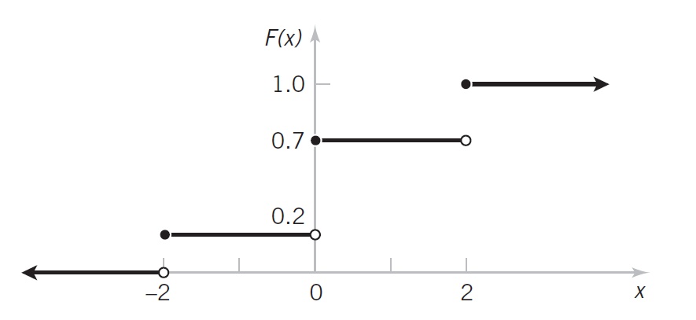
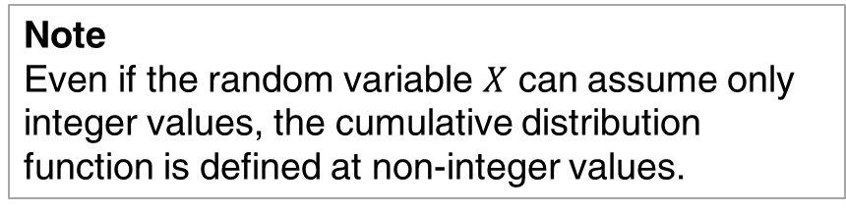
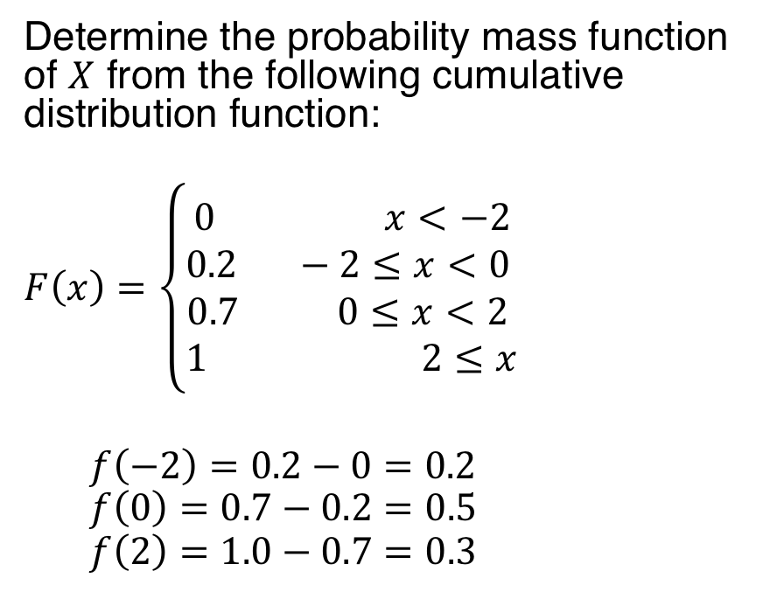
Example 3.6 | Cumulative Distribution Function
Determine the probability mass function of $X$ from the following cumulative distribution function:
$$F\left(x\right)=\left\{\begin{aligned}0 x<−2 \\ 0.2 −2≤x<0 \\ 0.7 0≤x<2 \\ 1 2≤x\end{aligned}\right.$$
$$f\left(−2\right)=0.2−0=0.2$$
$$f\left(0\right)=0.7−0.2=0.5$$
$$f\left(2\right)=1.0−0.7=0.3$$
Figure 3.3 Cumulative Distribution Function
Note
Even if the random variable $X$ can assume only integer values, the cumulative distribution function is defined at non-integer values.
Sec 3.2 Cumulative Distribution Functions

Slide 11
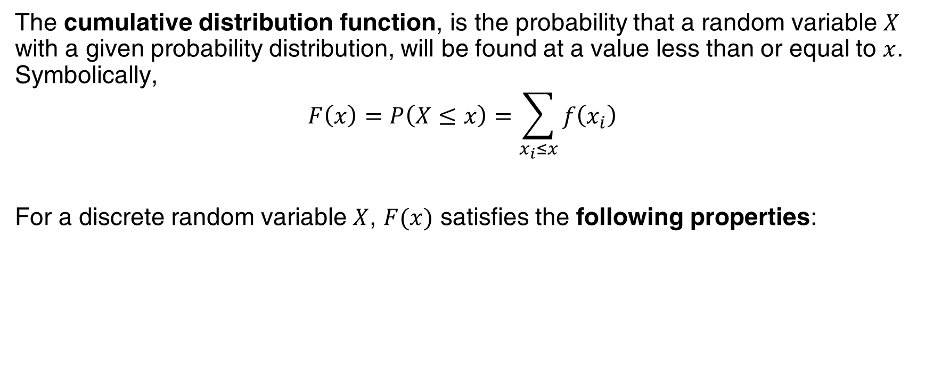
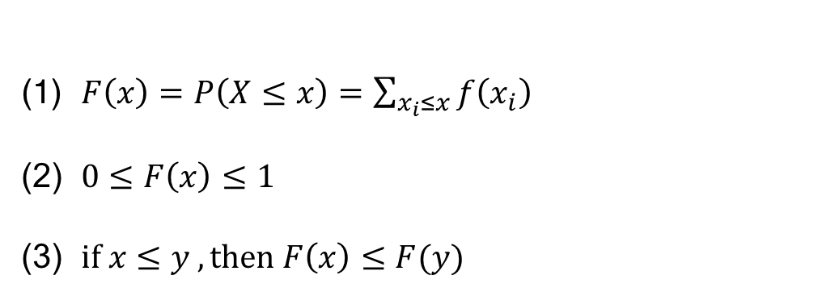
Cumulative Distribution Function and Properties
The cumulative distribution function, is the probability that a random variable $X$ with a given probability distribution, will be found at a value less than or equal to $x$. Symbolically,
$$F\left(x\right)=P\left(X≤x\right)=\sum_{x_{i}≤x}{f\left(x_{i}\right)}$$
For a discrete random variable $X$, $F(x)$ satisfies the following properties:
(1) $F\left(x\right)=P\left(X≤x\right)=\sum_{x_{i}≤x}{f\left(x_{i}\right)}$
(2) $0≤F\left(x\right)≤1$
(3) $if x≤y , then F\left(x\right)≤F(y)$
Sec 3.2 Cumulative Distribution Functions

Slide 12
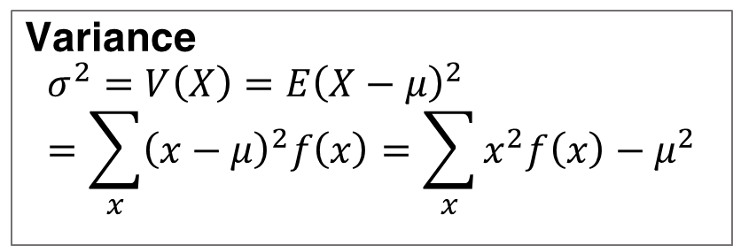
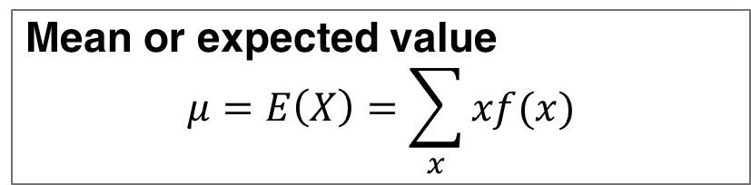

Mean and Variance of a Discrete Random Variable
Used to summarize a probability distribution
Mean: measure of center or middle of the probability distribution
For a discrete random variable, a weighted average of possible values with weights equal to probabilities
Variance: measure of the dispersion, or variability in the distribution
For a discrete random variable, a weighted measure of each possible squared deviation with weights equal to probabilities
Mean or expected value
$$μ=E\left(X\right)=\sum_{x}{xf(x)}$$
Variance
$$σ^{2}=V\left(X\right)=E{\left(X−μ\right)}^{2}=\sum_{x}{{\left(x−μ\right)}^{2}f\left(x\right)=\sum_{x}{x^{2}f\left(x\right)−μ^{2}}}$$
Standard deviation
$$σ=\sqrt{σ^{2}}$$
Sec 3.3 Mean and Variance of a Discrete Random Variable

Slide 13
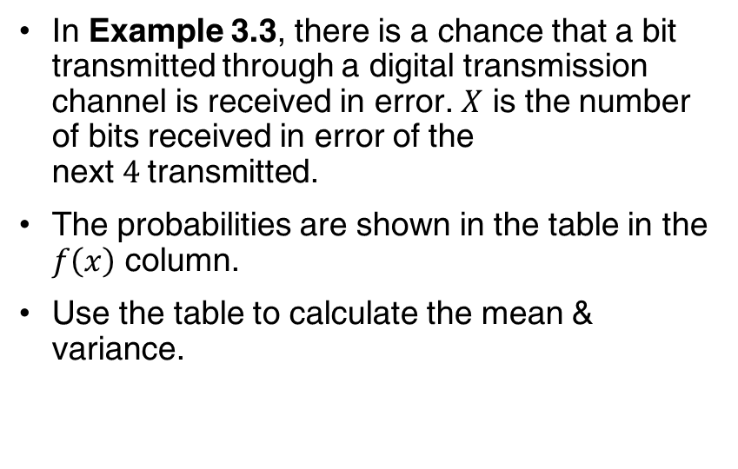
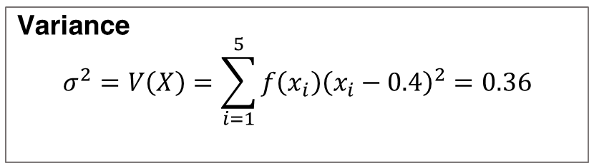
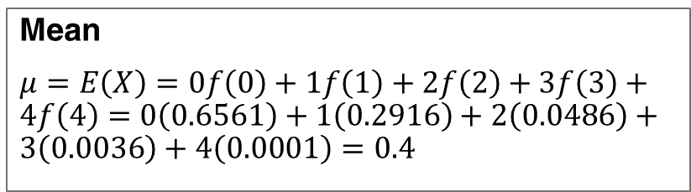
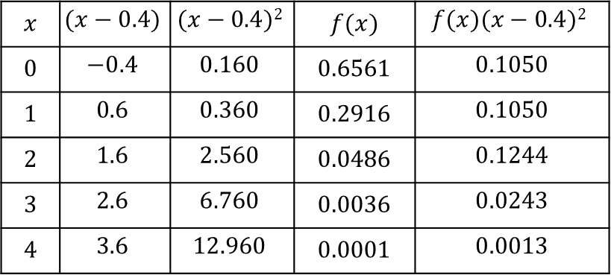
Example 3.7 | Digital Channel
In Example 3.3, there is a chance that a bit transmitted through a digital transmission channel is received in error. $X$ is the number of bits received in error of the next$4$transmitted.
The probabilities are shown in the table in the $f\left(x\right)$ column.
Use the table to calculate the mean & variance.
$$x$$ | $$(x−0.4)$$ | $$(x−0.4)2$$ | $$f(x)$$ | $$f(x)(x−0.4)2$$
$$0$$ | $$−0.4$$ | $$0.160$$ | $$0.6561$$ | $$0.1050$$
$$1$$ | $$0.6$$ | $$0.360$$ | $$0.2916$$ | $$0.1050$$
$$2$$ | $$1.6$$ | $$2.560$$ | $$0.0486$$ | $$0.1244$$
$$3$$ | $$2.6$$ | $$6.760$$ | $$0.0036$$ | $$0.0243$$
$$4$$ | $$3.6$$ | $$12.960$$ | $$0.0001$$ | $$0.0013$$
Mean
$μ=E\left(X\right)=0f\left(0\right)+1f\left(1\right)+2f\left(2\right)+3f\left(3\right)+4f\left(4\right)=0\left(0.6561\right)+1\left(0.2916\right)+2\left(0.0486\right)+3\left(0.0036\right)+4\left(0.0001\right)=0.4$
Variance
$$σ^{2}=V\left(X\right)=\sum_{i=1}^{5}{f\left(x_{i}\right){\left(x_{i}−0.4\right)}^{2}}=0.36$$
Sec 3.3 Mean and Variance of a Discrete Random Variable

Slide 14

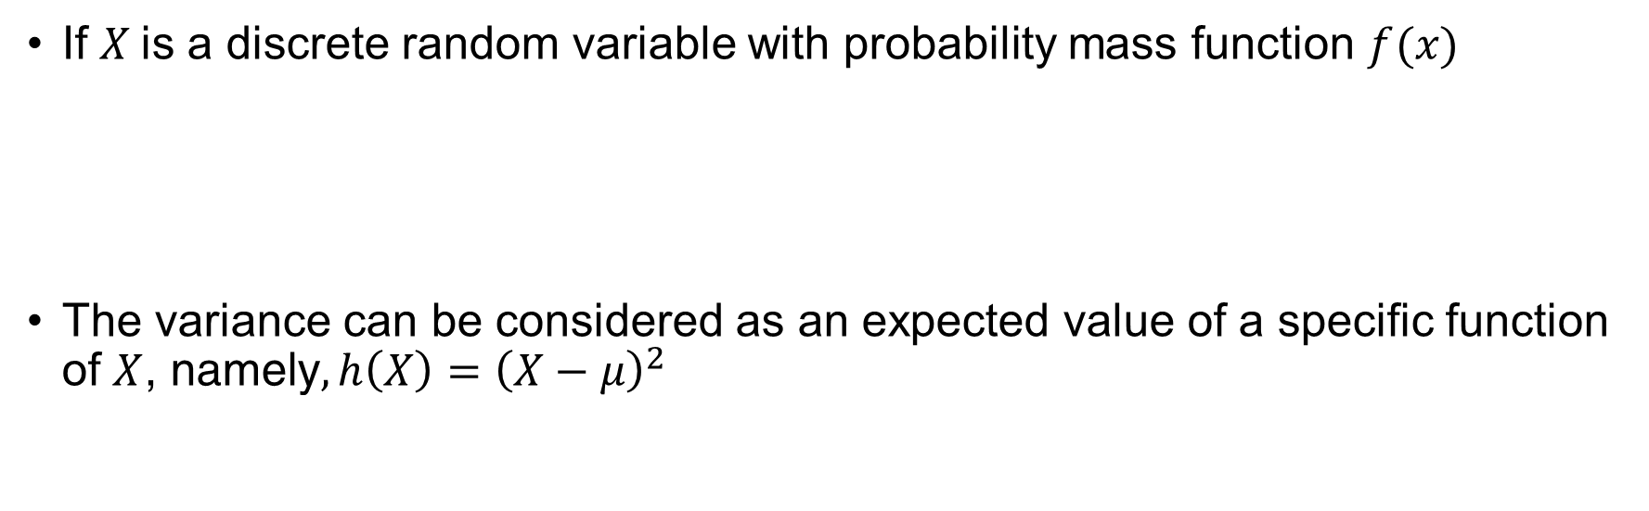
Expected Value of a Function of a Discrete Random Variable
If $X$is a discrete random variable with probability mass function $f(x)$
The variance can be considered as an expected value of a specific function of $X$, namely$,h\left(X\right)={\left(X−μ\right)}^{2}$
$$E[h(x)]=\sum_{x}{h(x)f(x)}$$
Sec 3.3 Mean and Variance of a Discrete Random Variable

Slide 15

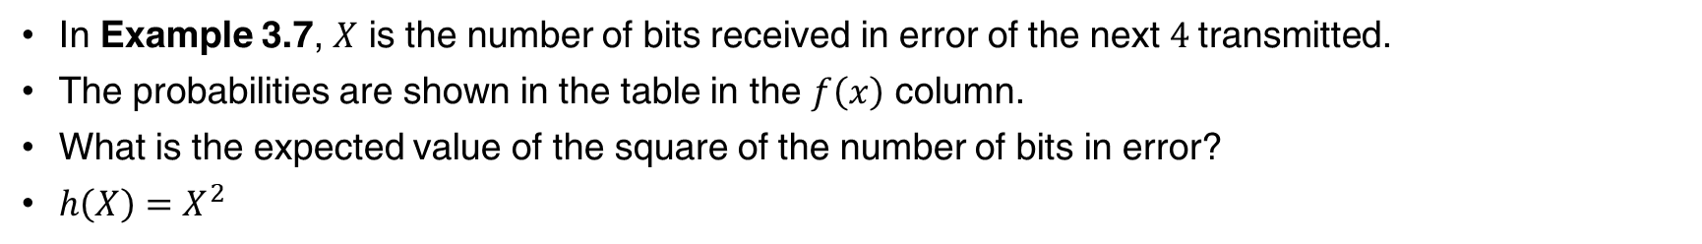
Example 3.9 | Digital Channel
In Example 3.7, $X$ is the number of bits received in error of the next$4$transmitted.
The probabilities are shown in the table in the $f\left(x\right)$ column.
What is the expected value of the square of the number of bits in error?
$h\left(X\right)=X^{2}$
Sec 3.3 Mean and Variance of a Discrete Random Variable

Slide 16
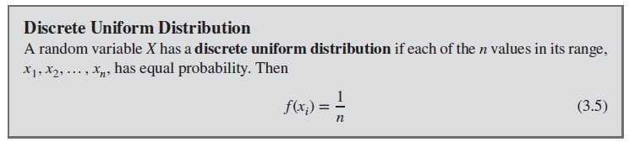
Discrete Uniform Distribution
Sec 3.4 Discrete Uniform Distribution

Slide 17
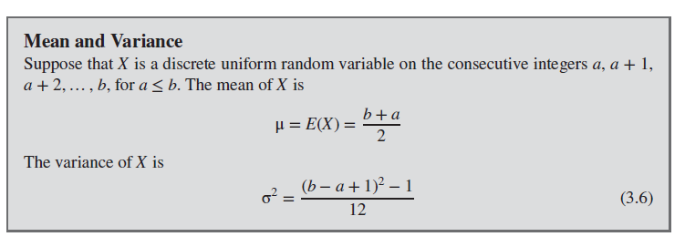
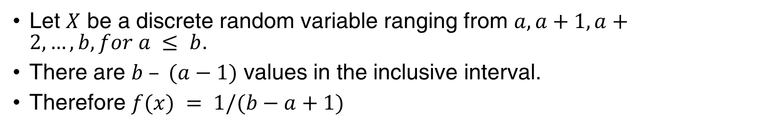
Mean and Variance of Discrete Uniform Distribution
Let $X$ be a discrete random variable ranging from $a,a+1,a+2,…,b, for a ≤ b$.
There are $b – (a−1)$ values in the inclusive interval.
Therefore $f(x) = 1/(b−a+1)$
Sec 3.4 Discrete Uniform Distribution

Slide 18

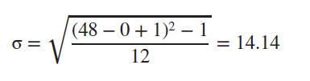
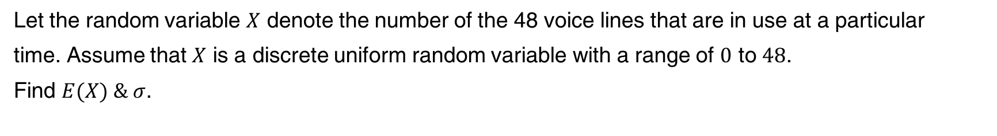
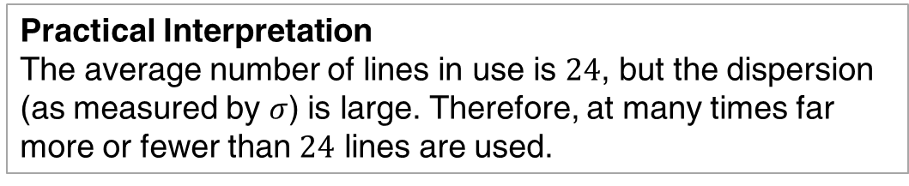
Example 3.11 | Number of Voice Lines
Let the random variable $X$ denote the number of the 48 voice lines that are in use at a particular
time. Assume that $X$ is a discrete uniform random variable with a range of $0$ to $48$.
Find $E(X) \& σ$.
Practical Interpretation
The average number of lines in use is $24$, but the dispersion (as measured by $σ$) is large. Therefore, at many times far more or fewer than $24$ lines are used.
Sec 3.4 Discrete Uniform Distribution

Slide 19
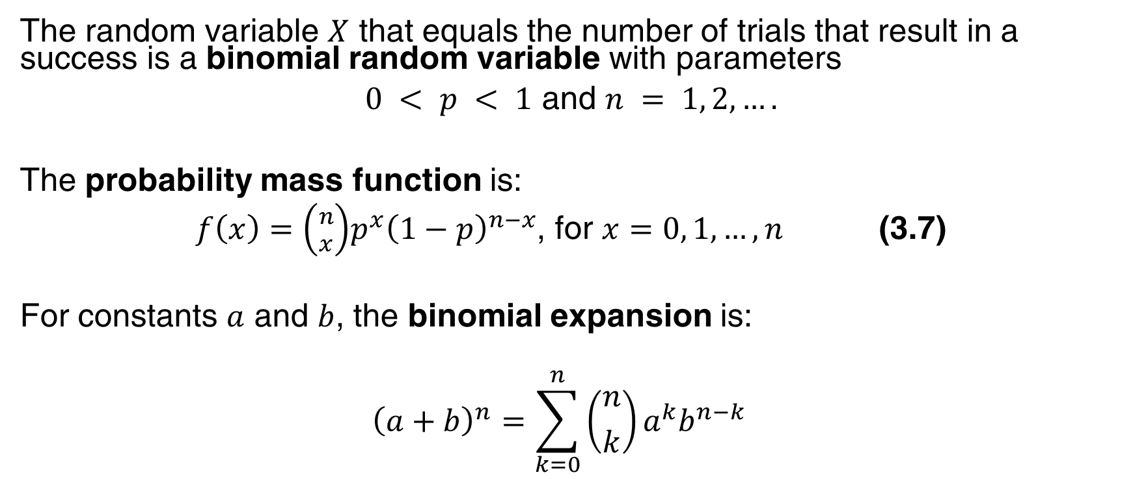
Binomial Distribution
The random variable $X$ that equals the number of trials that result in a success is a binomial random variable with parameters
$0 < p < 1$ and $n = 1, 2, ….$
The probability mass function is:
$f\left(x\right)=\left({n \atop x}\right)p^{x}{\left(1−p\right)}^{n−x}$, for $x=0, 1, …, n$ (3.7)
For constants $a$ and $b$, the binomial expansion is:
$${\left(a+b\right)}^{n}=\sum_{k=0}^{n}{\left({n \atop k}\right)a^{k}b^{n−k}}$$
Sec 3.5 Binomial Distribution

Slide 20
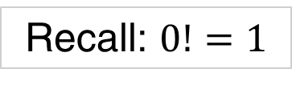
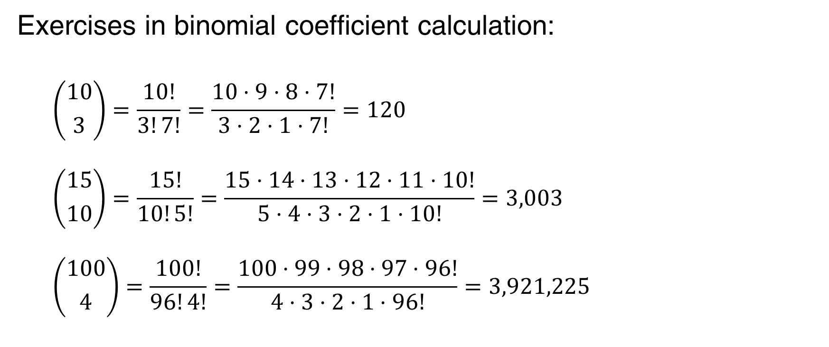
Example 3.14: Binomial Coefficient
Exercises in binomial coefficient calculation:
$$\left({10 \atop 3}\right)=\frac{10!}{3!7!}=\frac{10⋅9⋅8⋅7!}{3⋅2⋅1⋅7!}=120$$
$$\left({15 \atop 10}\right)=\frac{15!}{10!5!}=\frac{15⋅14⋅13⋅12⋅11⋅10!}{5⋅4⋅3⋅2⋅1⋅10!}=3,003$$
$$\left({100 \atop 4}\right)=\frac{100!}{96!4!}=\frac{100⋅99⋅98⋅97⋅96!}{4⋅3⋅2⋅1⋅96!}=3,921,225$$
Recall: $0!=1$
Sec 3.5 Binomial Distribution

Slide 21
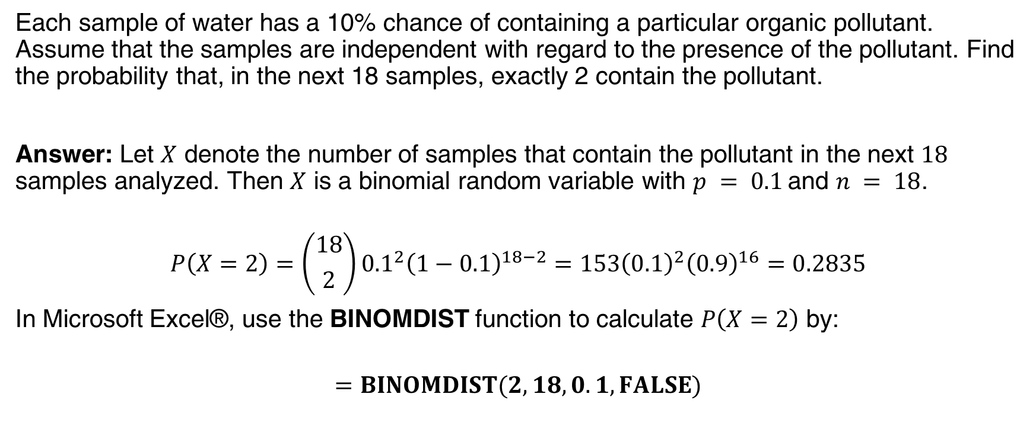
Example 3.15a: Organic Pollution
Each sample of water has a 10% chance of containing a particular organic pollutant. Assume that the samples are independent with regard to the presence of the pollutant. Find the probability that, in the next 18 samples, exactly 2 contain the pollutant.
Answer: Let $X$ denote the number of samples that contain the pollutant in the next $18$ samples analyzed. Then $X$ is a binomial random variable with $p = 0.1$and $n = 18$.
$$P\left(X=2\right)=\left({18 \atop 2}\right){0.1}^{2}{\left(1−0.1\right)}^{18−2}=153{\left(0.1\right)}^{2}{\left(0.9\right)}^{16}=0.2835$$
In Microsoft Excel®, use the BINOMDIST function to calculate $P\left(X=2\right)$ by:
$$=BINOMDIST(2,18,0.1,FALSE)$$
Sec 3.5 Binomial Distribution

Slide 22
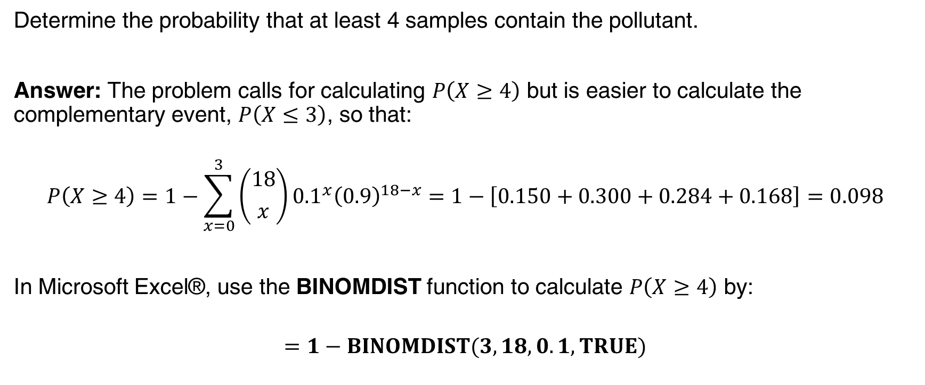
Example 3.15b: Organic Pollution
Determine the probability that at least 4 samples contain the pollutant.
Answer: The problem calls for calculating $P\left(X≥4\right)$ but is easier to calculate the complementary event, $P\left(X≤3\right)$, so that:
$$P\left(X≥4\right)=1−\sum_{x=0}^{3}{\left({18 \atop x}\right){0.1}^{x}{\left(0.9\right)}^{18−x}}=1−\left[0.150+0.300+0.284+0.168\right]=0.098$$
In Microsoft Excel®, use the BINOMDIST function to calculate $P\left(X≥4\right)$ by:
$$=1−BINOMDIST(3,18,0.1,TRUE)$$
Sec 3.5 Binomial Distribution

Slide 23
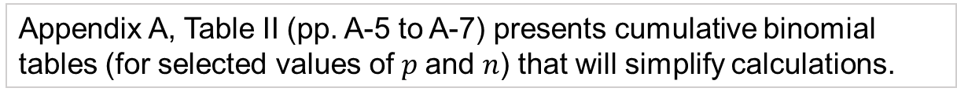
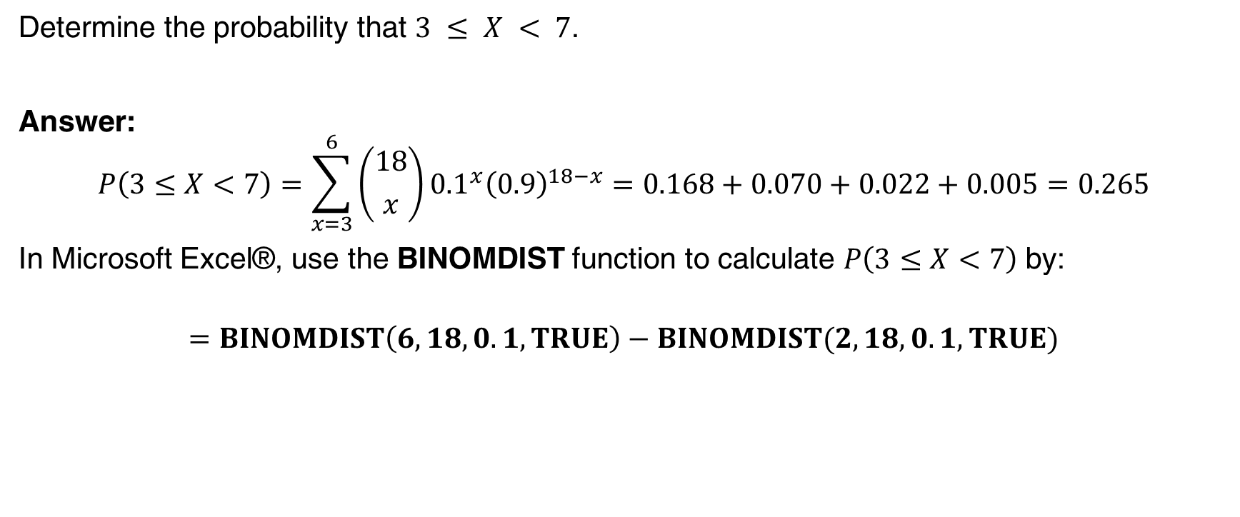
Example 3.15c: Organic Pollution
Determine the probability that $3 ≤ X < 7$.
Answer:
$$P\left(3≤X<7\right)=\sum_{x=3}^{6}{\left({18 \atop x}\right){0.1}^{x}{\left(0.9\right)}^{18−x}}=0.168+0.070+0.022+0.005=0.265$$
In Microsoft Excel®, use the BINOMDIST function to calculate $P\left(3≤X<7\right)$ by:
$$=BINOMDIST\left(6,18,0.1,TRUE\right)−BINOMDIST(2,18,0.1,TRUE)$$
Appendix A, Table II (pp. A-5 to A-7) presents cumulative binomial tables (for selected values of $p$and $n$) that will simplify calculations.
Sec 3.5 Binomial Distribution

Slide 24
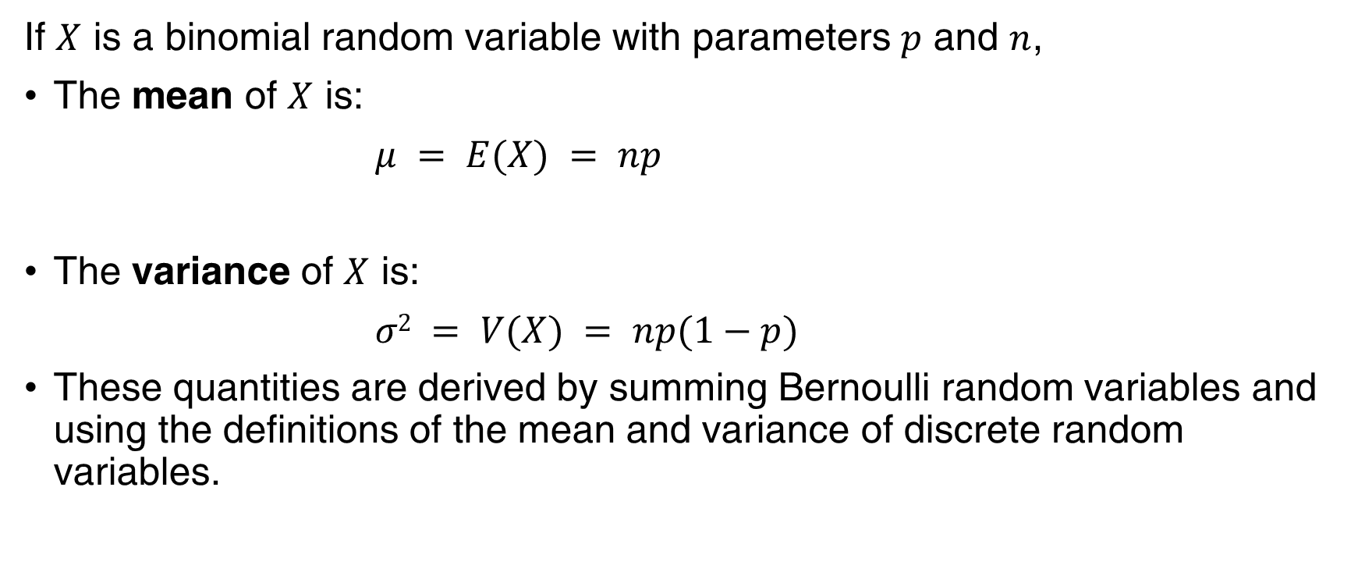
Binomial Mean and Variance
If $X$ is a binomial random variable with parameters $p$ and $n$,
The mean of $X$ is:
$μ = E(X) = np$
The variance of $X$ is:
$σ2 = V(X) = np(1−p)$
These quantities are derived by summing Bernoulli random variables and using the definitions of the mean and variance of discrete random variables.
Sec 3.5 Binomial Distribution

Slide 25
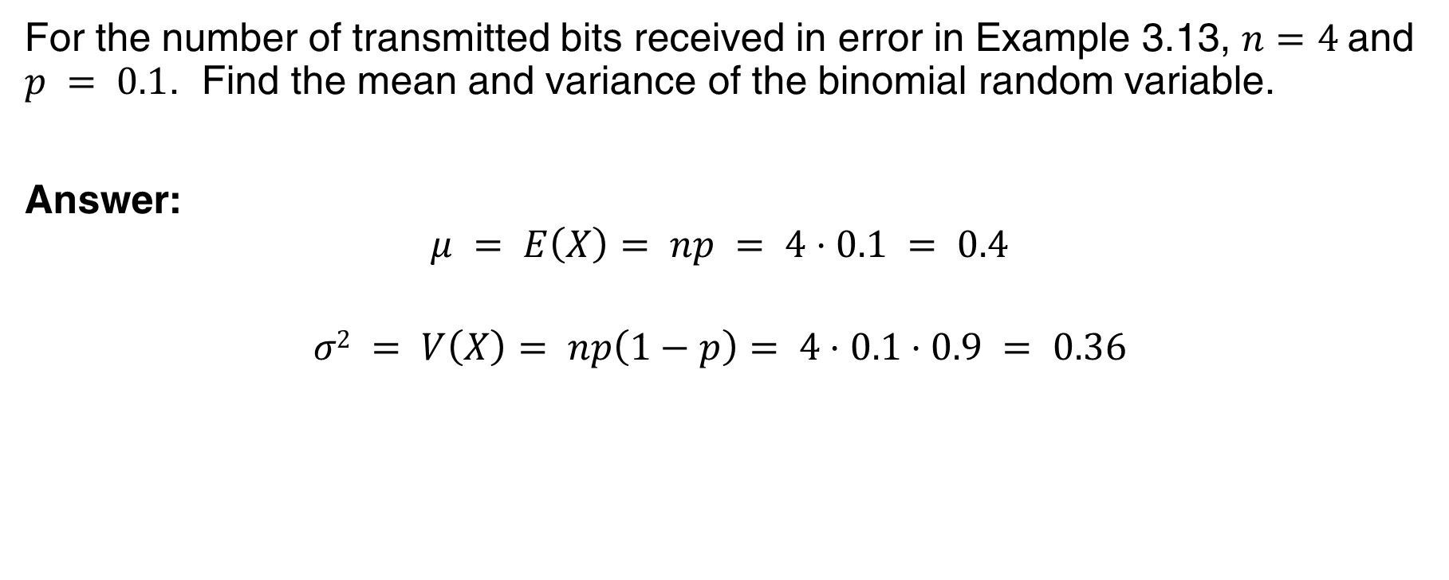
Example 3.16 | Binomial Mean and Variance
For the number of transmitted bits received in error in Example 3.13, $n=4$and $p = 0.1$. Find the mean and variance of the binomial random variable.
Answer:
$$μ = E\left(X\right)= np = 4⋅0.1 = 0.4$$
$$σ2 = V\left(X\right)= np\left(1−p\right)= 4⋅0.1⋅0.9 = 0.36$$
Sec 3.5 Binomial Distribution

Slide 26
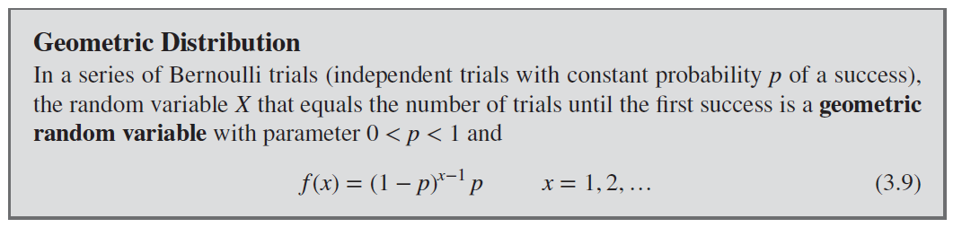
Geometric Distribution
Binomial distribution has
Fixed number of trials
Random number of successes
Geometric distribution has reversed roles
Random number of trials
Fixed number of successes, in this case 1
Sec 3.6 Geometric and Negative
Binomial Distributions

Slide 27
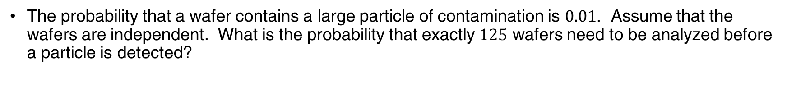
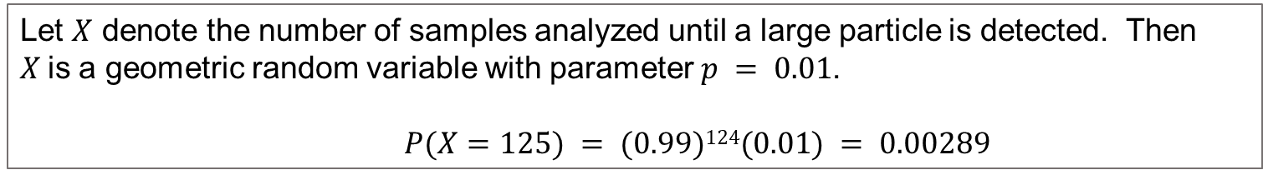
Example 3.18 | Wafer Contamination
The probability that a wafer contains a large particle of contamination is $0.01$. Assume that the wafers are independent. What is the probability that exactly $125$ wafers need to be analyzed before a particle is detected?
Let $X$ denote the number of samples analyzed until a large particle is detected. Then $X$is a geometric random variable with parameter $p = 0.01$.
$P(X=125) = (0.99)124(0.01) = 0.00289$
Sec 3.6 Geometric and Negative
Binomial Distributions

Slide 28
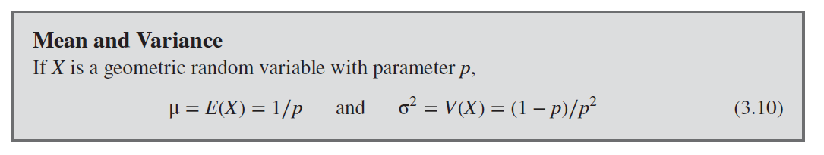
Geometric Mean and Variance
Sec 3.6 Geometric and Negative
Binomial Distributions

Slide 29
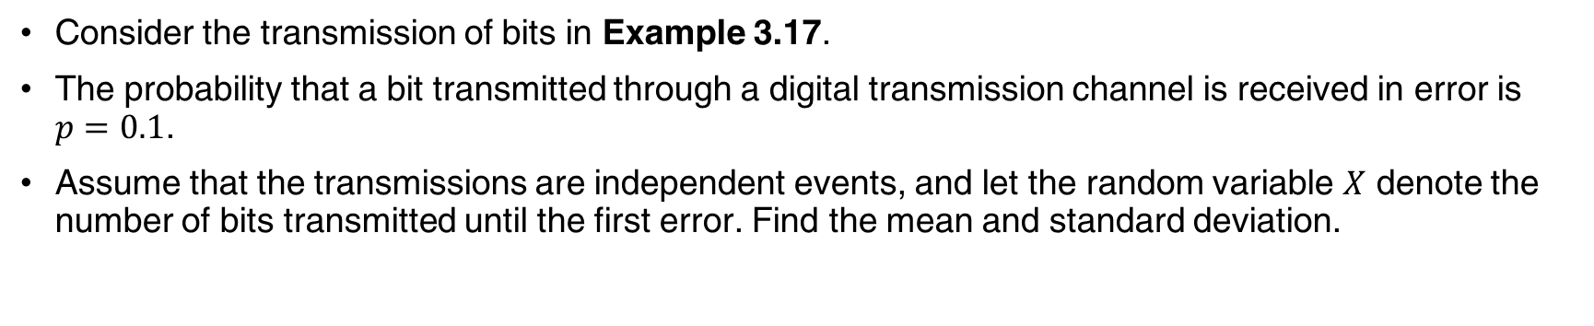
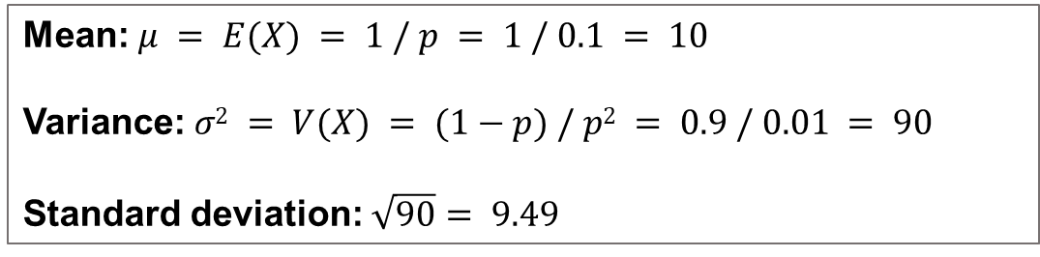
Example 3.19 | Mean and Standard Deviation
Consider the transmission of bits in Example 3.17.
The probability that a bit transmitted through a digital transmission channel is received in error is $p=0.1$.
Assume that the transmissions are independent events, and let the random variable $X$ denote the number of bits transmitted until the first error. Find the mean and standard deviation.
Mean: $μ = E(X) = 1 / p = 1 / 0.1 = 10$
Variance: $σ2 = V(X) = (1−p) / p2 = 0.9 / 0.01 = 90$
Standard deviation: $\sqrt{90}= 9.49$
Sec 3.6 Geometric and Negative
Binomial Distributions

Slide 30
Lack of Memory Property
For a geometric random variable, the trials are independent
Count of the number of trials until the next success can be started at any trial without changing the probability distribution of the random variable.
Implication: the system presumably will not wear out.
For all transmissions the probability of an error remains constant.
Hence, the geometric distribution is said to lack any memory.
Sec 3.6 Geometric and Negative
Binomial Distributions

Slide 31
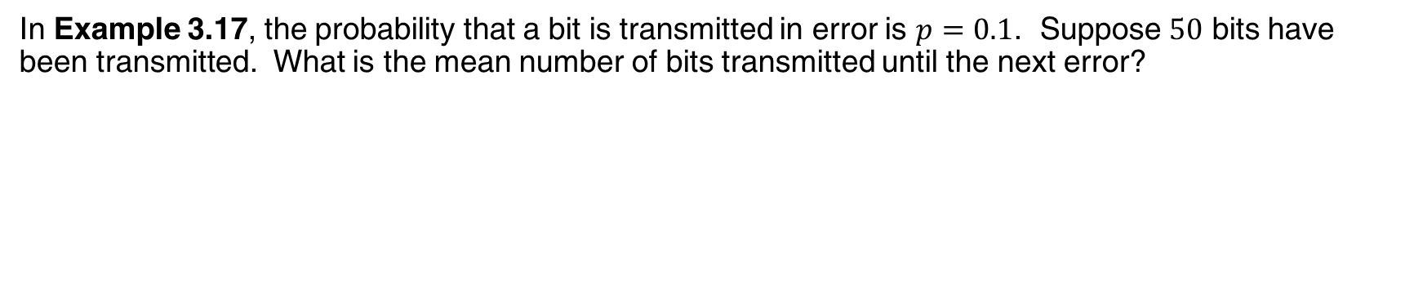
Example 3.20 | Lack of Memory Property
In Example 3.17, the probability that a bit is transmitted in error is $p=0.1$. Suppose $50$ bits have been transmitted. What is the mean number of bits transmitted until the next error?
The mean number of bits transmitted until the next error, after $50$ bits have already been transmitted, is $1/0.1 = 10$, the same result as the mean number of bits until the first error.
Sec 3.6 Geometric and Negative
Binomial Distributions

Slide 32
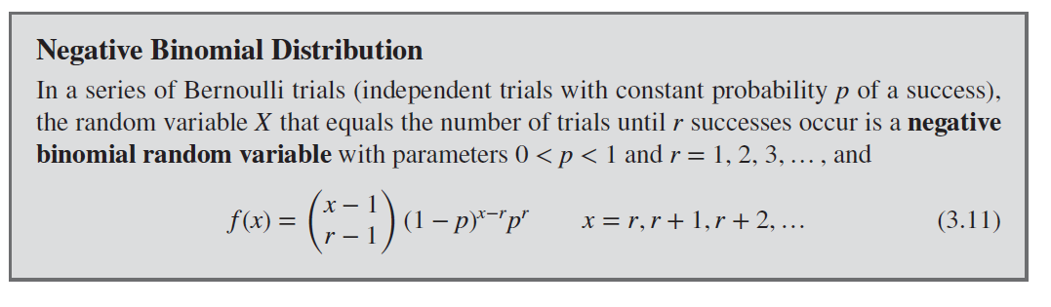
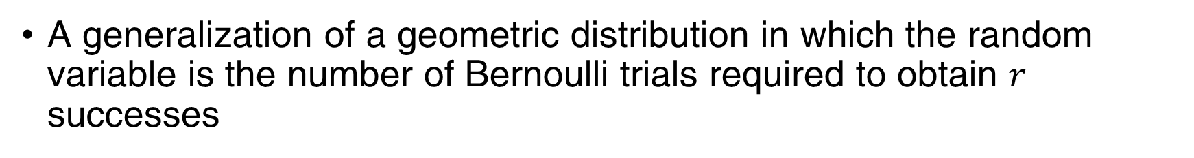
Negative Binomial Distribution
A generalization of a geometric distribution in which the random variable is the number of Bernoulli trials required to obtain $r$ successes
Sec 3.6 Geometric and Negative
Binomial Distributions

Slide 33
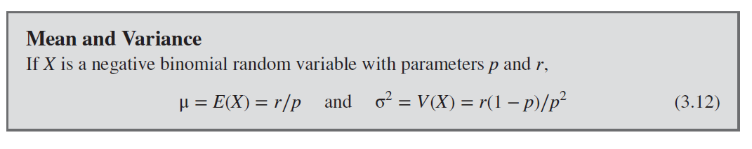
Mean & Variance of Negative Binomial
Sec 3.6 Geometric and Negative
Binomial Distributions

Slide 34
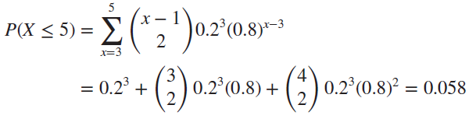


Example 3.22 | Camera Flashes
The probability that a camera passes a particular test is $0.8$, and the cameras perform independently.
What is the probability that the third failure is obtained in five or fewer tests?
Let $X$ denote the number of cameras tested until three failures have been obtained. The requested probability is $P(X ≤ 5)$. Here $X$ has a negative binomial distribution with $p = 0.2$ and $r = 3$. Therefore,
Sec 3.6 Geometric and Negative
Binomial Distributions

Slide 35

Hypergeometric Distribution
Samples are selected from a finite population without replacement
Sec 3.7 Hypergeometric Distribution

Slide 36



Example 3.23 | Sampling without replacement
A day’s production of 850 manufactured parts contains 50 parts that do not conform to customer requirements
Two parts are selected at random without replacement from the day’s production.
Let A and B denote the events that the first and second parts are nonconforming, respectively.
What is the probability that both parts conform, one part does not conform, and both parts do not conform?
Let $X$ denote the number of parts that
do not conform. Therefore,
Sec 3.7 Hypergeometric Distribution

Slide 37

Example 3.24a | Parts from Suppliers
A batch of parts contains 100 parts from a local supplier of circuit boards and 200 parts from a supplier in the next state.
If 4 parts are selected randomly, without replacement, what is the probability that they are all from the local supplier?
Sec 3.7 Hypergeometric Distribution

Slide 38

Example 3.24b | Parts from Suppliers
What is the probability that two or more parts in the sample are from the local supplier?
Sec 3.7 Hypergeometric Distribution

Slide 39

Example 3.24c | Parts from Suppliers
What is the probability that at least one part in the sample is from the local supplier?
Sec 3.7 Hypergeometric Distribution

Slide 40

Hypergeometric Mean & Variance
Sec 3.7 Hypergeometric Distribution

Slide 41

Poisson Distribution
Sec 3.8 Poisson Distribution

Slide 42




Example 3.27a | Wire Flaws
Flaws occur at random along the length of a thin copper wire.
Let $X$denote the random variable that counts the number of flaws in a length of $T mm$of wire and suppose that the average number of flaws is $2.3 per mm$.
Find the probability of exactly $10 flaws in 5 mm$of wire.
Let $X$ denote the number of flaws in 5 mm of wire. Then $X$ has the Poisson distribution with
Therefore,
Sec 3.8 Poisson Distribution

Slide 43




Example 3.27b | Wire Flaws
Find the probability of at least $1 flaw in 2 mm$of wire.
Let $X$ denote the number of flaws in 2 mm of wire. Then $X$ has the Poisson distribution with
Therefore,
Sec 3.8 Poisson Distribution

Slide 44


Poisson Mean & Variance
The mean and variance of the Poisson model are the same.
For example, if particle counts follow a Poisson distribution with a mean of $25$ particles per square centimeter, the variance is also $25$ and the standard deviation of the counts is $5$ per square centimeter.
If the variance of a data is much greater than the mean, then the Poisson distribution would not be a good model for the distribution of the random variable.
Sec 3.8 Poisson Distribution

Slide 45

Important Terms & Concepts of Chapter 3
Chapter 3 Important Terms and Concepts

