Slide 1
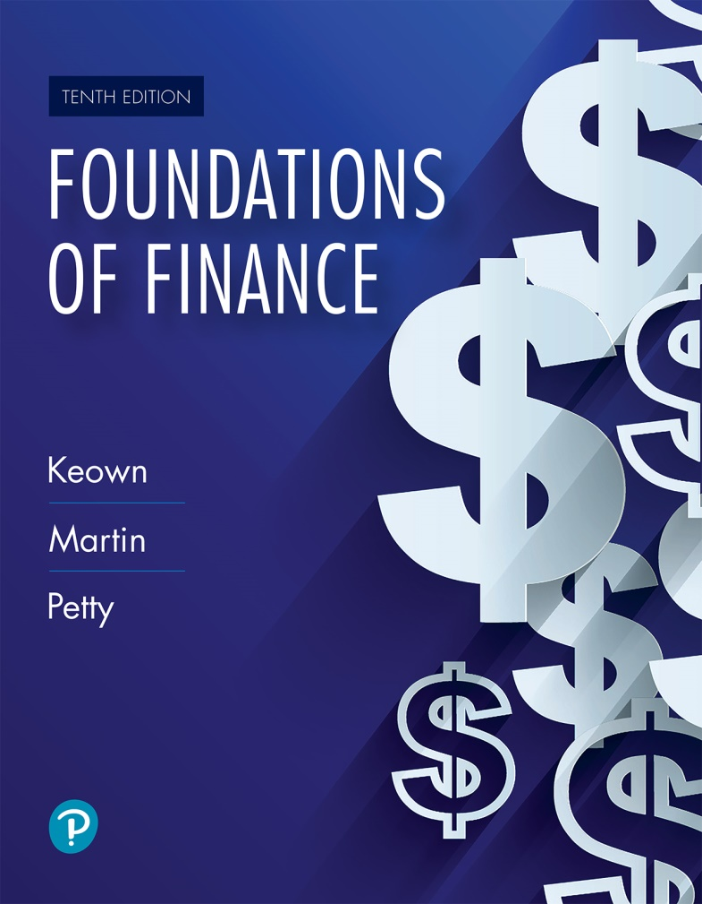
Foundations of Finance
Tenth Edition
Chapter 8
The Valuation and Characteristics of Stock
Copyright © 2020, 2017, 2014 Pearson Education, Inc. All Rights Reserved
Notes:
If this PowerPoint presentation contains mathematical equations, you may need to check that your computer has the following installed:
1) Math Type Plugin
2) Math Player (free versions available)
3) NVDA Reader (free versions available)

Slide 2
Learning Objectives
8.1 Identify the basic characteristics of preferred stock.
8.2 Value preferred stock.
8.3 Identify the basic characteristics of common stock.
8.4 Value common stock.
8.5 Calculate a stock’s expected rate of return.

Slide 3
Preferred Stock

Slide 4
Preferred Stock (1 of 1)
Preferred stock is often referred to as a hybrid security because it has many characteristics of both common stock and bonds.

Slide 5
Hybrid Nature of Preferred Stocks
Like common stocks, preferred stocks
Have no fixed maturity date
Failure to pay dividends does not lead to bankruptcy
Dividends are not a tax-deductible expense
Like Bonds
Dividends are fixed in amount (either as a dollar amount or as a percentage of par value)

Slide 6
The Characteristics of Preferred Stocks
Multiple series of preferred stock
Preferred stock’s claim on assets and income
Cumulative dividends
Protective provisions
Convertibility
Retirement provisions

Slide 7
Multiple Series
If a company desires, it can issue more than one series of preferred stock, and each series can have different characteristics (such as different protective provisions and convertibility rights)

Slide 8
Claim on Assets and Income
Claim on Assets: Preferred stock has priority over common stock with regard to claim on assets in the case of bankruptcy.
Preferred stockholders claims are honored before common stockholders, but after bonds.
Claim on Income: Preferred stock also has priority over common stock with regard to dividend payments.
Thus preferred stocks are safer than common stocks but riskier than bonds.

Slide 9
Cumulative Dividends
Cumulative feature (if it exists) requires that all past, unpaid preferred stock dividends be paid before any common stock dividends are declared.

Slide 10
Protective Provisions
Protective provisions generally allow for voting rights in the event of nonpayment of dividends, or they restrict the payment of common stock dividends if sinking-funds payments are not met or if the firm is in financial difficulty.
These protective provisions reduce the risk and consequently, expected return.

Slide 11
Convertibility
Convertible preferred stock can, at the discretion of the holder, be converted into a predetermined number of shares of common stock.
Almost one-third of preferred stock issued today is convertible preferred.

Slide 12
Retirement Provisions
Although preferred stock has no set maturity associated with it, issuing firms generally provide for some method of retiring the stock, such as a call provision or sinking fund provision.
Call provision entitles the corporation to repurchase its preferred stock at stated prices over a given time period.
Sinking fund provision requires the firm to set aside an amount of money for the retirement of its preferred stock.

Slide 13
Valuing Preferred Stock

Slide 14
Valuing Preferred Stock (1 of 2)
The economic or intrinsic value of a preferred stock is equal to the present value of all future dividends.
Value of preferred stock:
= Annual dividend/required rate of return

Slide 15
Valuing Preferred Stock (2 of 2)
Example: Assume Morgan Stanley’s preferred stock pays an annual dividend of $1.72 and the investors required rate of return is 6.2 percent.

Slide 16
Common Stock

Slide 17
Common Stock
Common stock is a certificate that indicates ownership in a corporation. When you buy a share, you buy a “part/share” of the company and attain ownership rights in proportion to your “share” of the company.
Common stockholders are the true owners of the firm. Bondholders and preferred stockholders can be viewed as creditors.

Slide 18

Figure 8.1 Sample Stock

Slide 19
Claim on Income
Common shareholders have the right to residual income after bondholders and preferred stockholders have been paid.
Residual income can be paid in the form of dividends or retained within the firm and reinvested in the business.
Claim on residual income implies there is no upper limit on income, but it also means that, on the downside, shareholders are not guaranteed anything and may have to settle for zero income in some years.

Slide 20
Claim on Assets
Common stock has a residual claim on assets in the case of liquidation.
Residual claim implies that the claims of debtholders and preferred stockholders have to be met prior to common stockholders.
Generally, if bankruptcy occurs, claims of the common shareholders are typically not satisfied.

Slide 21
Limited Liability
The liability of shareholders is limited to the amount of their investment.
The limited liability helps the firm in raising funds.

Slide 22
Voting Rights (1 of 2)
Most often, common stockholders are the only security holders with a vote.
Majority of shareholders generally vote by proxy. Proxy fights are battles between rival groups for proxy votes.
Common shareholders are entitled to
Elect the board of directors
Approve any change in the corporate charter

Slide 23
Voting Rights (2 of 2)
Voting for directors and charter changes occur at the corporation’s annual meeting.
With majority voting—each share of stock allows the shareholder one vote. Each position on the board is voted on separately.
With cumulative voting—each share of stock allows the stockholder a number of votes equal to the number of directors being elected.

Slide 24
Voting for Board of Directors
In the real world, shareholders do not really pick the board; rather, they simply select from a list of nominees chosen by the management.
This opens the door for management-favored boards, which may not always be in the best interest of shareholders.

Slide 25
Preemptive Rights
Preemptive rights entitle the common shareholder to maintain a proportionate share of ownership in the firm.
Thus, if a shareholder currently owns 25 percent of the shares, s/he has the right to purchase 25 percent of the shares when new shares are issued.
These rights are issued in the form of certificates that give shareholders the option to buy new shares at a specific price during a 2- to 10- week period. These rights can be exercised, sold in the open market, or allowed to expire.

Slide 26
Valuing Common Stock

Slide 27
Valuing Common Stock
Like bonds and preferred stock, the value of common stock is equal to the present value of all future expected cash flows (i.e., dividends).
However, dividends are neither fixed nor guaranteed, which makes it harder to value common stocks compared to bonds and preferred stocks.

Slide 28
Dividend Model
Unlike preferred stock, common stock dividend is not fixed.
Dividend pattern varies among firms, but dividends generally tend to increase with the growth in corporate earnings.

Slide 29
How Can a Company Grow?
Through infusion of capital by borrowing or issuing new common stock
Through internal growth by management retaining some or all of the firm’s profits for reinvestment in the firm, resulting in future earnings growth and value of stock
Internal growth directly affects the existing stockholders and is the only growth factor used for valuation purposes.

Slide 30
Internal Growth
where:
g = the growth rate of future earnings and the growth in the common stockholders’ investment in the firm
ROE = the return on equity (net income/common book value)
pr = % of profits retained (profit retention rate)

Slide 31
Dividend Valuation Model
Value of common stock = PV of future dividends

Slide 32
Dividend Valuation Model Example (1 of 2)
Consider the valuation of a common stock that paid $2 dividend at the end of the last year and is expected to pay a cash dividend in the future. Dividends are expected to grow at 4 percent and the investors required rate of return is 14 percent.

Slide 33
Dividend Valuation Model Example (2 of 2)
The dividend last year was $2. Compute the new dividend (D₁) by:
2.

Slide 34
The Expected Rate of Return of Stockholders

Slide 35
The Expected Rate of Return of Preferred Stockholders
The expected rate of return on a security is the required rate of return of investors who are willing to pay the market price for the security.
Example: If the current market price of preferred stock is $50, and the stock pays $3.64 dividend, the expected rate of return is

Slide 36
Expected Rate of Return of Common Stockholders (1 of 2)
Example: The current market price of Pearson, Inc. stock is $45 and the stock pays dividend of $2 with a growth rate of 6 percent. If your required rate of return is 12 percent, should you buy the stock?

Slide 37
Expected Rate of Return of Common Stockholders (2 of 2)
You should not buy the stock because the expected rate of return (10.44 percent) is less than your required rate of return (12 percent).
Historically, most of the returns on stocks has come from price appreciation or capital gains.
The S & P 500 Index has returned an average annual return of 10 percent since 1926, with dividend yield accounting for only about 2 percent to 3 percent of the return.

Slide 38
Key Terms (1 of 3)
Call provision
Common stock
Convertible preferred stock
Cumulative feature
Cumulative voting
Dividend-payout ratio

Slide 39
Key Terms (2 of 3)
Expected rate of return
Internal growth
Limited liability
Majority voting
Preemptive right
Preferred stock

Slide 40
Key Terms (3 of 3)
Profit-retention rate
Protective provisions
Proxy
Proxy fight
Right
Sinking fund provision

Slide 41

Copyright
This work is protected by United States copyright laws and is provided solely for the use of instructors in teaching their courses and assessing student learning. Dissemination or sale of any part of this work (including on the World Wide Web) will destroy the integrity of the work and is not permitted. The work and materials from it should never be made available to students except by instructors using the accompanying text in their classes. All recipients of this work are expected to abide by these restrictions and to honor the intended pedagogical purposes and the needs of other instructors who rely on these materials.

