Slide 1
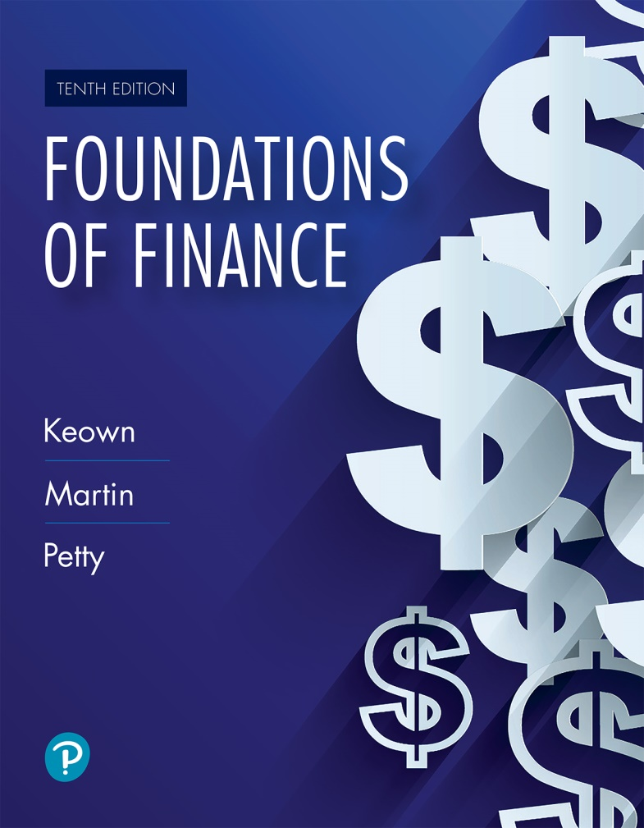
Foundations of Finance
Tenth Edition
Chapter 1
An Introduction to the Foundations of Financial Management
Copyright © 2020, 2017, 2014 Pearson Education, Inc. All Rights Reserved
Notes:
If this PowerPoint presentation contains mathematical equations, you may need to check that your computer has the following installed:
1) Math Type Plugin
2) Math Player (free versions available)
3) NVDA Reader (free versions available)

Slide 2
Learning Objectives
1.1 Identify the goal of the firm.
1.2 Understand the basic principles of finance, their importance, and the importance of ethics and trust.
1.3 Describe the role of finance in business.
1.4 Distinguish among the different legal forms of business organization.
1.5 Explain what has led to the era of the multinational corporation.
1.6 Describe how this course and the skills you will develop in it will help you in your career and in your life.

Slide 3
The Goal of the Firm

Slide 4
The Goal of the Firm
The goal of the firm is to create value for the firm’s owners (that is, its shareholders). Thus the goal of the firm is to “maximize shareholder wealth” by maximizing the price of the existing common stock.
Good financial decisions will increase stock price, and poor financial decisions will lead to a decline in stock price.

Slide 5
Five Principles That Form the Foundations of Finance

Slide 6
Principle 1: Cash Flow Is What Matters
Accounting profits are not equal to cash flows. It is possible for a firm to generate accounting profits but not have cash or to generate cash flows and not report accounting profits in the books.
Cash flow, and not profits, drive the value of a business.
We must determine incremental or marginal cash flows when making financial decisions.
  Incremental cash flow is the difference between the projected cash flows if the project is selected versus what they will be if the project is not selected.

Slide 7
Principle 2: Money Has a Time Value (1 of 2)
A dollar received today is worth more than a dollar received in the future.
  Because we can earn interest on money received today, it is better to receive money sooner rather than later.

Slide 8
Principle 2: Money Has a Time Value (2 of 2)
Opportunity Cost – It is the cost of making a choice in terms of next best alternative that must be forgone.
  Example: By lending money to your friend at zero percent interest, there is an opportunity cost of 1% that could potentially be earned by depositing the money in a savings account in a bank.

Slide 9
Principle 3: Risk Requires a Reward
Investors will not take on additional risk unless they expect to be compensated with additional reward or return.
Investors expect to be compensated for “delaying consumption’’ and “taking on risk.’’
  Thus, investors expect a return when they deposit their savings in a bank (e.g., delayed consumption), and they expect to earn a relatively higher rate of return on stocks compared to a bank savings account (e.g., taking on risk).

Slide 10
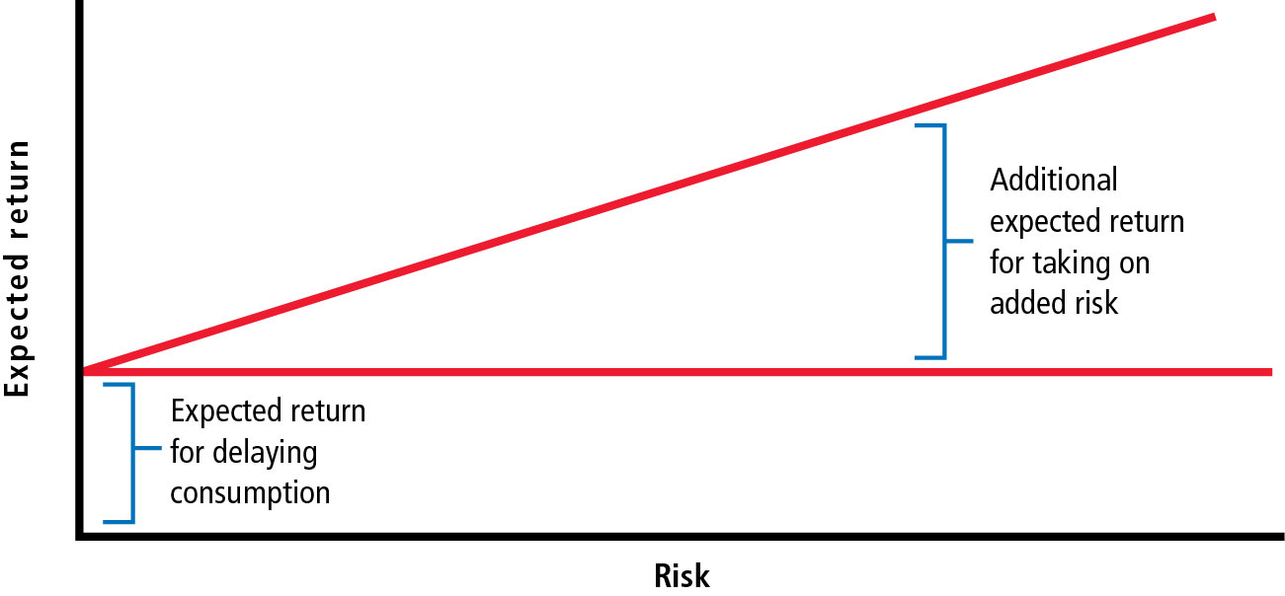
Figure 1.1 The Risk-Return Trade-off

Slide 11
Principle 4: Market Prices Are Generally Right
In an efficient market, the market prices of all traded assets (such as stocks and bonds) fully reflect all available information at any moment in time.
Thus stock prices are a useful indicator of the value of the firm. Price changes reflect changes in expected future cash flows. Good decisions will tend to increase in stock price and vice versa.
Note there are inefficiencies in the market that may distort the market prices from value of assets. Such inefficiencies are often caused by behavioral biases.

Slide 12
Principle 5: Conflicts of Interest Cause Agency Problems
The separation of management and the ownership of the firm creates an agency problem. Managers may make decisions that are not consistent with the goal of maximizing shareholder wealth.
  Agency conflict is reduced through monitoring (e.g., annual reports), compensation schemes (e.g., stock options), and market mechanisms (e.g., takeovers).

Slide 13
Ethics and Trust in Business
Ethical behavior is doing the right thing! But what is the right thing?
Ethical dilemma—Each person has his or her own set of values, which forms the basis for personal judgments about what is the right thing.
Sound ethical standards are important for business and personal success. Unethical decisions can destroy shareholder wealth (e.g., Enron scandal).

Slide 14
The Role of Finance in Business

Slide 15
The Role of Finance in Business (1 of 2)
Three basic issues are addressed by the study of finance:
  What long-term investments should the firm undertake? (Capital budgeting decision)
  How should the firm raise money to fund these investments? (Capital structure decision)
  How should cash flows arising from day-to-day operations be managed? (Working capital decision)

Slide 16
The Role of Finance in Business (2 of 2)
Knowledge of financial tools is relevant for decision making in all areas of business (be it marketing, production, etc.) and also in managing personal finances.
Decisions involve an element of time and uncertainty; financial tools help adjust for time and risk.
Decisions taken in business should be financially viable; financial tools help determine the financial viability of decisions.

Slide 17
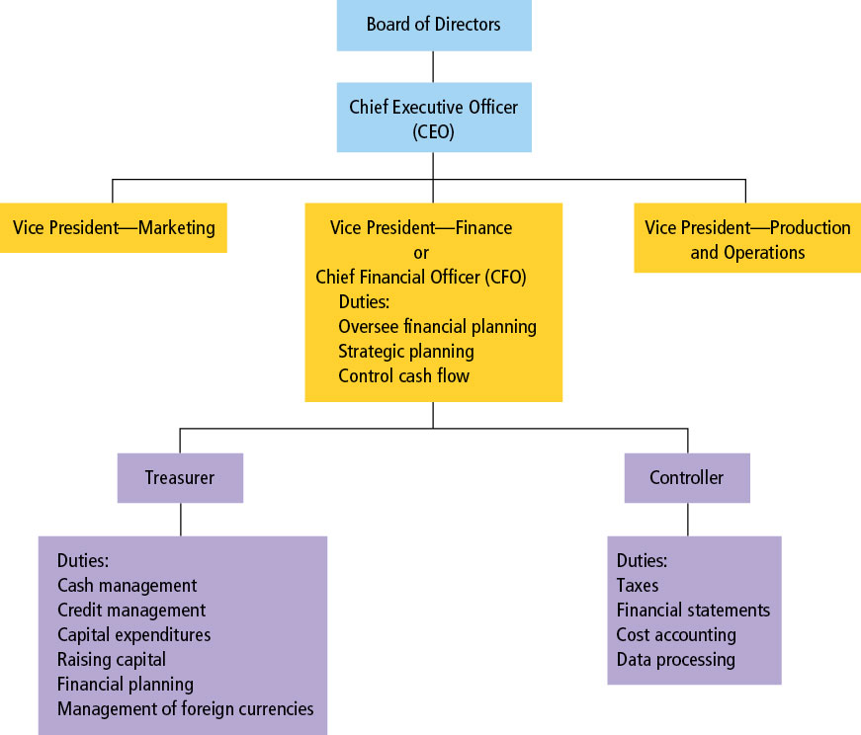
Figure 1.2 How the Finance Area Fits into a Firm

Slide 18
The Legal Forms of Business Organization (1 of 2)

Slide 19
The Legal Forms of Business Organization (2 of 2)
Business Forms
  Sole Proprietorship
  Partnership
  Corporation
  Hybrid
    S-Type
    LLC

Slide 20
Sole Proprietorship
Business owned by an individual
Owner maintains title to assets and profits
Unlimited liability
Termination occurs on owner’s death or by the owner’s choice

Slide 21
Partnership
Two or more persons come together as co-owners.
General Partnership: All partners are fully responsible for liabilities incurred by the partnership.
Limited Partnerships: One or more partners can have limited liability, restricted to the amount of capital invested in the partnership. There must be at least one general partner with unlimited liability. Limited partners cannot participate in the management of the business, and their names cannot appear in the name of the firm.

Slide 22
Corporation
Functions legally as a separate entity and apart from its owners.
  Corporation can sue, be sued, purchase, sell, and own property.
Owners (shareholders) dictate direction and policies of the corporation, oftentimes through elected board of directors.
Shareholder’s liability is restricted to amount of investment in company.
Life of corporation does not depend on the owners; corporation continues to be run by managers after transfer of ownership through sale or inheritance.

Slide 23
The Trade-Offs: Corporate Form
Benefits: Limited liability, easy to transfer ownership, easier to raise capital, unlimited life (unless the firm goes through corporate restructuring such as mergers and bankruptcies)
Drawbacks: No secrecy of information, maybe delays in decision making, greater regulation, double taxation

Slide 24
Double Taxation Example (1 of 2)
Assume earnings before tax = $1,000
  Federal tax @ 25% = $250
  After-tax income available for distribution to shareholders = $750
Compute the taxes if the company chooses to distribute the entire after-tax profits to shareholders as dividends.

Slide 25
Double Taxation Example (2 of 2)
If corporation distributes profits as dividends to shareholders, shareholders will be taxed again.
Assuming dividends are taxed @ 15%
  Dividend tax = 15% of $750 = $112.50
==>

Slide 26
S-Corporations and Limited Liability Companies (LLCs) (1 of 2)
S-Type Corporations
  Benefits
    Limited liability
    Taxed as partnership (no double taxation like corporations)
  Limitations
    Owners must be people so cannot be used for a joint ventures between two corporations

Slide 27
S-Corporations and Limited Liability Companies (LLCs) (2 of 2)
Limited Liability Companies (LLC)
  Benefits
    Limited liability
    Taxed like a partnership
  Limitations
    Qualifications vary from state to state
    Cannot appear like a corporation otherwise it will be taxed like one

Slide 28
Table 1.1 The Different Business Organizational Forms (1 of 2)
Blank | Number of Owners | Liability for Firm's Debts | Change in Ownership Dissolves the Firm | Taxation
Sole Proprietorship | One | Yes | Yes | Personal/Pass-Through
Types of Partnerships | Blank | Blank | Blank | Blank
1. General Partnerships | No Limit | Each partner is liable for the entire amount | Yes | Personal/Pass-Through
2. Limited Partnerships | At least one general partner (GP), no limit on limited partners (LP) | GP - Yes, LP - No | GP - Yes, LP - No | Personal/Pass-Through

Slide 29
Table 1.1 The Different Business Organizational Forms (2 of 2)
Blank | Number of Owners | Liability for Firm's Debts | Change in Ownership Dissolves the Firm | Taxation
Types of Corporations | Blank | Blank | Blank | Blank
1. Corporation | No Limit | No | No | Both corporate and personal taxes
2. S-corporation | Maximum of 100 | No | No | Personal/Pass-Through
3. Limited Liability Company | No Limit | No | No | Personal/Pass-Through

Slide 30
Finance and the Multinational Firm: The New Role

Slide 31
Finance and the Multinational Firm: The New Role
Coca-Cola, among other companies, receives significant profits from overseas sales.
U.S. firms are looking to international expansion to discover profits.
In addition to U.S. firms going abroad, we have also witnessed many foreign firms making their mark in the United States. For example, auto industry dominated by Toyota, Honda, Nissan, and BMW.

Slide 32
Developing Skills for Your Career
Finance is a skill needed regardless of career choice. In this class, you will learn:
  Critical thinking skills
  Excel skills
  Data analysis skills
  Collaboration and communication skills

Slide 33
Key Terms (1 of 2)
Agency problem
Capital budgeting
Capital structure decisions
Corporation
Efficient market
Financial markets
General partnership
Incremental cash flow

Slide 34
Key Terms (2 of 2)
Limited Liability Company (LLC)
Limited partnership
Partnership
Opportunity cost
S-corporation
Sole proprietorship
Working capital management

Slide 35

Copyright
This work is protected by United States copyright laws and is provided solely for the use of instructors in teaching their courses and assessing student learning. Dissemination or sale of any part of this work (including on the World Wide Web) will destroy the integrity of the work and is not permitted. The work and materials from it should never be made available to students except by instructors using the accompanying text in their classes. All recipients of this work are expected to abide by these restrictions and to honor the intended pedagogical purposes and the needs of other instructors who rely on these materials.

