Slide 1
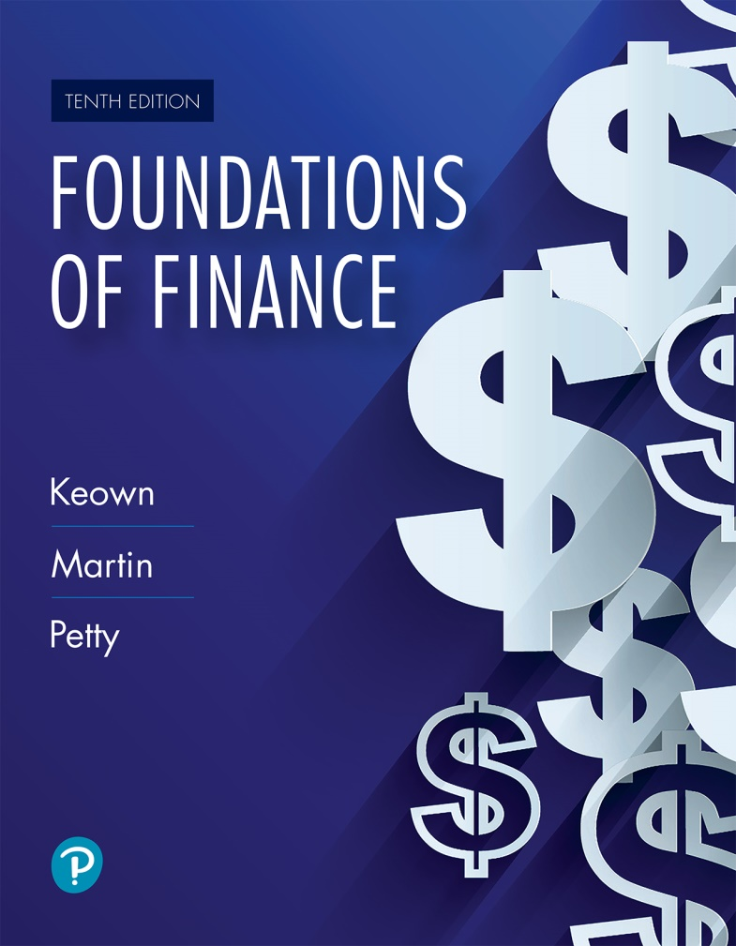
Foundations of Finance
Tenth Edition
Chapter 2
The Financial Markets and Interest Rates
Copyright © 2020, 2017, 2014 Pearson Education, Inc. All Rights Reserved
Notes:
If this PowerPoint presentation contains mathematical equations, you may need to check that your computer has the following installed:
1) Math Type Plugin
2) Math Player (free versions available)
3) NVDA Reader (free versions available)

Slide 2
Learning Objectives
2.1 Describe key components of the U.S. financial market system and the financing of business.
2.2 Understand how funds are raised in the capital markets.
2.3 Be acquainted with recent rates of return.
2.4 Explain the fundamentals of interest rate determination and the popular theories of the term structure of interest rates.

Slide 3
Financing of Business: The Movement of Funds Through the Economy

Slide 4
Financial Markets: Transfer of Capital
Financial markets play a critical role in capitalist economies. Financial markets help facilitate the transfer of funds from “saving surplus” units to “saving deficit” units, i.e., transfer money from those who have the money to those who need it.
See Figure 2.1 for three ways to transfer capital in the economy:
  Direct transfer
  Indirect transfer using the investment banker
  Indirect transfer using the financial intermediary

Slide 5
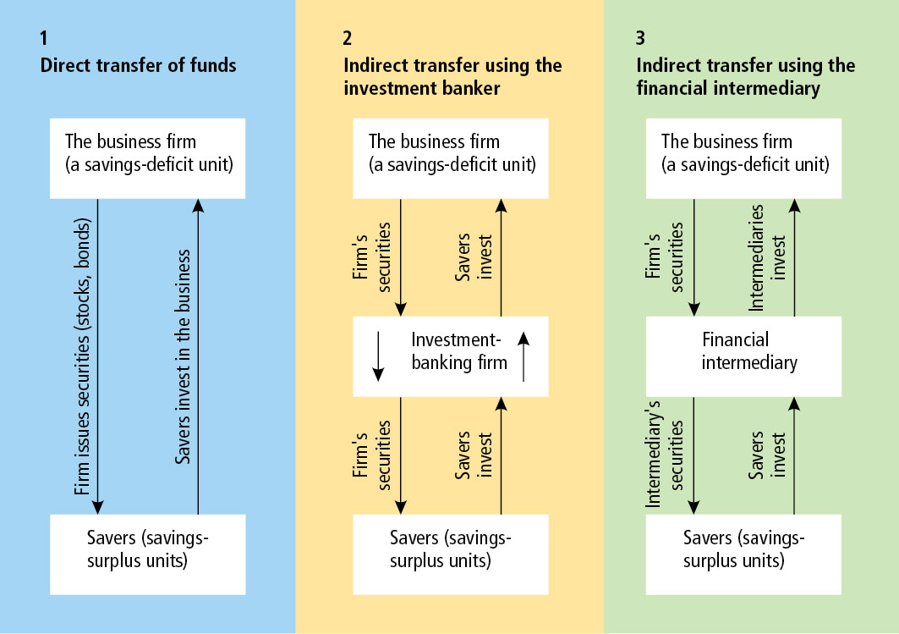
Figure 2.1 Three Ways to Transfer Capital in the Economy

Slide 6
Direct Transfer
Direct Transfer
  Firm seeking funds directly approaches a wealthy investor.
    For example, a new business venture seeking funding from venture capitalist.

Slide 7
Role of Venture Capitalist
Venture capitalist are the prime source of funding for start-up companies and companies in “turnaround” situations. Funding such ventures is very risky but carries the potential for high returns.
The borrowing firm may not have the option of pursuing public offering due to small size, no record of profits, and uncertain future growth prospects.

Slide 8
Indirect Transfer (1 of 2)
Indirect Transfer (using investment banks)
  Here the investment bank acts as a link between the firm (needing funds) and the investors (with surplus funds)

Slide 9
Indirect Transfer (2 of 2)
Indirect Transfer (using financial intermediary)
  Here the financial intermediary (such as mutual funds) collects funds from savers in exchange for its own securities (indirect). The collected funds are then used to acquire securities (such as stocks and bonds) from the firm.

Slide 10
Public Offerings versus Private Placements
Public Offering
  Both individuals and institutional investors have the opportunity to purchase securities. The securities are initially sold by the managing investment bank firm. The issuing firm never actually meets the ultimate purchaser of securities.
Private or Direct Placement
  The securities are offered and sold directly to a limited number of investors.

Slide 11
Primary Markets versus Secondary Markets (1 of 2)
Primary Market (initial issue)
  This is the market in which new issues of a securities are sold to initial buyers. This is the only time the issuing firm ever gets any money for the securities. For example, Google raised $1.76 billion through public sale of shares in August 2004.
Seasoned Equity Offering (SEO)
  It refers to sale of additional shares by a company with shares that are already publicly traded. For example, Google raised $4.18 billion in September 2005.

Slide 12
Primary Markets versus Secondary Markets (2 of 2)
Secondary Market (subsequent trading)
  This is the market in which previously issued securities are traded. The issuing corporation does not get any money for stocks traded on the secondary market, for example, trading among investors today of Google stocks.
    Primary and secondary markets are regulated by the SEC. Firms have to get SEC approval before the sale of securities in primary market. Firms must report financial information to SEC on a regular basis (ex. financial statements) to protect investors.

Slide 13
The Money Market versus the Capital Market
Money Market
  This is the market for short-term debt instruments (maturity periods of one year or less). Money market is typically a telephone and computer market (rather than a physical building).
    Examples: Treasury bills (issued by federal government), commercial paper, negotiable CDs, bankers’ acceptances
Capital Market
  This is the market for long-term financial securities (maturity greater than one year).
    Examples: Corporate bonds, common stocks, Treasury bonds, term loans, and financial leases

Slide 14
Spot Markets Versus Futures Markets
Cash Markets
  This is the market in which something sells immediately.
Futures Markets
  This is the market for buying and selling at some future date.

Slide 15
Organized Securities Exchanges
Organized Securities Exchanges are tangible entities and financial instruments are traded on its premises.
  New York Stock Exchange (N Y S E, also known as “big board”) is the oldest of all the organized exchanges. In 2018, the value of the shares of stock listed in the NYSE was more than $22 trillion.
  The N YS E is a hybrid market allowing face-to-face and electronic trading.

Slide 16
Over-the-Counter Markets
If firms do not meet the listing requirements of the exchange or wish to avoid higher reporting requirements and fees of exchanges, they may choose to trade on over-the-counter (OTC) markets.
OTC market refers to all securities market except organized exchanges. There is no specific geographic location for OTC market. Most transactions are done through a network of security dealers who are known as broker-dealers and brokers. Their profit depends on the price at which they are willing to buy (bid price) and the price at which they are willing to sell (ask price).
The most prominent OTC market for stocks is NASDAQ. NASDAQ lists more than 5,000 securities (including Facebook, Apple, and Amazon). Most corporate bond transactions are also conducted on OTC markets.

Slide 17
Stock Exchange Benefits
Provides a continuous market
Establishes and publicizes fair security prices
Helps businesses raise new capital

Slide 18
Selling Securities to the Public

Slide 19
Investment Banking Function
Investment Banker/Underwriter
  They are financial specialists involved as an intermediary in the sale of securities (stocks and bonds). They buy the entire issue of securities from the issuing firm and then resell it to the general public.
  The difference between the price the corporation gets and the public offering price is called the underwriter’s spread.

Slide 20
Functions of an Investment Banker
Underwriting
  Underwriting means assuming risk. Because money for securities is paid to the issuing firm before the securities are sold, there is a risk to the investment bank(s).
Distributing
  Once the securities are purchased from issuing firm, they are distributed to ultimate investors.
Advising
  On timing of sale, type of security, etc.

Slide 21
Distribution Methods (1 of 4)
Negotiated Purchase
  Issuing firm selects an investment banker to underwrite the issue. The firm and the investment banker negotiate the terms of the offer.
Competitive Bid Purchase
  Several investment bankers bid for the right to underwrite the firm’s issue. The firm selects the banker offering the highest price.

Slide 22
Distribution Methods (2 of 4)
Commission or Best-Efforts Basis
  Issue is not underwritten, i.e., no money is paid upfront for the stocks. Investment bank, acting as an agent, attempt to sell the stocks in return for a commission.
Privileged Subscription
  Investment banker helps market the new issue to a select group of investors such as current stockholders, employees, or customers.

Slide 23
Distribution Methods (3 of 4)
Dutch Auction
  Investors place bids indicating how many shares they are willing to buy and at what price. The price the stock is then sold for becomes the lowest price at which the issuing company can sell all the available shares.
  See Figure 2.2.

Slide 24
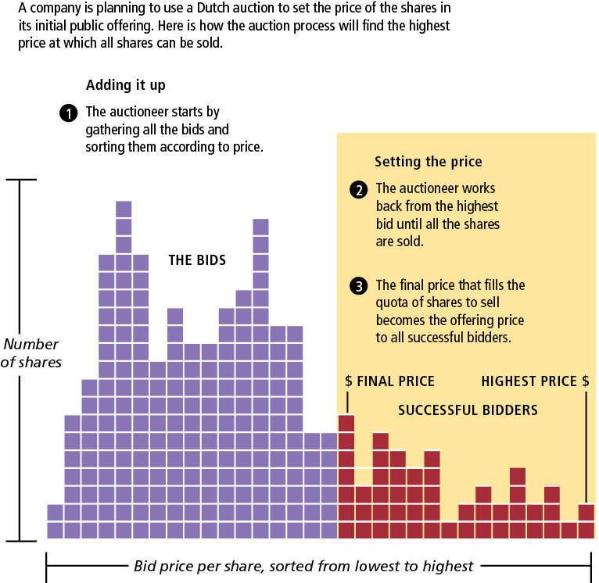
Figure 2.2 A Dutch Auction Primer

Slide 25
Distribution Methods (4 of 4)
Direct Sale
  Issuing firm sells the securities directly to the investing public.
  No investment banker is involved.

Slide 26
Private Debt Placements (1 of 2)
Private placements of debt refers to raising money directly from prominent investors such as life insurance companies, pension funds. It can be accomplished with or without the assistance of investment bankers.

Slide 27
Private Debt Placements (2 of 2)
Advantages
  Faster to raise money
  Reduces flotation costs
  Offers financing flexibility
Disadvantages
  Interest costs are higher than public issues
  Restrictive covenants
  Possible future SEC registration

Slide 28
Flotation Costs
Flotation costs are transaction costs incurred when a firm raises funds by issuing securities:
  Underwriter’s spread (difference between gross and net proceeds)
  Issuing costs (printing and engraving of security certificates, legal fees, accounting fees, trustee fees, other miscellaneous expenses)

Slide 29
Sarbanes-Oxley Act (SOX)
In response to corporate scandals, Congress passed SOX in 2002.
SOX holds senior corporate advisors (such as accountants, lawyers, board of directors, officers) responsible for any instance of misconduct.
SOX attempts to protect the interest of investors by improving transparency and accuracy of corporate disclosures.
SOX has been criticized for imposing additional compliance costs on the firms. Some firms have responded by delisting from major exchanges or choosing to list on foreign exchanges.

Slide 30
Rates of Return in the Financial Markets

Slide 31
Long-Term Rates of Return
See Figure 2.3.
Higher returns are associated with higher risk.
Investors demand compensation for inflation and other elements of risk (such as default).

Slide 32
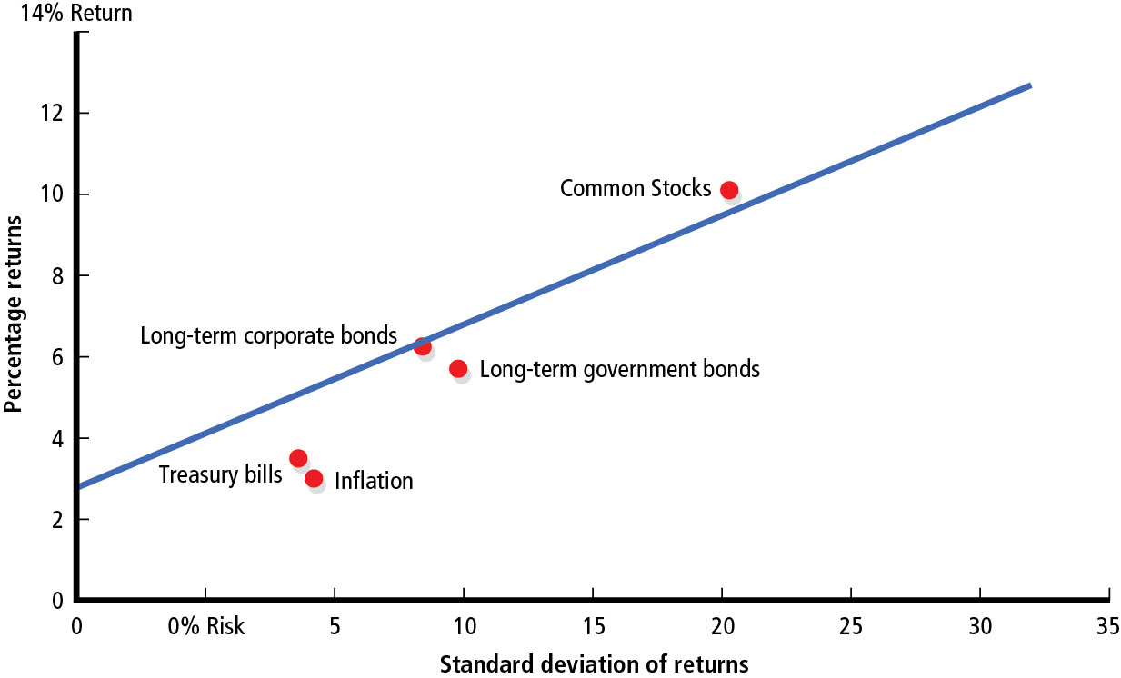
Figure 2.3 Rates of Return and Standard Deviations, 1926 to 2017

Slide 33
Important Definitions
Opportunity cost—Rate of return on next best investment alternative to the investor
Standard deviation—Dispersion or variability around the mean rate of return in the financial markets
Real return—Return earned above the rate of inflation
Maturity-risk premium—Additional return required by investors in long-term securities to compensate for greater risk of price fluctuations on those securities caused by interest rate changes
Liquidity-risk premium—Additional return required by investors in securities that cannot be quickly converted into cash at a reasonably predictable price

Slide 34
Interest Rate Levels
Interest rate levels and inflation are displayed in Table 2.2 and Figure 2.4. We observe the following:
  Inflation and interest rates have a direct relationship.
  The returns are affected by the degree of inflation, default premium, maturity premium, and liquidity premium.

Slide 35
Table 2.1 Interest Rate Levels and Inflation Rates, 1990 through 2017 (1 of 4)
Year | 3-month Treasury Bills % | 30-yr Treasury Bonds % | 30-yr Aaa Corporate Bonds % | Inflation Rate %
1990 | 7.50 | 8.61 | 9.32 | 5.4
1991 | 5.38 | 8.14 | 8.77 | 4.2
1992 | 3.43 | 7.67 | 8.14 | 3.0
1993 | 3.00 | 6.59 | 7.22 | 3.0
1994 | 4.25 | 7.37 | 7.97 | 2.6
1995 | 5.49 | 6.88 | 7.59 | 2.8
1996 | 5.01 | 6.71 | 7.37 | 2.9

Slide 36
Table 2.1 Interest Rate Levels and Inflation Rates, 1990 through 2017 (2 of 4)
Year | 3-month Treasury Bills % | 30-yr Treasury Bonds % | 30-yr Aaa Corporate Bonds % | Inflation Rate %
1997 | 5.06 | 6.61 | 7.27 | 2.3
1998 | 4.78 | 5.58 | 6.53 | 1.6
1999 | 4.64 | 5.87 | 7.05 | 2.2
2000 | 5.82 | 5.94 | 7.62 | 3.4
2001 | 3.40 | 5.49 | 7.08 | 2.8
2002 | 1.61 | 5.43 | 6.49 | 1.6
2003 | 1.01 | 4.93 | 5.66 | 2.3
2004 | 1.37 | 4.86 | 5.63 | 2.7

Slide 37
Table 2.1 Interest Rate Levels and Inflation Rates, 1990 through 2017 (3 of 4)
Year | 3-month Treasury Bills % | 30-yr Treasury Bonds % | 30-yr Aaa Corporate Bonds % | Inflation Rate %
2005 | 3.15 | 4.51 | 5.23 | 3.4
2006 | 4.73 | 4.91 | 5.59 | 3.2
2007 | 4.36 | 4.84 | 5.56 | 2.9
2008 | 1.37 | 4.28 | 5.63 | 3.8
2009 | 0.15 | 4.08 | 5.31 | −0.4
2010 | 0.14 | 4.25 | 4.94 | 1.6
2011 | 0.05 | 3.91 | 4.64 | 3.2
2012 | 0.09 | 2.92 | 3.67 | 2.1

Slide 38
Table 2.1 Interest Rate Levels and Inflation Rates, 1990 through 2017 (4 of 4)
Year | 3-month Treasury Bills % | 30-yr Treasury Bonds % | 30-yr Aaa Corporate Bonds % | Inflation Rate %
2013 | 0.06 | 3.45 | 4.23 | 1.5
2014 | 0.03 | 3.34 | 4.16 | 1.6
2015 | 0.23 | 2.97 | 4.06 | 0.1
2016 | 0.51 | 3.11 | 4.04 | 1.3
2017 | 1.32 | 2.77 | 3.52 | 2.0
Mean | 2.78 | 5.22 | 6.08 | 2.48
Source: Federal Reserve System, Release H-15, Selected Interest Rates. Office of Inspector General c/o Board of Governors of the Federal Reserve System.

Slide 39
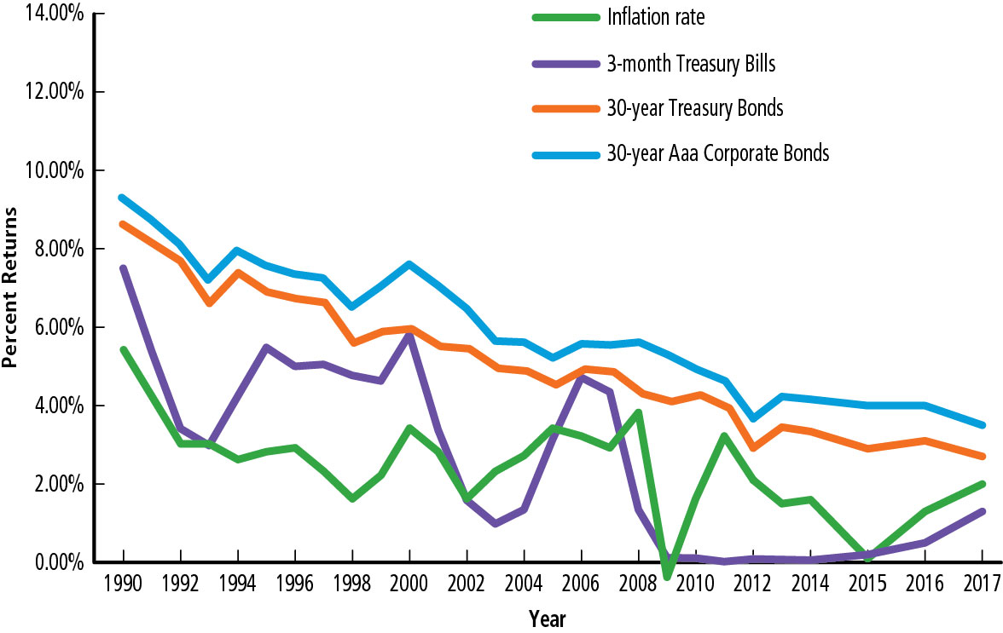
Figure 2.4 Interest Rate Levels and Inflation Rates, 1990 through 2017
Source: Federal Reserve System, Release H-15, Selected Interest Rates. Office of Inspector General c/o Board of Governors of the Federal Reserve System.

Slide 40
Observations from Table 2.1 and Figure 2.4
Between 1990 and 2017:
  Average inflation premium = 2.48%
  Average default risk premium = 0.86%
  Average maturity risk premium = 2.44%

Slide 41
Interest Rate Determinants

Slide 42
Interest Rate Determinants
Nominal interest rate = Real risk-free rate + Inflation premium + Default-risk premium + Maturity-risk Premium + Liquidity-risk Premium
Thus the nominal rate or quoted rate for securities is driven by all of these risk premium factors. Such knowledge is critical when companies set an interest rate for their issues.

Slide 43
Real and Nominal Rates
Real risk-free interest rate = risk-free rate − inflation premium
Nominal interest rate ≈ real rate of interest + inflation risk premium
The real rate of interest is the nominal (quoted) rate of interest less any loss in purchasing power of the dollar during the time of the investment.

Slide 44
The Term Structure of Interest Rates
Figure 2.5 shows the relationship between a debt security’s rate of return and the length of time until the debt matures, where the risk of default is held constant.
The graph could be upward sloping (indicating longer term securities command higher returns), flat (equal returns for long- and short-term securities), or inverted (longer-term securities command lower returns compared to short-term securities).
The graph changes over time. An upward-sloping curve is most commonly observed.

Slide 45
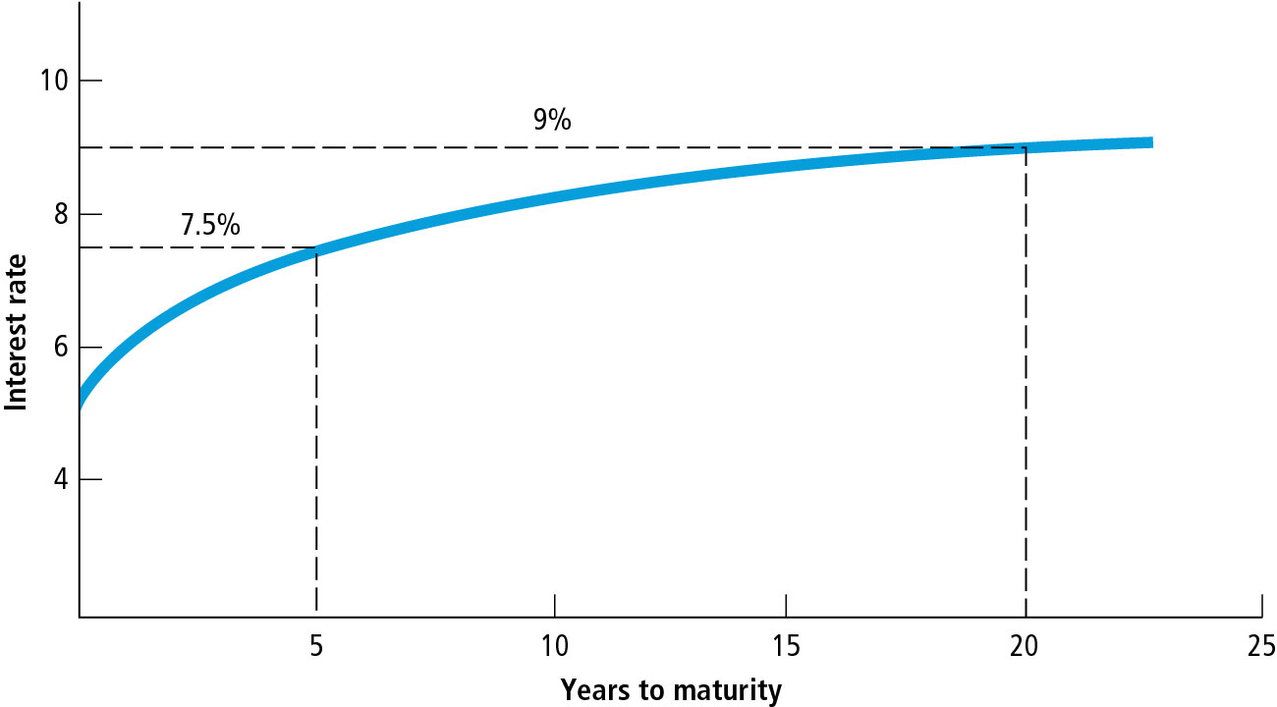
Figure 2.5 The Term Structure of Interest Rates

Slide 46
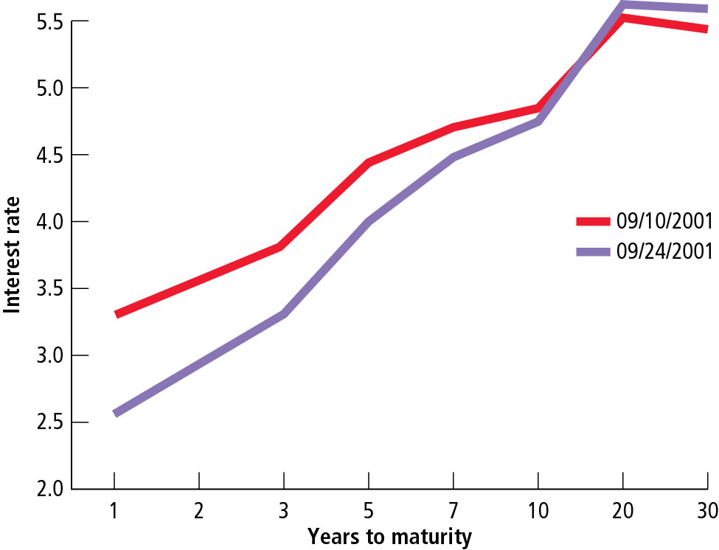
Figure 2.6 Changes in the Term Structure of Interest Rates around September 11, 2001
Source: Federal Reserve System, Release H-15, Office of Inspector General c/o Board of Governors of the Federal Reserve System.

Slide 47
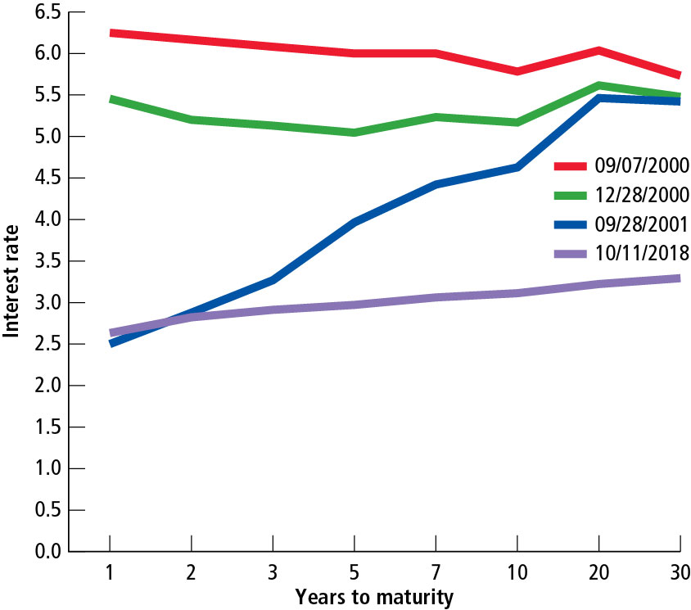
Figure 2.7 Historical Term Structures of Interest Rates for Government Securities
Source: Federal Reserve System, Release H-15, Office of Inspector General c/o Board of Governors of the Federal Reserve System.

Slide 48
What Explains the Shape of the Term Structure? (1 of 3)
The Unbiased Expectations Theory
  Term structure is determined by an investor’s expectations about future interest rates.

Slide 49
What Explains the Shape of the Term Structure? (2 of 3)
The Liquidity Preference Theory
  Investors require maturity-risk premiums to compensate them for buying securities that expose them to the risks of fluctuating interest rates.

Slide 50
What Explains the Shape of the Term Structure? (3 of 3)
The Market Segmentation Theory
  Legal restrictions and personal preferences limit choices for investors to certain ranges of maturities.
  This theory implies that the rate of interest for a particular maturity is determined by demand and supply for a given maturity.

Slide 51
Key Terms (1 of 5)
Angel investor
Basis point
Capital markets
Default-risk premium
Direct sale
Dutch auction
Flotation costs
Futures market

Slide 52
Key Terms (2 of 5)
Initial public offering (I P O)
Inflation premium
Investment banker
Liquidity preference theory
Liquidity-risk premium
Market segmentation theory
Maturity-risk premium
Money market

Slide 53
Key Terms (3 of 5)
Nominal (or quoted) rate of interest
Opportunity cost of funds
Organized security exchanges
Over-the-counter markets
Primary market
Private placement
Privileged subscription
Public offering

Slide 54
Key Terms (4 of 5)
Real rate of interest
Real risk-free interest rate
Seasoned equity offering (S E O)
Secondary market
Spot market
Syndicate
Term structure of interest rates
Unbiased expectations theory

Slide 55
Key Terms (5 of 5)
Underwriting
Underwriter’s spread
Venture capitalist

Slide 56

Copyright
This work is protected by United States copyright laws and is provided solely for the use of instructors in teaching their courses and assessing student learning. Dissemination or sale of any part of this work (including on the World Wide Web) will destroy the integrity of the work and is not permitted. The work and materials from it should never be made available to students except by instructors using the accompanying text in their classes. All recipients of this work are expected to abide by these restrictions and to honor the intended pedagogical purposes and the needs of other instructors who rely on these materials.

