Slide 1
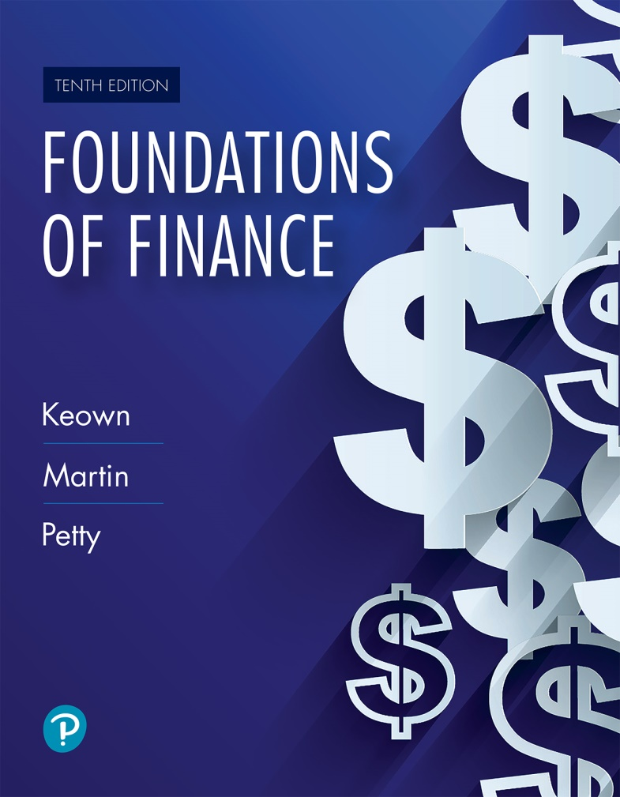
Foundations of Finance
Tenth Edition
Chapter 7
The Valuation and Characteristics of Bonds
Slide in this Presentation Contain Hyperlinks. JAWS users should be able to get a list of links by using INSERT+F7
Copyright © 2020, 2017, 2014 Pearson Education, Inc. All Rights Reserved
Notes:
If this PowerPoint presentation contains mathematical equations, you may need to check that your computer has the following installed:
1) Math Type Plugin
2) Math Player (free versions available)
3) NVDA Reader (free versions available)

Slide 2
Learning Objectives
7.1 Distinguish between different kinds of bonds.
7.2 Explain the more popular features of bonds.
7.3 Define the term value as used for several different purposes.
7.4 Explain the factors that determine value.
7.5 Describe the basic process for valuing assets.
7.6 Estimate the value of a bond.
7.7 Compute a bond’s expected rate of return and its current yield.
7.8 Explain three important relationships that exist in bond valuation.

Slide 3
Types of Bonds

Slide 4
Bonds
Meaning: A bond is a type of debt or long-term promissory note, issued by a borrower, promising to its holder a predetermined and fixed amount of interest per year and repayment of principal at maturity.
Bonds are issued by corporations, the U.S. government, state governments, and local municipalities.

Slide 5
Debentures
Debentures are unsecured long-term debt.
For an issuing firm, debentures provide the benefit of not tying up property as collateral.
For bondholders, debentures are more risky than secured bonds and provide a higher yield than secured bonds.

Slide 6
Subordinated Debentures
There is a hierarchy of payout in case of insolvency.
The claims of subordinated debentures are honored only after the claims of secured debt and unsubordinated debentures have been satisfied.

Slide 7
Mortgage Bonds
Mortgage bond is secured by a lien on real property.
Typically, the value of the real property is greater than that of the bonds issued, providing bondholders a margin of safety.

Slide 8
Eurobonds
Securities (bonds) issued in a country different from the one in whose currency the bond is denominated.
For example, a bond issued by an American corporation in Japan that pays interest and principal in dollars.

Slide 9
Convertible Bonds
Convertible bonds are debt securities that can be converted into a firm’s stock at a prespecified price.

Slide 10
Terminologies and Characteristics of Bonds

Slide 11
Claims on Assets and Income
Seniority in claims
  In the case of insolvency, claims of debt, including bonds, are generally honored before those of common or preferred stock.

Slide 12
Par Value
Par value is the face value of the bond, returned to the bondholder at maturity.
In general, corporate bonds are issued at denominations or par value of $1,000.
Prices are represented as a percentage of face value. Thus, a bond quoted at 104 can be bought at 104 percent of its par value in the market. Bonds will return the par value at maturity, regardless of the price paid at the time of purchase.

Slide 13
Coupon Interest Rate
The percentage of the par value of the bond that will be paid periodically in the form of interest.
Example: A bond with a $1,000 par value and 5 percent annual coupon rate will pay $50 annually (= 0.05×1,000) or $25 (if interest is paid semiannually).

Slide 14
Zero Coupon Bonds
Zero coupon bonds have zero or very low coupon rate. Instead of paying interest, the bonds are issued at a substantial discount below the par or face value.

Slide 15
Maturity
Maturity of bond refers to the length of time until the bond issuer returns the par value to the bondholder and terminates or redeems the bond.

Slide 16
Call Provision
Call provision (if it exists on a bond) gives a corporation the option to redeem the bonds before the maturity date. For example, if the prevailing interest rate declines, the firm may want to pay off the bonds early and reissue at a more favorable interest rate.
Issuer must pay the bondholders a premium.
There is also a call protection period where the firm cannot call the bond for a specified period of time.

Slide 17
Indenture
An indenture is the legal agreement between the firm issuing the bond and the trustee who represents the bondholders.
It provides for specific terms of the loan agreement (such as rights of bondholders and issuing firm).
Many of the terms seek to protect the status of bonds from being weakened by managerial actions or by other security holders.

Slide 18
Bond Ratings
Bond ratings reflect the future risk potential of the bonds.
Three prominent bond rating agencies are Standard & Poor’s, Moody’s, and Fitch Investor Services.
A lower bond rating indicates higher probability of default. It also means that the rate of return demanded by the capital markets will be higher on such bonds.

Slide 19
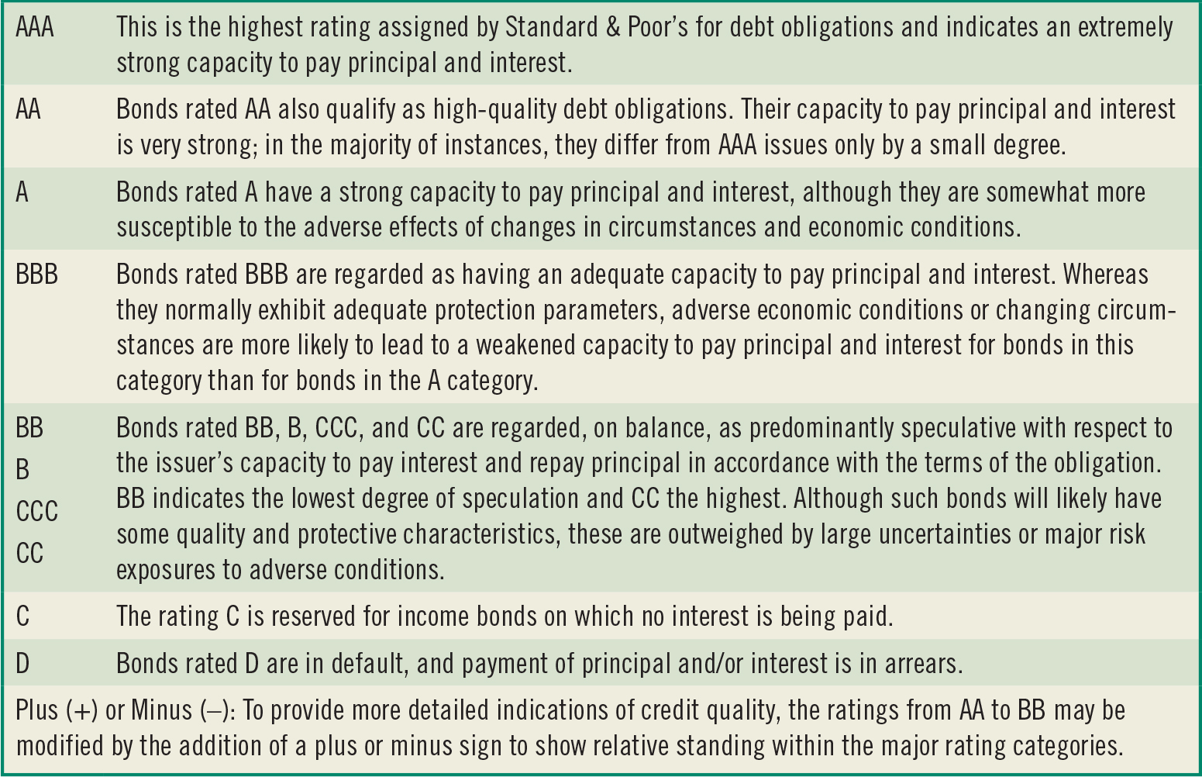
Table 7.1 Standard & Poor’s Corporate Bond Ratings
Source: Adapted from https://www.globalcreditportal.com, accessed May 20, 2015.

Slide 20
Factors Having a Favorable Effect on Bond Rating
A greater reliance on equity as opposed to debt in financing the firm
Profitable operations
Low variability in past earnings
Large firm size
Little use of subordinated debt

Slide 21
Junk Bonds
Junk bonds are high-risk bonds with ratings of BB or below by Moody’s and Standard & Poor’s.
Junk bonds are also referred to as high-yield bonds because they pay a high interest rate, generally 3 percent to 5 percent more than AAA-rated bonds.

Slide 22
Defining Value

Slide 23
Defining Value
Book value: Value of an asset as shown on a firm’s balance sheet.
Liquidation value: The dollar sum that could be realized if an asset were sold individually and not as part of a going concern.
Market value: The observed value for the asset in the marketplace.
Intrinsic or economic value: Also called fair value—represents the present value of the asset’s expected future cash flows.

Slide 24
Value and Efficient Markets
In an efficient market, the values of all securities at any instant fully reflect all available public information.
If the markets are efficient, the market value and the intrinsic value will be the same.
The field of behavioral finance studies the irrationality of investors.

Slide 25
What Determines Value?

Slide 26
What Determines Value?
Value of an asset = present value of its expected future cash flows using the investor’s required rate of return as the discount rate.
Thus value is affected by three elements:
  Amount and timing of the asset’s expected future cash flows
  Riskiness of the cash flows
  Investor’s required rate of return for undertaking the investment

Slide 27
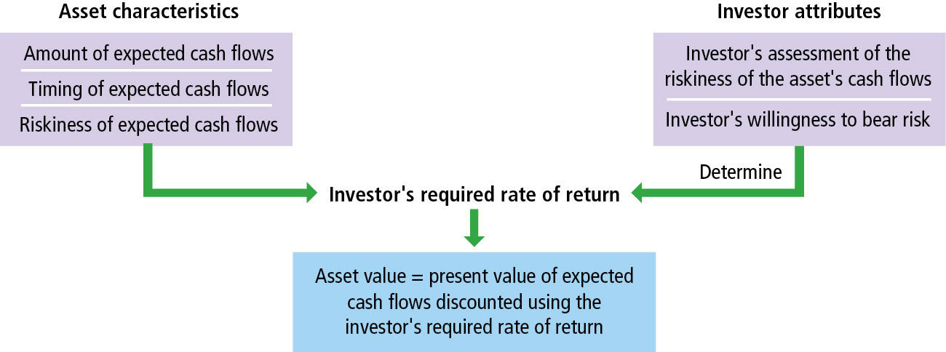
Figure 7.1 Basic Factors Determining an Asset’s Value

Slide 28
Valuation: The Basic Process

Slide 29
Bond Valuation (1 of 2)
The value of a bond (V) is a combination of:
  C: Future expected cash flows in the form of interest and repayment of principal
  n: The time to maturity of the loan
  r: The investor’s required rate of return

Slide 30
Bond Valuation (2 of 2)
Or stated in symbols we have:

Slide 31
Valuing Bonds

Slide 32
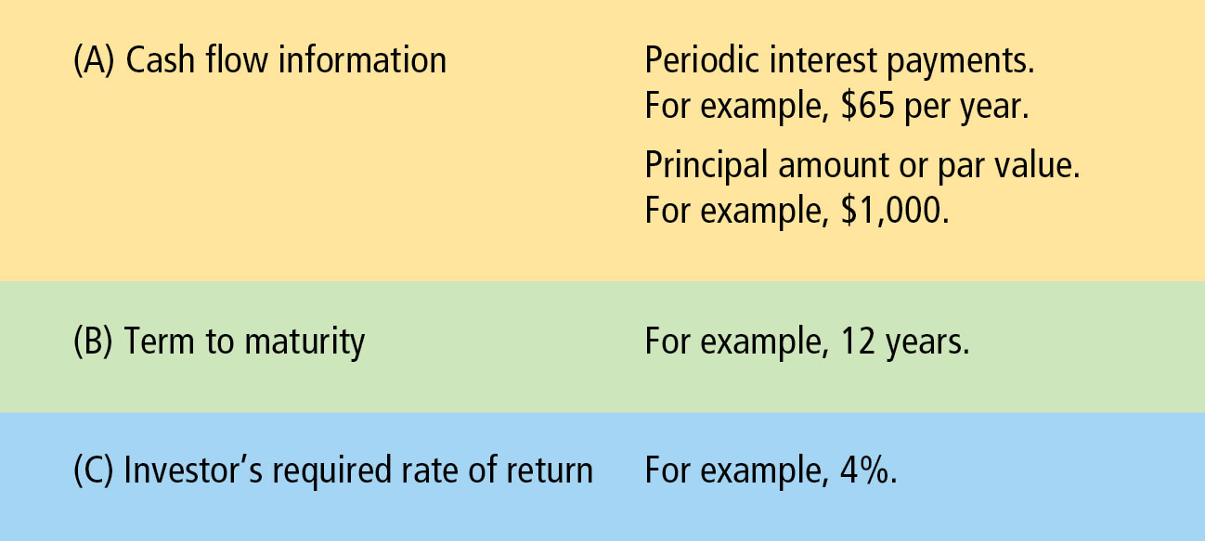
Figure 7.2 Data Requirements for Bond Valuation

Slide 33
Example on Bond Valuation
Consider a bond issued by Toyota with a maturity date of 2022 and a stated coupon of 3.4 percent. In 2017, with 5 years left to maturity, investors owning the bonds are requiring a 2.7 percent rate of return.

Slide 34
Toyota Bond Example
Step 1 (CF): Estimate amount and timing of the expected future cash flows:
  Annual interest payments
  0.034 × $1,000 = $34 every year for five years
  Face value to be received in 2022
    $1,000

Slide 35
Summary of Cash Flows (For One Bond)
Time | Bondholder | Corporation
0 | Price = ? | Price = ?
1–5 | $34 | −$34
5 | +1,000 | −1,000

Slide 36
Toyota Bond Example (1 of 3)
Step 2 (r) Determine the investor’s required rate of return by evaluating the riskiness of the bond’s future cash flows. Remember: the investors required rate of return equals the risk-free rate plus a risk premium. Here, the required rate of return (r) is given as 2.7 percent.

Slide 37
Toyota Bond Example (2 of 3)
Step 3: Calculate the intrinsic value of the bond.
Bond Value
  = PV (Interest, received every year)
  + PV (Par, received at maturity)

Slide 38
Toyota Bond Example (3 of 3)
Using calculator:
  Annual interest payments (PMT) = $34
  Par value (FV) = $1,000
  Years until maturity (N) = 5
  Required rate of return (I) = 2.7%
Solve for PV = $1,032.33

Slide 39
Bond Yields

Slide 40
Bond Yields (1 of 2)
Yield to Maturity (YTM) refers to the rate of return the investor will earn if the bond is held to maturity. YTM is also known as bondholder’s expected rate of return.
YTM = Discount rate that equates the present value of the future cash flows with the current market price of the bond

Slide 41
Bond Yields (2 of 2)
To find YTM, we need to know:
a. current price
b. time left to maturity
c. par value, and
d. annual interest payment

Slide 42
Computing YTM (1 of 2)
What is the yield to maturity (YTM) on a 6 percent bond that is currently trading for $1,100 and matures in 10 years?
Current price = $1,100
  Coupon = $60
  Time = 10 years
  Par value = $1,000

Slide 43
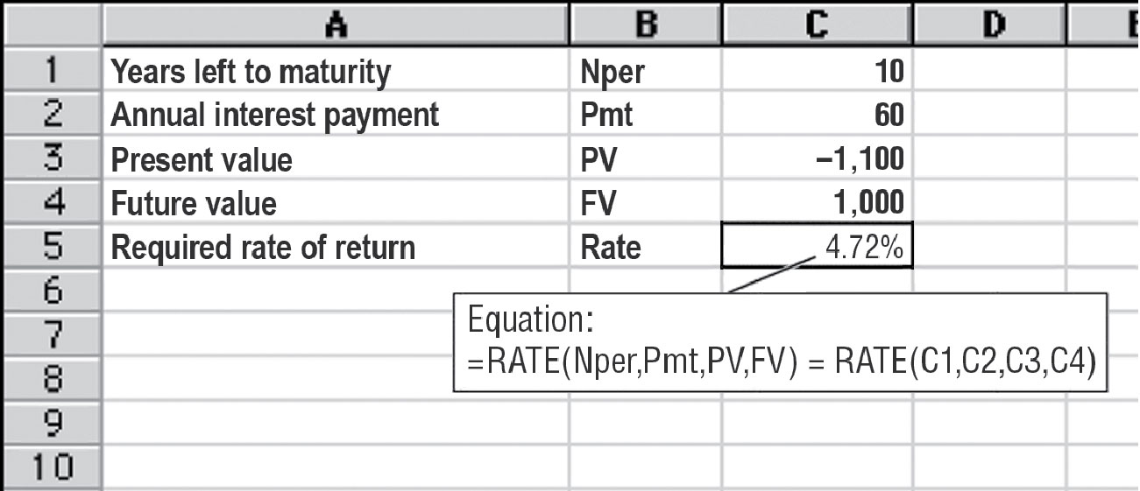
Computing YTM (2 of 2)

Slide 44
Current Yield
Current yield is the ratio of the interest payment to the bond’s current market price.
Example: The current yield on a $1,000 par value bond with 4 percent coupon rate and market price of $920

Slide 45
Bond Valuation: Three Important Relationships

Slide 46
Bond Valuation: Three Important Relationships (1 of 2)
Relationship 1
The value of a bond is inversely related to changes in the investor’s present required rate of return (the current interest rate).
As interest rates increase (decrease), the value of the bond decreases (increases).

Slide 47
Bond Valuation: Three Important Relationships (2 of 2)
Relationship 2
The market value of a bond will be less than the par value if the investor’s required rate of return is above the coupon interest rate.
Bond will be valued above par value if the investor’s required rate of return is below the coupon interest rate.

Slide 48
Discount Bonds
The market value of a bond will be below the par when the investor’s required rate is greater than the coupon interest rate. These bonds are known as discount bonds.

Slide 49
Premium Bonds
The market value of a bond will be above the par or face value when the investor’s required rate is lower than the coupon interest rate. These bonds are known as premium bonds.
If investor’s required rate of return is equal to the coupon interest rate, the bonds will trade at par.

Slide 50
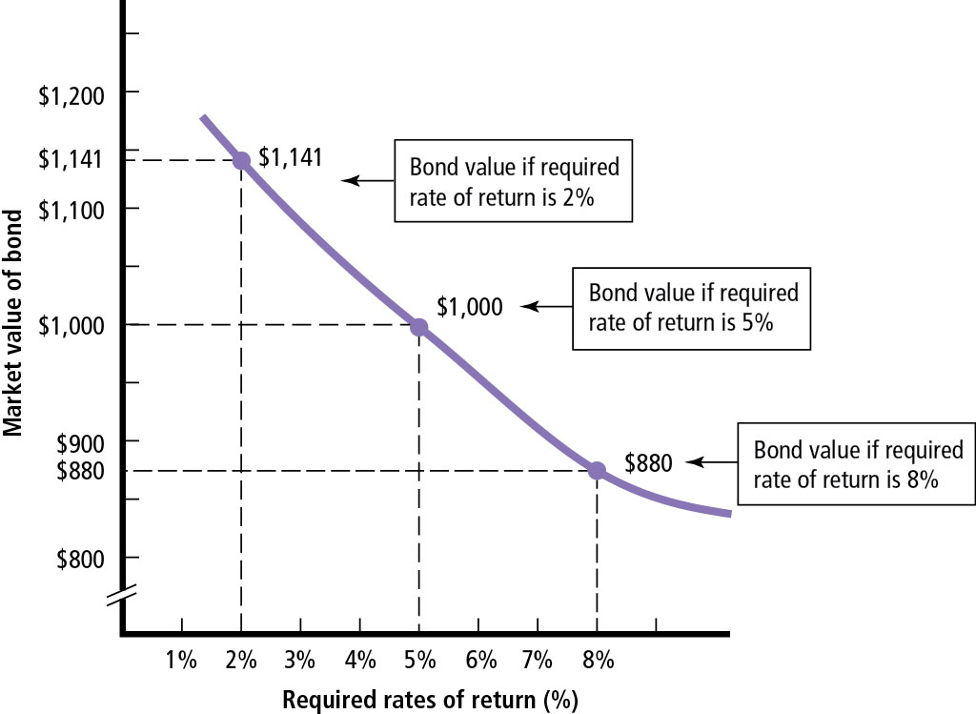
Figure 7.3 Value and Required Rates for a 5-Year Bond at a 5 Percent Coupon Rate

Slide 51
Bond Valuation: Three Important Relationships (3 of 3)
Relationship 3
Long-term bonds have greater interest rate risk than do short-term bonds.
In other words, a change in interest rate will have relatively greater impact on long-term bonds.

Slide 52
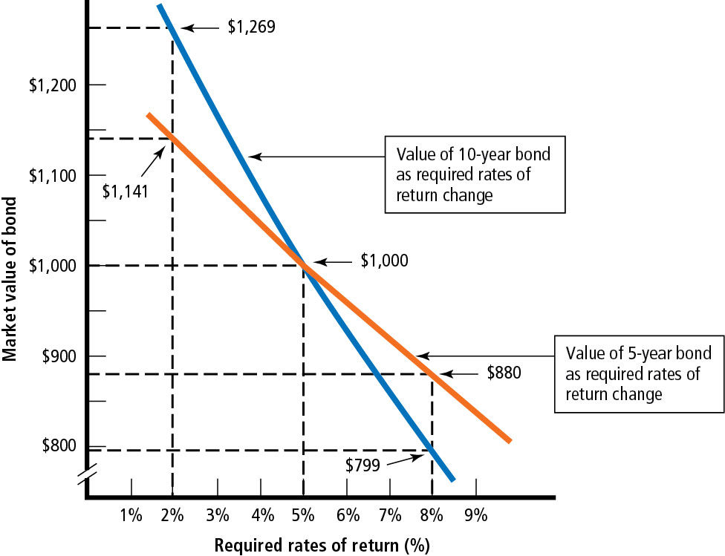
Figure 7.4 The Market Values of a 5-Year and a 10-Year Bond at Different Required Rates of Return

Slide 53
Main Risks for Bondholders
Interest rate risk: if interest rates rise, the market value of bonds will fall
Default risk: this may mean no or partial payment on debt as in bankruptcy cases
Call risk: if bonds are called before maturity date; bonds are generally called when interest rates decrease. Thus, investors will have to reinvest the money received from the corporation at a lower rate.

Slide 54
Key Terms (1 of 4)
Behavioral finance
Bond
Book value
Callable bond (redeemable bond)
Call protection period
Convertible bond
Coupon interest rate
Current yield

Slide 55
Key Terms (2 of 4)
Debenture
Discount bond
Efficient market
Eurobond
Expected rate of return
Fixed-rate bond
Fair value
High-yield bond

Slide 56
Key Terms (3 of 4)
Indenture
Interest rate risk
Intrinsic, or economic (fair) value
Junk bond (high-yield bond)
Liquidation value
Market value
Maturity
Mortgage bond

Slide 57
Key Terms (4 of 4)
Par value
Premium bond
Subordinated debentures
Yield to maturity
Zero coupon bond

Slide 58

Copyright
This work is protected by United States copyright laws and is provided solely for the use of instructors in teaching their courses and assessing student learning. Dissemination or sale of any part of this work (including on the World Wide Web) will destroy the integrity of the work and is not permitted. The work and materials from it should never be made available to students except by instructors using the accompanying text in their classes. All recipients of this work are expected to abide by these restrictions and to honor the intended pedagogical purposes and the needs of other instructors who rely on these materials.

