Slide 1
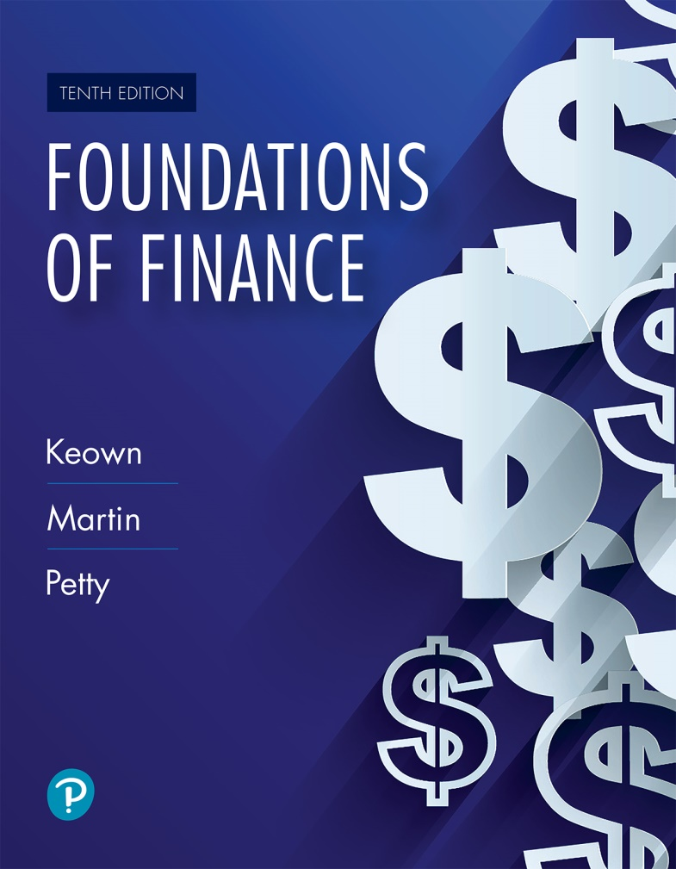
Foundations of Finance
Tenth Edition
Chapter 9
The Cost of Capital
Copyright © 2020, 2017, 2014 Pearson Education, Inc. All Rights Reserved
Notes:
If this PowerPoint presentation contains mathematical equations, you may need to check that your computer has the following installed:
1) Math Type Plugin
2) Math Player (free versions available)
3) NVDA Reader (free versions available)

Slide 2
Learning Objectives
9.1 Understand the concepts underlying the firm’s cost of capital.
9.2 Evaluate the costs of the individual sources of capital
9.3 Calculate a firm’s weighted average cost of capital.
9.4 Estimate divisional costs of capital.

Slide 3
The Cost of Capital: Key Definitions and Concepts

Slide 4
Capital Structure
Capital
Capital represents the funds used to finance a firm’s assets and operations. Capital constitutes all items on the right hand side of balance sheet, i.e., liabilities and common equity.
Main sources: Debt, preferred stock, retained earnings, and common stock
Figure 9.1 illustrates two firms with very different types of capital structures.

Slide 5
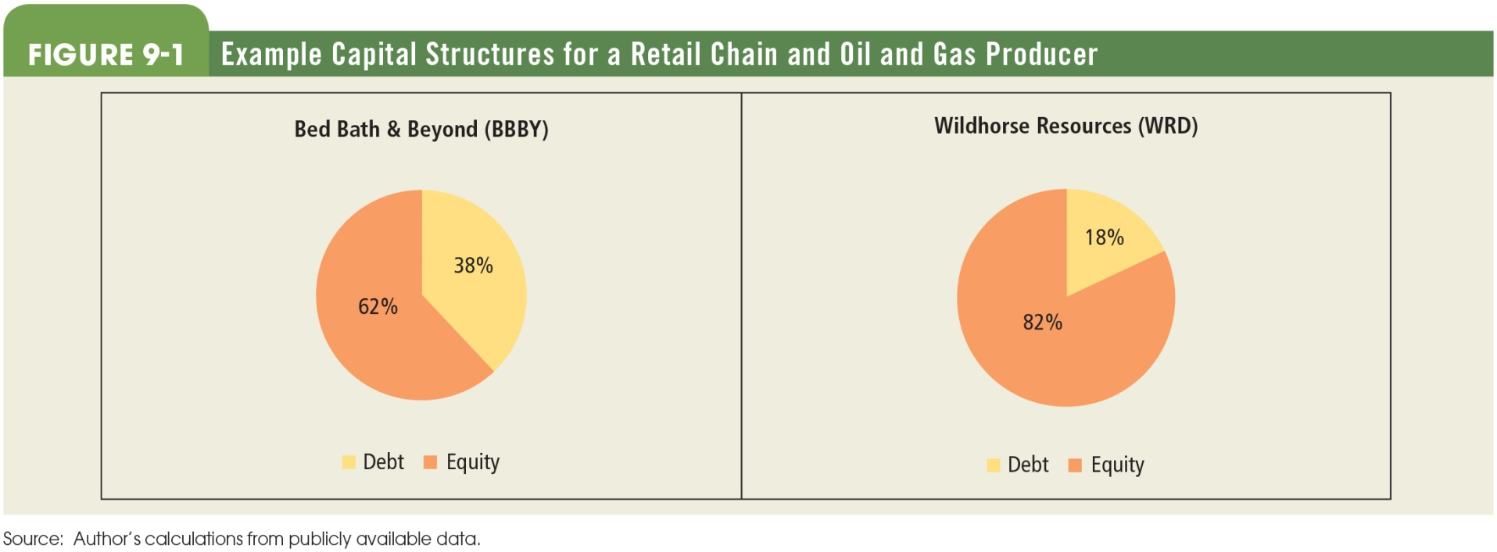
Figure 9.1 Example Capital Structures for a Retail Chain and Oil and Gas Producer

Slide 6
Opportunity Cost of Capital
Cost of Capital
  The firm’s cost of capital is also referred to as the firm’s opportunity cost of capital.

Slide 7
Investor’s Required Rate of Return
(1 of 2)
Investor’s Required Rate of Return—the minimum rate of return necessary to attract an investor to purchase or hold a security
Investor’s required rate of return is not the same as cost of capital due to taxes and transaction costs.
  Impact of taxes: For example, a firm may pay 8 percent interest on debt but due to tax benefit on interest expense, the net cost to the firm will be lower than 8 percent.

Slide 8
Investor’s Required Rate of Return
(2 of 2)
Impact of transaction costs on cost of capital: For example, if a firm sells new stock for $50 a share and incurs $5 in flotation costs, and the investors have a required rate of return of 15 percent, what is the cost of capital?
The firm has only $45 to invest after transaction cost.

Slide 9
Financial Policy
A firm’s financial policy indicates the desired sources of financing and the particular mix in which it will be used.
For example, a firm may choose to raise capital by issuing stocks and bonds in the ratio of 6:4 (60 percent stocks and 40 percent bonds). The choice of mix will impact the cost of capital.

Slide 10
Determining the Costs of the Individual Sources of Capital

Slide 11
The Cost of Debt (1 of 3)
The bondholder’s required rate of return on debt is the return that bondholders demand. As seen in Chapter 7, this can be estimated using the bond price equation:

Slide 12
The Cost of Debt (2 of 3)
Because firms must pay flotation costs when they sell bonds, the net proceeds per bond received by firm is less than the market price of the bond. Hence, the cost of debt capital (K_{d}) will be higher than the bondholder’s required rate of return. It can be calculated using the following equation:

Slide 13
The Cost of Debt (3 of 3)
See Example 9.1
Investor’s required rate of return on a 8 percent 20-year bond trading for $908.32 = 9 percent and 21 percent tax bracket.

Slide 14
The Cost of Preferred Stock (1 of 2)
If flotation costs are incurred, preferred stockholder’s required rate of return will be less than the cost of preferred capital to the firm.
Thus, in order to determine the cost of preferred stock, we adjust the price of preferred stock for flotation cost to give us the net proceeds.
Net proceeds = issue price − flotation cost

Slide 15
The Cost of Preferred Stock (2 of 2)
Cost of Preferred Stock:
Pn = net proceeds (i.e., issue price − flotation costs)
D_{p} = preferred stock dividend per share
Example: Determine the cost for a preferred stock that pays annual dividend of $4.25, has current stock price $58.50, and incurs flotation costs of $1.375 per share.

Slide 16
The Cost of Common Equity (1 of 2)
Cost of equity is more challenging to estimate than the cost of debt or the cost of preferred stock because common stockholder’s rate of return is not fixed as there is no stated coupon rate or dividend.
Furthermore, the costs will vary for two sources of equity (i.e., retained earnings and new issue).

Slide 17
The Cost of Common Equity (2 of 2)
There are no flotation costs on retained earnings, but the firm incurs costs when it sells new common stock.
Note that retained earnings are not a free source of capital. There is an opportunity cost.

Slide 18
Cost Estimation Techniques
Two commonly used methods for estimating common stockholder’s required rate of return are
  The Dividend Growth Model
  The Capital Asset Pricing Model

Slide 19
The Dividend Growth Model (1 of 3)
Investors’ required rate of return (for Retained Earnings):
D₁ = Dividends expected one year hence
​
P_{cs} = Price of common stock
g = growth rate

Slide 20
The Dividend Growth Model (2 of 3)
Investors’ required rate of return (For new issues)
​
D1 = Dividends expected one year hence
​
P_{cs} = Net proceeds per share
g = growth rate

Slide 21
The Dividend Growth Model (3 of 3)
Dividend growth model is simple to use but suffers from the following drawbacks:
  It assumes a constant growth rate.
  It is not easy to forecast the growth rate.

Slide 22
The Capital Asset Pricing Model
(1 of 2)
r_{f} = Risk-free rate
β = Beta
r_{m} − r_{f} = Market Risk Premium or expected rate of return for “average security” minus the risk-free rate

Slide 23
The Capital Asset Pricing Model
(2 of 2)
Example: If beta is 1.40, risk-free rate is 2.75 percent and expected return on market is 10 percent.

Slide 24
Capital Asset Pricing Model Variable Estimates
CAPM is easy to apply. Also, the estimates for model variables are generally available from public sources.
Risk-Free Rate: Wide range of U.S. government securities can be used as base for risk-free rate.
Beta: Estimates of beta are available from a wide range of services or can be estimated using regression analysis of historical data.
Market Risk Premium: It can be estimated by looking at history of stock returns and premium earned over risk-free rate.

Slide 25
The Weighted Average Cost of Capital

Slide 26
The Weighted Average Cost of Capital (WACC)
Bringing it all together: WACC
To estimate WACC, we need to know the capital structure mix and the cost of each of the sources of capital.
For a firm with only two sources: debt and common equity,

Slide 27
WACC Example
A firm borrows money at 6 percent interest after taxes and pays 10 percent for equity. The company raises capital in equal proportions, i.e., 50 percent debt and 50 percent equity.
WACC = (0.06 × 0.5) + (0.10 × 0.5)
= 0.08 or 8.0%

Slide 28
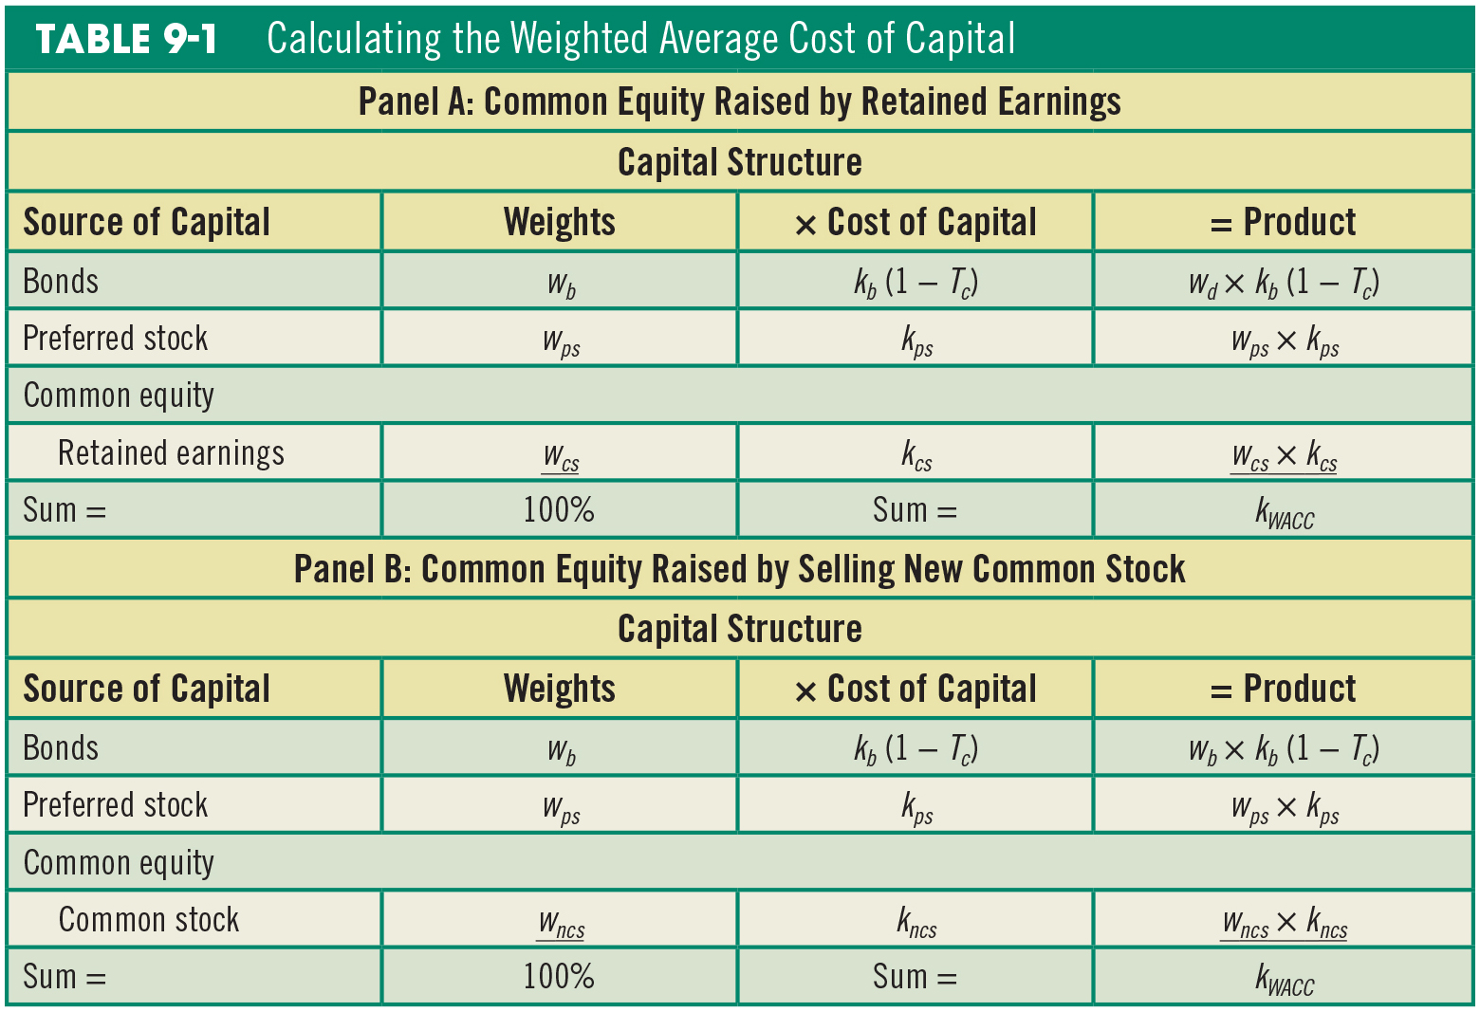
Table 9.1 Calculating the Weighted Average Cost of Capital

Slide 29
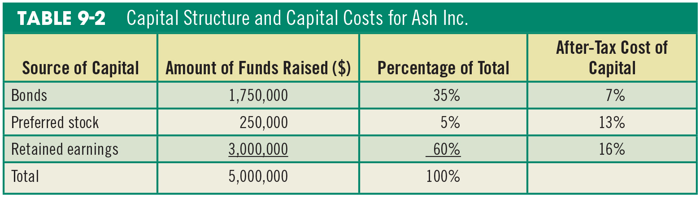
Table 9.2 Capital Structure and Capital Costs for Ash Inc

Slide 30
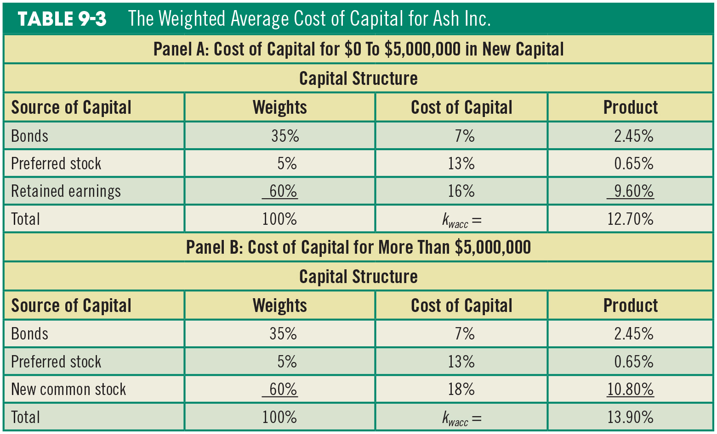
Table 9.3 The Weighted Average Cost of Capital for Ash Inc

Slide 31
Calculating Divisional Costs of Capital

Slide 32
Divisional Costs of Capital
Firms with multiple operating divisions often have unique risks and different costs of capital for each division.
Consequently, the WACC used in each division is potentially unique for each division.

Slide 33
Advantages of Divisional WACC
Different discount rates reflect differences in the systematic risk of the projects evaluated by different divisions.
It entails calculating one cost of capital for each division (rather than each project).
Divisional cost of capital limits managerial latitude and the attendant influence costs.

Slide 34
Using Pure Play Firms to Estimate Divisional WACCs
Divisional cost of capital can be estimated by identifying “pure play” comparison firms that operate in only one of the individual business areas.
For example, Valero Energy Corp. may use the WACC estimate of firms that operate in the refinery industry to estimate the WACC of its division engaged in refining crude oil.

Slide 35
Divisional WACC Example
Table 9.4 contains hypothetical estimates of the divisional WACC for the refining and retail (convenience store) industries.
Panel A: Cost of debt (tax = 38%)
Panel B: Cost of equity (betas differ)
Panels D & E: Divisional WACCs

Slide 36
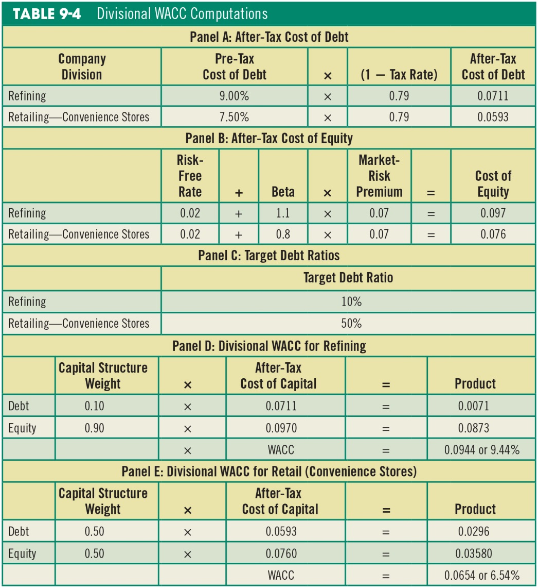
Table 9.4 Divisional WACC Computations

Slide 37
Divisional WACC—Estimation Issues and Limitations
Sample chosen may not be a good match for the firm or one of its divisions due to differences in capital structure or project risk.
Good comparison firms for a particular division may be difficult to find.

Slide 38
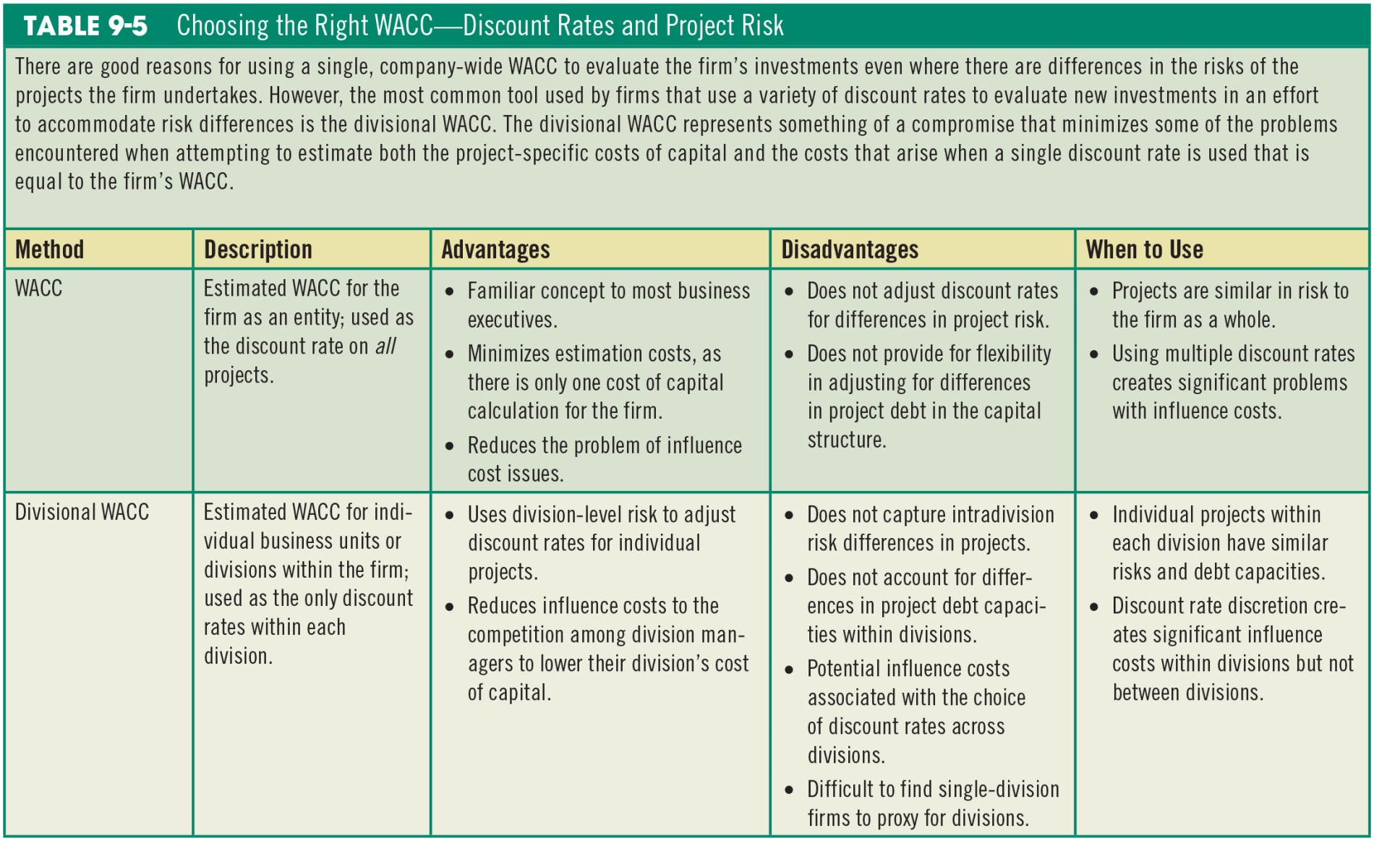
Table 9.5 Choosing the Right WACC-Discount Rates and Project Risk

Slide 39
Cost of Capital to Evaluate New Capital Investments
Cost of capital can serve as the discount rate in evaluating new investments when the projects offer the same risk as the firm as a whole.
If risk differs, it is better to calculate a different cost of capital for each division. Figure 9.2 illustrates the danger of not doing so.

Slide 40
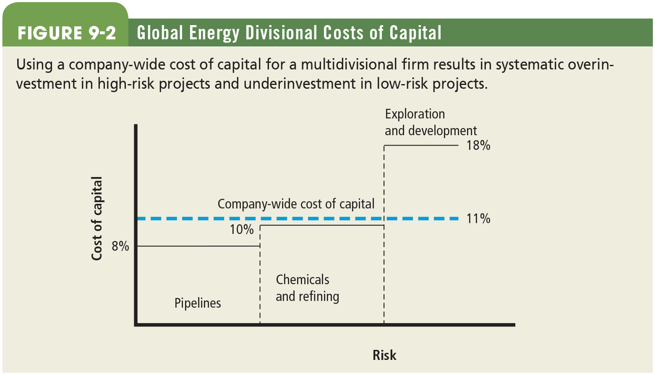
Figure 9.2 Global Energy Divisional Costs of Capital

Slide 41
Key Terms
Capital structure
Cost of debt
Cost of common equity
Cost of preferred equity
Divisional WACC
Financial policy
Flotation costs
Opportunity cost
Weighted average cost of capital (WACC)

Slide 42

Copyright
This work is protected by United States copyright laws and is provided solely for the use of instructors in teaching their courses and assessing student learning. Dissemination or sale of any part of this work (including on the World Wide Web) will destroy the integrity of the work and is not permitted. The work and materials from it should never be made available to students except by instructors using the accompanying text in their classes. All recipients of this work are expected to abide by these restrictions and to honor the intended pedagogical purposes and the needs of other instructors who rely on these materials.

