Slide 1
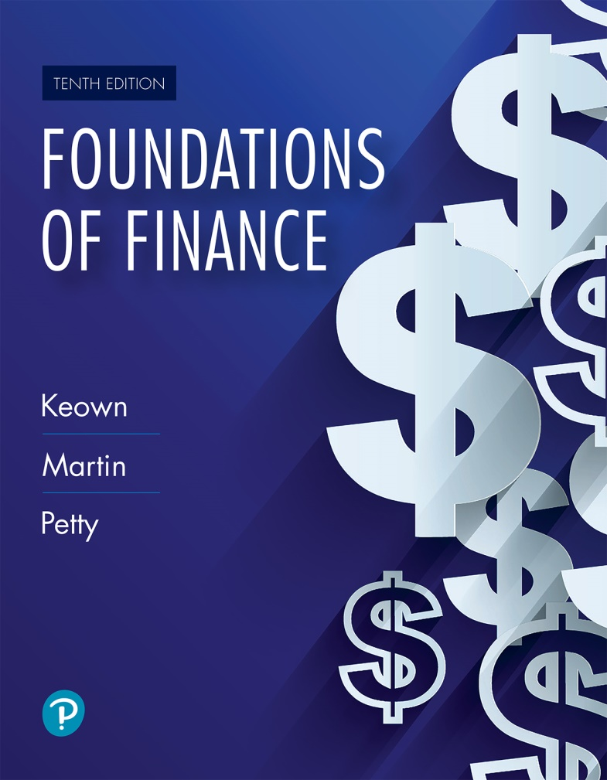
Foundations of Finance
Tenth Edition
Chapter 3
Understanding Financial Statements and Cash Flows
Copyright © 2020, 2017, 2014 Pearson Education, Inc. All Rights Reserved
Notes:
If this PowerPoint presentation contains mathematical equations, you may need to check that your computer has the following installed:
1) Math Type Plugin
2) Math Player (free versions available)
3) NVDA Reader (free versions available)

Slide 2
Learning Objectives
3.1 Compute a company’s profits, as reflected by its income statement.
3.2 Determine a firm’s financial position at a point in time based on its balance sheet.
3.3 Measure a company’s cash flows.
3.4 Describe the limitations of financial statements.
3.5 Calculate a firm’s free cash flows and financing cash flows.

Slide 3
The Income Statement

Slide 4
The Income Statement
It is also known as profit/loss statement.
It measures the results of firm’s operation over a specific period.
The bottom line of the income statement shows the firm’s profit or loss for a period.
Sales − Expenses = Profits

Slide 5
Income Statement Terms (1 of 2)
Revenue (Sales)
  Money derived from selling the company’s product or service
Cost of Goods Sold (COGS)
  The cost of producing or acquiring the goods or services to be sold
Operating Expenses
  Expenses related to marketing and distributing the product or service, general administrative expenses and depreciation expense

Slide 6
Income Statement Terms (2 of 2)
Financing Costs
  The interest paid to creditors
Tax Expenses
  Amount of taxes owed, based upon taxable income

Slide 7
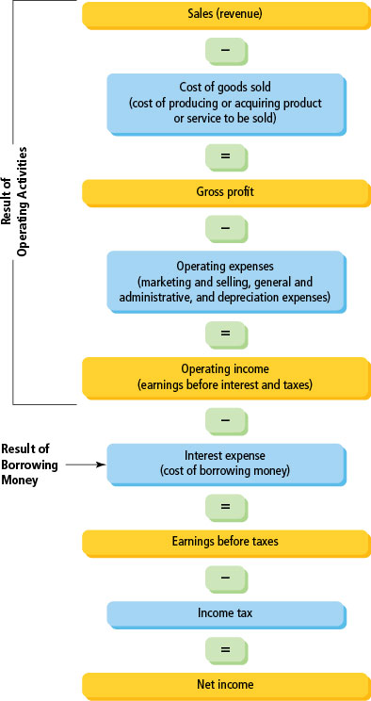
Figure 3.1 The Income Statement: An Overview

Slide 8
Common-Sized Income Statement
Common-sized income statement restates the income statement items as a percentage of sales.
Common-sized income statement makes it easier to compare trends over time and across firms in the industry.
See Table 3.1.

Slide 9
Table 3.1 Walmart: Income Statement for the year ending January 31, 2018 (expressed in millions, except per share data, and as a percentage of sales) (1 of 4)
Blank | Dollars | Percentage of Sales | Blank
Sales | $500,343 | 100% | Blank
Cost of goods sold | (373,396) | –74.6 | Blank
Gross profits | 126,947 | 25.4 | Gross profit margin

Slide 10
Table 3.1 Walmart: Income Statement for the year ending January 31, 2018 (expressed in millions, except per share data, and as a percentage of sales) (2 of 4)
Blank | Dollars | Percentage of Sales | Blank
Operating expenses | Blank | Blank | Blank
Selling, and administrative expenses | (95,981) | –19.2 | Blank
Depreciation expense | (10,529) | –2.1 | Blank
Total operating expenses | (106,510) | –21.3 | Blank
Operating income (earnings before interest and taxes) | 20,437 | 4.1 | Operating profit margin

Slide 11
Table 3.1 Walmart: Income Statement for the year ending January 31, 2018 (expressed in millions, except per share data, and as a percentage of sales) (3 of 4)
Blank | Dollars | Percentage of Sales | Blank
Interest expense | (2,178) | –0.4 | Blank
Non-operating losses | (3,136) | –0.6 | Blank
Earnings before taxes (taxable income) | (15,123) | 3.0 | Blank
Income taxes | (5,261) | –1.1 | Blank
Net income (earnings available to common shareholders) | $9,862 | 2.0% | Net profit margin

Slide 12
Table 3.1 Walmart: Income Statement for the year ending January 31, 2018 (expressed in millions, except per share data, and as a percentage of sales) (4 of 4)
Additional information: | Blank
Number of shares outstanding (millions) | 3,007
Earnings per share (net income/number of shares) | $3.28
Dividends paid to shareholders | $6,124
Dividends per share | $2.04

Slide 13
Profit-to-Sales Analysis from Common-Sized Income Statement
See Table 3.1
  Gross profit margin (or percentage of sales going toward gross profit) is 25.4%.
  Operating profit margin (or percentage of sales going toward operating profit) is 4.1%.
  Net profit margin (or percentage of sales going toward net profit) is 2.0%.

Slide 14
The Balance Sheet

Slide 15
The Balance Sheet
The balance sheet provides a snapshot of a firm’s financial position at a particular date.
It includes three main items: assets, liabilities, and owner-supplied capital (shareholders’ equity).
  Assets (A) are resources owned by the firm.
  Liabilities (L) and owner’s equity (E) indicate how those resources are financed:
    A = L + E
The transactions in balance sheet are recorded at cost price, so the book value of a firm may be very different from its current market value.

Slide 16
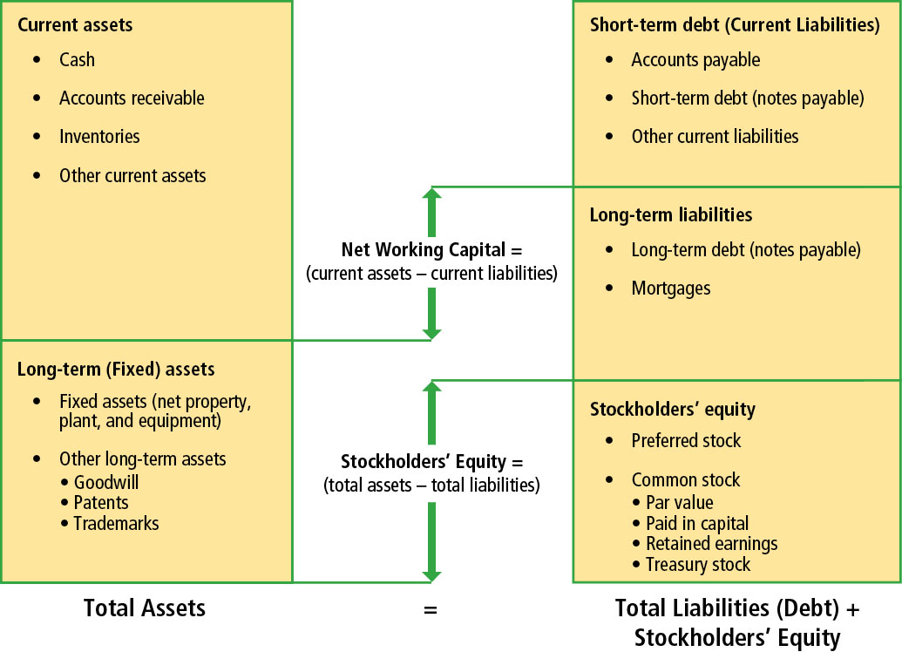
Figure 3.2 The Balance Sheet: An Overview

Slide 17
Balance Sheet Terms: Assets (1 of 2)
Current assets comprise assets that are relatively liquid, or expected to be converted into cash within 12 months. Current assets typically include:
  Cash
  Accounts receivable (payments due from customers who buy on credit)
  Inventory (raw materials, work in process, and finished goods held for eventual sale)
  Other assets (e.g., prepaid expenses are items paid for in advance)

Slide 18
Balance Sheet Terms: Assets (2 of 2)
Long-Term Asset
Fixed Assets
  Include assets that will be used for more than one year. Fixed assets typically include:
    Machinery and equipment, buildings, land
Other Assets
  Assets that are neither current assets nor fixed assets. They may include long-term investments and intangible assets such as patents, copyrights, and goodwill.

Slide 19
Balance Sheet Terms: Liabilities (1 of 2)
Debt (Liabilities)
  Money that has been borrowed from a creditor and must be repaid at some predetermined date.
  Debt could be current (must be repaid within 12 months) or long-term (repayment time exceeds one year).

Slide 20
Balance Sheet Terms: Liabilities (2 of 2)
Short-Term Debt (Current Liabilities)
  Accounts payable (Credit extended by suppliers to a firm when it purchases inventories)
  Accrued expenses (Short-term liabilities incurred in the firm’s operations but not yet paid for)
  Short-term notes (Borrowings from a bank or lending institution due and payable within 12 months)
Long-Term Debt
  Borrowings from banks and other sources for more than one year

Slide 21
Balance Sheet Terms: Equity
Equity: Shareholder’s investment in the firm in the form of preferred stock and common stock. Preferred stockholders enjoy preference with regard to payment of dividend and seniority at settlement of bankruptcy claims.
Treasury Stock: Stock that have been repurchased by the company
Retained Earnings: Cumulative total of all the net income over the life of the firm, less common stock dividends that have been paid out over the years
  Note that retained earnings are not equal to hard cash!

Slide 22
Balance Sheet: A = L + E
Assets (A)
  Current Assets
  Fixed Assets
    Total Assets
Liabilities (L)
  Current Liabilities
  Long-Term Liabilities
    Total Liabilities
Owner’s Equity (E)
  Preferred Stock
  Common Stock
  Retained Earnings
    Total Owner’s Equity
    Total Liabilities + Equity

Slide 23
Table 3.2 Walmart Balance Sheet for Years Ending January 31, 2017 and January 31, 2018 (expressed in millions) (1 of 4)
Assets | Dollars January 31, 2017 | Percentage of Assets January 31, 2017 | Dollars January 31, 2018 | Percentage of Assets January 31, 2018
Cash and cash equivalents | $6,867 | 3.5% | $6,756 | 3.3%
Accounts receivable | 5,835 | 2.9% | 5,614 | 2.7%
Inventories | 43,046 | 21.7% | 43,783 | 21.4%
Prepaid expenses and other current assets | 1,941 | 1.0% | 3,511 | 1.7%
Total current assets | $57,689 | 29.0% | $59,664 | 29.2%
Gross plant and equipment | $191,129 | 96.1% | $202,298 | 98.9%
Less accumulated depreciation | (76,951) | –38.7% | (87,480) | –42.8%
Net plant and equipment | $114,178 | 57.4% | $114,818 | 56.1%

Slide 24
Table 3.2 Walmart Balance Sheet for Years Ending January 31, 2017 and January 31, 2018 (expressed in millions) (2 of 4)
Blank | Dollars January 31, 2017 | Percentage of Assets January 31, 2017 | Dollars January 31, 2018 | Percentage of Assets January 31, 2018
Goodwill and other intangible assets | 26,958 | 13.6% | 30,040 | 14.7%
Total assets | $198,825 | 100.0% | $204,522 | 100.0%
Liabilities and Equity | Blank | Blank | Blank | Blank
Current liabilities | Blank | Blank | Blank | Blank
Accounts payable | $41,433 | 20.8% | $46,510 | 22.7%
Accrued liabilities | 21,575 | 10.9% | 24,031 | 11.7%
Short-term notes | 9,320 | 4.7% | 9,662 | 4.7%
Total current liabilities | $72,328 | 36.4% | $80,203 | 39.2%

Slide 25
Table 3.2 Walmart Balance Sheet for Years Ending January 31, 2017 and January 31, 2018 (expressed in millions) (3 of 4)
Blank | Dollars January 31, 2017 | Percentage of Assets January 31, 2017 | Dollars January 31, 2018 | Percentage of Assets January 31, 2018
Long-term debt | 51,362 | 25.8% | 45,179 | 22.1%
Total debt | $123,690 | 62.2% | $125,382 | 61.3%
Stockholders’ equity: | Blank | Blank | Blank | Blank
Common stock (par value) | $305 | 0.2% | $295 | 0.1%
Paid-in capital | 2,371 | 1.2% | 2,648 | 1.3%
Retained earnings | 72,459 | 36.4% | 76,197 | 37.3%
Total equity | $75,135 | 37.8% | $79,140 | 38.7%
Total liabilities and equity | $198,825 | 100.0% | $204,522 | 100.0%

Slide 26
Table 3.2 Walmart Balance Sheet for Years Ending January 31, 2017 and January 31, 2018 (expressed in $ millions) (4 of 4)
Total assets exceeded $200 billion, consisting of about one-third current assets and two-thirds of long-term assets
Holding over $6 billion in cash, or about 3% of all the company’s assets.
Held 21 percent of its assets as inventory and 3% as accounts receivable.
Property, plant and equipment accounted for about 56% of its assets.
Intangible assets made up 15% of the assets.

Slide 27
Debt Ratio
Debt ratio is the percentage of assets that are financed by debt.
Debt ratio is an indication of “financial risk.” Generally, the higher the ratio, the more risky the firm is, as firms have to pay interest on debt regardless of the earnings or cash flow situation.

Slide 28
Net Working Capital
Net Working Capital = Current assets − current liabilities
  The larger the net working capital, the better the firm’s ability to repay its debt.
  Net working capital can be positive or zero or negative. It is generally positive.
  An increase in net working capital may not always be good news. For example, if the level of inventory goes up, current assets will increase, and thus net working capital will also increase. However, increasing inventory level may well be a sign of inability to sell.

Slide 29
Measuring Cash Flows

Slide 30
Measuring Cash Flows
Profits in the financial statements are calculated on “accrual basis” rather than “cash basis.”
Thus, profits are not equal to cash.

Slide 31
Accrual Basis Accounting
Accrual basis is the principle of recording revenues when earned and expenses when incurred rather than when cash is received or paid.
  Thus, sales revenue recorded in the income statement includes both cash and credit sales. Similarly, inventory purchases may not be entirely paid for in cash because suppliers may extend credit for some of the purchases.
Treatment of long-term assets: Asset acquisitions (that will last more than one year, such as equipment) are not recorded as an expense but are written off every year as depreciation expense.

Slide 32
The Beginning Point: Changes in the Balance Sheet and Cash Flows
Sources of Cash | Use of Cash
Decrease in an Asset | Increase in an Asset
Example: Selling inventories or collecting receivables provides cash. | Example: Investing in fixed assets or buying more inventories uses cash.
Increase in a Liability or Equity | Decrease in a Liability or Equity
Example: Borrowing funds or selling stock provides the firm with cash. | Example: Paying off a loan or buying back stock uses cash.

Slide 33
Table 3.3 Walmart’s Changes in Balance Sheets Between 2017 and 2018 Create Sources and Uses of Cash ($ millions) (1 of 2)
Changes in Assets | January 31, 2017 | January 31, 2018 | Changes | Sources | Uses
Accounts receivable | $5,835 | $5,614 | ($221) | ($221) | Blank
Inventories | $43,046 | $43,783 | $737 | Blank | $737
Prepaid expenses and other current assets | $1,941 | $3,511 | $1,570 | Blank | $1,570
Gross plant and equipment | $191,129 | $202,298 | $11,169 | Blank | $11,169
Goodwill and other intangible assets | $26,958 | $30,040 | $3,082 | Blank | $3,082

Slide 34
Table 3.3 Walmart’s Changes in Balance Sheets Between 2017 and 2018 Create Sources and Uses of Cash ($ millions) (2 of 2)
Changes in debt and equity | January 31, 2018 | January 31, 2017 | Changes | Sources | Uses
Accounts payable | $41,433 | $46,510 | $5,077 | $5,077 | Blank
Accrued liabilities | $21,575 | $24,031 | $2,456 | $2,456 | Blank
Short-term notes | $9,320 | $9,662 | $342 | $342 | Blank
Long-term debt | $51,362 | $45,179 | ($6,183) | Blank | ($6,138)
Par value | $305 | $295 | ($10) | Blank | ($10)
Paid-in capital | $2,371 | $2,648 | $277 | $277 | Blank

Slide 35
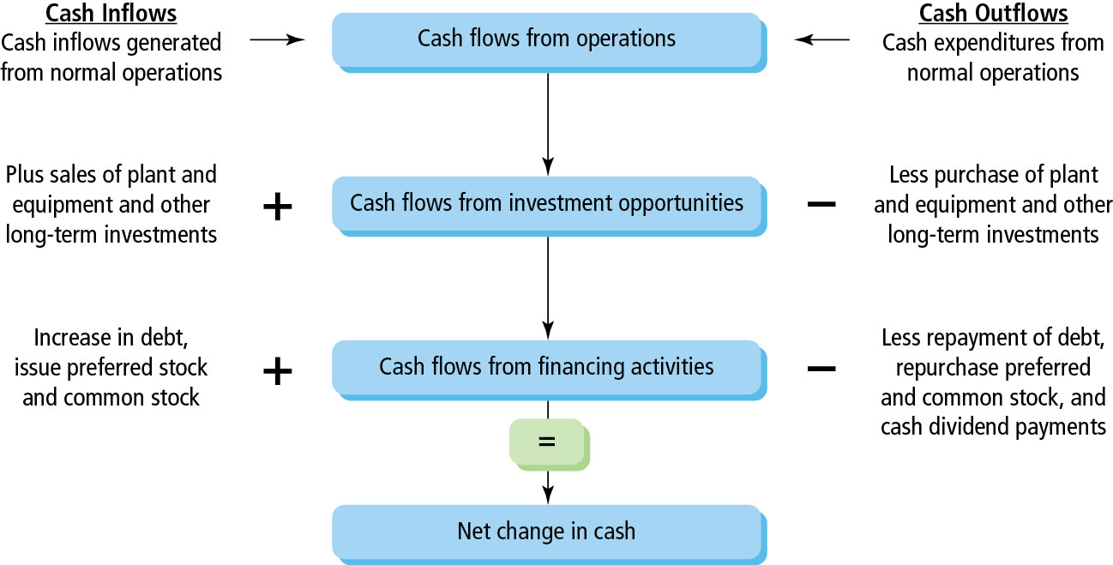
Figure 3.3 Statement of Cash Flows: An Overview

Slide 36
Three Sources of Cash Flows (1 of 2)
Cash flows from Operations (e.g., sales revenue, labor expenses)
Cash flows from Investments (e.g., purchase of new equipment)
Cash flows from Financing (e.g., borrowing funds, payment of dividends)

Slide 37
Three Sources of Cash Flows (2 of 2)
If we know the cash flows from operations, investments, and financing, we can understand the firm’s cash flow position better, that is, how cash was generated and how it was used.

Slide 38
Income Statement Conversion: From Accrual to Cash Basis
Cash Flow from Operations: Five Steps
  Add back depreciation.
  Subtract (add) any increase (decrease) in accounts receivable.
  Subtract (add) any increase (decrease) in inventory.
  Subtract (add) any increase (decrease) in other current assets.
  Add (subtract) any increase (decrease) in accounts payable
  Add (subtract) any increase (decrease) in other accrued expenses.

Slide 39
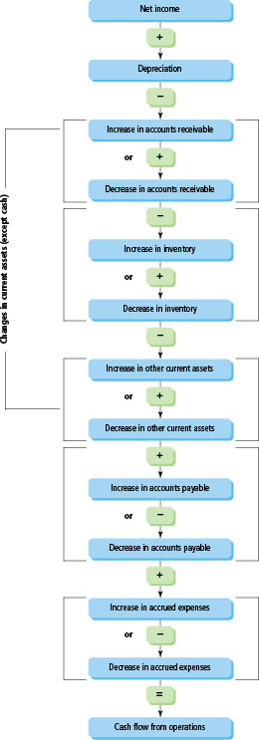
Figure 3.4 Cash Flow from Operations

Slide 40
Walmart’s Cash Flow from Operations
Net income | Blank | $9,862
Depreciation expense (Source of cash) | $10,529 | Blank
Decrease in accounts receivable (Source of cash) | 221 | Blank
Increase in inventories (Use of cash) | (737) | Blank
Increase in other current assets (Use of cash) | (1,570) | Blank
Increase in accounts payable (Source of cash) | 5,077 | Blank
Increase in accrued liabilities (Source of cash) | 2,456 | Blank
Total adjustments to net income | Blank | $15,976
Cash flows from operating activities | Blank | $25,838

Slide 41
Cash Flow from Investing in
Long-Term Assets
Long-term assets include fixed assets and other long-term assets. A firm may be engaged in acquisition and sale of such assets leading to cash flows.
Walmart example:
Changes in Long-Term Assets | January 31, 2017 | January 31, 2018 | Changes | Inflow | Outflow
Gross plant and equipment | $191,129 | $202,298 | $11,169 | Blank | ($11,169)
Goodwill and other intangible assets | $26,958 | $30,040 | $3,082 | Blank | $3,082

Slide 42
Cash Flows from Financing the Business
Cash Inflow | Cash Outflow
The firm borrows more money (an increase in short-term or long-term debt). | The firm repays debt (a decrease in short-term or long-term debt).
Owner(s) invest in the business (an increase in stockholders’ equity). | The firm pays dividends to the owner(s) or repurchases the owners’ stocks (a decrease in equity).

Slide 43
Financing the Business Illustrated: Walmart
Dividends paid to shareholders | ($6,124)
Increase in short-term notes payable | 342
Decrease in long-term debt | ($6,183)
Issued new common stock (increase in par value and paid-in capital) | $267
Net cash outflows from financing activities | ($11,698)

Slide 44
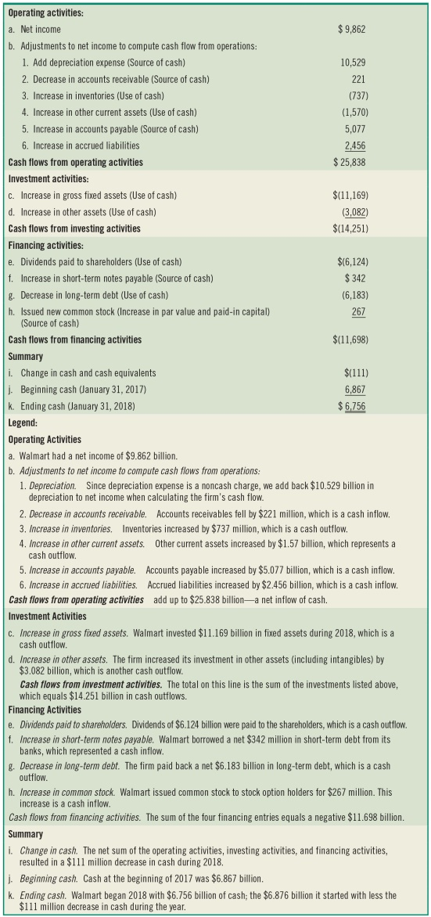
Table 3.4 The Walmart Company Statement of Cash Flows ($ millions) Year Ended January 31, 2018

Slide 45
Suggestions for Computing Cash Flows
Consider one section at a time.
You need only two items from the income statement: net income and depreciation expense.
Consider change for all items in the balance sheet, except ignore accumulated depreciation and net fixed assets; ignore change in retained earnings.

Slide 46
The Limitations of Financial Statements and Accounting Malpractice

Slide 47
Accounting Malpractice and Limitations of Financial Statements
Financial statements are prepared following the Financial Accounting Standards Board’s generally accepted accounting principles (GAAP).
Because accounting rules give managers discretionary powers, it is possible that two firms with similar financial performance may report different results.
There have been several cases of accounting malpractice where rules have been broken.

Slide 48
Key Terms (1 of 7)
Accounts payable (trade credit)
Accounts receivable
Accrual basis accounting
Accrued expenses
Accumulated depreciation
Balance sheet
Book value
Cash

Slide 49
Key Terms (2 of 7)
Cash basis accounting
Common-size balance sheet
Common-size income statement
Common stock
Common stockholders
Cost of goods sold
Current assets (gross working capital)
Debt

Slide 50
Key Terms (3 of 7)
Debt ratio
Depreciation expense
Dividends per share
Earnings before taxes (taxable income)
Earnings per share
Equity
Financing cash flows
Fixed assets

Slide 51
Key Terms (4 of 7)
Fixed costs
Free cash flows
Gross fixed assets
Gross profit
Gross profit margin
Income statement (profit and loss statement)
Inventories
Liquidity

Slide 52
Key Terms (5 of 7)
Long-term debt
Mortgage
Net fixed assets
Net income (net profit, or earnings available to common stockholders)
Net profit margin
Net working capital
Operating expenses

Slide 53
Key Terms (6 of 7)
Operating income (earnings before interest and taxes)
Operating profit margin
Other current assets
Paid-in capital
Par value
Preferred stockholders
Profit margins
Retained earnings

Slide 54
Key Terms (7 of 7)
Semi-variable costs
Short-term debt (current liabilities)
Short-term notes (debt)
Statement of cash flows
Treasury stock
Variable costs

Slide 55

Copyright
This work is protected by United States copyright laws and is provided solely for the use of instructors in teaching their courses and assessing student learning. Dissemination or sale of any part of this work (including on the World Wide Web) will destroy the integrity of the work and is not permitted. The work and materials from it should never be made available to students except by instructors using the accompanying text in their classes. All recipients of this work are expected to abide by these restrictions and to honor the intended pedagogical purposes and the needs of other instructors who rely on these materials.

