Slide 1
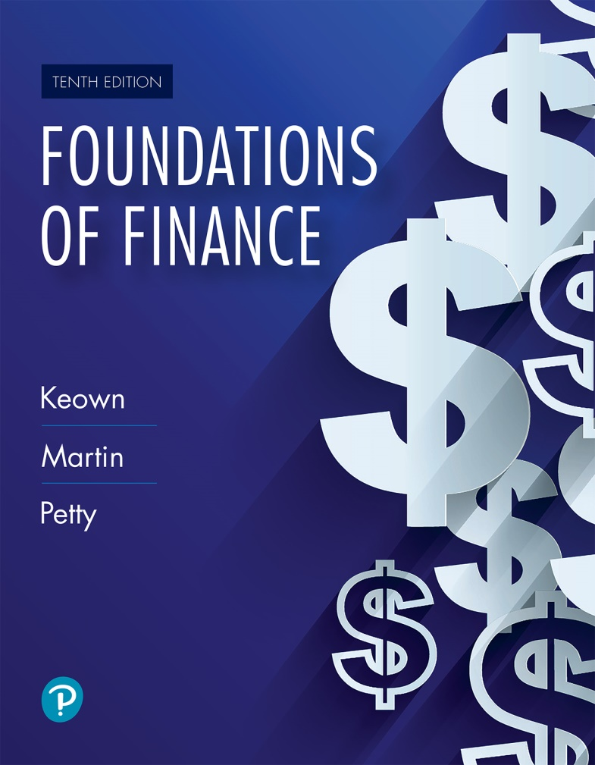
Foundations of Finance
Tenth Edition
Chapter 4
Evaluating a Firm’s Financial Performance
Copyright © 2020, 2017, 2014 Pearson Education, Inc. All Rights Reserved
Notes:
If this PowerPoint presentation contains mathematical equations, you may need to check that your computer has the following installed:
1) Math Type Plugin
2) Math Player (free versions available)
3) NVDA Reader (free versions available)

Slide 2
Learning Objectives
4.1 Explain the purpose and importance of financial analysis.
4.2 Calculate and use a comprehensive set of measurements to evaluate a company’s performance.
4.3 Describe the limitations of financial ratio analysis.

Slide 3
The Purpose of Financial Analysis

Slide 4
The Purpose of Financial Analysis
Financial analysis using ratios
  A popular way to analyze the financial statements is by computing ratios. A ratio is a relationship between two numbers, e.g., a given ratio of A:B = 30:10 means A is 3 times B.
A ratio by itself may have no meaning. Hence, a given ratio is compared to
  ratios from previous years
  ratios of other firms or leaders in the same industry
See Figure 4.1 for a financial analysis example.

Slide 5
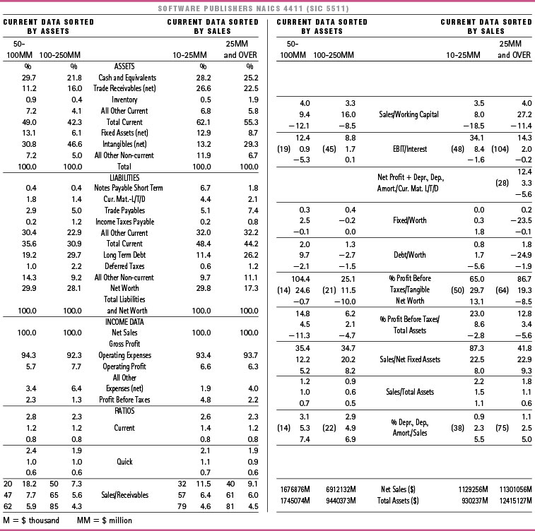
Figure 4.1 Financial Statement Data by Industry Norms for Software Publishers

Slide 6
Uses of Financial Ratios: Within the Firm (1 of 3)
Identify deficiencies in a firm’s performance and take corrective action.
Evaluate employee performance and determine incentive compensation.
Compare the financial performance of the firm’s different divisions.

Slide 7
Uses of Financial Ratios: Within the Firm (2 of 3)
Prepare, at both firm and division levels, financial projections.
Understand the financial performance of the firm’s competitors.
Evaluate the financial condition of a major supplier.

Slide 8
Uses of Financial Ratios: Within the Firm (3 of 3)
Financial ratios are used by
Lenders in deciding whether or not to lend to a company.
Credit-rating agencies in determining a firm’s credit worthiness.
Investors (shareholders and bondholders) in deciding whether or not to invest in a company.
Major suppliers in deciding to whether or not to extend credit to a company or in designing the specific credit terms.

Slide 9
Measuring Key Financial Relationships

Slide 10
Question 1: How Liquid Is the Firm? Can It Pay Its Bills?
A liquid asset is one that can be converted quickly and routinely into cash at the current market price.
Liquidity measures the firm’s ability to pay its bills on time. It indicates the ease with which noncash assets can be converted to cash to meet the financial obligations.

Slide 11
How Liquid Is the Firm?
Liquidity is measured by two approaches:
  Comparing the firm’s current assets and current liabilities
  Examining the firm’s ability to convert accounts receivables and inventory into cash on a timely basis

Slide 12
Measuring Liquidity: Perspective 1
Compare a firm’s current assets with current liabilities using:
  Current Ratio
  Acid Test or Quick Ratio

Slide 13
Table 4.1 Walmart Income Statement for the Year Ending January 31, 2018 (expressed in millions, except per share data) (1 of 2)
Sales | $ 500,343
Cost of goods sold | (373,396)
Gross profit | $ 126,947
Operating expenses: | Blank
Selling, general and administrative expenses | $ (95,981)
Depreciation expenses | (10,529)
Total operating expenses | $(106,510)
Operating income (earning before interest and taxes) | $ 20,437
Interest expense | (2,178)
Non-operating losses | (3,136)
Earnings before taxes (taxable income) | $ 15,123
Income taxes | (5,261)
Net income (earnings available to common shareholders) | $ 9,862

Slide 14
Table 4.1 Walmart Income Statement for the Year Ending January 31, 2018 (expressed in millions, except per share data) (2 of 2)
Additional information: | Blank
Number of shares outstanding (millions) | 3,007
Earnings per share | $ 3.28
Dividends paid to stockholders | $ 6,124
Dividends per share | $ 2.04

Slide 15
Table 4.2 Walmart’s Balance Sheet for the Year Ending January 31, 2018 (expressed in millions) (1 of 2)
Cash and cash equivalents | $ 6,756
Accounts receivable | 5,614
Inventories | 43,783
Prepaid expenses and other current assets | 3,511
Total current assets | $ 59,664
Gross plant and equipment | $202,298
Less accumulated depreciation | (87,480)
Net plant and equipment | $114,818
Goodwill and other intangible assets | 30,040
Total assets | $ 204,522

Slide 16
Table 4.2 Walmart’s Balance Sheet for the Year Ending January 31, 2018 (expressed in millions) (2 of 2)
Liabilities and Equity | Blank
Accounts payable | $ 46,510
Accrued liabilities | 24,031
Short-term notes | 9,662
Total current liabilities | $ 80,203
Long-term debt | 45,179
Total debt | $125,382
Stockholders' equity | Blank
Common stock (par value) | $ 295
Paid-in capital | 2,648
Retained earnings | 76,197
Total equity | $ 79,140
Total liabilities and equity | $ 204,522

Slide 17
Current Ratio
Current ratio compares a firm’s current assets to its current liabilities.
Walmart has $0.74 in current assets for every $1 in current liabilities. Walmart’s liquidity is slightly less than that of Target, which has a current ratio of 0.95.

Slide 18
Acid Test or Quick Ratio
Quick ratio compares cash and current assets (minus inventory) that can be converted into cash during the year with the liabilities that should be paid within the year.
Walmart has 15 cents in quick assets for every $1 in current debt. Walmart is slightly less liquid than Target, which has 20 cents for every $1 in current debt.

Slide 19
Measuring Liquidity: Perspective 2
Measures a firm’s ability to convert accounts receivable and inventory into cash:
  Days in Receivables or Average Collection Period
  Inventory Turnover

Slide 20
Days in Receivables (Average Collection Period)
How long does it take to collect the firm’s receivables?
Walmart (at 10.24 days) is slightly slower than Target (at 9.56 days) in collecting accounts receivable.

Slide 21
Accounts Receivable Turnover
How many times are the accounts receivable “rolled-over” each year?
The conclusion is the same — Walmart (35.65X) is slightly slower than Target (38X) in collecting accounts receivable.

Slide 22
Days in Inventory
How long is the inventory held before being sold?
Walmart carries inventory for a shorter time (42.80 days) than Target (61.81 days).

Slide 23
Inventory Turnover
How many times are the firm’s inventories sold and replaced during the year?
The conclusion is the same—Walmart moves inventory much quicker (8.53X) than Target (5.91X).

Slide 24
Question 2: Are the Firm’s Managers Generating Adequate Operating Profits from the Company’s Assets?
This question focuses on the profitability of the assets in which the firm has invested. We consider the following ratios to answer the question:
  Operating Return on Assets
  Operating Profit Margin
  Total Asset Turnover
  Fixed Assets Turnover

Slide 25
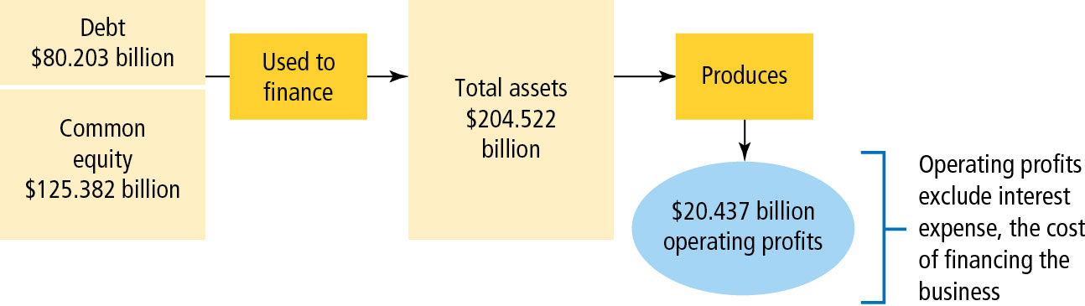
Figure 4.2 Walmart Operating Profits Resulting from Asset Investments

Slide 26
Operating Return on Assets (ORA)
O R A indicates the level of operating profits relative to the firm’s total assets.
Thus Walmart managers are generating 10 cents of
operating profit for every $1 of assets, which is less than Target (11.1%).

Slide 27
Disaggregation of Operating Return on Assets
Calculated as follows:

Slide 28
Managing Operations: Operating Profit Margin (O P M)
O P M examines how effective the company is in managing its cost of goods sold and operating expenses that determine the operating profit.
Target managers are better than Walmart in managing the cost of goods sold and operating expenses, as the Operating Profit Margin for Target is 6.0% compared to Walmart at 4.1%.

Slide 29
Managing Assets: Total Asset Turnover
This ratio measures how efficiently a firm is using its assets in generating sales.
Walmart is generating $2.45 cents in sales for every $1 invested in assets, which is higher than Target (1.84X).

Slide 30
Managing Assets: Fixed Asset Turnover
Examines efficiency in generating sales from investment in “fixed assets.”
Walmart generates $4.36 in sales for every $1 invested in fixed assets, which is much higher than Target (2.87X).

Slide 31
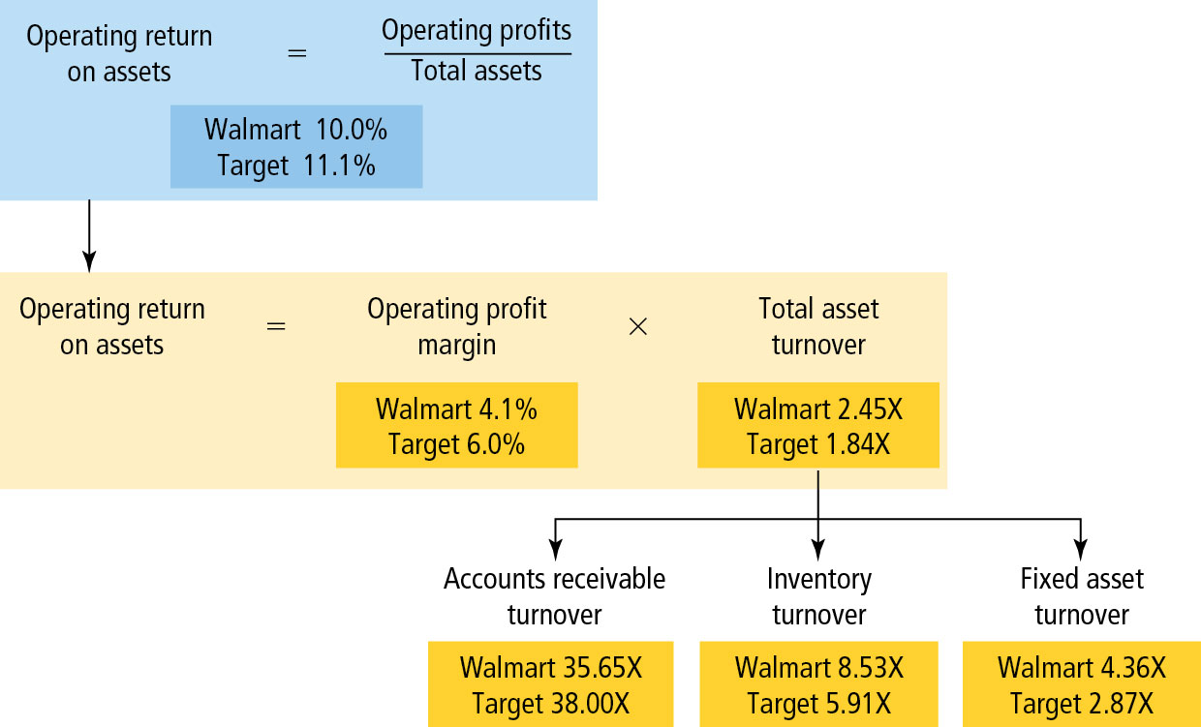
Figure 4.3 Analysis of Walmart’s Operating Return on Assets

Slide 32
Question 3: How Is the Firm Financing Its Assets?
Here we examine the question: Does the firm finance its assets by debt or equity or both? We use the following two ratios to answer the question:
  Debt Ratio
  Times Interest Earned

Slide 33
Debt Ratio
This ratio indicates the percentage of the firm’s assets that are financed by debt (implying that the balance is financed by equity).
Walmart finances 61% of its assets by debt and 39% by equity compared to Target financing 70% of its assets by debt.

Slide 34
Times Interest Earned (1 of 2)
This ratio indicates the amount of operating income available to service interest payments.
Walmart’s operating income is 9 times the annual interest expense and higher than Target (6.47X) due to its relatively higher operating profits.

Slide 35
Times Interest Earned (2 of 2)
Note
  Interest is not paid with income but with cash.
  Oftentimes, firms are required to repay part of the principal annually.
  Thus, times interest earned is only a crude measure of the firm’s capacity to service its debt.

Slide 36
Question 4: Are the Firm’s Managers Providing a Good Return on the Capital Provided by the Company’s Shareholders?
This is analyzed by computing the firm’s accounting return on common stockholder’s investment or return on equity (R O E).
Note: Common equity includes both common stock and retained earnings.

Slide 37
Return On Equity (ROE)
Owners of Walmart are receiving a 12.5% return compared to Target’s 25%.
One of the reasons for lower ROE is the lower operating return on assets (10.0% for Walmart v. 11.1% for Target).
  A lower return on the firm’s assets will always result in a lower return on equity and vice versa.
Also, Walmart uses less debt (61% for Walmart v. 70% for Target).
  Higher debt translates to higher ROE under favorable business conditions.

Slide 38
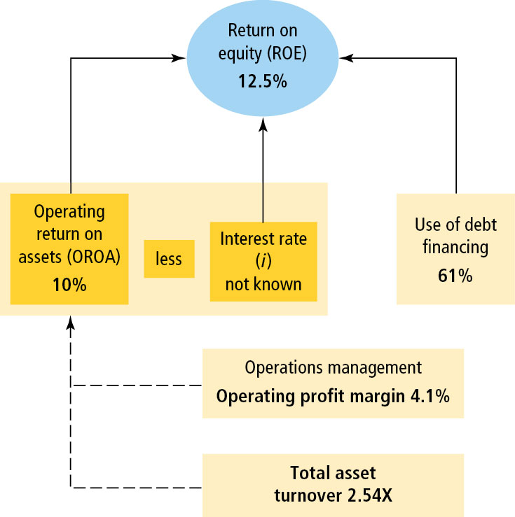
Figure 4.4 Return on Equity Relationships for the Walmart Company

Slide 39
Question 5: Are the Firm’s Managers Creating Shareholder Value?
We can use two approaches to answer this question:
  Market value ratios (P/E)
  Economic Value Added (E V A)
These ratios indicate what investors think of management’s past performance and future prospects.

Slide 40
Price/Earnings Ratio
Measures how much investors are willing to pay for $1 of reported earnings.
Investors are willing pay more for Walmart for every dollar of earnings per share compared to Target ($26.22 for Walmart versus $14.07 for Target).

Slide 41
Price/Book Ratio
Compares the market value of a share of stock to the book value per share of the reported equity on the balance sheet.
A ratio greater than 1 indicates that the shares are more valuable than what the shareholders originally paid. The Walmart ratio of 3.27X is lower than Target ratio of 3.53X, suggesting that Target is perceived as having better growth prospects relative to its risk.

Slide 42
Summary of Ratios

Slide 43
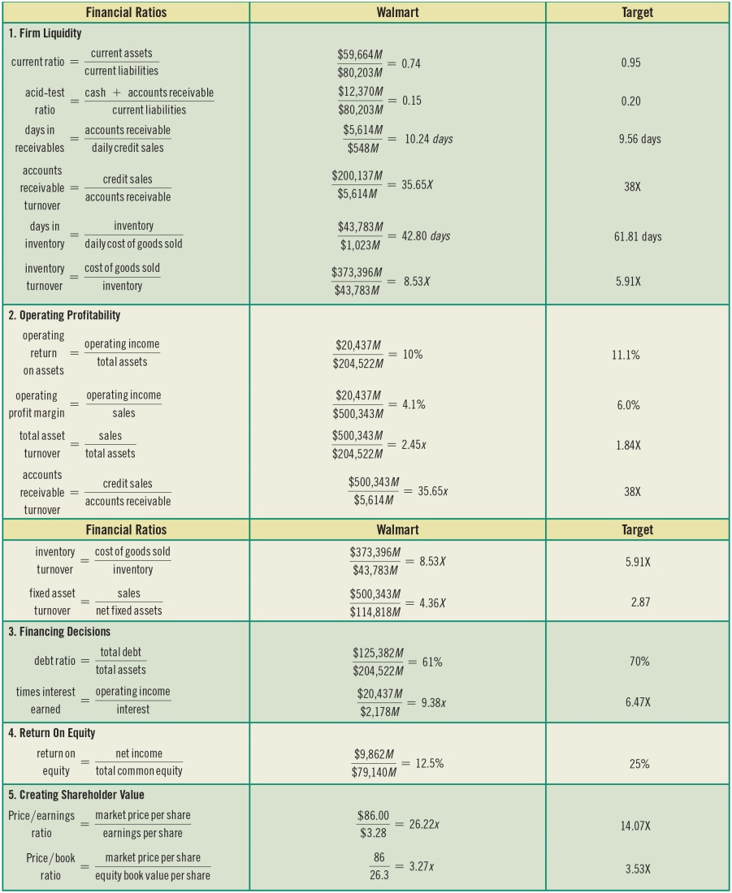
Table 4.3 Walmart and Target: Financial Ratio Analysis

Slide 44
The Limitations of Financial Ratio Analysis

Slide 45
The Limitations of Financial Ratio Analysis
It is sometimes difficult to identify industry categories or comparable peers.
The published peer group or industry averages are only approximations.
Industry averages may not provide a desirable target ratio.
Accounting practices differ widely among firms.
A high or low ratio does not automatically lead to a specific conclusion.
Seasons may bias the numbers in the financial statements.

Slide 46
Key Terms (1 of 2)
Accounts receivable turnover ratio
Acid-test (quick) ratio
Asset management
Current ratio
Days in inventory
Days in receivables (average collection period)
Debt ratio
Financial ratios
Fixed asset turnover
Inventory turnover

Slide 47
Key Terms (2 of 2)
Liquidity
Operating profit margin
Operating return on assets (OROA)
Operations management
Price/book ratio
Price/earnings ratio
Return on equity
Times interest earned
Total asset turnover
Total common equity (total stockholder equity)

Slide 48

Copyright
This work is protected by United States copyright laws and is provided solely for the use of instructors in teaching their courses and assessing student learning. Dissemination or sale of any part of this work (including on the World Wide Web) will destroy the integrity of the work and is not permitted. The work and materials from it should never be made available to students except by instructors using the accompanying text in their classes. All recipients of this work are expected to abide by these restrictions and to honor the intended pedagogical purposes and the needs of other instructors who rely on these materials.

