Slide 1
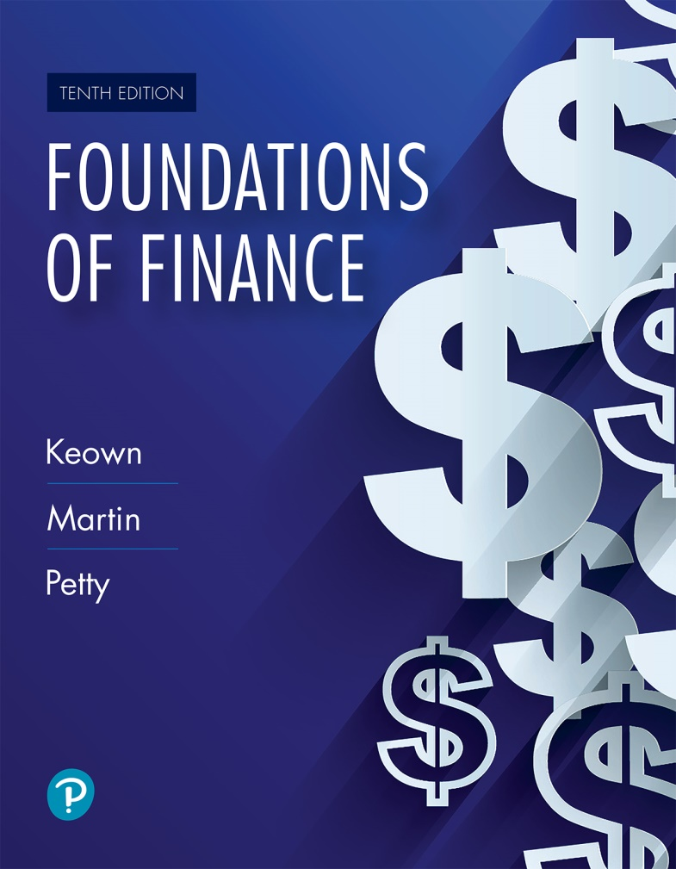
Foundations of Finance
Tenth Edition
Chapter 5
The Time Value of Money
Copyright © 2020, 2017, 2014 Pearson Education, Inc. All Rights Reserved
Notes:
If this PowerPoint presentation contains mathematical equations, you may need to check that your computer has the following installed:
1) Math Type Plugin
2) Math Player (free versions available)
3) NVDA Reader (free versions available)

Slide 2
Learning Objectives
5.1 Explain the mechanics of compounding, and bringing the value of money back to the present.
5.2 Understand annuities.
5.3 Determine the future or present value of a sum when there are nonannual compounding periods.
5.4 Determine the present value of an uneven stream of payments and understand perpetuities.

Slide 3
Compound Interest, Future, and Present Value

Slide 4
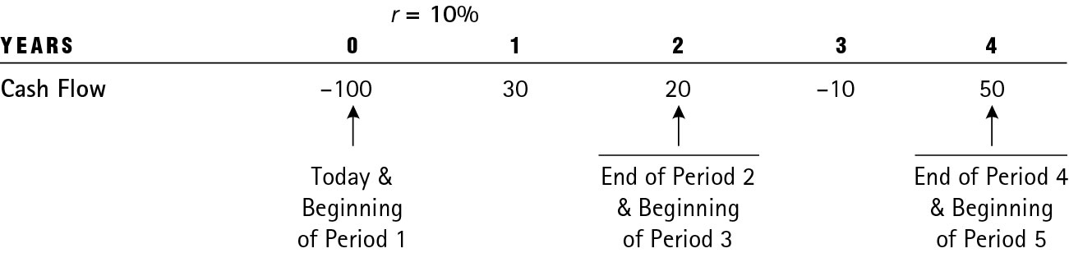
Using Timelines to Visualize Cash Flows
Timeline of cash flows

Slide 5
Compound Interest (1 of 2)
Compounding is when interest paid on an investment during the first period is added to the principal; then, during the second period, interest is earned on the new sum (that includes the principal and interest earned so far).

Slide 6
Compound Interest (2 of 2)
Example: Compute compound interest on $100 invested at 6% for three years with annual compounding.
  First year interest is $6.00; principal now is $106.00.
  Second year interest is $6.36; principal now is $112.36.
  Third year interest is $6.74; principal now is $119.10.
  Total interest earned: $19.10

Slide 7
Future Value
Future value is the amount a sum will grow to in a certain number of years when compounded at a specific rate.
FVN = the future of the investment at the end of “n” years
r = the annual interest (or discount) rate
n = number of years
PV = the present value, or original amount invested at the beginning of the first year

Slide 8
Future Value Example
Example: What will be the FV of $100 in 2 years at interest rate of 6%?

Slide 9
How to Increase the Future Value?
Future value can be increased by
  Increasing number of years of compounding (N)
  Increasing the interest or discount rate (r)
  Increasing the original investment (PV)
See example on next slide.

Slide 10
Changing R, N, and PV
a. You deposit $500 in bank for 2 years. What is the FV at 2%? What is the FV if you change interest rate to 6%?
b. Continue the same example but change time to 10 years. What is the FV now?
c. Continue the same example but change contribution to $1,500. What is the FV now?

Slide 11
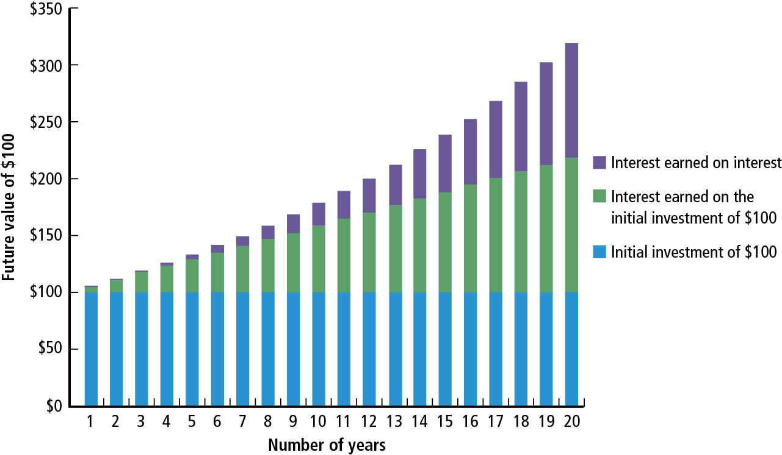
Figure 5.1 $100 Compounded at 6 Percent over 20 Years

Slide 12
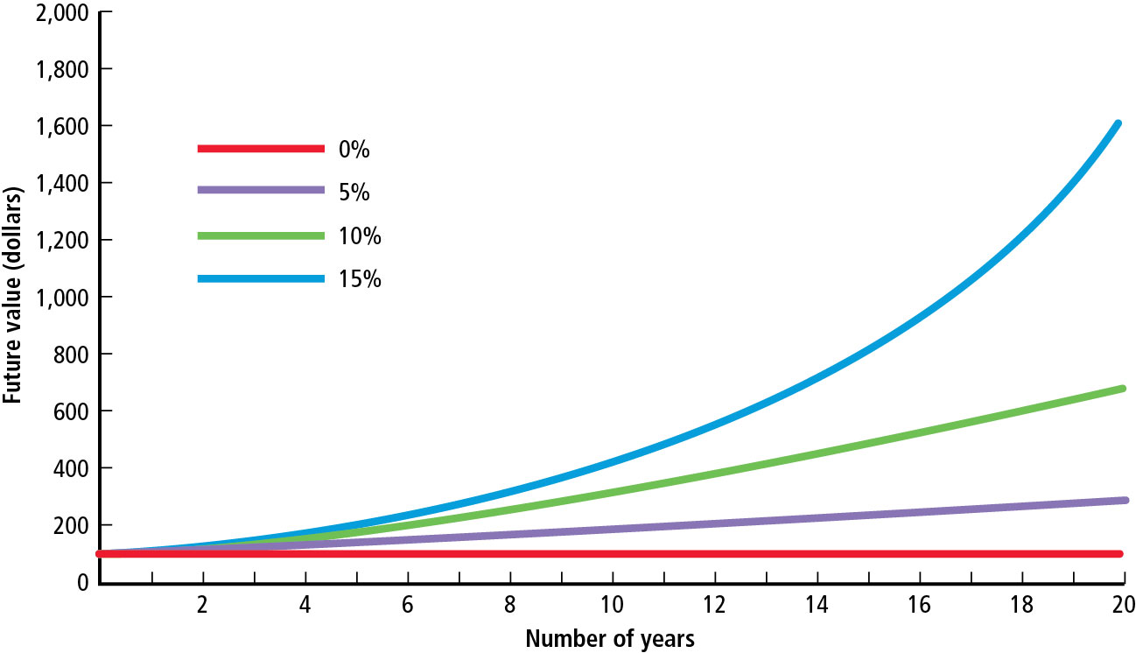
Figure 5.2 The Future of $100 Initially Deposited and Compounded at 0, 5, 10, and 15 Percent (1 of 2)

Slide 13
Figure 5.2 The Future of $100 Initially Deposited and Compounded at 0, 5, 10, and 15 Percent (2 of 2)
Figure 5.2 illustrates that we can increase the FV by
  Increasing the number of years for which money is invested
  Investing at a higher interest rate

Slide 14
Computing Future Values Using Calculator or Excel
Review discussion in the textbook.
Excel Function for FV: = FV(rate, nper, pmt, pv)

Slide 15
Present Value (1 of 2)
Present value reflects the current value of a future payment or receipt.

Slide 16
Present Value (2 of 2)
FVn = the future value of the investment at the end of n years
n = number of years until payment is received
r = the interest rate
PV = the present value of the future sum of money

Slide 17
Present Value Example
What will be the present value of $500 to be received 10 years from today if the discount rate is 6%?

Slide 18
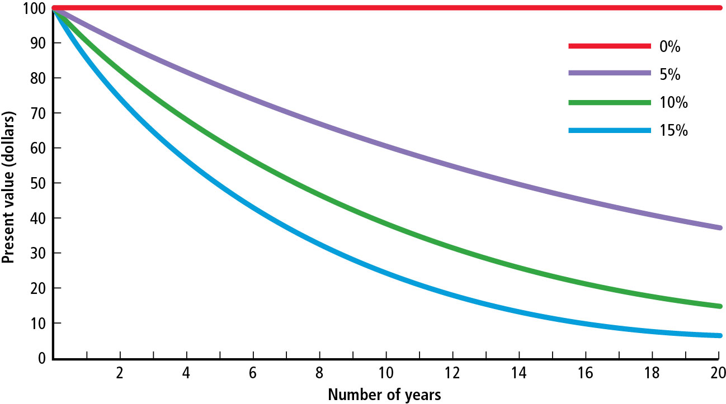
Figure 5.3 The Present Value of $100 to Be Received at a Future Date and Discounted Back to the Present at 0, 5, 10, and 15 Percent (1 of 2)

Slide 19
Figure 5.3 The Present Value of $100 to Be Received at a Future Date and Discounted Back to the Present at 0, 5, 10, and 15 Percent (2 of 2)
Figure 5.3 illustrates that PV is lower if
  Time period is longer, or
  Interest rate is higher.

Slide 20
Using Excel
Excel Function for PV: = PV(rate,nper,pmt,fv)

Slide 21
Annuities

Slide 22
Annuities
An annuity is a series of equal dollar payments for a specified number of years.
Ordinary annuity payments occur at the end of each period.

Slide 23
FV of Annuity
Compound Annuity
Depositing or investing an equal sum of money at the end of each year for a certain number of years and allowing it to grow

Slide 24
FV Annuity Example
What will be the FV of a 5-year, $500 annuity compounded at 6%?

Slide 25
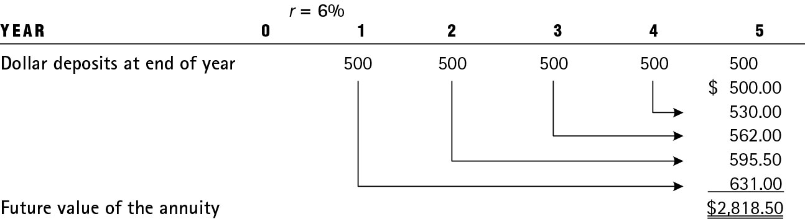
Table 5.1 Growth of a 5-Year, $500 Annuity Compounded at 6 Percent

Slide 26
FV of an Annuity – Using the Mathematical Formulas (1 of 2)
FV_{n} = the future of an annuity at the end of the nth year
PMT = the annuity payment deposited or received at the end of each year
r = the annual interest (or discount) rate
n = the number of years

Slide 27
FV of an Annuity – Using the Mathematical Formulas (2 of 2)
What will $500 deposited in the bank every year for 5 years at 6% be worth?
​

Slide 28
FV of Annuity: Changing PMT, N, and r (1 of 2)
What will $5,000 deposited annually for 50 years be worth at 7%?
  FV = $2,032,644
  Contribution = $250,000 (= 5000×50)
Change PMT = $6,000 for 50 years at 7%
  FV = $2,439,173
  Contribution = $300,000 (= 6000×50)

Slide 29
FV of Annuity: Changing PMT, N, and r (2 of 2)
3. Change time = 60 years, $6,000 at 7%
  FV = $4,881,122
  Contribution = $360,000 (= 6000×60)
4. Change r = 9%, 60 years, $6,000
  FV = $11,668,753
  Contribution = $360,000 (= 6000×60)

Slide 30
Present Value of an Annuity
Pensions, insurance obligations, and interest owed on bonds are all annuities. To compare these three types of investments we need to know the present value (PV) of each.

Slide 31
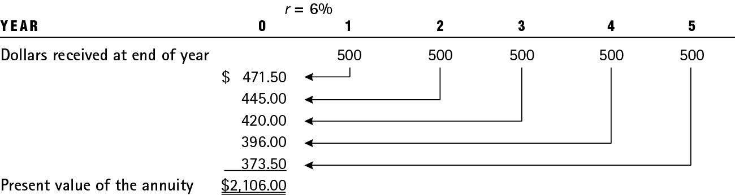
Table 5.2 Illustration of a 5-Year, $500 Annuity Discounted to the Present at 6 Percent

Slide 32
PV of Annuity – Using the Mathematical Formulas

Slide 33
Annuities Due (1 of 2)
Annuities due are ordinary annuities in which all payments have been shifted forward by one time period. Thus, with annuity due, each annuity payment occurs at the beginning of the period rather than at the end of the period.

Slide 34
Annuities Due (2 of 2)
Continuing the same example: If we assume that $500 invested every year for 5 years at 6% to be annuity due, the future value will increase due to compounding for one additional year.
​
(versus $2,818.80 for ordinary annuity)

Slide 35
Amortized Loans (1 of 2)
Loans paid off in equal installments over time are called amortized loans.
Examples: Home mortgages, auto loans
Reducing the balance of a loan via annuity payments is called amortizing.

Slide 36
Amortized Loans (2 of 2)
The periodic payment is fixed. However, different amounts of each payment are applied toward the principal and interest. With each payment, you owe less toward principal. As a result, the amount that goes toward interest declines with every payment (as seen in Figure 5.4).

Slide 37
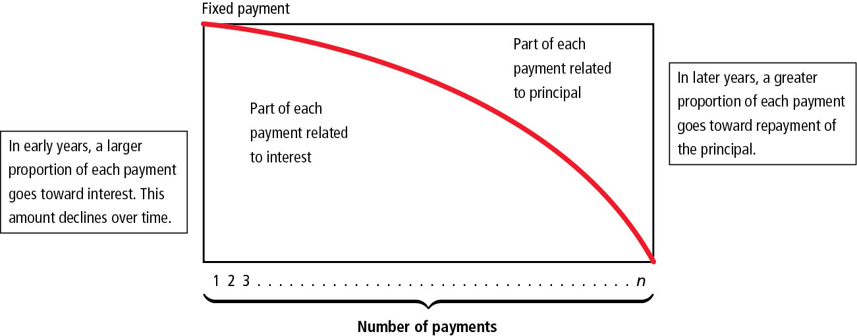
Figure 5.4 The Amortization Process

Slide 38
Amortization Example
Example: If you want to finance a new machinery with a purchase price of $6,000 at an interest rate of 15% over 4 years, what will your annual payments be?

Slide 39
Finding PMT – Using the Mathematical Formulas
Finding Payment: Payment amount can be found by solving for PMT using PV of annuity formula.

Slide 40
Table 5.3 Loan Amortization Schedule Involving a $6,000 Loan at 15 Percent to Be Repaid in 4 Years
Year | Annuity | Interest portion of the Annuityª | Repayment of the principal portion of the Annuity^{b} | Outstanding loan Balance After the Annuity Payment
0 | 0 | 0 | 0 | $6,000.00
1 | $2,101.59 | $900.00 | $1,201.59 | 4,798.41
2 | 2,101.59 | 719.76 | 1,381.83 | 3,416.58
3 | 2,101.59 | 512.49 | 1,589.10 | 1,827.48
4 | 2,101.59 | 274.12 | 1,827.48 | Blank
ªThe interest portion of the annuity is calculated by multiplying the outstanding loan balance at the beginning of the year by the interest rate of 15%. Thus, for year 1 it was $6,000 × 0.15 = $900.00; for year 2 it was $4,798.41 × 0.15 = $719.76; and so on.
^{b}Repayment of the principal portion of the annuity was calculated by subtracting the interest portion of the annuity (column 2) from the annuity (column 1).

Slide 41
Making Interest Rates Comparable

Slide 42
Making Interest Rates Comparable
We cannot compare rates with different compounding periods. For example, 5% compounded annually is not the same as 5% percent compounded quarterly.
To make the rates comparable, we compute the annual percentage rate (APR) and the effective annual rate (EAR).

Slide 43
Quoted Rate versus Effective Rate (1 of 2)

Slide 44
Quoted Rate versus Effective Rate (2 of 2)
Quoted rate could be very different from the effective rate if compounding is not done annually.
If the APR of a quoted loan is 7.85%, but it is compounded quarterly, the EAR is actually 8.084%.

Slide 45
Table 5.4 The Value of $100 Compounded at Various Intervals
(1 of 2)
For 1 Year at r Percent
r = | 2% | 5% | 10% | 15%
Compounded annually | $102.00 | $105.00 | $110.00 | $115.00
Compounded semiannually | 102.01 | 105.06 | 110.25 | 115.56
Compounded quarterly | 102.02 | 105.09 | 110.38 | 115.87
Compounded monthly | 102.02 | 105.12 | 110.47 | 116.08
Compounded weekly (52) | 102.02 | 105.12 | 110.51 | 116.16
Compounded daily (365) | 102.02 | 105.13 | 110.52 | 116.18

Slide 46
Table 5.4 The Value of $100 Compounded at Various Intervals
(2 of 2)
For 10 Years at r Percent
r = | 2% | 5% | 10% | 15%
Compounded annually | $121.90 | $162.89 | $259.37 | $404.56
Compounded semiannually | 122.02 | 163.86 | 265.33 | 424.79
Compounded quarterly | 122.08 | 164.36 | 268.51 | 436.04
Compounded monthly | 122.10 | 164.70 | 270.70 | 444.02
Compounded weekly (52) | 122.14 | 164.83 | 271.57 | 447.20
Compounded daily (365) | 122.14 | 164.87 | 271.79 | 448.03

Slide 47
Finding PV and FV with Nonannual Periods
If interest is not paid annually, we need to change the interest rate and time period to reflect the nonannual periods when computing PV and FV.
  r = stated rate/# of compounding periods
  N = # of years×# of compounding periods in a year
Example: If your investment earns 10% a year, with quarterly compounding for 10 years, what should we use for “r” and “N”?

Slide 48
The Present Value of an Uneven Stream and Perpetuities

Slide 49
The Present Value of an Uneven Stream
Some cash flow stream may not follow a conventional pattern. For example, the cash flows may be erratic (with some positive cash flows and some negative cash flows) or cash flows may be a combination of single cash flows and annuity (as illustrated in Table 5.5).

Slide 50
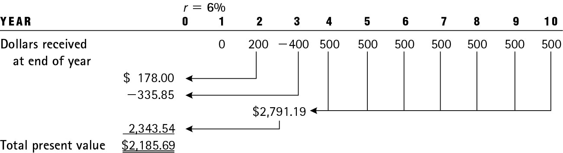
Table 5.5 The Present Value of an Uneven Stream Involving One Annuity Discounted to the Percent at 6 Percent: An Example

Slide 51
Table 5.6 Determining the Present Value of an Uneven Stream Involving One Annuity Discounted to the Present at 6 Percent: An Example
1. Present value of $200 received at the end of 2 years at 6% = | $ 178.00
2. Present value of a $400 outflow at the end of 3 years at 6% = | −335.85
3. (a) Value at end of year 3 of a $500 annuity, years 4–10 at 6% = $ 2,791.19 (b) Present value of $2,791.19 received at the end of year 3 at 6% = | 2,343.54
4. Total present value = | $2,185.69

Slide 52
Perpetuity (1 of 2)
A perpetuity is an annuity that continues forever.
The present value of a perpetuity is given by
PV = present value of the perpetuity
PP = constant dollar amount provided by the perpetuity
r = annual interest (or discount) rate

Slide 53
Perpetuity (2 of 2)
Example: What is the present value of $2,000 perpetuity discounted back to the present at 10% interest rate?

Slide 54
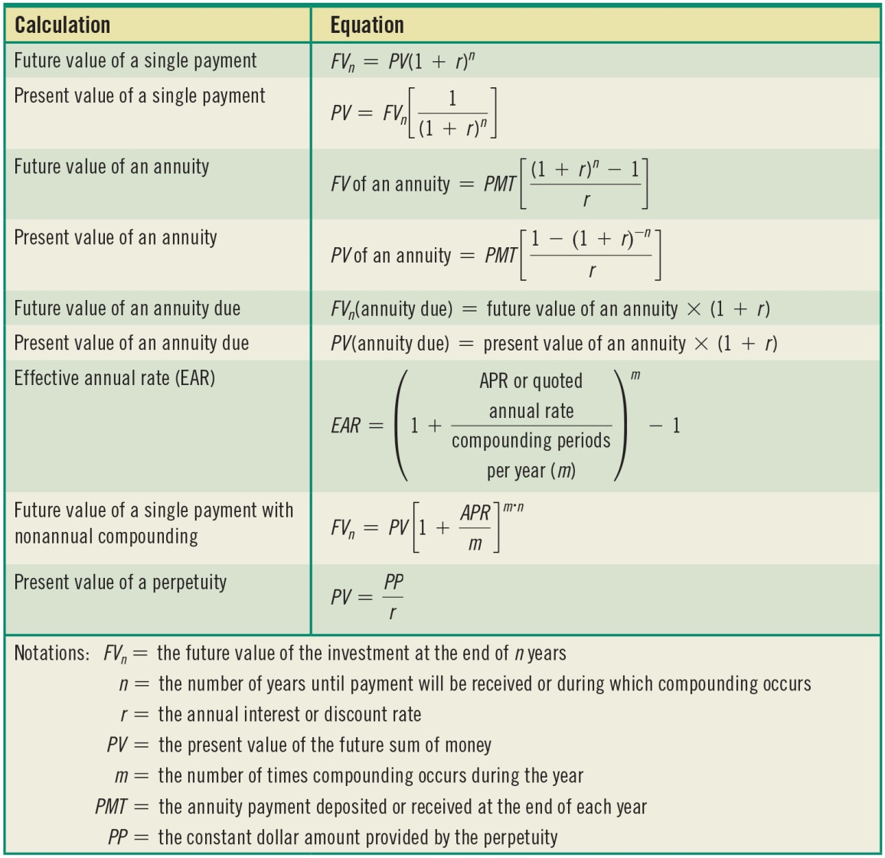
Table 5.7 Summary of Time Value of Money Equation

Slide 55
Key Terms (1 of 2)
Amortized loan
Annual percentage rate (APR)
Annuity
Annuity due
Annuity future value factor
Annuity present value factor
Compound annuity
Compound interest

Slide 56
Key Terms (2 of 2)
Effective annual rate (EAR)
Future value
Future value factor
Ordinary annuity
Nominal or stated interest rate
Present value
Present value factor
Perpetuity
Simple interest

Slide 57

Copyright
This work is protected by United States copyright laws and is provided solely for the use of instructors in teaching their courses and assessing student learning. Dissemination or sale of any part of this work (including on the World Wide Web) will destroy the integrity of the work and is not permitted. The work and materials from it should never be made available to students except by instructors using the accompanying text in their classes. All recipients of this work are expected to abide by these restrictions and to honor the intended pedagogical purposes and the needs of other instructors who rely on these materials.

