Slide 1

Foundations of Finance
Tenth Edition
Chapter 10
Capital-Budgeting Techniques and Practice
Copyright © 2020, 2017, 2014 Pearson Education, Inc. All Rights Reserved
Notes:
If this PowerPoint presentation contains mathematical equations, you may need to check that your computer has the following installed:
1) Math Type Plugin
2) Math Player (free versions available)
3) NVDA Reader (free versions available)

Slide 2
Learning Objectives
10.1 Discuss the difficulty encountered in finding profitable projects in competitive markets and the importance of the search.
10.2 Determine whether a new project should be accepted or rejected using the payback period, net present value, the profitability index, and the internal rate of return.
10.3 Explain how the capital-budgeting decision process changes when a dollar limit is placed on the capital budget.
10.4 Discuss the problems encountered when deciding among mutually exclusive projects.

Slide 3
Finding Profitable Projects

Slide 4
Capital Budgeting
Meaning: The process of decision making with respect to investments in fixed assets—that is, whether a proposed project should be accepted or rejected.
It is easier to “evaluate” profitable projects than to “find them.”

Slide 5
Source of Ideas for Projects
R & D: Typically, a firm has a research and development (R & D) department that searches for ways of improving existing products or finding new projects.
Other sources: Employees, competition, suppliers, customers

Slide 6
Capital-Budgeting Decision Criteria

Slide 7
Capital-Budgeting Decision Criteria
The Payback Period
Net Present Value
Profitability Index
Internal Rate of Return

Slide 8
The Payback Period
Meaning: Number of years needed to recover the initial cash outlay related to an investment
Decision Rule: Project is considered feasible or desirable if the payback period is less than or equal to the firm’s maximum desired payback period. In general, shorter payback period is preferred when comparing two projects.

Slide 9
Payback Period Example 1
Example: Project with an initial cash outlay of $10,000 with following free cash flows for 5 years.
Table 10.1 Payback Period Example
Blank | Project A | Project B
Initial cash outlay | −$ 10,000 | −$ 10,000
Annual free cash inflows | Blank | Blank
Year 1 | $ 6,000 | $ 5,000
2 | 4,000 | 5,000
3 | 3,000 | 0
4 | 2,000 | 0
5 | 1,000 | 0
Payback is 2 years.

Slide 10
Trade-Offs
Benefits
  Uses cash flows rather than accounting profits
  Easy to compute and understand
  Useful for firms that have capital constraints
Drawbacks
  Ignores the time value of money
  Does not consider cash flows beyond the payback period

Slide 11
Discounted Payback Period (1 of 2)
The discounted payback period is similar to the traditional payback period except that it uses discounted free cash flows rather than actual undiscounted cash flows.
The discounted payback period is defined as the number of years needed to recover the initial cash outlay from the discounted free cash flows.

Slide 12
Discounted Payback Period (2 of 2)

Slide 13
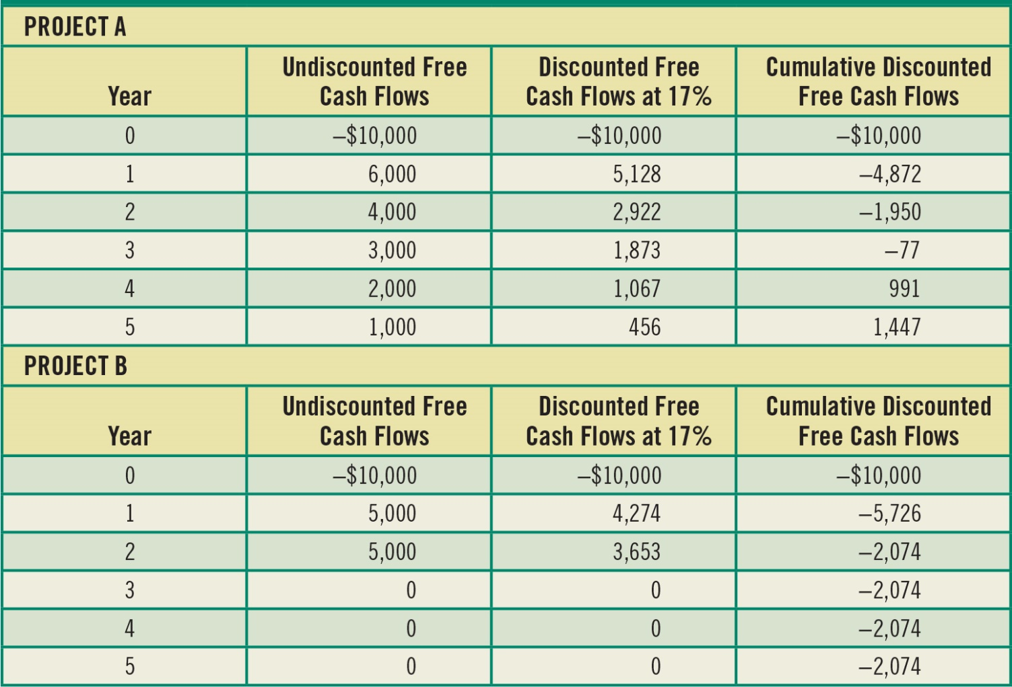
Table 10.2 Discounted Payback Period Example Using a 17 Percent Required Rate of Return

Slide 14
Payback Period Example 2
Table 10.2 shows the difference between traditional payback and discounted payback methods.
With undiscounted free cash flows, the payback period is only 2 years, while with discounted free cash flows (at 17 percent), the discounted payback period is 3.07 years.

Slide 15
Net Present Value (N P V)
N P V is equal to the present value of all future free cash flows less the investment’s initial outlay. It measures the net value of a project in today’s dollars.

Slide 16
NPV Example (1 of 2)
Example: Project with an initial cash outlay of $40,000 with following free cash flows for 5 years and a required rate of return of 12 percent.
Table 10.3 Ski-Doo’s Investment in New Machinery and Its Associated Free Cash Flows
Blank | Free Cash Flow
Initial outlay | −$40,000
Inflow year 1 | 15,000
Inflow year 2 | 14,000
Inflow year 3 | 13,000
Inflow year 4 | 12,000
Inflow year 5 | 11,000

Slide 17
NPV Example (2 of 2)
PV of FCF = $47,675
Subtracting the initial cash outlay of $40,000 leaves an N P V of $7,675.
Because N P V > 0, project is feasible.

Slide 18
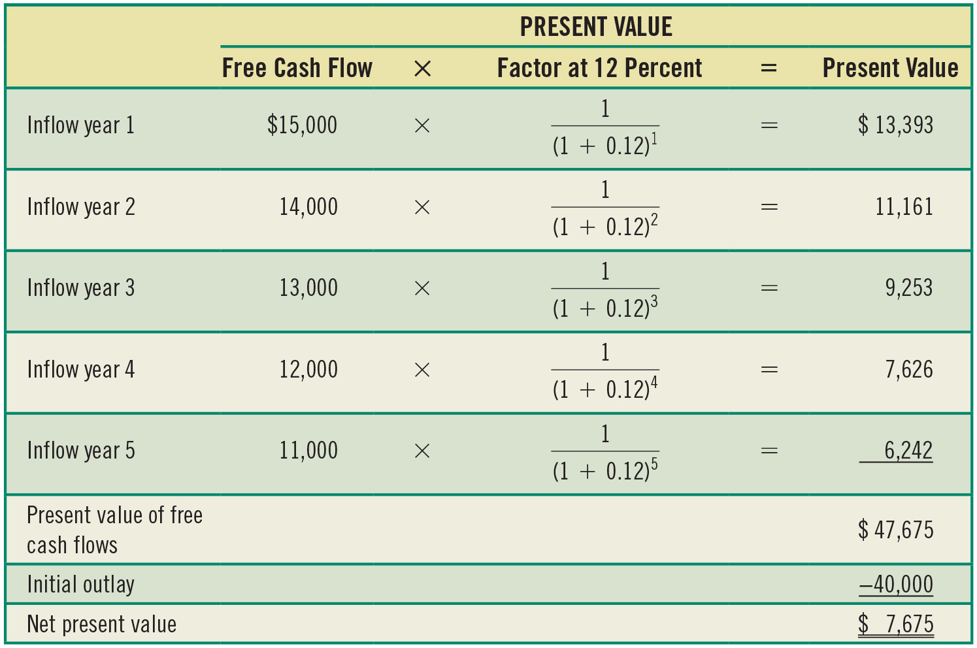
Table 10.4 Calculating the N P V of Ski-Doo’s Investment in New Machinery

Slide 19
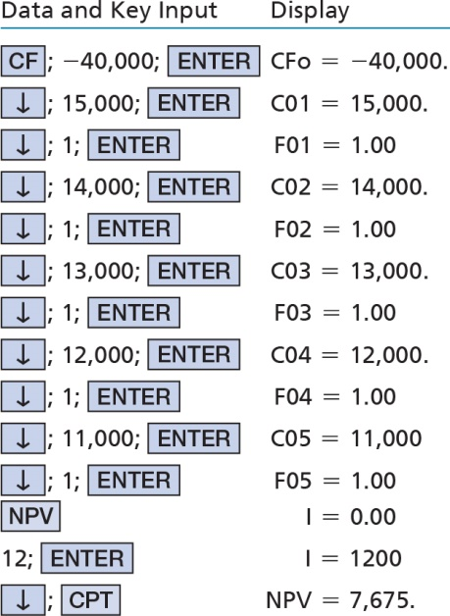
Calculator Solution (Using a Texas Instruments BA II Plus)

Slide 20
N P V Trade-Offs
Benefits
  Considers all cash flows
  Recognizes time value of money
Drawbacks
  Requires detailed long-term forecast of cash flows
N P V is generally considered to be the most theoretically correct criterion for evaluating capital budgeting projects.

Slide 21
The Profitability Index (P I) (Benefit-Cost Ratio)
The profitability index (P I) is the ratio of the present value of the future free cash flows (F C F) to the initial outlay.
It yields the same accept/reject decision as N P V.

Slide 22
Profitability Index
Decision Rule

Slide 23
Profitability Index Example
A firm with a 10 percent required rate of return is considering investing in a new machine with an expected life of 6 years. The initial cash outlay is $50,000.
Table 10.5 The Cash Flows Associated with an Investment in New Machinery
Blank | Free Cash Flow
Initial outlay | −$50,000
Inflow year 1 | 15,000
Inflow year 2 | 8,000
Inflow year 3 | 10,000
Inflow year 4 | 12,000
Inflow year 5 | 14,000
Inflow year 6 | 16,000

Slide 24
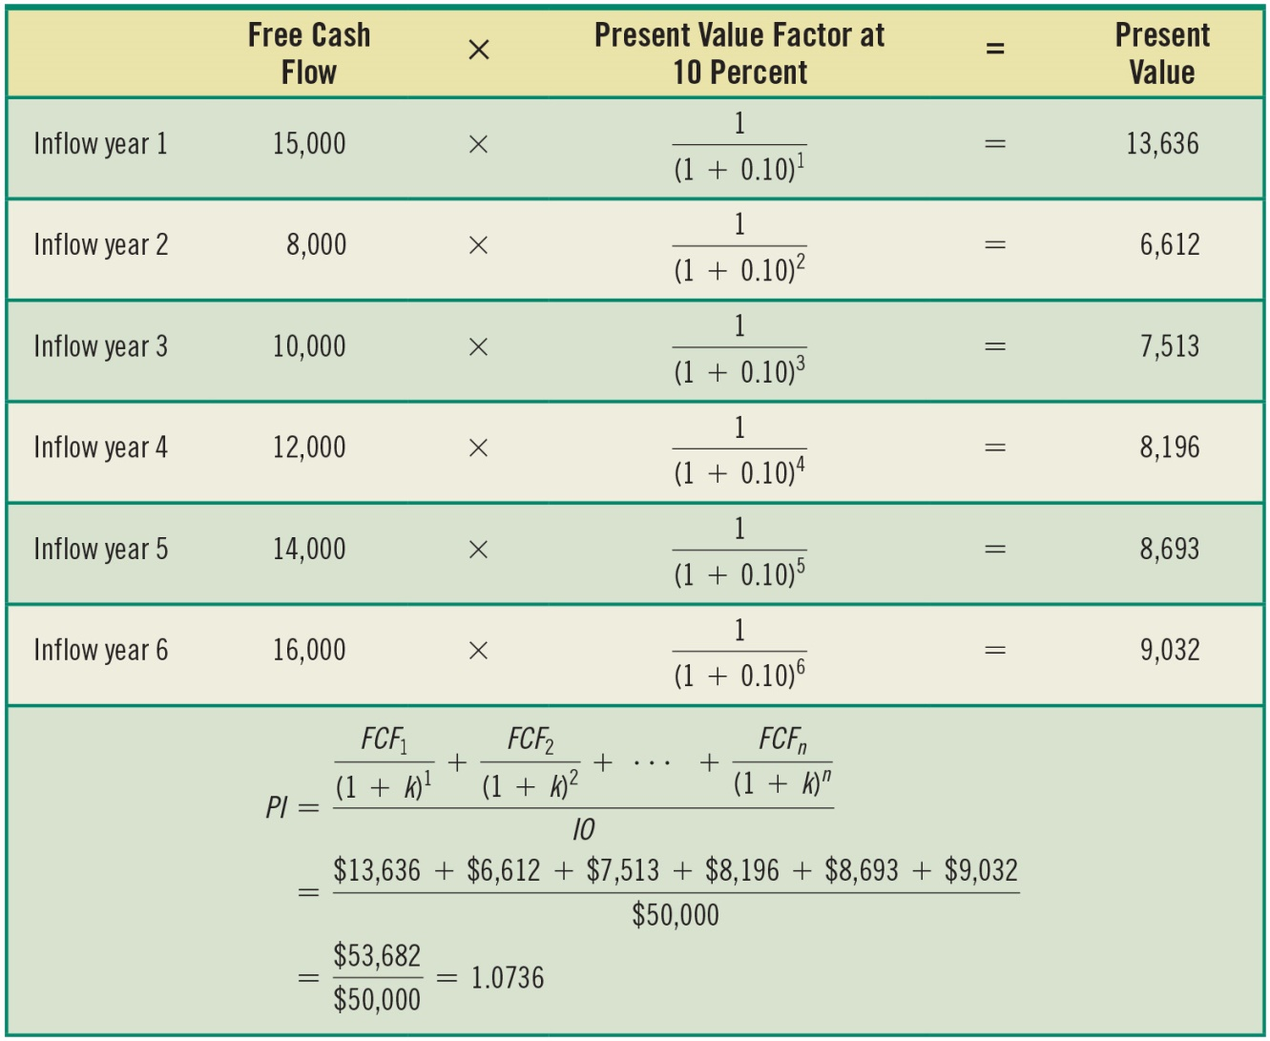
Table 10.6 Calculating the P I of an Investment in New Machinery

Slide 25
N P V and P I
When the present value of a project’s free cash inflows are greater than the initial cash outlay, the project N P V will be positive. P I will also be greater than 1.
N P V and P I will always yield the same decision.

Slide 26
Internal Rate of Return (I R R)
I R R is the discount rate that equates the present value of a project’s future net cash flows with the project’s initial cash outlay (I O).
​

Slide 27
Internal Rate of Return
Decision Rule
  If IRR ≤ Required Rate of Return, accept
  If IRR < Required Rate of Return, reject

Slide 28
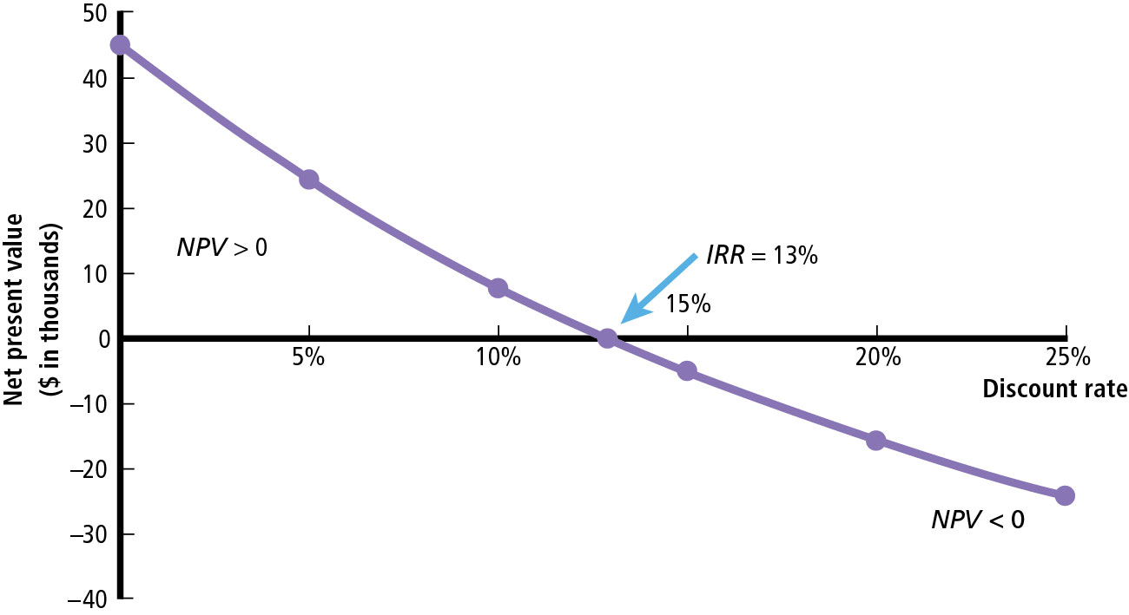
Figure 10.1 An Example of the Net Present Value Profile of a Project

Slide 29
I R R and N P V
If N P V is positive, I R R will be greater than the required rate of return
If N P V is negative, I R R will be less than required rate of return
If N P V = 0, I R R is the required rate of return.

Slide 30
Multiple I R R s
A normal cash flow pattern for project is negative initial outlay followed by positive cash flows (−, +, +, + …)
However, if the cash flow pattern is not normal (such as −, +, −), there can be more than one I R R.
Figure 10.2 is based on cash flows of −1,600, +10,000, −10,000 in years 0, 1, 2.

Slide 31
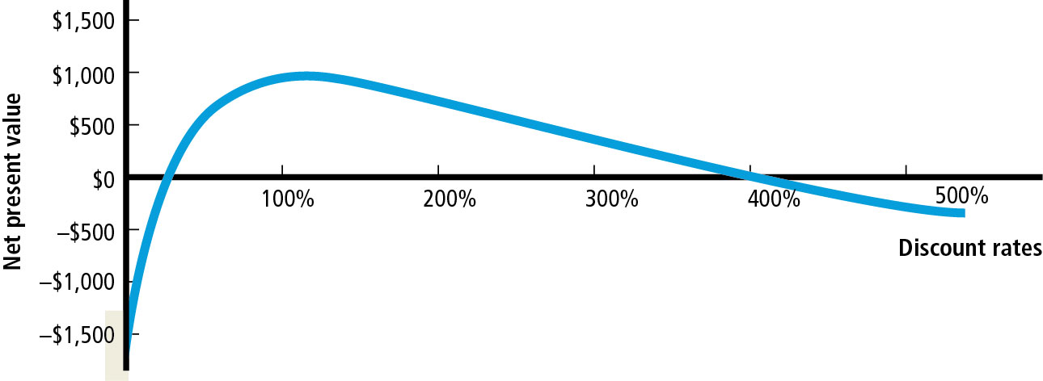
Figure 10.2 Multiple I R R s

Slide 32
Modified I R R (M I R R)
Primary drawback of the I R R relative to the net present value is the reinvestment rate assumption made by the internal rate of return. Modified I R R allows the decision maker to directly specify the appropriate reinvestment rate.

Slide 33
Modified I R R
Accept if MIRR ≥ required rate of return
Reject if MIRR < required rate of return

Slide 34
M I R R Example (1 of 3)
Project having a 3-year life and a required rate of return of 10 percent with the following free cash flows:
Blank | Free Cash Flows
Initial outlay | −$6,000
Year 1 | 2,000
Year 2 | 3,000
Year 3 | 4,000

Slide 35
M I R R Example (2 of 3)
Step 1: Determine the P V of the project’s free cash outflows; $6,000 is already at the present.
Step 2: Determine the terminal value of the project’s free cash inflows. To do this, use the project’s required rate of return to calculate the F V of the project’s three cash inflows. They turn out to be $2,420 + $3,300 + $4,000 = $9,720 for the terminal value.

Slide 36
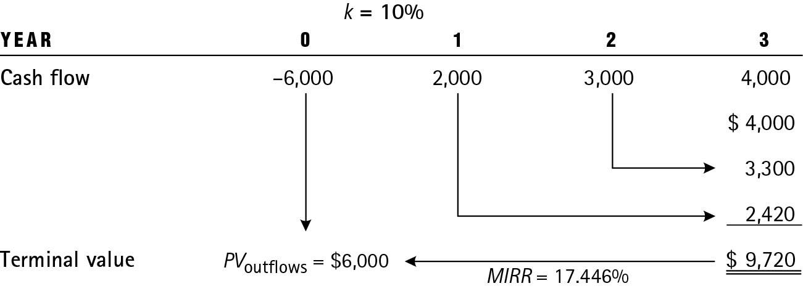
Figure 10.3 Calculating the M I R R

Slide 37
M I R R Example (3 of 3)
Step 3: Determine the discount rate that equates the P V of the terminal value and the P V of the project’s cash outflows. M I R R = 17.446%
Decision: M I R R is greater than required rate of return, so accept.

Slide 38
Capital Rationing

Slide 39
Capital Rationing (1 of 2)
Capital rationing refers to situation where there is a limit on the dollar size of the capital budget. This may be due to the following:
  Temporary adverse conditions in the market
  Shortage of qualified personnel to direct new projects
  Other factors, such as not being willing to take on excess debt to finance new projects

Slide 40
Capital Rationing (2 of 2)
How to select? Select a set of projects with the highest N P V—subject to the capital constraint.
Note, using N P V may preclude accepting the highest ranked project in terms of P I or I R R.

Slide 41
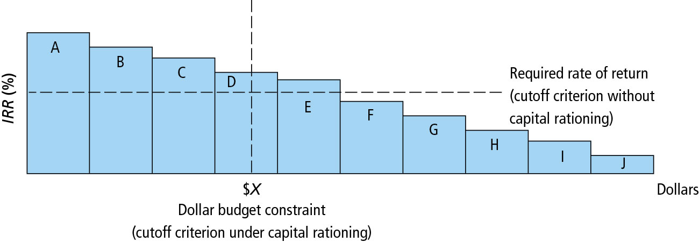
Figure 10.4 Projects Ranked by the I R R

Slide 42
Table 10.7 Capital Rationing: Choosing Among Five Indivisible Projects
Project | Initial Outlay | Profitability Index | Net Present Value
A | $200,000 | 2.4 | $280,000
B | 200,000 | 2.3 | 260,000
C | 800,000 | 1.7 | 560,000
D | 300,000 | 1.3 | 90,000
E | 300,000 | 1.2 | 60,000

Slide 43
Ranking Mutually Exclusive Projects

Slide 44
Ranking Mutually Exclusive Projects
Size disparity
Time disparity
Unequal life

Slide 45
Size Disparity
This occurs when we examine mutually exclusive projects of unequal size.
Example: Consider the following cash flows for two 1-year projects, A and B, with required rates of return of 10 percent.
  Initial Outlay: A = $200; B = $1,500
  Inflow: A = $300; B = $1,900

Slide 46
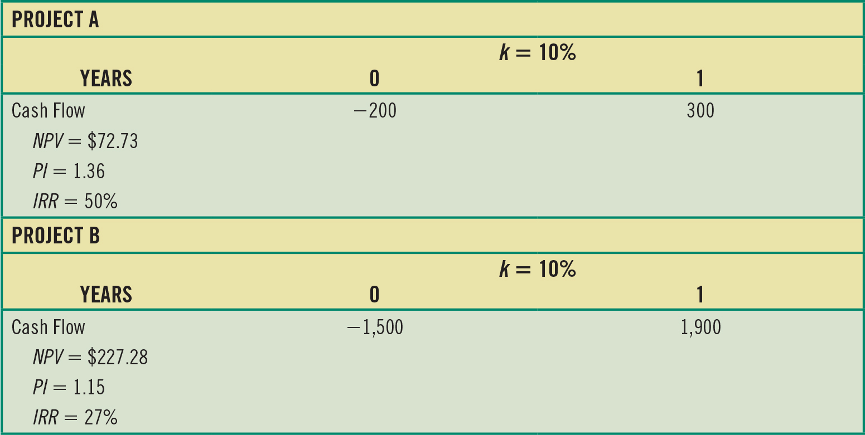
Table 10.8 The Size-Disparity Ranking Problem

Slide 47
Size-Disparity Ranking Problem (1 of 2)
Blank | Project A | Project B
N P V | $72.73 | $227.28
P I | 1.36 | 1.15
I R R | 50% | 27%
Ranking Conflict
  Using N P V, Project B is better.
  Using P I and I R R, Project A is better.

Slide 48
Size-Disparity Ranking Problem (2 of 2)
Which technique to use to select the project?
Use N P V whenever there is size disparity. If there is no capital rationing, project with the largest N P V will be selected. When capital rationing exists, rank and select set of projects based on N P V.

Slide 49
Unequal-Lives Problem (1 of 2)
This occurs when we are comparing two mutually exclusive projects with different life spans.
To compare projects, we compute the equivalent annual annuity (E A A).

Slide 50
Unequal-Lives Problem (2 of 2)
Example: If you have two projects, A and B, with equal investment of $1,000, required rate of return of 10 percent, and following cash flows in years 1–3 (for project A) and 1–6 (for project B)
  Project A = $500 each in years 1–3
  Project B = $300 each in years 1–6

Slide 51
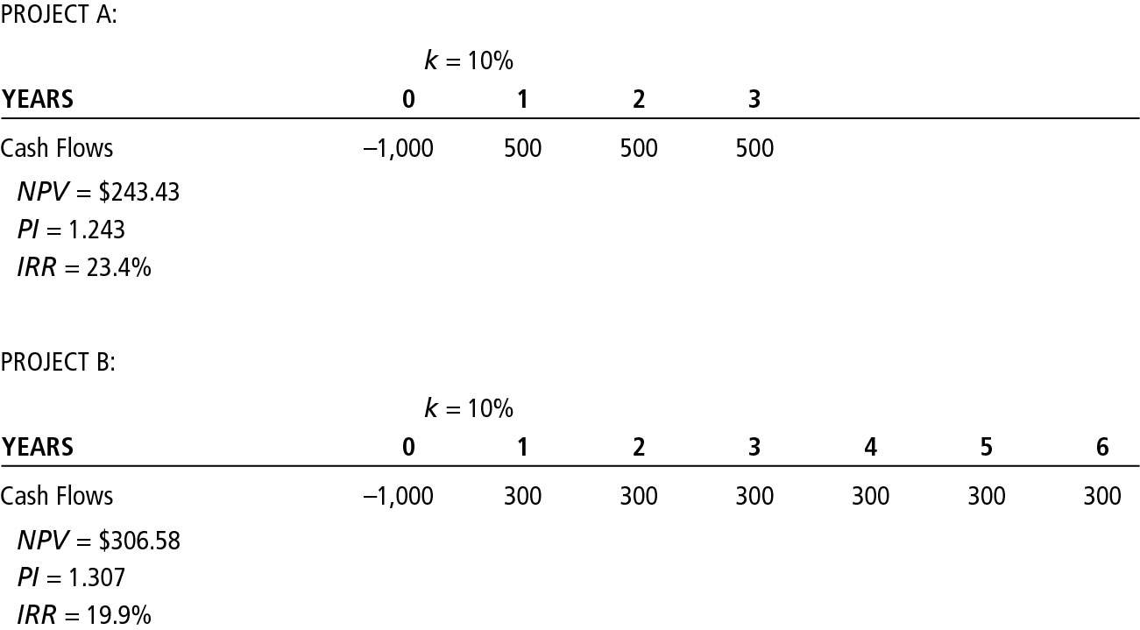
Figure 10.5 Unequal Lives Ranking Problem

Slide 52
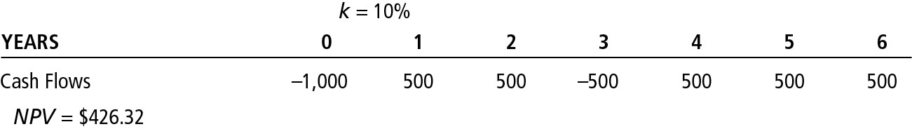
Figure 10.6 Replacement Chain Illustration: Two Project A’s Back to Back

Slide 53
Computing E A A
Calculate the project’s N P V:
  A = $243.43 and B = $306.58
Calculate E A A = N P V/annual annuity factor
  A = $97.89
  B = $70.39
Project A is better.

Slide 54
Key Terms
Capital budgeting
Capital rationing
Discounted payback period
Equivalent annual annuity (E A A)
Internal rate of return (I R R)
Modified internal rate of return (M I R R)
Mutually exclusive projects
Net present value (N P V)
Net present value profile
Payback period
Profitability index (P I) or benefit-cost ratio

Slide 55

Copyright
This work is protected by United States copyright laws and is provided solely for the use of instructors in teaching their courses and assessing student learning. Dissemination or sale of any part of this work (including on the World Wide Web) will destroy the integrity of the work and is not permitted. The work and materials from it should never be made available to students except by instructors using the accompanying text in their classes. All recipients of this work are expected to abide by these restrictions and to honor the intended pedagogical purposes and the needs of other instructors who rely on these materials.

