Slide 1
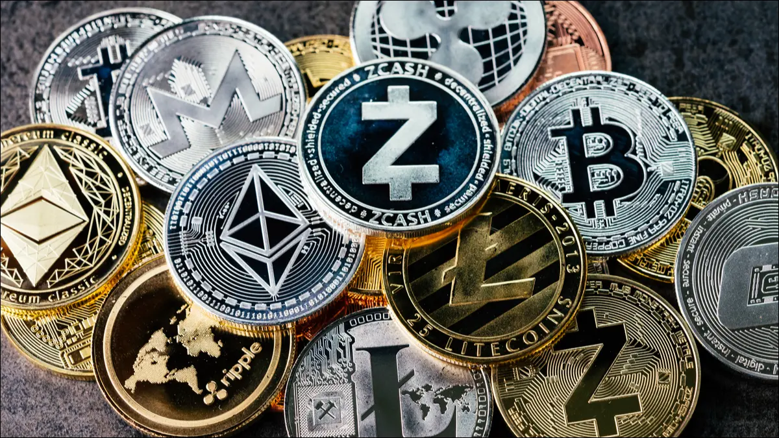
Cryptocurrency
Madeline Cloyd, Jack Heed, and Tom Heed

Slide 2
What is cryptocurrency?
A digital form of currency secured by cryptography
Impossible to counterfeit or double spend
Decentralized network based on blockchain technology
Blockchain Technology is a distributed ledger controlled by a spread out network of computers

Slide 3
Advantages of Cryptocurrency
Many people believe that blockchain technology will disrupt many different professions like finance and law
Decentralized structure makes them immune to governmental authority and manipulation
Simple exchange process, no need for third party involvement
Minimal processing fees
Privacy
Inflation resistance

Slide 4
Disadvantages of Cryptocurrency
Often used to host illegal activities (money laundering and tax evasion)
Exchange rate volatility
Vulnerable infrastructure underlying them
Can be wiped out by destruction of a hard drive
Rapid surges and collapses of value
They are not rooted in material goods

Slide 5
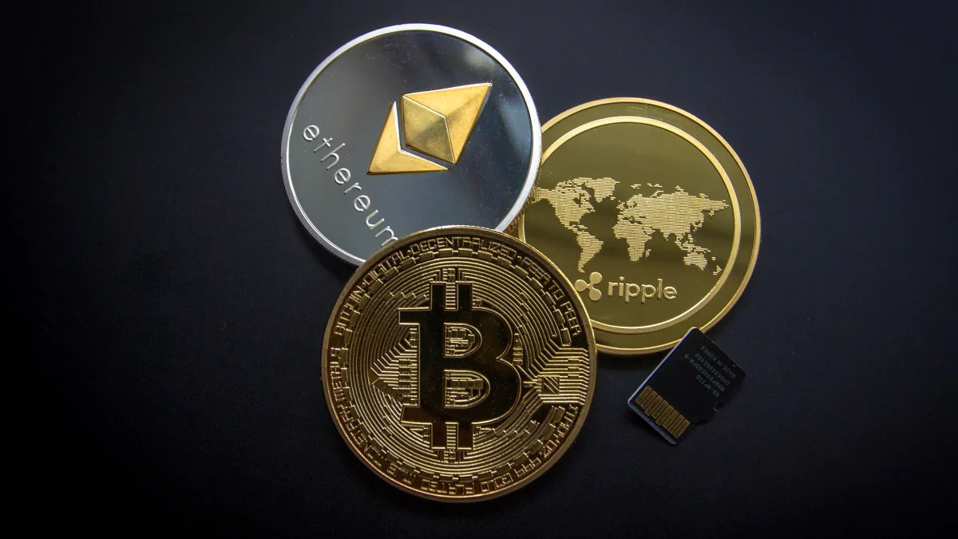
Types of Cryptocurrencies
Bitcoin
Ethereum
Dogecoin
Bitcoin Cash
Litecoin
Ripple
Stellar
NEO
Cardano
IOTA

Slide 6
How to get cryptocurrency
Buy it with cash
Buy it through exchange of other cryptocurrencies
Mining, which entails cracking codes and solving puzzles using complex technology
Exchanges:
Coinbase
Coinbase Pro
Cash App
Bisq
Binance
Final Verdict

Slide 7
ETHEREUM
Open source blockchain platform with it’s own cryptocurrency (ETH)
Initially created to build and publish smart contracts without fraud or interference
Smart contracts are self executing contracts with the terms and agreement of a buyer and seller, written in the lines of code. They allow for anonymous and secure transactions to occur without a third party.
The blockchain not only enables transactions of ETH but it also allows software developers to create games and dApps at a low risk to the World Wide Web

Slide 8
ETH - Ethereum’s form of Cryptocurrency
Price typically mirrors Bitcoin pricing
Second most valuable cryptocurrency, after Bitcoin
Designed to be used in the Ethereum market but is now accepted by some services and vendors
Highly volatile
https://www.investing.com/news/cryptocurrency-news/ethereum-falls-10-in-rout-2609571

Slide 9
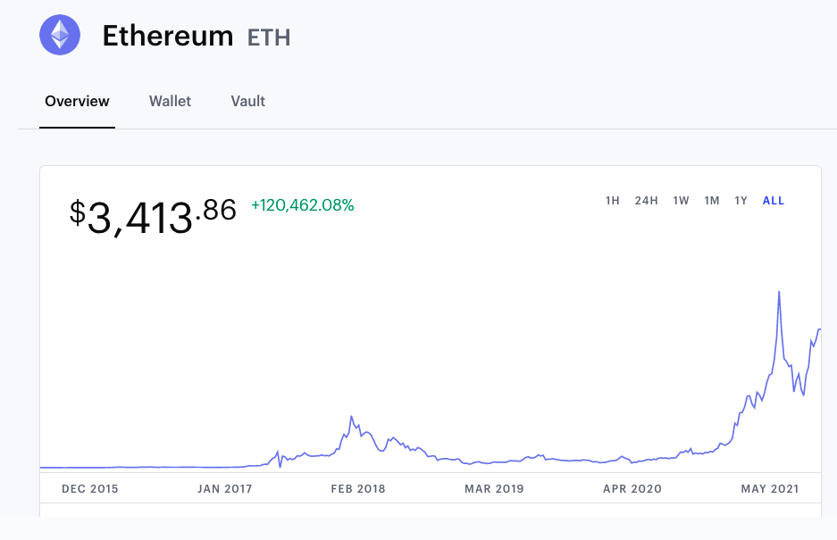

Slide 10
Ethereum vs Bitcoin
https://www.youtube.com/watch?v=0UBk1e5qnr4

Slide 11
Bitcoin Background
Bitcoin is a digital currency created in January 2009.
The identity of the person or persons who created the technology is still a mystery.
Bitcoin offers the promise of lower transaction fees than traditional online payment mechanisms and, unlike government-issued currencies, it is operated by a decentralized authority.
Bitcoin's history as a store of value has been turbulent; it has gone through several cycles of boom and bust over its relatively short lifespan.

Slide 12
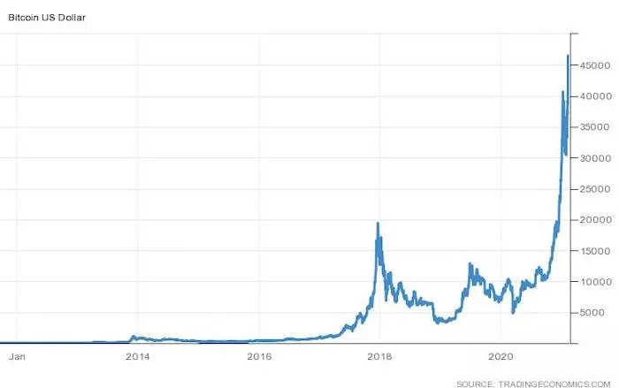
Bitcoin Continued
Currently bitcoin is the highest valued
cryptocurrency in the world.
It is valued currently at around
$47,000

Slide 13
Bitcoin Video
How the transactions work:
https://www.youtube.com/watch?v=l9jOJk30eQs
El Salvador Bitcoin Rollout
https://www.youtube.com/watch?v=2OTAo9hFcWY

Slide 14
DOGECOIN
-Dogecoin is an open-source cryptocurrency started in 2013 by Jackson Palmer and Billy Markus.
-Dogecoin initially started as a joke based on a popular meme featuring a Shiba Inu (a Japanese breed of dog).
-It is based on Litecoin and has the same technology behind its proof-of-work.
-Dogecoin has a loyal community of supporters who trade it and use it as a tipping currency for social media content.

Slide 15
Video
https://www.youtube.com/watch?v=AMuL0wA_q6o

Slide 16
Latest News in Cryptocurrency
https://www.indiatoday.in/business/story/cryptocurrency-price-september-8-bitcoin-dogecoin-ether-cardano-latest-rates-1850479-2021-09-08
https://www.youtube.com/watch?v=xqg-0hF7_xY

Slide 17
Resources
https://www.investopedia.com/terms/c/cryptocurrency.asp
https://www.sofi.com/learn/content/understanding-the-different-types-of-cryptocurrency/
https://www.investopedia.com/best-crypto-exchanges-5071855
https://www.investopedia.com/terms/s/smart-contracts.asp

