Slide 1
Chapter 11 and Chapter 12 Part I - Introduction of Banks

Slide 2
What is bank?
Bank originally means: counter or table cloth
In 15th century
Bank’s characteristics:
Spread income margin – core business
Borrow @ low interest rate from depositor
Lend @ high interest rate as loan
Liquidity inventor
Bank borrow for short term and lend out for long term
Long term is locked up but short term is cashable at anytime
Bank run is inevitable
Notes issuer in the past
This role was replace by government bank
Two areas still allow private banks to issue notes
HK and UK

Slide 3
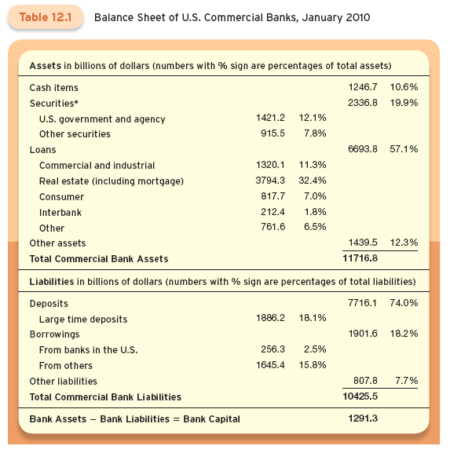

Slide 4
History of Banking Industry
Interest rate appeared in 2000BC in Sumerian.
Guess what did interest rate mean at that time?
First record of interest rate was in Song Dynasty in year 940 in China.
Modern bank appeared in Italy in year 1472,
Banke Monte Dei Praci de Siena in Siena, still operating
Deposit insurance appeared in this bank, insured by a Duke for all deposits.

Slide 5
History of Banking Industry (II)
In UK, in 16th century, gold smith banker
Took gold from depositors and issued notes
Notes were used to buy merchandise with endorsement
So one note passed around with many endorsement
Eventually, only “bearer's name appeared in the note
Banking started from here in UK

Slide 6
Banking Industry Crisis
Bank run
Moral hazard of banks
How to avoid banking industry crisis?
Government regulation
Deposit insurance

Slide 7
Major Bank Types
Commercial Banks
Take deposits and make out loans
In 2010, $104 trillion assets for all US located banks
Only $10.1 trillion for US chartered banks
Saving banks
In 2010, total assets are $1.2 trillion
Old style institution but grows very slow
Credit unions
$0.9 trillion in 2010.
Like clubs

Slide 8
Theory of Banks
Diamond and Dybvig model, JPE, 1988.
Banks are liquidity provider
Banks’ product is liquidity
Under normal and bad economy, depositors expect different from banks
Multi-equilibrium exist
Their model explains bank run as one state of equilibrium.
Recent crisis was due to real estate bubble, causing failure of banking system
So hard to keep banks under control and Diamond’s model has its limits.

Slide 9
Why do we need bank?
Adverse selection problem
How can depositors identify borrower?
Bankers are financial intermediary
Familiar with community
Supervise borrower
Expert as loan officer

Slide 10
Why do we need bank? (II)
Moral Hazard problem
Borrowers can make wild investment with depositor’s money.
With bank as monitors and experts
Business ties force borrowers to obey rules
Banks lend out on short term, so borrowers are disciplined.

Slide 11
How to avoid bank run?
Need deposit insurance
Started in 16th century in Italy.
Deposit insurance scheme backed up by governments failed many times in history
FDIC, Federal Deposit Insurance Corporation
Started in 1933 initiated by President Franklin Roseville
Never failed, because people believe in it.
FSLIC – saving bank insurance – failed
S&L crisis in 1980s and US gov bailed it out for $150 billion but FSLIC was gone.

Slide 12
Bank Regulation
Bankers also have moral hazard
Basel I, 1988; Basel ii, 2000; Basel iii, 2010
Basel is located in Switzerland
Basel committee has no authority but it makes worldwide recommendations of bank regulation.
Banks are now interlinked
Most recommendations are adopted worldwide

Slide 13
Bank Regulation (II)
Basel II, 2000
Basel II was incurred because of more and more complicated financial markets, such as derivatives.
But Basel II failed and resulted in financial crisis
Basel iii, 2010
Will be phased out in full in 2019.
Medium-term impact of Basel III implementation on GDP growth is in the range of −0.05% to −0.15% per year.

Slide 14
Why Aren’t Banks Lending to Small Business?
In Basel I and also in Basel II and III
Capital requirement of assets is based on risk level of assets
Risk level Example
0% OCEP gov bond, US gov bond
20% Muni issued by city, state, and Fannie and Freddie
50% Mortgage
100% Anything else such as loans to business
Fannie and Freddie issue sub-prime loans
Even though not stated anywhere, people believe Fannie and Freddie are backed up by US gov.
They are still rated with 20% of capital requirement.

Slide 15
Why Aren’t Banks Lending to Small Business? (II)
Imagine a bank with $400 million assets in balance sheets
100 million gov bond 0% capital requirement
100 million Fannie 20% capital requirement
100 million mortgage 50% capital requirement
100 m loan to small business 100% capital requirement
How much is the total risk weighted assets?
(170 million)

Slide 16
Why Aren’t Banks Lending to Small Business? (III)
How much is the total
Basel III requires
Common equity must be 4.5% of Risk weighted assets (RWA)
Plus 2.5% of capital conservation buffer
So total 7% of capital requirements
How much is the bank’s capital requirement with $170m RWA?
($11.9million)

Slide 17
Why Aren’t Banks Lending to Small Business? (IV)
How much is the total Basel III requires
Common equity must be 4.5% of Risk weighted assets (RWA)
Plus 2.5% of capital conservation buffer
So total 7% of capital requirements
How much is the bank’s capital requirement with $170m RWA?
($11.9million)

Slide 18
Why Aren’t Banks Lending to Small Business? (V)
This $11.9 million should be lower than the common equity component in balance sheet
Assume this bank common equity is $12.9million
It has one extra million that can lend out
How?
Can buy $70m worth of Fannie (1million / (20%*7%))
Can lend out only $14m to small business (1million / (100%*7%))
Of course, board of bank will choose to buy Fannie

Slide 19
Critiques of Basel
Encourage banks to buy sub-prime loan instead of lending to small business
Basel committee’s defense
Basel is to regulate banking industry to avoid bank run.

Slide 20
Banking Industry Crisis Worldwide
Mexico crisis in 1994 and 1995
Lending boom,
10% of GDP is lending in 1988
40% in 1994
Bubble and boom without regulation
Government cannot bail out every bank
Mexican banks were destroyed and taken over by foreign banks.

Slide 21
Banking Industry Crisis Worldwide (II)
Asian Crisis in 1997 and 1998
Before the crisis, international banks heavily lend out to Asian governments
International banks pulled out capital, causing bank runs in those countries
Hit Thailand, Korean, Indonesia, Russia and Brazil.

Slide 22
Conclusion
Banks provide liquidity so that individual and business both function well.
Banks solve adverse selection and moral hazard.
Banks should be regulated.
With financial market getting more and more complicated, who should be regulated.

