Slide 1
Chapter 11 and Chapter 12 Part II - Understanding Bank’s Balance Sheet

Slide 2
Review of Bank’s Balance Sheet
Assets are loans that the bank makes (and a little cash and other assets).
Liabilities is the money the bank borrows from depositors or other sources.
Capital is the amount of money investors put into the bank plus any retained earnings.
Assets = Capital + Liabilities Example: Banks borrowed at 3%, loaned the money at 6%, for a spread of 3%. The difference between 6% and 3% is called the "net interest margin".

Slide 3
Sample of Bank’s Balance Sheet
Liabilities | Assets
a. Share Capital | a. i. Cash in Hand
b. Reserve Funds | ii. Cash with the Central Bank (RBI)
c. Deposits | iii. Cash with the other banks
i. Fixed Deposits | b. Money at short
ii. Saving Deposits | c. Bills and securities discounted
iii.Current Deposits | d. Investment of bank
iv. Other Deposits | e. Loans and Advances given
d. Borrowings | f. Other Assets
e. Other liabilities
The balance is: Assets = Capital + Liabilities
What is bank’s capital?
Where are inventory, fixed assets, AR, AP?

Slide 4
Bank's assets
Cash in hand
cash with other banks
Cash with central bank
money at short notice
bills and securities discounted
bank's investments
loans sanctioned by the banks
loans and advances.

Slide 5
Bank's liabilities
Deposits
Borrowing from central and other commercial banks.
The share capital
the contribution which shareholders have contributed for starting the bank.
Reserve funds
bank has accumulated over the years from its undistributed profits.

Slide 6
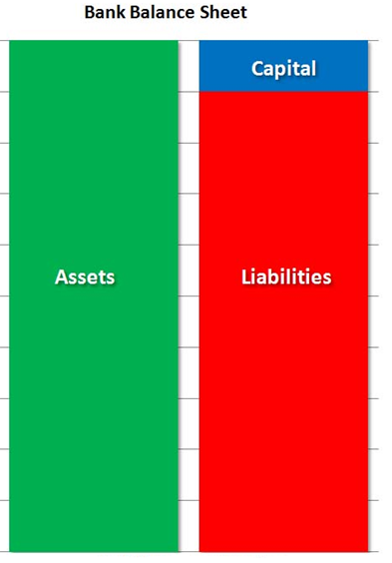

Slide 7
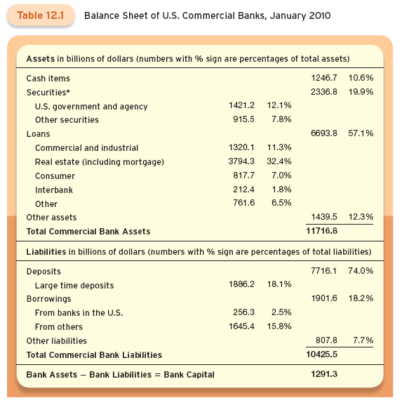

Slide 8
Assets: Uses of Funds
The asset side of the balance sheet shows what banks do with the funds they raise.
Assets are divided into four broad categories:
Cash,
Securities,
Loans, and
All other assets.
In winter of 2010, bank assets were equivalent to about 80 percent of one year’s GDP.

Slide 9
Cash Items
Cash asset are of three types:
Reserves - the most important.
Regulations require a certain percent of cash held in reserves.
Include the cash in the bank’s vault, vault cash, and bank’s deposits at the Federal Reserve System.
Cash is the most liquid of the bank’s assets.
Cash items in process of collection.
The uncollected funds from checks.

Slide 10
Cash Items
Balances of the accounts that banks hold at other banks.
Small banks have accounts at large banks - correspondent bank deposits.
In January 2010, banks held more than 10% of their assets in cash.
Up until the financial crisis of 2007-2009, banks held about 3%.
Banks want to minimize cash holdings because they earn less on cash.

Slide 11
Securities
Securities are the second largest component of bank assets.
Banks cannot hold stocks, so these are only bonds.
They are split between:
U.S. government and agency securities (12.1% of assets), and
Other securities (state and local government bonds) (7.8% of assets).

Slide 12
Securities
About half of all securities are mortgage-backed.
A sizeable portion are very liquid - can be sold quickly if the bank needs cash.
Securities are therefore sometimes referred to as secondary reserves.
The share of securities in banks assets has varied around 20% from 1973 to 2010.

Slide 13
Loans
Loans are the primary assets of modern commercial banks, accounting for well over one-half of assets.
Loans can be divided into five categories:
Business loans called commercial and industrial (C&I) loans;
Real estate loans, including both home and commercial mortgages and home equity loans;
Consumer loans, like auto and credit card loans;
Interbank loans; and
Other types, including loans for the purchase of other securities.

Slide 14
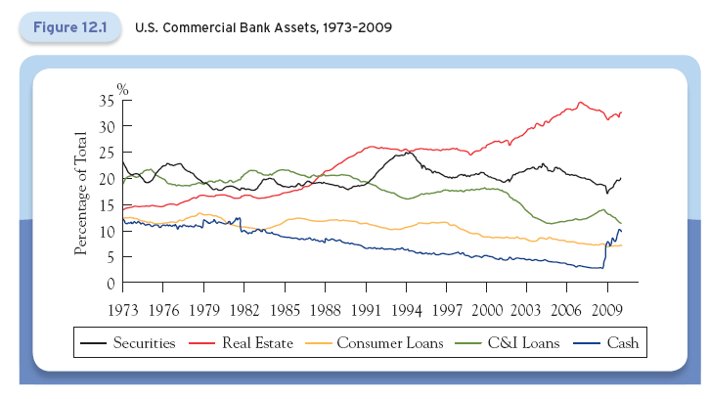
Balance Sheet of Commercial Banks: Changes in Assets Over Time

Slide 15
Liabilities: Sources of Funds
Banks get funds from savers and from borrowing in the financial markets.
To entice individuals to put funds into their bank, institutions offer a wide range of services that we discussed in chapter 11.
There are two types of deposit accounts:
Transaction accounts - checkable deposits, and
Nontransaction accounts.

Slide 16
Checkable Deposits
Checking accounts can include NOW, super-NOW, and insured market rate accounts.
Financial innovation has reduced the importance of checkable deposits in the day-to-day business of banking.
Checkable deposits plummeted from 40% of total liabilities in the 1970s to less than 10% in 2009.
Innovative accounts whose balances are easily transferred to checking accounts change the amount held in traditional deposit accounts.

Slide 17
Nontransaction Deposits
In 2009 nontransaction deposits accounted for more than half of fall commercial bank liabilities.
Savings deposits, knows as passbook savings accounts, were popular for may decades, but less so today.
Time deposits are certificates of deposit (CDs) with a fixed maturity.
Large CDs are greater than $100,000 in face value and are negotiable - they can be bought and sold in financial markets.
Large CDs have an important role in bank financing

Slide 18
Borrowings
Borrowing is the second most important source of bank funds.
Accounts for somewhat less than 20% of bank liabilities.
Banks can borrow by:
Borrowing from the Federal Reserve, which is rare, or
Borrowing from other banks.

Slide 19
Borrowings
Banks with excess reserves will lend their surplus funds to banks that need them though an interbank market called the federal funds market.
The lending bank must trust the borrowing bank as these loans are unsecured.
Commercial banks will also borrow from foreign banks.

Slide 20
Borrowings
Banks finally can borrow using an instrument called a repurchase agreement, or repo.
A short-term collateralized loan in which a security is exchanged for cash.
The parties agree to reverse the transaction on a specific future date.

Slide 21
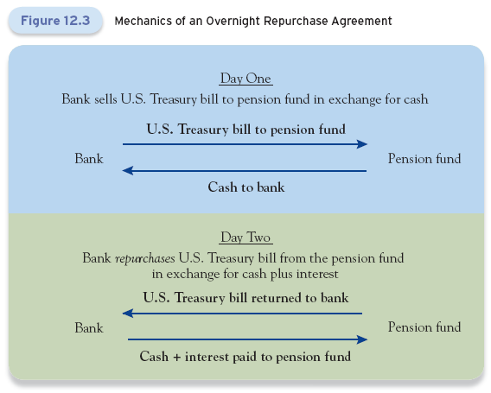

Slide 22
Bank Capital and Profitability
The difference between a bank’s assets and liabilities is the bank’s capital, or net worth.
Net worth is the value of the bank to its owners.
Net worth is referred to as bank capital, or equity capital.
We can think of capital as the owners’ stake in the bank.
Capital is the cushion banks have against a sudden drop in the value of their assets or an unexpected withdrawal of liabilities.
It provides some insurance against insolvency.

Slide 23
Bank Capital and Profitability
Net interest income can also be expressed as a percentage of total assets to yield: net interest margin.
This is the bank’s interest rate spread - the weighted average difference between the interest rate received on assets and the interest rate paid for liabilities.
Well-run banks have a high net interest income and a high net interest margin.
If a bank’s net interest margin is currently improving, its profitability is likely to improve in the future.

Slide 24
How Do Banks Make Money?
Banks report "net interest margin".
Net Interest Margin (NIM) is the interest earned (net interest income), minus the interest paid, divided by total assets.
Wells Fargo’s net interest margin is 3.66%
Wells Fargo’s asset is 1.4 trillion. NIM of 3.66% means $51.25 billion annual profits before expenses and charge-offs
Wells Fargo’s total equity is $20.066 billion (Capital).
This is roughly 70-to-1 leverage
Many banks were levered 30-to-1 or more.

Slide 25
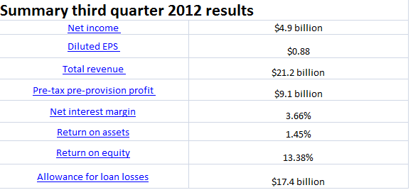
Wells Fargo’s Investment Profile
September 30, 2012
$1.4 trillion in assets, 4th largest in United States

Slide 26
Bank Profitability
There are several measures of bank profitability.
Return on assets (ROA).
ROA is the bank’s profit left after taxes divided by the bank’s total assets.
It is a measure of how efficiently a particular banks uses its assets.
This is less important to bank owners than the return on their own investment.

Slide 27
Bank Capital and Profitability
The bank’s return to its owners is measured by the return on equity (ROE).
This is the bank’s net profit after taxes divide by the bank’s capital.
ROA and ROE are related to leverage.
One measure of leverage is the ratio of banks assets to bank capital.
Multiplying ROA by this ratio yields ROE.

Slide 28


Bank Profitability
Return on Average Assets (ROA )
Return on Average Equity (ROAE)

Slide 29
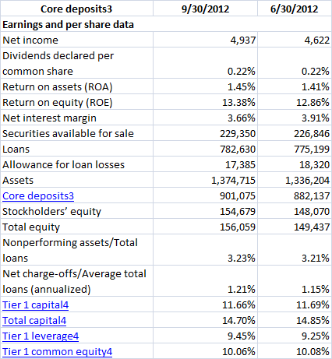
Wells Fargo Financial Highlights

