Slide 1
Cryptocurrency – Bitcoin - Mining
FIN451 / MBA651

Slide 2
Bitcoin Mining Process
The mining process involves several key steps:
Transaction Collection: Miners collect transactions from the network and organize them into a candidate block. These transactions are typically those that include higher transaction fees, as miners are incentivized to prioritize these transactions.
Hash Calculation: Miners then begin the process of finding a valid hash for the block. A hash is a fixed-length string of characters generated from the block's data using a cryptographic function. The goal is to find a hash that is less than a target value set by the network, which requires finding the correct nonce—a random number added to the block's data.

Slide 3
Bitcoin Mining Process
The mining process involves several key steps:
Proof-of-Work: This step involves intense computational work, as miners try different nonces until they find a valid hash. This process is known as proof-of-work because it demonstrates that the miner has invested significant computational effort.
Block Addition: Once a valid hash is found, the block is added to the blockchain, and the miner is rewarded with new bitcoins and transaction fees. The process then starts over with a new block.

Slide 4
The Economics of Mining
Mining is a competitive and resource-intensive process. As more miners join the network, the difficulty of solving the puzzles increases, requiring more computational power and electricity.
This has led to the development of specialized mining hardware, known as Application-Specific Integrated Circuits (ASICs), which are designed specifically for Bitcoin mining.
The reward for mining a block is halved approximately every four years in an event known as the "halving." This reduces the rate at which new bitcoins are created and contributes to Bitcoin's deflationary nature. Initially, the reward was 50 bitcoins per block; as of 2024, it is 6.25 bitcoins per block.
The increasing difficulty and decreasing rewards mean that mining is no longer profitable for individual miners using standard hardware. Today, mining is typically conducted by large mining farms or pools, where miners combine their computational resources to increase their chances of solving a block and sharing the rewards.

Slide 5
Bitcoin Mining – Environmental Concerns
Bitcoin mining has attracted criticism for its environmental impact due to the large amount of electricity required to power the mining hardware.
This energy consumption has raised concerns about the sustainability of Bitcoin, especially as the network grows.
However, some argue that mining operations are increasingly being powered by renewable energy sources, and efforts are underway to make the process more energy-efficient.

Slide 6
The Proof-of-Work Consensus Mechanism
Proof-of-work (PoW) is the consensus algorithm used by the Bitcoin network to validate transactions and secure the blockchain.
It is a form of cryptographic proof in which one party (the miner) proves to others that a certain amount of computational effort has been expended. This process is fundamental to the security and decentralization of the Bitcoin network.
In the PoW system, miners compete to solve a mathematical puzzle that requires significant computational power.
The first miner to solve the puzzle broadcasts their solution to the network, and if the solution is valid, the miner is allowed to add a new block to the blockchain.
This process ensures that the network reaches consensus on the state of the blockchain, with the longest chain being considered the valid one.

Slide 7
The Role of PoW in Security
PoW plays a crucial role in securing the Bitcoin network. By requiring miners to expend significant computational effort, PoW makes it prohibitively expensive for any single entity to alter the blockchain.
To change a transaction, an attacker would need to redo the PoW for that block and all subsequent blocks, which would require an immense amount of computational power and is therefore practically impossible.
This security feature makes Bitcoin resistant to double-spending attacks and other forms of fraud, as any attempt to alter the blockchain would be immediately apparent and rejected by the network.

Slide 8
Criticisms of PoW
Energy Consumption: PoW requires a vast amount of energy, leading to concerns about its environmental impact. The energy consumption of the Bitcoin network has been compared to that of entire countries, prompting debates about the sustainability of the system.
Centralization of Mining: As mining becomes more resource-intensive, it has become increasingly centralized, with a few large mining pools controlling the majority of the network's hash power. This concentration of power contradicts the decentralized ethos of Bitcoin and raises concerns about the potential for collusion or attacks by these pools.
Scalability Issues: PoW limits the speed at which new blocks can be added to the blockchain, which in turn limits the number of transactions that the network can process. This scalability issue has led to high transaction fees and long confirmation times during periods of high demand.

Slide 9
Alternatives to PoW
In response to the criticisms of PoW, alternative consensus mechanisms have been proposed, such as Proof-of-Stake (PoS), which requires validators to hold a certain amount of cryptocurrency as collateral rather than expending computational power.
However, PoS and other alternatives have their own trade-offs and challenges, and PoW remains the most widely used and proven method for securing decentralized networks.

Slide 10
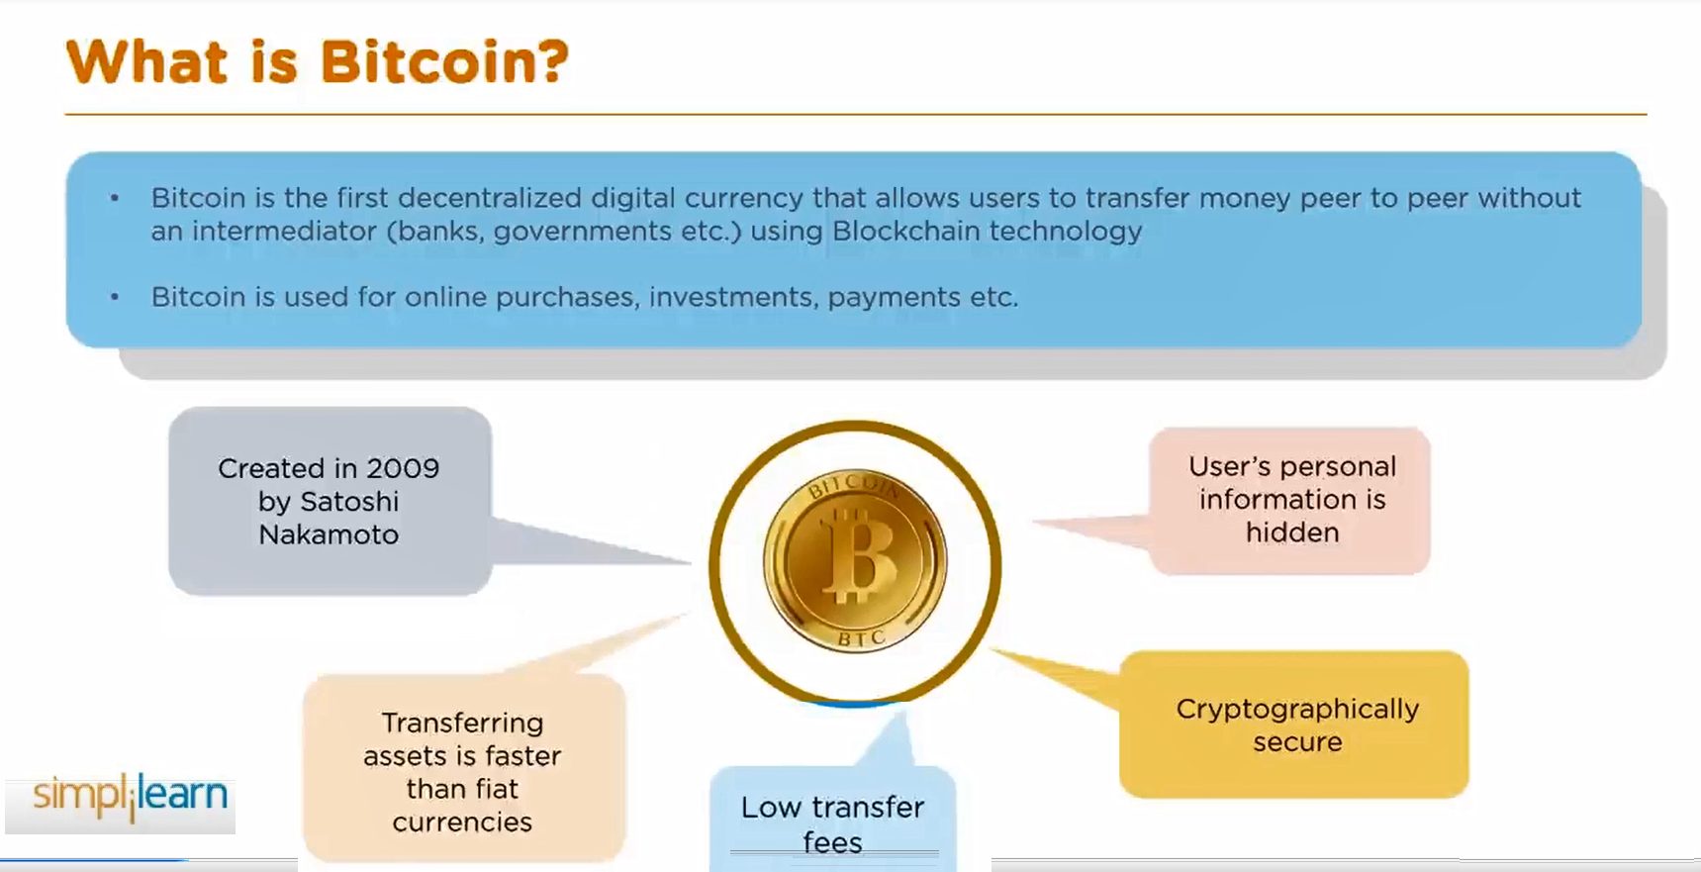
Bitcoin Mining

Slide 11
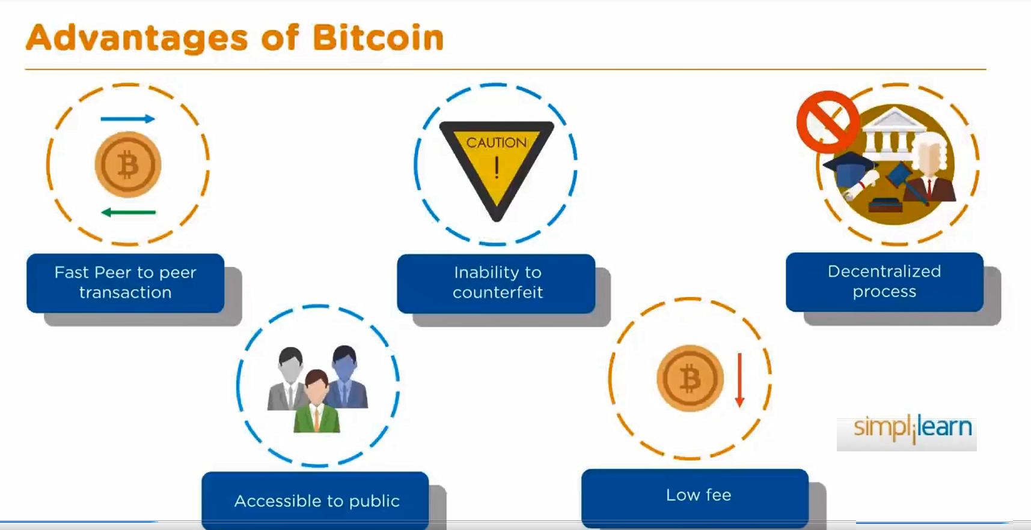
Bitcoin Mining

Slide 12
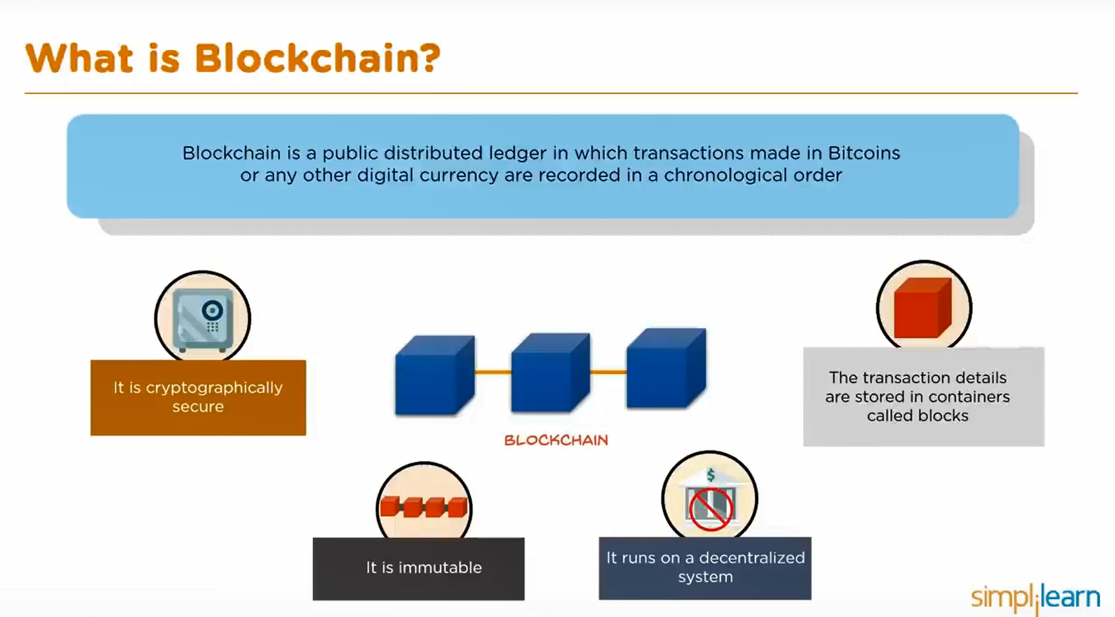
Bitcoin Mining

Slide 13
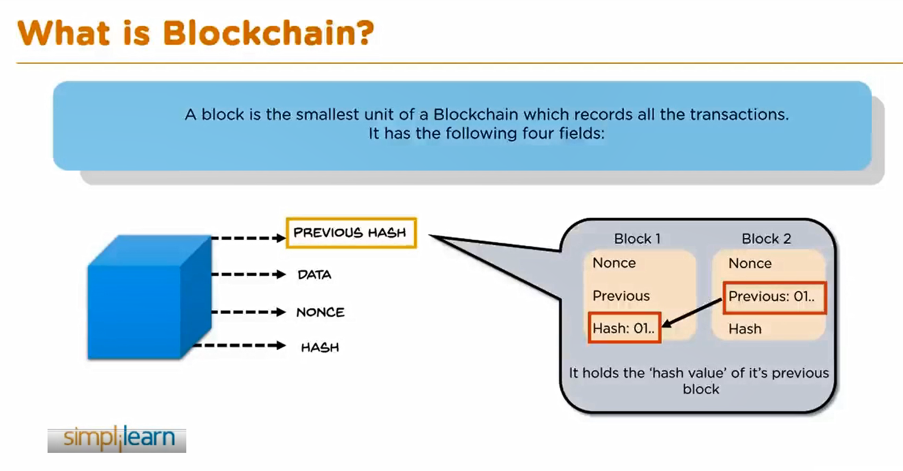
Bitcoin Mining

Slide 14
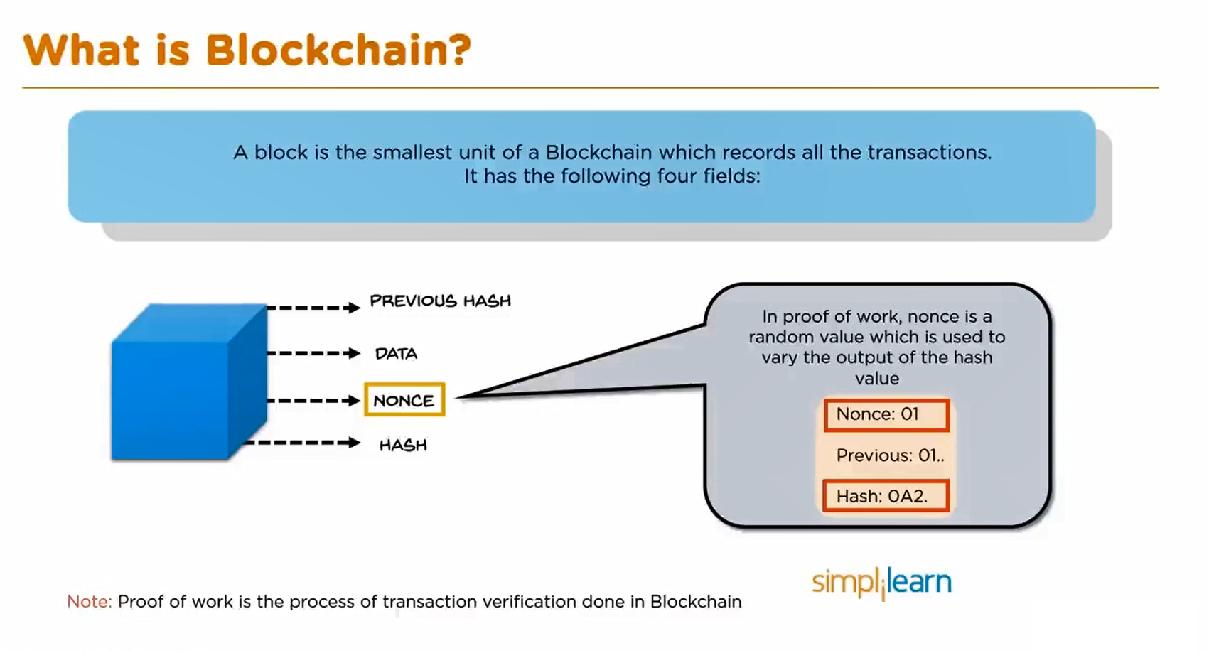
Bitcoin Mining

Slide 15
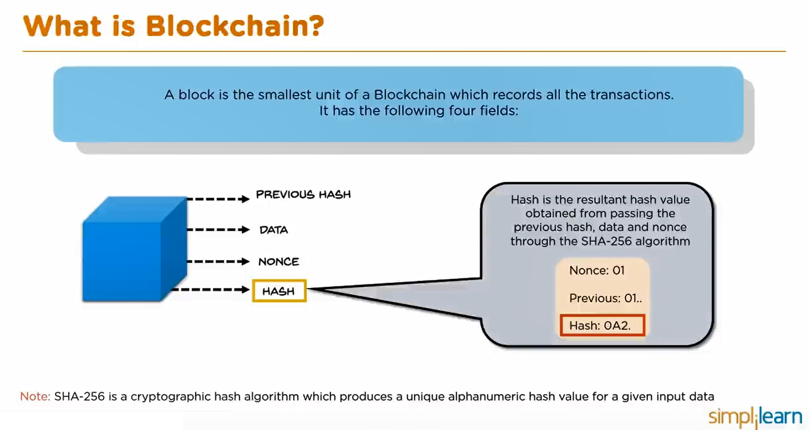
Bitcoin Mining

Slide 16
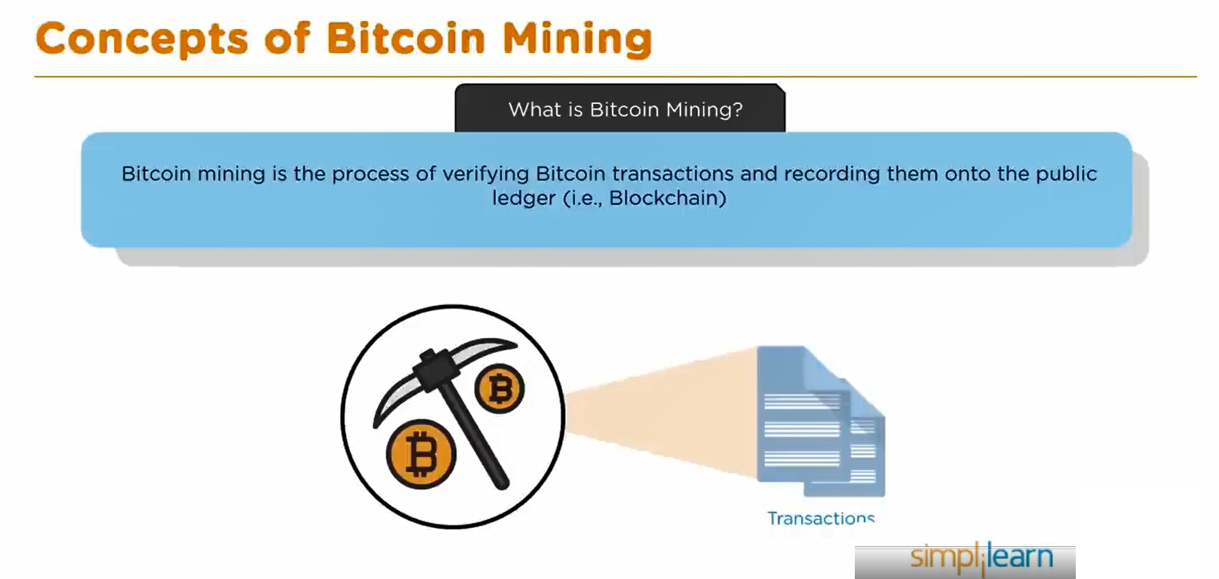
Bitcoin Mining

Slide 17
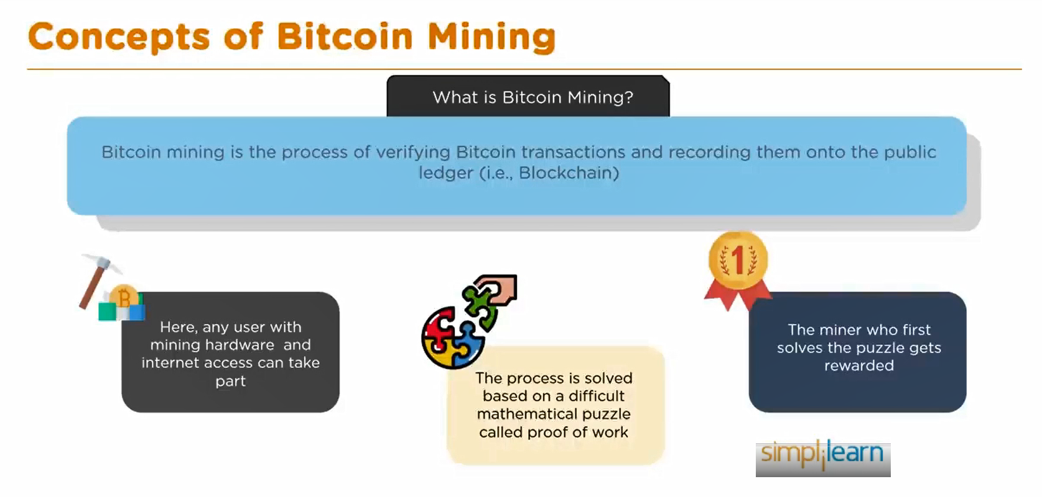
Bitcoin Mining

Slide 18
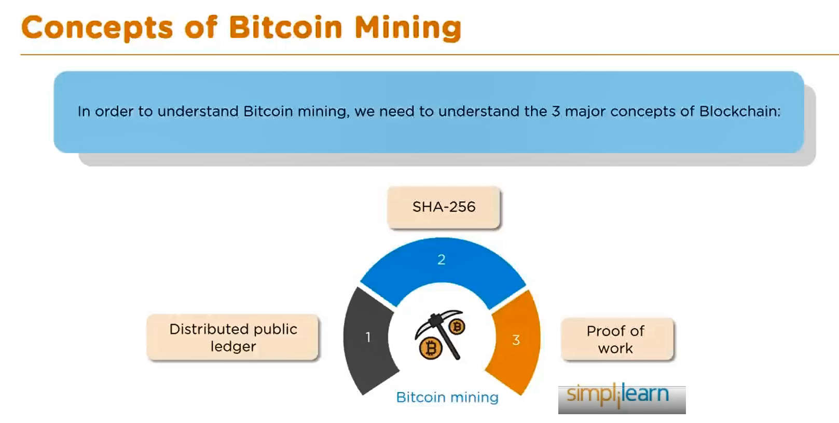
Bitcoin Mining

Slide 19
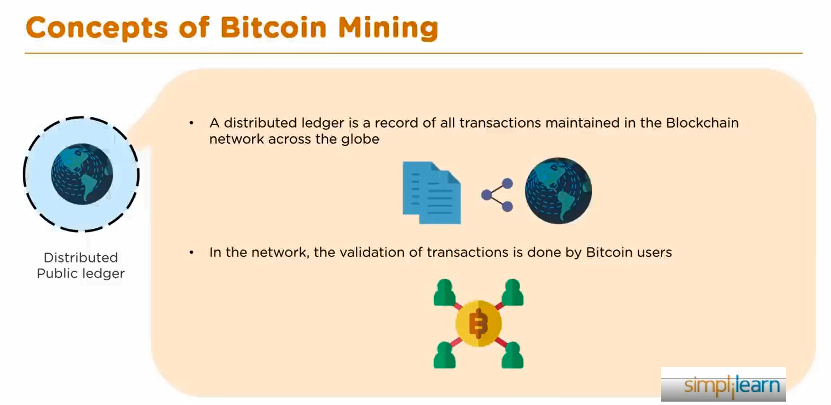
Bitcoin Mining

Slide 20
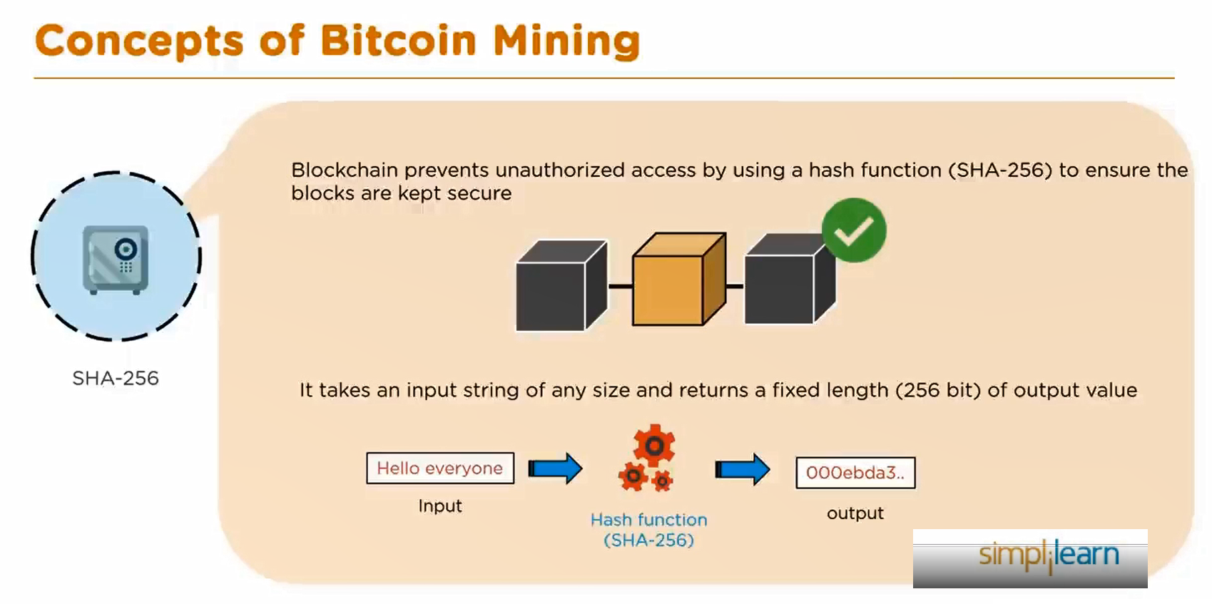
Bitcoin Mining

Slide 21
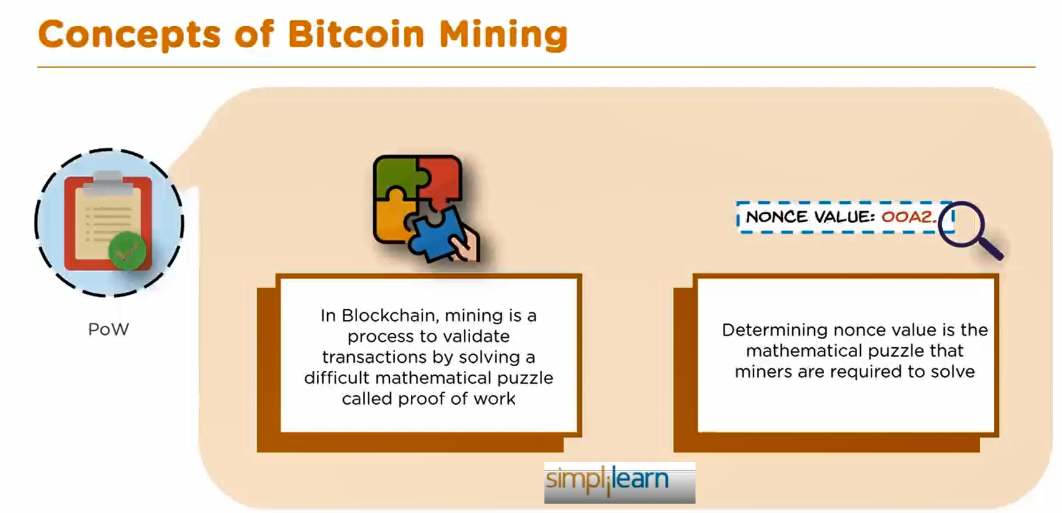
Bitcoin Mining

Slide 22
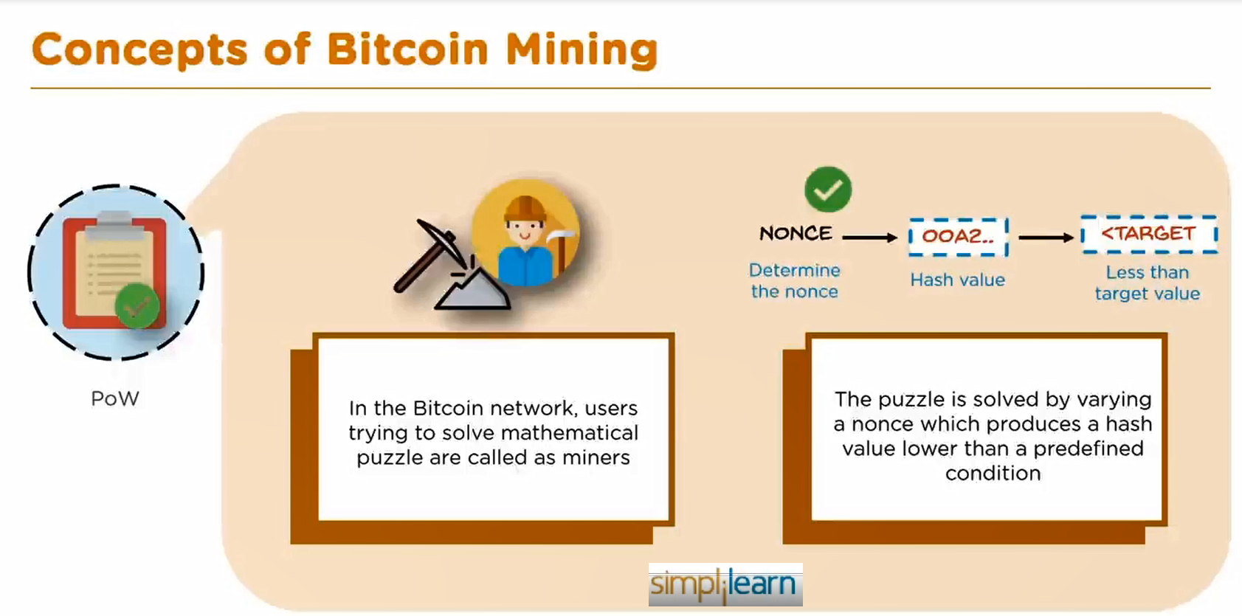
Bitcoin Mining

Slide 23
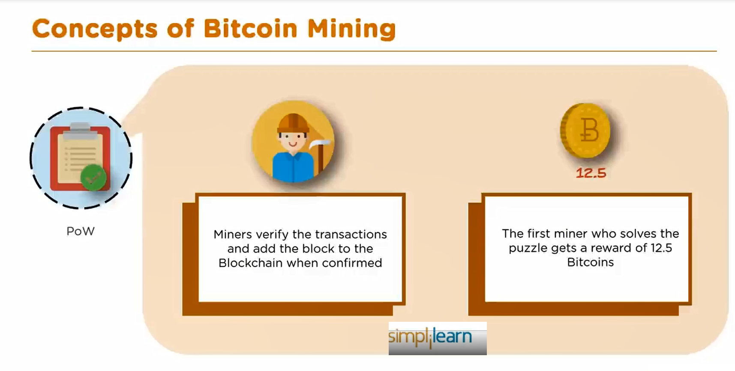
Bitcoin Mining

Slide 24
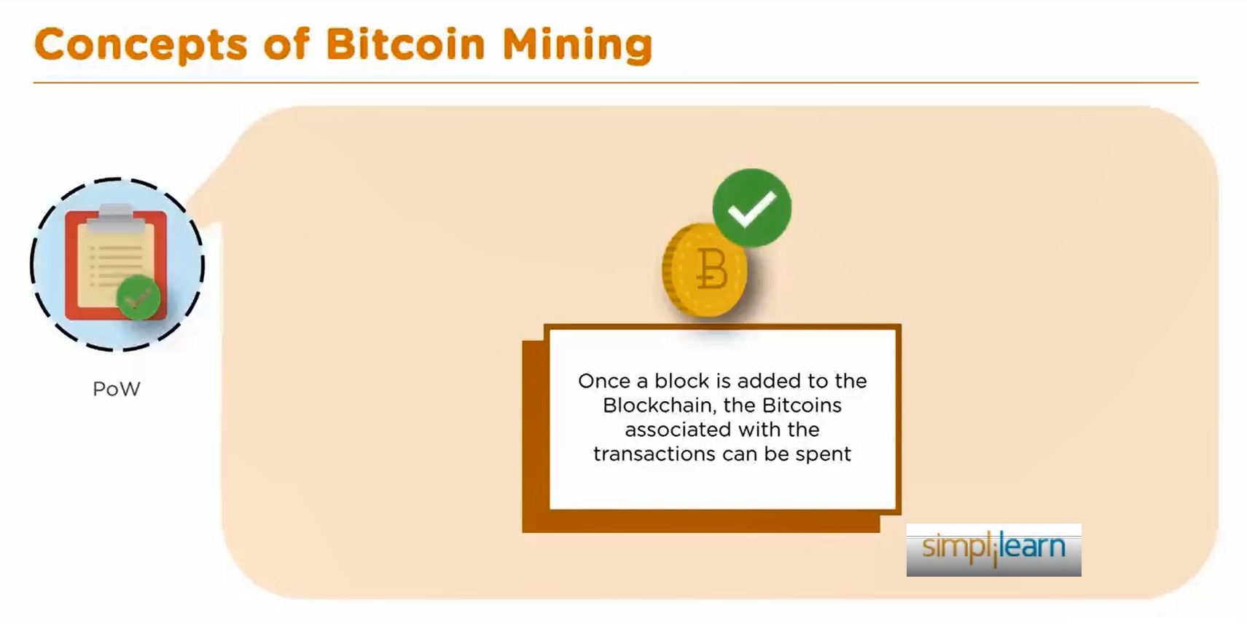
Bitcoin Mining

Slide 25
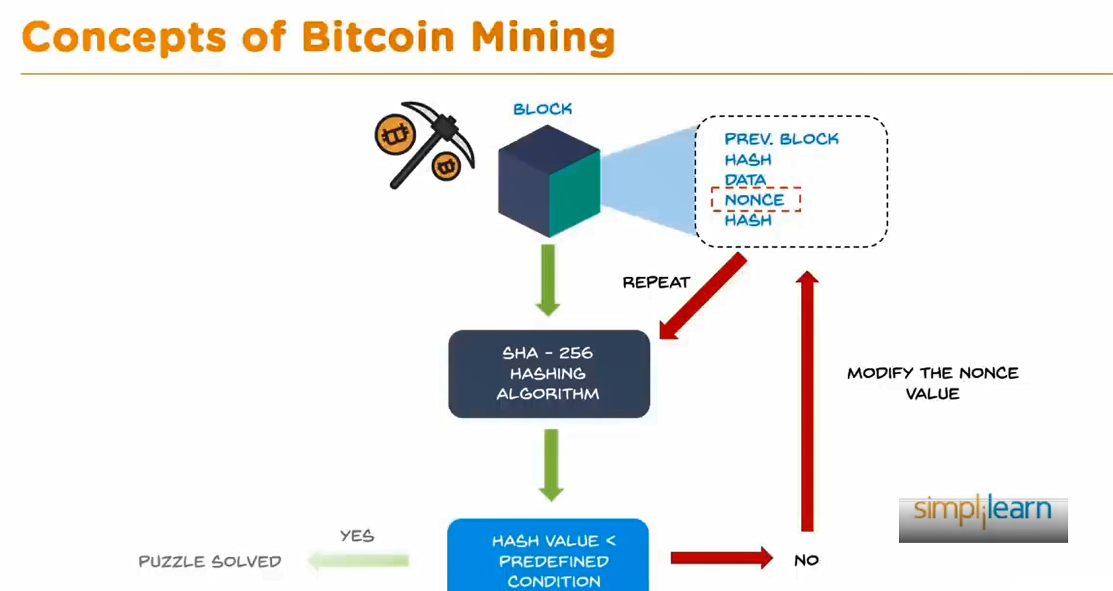
Bitcoin Mining

Slide 26
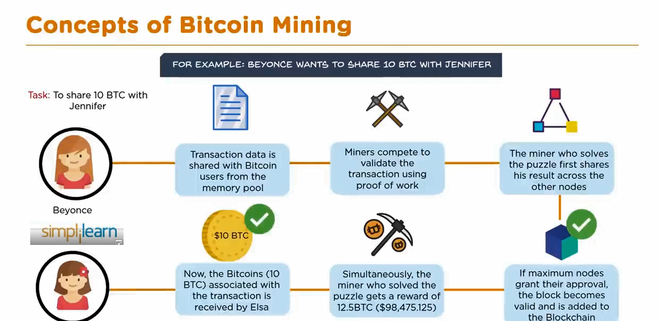
Bitcoin Mining

Slide 27
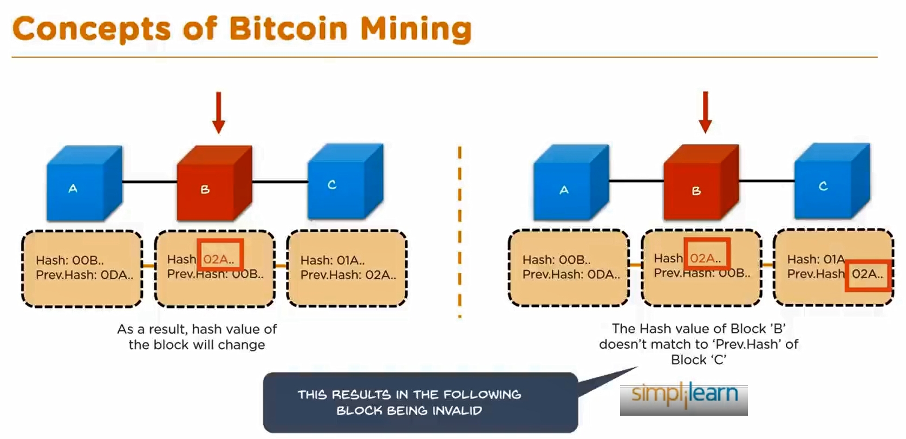
Bitcoin Mining

Slide 28
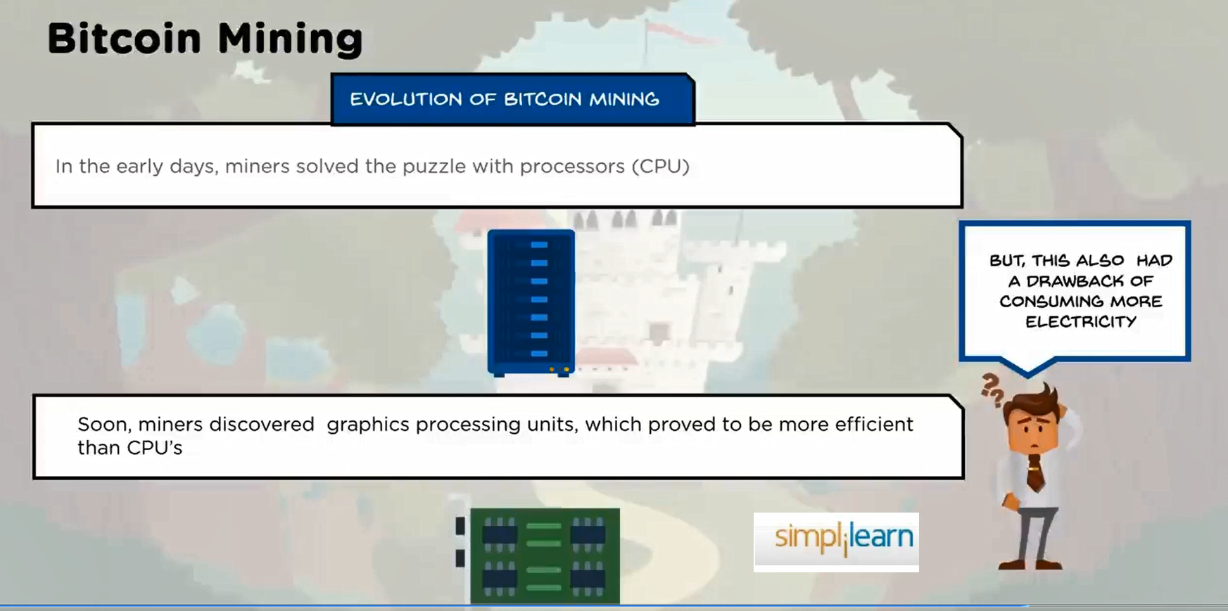
Bitcoin Mining

Slide 29
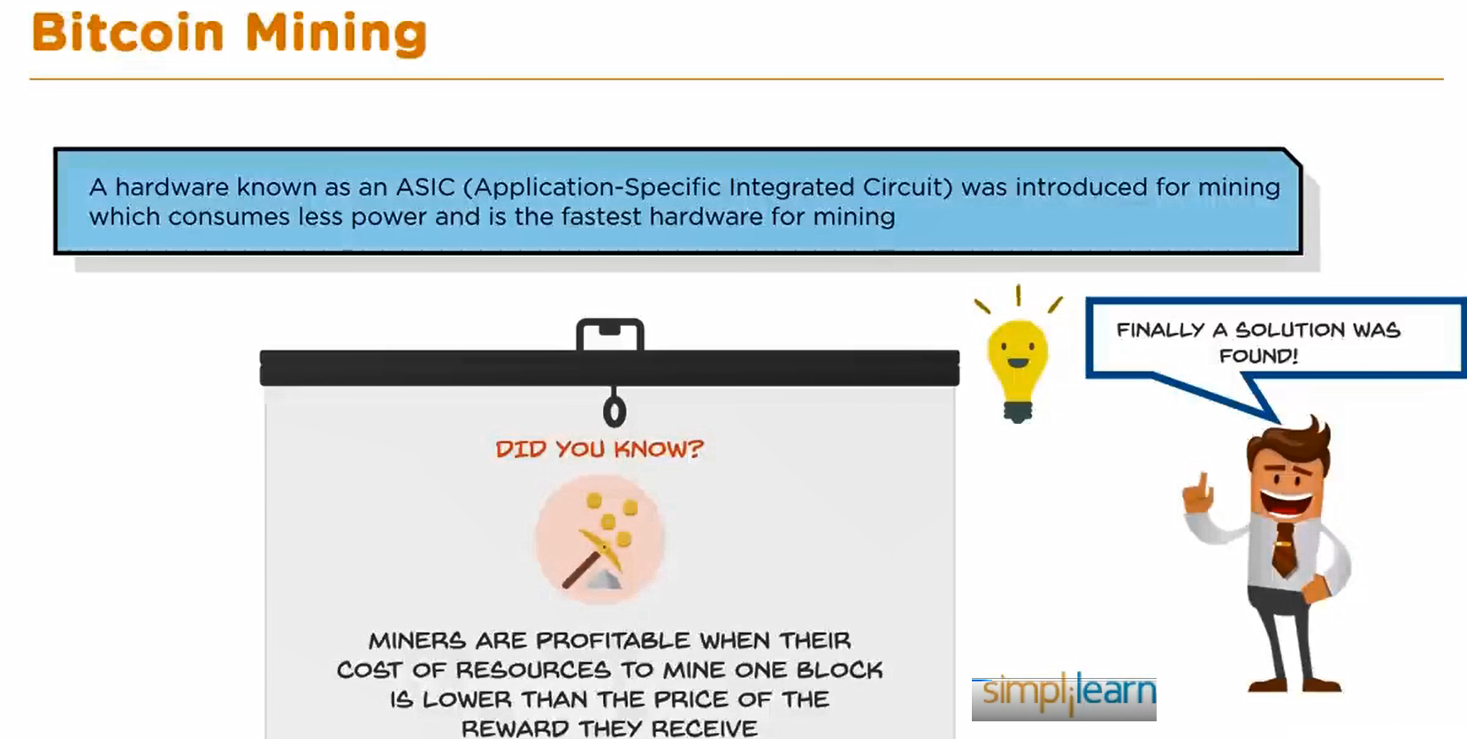
Bitcoin Mining

Slide 30
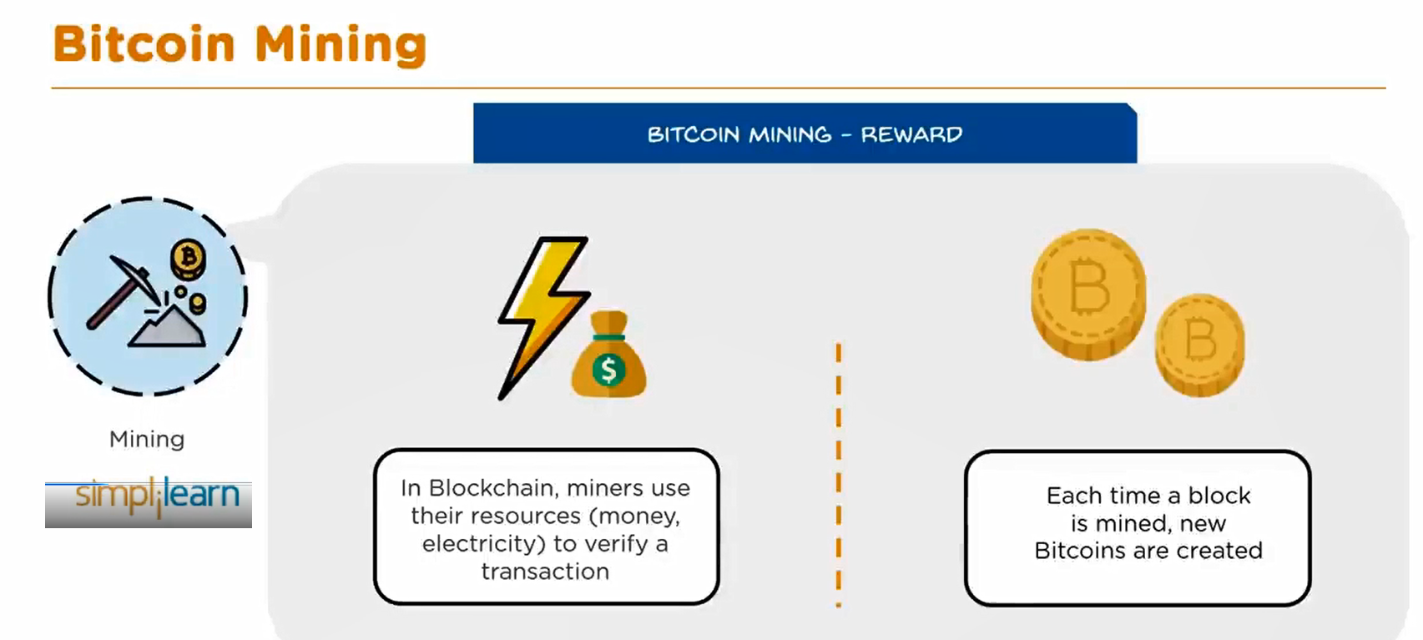
Bitcoin Mining

Slide 31
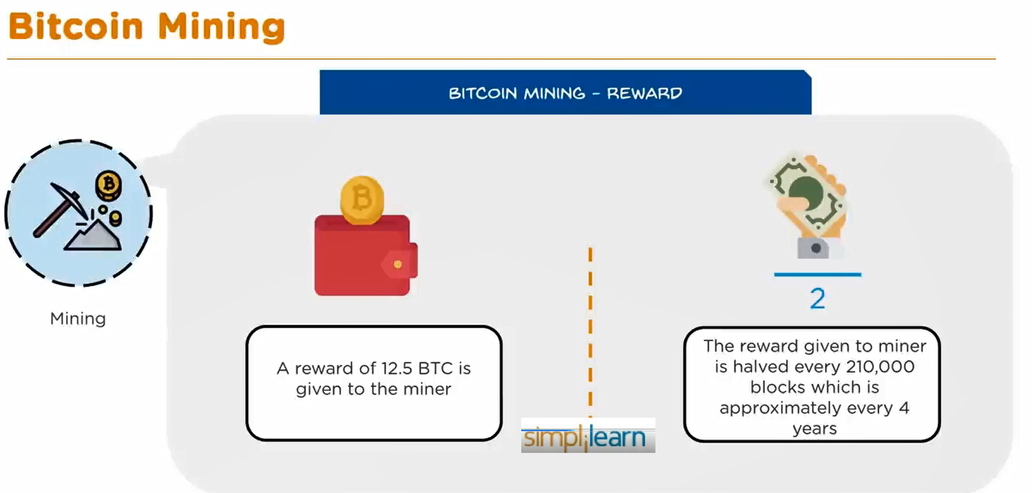
Bitcoin Mining

Slide 32
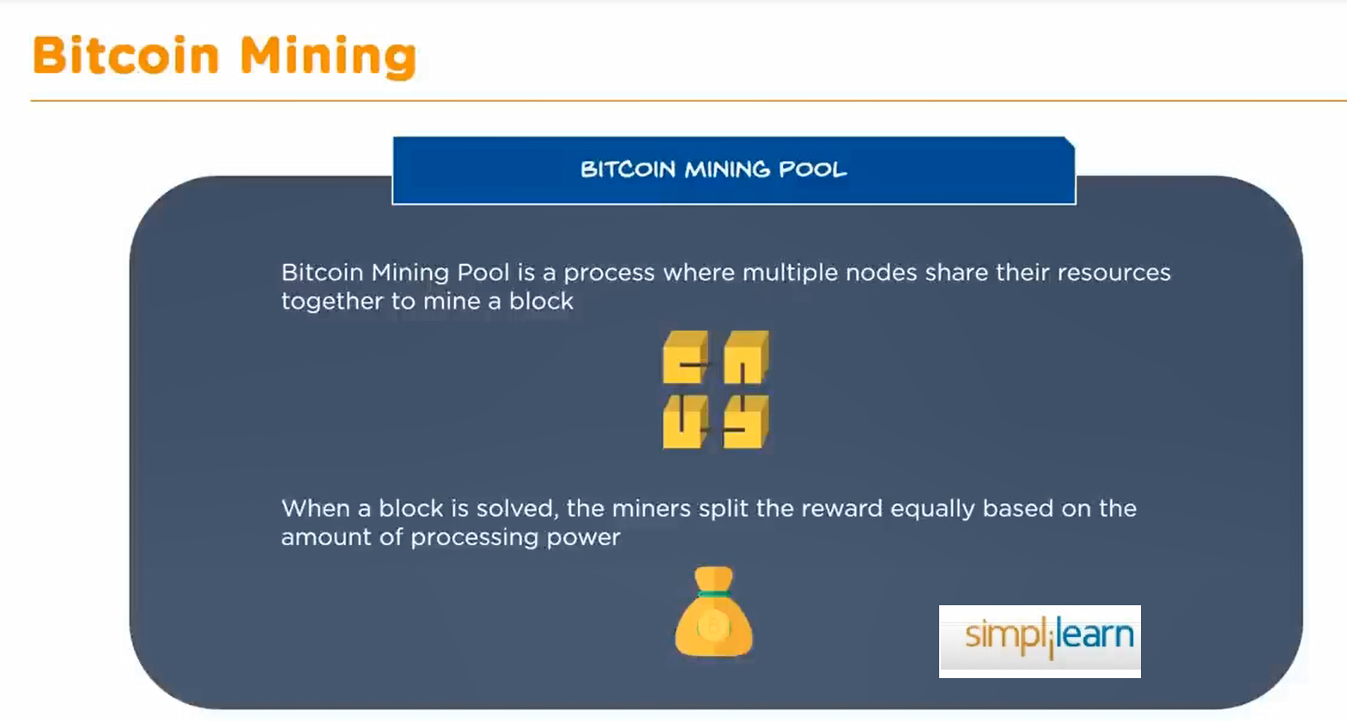
Bitcoin Mining

Slide 33
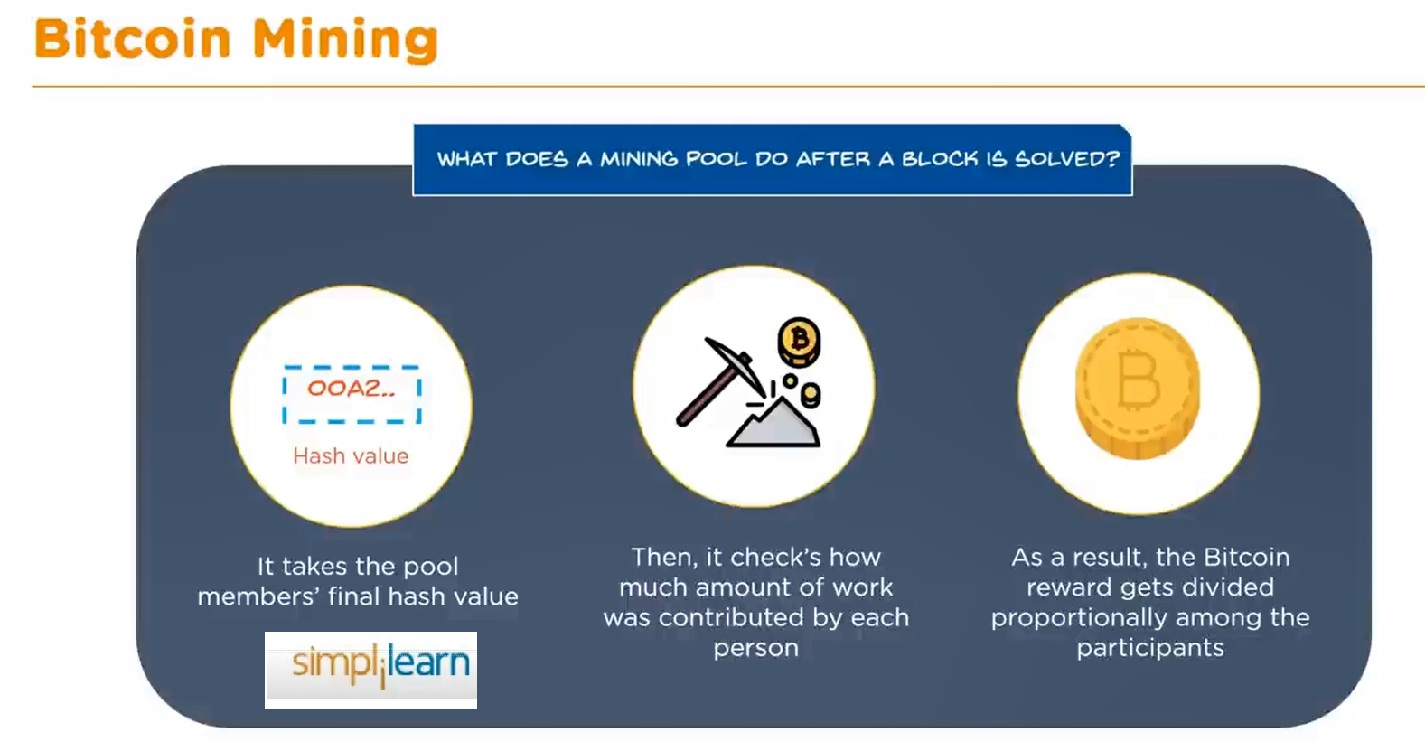
Bitcoin Mining

Slide 34
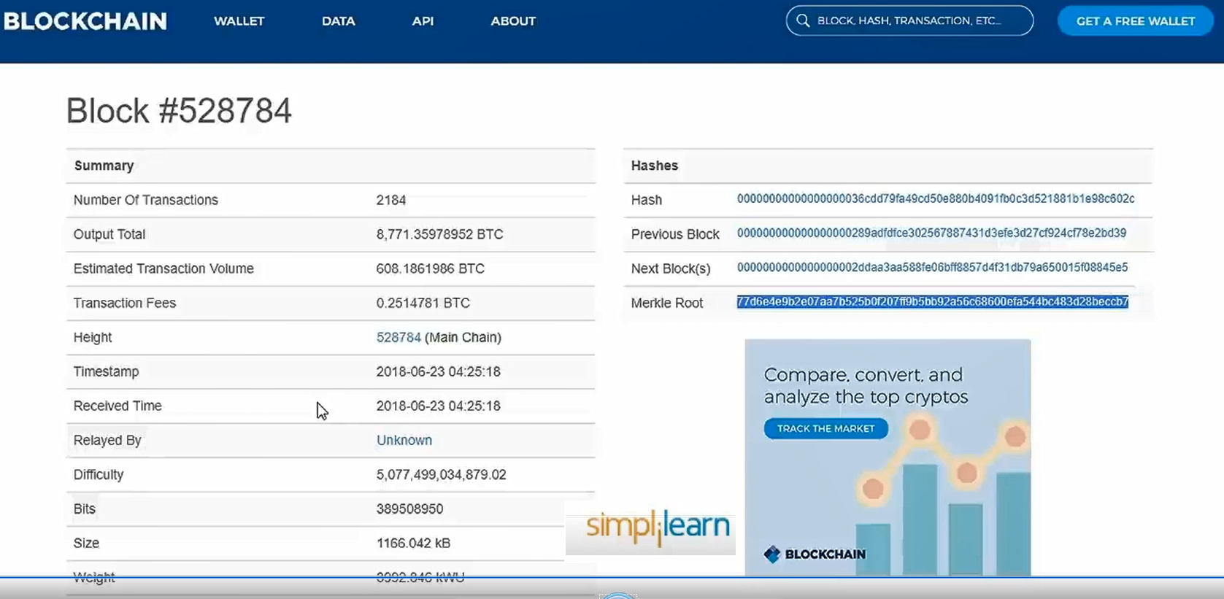
Bitcoin Mining

Slide 35
Conclusion
Bitcoin's introduction as the first cryptocurrency has had a profound impact on the financial world, challenging traditional systems and offering a new way to think about money and transactions. Its decentralized nature, combined with the innovative use of blockchain technology, has made it a resilient and secure system that continues to attract attention and adoption worldwide.
Understanding the genesis of Bitcoin, the mechanics of mining, the proof-of-work consensus algorithm, and the intricacies of the Bitcoin network is essential for anyone looking to grasp the broader implications of this groundbreaking technology. As Bitcoin continues to evolve, its role in the future of finance will undoubtedly be a subject of ongoing discussion and exploration.

Slide 36
Questions and Comments?

