Slide 1
Bitcoin Wallet
FIN451 / MBA651

Slide 2
What is a Bitcoin Wallet?
Definition: A Bitcoin wallet is a digital tool that allows you to send, receive, and store your bitcoins.
  It’s like a bank account for your bitcoins, but instead of holding physical money, it holds digital currency.
Analogy: Imagine a Bitcoin wallet as a real wallet you carry in your pocket.
  Just like you use your physical wallet to store cash, a Bitcoin wallet stores your digital money (bitcoins).

Slide 3
How Does a Bitcoin Wallet Work?
Private Key and Public Key:
  Private Key: This is a secret code that allows you to access and control your bitcoins. It’s like the password to your bank account.
    If someone has your private key, they can spend your bitcoins, so it’s essential to keep it safe.
  Public Key: This is like your bank account number. It’s a code that people use to send you bitcoins.
    You can share your public key with others, and they can use it to send bitcoins to your wallet.
Analogy: Think of your private key as the key to a safety deposit box.
  Only you should have access to this key because it gives you control over the money inside.
  The public key is like the address of the bank where your safety deposit box is located, which others can use to send money to your box.

Slide 4
Types of Bitcoin Wallets
Software Wallets:
  These are apps or programs you can install on your computer or smartphone
  Example: Mobile wallets like Coinbase or desktop wallets like Electrum.
Hardware Wallets:
  These are physical devices, like a USB stick, that store your private keys offline.
    They are more secure because they are not connected to the internet, making them less vulnerable to hacking.
  Example: Ledger Nano S, Trezor.
Paper Wallets:
  This is a piece of paper with your public and private keys printed on it.
    It’s a very secure way to store bitcoins, as long as you keep the paper safe.
  Example: You generate a paper wallet using a secure online service, then print it out and store it in a safe place.

Slide 5
Why Use a Bitcoin Wallet?
Security: A Bitcoin wallet helps keep your bitcoins safe.
  By securely storing your private key, you control who can access your funds.
Convenience: Bitcoin wallets make it easy to send and receive bitcoins.
  You can quickly make transactions by scanning a QR code or entering an address.
Ownership: When you have a Bitcoin wallet, you have full control over your bitcoins.
  No one else can access your funds unless they have your private key.

Slide 6
How to Use a Bitcoin Wallet
Receiving Bitcoins:
  To receive bitcoins, you give someone your public key (or wallet address).
  They send the bitcoins to that address, and it shows up in your wallet.
  Example: You can send your friend a QR code that represents your wallet address, and they can scan it to send you bitcoins.
Sending Bitcoins:
  To send bitcoins, you enter the recipient’s wallet address and the amount you want to send.
  The wallet uses your private key to authorize the transaction.
  Example: If you want to pay for something online with Bitcoin, you would enter the seller's wallet address and send the payment through your wallet.

Slide 7
Security Tips
Backup: Always back up your wallet.
  If you lose your private key, you lose your bitcoins forever.
Secure Storage: Keep your private key safe.
  Use hardware wallets or paper wallets for long-term storage, especially if you have a significant amount of bitcoins.
Beware of Scams: Never share your private key with anyone, and be cautious of phishing attempts that try to steal your private key.

Slide 8
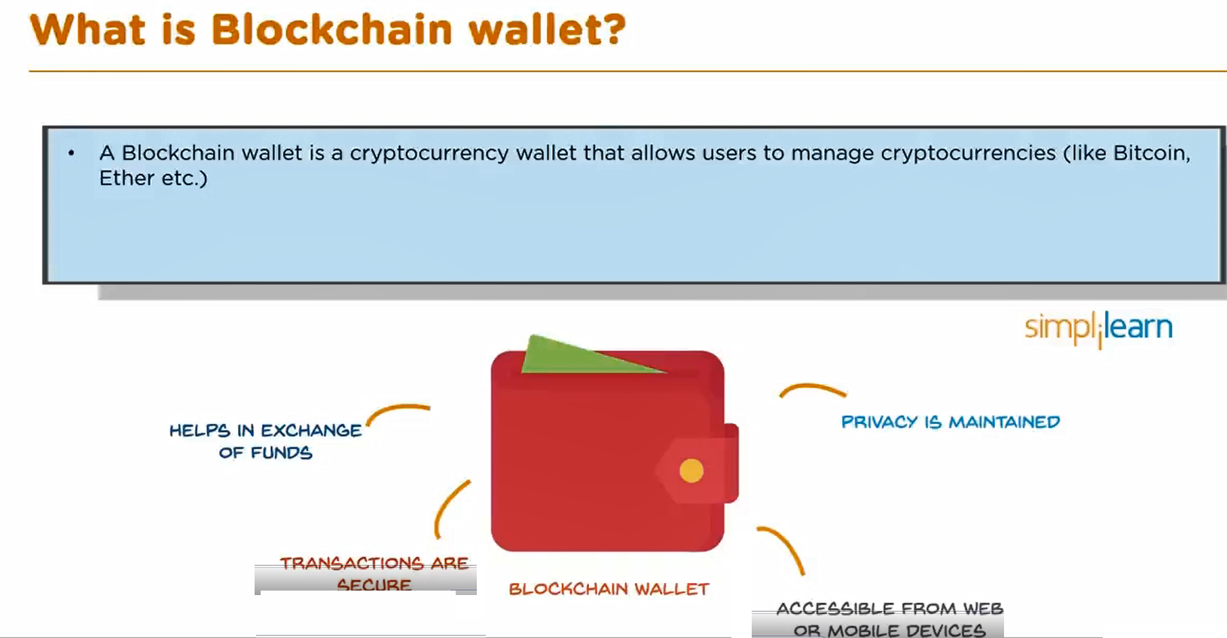

Slide 9
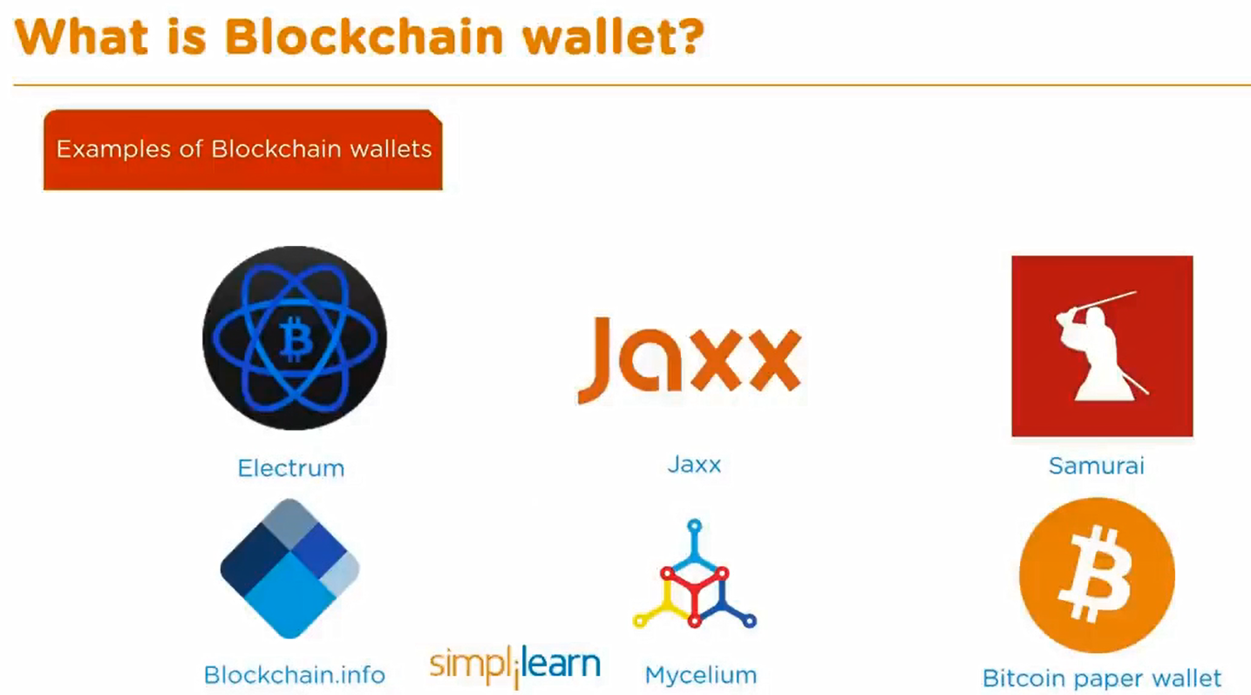

Slide 10
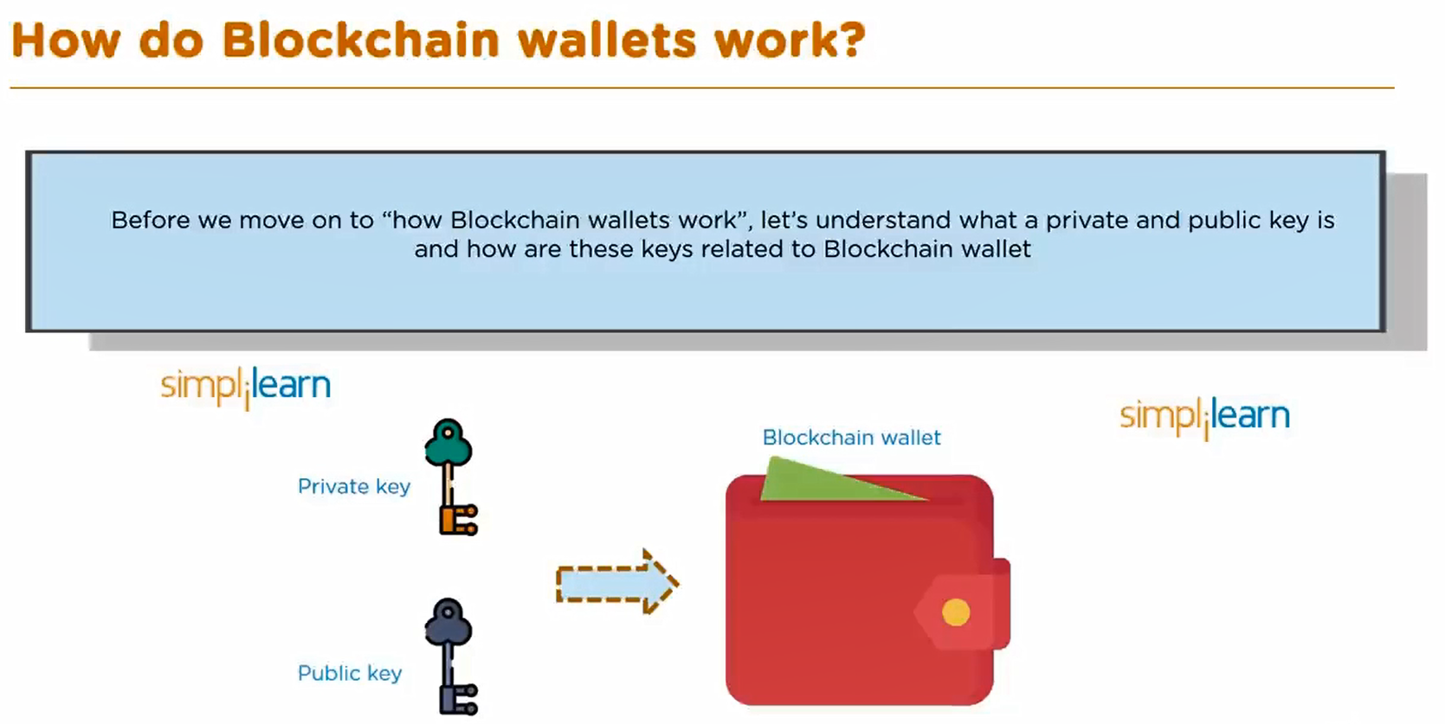

Slide 11
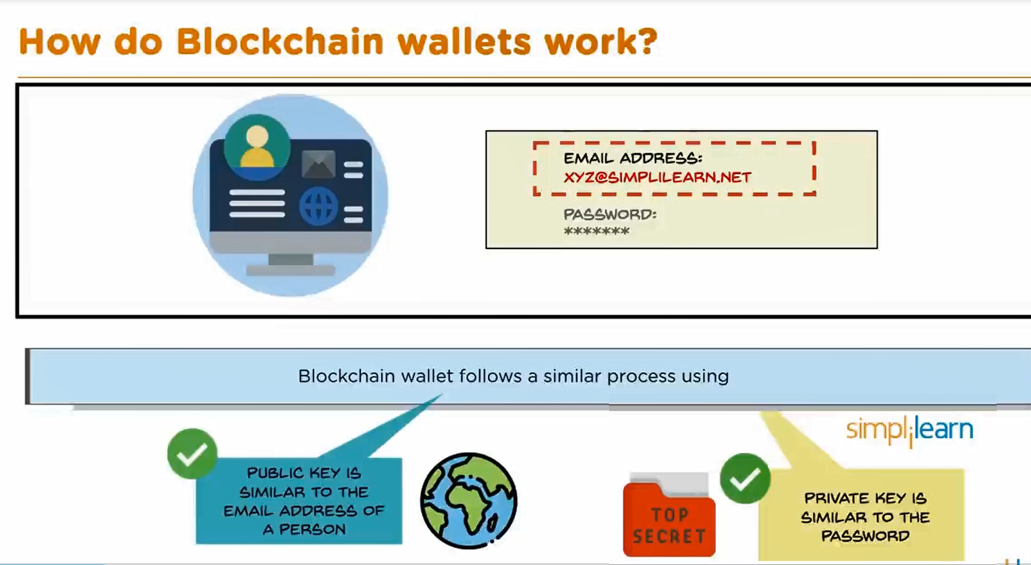

Slide 12
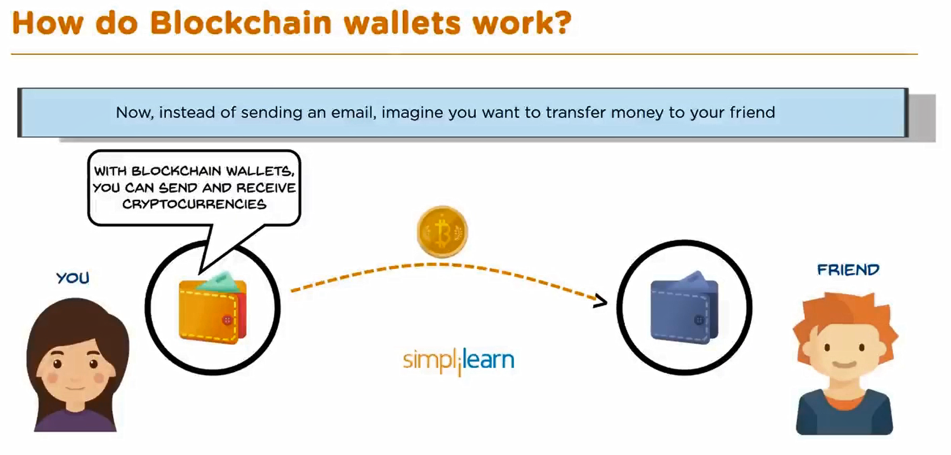

Slide 13
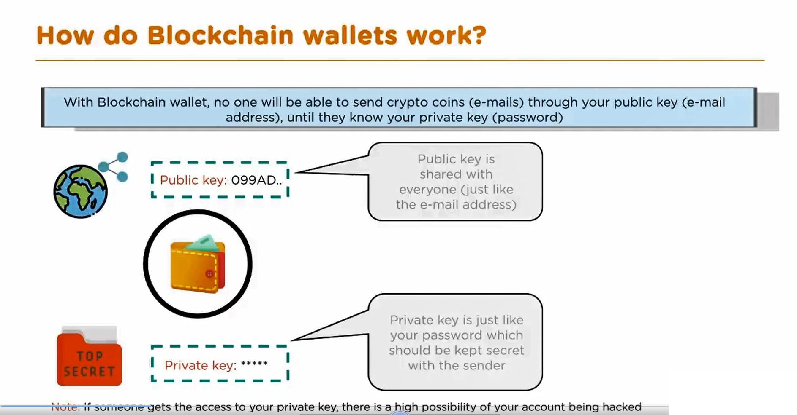

Slide 14
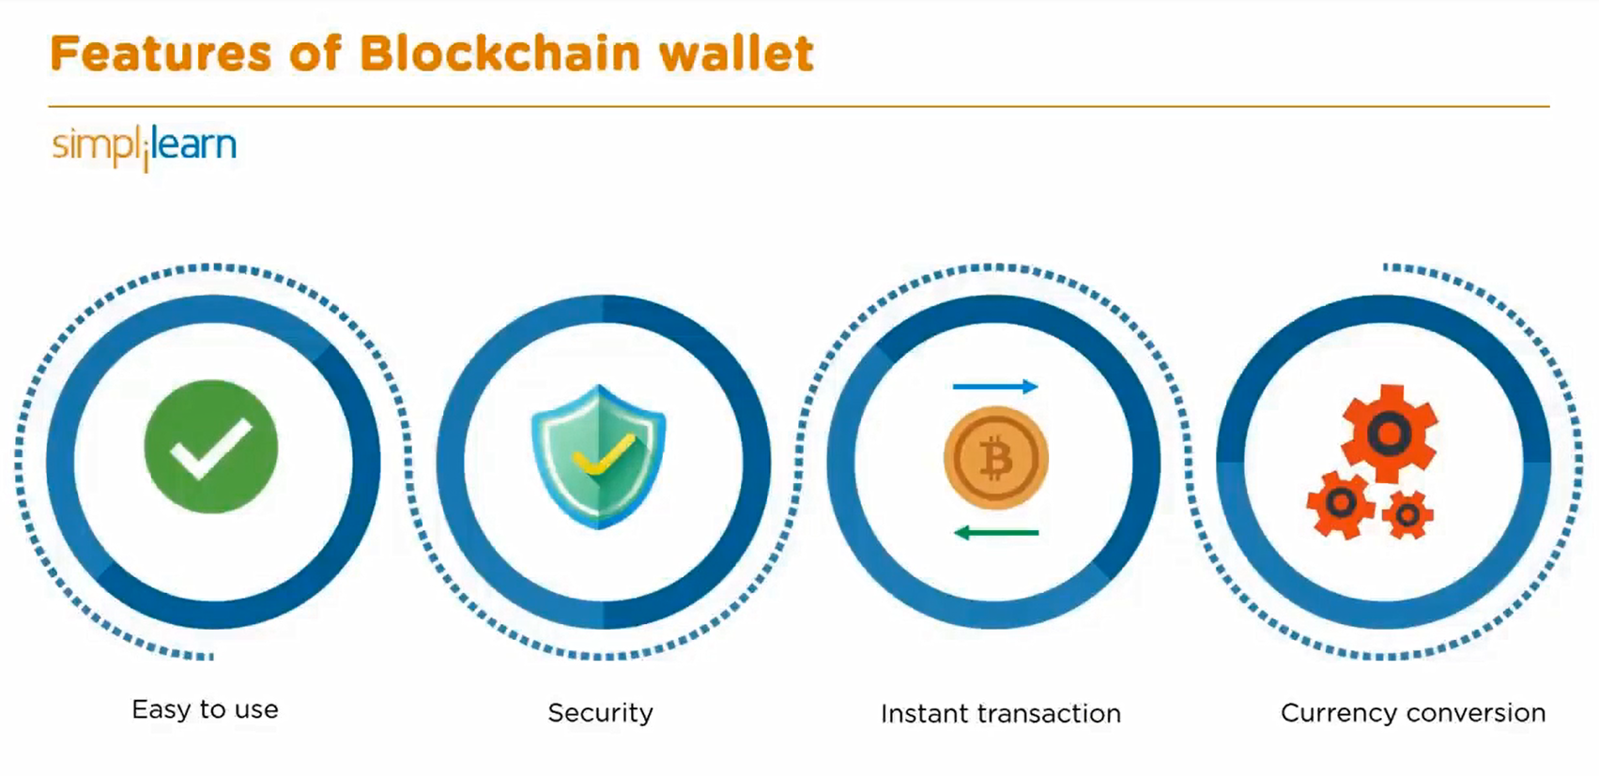

Slide 15
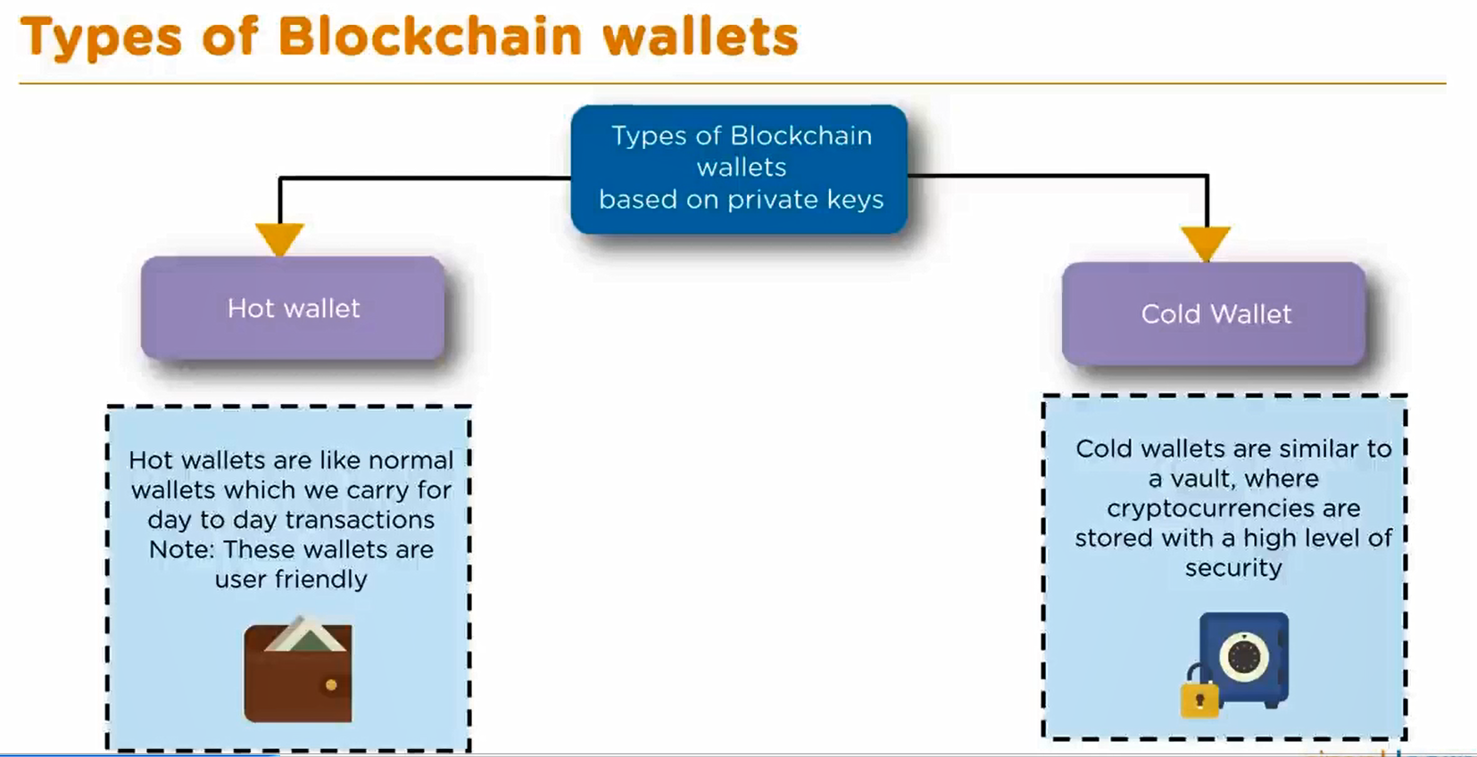

Slide 16
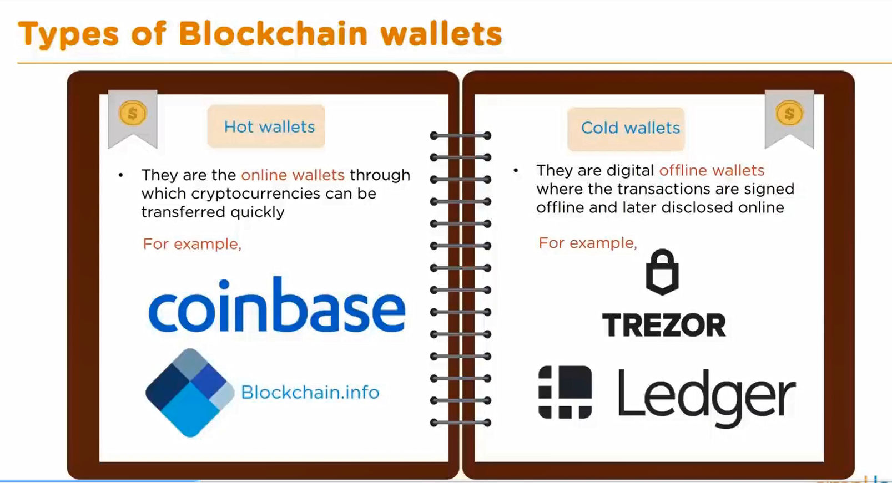

Slide 17
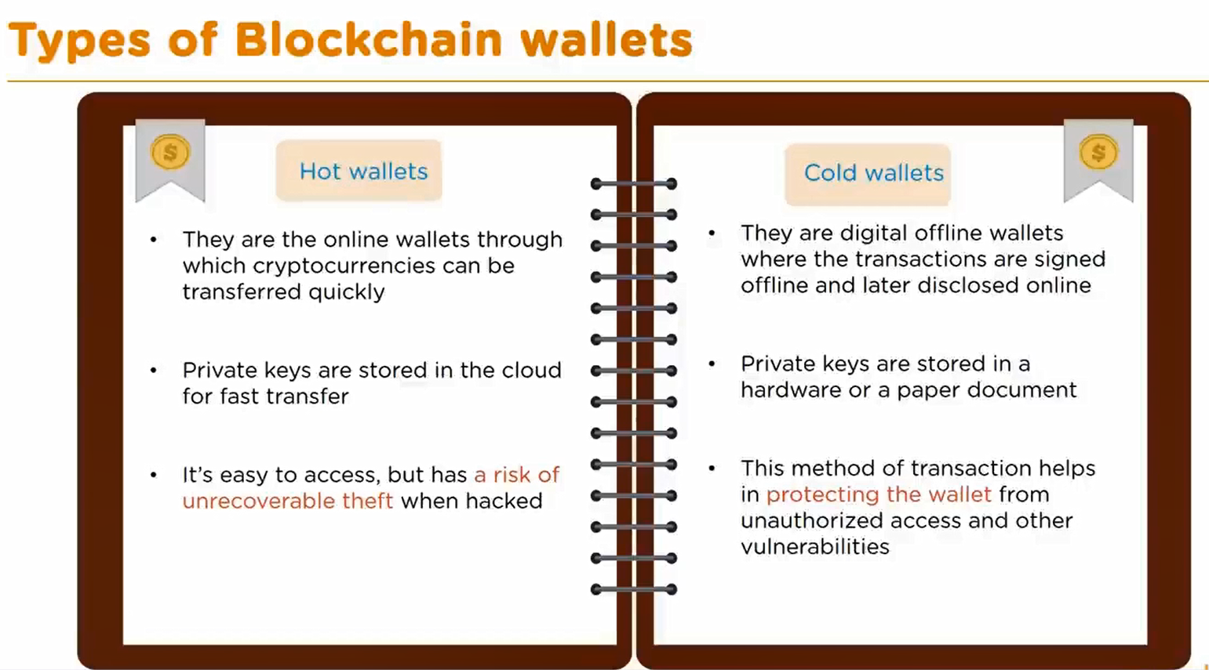

Slide 18
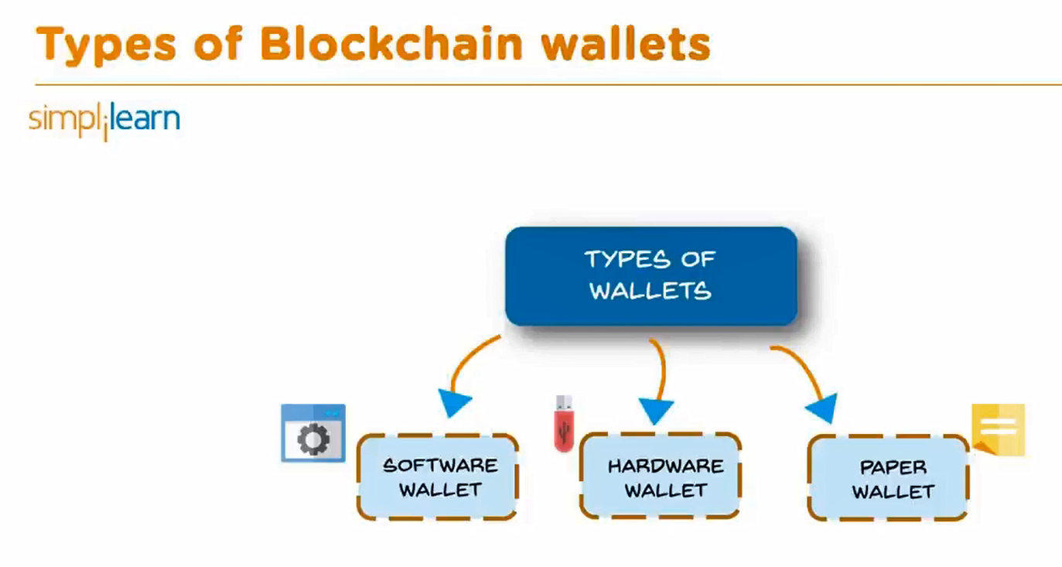

Slide 19
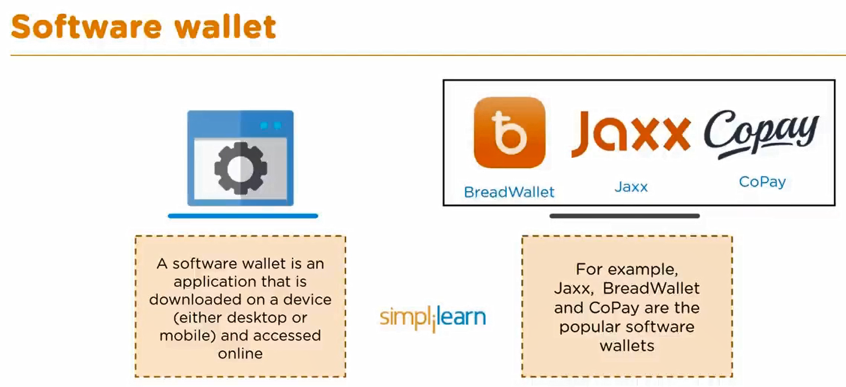

Slide 20
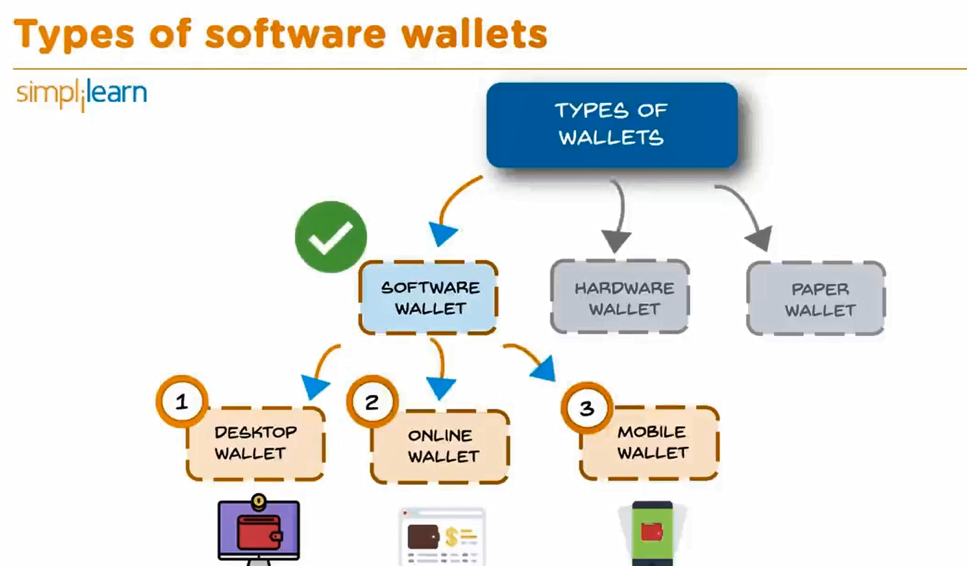

Slide 21
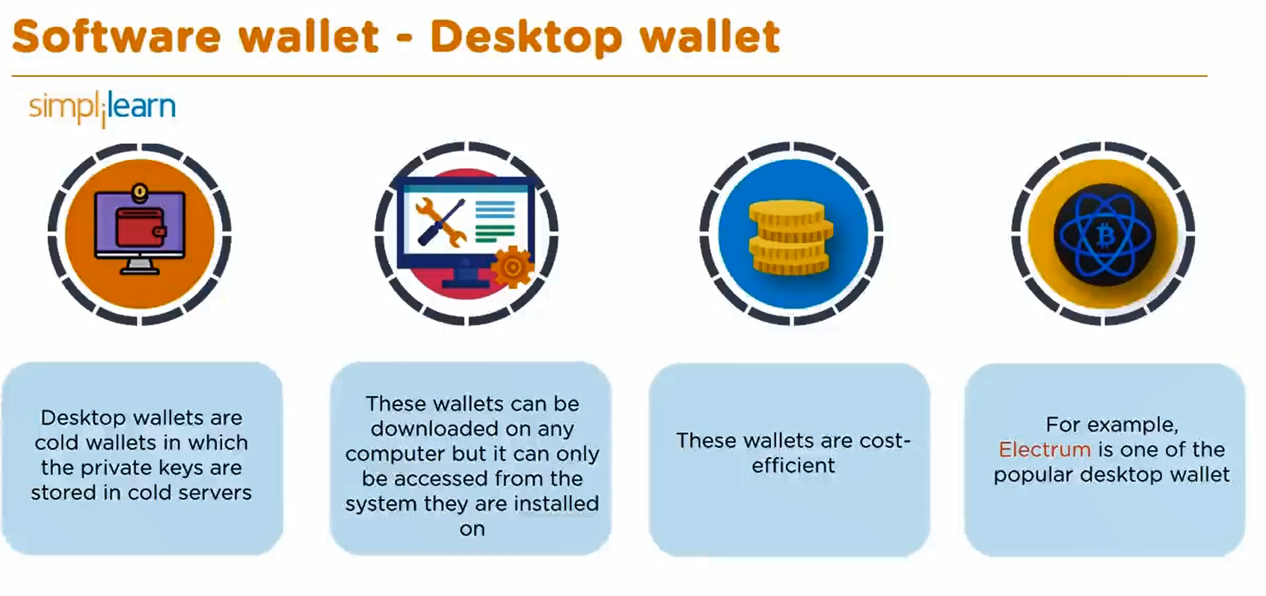

Slide 22
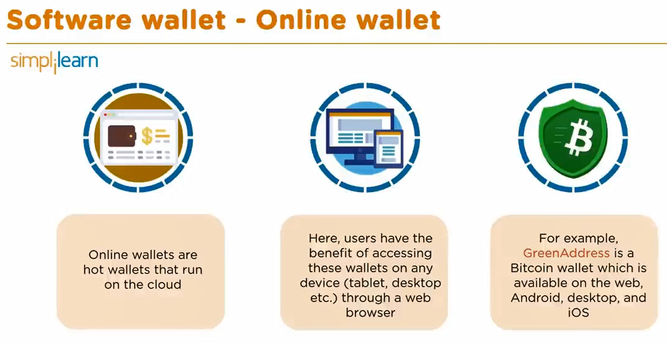

Slide 23
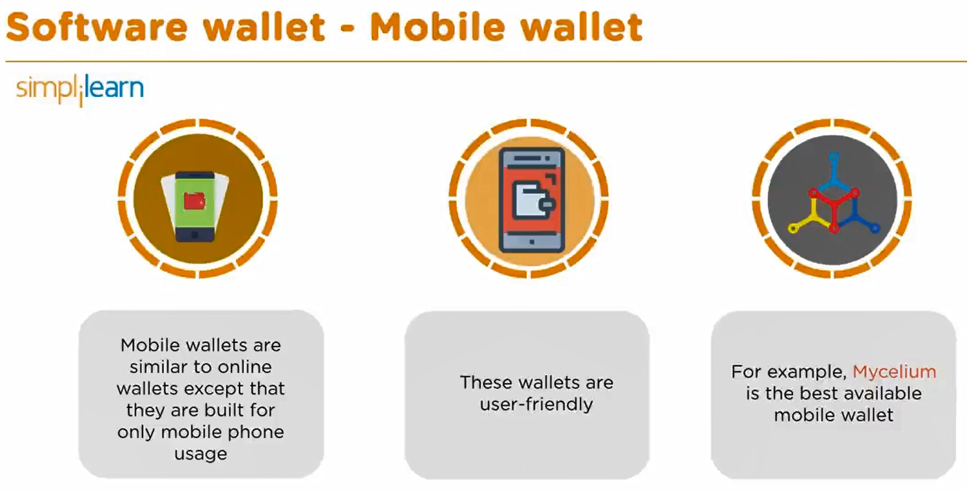

Slide 24
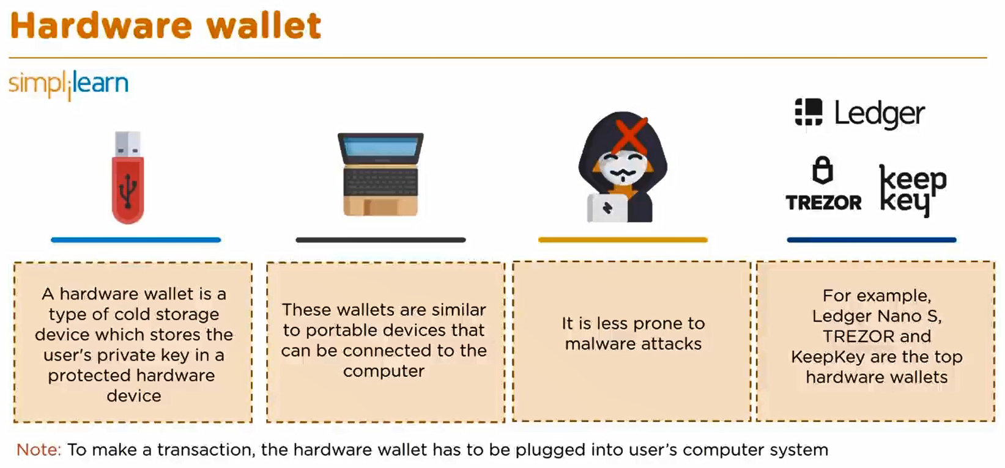

Slide 25
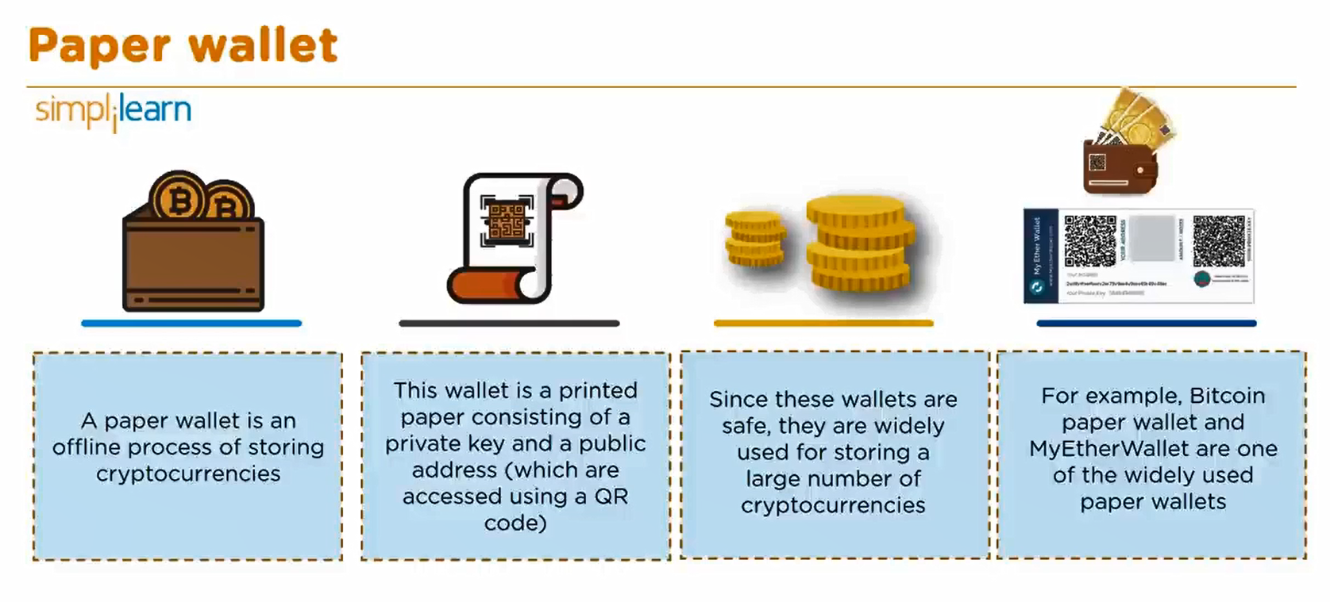

Slide 26
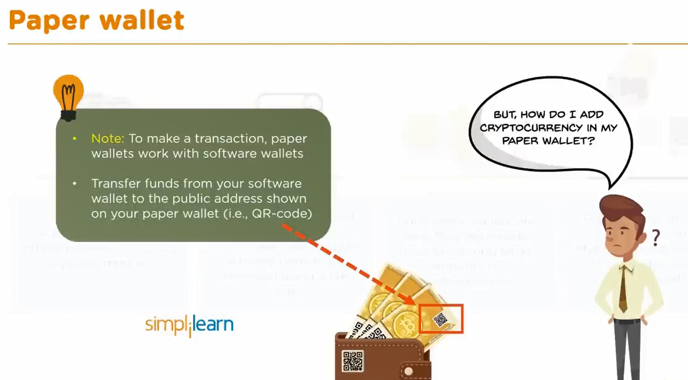

Slide 27
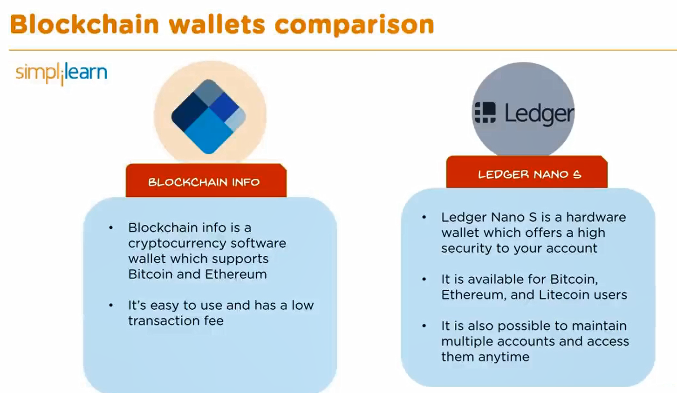

Slide 28
