Slide 1

Exchange Rate Determination
Chapter 4

Slide 2
Chapter Objectives
Explain how exchange rate movements are measured.
Explain how the equilibrium exchange rate is determined.
Examine factors that determine the equilibrium exchange rate.
Explain the movement in cross exchange rates.
Explain how financial institutions attempt to capitalize on anticipated exchange rate movements.

Slide 3
Measuring Exchange Rate Movements
Depreciation: decline in a currency’s value
Appreciation: increase in a currency’s value
Comparing foreign currency spot rates over two points in time, S and S_{t − 1}
A positive percent change indicates that the currency has appreciated. A negative percent change indicates that it has depreciated. (Exhibit 4.1)

Slide 4
Exhibit 4.1 How Exchange Rate Movements and Volatility Are Measured
 | Value of Canadian Dollar (C$) | Monthly % Change in C$ | Value of Euro | Monthly % Change in Euro
Jan. 1 | $0.70 | — | $1.18 | —
Feb. 1 | $0.71 | +1.43% | $1.16 | −1.69%
March 1 | $0.70 | −0.99% | $1.15 | −0.86%
April 1 | $0.70 | −0.85% | $1.12 | −2.61%
May 1 | $0.69 | −0.72% | $1.11 | −0.89%
June 1 | $0.70 | +043% | $1.14 | +2.70%
July 1 | $0.69 | −1.29% | $1.17 | +2.63%
Standard deviation of monthly changes |  | 1.04% |  | 2.31%

Slide 5
Exchange Rate Equilibrium (1 of 2)
The exchange rate represents the price of a currency, or the rate at which one currency can be exchanged for another.
Demand for a currency increases when the value of the currency decreases, leading to a downward sloping demand schedule. (See Exhibit 4.2)
Supply of a currency for sale increases when the value of the currency increases, leading to an upward sloping supply schedule. (See Exhibit 4.3)
Equilibrium equates the quantity of pounds demanded with the supply of pounds for sale. (See Exhibit 4.4)

Slide 6
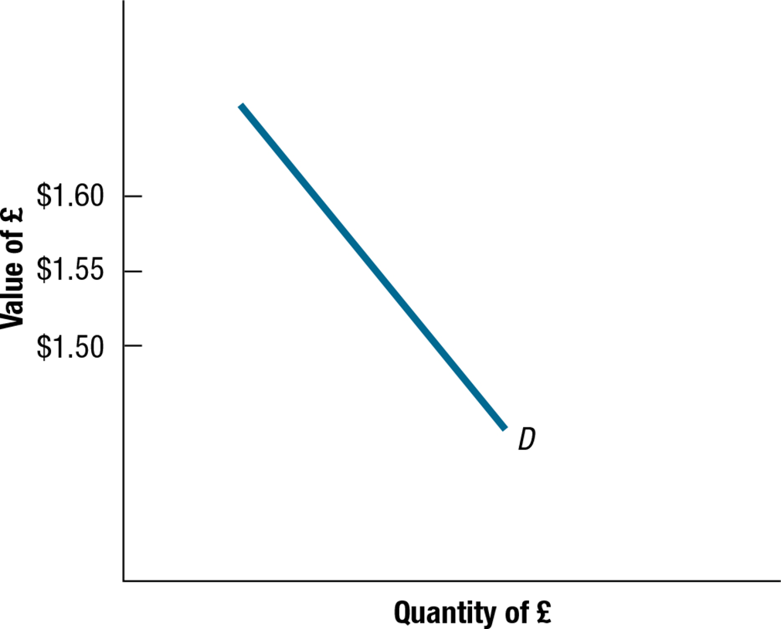
Exhibit 4.2 Demand Schedule for British Pounds

Slide 7
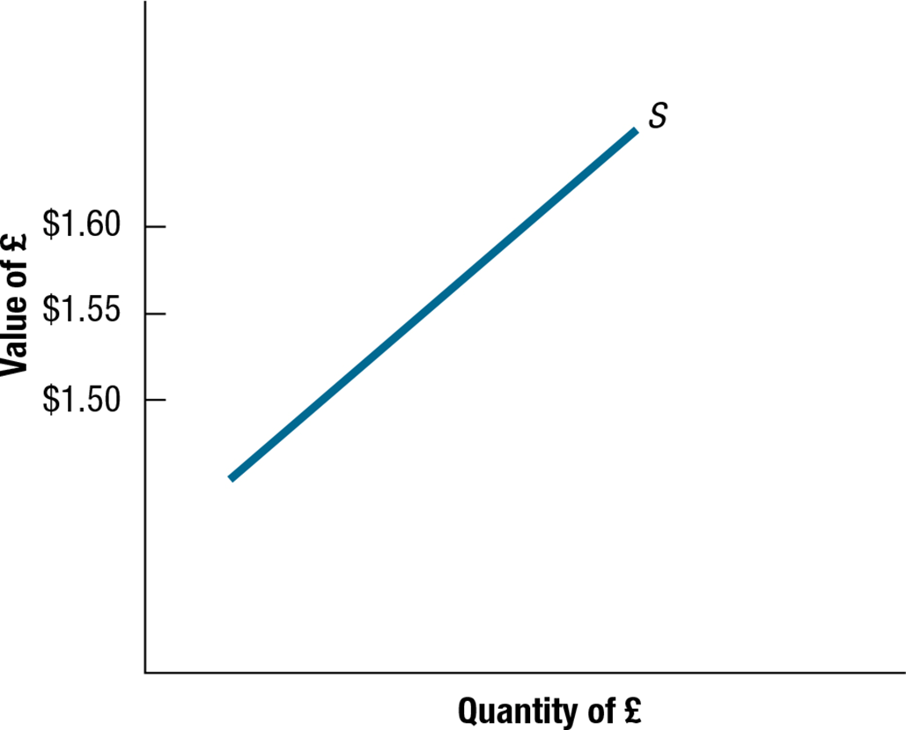
Exhibit 4.3 Supply Schedule of British Pounds for Sale

Slide 8
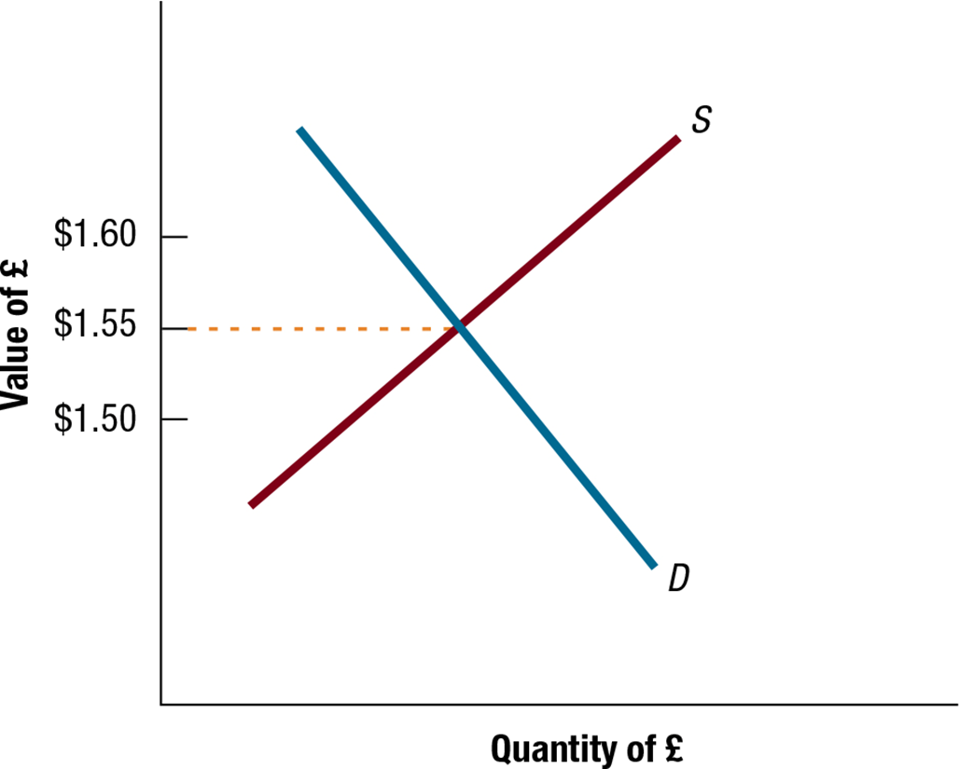
Exhibit 4.4 Equilibrium Exchange Rate Determination

Slide 9
Exchange Rate Equilibrium (2 of 2)
Change in the Equilibrium Exchange Rate
Increase in demand schedule: Banks will increase the exchange to the level at which the amount demanded is equal to the amount supplied in the foreign exchange market.
Decrease in demand schedule: Banks will reduce the exchange to the level at which the amount demanded is equal to the amount supplied in the foreign exchange market.
Increase in supply schedule: Banks will reduce the exchange to the level at which the amount demanded is equal to the amount supplied in the foreign exchange market.
Decrease in supply schedule: Banks will increase the exchange to the level at which the amount demanded is equal to the amount supplied in the foreign exchange market.

Slide 10
Factors That Influence Exchange Rates (1 of 5)
The equilibrium exchange rate will change over time as supply and demand schedules change.
e = f (ΔINF , ΔINT, ΔINC, ΔGC , ΔEXP)
where
e = percentage change in the spot rate
ΔINF = change in the differential between U. S . inflation and the foreign country's inflation
ΔINT = change in the differential between the U.S. interest rate and the foreign country's interest rate
ΔINC = change in the differential between the U.S. income level and the foreign country's income level
ΔGC = change in government controls
ΔEXP = change in expectations of future exchange rates

Slide 11
Factors That Influence Exchange Rates (2 of 5)
Relative Inflation Rates: Increase in U.S. inflation leads to increase in U.S. demand for foreign goods, an increase in U.S. demand for foreign currency, and an increase in the exchange rate for the foreign currency. (See Exhibit 4.5)
Relative Interest Rates: Increase in U.S. rates leads to increase in demand for U.S. deposits and a decrease in demand for foreign deposits, leading to an increase in demand for dollars and an increased exchange rate for the dollar. (See Exhibit 4.6)
Real Interest Rates
Fisher Effect:

Slide 12
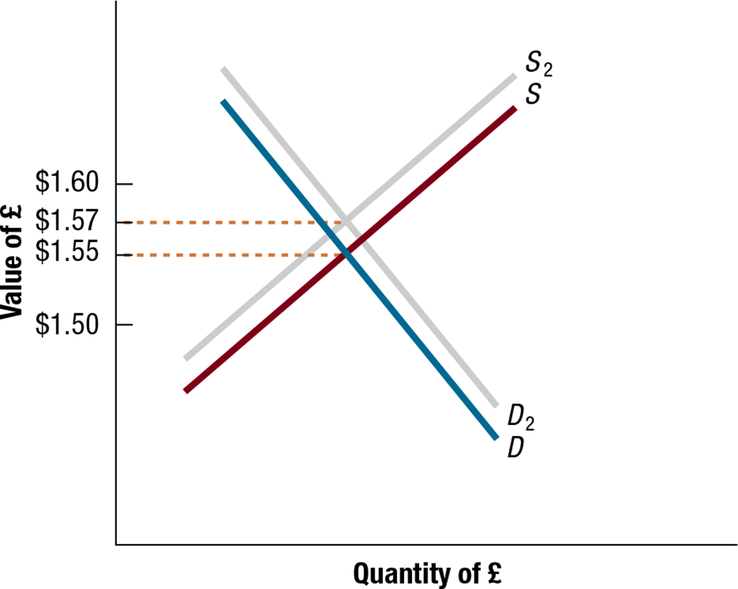
Exhibit 4.5 Impact of Rising U.S. Inflation on the Equilibrium Value of the British Pound

Slide 13
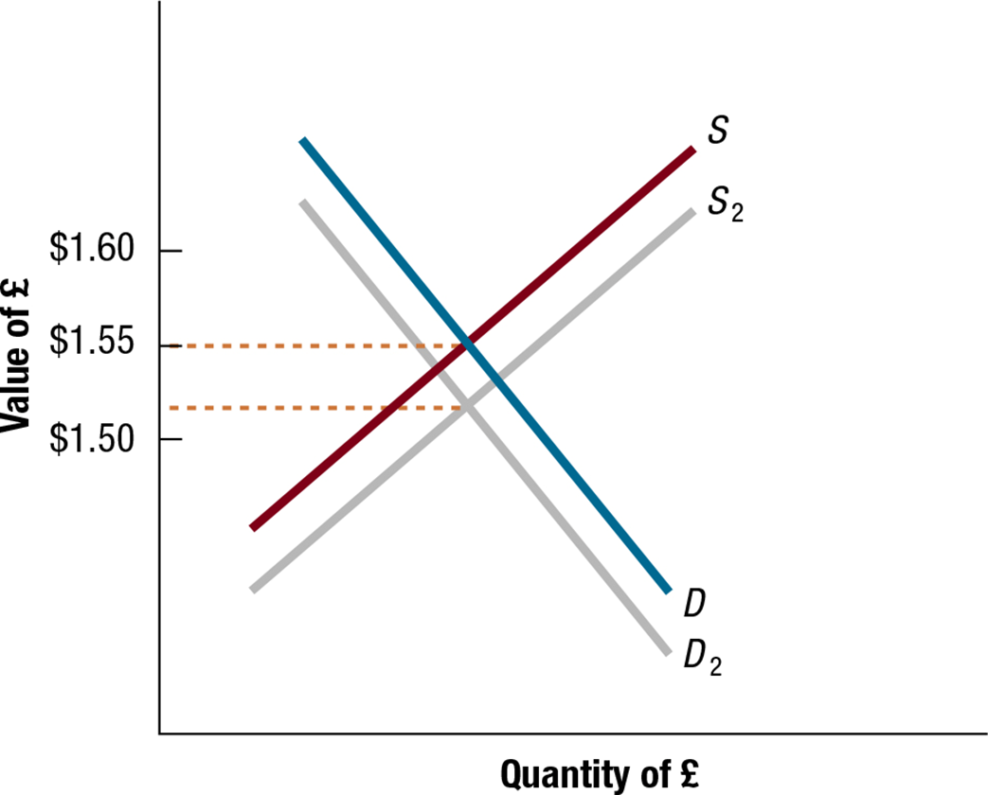
Exhibit 4.6 Impact of Rising U.S. Interest Rates on the Equilibrium Value of the British Pound

Slide 14
Factors That Influence Exchange Rates (3 of 5)
Relative Income Levels: Increase in U.S. income leads to an increase in U.S. demand for foreign goods, an increased demand for foreign currency relative to the dollar, and an increase in the exchange rate for the foreign currency. (See Exhibit 4.7)
Government Controls via:
Imposing foreign exchange barriers
Imposing foreign trade barriers
Intervening in foreign exchange markets
Affecting macro variables such as inflation, interest rates, and income levels

Slide 15
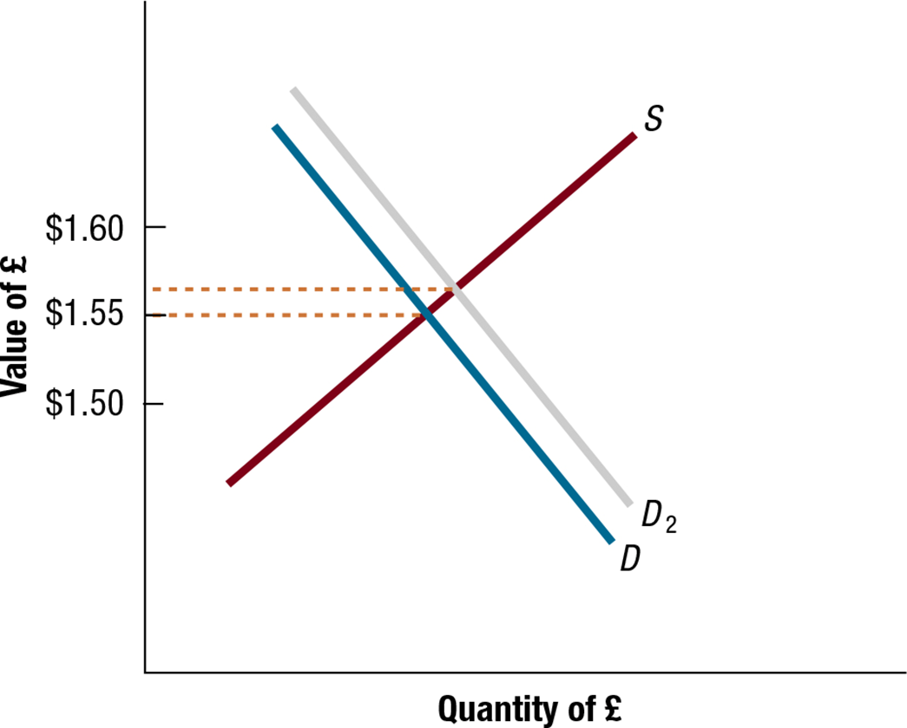
Exhibit 4.7 Impact of Rising U.S. Income Levels on Equilibrium Value of the British Pound

Slide 16
Factors That Influence Exchange Rates (4 of 5)
Expectations:
Impact of favorable expectations: If investors expect interest rates in one country to rise, they may invest in that country, leading to a rise in the demand for foreign currency and an increase in the exchange rate for foreign currency.
Impact of unfavorable expectations: Speculators can place downward pressure on a currency when they expect it to depreciate.
Impact of signals on currency speculation: Speculators may overreact to signals, causing currency to be temporarily overvalued or undervalued.

Slide 17
Factors That Influence Exchange Rates (5 of 5)
Interaction of Factors: Some factors place upward pressure while other factors place downward pressure. (See Exhibit 4.8)
Influence of Factors across Multiple Currency Markets: common for European currencies to move in the same direction against the dollar.
Influence of Liquidity on Exchange Rate adjustment: If a currency’s spot market is liquid then its exchange rate will not be highly sensitive to a single large purchase or sale.

Slide 18
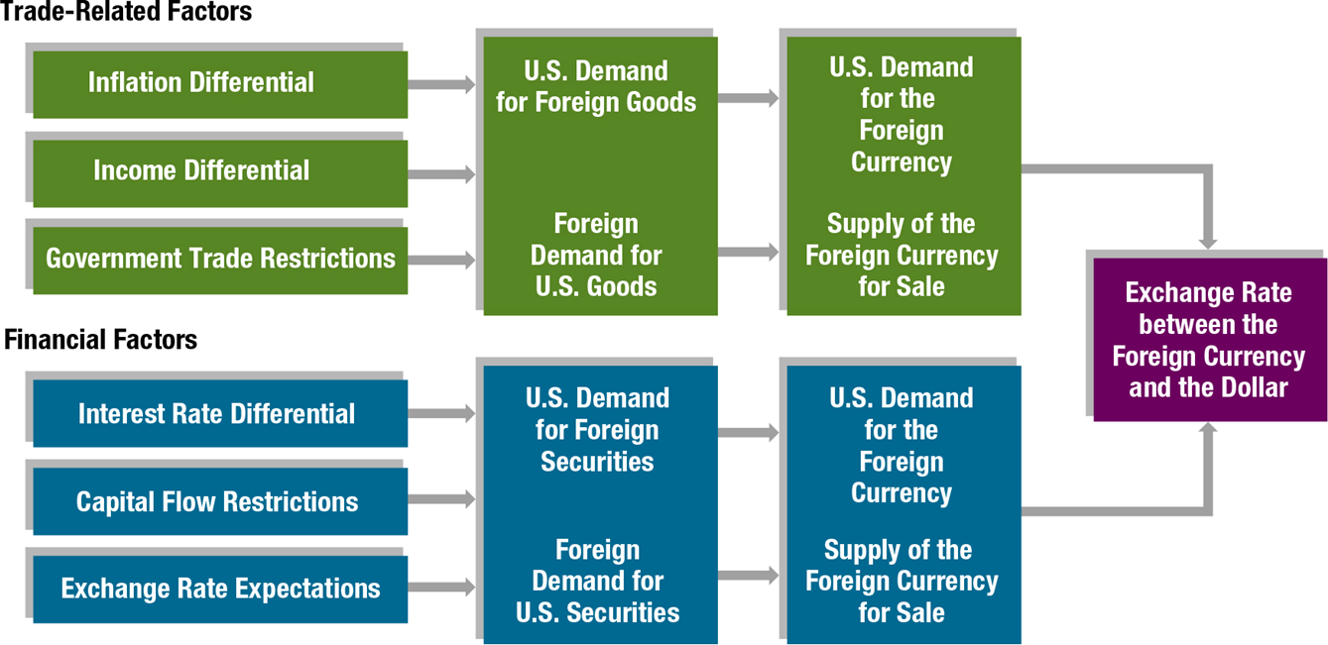
Exhibit 4.8 Summary of How Factors Affect Exchange Rates

Slide 19
Movements in Cross Exchange Rates (1 of 2)
If currencies A and B move in same direction, there is no change in the cross exchange rate.
When currency A appreciates against the dollar by a greater (smaller) degree than currency B, then currency A appreciates (depreciates) against B.
When currency A appreciates (depreciates) against the dollar, while currency B is unchanged against the dollar, currency A appreciates (depreciates) against currency B by the same degree as it appreciates (depreciates) against the dollar.

Slide 20
Movements in Cross Exchange Rates (2 of 2)
Explaining Movements in Cross Exchange Rate.
Changes are affected in the same way as types of forces explained earlier for those that affect demand and supply conditions between two currencies.

Slide 21
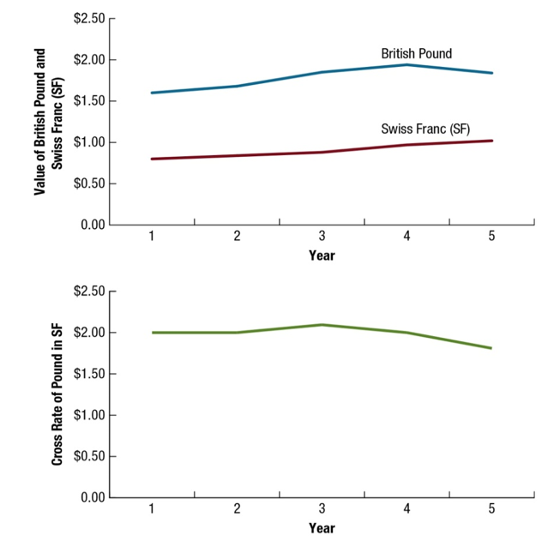
Exhibit 4.9 Example of How Forces Affect the Cross Exchange Rate (1 of 2)

Slide 22
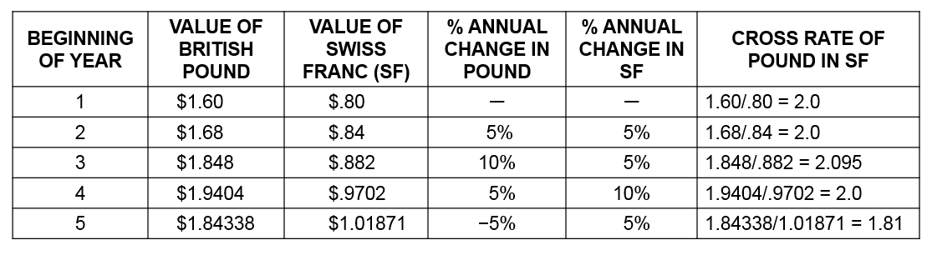
Exhibit 4.9 Example of How Forces Affect the Cross Exchange Rate (2 of 2)

Slide 23
Capitalizing on Expected Exchange Rate Movements (1 of 2)
Institutional speculation based on expected appreciation: When financial institutions believe that a currency is valued lower than it should be in the foreign exchange market, they may invest in that currency before it appreciates.
Institutional speculation based on expected depreciation: If financial institutions believe that a currency is valued higher than it should be in the foreign exchange market, they may borrow funds in that currency and convert it to their local currency now before the currency’s value declines to its proper level.
Speculation by individuals: Individuals can speculate in foreign currencies.

Slide 24
Capitalizing on Expected Exchange Rate Movements (2 of 2)
The “Carry Trade” — Where investors attempt to capitalize on the differential in interest rates between two countries.
Impact of appreciation in the investment currency: Increased trade volume can have a major influence on exchange rate movements over a short period.
Risk of the Carry Trade: Exchange rates may move opposite to what the investors expected.

Slide 25
Summary (1 of 3)
Exchange rate movements are commonly measured by the percentage change in their values over a specified period, such as a month or a year. M N Cs closely monitor exchange rate movements over the period in which they have cash flows denominated in the foreign currencies of concern.
The equilibrium exchange rate between two currencies at any time is based on the demand and supply conditions. Changes in the demand for a currency or the supply of a currency for sale will affect the equilibrium exchange rate.

Slide 26
Summary (2 of 3)
The key economic factors that can influence exchange rate movements through their effects on demand and supply conditions are relative inflation rates, interest rates, income levels, and government controls. When these factors lead to a change in international trade or financial flows, they affect the demand for a currency or the supply of currency for sale and thus the equilibrium exchange rate. If a foreign country experiences an increase in interest rates (relative to U.S. interest rates), then the inflow of U.S. funds to purchase its securities should increase (U.S. demand for its currency increases), the outflow of its funds to purchase U.S. securities should decrease (supply of its currency to be exchanged for U.S. dollars decreases), and there should be upward pressure on its currency’s equilibrium value. All relevant factors must be considered simultaneously when attempting to predict the most likely movement in a currency’s value.

Slide 27
Summary (3 of 3)
There are distinct international trade and financial flows between every pair of countries. These flows dictate the unique supply and demand conditions for the currencies of the two countries, which affect the equilibrium cross exchange rate between their currencies. Movement in the exchange rate between two non-dollar currencies can be inferred from the movement in each currency against the dollar.
Financial institutions can attempt to benefit from the expected appreciation of a currency by purchasing that currency. Analogously, they can benefit from expected depreciation of a currency by borrowing that currency and exchanging it for their home currency.

