Slide 1
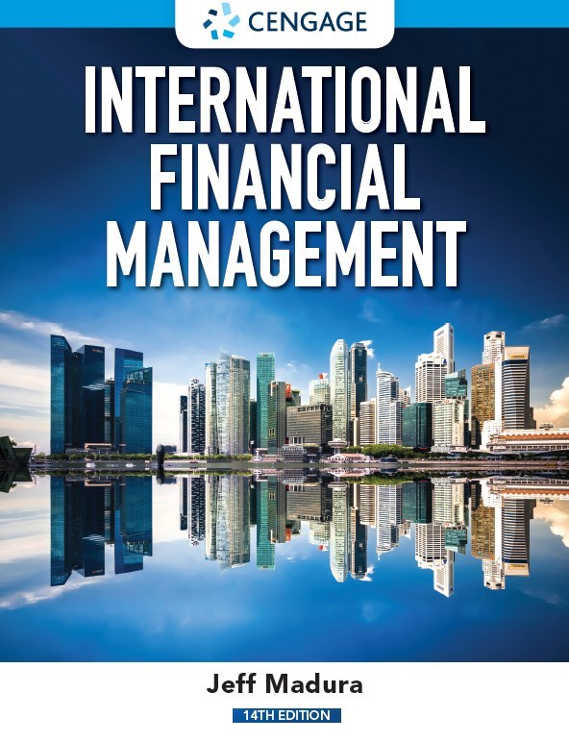
Managing Transaction Exposure
Chapter 11

Slide 2
Chapter Objectives
Describe common policies for hedging transaction exposure.
Compare the techniques commonly used to hedge payables.
Compare the techniques commonly used to hedge receivables.
Describe limitations of hedging.
Suggest other methods of reducing exchange rate risk when hedging techniques are not available.

Slide 3
Policies for Hedging Transaction Exposure
Hedging Most of the Exposure
Hedging most of the transaction exposure allows M N Cs to more accurately forecast future cash flows (in their home currency) so that they can make better decisions regarding the amount of financing they will need.
Selective Hedging
M N C must identify its degree of transaction exposure.
M N C must consider the various techniques to hedge the exposure so that it can decide which hedging technique is optimal and whether to hedge its transaction exposure.

Slide 4
Hedging Exposure to Payables (1 of 8)
An M N C may decide to hedge part or all of its known payables transactions using:
Forward or futures hedge
Money market hedge
Currency option hedge

Slide 5
Hedging Exposure to Payables (2 of 8)
Forward or Futures Hedge on Payables
Allows an M N C to lock in a specific exchange rate at which it can purchase a currency and hedge payables. A forward contract is negotiated between the firm and a financial institution. The contract will specify the:
currency that the firm will pay.
currency that the firm will receive.
amount of currency to be received by the firm.
rate at which the M N C will exchange currencies (called the forward rate).
future date at which the exchange of currencies will occur.

Slide 6
Hedging Exposure to Payables (3 of 8)
Money Market Hedge on Payables
Involves taking a money market position to cover a future payables position.
If a firm prefers to hedge payables without using its cash balances, then it must
Borrowed funds in the home currency and
Short-term investment in the foreign currency.
Money market hedge versus forward hedge
Since the results of both hedges are known beforehand, the firm can implement the one that is more feasible.

Slide 7
Hedging Exposure to Payables (4 of 8)
Call Option Hedge on Payables
A currency call option provides the right to buy a specified amount of a particular currency at a specified strike price or exercise price within a given period of time.
The currency call option does not obligate its owner to buy the currency at that price. The M N C has the flexibility to let the option expire and obtain the currency at the existing spot rate when payables are due.

Slide 8
Hedging Exposure to Payables (5 of 8)
Call Option Hedge on Payables (continued)
Applying a Contingency Graph (Exhibit 11.1)
Advantage: provides an effective hedge
Disadvantage: premium must be paid
Applying Currency Forecasts (Exhibit 11.2)
M N C can incorporate forecasts of the spot rate to more accurately estimate the cost of hedging with call options.
Consideration of Alternative Call Options
Several different types of call options may be available, with different exercise prices and premiums for a given currency and expiration date.
Whatever call option is perceived to be most desirable for hedging a particular payables position would be analyzed, so that it could then be compared to the other hedging techniques.

Slide 9
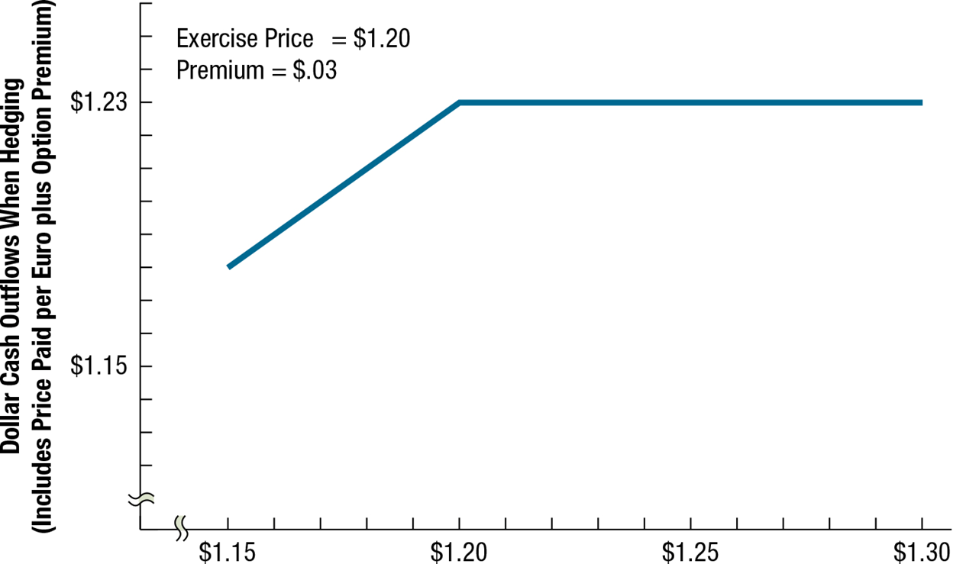
Exhibit 11.1 Contingency Graph for Hedging Payables With Call Options

Slide 10
Exhibit 11.2 Using Currency Call Options to Hedge Euro Payables (exercise price = $1.20, premium = $.03)
(1) | (2) | (3) | (4) | (5) = (4) + (3) | (6)
SCENARIO | SPOT RATE WHEN PAYABLES ARE DUE | PREMIUM PER UNIT PAID ON CALL OPTIONS | MOUNT PAID PER UNIT WHEN OWNING CALL OPTIONS | TOTAL AMOUNT PAID PER UNIT (INCLUDING THE PREMIUM) WHEN OWNING CALL OPTIONS | $ AMOUNT PAID FOR 100,000 EUROS WHEN OWNING CALL OPTIONS
1 | $1.16 | $.03 | $1.16 | $1.19 | $119,000
2 | 1.22 | .03 | 1.20 | 1.23 | 123,000
3 | 1.24 | .03 | 1.20 | 1.23 | 123,000

Slide 11
Hedging Exposure to Payables (6 of 8)
Comparison of Techniques to Hedge Payables (Exhibit 11.3)
The cost of the forward hedge or money market hedge can be determined with certainty.
The currency call option hedge has different outcomes depending on the future spot rate at the time payables are due.

Slide 12
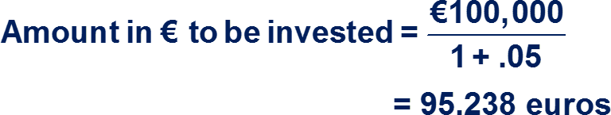
Exhibit 11.3 Comparison of Hedging Alternatives for Coleman Co. (1 of 2)
Forward Hedge
Purchase euros (€) one year forward.
Dollars needed in one year = payables in € × forward rate of euro
= 100,000 euros × $1.20
= $120,000
Money Market Hedge
Borrow $, convert to €, invest €, repay $ loan in one year.
Amount in $ needed to convert into € for deposit = €95,238 × $1.18
= $112,381
Interest and principal owed on $ loan after one year = $112,381 × (1 + .08)
= $121,371

Slide 13
Exhibit 11.3 Comparison of Hedging Alternatives for Coleman Co. (2 of 2)
Call Option
Purchase call option. (The following computations assume that the option is to be exercised on the day euros are needed, or not at all; exercise price = $1.20, premium = $.03.)
POSSIBLE SPOT RATE IN ONE YEAR | PREMIUM PER UNIT PAID FOR OPTION | EXERCISE OPTION? | TOTAL PRICE (INCLUDING OPTION PREMIUM PAID PER UNIT) | TOTAL PRICE PAID FOR 100,000 EUROS | PROBABILITY
$1.16 | $.03 | No | $1.19 | $119,000 | 20%
1.22 | .03 | Yes | 1.23 | 123,000 | 70
1.24 | .03 | Yes | 1.23 | 123,000 | 10

Slide 14
Hedging Exposure to Payables (7 of 8)
Comparison of Techniques to Hedge Payables
Optimal Technique for Hedging Payables (Exhibit 11.4)
Select optimal hedging technique by:
Considering whether futures or forwards are preferred.
Considering desirability of money market hedge versus futures/forwards based on cost.
Assessing the feasibility of a currency call option based on estimated cash outflows.
Optimal hedge versus no hedge for payables.
Even when an M N C knows what its future payables will be, it may decide not to hedge in some cases.

Slide 15
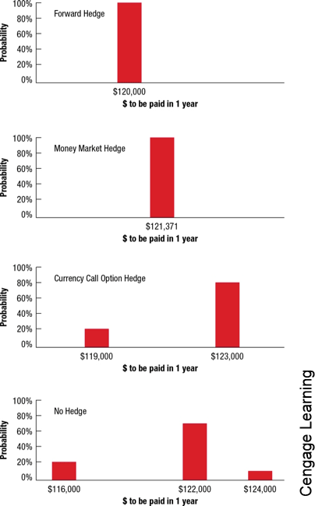
Exhibit 11.4 Graphic Comparison of Techniques to Hedge Payables

Slide 16
Hedging Exposure to Payables (8 of 8)
Evaluating Past Decisions on Hedging Payables
Evaluate past hedging decisions by estimating the real cost of hedging payables, which is measured as follows:
RCH_{p} = Cash outflows when hedging payables − Cash outflows when unhedged

Slide 17
Hedging Exposure to Receivables (1 of 4)
Forward or futures hedge on receivables allows the M N C to lock in the exchange rate at which it can sell a specific currency.
Money market hedge on receivables involves borrowing the currency that will be received and using the receivables to pay off the loan.

Slide 18
Hedging Exposure to Receivables (2 of 4)
Put option hedge on receivables provides the right to sell a specified amount of a particular currency at a specified strike price by a specified expiration date.
Applying a Contingency Graph (Exhibit 11.5)
Advantage: provides an effective hedge
Disadvantage: premium must be paid
Applying Currency Forecasts (Exhibit 11.6)
M N C can use currency forecasts to more accurately estimate the dollar cash inflows to be received when hedging with put options.
Consideration of Alternative Put Options
Several different types of put options may be available that feature different exercise prices and premiums for a given currency and expiration date.

Slide 19
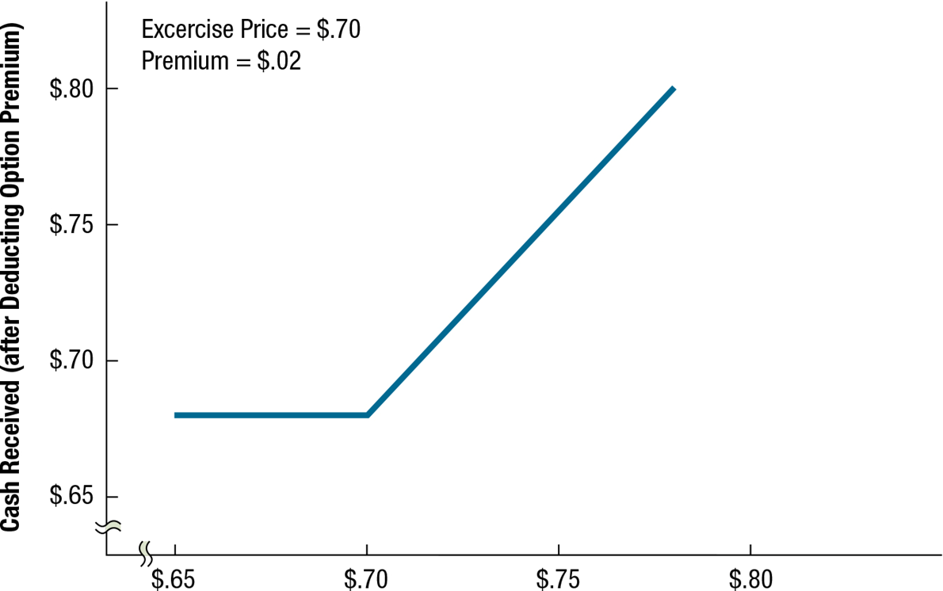
Exhibit 11.5 Contingency Graph for Hedging Receivables with Put Options

Slide 20
Exhibit 11.6 Use of Currency Put Options for Hedging Swiss Franc Receivables (exercise price = $.72; premium = $.02)
(1) | (2) | (3) | (4) | (5) = (4) − (3) | (6)
SCENARIO | SPOT RATE WHEN PAYMENT ON RECEIVABLES IS RECEIVED | PREMIUM PER UNIT ON PUT OPTIONS | AMOUNT RECEIVED PER UNIT WHEN OWNING PUT OPTIONS | NET AMOUNT RECEIVED PER UNIT (AFTER ACCOUNTING FOR PREMIUM PAID) | DOLLAR AMOUNT RECEIVED FROM HEDGING SF200,000 RECEIVABLES WITH PUT OPTIONS
1 | $.71 | $.02 | $.72 | $.70 | $140,000
2 | .74 | .02 | .74 | .72 | 144,000
3 | .76 | .02 | .76 | .74 | 148,000

Slide 21
Hedging Exposure to Receivables (3 of 4)
Comparison of Techniques for Hedging Receivables (Exhibit 11.7)
Optimal Technique for Hedging Receivables: (Exhibit 11.8)
Consider whether futures or forwards are preferred.
Consider desirability of money market hedge versus futures/forwards based on cost.
Assess the feasibility of a currency put option based on estimated cash outflows.
Optimal hedge versus no hedge on receivables
An M N C may know what its future receivables will be yet still decide not to hedge. In that case, the M N C needs to determine the probability distribution of its revenue from receivables when not hedging

Slide 22
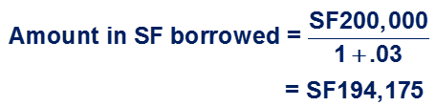
Exhibit 11.7 Comparison of Hedging Alternatives for Viner Co. (1 of 2)
Forward Hedge
Sell Swiss francs six months forward.
Dollars to be received in six months = receivables in SF × forward rate of SF
= SF200,000 × $.71
= $142,000
Money Market Hedge
Borrow SF, convert to $, invest $, use receivables to pay off loan in six months.
$ received from converting SF = SF194,175 × $70 per SF
= $135,922
$ accumulated after six months = $135,922 × (1 + .02)
= $138,640

Slide 23
Exhibit 11.7 Comparison of Hedging Alternatives for Viner Co. (2 of 2)
Put Option Hedge
Purchase put option. (Assume the options will be exercised on the day SF are to be received, or not at all; exercise price = $.72, premium = $.02.)
POSSIBLE SPOT RATE IN SIX MONTHS | PREMIUM PER UNIT PAID FOR OPTION | EXERCISE OPTION? | RECEIVED PER UNIT (AFTER ACCOUNTING FOR THE PREMIUM) | TOTAL DOLLARS RECEIVED FROM CONVERTING SF200,000 | PROBABILITY
.71 | $.02 | Yes | $.70 | $140,000 | 30%
.74 | .02 | No | .72 | 144,000 | 40
.76 | .02 | No | .74 | 148,000 | 30

Slide 24
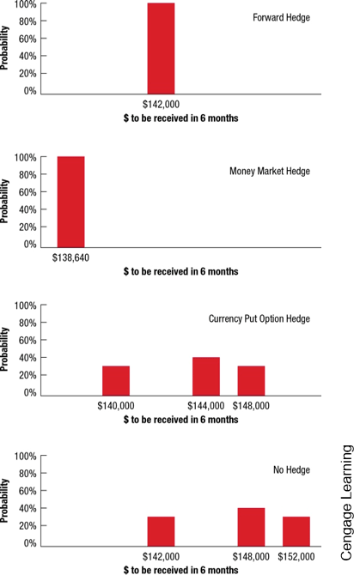
Exhibit 11.8 Graph Comparison of Techniques to Hedge Receivables

Slide 25
Hedging Exposure to Receivables (4 of 4)
Evaluating the hedge decision by estimating the real cost of hedging receivables versus the cost of receivables if not hedged.
Summary of Hedging Techniques (Exhibit 11.9)

Slide 26
Exhibit 11.9 Review of Techniques for Hedging Transaction Exposure
TECHNIQUE | TO HEDGE PAYABLES | TO HEDGE RECEIVABLES
Futures hedge | Purchase a currency futures contract (or contracts) representing the currency and amount related to the payables. | Sell a currency futures contract (or contracts) representing the currency and amount related to the receivables.
Forward hedge | Negotiate a forward contract to purchase the amount of foreign currency needed to cover the payables. | Negotiate a forward contract to sell the amount of foreign currency that will be received as a result of the receivables.
Money market hedge | Borrow local currency and convert to the currency denominating payables. Invest these funds until they are needed to cover the payables. | Borrow the currency denominating the receivables, convert it to the local currency, and invest it. Then pay off the loan with cash inflows from the receivables.
Currency option hedge | Purchase a currency call option (or options) representing the currency and amount related to the payables. | Purchase a currency put option (or options) representing the currency and amount related to the receivables.

Slide 27
Limitations of Hedging
Limitation of Hedging an Uncertain Payment
Some international transactions involve an uncertain amount of foreign currency, leading to overhedging.
Limitation of Repeated Short-Term Hedging
The continual short-term hedging of repeated transactions may have limited effectiveness. (Exhibits 11.10 and 11.11)
Long-term Hedging as a Solution
Some banks offer forward contracts for up to 5 years or 10 years on some commonly traded currencies.

Slide 28
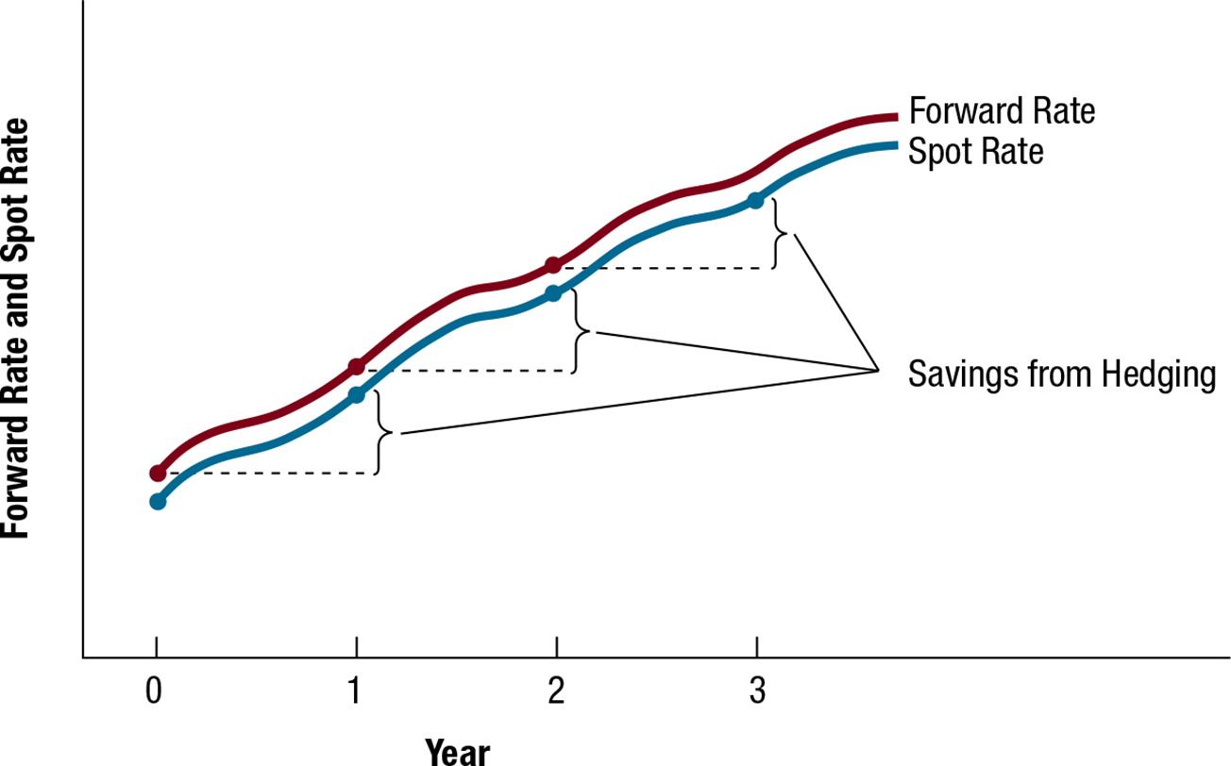
Exhibit 11.10 Repeated Hedging of Foreign Payables When the Foreign Currency Is Appreciating

Slide 29
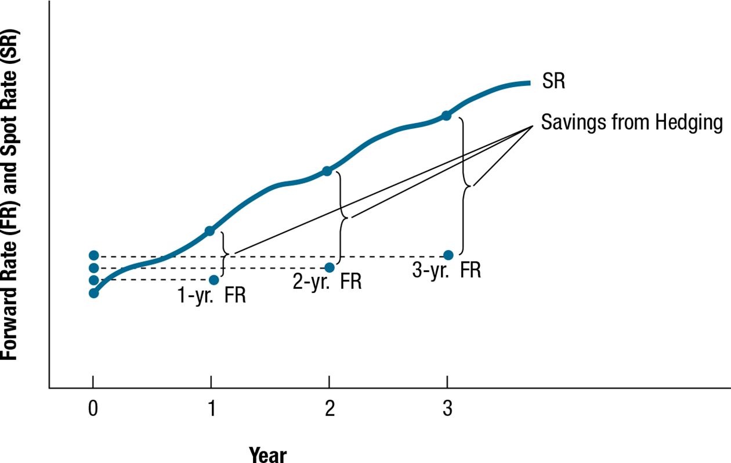
Exhibit 11.11 Long-Term Hedging of Payables When the Foreign Currency Is Appreciating

Slide 30
Alternative Hedging Techniques
Leading and Lagging: Adjusting the timing of a payment or disbursement to reflect expectations about future currency movements.
Cross-Hedging: Hedging by using a currency that serves as a proxy for the currency in which the M N C is exposed.
Currency Diversification: Reducing exposure by diversifying business among numerous countries.

Slide 31
Summary (1 of 4)
An M N C may choose to hedge most of its transaction exposure or to selectively hedge. Some M N Cs hedge most of their transaction exposure so that they can more accurately predict their future cash inflows or outflows and make better decisions regarding the amount of financing they will need. Many M N Cs use selective hedging, in which they consider each type of transaction separately.
To hedge payables, a futures or forward contract on the foreign currency can be purchased. Alternatively, a money market hedge strategy can be used; in this case, the M N C borrows its home currency and converts the proceeds into the foreign currency that will be needed in the future. Finally, call options on the foreign currency can be purchased.

Slide 32
Summary (2 of 4)
To hedge receivables, a futures or forward contract on the foreign currency can be sold. Alternatively, a money market hedge strategy can be used. In this case, the M N C borrows the foreign currency to be received and converts the funds into its home currency; the loan is to be repaid by the receivables. Finally, put options on the foreign currency can be purchased. When hedging techniques like forward and currency option contracts are not available, there are still some methods of reducing transaction exposure, such as leading and lagging, cross-hedging, and currency diversification. The currency option hedge has an advantage over the other hedging techniques in that the options do not have to be exercised. However, a premium must be paid to purchase the currency option, so there is a cost for the flexibility they provide.

Slide 33
Summary (3 of 4)
One limitation of hedging is that if the actual payment on a transaction is less than the expected payment, the M N C overhedged and is partially exposed to exchange rate movements. Alternatively, if an M N C hedges only the minimum possible payment in the transaction, it will be partially exposed to exchange rate movements if the transaction involves a payment that exceeds the minimum. Another limitation of hedging is that a short-term hedge is only effective for the period in which it was applied. One potential solution to this limitation is for an M N C to use long-term hedging rather than repeated short-term hedging. This choice is more effective if the M N C can be sure that its transaction exposure will persist into the distant future.

Slide 34
Summary (4 of 4)
When hedging techniques like forward and currency option contracts are not available, there are still some methods of reducing transaction exposure, such as leading and lagging, cross-hedging, and currency diversification.

