Slide 1
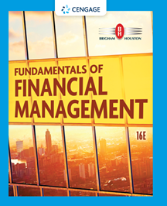
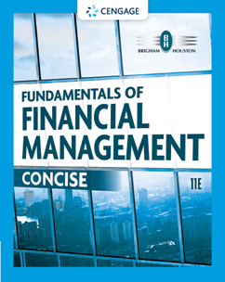
Chapter 7
Bonds and Their Valuation
Brigham & Houston, Fundamentals of Financial Management, Sixteenth Edition. © 2022 Cengage. All Rights Reserved. May not be scanned, copied or duplicated, or posted to a publicly accessible website, in whole or in part.

Slide 2
Overview
Key Features of Bonds
Bond Valuation
Measuring Yield
Assessing Risk

Slide 3
What is a bond?
A long-term debt instrument in which a borrower agrees to make payments of principal and interest, on specific dates, to the holders of the bond.

Slide 4
Key Features of a Bond
Par value: face amount of the bond, which
is paid at maturity (assume $1,000).
Coupon interest rate: stated interest rate (generally fixed) paid by the issuer. Multiply by par value to get dollar payment of interest.
Maturity date: years until the bond must be repaid.
Issue date: when the bond was issued.
Yield to maturity: rate of return earned on
a bond held until maturity (also called the “promised yield”).

Slide 5
Other Types (Features) of Bonds
Convertible bond: may be exchanged for common stock of the firm, at the holder’s option.
Warrant: long-term option to buy a stated number of shares of common stock at a specified price.
Putable bond: allows holder to sell the bond back to the company prior to maturity.
Income bond: pays interest only when interest is earned by the firm.
Indexed bond: interest rate paid is based upon the rate of inflation.

Slide 6
Effect of a Call Provision
Allows issuer to refund the bond issue if rates decline (helps the issuer, but hurts the investor).
Bond investors require higher yields on callable bonds.
In many cases, callable bonds include a deferred call provision and a declining call premium.

Slide 7
What is a sinking fund?
Provision to pay off a loan over its life rather than all at maturity.
Similar to amortization on a term loan.
Reduces risk to investor, shortens average maturity.
But not good for investors if rates decline after issuance.

Slide 8
How are sinking funds executed?
Call x% of the issue at par, for sinking fund purposes.
  Likely to be used if r_{d} is below the coupon rate and the bond sells at a premium.
Buy bonds in the open market.
  Likely to be used if r_{d} is above the coupon rate and the bond sells at a discount.

Slide 9
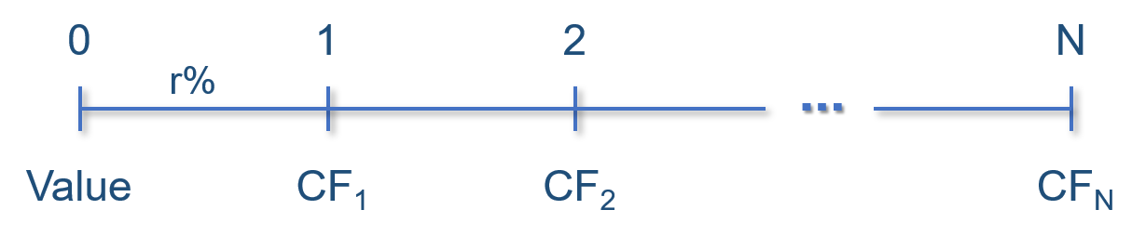
The Value of Financial Assets

Slide 10
What is the opportunity cost of debt capital?
The discount rate (r_{i}) is the opportunity cost of capital, and is the rate that could be earned on alternative investments of equal risk.
r_{i} = r* + IP + MRP + DRP + LP

Slide 11
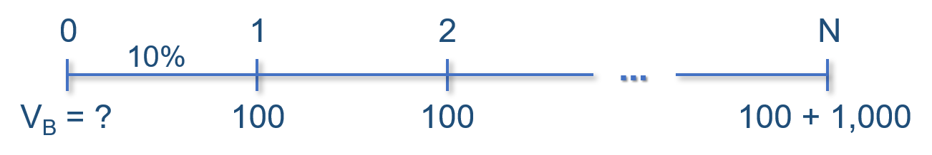
What is the value of a 10-year, 10% annual coupon bond, if r_{d} = 10%?

Slide 12
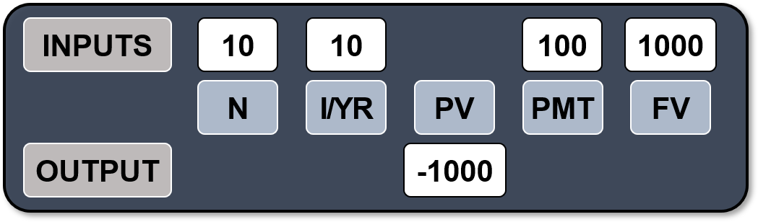
Calculating the Value of a Bond
This bond has a $1,000 lump sum (the par value) due at maturity (t = 10), and annual $100 coupon payments beginning at t = 1 and continuing through t = 10. The price of the bond can be found by solving for the PV of these cash flows.
Excel: =PV(.10,10,100,1000)

Slide 13
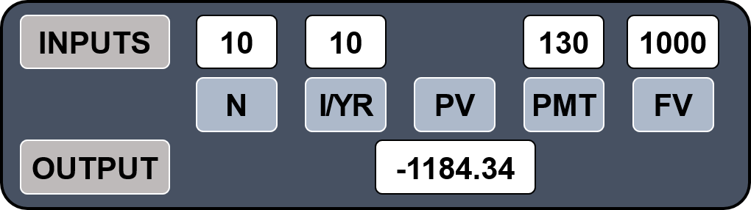
What’s the value of a 10-year bond outstanding with the same risk but a 13% annual coupon rate?
The annual coupon payment is $130. Since the risk is the same it has the same yield to maturity as the previous bond (10%). This bond sells at a premium because the coupon rate > the yield to maturity.
Excel: =PV(.10,10,130,1000)

Slide 14
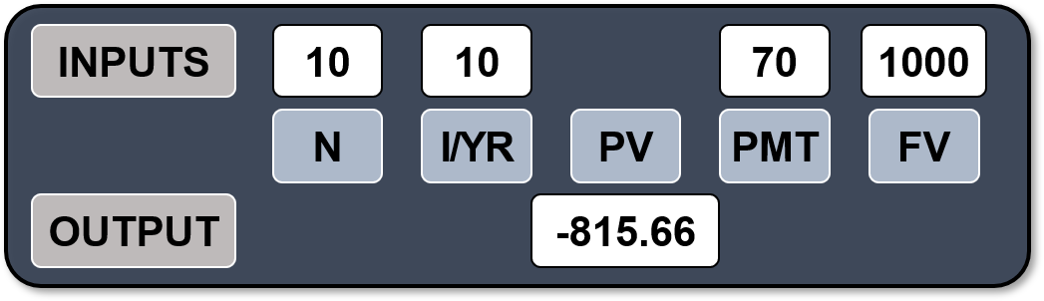
What’s the value of a 10-year bond outstanding with the same risk but a 7% annual coupon rate?
The annual coupon payment is $70. Since the risk is the same it has the same yield to maturity as the previous bonds (10%). This bond sells at a discount because the coupon rate < the yield to maturity.
Excel: =PV(.10,10,70,1000)

Slide 15
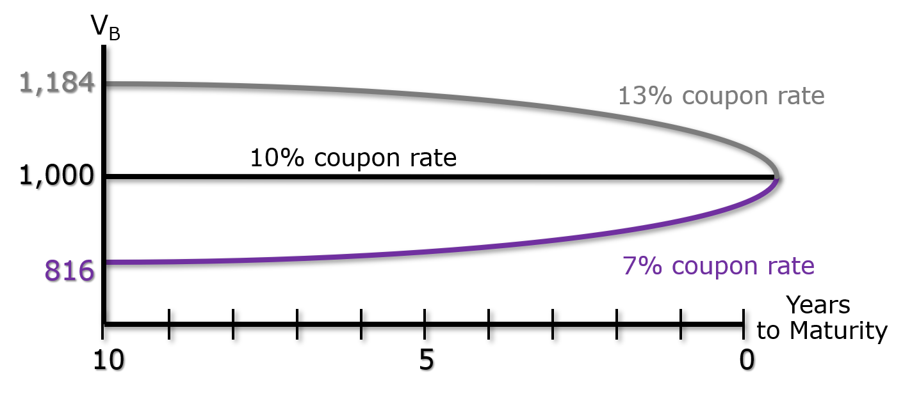
Changes in Bond Value over Time
What would happen to the value of these three bonds if the required rate of return remained at 10%?

Slide 16
Bond Values over Time
At maturity, the value of any bond must equal its par value.
If r_{d} remains constant:
  The value of a premium bond would decrease over time, until it reached $1,000.
  The value of a discount bond would increase over time, until it reached $1,000.
  The value of a par bond stays at $1,000.

Slide 17
What is the YTM on the following bond?
10-year; 9% annual coupon; $1,000 par value; selling for $887.
Must find the r_{d} that solves this equation.

Slide 18
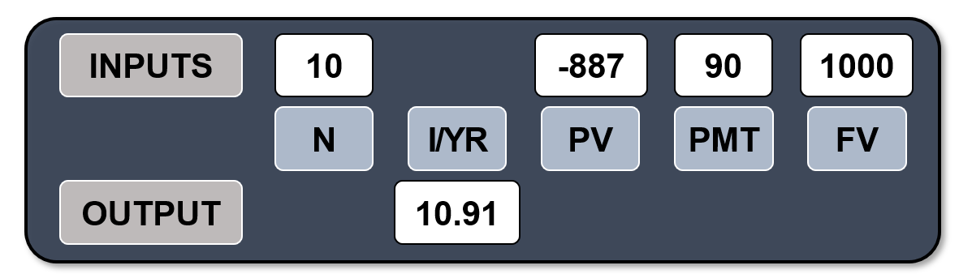
Solving for the YTM
Solving for I/YR, the YTM of this bond is 10.91%. This bond sells at a discount, because YTM > coupon rate.
Excel: =RATE(10,90,-887,1000)

Slide 19
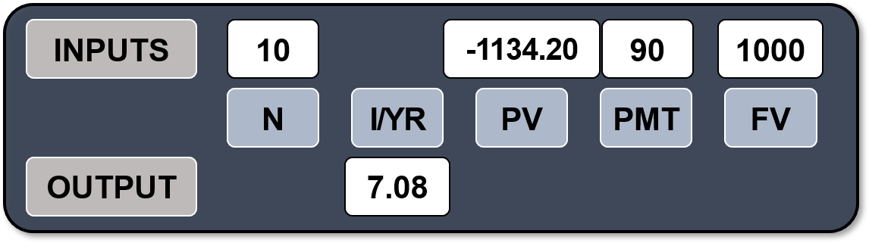
Find YTM If the Bond Price is $1,134.20
Solving for I/YR, the YTM of this bond is 7.08%. This bond sells at a premium, because YTM < coupon rate.
Excel: =RATE(10,90,-1134.20,1000)

Slide 20
Definitions

Slide 21
An Example: Current and Capital Gains Yields
Find the current yield and the capital gains yield for a 10-year, 9% annual coupon bond that sells for $887, and has a face value of $1,000.

Slide 22
Calculating Capital Gains Yield
YTM = Current yield + Capital gains yield
Could also find the expected price one year from now and divide the change in price by the beginning price, which gives the same answer.

Slide 23

What is price risk? Does a 1-year or 10-year bond have more price risk?
Price risk is the concern that rising r_{d} will cause the value of a bond to fall.
r_{d} | 1-year | Change | 10-year | Change
5% | $1,048 |  | $1,386
10% | 1,000 | + 4.8% | 1,000 | +38.6%
15% | 956 | – 4.4% | 749 | –25.1%
The 10-year bond is more sensitive to interest rate changes, and hence has more price risk.

Slide 24
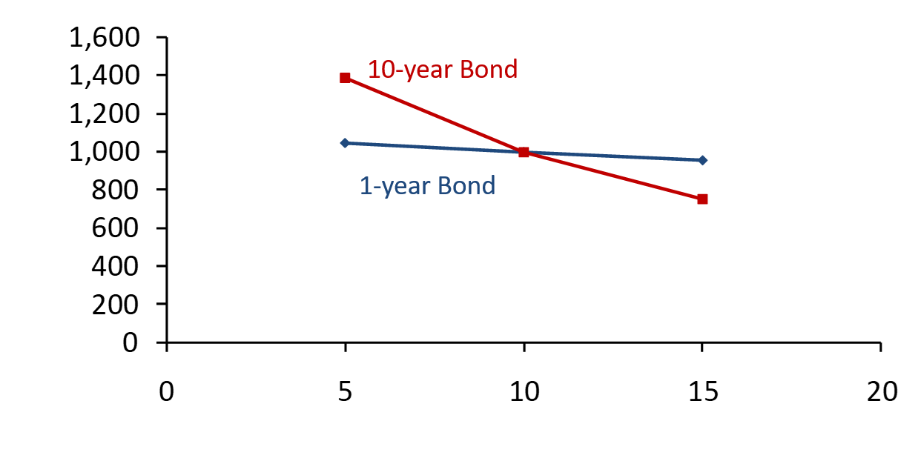
Illustrating Price Risk
Value ($)
YTM(%)

Slide 25
What is reinvestment risk?
Reinvestment risk is the concern that r_{d} will fall, and future CFs will have to be reinvested at lower rates, hence reducing income.
EXAMPLE: Suppose you just won $500,000 playing the lottery. You intend to invest the money and live off the interest.

Slide 26
Reinvestment Risk Example
You may invest in either a 10-year bond or a series of ten 1-year bonds. Both 10-year and 1-year bonds currently yield 10%.
If you choose the 1-year bond strategy:
  After Year 1, you receive $50,000 in income and have $500,000 to reinvest. But, if 1-year rates fall to 3%, your annual income would fall to $15,000.
If you choose the 10-year bond strategy:
  You can lock in a 10% interest rate, and $50,000 annual income for 10 years, assuming the bond is not callable.

Slide 27
Conclusions about Price Risk and Reinvestment Risk
 | Short term AND/OR High coupon Bonds | Long term AND/OR Low coupon Bonds
Price risk | Low | High
Reinvestment risk | High | Low

Slide 28
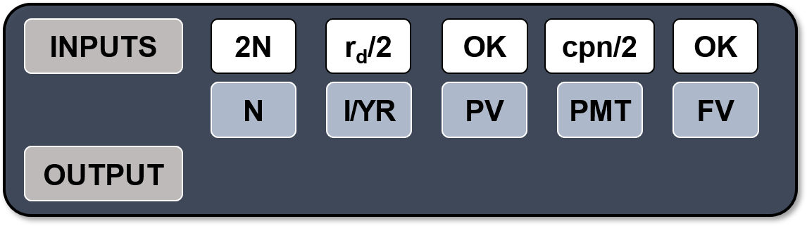
Semiannual Bonds
Multiply years by 2: Number of periods = 2N
Divide nominal rate by 2: Periodic rate (I/YR) = r_{d}/2
Divide annual coupon by 2: PMT = Annual coupon/2

Slide 29
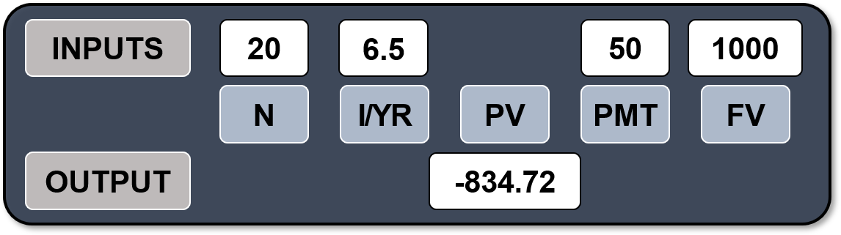
What is the value of a 10-year, 10% semiannual coupon bond, if r_{d} = 13%?
Multiply years by 2: N = 2 × 10 = 20
Divide nominal rate by 2: I/YR = 13/2 = 6.5
Divide annual coupon by 2: PMT = 100/2 = 50
Excel: =PV(.065,20,50,1000)

Slide 30
Would you prefer to buy a 10-year, 10% annual coupon bond or a 10-year, 10% semiannual coupon bond, all else equal?
The semiannual bond’s effective rate is:
Excel: =EFFECT(.10,2)
= 10.25%
10.25% > 10% (the annual bond’s effective rate), so you would prefer the semiannual bond.

Slide 31
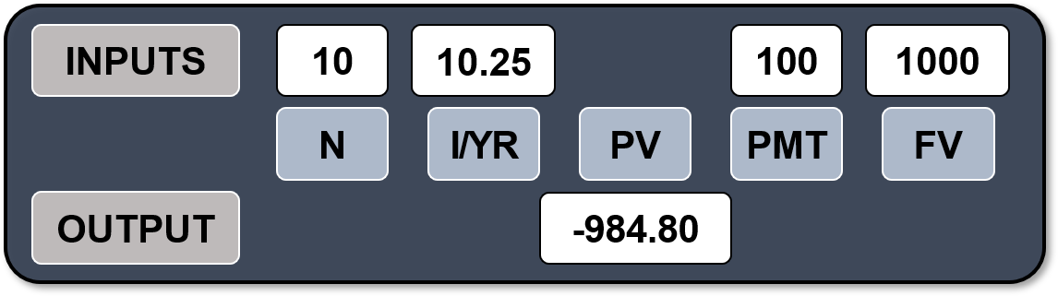
If the proper price for this semiannual bond is $1,000, what would be the proper price for the annual coupon bond?
The semiannual bond has a 10.25% effective rate, so the annual bond should earn the same EAR. At these prices, the annual and semiannual bonds are in equilibrium.
Excel: =PV(.1025,10,100,1000)

Slide 32
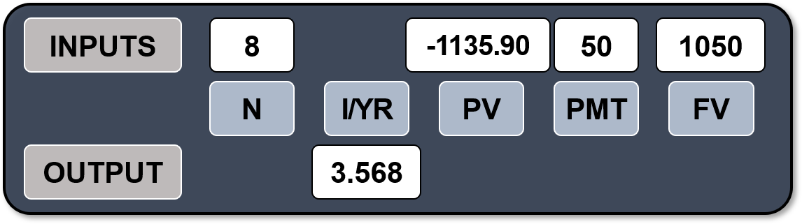
A 10-year, 10% semiannual coupon bond selling for $1,135.90 can be called in 4 years for $1,050, what is its yield to call (YTC)?
The bond’s yield to maturity is 8%. Solving for the YTC is identical to solving for YTM, except the time to call is used for N and the call premium is FV.
Excel: =RATE(8,50,-1135.90,1050)

Slide 33
Yield to Call
3.568% represents the periodic semiannual yield to call.
YTC_{NOM} = r_{NOM} = 3.568% × 2 = 7.137% is the rate that a broker would quote.
The effective yield to call can be calculated.
  YTC_{EFF} = (1.03568)² – 1 = 7.26%
  Excel: =EFFECT(.07137,2) = 7.26%

Slide 34
If you bought these callable bonds, would you be more likely to earn the YTM or YTC?
The coupon rate = 10% compared to YTC = 7.137%. The firm could raise money by selling new bonds which pay 7.137%.
Could replace bonds paying $100 per year with bonds paying only $71.37 per year.
Investors should expect a call, and to earn the YTC of 7.137%, rather than the YTM of 8%.

Slide 35
When is a call more likely to occur?
In general, if a bond sells at a premium, then (1) coupon > r_{d}, so (2) a call is more likely.
So, expect to earn:
  YTC on premium bonds.
  YTM on par and discount bonds.

Slide 36
Default Risk
If an issuer defaults, investors receive less than the promised return. Therefore, the expected return on corporate and municipal bonds is less than the promised return.
Influenced by the issuer’s financial strength and the terms of the bond contract.

Slide 37
Evaluating Default Risk: Bond Ratings
 | Investment Grade | Junk Bonds
Moody’s | Aaa Aa A Baa | Ba B Caa C
S & P | AAA AA A BBB | BB B CCC C
Bond ratings are designed to reflect the probability of a bond issue going into default.

Slide 38
Factors Affecting Default Risk and Bond Ratings
Financial performance
  Debt ratio
  TIE ratio
  Current ratio
Qualitative factors: Bond contract terms
  Secured vs. unsecured debt
  Senior vs. subordinated debt
  Guarantee and sinking fund provisions
  Debt maturity

Slide 39
Other Factors Affecting Default Risk
Miscellaneous qualitative factors
  Earnings stability
  Regulatory environment
  Potential antitrust or product liabilities
  Pension liabilities
  Potential labor problems

Slide 40
Chapter 11 Bankruptcy
If company can’t meet its obligations…
  It files under Chapter 11 to stop creditors from foreclosing, taking assets, and closing the business and it has 120 days to file a reorganization plan.
  Court appoints a “trustee” to supervise reorganization.
  Management usually stays in control.
Company must demonstrate in its reorganization plan that it is “worth more alive than dead.”
  If not, judge will order liquidation under Chapter 7.

Slide 41
Priority of Claims in Liquidation
Secured creditors from sales of secured assets
Trustee’s costs
Wages, subject to limits
Taxes
Unfunded pension liabilities
Unsecured creditors
Preferred stock
Common stock

Slide 42
Reorganization
In a liquidation, unsecured creditors generally receive nothing. This makes them more willing to participate in reorganization even though their claims are greatly scaled back.
Various groups of creditors vote on the reorganization plan. If both the majority of the creditors and the judge approve, the company “emerges” from bankruptcy with lower debts, reduced interest charges, and a chance for success.

