Slide 1
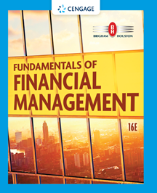
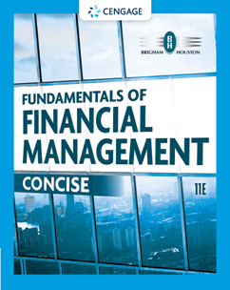
Chapter 10
The Cost of Capital
Brigham & Houston, Fundamentals of Financial Management, Sixteenth Edition. © 2022 Cengage. All Rights Reserved. May not be scanned, copied or duplicated, or posted to a publicly accessible website, in whole or in part.

Slide 2
Overview
Sources of Capital
Component Costs
Adjusting for Flotation Costs
WACC
Adjusting for Risk

Slide 3
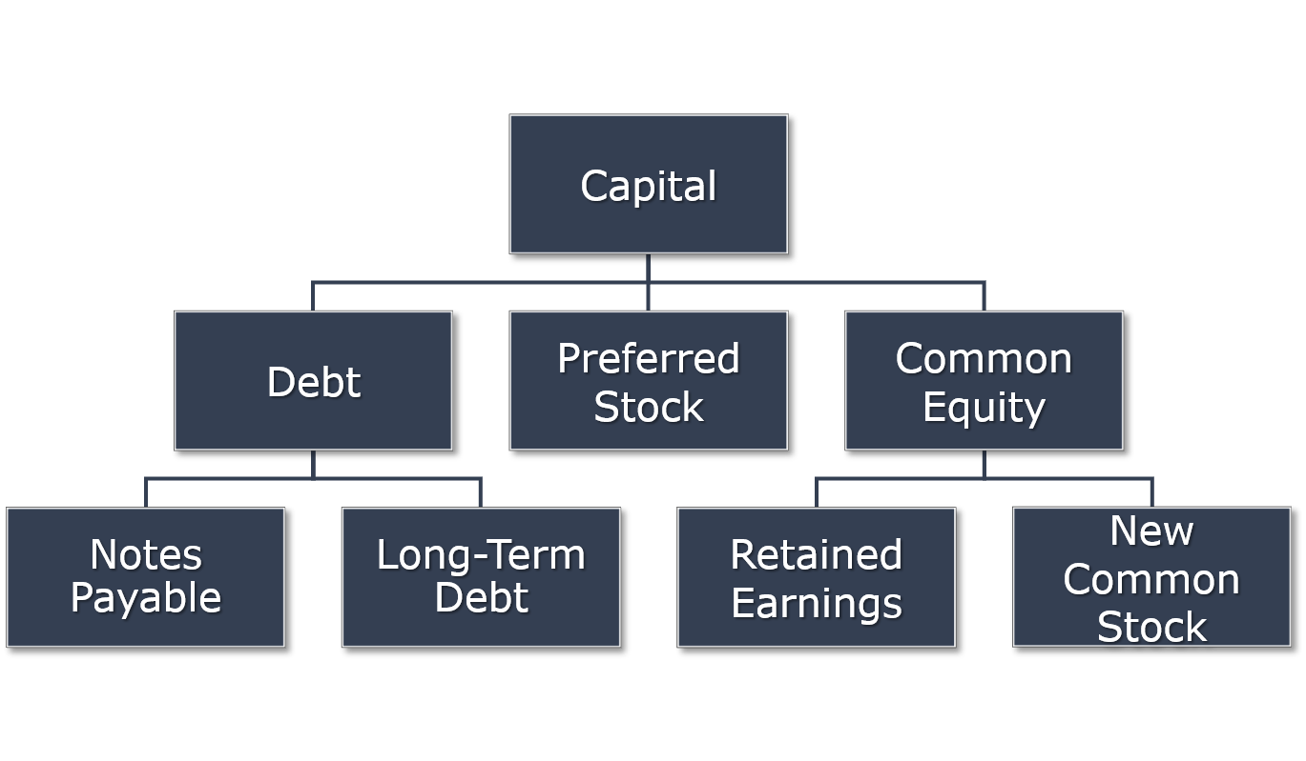
What sources of capital do firms use?

Slide 4
Calculating the Weighted Average Cost of Capital
WACC = w_{d}r_{d}(1 – T) + w_{p}r_{p} + w_{c}r_{s}
The w’s refer to the firm’s capital structure weights.
The r’s refer to the cost of each component.

Slide 5
Should our analysis focus on before-tax or after-tax capital costs?
Stockholders focus on after-tax CFs. Therefore, we should focus on after-tax capital costs; i.e., use after-tax costs of capital in WACC. Only r_{d} needs adjustment, because interest is tax deductible.

Slide 6
Should our analysis focus on historical (embedded) costs or new (marginal) costs?
The cost of capital is used primarily to make decisions that involve raising new capital. So, focus on today’s marginal costs (for WACC).

Slide 7
How are the weights determined?
WACC = w_{d}r_{d}(1 – T) + w_{p}r_{p} + w_{c}r_{s}
Use accounting numbers or market value (book vs. market weights)?
Use actual numbers or target capital structure?

Slide 8
Overview of Coleman Technologies Inc.
Firm calculating cost of capital for major expansion program.
Tax rate = 25%.
15-year, 12% coupon, semiannual payment noncallable bonds sell for $1,153.72. New bonds will be privately placed with no flotation cost.
10%, $100 par value, quarterly dividend, perpetual preferred stock sells for $111.10.
Common stock sells for $50. D₀ = $4.19 and g = 5%.
b = 1.2; r_{RF} = 7%; RPM = 6%.
Bond-Yield Risk Premium = 4%.
Target capital structure: 30% debt, 10% preferred, 60% common equity.

Slide 9
Review of Coleman’s Capital Structure
 | Book Value | Market Value | Target
Debt (includes notes payable) | 48% | 25% | 30%
Preferred stock | 2 | 5 | 10
Common equity | 50 | 70 | 60
Number of shares not given in problem, so actual calculations cannot be done. Analysis is meant for illustration. Typically, book value capital structure will show a higher percentage of debt because a typical firm’s M/B ratio > 1.

Slide 10
Component Cost of Debt (1 of 2)
WACC = w_{d}r_{d}(1 – T) + w_{p}r_{p} + w_{c}r_{s}
r_{d} is the marginal cost of debt capital.
The yield to maturity on outstanding L-T debt is often used as a measure of r_{d}.
Why tax-adjust; i.e., why r_{d}(1 – T)?

Slide 11
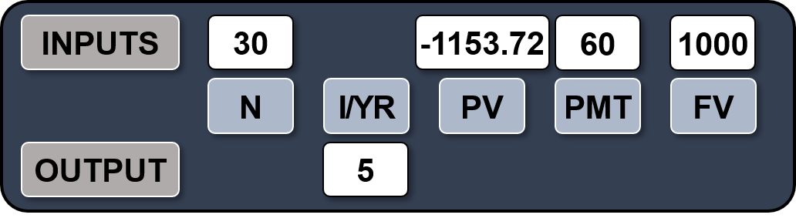
A 15-year, 12% semiannual coupon bond sells for $1,153.72. What is the cost of debt (r_{d})?
Remember, the bond pays a semiannual coupon, so r_{d} = 5.0% × 2 = 10%.

Slide 12
Component Cost of Debt (2 of 2)
Interest is tax deductible, so
AT r_{d} = BT r_{d}(1 – T)
= 10%(1 – 0.25) = 7.5%
Use nominal rate.
Flotation costs are small, so ignore them.

Slide 13
Component Cost of Preferred Stock
WACC = w_{d}r_{d}(1 – T) + w_{p}r_{p} + w_{c}r_{s}
r_{p} is the marginal cost of preferred stock, which is the return investors require on a firm’s preferred stock.
Preferred dividends are not tax-deductible, so no tax adjustments necessary. Just use nominal r_{p}.
Our calculation ignores possible flotation costs.

Slide 14
What is the cost of preferred stock?
The cost of preferred stock can be solved by using this formula:
r_{p} = D_{p}/P_{p}
= $10/$111.10
= 9%

Slide 15
Is preferred stock more or less risky to investors than debt?
More risky; company not required to pay preferred dividend.
However, firms try to pay preferred dividend. Otherwise, (1) cannot pay common dividend, (2) difficult to raise additional funds, (3) preferred stockholders may gain control of firm.

Slide 16
Why is the yield on preferred stock lower than debt?
Preferred stock will often have a lower BT yield than the BT yield on debt.
Corporations own most preferred stock, so 50% of preferred dividends are excluded from corporate taxation.
The AT yield to an investor, and the AT cost to the issuer, are higher on preferred stock than on debt. Consistent with higher risk of preferred stock

Slide 17
Component Cost of Equity
WACC = w_{d}r_{d}(1 – T) + w_{p}r_{p} + w_{c}r_{s}
r_{s} is the marginal cost of common equity using retained earnings.
r_{e} is the marginal cost of common equity when the firm issues new common stock.

Slide 18
Why is there a cost for retained earnings?
Earnings can be reinvested or paid out as dividends.
Investors could buy other securities, earn a return.
If earnings are retained, there is an opportunity cost (the return that stockholders could earn on alternative investments of equal risk).
Investors could buy similar stocks and earn r_{s}.
Firm could repurchase its own stock and earn r_{s}.

Slide 19
Three Ways to Determine the Cost of Common Equity, r_{s}
CAPM: r_{s} = r_{RF} + (r_{M} – r_{RF})b
DCF: r_{s} = (D₁/P₀) + g
Bond-Yield-Plus-Risk-Premium:
r_{s} = r_{d} + RP

Slide 20
Find the Cost of Common Equity Using the CAPM Approach
The r_{RF} = 7%, RP_{M} = 6%, and the firm’s beta is 1.2.
r_{s} = r_{RF} + (r_{M} – r_{RF})b
= 7.0% + (6.0%)1.2 = 14.2%

Slide 21
Find the Cost of Common Equity Using the
DCF Approach
D₀ = $4.19, P₀ = $50, and g = 5%.
D₁ = D₀(1 + g)
= $4.19(1 + 0.05)
= $4.3995
r_{s} = (D₁/P₀) + g
= ($4.3995/$50) + 0.05
= 13.8%

Slide 22
Can DCF methodology be applied if growth is not constant?
Yes, nonconstant growth stocks are expected to attain constant growth at some point, generally in 5 to 10 years.
May be complicated to calculate.

Slide 23
Find r_{s} Using the
Bond-Yield-Plus-Risk-Premium Approach
r_{d} = 10% and RP = 4%.
This RP is not the same as the CAPM RPM.
This method produces a ballpark estimate of r_{s}, and can serve as a useful check.
r_{s} = r_{d} + RP
r_{s} = 10.0% + 4.0% = 14.0%

Slide 24
What is a reasonable final estimate of r_{s}?
Method | Estimate
CAPM | 14.2%
DCF | 13.8
r_{d} + RP | 14.0
Range = 13.8% − 14.2%, might use midpoint of range, 14%.

Slide 25
Why is the cost of retained earnings cheaper than the cost of issuing new common stock?
When a company issues new common stock they also have to pay flotation costs to the underwriter.
Issuing new common stock may send a negative signal to the capital markets, which may depress the stock price.

Slide 26
If new common stock issue incurs a flotation cost of 15% of the proceeds, what is r_{e}?

Slide 27
What is the firm’s WACC (ignoring flotation costs)?
WACC = w_{d}r_{d}(1 – T) + w_{p}r_{p} + w_{c}r_{s}
= 0.3(10%)(0.75) + 0.1(9%) + 0.6(14%)
= 2.3% + 0.9% + 8.4%
= 11.6%

Slide 28
What factors influence a company’s composite WACC?
Factors the firm cannot control:
Market conditions such as interest rates and tax rates.
Factors the firm can control:
Firm’s capital structure.
Firm’s dividend policy.
The firm’s investment policy. Firms with riskier projects generally have a higher WACC.

Slide 29
Should the company use the composite WACC as the hurdle rate for each of its projects?
NO! The composite WACC reflects the risk of an average project undertaken by the firm. Therefore, the WACC only represents the “hurdle rate” for a typical project with average risk.
Different projects have different risks. The project’s WACC should be adjusted to reflect the project’s risk.
The next slide illustrates the importance of risk-adjusting the cost of capital. Note, if the company correctly risk-adjusted the WACC, then it would select Project L and reject Project H. Alternatively, if the company didn’t risk-adjust and instead used the composite WACC for all projects, it would mistakenly select Project H and reject Project L.

Slide 30
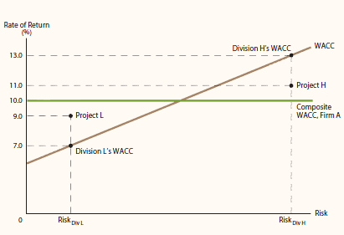
Divisional Cost of Capital

