Slide 1
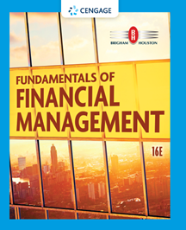
Chapter 21
Mergers and Divestitures
Brigham & Houston, Fundamentals of Financial Management, Sixteenth Edition. © 2022 Cengage. All Rights Reserved. May not be scanned, copied or duplicated, or posted to a publicly accessible website, in whole or in part.

Slide 2
Overview
Types of Mergers
Merger Analysis
Continuing Value
Shareholder Wealth
Role of Investment Bankers

Slide 3
What are some good reasons for mergers?
Synergy: value of the whole exceeds sum of the parts. Could arise from:
  Operating economies
  Financial economies
  Differential management efficiency
  Increased market power
  Taxes (use accumulated losses)
Break-up value: assets would be more valuable if sold to some other company.

Slide 4
What are some questionable reasons for mergers?
Diversification
Purchase of assets at below-replacement cost
Get bigger using debt-financed mergers to help fight off takeovers

Slide 5
What is the difference between a “friendly” and a “hostile” merger?
Friendly merger
  The merger is supported by the managements of both firms.
Hostile merger
  Target firm’s management resists the merger.
  Acquirer must go directly to the target firm’s stockholders and try to get 51% to tender their shares.
  Often, mergers that start out hostile end up as friendly when offer price is raised.

Slide 6
Merger Analysis: Post-Merger Cash Flow Statements
 | 2021 | 2022 | 2023 | 2024
Net sales | $60.0 | $90.0 | $112.5 | $127.5
− Cost of goods sold | 36.0 | 54.0 | 67.5 | 76.5
− Selling/admin exp | 4.6 | 6.0 | 7.4 | 9.0
− Interest expense | 3.0 | 4.4 | 4.4 | 6.0
EBT | $16.4 | $25.6 | $33.2 | $36.0
− Taxes | 4.1 | 6.4 | 8.3 | 9.0
Net income | $12.3 | $19.2 | $24.9 | $27.0
Retentions | 0.0 | 7.5 | 6.0 | 4.5
Cash flow | $12.3 | $11.7 | $18.9 | $22.5

Slide 7
Why is interest expense included in the analysis?
Debt associated with a merger is more complex than the single issue of new debt associated with a normal capital project.
  Acquiring firms often assume the debt of the target firm, so old debt at different coupon rates is often part of the deal.
  The acquisition is often financed partially by debt.
  If the subsidiary is to grow in the future, new debt will have to be issued over time to support the expansion.

Slide 8
Why are earnings retentions deducted in the analysis?
If the subsidiary is to grow, not all income may be assumed by the parent firm.
  Like any other company, the subsidiary must reinvest some of its earnings to sustain growth.

Slide 9
What is the appropriate discount rate to apply to the target’s cash flows?
Estimated cash flows are residuals which belong to the acquirer’s shareholders.
They are riskier than the typical capital budgeting cash flows. Because fixed interest charges are deducted, this increases the volatility of the residual cash flows.
Because the cash flows are risky equity flows, they should be discounted using the cost of equity rather than the WACC.

Slide 10
Discounting the Target’s Cash Flows
The cash flows reflect the target’s business risk, not the acquiring company’s.
However, the merger will affect the target’s leverage and tax rate, hence its financial risk.

Slide 11
Calculating Continuing Value
Find the appropriate discount rate
r_{s(Target)} = r_{RF} + (r_{M} − r_{RF})b_{Target} = 9% + (4%)(1.43) = 14.72%
Determine continuing value
Continuing value₂₀₂₄ = CF₂₀₂₄(1 + g)/(r_{s} − g)
= $22.5(1.06)/(0.1472 − 0.06)
= $273.5 million

Slide 12
Cash Flow Stream
 | 2021 | 2022 | 2023 | 2024
Annual cash flow | $12.3 | $11.7 | $18.9 | $ 22.5
Continuing value |  |  |  | 273.5
Cash flow | $12.3 | $11.7 | $18.9 | $296.0
Value of target firm
  Enter CFs in calculator CFLO register, and enter I/YR = 14.72%. Solve for NPV = $203.03 million

Slide 13
Would another acquiring company obtain the same value?
No. The input estimates would be different, and different synergies would lead to different cash flow forecasts.
Also, a different financing mix or tax rate would change the discount rate.

Slide 14
The Target Firm Has 10 Million Shares Outstanding at a Price of $12.50 per Share
What should the offering price be?
  The acquirer estimates the maximum price they would be willing to pay by dividing the target’s value by its number of shares:
Max. price = Target’s value/# of shares
= $203.03 million/10 million
= $20.30
Offering range is between $12.50 and $20.30 per share.

Slide 15
Making the Offer
The offer could range from $12.50 to $20.30 per share.
At $12.50 all the merger benefits would go to the acquirer’s shareholders.
At $20.30, all value added would go to the target’s shareholders.
Acquiring and target firms must decide how much wealth they are willing to forego.

Slide 16
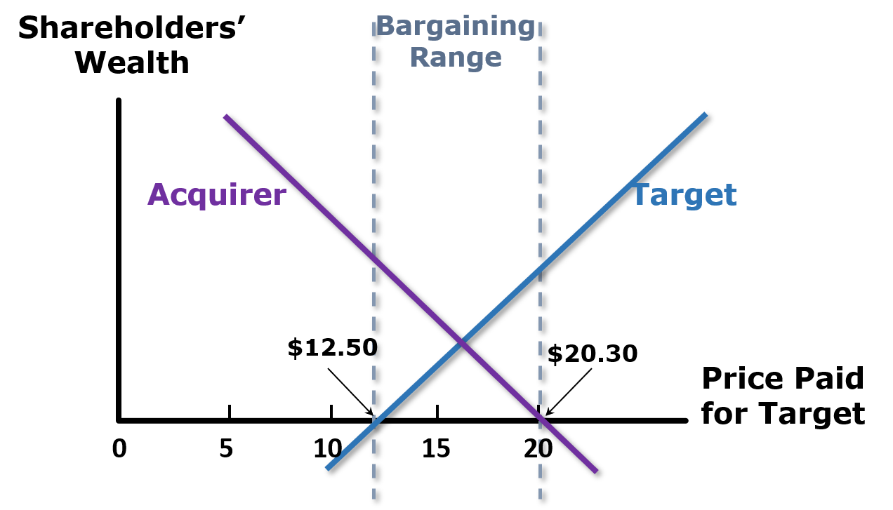
Shareholder Wealth in a Merger

Slide 17
Shareholder Wealth (1 of 2)
Nothing magic about crossover price from the graph.
Actual price would be determined by bargaining. Higher if target is in better bargaining position, lower if acquirer is.
If target is good fit for many acquirers, other firms will come in, price will be bid up. If not, could be close to $12.50.

Slide 18
Shareholder Wealth (2 of 2)
Acquirer might want to make high “preemptive” bid to ward off other bidders, or make a low bid and then plan to increase it. It all depends upon its strategy.
Do target’s managers have 51% of stock and want to remain in control?
What kind of personal deal will target’s managers get?

Slide 19
Do mergers really create value?
The evidence strongly suggests:
  Acquisitions do create value as a result of economies of scale, other synergies, and/or better management.
  Shareholders of target firms reap most of the benefits, because of competitive bids.

Slide 20
Functions of Investment Bankers in Mergers
Arranging mergers
Assisting in defensive tactics
Establishing a fair value
Financing mergers
Risk arbitrage

