Slide 1
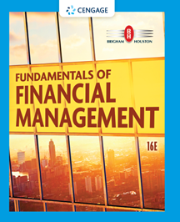
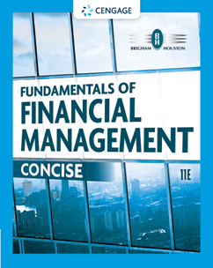
Chapter 12
Cash Flow Estimation and Risk Analysis
Brigham & Houston, Fundamentals of Financial Management, Sixteenth Edition. © 2022 Cengage. All Rights Reserved. May not be scanned, copied or duplicated, or posted to a publicly accessible website, in whole or in part.

Slide 2
Overview
Relevant Cash Flows
Types of Risk
Risk Analysis

Slide 3
Proposed Project (1 of 2)
Equipment Cost
Equipment purchase price: $280,000
Equipment eligible for 100% bonus depreciation
After-tax cost @ t = 0: $280,000 × (1 − T) = $210,000
Changes in net operating working capital
Inventories will rise by $25,000
Accounts payable will rise by $5,000
Effect on operations
New sales: 100,000 units/year @ $2/unit
Variable cost: 60% of sales

Slide 4
Proposed Project
Life of the project
Economic life: 4 years
Equipment eligible for 100% bonus depreciation
We are interested in cash flows, so our focus is on tax depreciation.
Equipment will be fully depreciated at time of purchase.
Salvage value: $25,000
Tax rate: 25%
WACC: 10%

Slide 5
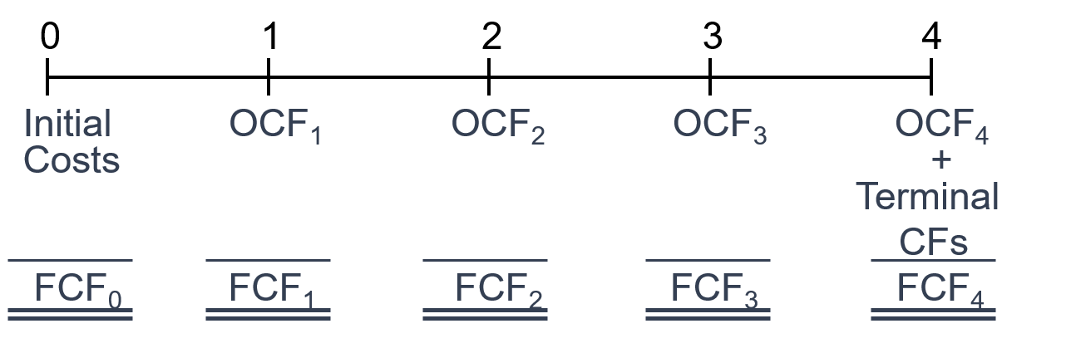
Determining Project Value
Estimate relevant cash flows
Calculating annual operating cash flows.
Identifying changes in net operating working capital.
Calculating terminal cash flows: after-tax salvage value and recovery of NOWC.

Slide 6
Initial Year Investment Outlays
Find ΔNOWC.
 in inventories of $25,000
Funded partly by an  in A/P of $5,000
Δ NOWC = $25,000 – $5,000 = $20,000
Initial year outlays:
CAPEX (1 − T) | −210,000
ΔNOWC | −20,000
FCF₀ | −$230,000

Slide 7
Project Operating Cash Flows
(Thousands of dollars) | 1 | 2 | 3 | 4
Revenues | 200.0 | 200.0 | 200.0 | 200.0
– Op. costs | 120.0 | 120.0 | 120.0 | 120.0
– Depr. (100% at t = 0) | 0.0 | 0.0 | 0.0 | 0.0
EBIT | 80.0 | 80.0 | 80.0 | 80.0
– Tax (25%) | 20.0 | 20.0 | 20.0 | 20.0
EBIT(1 – T) | 60.0 | 60.0 | 60.0 | 60.0
+ Depreciation | 0.0 | 0.0 | 0.0 | 0.0
EBIT(1 – T) + DEP | 60.0 | 60.0 | 60.0 | 60.0

Slide 8
Terminal Cash Flows (1 of 2)
(Thousands of dollars)
Salvage value | $25.00
– Tax on SV (25%) | 6.25
AT salvage value | $18.75
+ ΔNOWC | 20.00
Terminal CF | $38.75
FCF₄ = EBIT(1 – T) + DEP – CAPEX – ΔNOWC
= $60.00 + $38.75
= $98.75

Slide 9
Terminal Cash Flows (2 of 2)
Q. How is NOWC recovered?
Recovered at the end of the project’s life, there is no tax impact.
Q. Is there always a tax on SV?
Tax is calculated as (SV − BV) × T, so if SV = BV the tax would be zero.
Q. Is the tax on SV ever a positive cash flow?
If SV < BV, there will be a tax credit.

Slide 10
Should financing effects be included in cash flows?
No, dividends and interest expense should not be included in the analysis.
Financing effects have already been taken into account by discounting cash flows at the WACC of 10%.
Deducting interest expense and dividends would be “double counting” financing costs.

Slide 11
Should a $50,000 improvement cost from the previous year be included in the analysis?
No, the building improvement cost is a sunk cost and should not be considered.
This analysis should only include incremental investment.

Slide 12
If the facility could be leased out for $25,000 per year, would this affect the analysis?
Yes, by accepting the project, the firm foregoes a possible annual cash flow of $25,000, which is an opportunity cost to be charged to the project.
The relevant cash flow is the annual after-tax opportunity cost.
A-T opportunity cost:
= $25,000(1 – T)
= $25,000(0.75)
= $18,750

Slide 13
If the new product line decreases the sales of the firm’s other lines, would this affect the analysis?
Yes. The effect on other projects’ CFs is an “externality.”
Net CF loss per year on other lines would be a cost to this project.
Externalities can be positive (in the case of complements) or negative (substitutes).

Slide 14
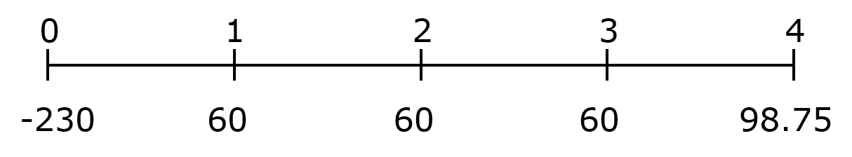
Proposed Project’s Cash Flow Time Line
(Thousands of dollars)
Enter CFs into calculator CFLO register, and enter I/YR = 10%.
NPV | = −$13.34
IRR | = 7.5%
MIRR | = 8.4%
Payback | = 3.5 years

Slide 15
If this were a replacement rather than a new project, would the analysis change?
Yes, the old equipment would be sold, and new equipment purchased.
The incremental CFs would be the changes from the old to the new situation.
The relevant depreciation expense would be the change with the new equipment.
If the old machine was sold, the firm would not receive the SV at the end of the machine’s life. This is the opportunity cost for the replacement project.

Slide 16
What are the 3 types of project risk?
Stand-alone risk
Corporate risk
Market risk

Slide 17
What is stand-alone risk?
The project’s total risk, if it were operated independently.
Usually measured by standard deviation (or coefficient of variation).
However, it ignores the firm’s diversification among projects and investors’ diversification among firms.

Slide 18
What is corporate risk?
The project’s risk when considering the firm’s other projects, i.e., diversification within the firm.
Corporate risk is a function of the project’s NPV and standard deviation and its correlation with the returns on other firm projects.

Slide 19
What is market risk?
The project’s risk to a well-diversified investor.
Theoretically, it is measured by the project’s beta and it considers both corporate and stockholder diversification.

Slide 20
Which type of risk is most relevant?
Market risk is the most relevant risk for capital projects, because management’s primary goal is shareholder wealth maximization.
However, since corporate risk affects creditors, customers, suppliers, and employees, it should not be completely ignored.

Slide 21
Which risk is the easiest to measure?
Stand-alone risk is the easiest to measure. Firms often focus on stand-alone risk when making capital budgeting decisions.
Focusing on stand-alone risk is not theoretically correct, but it does not necessarily lead to poor decisions.

Slide 22
Are the three types of risk generally highly correlated?
Yes, since most projects the firm undertakes are in its core business, stand-alone risk is likely to be highly correlated with its corporate risk.
In addition, corporate risk is likely to be highly correlated with its market risk.

Slide 23
What is sensitivity analysis?
Sensitivity analysis measures the effect of changes in a variable on the project’s NPV.
To perform a sensitivity analysis, all variables are fixed at their expected values, except for the variable in question which is allowed to fluctuate.
Resulting changes in NPV are noted.

Slide 24
What are the advantages and disadvantages of sensitivity analysis?
Advantage
Identifies variables that may have the greatest potential impact on profitability and allows management to focus on these variables.
Disadvantages
Does not reflect the effects of diversification.
Does not incorporate any information about the possible magnitude of the forecast errors.

Slide 25
Evaluating Projects with Unequal Lives
Machines A and B are mutually exclusive, and will be repurchased. If WACC = 10%, which is better?
Expected Net CFs
Year | Machine A | Machine B
0 | ($50,000) | ($50,000)
1 | 17,500 | 34,000
2 | 17,500 | 27,500
3 | 17,500 | –
4 | 17,500 | –

Slide 26
Solving for NPV with No Repetition
Enter CFs into calculator CFLO register for both projects, and enter I/YR = 10%.
NPV_{A} = $5,472.65
NPV_{B} = $3,636.36
Is Machine A better?
Need replacement chain and/or equivalent annual annuity analysis

Slide 27
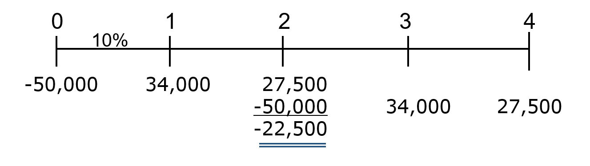
Replacement Chain
Use the replacement chain to calculate an extended NPV_{B} to a common life.
Since Machine B has a 2-year life and Machine A has a 4-year life, the common life is 4 years.
NPV_{B} = $6,641.62 (on extended basis)

Slide 28
Equivalent Annual Annuity
Using the previously solved project NPVs, the EAA is the annual payment that the project would provide if it were an annuity.
Machine A
Enter N = 4, I/YR = 10, PV = −5472.65, FV = 0; solve for PMT = EAA_{A} = $1,726.46.
Machine B
Enter N = 2, I/YR = 10, PV = −3636.36, FV = 0; solve for PMT = EAA_{B} = $2,095.24.
Machine B is better!

Slide 29
If expected inflation equals 5% is NPV biased?
The discount rate already reflects the market’s inflation expectation. Higher expected inflation translates into higher nominal rates.
Higher expected inflation may also lead to changes in the CF forecasts (both the revenues and costs are likely to increase). If those changes have not been incorporated in the analysis, then the NPV calculation is biased.

Slide 30
Project Operating Cash Flows, If Expected Inflation = 5%
(Thousands of dollars) | 1 | 2 | 3 | 4
Revenues | 210 | 220 | 232 | 243
– Op. costs | 126 | 132 | 139 | 146
– Depr. (100% at t = 0) | 0 | 0 | 0 | 0
EBIT | 84 | 88 | 92 | 97
– Tax (25%) | 21 | 22 | 23 | 24
EBIT(1 – T) | 63 | 66 | 69 | 73
+ Depreciation | 0 | 0 | 0 | 0
EBIT(1 – T) + DEP | 63 | 66 | 69 | 73

Slide 31
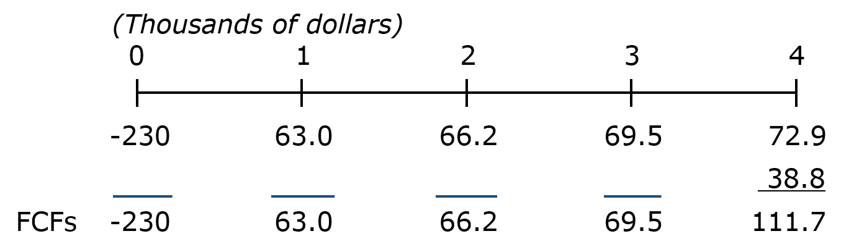
Considering Inflation:
Project CFs, NPV, and IRR
Enter CFs into calculator CFLO register, and enter I/YR = 10%.
NPV = $10.4. MIRR = 11.2%.
IRR = 11.9%. Payback = 3.3 years.

Slide 32
Perform a Scenario Analysis of the Project, Based on Changes in the Sales Forecast
Suppose we are confident of all the variable estimates, except unit sales. The actual unit sales are expected to follow the following probability distribution:
Case | Probability | Unit Sales
Worst | 0.25 | 75,000
Base | 0.50 | 100,000
Best | 0.25 | 125,000

Slide 33
Scenario Analysis
All other factors shall remain constant and the NPV under each scenario can be determined.
Case | Probability | NPV
Worst | 0.25 | ($43.1)
Base | 0.50 | 10.4
Best | 0.25 | 63.9

Slide 34
Determining Expected NPV, σ_{NPV}, and CV_{NPV} from the Scenario Analysis
E(NPV) = 0.25(−$43.1) + 0.5($10.4) + 0.25($63.9) = $10.4
σNPV = [0.25(-$43.1 − $10.4)² + 0.5($10.4 − $10.4)² + 0.25($63.9 − $10.4)²]^{1/2} = $37.8
CV_{NPV} = $37.8/$10.4 = 3.6

Slide 35
If firm’s average projects’ CV_{NPV} range is 1.25 - 1.75, would this project have high, average, or low risk?
With a CV_{NPV} of 3.6, this project would be classified as a high-risk project.
Perhaps, some sort of risk correction is required for proper analysis.

Slide 36
Is this project likely to be correlated with the firm’s business? How would it contribute to the firm’s overall risk?
We would expect a positive correlation with the firm’s aggregate cash flows.
As long as correlation is not perfectly positive (i.e., ρ ≠ 1), we would expect it to contribute to the lowering of the firm’s overall risk.

Slide 37
If the project had a high correlation with the economy, how would corporate and market risk be affected?
The project’s corporate risk would not be directly affected. However, when combined with the project’s high stand-alone risk, correlation with the economy would suggest that market risk (beta) is high.

Slide 38
If the firm uses a +/−4% risk adjustment for the cost of capital, should the project be accepted?
Reevaluating this project at a 14% cost of capital (due to high stand-alone risk), the NPV of the project is −$10.83.
If, however, it were a low-risk project, we would use a 6% cost of capital and the project NPV is $35.09.

Slide 39
What subjective risk factors should be considered before a decision is made?
Numerical analysis sometimes fails to capture all sources of risk for a project.
If the project has the potential for a lawsuit, it is more risky than previously thought.
If assets can be redeployed or sold easily, the project may be less risky than otherwise thought.

