Slide 1
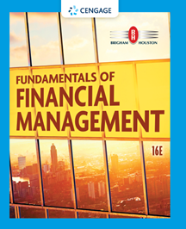
Chapter 19
Derivatives and Risk Management
Brigham & Houston, Fundamentals of Financial Management, Sixteenth Edition. © 2022 Cengage. All Rights Reserved. May not be scanned, copied or duplicated, or posted to a publicly accessible website, in whole or in part.

Slide 2
Overview
Motivations for Risk Management
Options
Valuing Derivatives
Other Derivatives
Fundamentals of Risk Management

Slide 3
Why might stockholders be indifferent to whether a firm reduces the volatility of its cash flows?
Diversified shareholders may already be hedged against various types of risk.
Reducing volatility increases firm value only if it leads to higher expected cash flows and/or a reduced WACC.

Slide 4
Reasons That Corporations Engage in Risk Management
Reduced volatility reduces bankruptcy risk, which enables the firm to increase its debt capacity.
By reducing the need for external equity, firms can maintain their optimal capital budget.
Reduced volatility helps avoid financial distress costs.
Managers have a comparative advantage in hedging certain types of risk.
Reduced volatility reduces the costs of borrowing.
Reduced volatility reduces the higher taxes that result from fluctuating earnings.
Certain compensation schemes reward managers for achieving stable earnings.

Slide 5
What is an option?
A contract that gives its holder the right, but not the obligation, to buy (or sell) an asset at some predetermined price within a specified period of time.
It’s important to remember:
It does not obligate its owner to take action.
It merely gives the owner the right to buy or sell an asset.

Slide 6
Option Terminology
Call option: an option to buy a specified number of shares of a security within some future period.
Put option: an option to sell a specified number of shares of a security within some future period.
Exercise (or strike) price: the price stated in the option contract at which the security can be bought or sold.
Option price: option contract’s market price.

Slide 7
Option Terminology (Cont’d) (1 of 2)
Expiration date: the date the option expires.
Exercise value: the value of an option if it were exercised today (Current stock price – Strike price).
Covered option: an option written against stock held in an investor’s portfolio.
Naked (uncovered) option: an option written without the stock to back it up.

Slide 8
Option Terminology (Cont’d) (2 of 2)
In-the-money call: a call option whose exercise price is less than the current price of the underlying stock.
Out-of-the-money call: a call option whose exercise price exceeds the current stock price.
Long-term Equity AnticiPation Securities (LEAPS): similar to normal options, but they are longer-term options with maturities of up to 2½ years.

Slide 9
Option Example
A call option with an exercise price of $25, has the following values at these prices:
Stock Price | Call Option Price
$25 | $ 3.00
30 | 7.50
35 | 12.00
40 | 16.50
45 | 21.00
50 | 25.50

Slide 10
Determining Option Exercise Value and Option Premium
Stock Price | Strike Price | Exercise Value | Option Price | Option Premium
$25.00 | $25.00 | $0.00 | $3.00 | $3.00
30.00 | 25.00 | 5.00 | 7.50 | 2.50
35.00 | 25.00 | 10.00 | 12.00 | 2.00
40.00 | 25.00 | 15.00 | 16.50 | 1.50
45.00 | 25.00 | 20.00 | 21.00 | 1.00
50.00 | 25.00 | 25.00 | 25.50 | 0.50

Slide 11
How does the option premium change as the stock price increases?
The premium of the option price over the exercise value declines as the stock price increases.
This is due to the declining degree of leverage provided by options as the underlying stock price increases, and the greater loss potential of options at higher option prices.

Slide 12
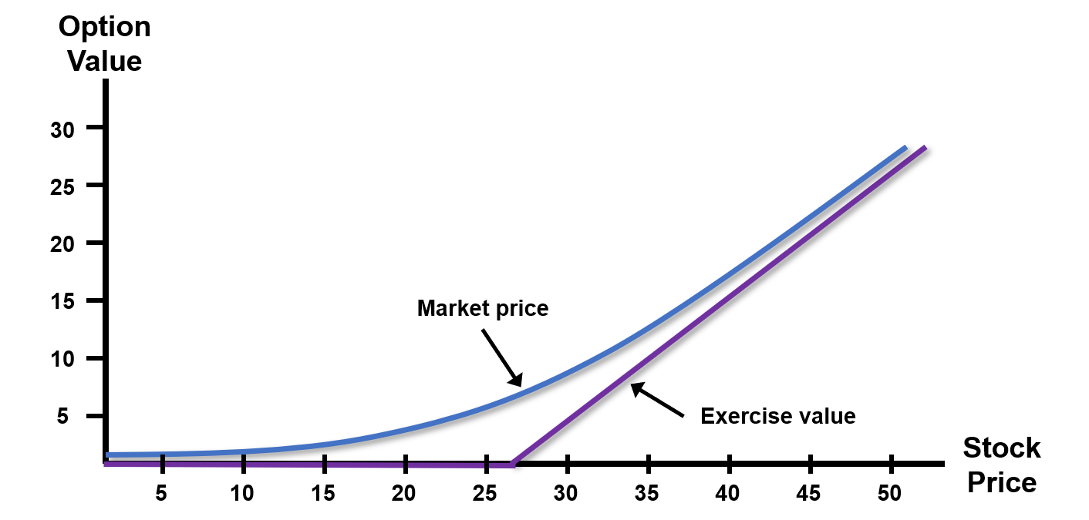
Call Premium Diagram

Slide 13
What are the assumptions of the Black-Scholes Option Pricing Model?
The stock underlying the call option pays no dividends during the call option’s life.
There are no transactions costs for the sale/purchase of either the stock or the option.
Unlimited borrowing and lending at the short-term, risk-free rate (r_{RF}), which is known and constant.
No penalty for short selling and sellers receive immediately full cash proceeds at today’s price.
Option can only be exercised on its expiration date.
Security trading takes place in continuous time, and stock prices move randomly in continuous time.

Slide 14
Using the Black-Scholes Option Pricing Model

Slide 15
Use the B-S OPM to Find the Option Value of a Call Option
P = $27, X = $25, r_{RF} = 6%, t = 0.5 years, and σ² = 0.11
From Appendix C in the textbook
N(d₁) = N(0.5736) = 0.5000 + 0.2168 = 0.7168
N(d₂) = N(0.3391) = 0.5000+ 0.1327 = 0.6327

Slide 16
Solving for Option Value

Slide 17
Create a Riskless Hedge to Determine Value of a Call Option (1 of 4)
Data: P = $15; X = $15; t = 0.5; r_{RF} = 6%
 | Ending Stock Price | Strike Price | Call Option Value
 | $10 | $15 | $0
 | $20 | $15 | $5
Range | $10 |  | $5

Slide 18
Create a Riskless Hedge to Determine Value of a Call Option (2 of 4)
Step 1: Calculate the value of the portfolio at the end of 6 months. (If the option is in-the-money, it will be sold.)
Ending Stock Price | × 0.5 | Ending Stock Value | + | Ending Option Value | = | Value of Portfolio
$10 | × 0.5 | $5 | + | $0 | = | $5
$20 | × 0.5 | $10 | + | -$5 | = | $5

Slide 19
Create a Riskless Hedge to Determine Value of a Call Option (3 of 4)
Step 2: Calculate the PV of the riskless portfolio today.

Slide 20
Create a Riskless Hedge to Determine Value of a Call Option (4 of 4)
Step 3: Calculate the cost of the stock in the portfolio.
Step 4: Calculate the market value of the option.

Slide 21
How do the factors of the B-S OPM affect a call option’s value?
As Factor Increases | Option Value
Current stock price | Increases
Exercise price | Decreases
Time to expiration | Increases
Risk-free rate | Increases
Stock return volatility | Increases

Slide 22
How do the factors of the B-S OPM affect a put option’s value?
As Factor Increases | Option Value
Current stock price | Decreases
Exercise price | Increases
Time to expiration | Increases
Risk-free rate | Decreases
Stock return volatility | Increases

Slide 23
Forward and Futures Contracts
Forward contract: one party agrees to buy a commodity at a specific price on a future date and the counterparty agrees to make the sale. There is physical delivery of the commodity.
Futures contract: standardized, exchange-traded contracts in which physical delivery of the underlying asset does not actually occur.
Commodity futures
Financial futures

Slide 24
Swaps
The exchange of cash payment obligations between two parties, usually because each party prefers the terms of the other’s debt contract.
Fixed for floating
Floating for fixed
Swaps can reduce each party’s financial risk.

Slide 25
Hedging Risks
Hedging is usually used when a price change could negatively affect a firm’s profits.
Long hedge: involves the purchase of a futures contract to guard against a price increase.
Short hedge: involves the sale of a futures contract to protect against a price decline.

Slide 26
How can commodity futures markets be used to reduce input price risk?
The purchase of a commodity futures contract will allow a firm to make a future purchase of the input at today’s price, even if the market price on the item has risen substantially in the interim.

Slide 27
What is corporate risk management, and why is it important to all firms?
Corporate risk management relates to the management of unpredictable events that would have adverse consequences for the firm.
All firms face risks, but the lower those risks can be made, the more valuable the firm, other things held constant. Of course, risk reduction has a cost.

Slide 28
Definitions of Different Types of Risk (1 of 2)
Speculative risks: offer the chance of a gain as well as a loss.
Pure risks: offer only the prospect of a loss.
Demand risks: risks associated with the demand for a firm’s products or services.
Input risks: risks associated with a firm’s input costs.
Financial risks: result from financial transactions.

Slide 29
Definitions of Different Types of Risk (2 of 2)
Property risks: risks associated with loss of a firm’s productive assets.
Personnel risk: result from human actions.
Environmental risk: risk associated with polluting the environment.
Liability risks: connected with product, service, or employee liability.
Insurable risks: risks that typically can be covered by insurance.

Slide 30
Definitions of Different Types of Risk
Identify the risks faced by the firm.
Measure the potential impact of the identified risks.
Decide how each relevant risk should be handled.

