Slide 1
dApp and DAO - Ethereum
FIN451 / MBA651

Slide 2
What is a Decentralized Applications (dApps)?
A decentralized application (dApp) is a type of software application that operates on a blockchain or decentralized network rather than being hosted on a centralized server.
Unlike traditional applications, which rely on centralized entities to manage and operate the backend, dApps use smart contracts on blockchain networks to handle their logic and operations, making them more secure, transparent, and resistant to censorship.

Slide 3
Key Features of dApps:
Decentralized: dApps run on a decentralized network of nodes (computers), often on a blockchain like Ethereum. This means no single entity controls the application, making it less vulnerable to downtime, censorship, or manipulation.
Open Source: Many dApps are open-source, meaning their code is available for anyone to inspect, modify, or contribute to. This fosters innovation and trust within the community.
Smart Contracts: dApps are powered by smart contracts, which automate the execution of the application’s operations according to predefined rules. For example, a decentralized finance (DeFi) dApp might use a smart contract to automatically lend or borrow cryptocurrency based on user inputs.
Token-based: dApps often use tokens as a form of currency or governance within the application. These tokens can be native to the dApp and are used to pay for services, incentivize users, or participate in governance decisions.

Slide 4
How to Run a dApp:
Choose a Blockchain Platform: The first step is to select a blockchain that supports smart contracts, such as Ethereum, Binance Smart Chain, or Solana.
Develop Smart Contracts: Write the smart contracts that will handle the logic of your dApp using a language like Solidity (for Ethereum). These contracts should include all the rules and functions required for your dApp to operate.
Deploy the Smart Contracts: Once developed and tested, deploy the smart contracts to the blockchain. This process will give your dApp a unique address on the blockchain where it can be interacted with.
Create a Frontend Interface: Develop a user-friendly frontend (website or mobile app) that interacts with the smart contracts. This allows users to interact with the blockchain without needing to understand the underlying technology.
Connect to a Wallet: Users will need a cryptocurrency wallet (like MetaMask) to interact with your dApp. The wallet is used to sign transactions and interact with the smart contracts.
Launch and Maintain: Once everything is ready, launch your dApp. You’ll need to monitor and maintain it, including updating the frontend and potentially upgrading smart contracts if necessary.

Slide 5
Key Components of Ethereum - Ether (ETH)
Ether (ETH) is the native cryptocurrency of the Ethereum network, and it plays a crucial role in the execution of smart contracts.
When a smart contract is executed on Ethereum, it consumes computational resources. These resources are paid for in ETH, through a mechanism called "gas."
Gas is a unit of measurement that dictates the amount of computational work required to execute a transaction or a smart contract. The more complex the smart contract, the more gas it requires, and the more ETH must be paid.

Slide 6
What is a Decentralized Autonomous Organizations (DAOs)?
A Decentralized Autonomous Organization (DAO) is an organization governed by smart contracts on a blockchain, where decisions are made collectively by the community or members, rather than by a central authority.
DAOs operate through a set of rules encoded in smart contracts, and they often manage a treasury of tokens that can be used to fund projects, pay for services, or reward members.

Slide 7
Key Features of DAOs
Decentralized Governance: Decisions in a DAO are made through a voting process, where each member typically has a say proportional to the number of tokens they hold or their stake in the organization.
Smart Contract Management: The rules and operations of the DAO are encoded in smart contracts, ensuring transparency and immutability. These contracts automatically enforce decisions made by the community.
Token-based: DAOs usually issue tokens that represent voting power and ownership in the organization. Members use these tokens to vote on proposals and make decisions.
Autonomous: Once established, a DAO can operate autonomously according to its predefined rules, without requiring continuous input from its creators.

Slide 8
How to Run a DAO:
Define the Purpose: Clearly outline the purpose and goals of the DAO. This could be anything from managing a community fund to running a decentralized protocol.
Develop the Smart Contracts: Write the smart contracts that will govern the DAO. These contracts should include rules for governance, voting, fund management, and other operations.
Token Issuance: Create a token that will be used for governance and voting within the DAO. This token can also represent shares or ownership in the DAO’s assets.
Deploy the DAO: Deploy the smart contracts and tokens to the blockchain. This step officially establishes the DAO and makes it operational.
Community Involvement: Promote your DAO to attract members who are interested in its goals. Community members can join by purchasing or earning tokens.
Propose and Vote: Members can propose changes, initiatives, or funding projects. Proposals are put to a vote, and if they pass (based on the rules encoded in the smart contract), the smart contracts automatically execute the decision.
Manage the DAO: Continuously manage the DAO by engaging the community, proposing new initiatives, and ensuring that the organization remains aligned with its goals.

Slide 9
dApps vs. DAOs
dApps are decentralized applications that provide services or products directly to users, operating on a blockchain.
  They rely on smart contracts to execute their functions automatically and can be anything from financial services to games.
DAOs are decentralized organizations that focus on governance and decision-making, usually around a shared goal or project.
  They operate through collective voting and smart contracts that enforce the community’s decisions.

Slide 10
Conclusion
dApps are decentralized software applications that run on blockchain networks, while DAOs are decentralized organizations that are managed by their members using smart contracts.
Both dApps and DAOs are integral parts of the blockchain ecosystem, offering new ways to interact with technology, governance, and finance.

Slide 11
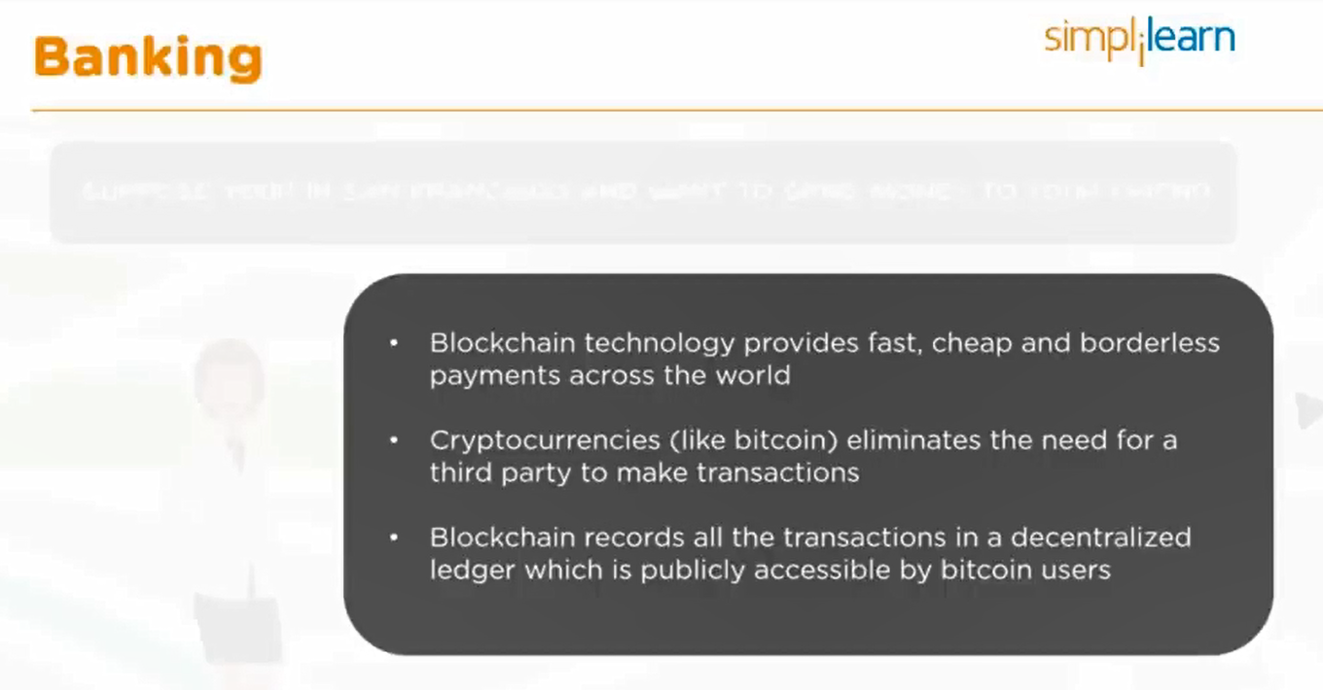

Slide 12
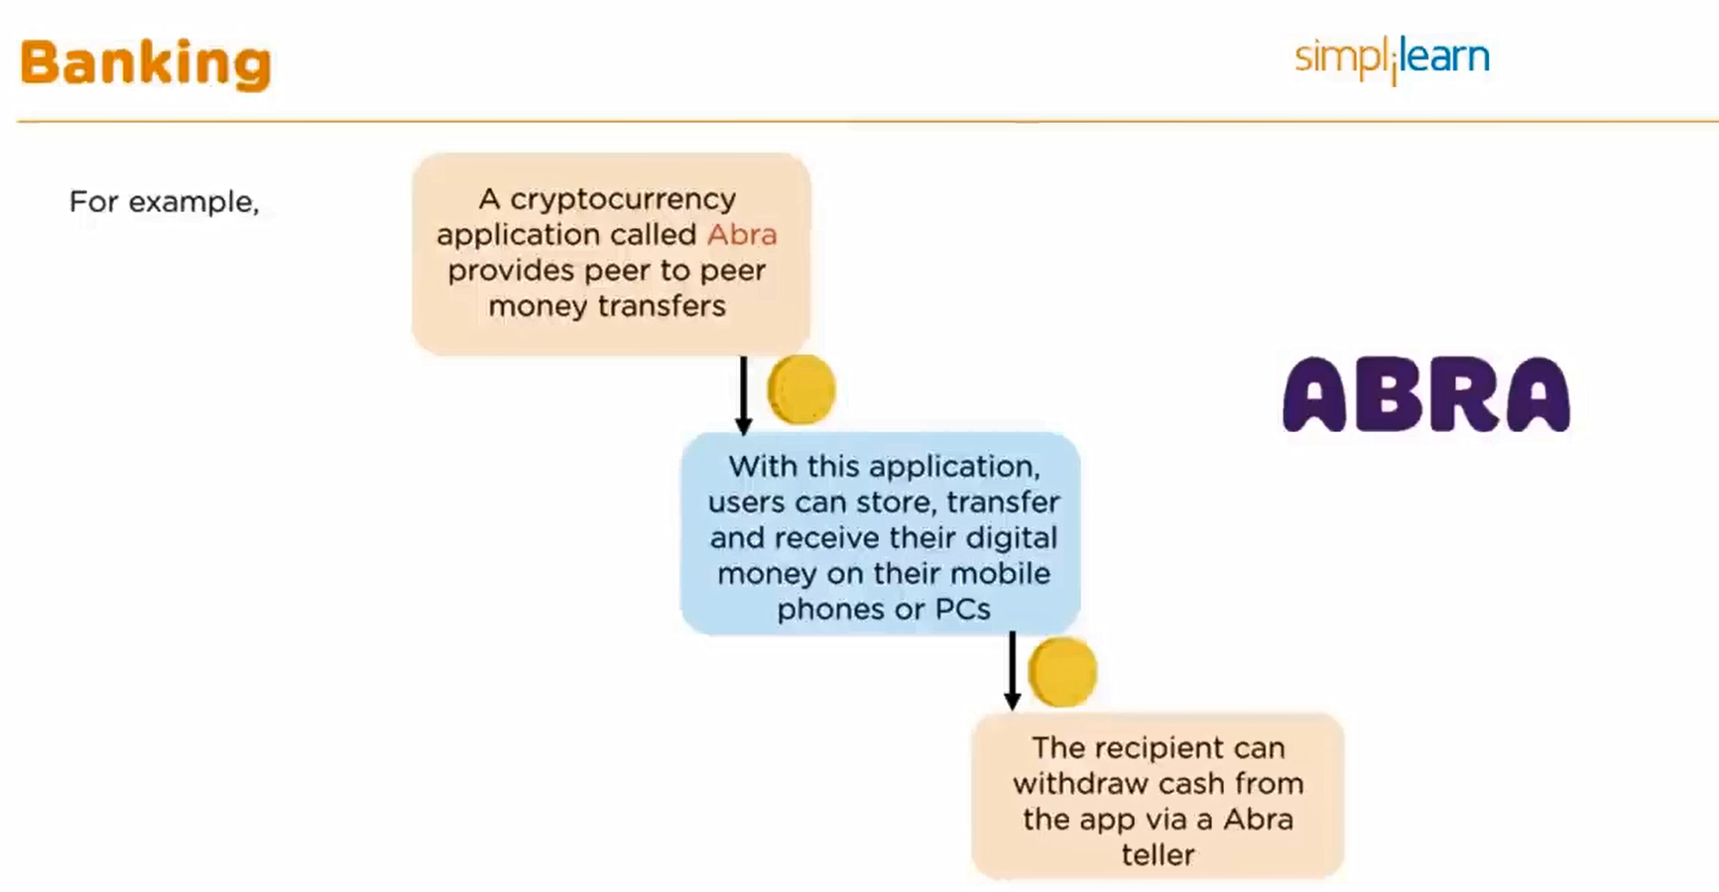

Slide 13
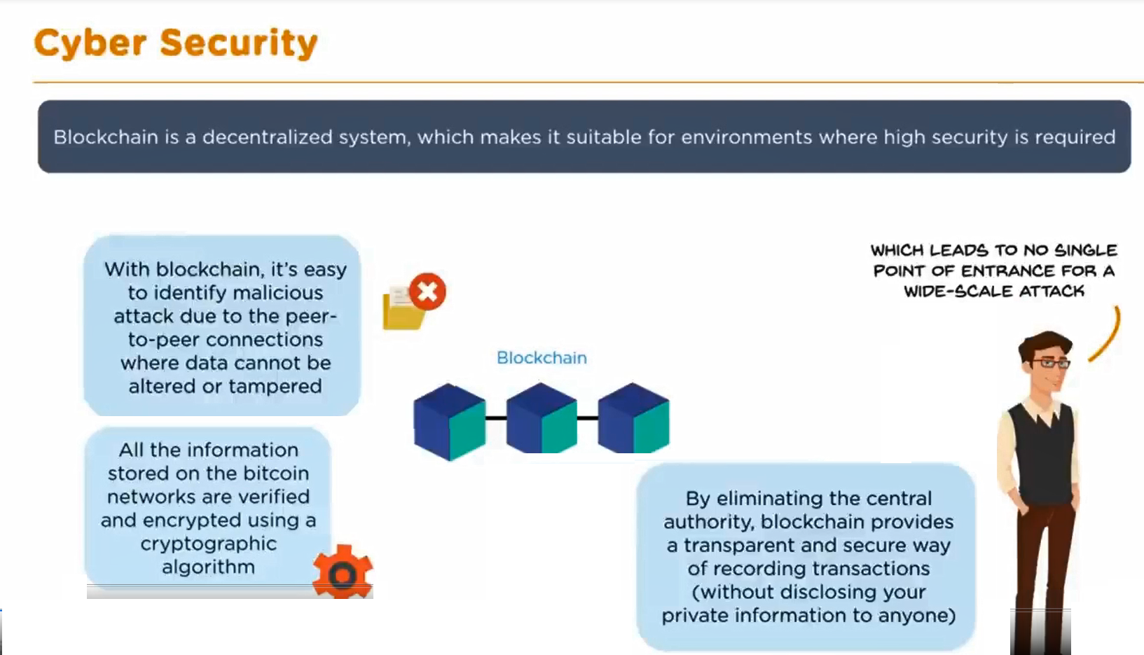

Slide 14
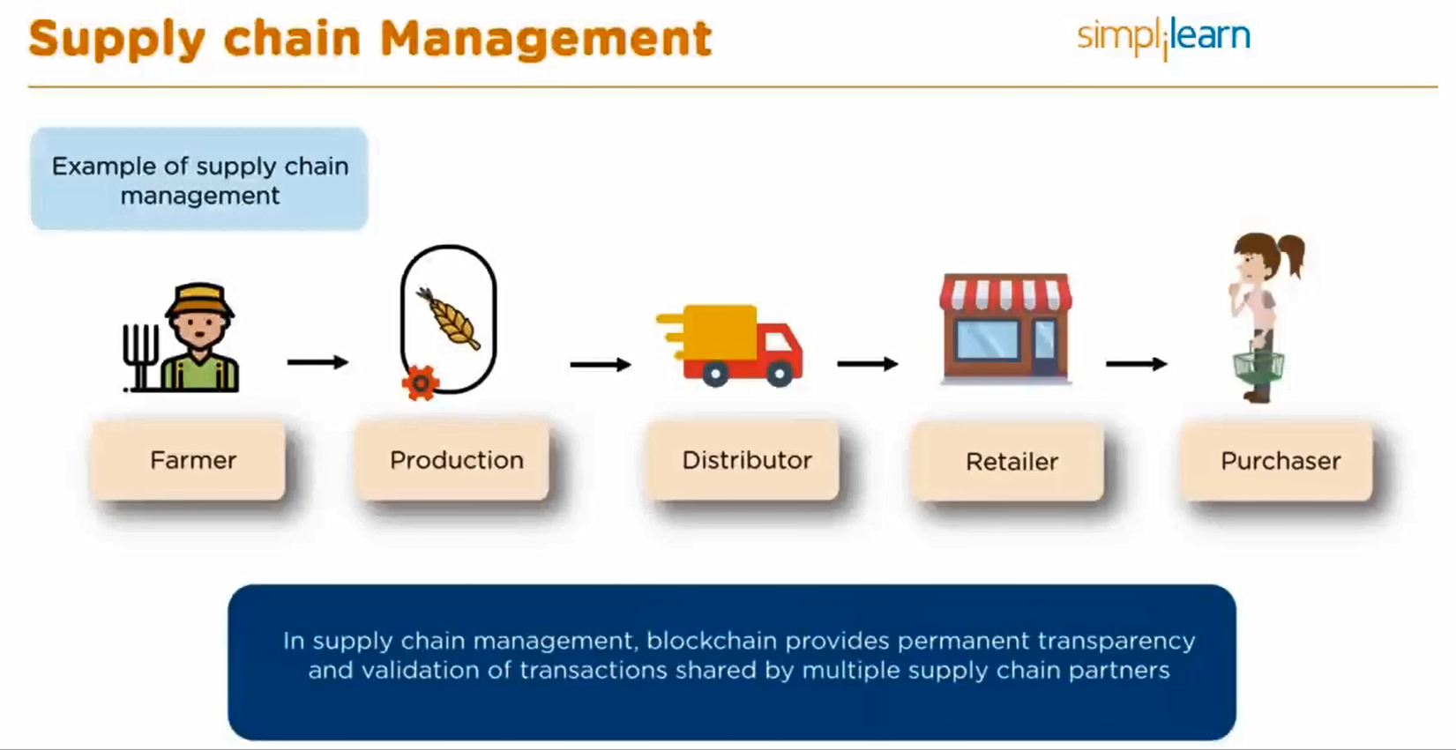

Slide 15
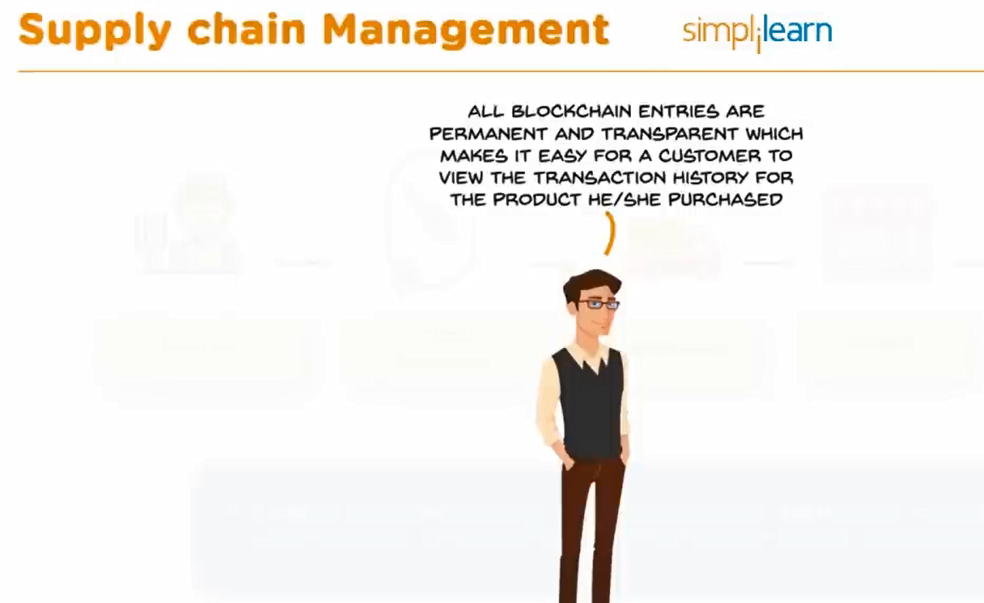

Slide 16
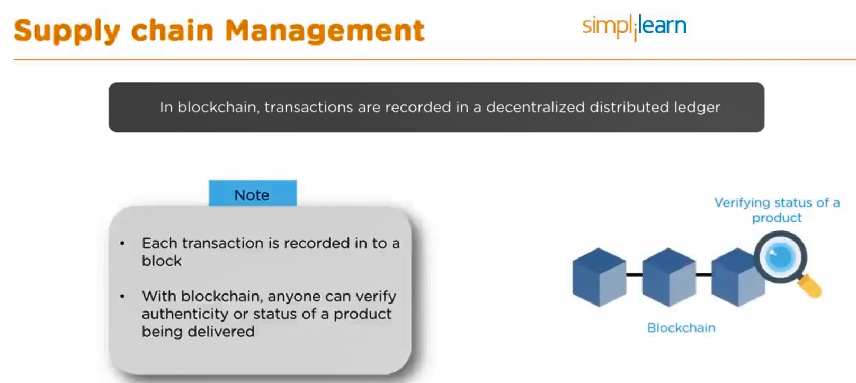

Slide 17
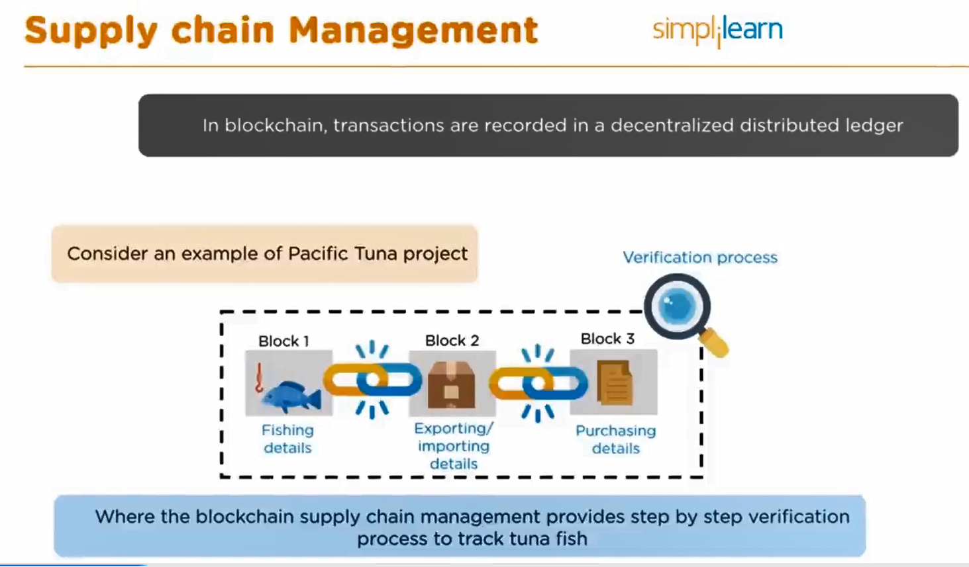

Slide 18
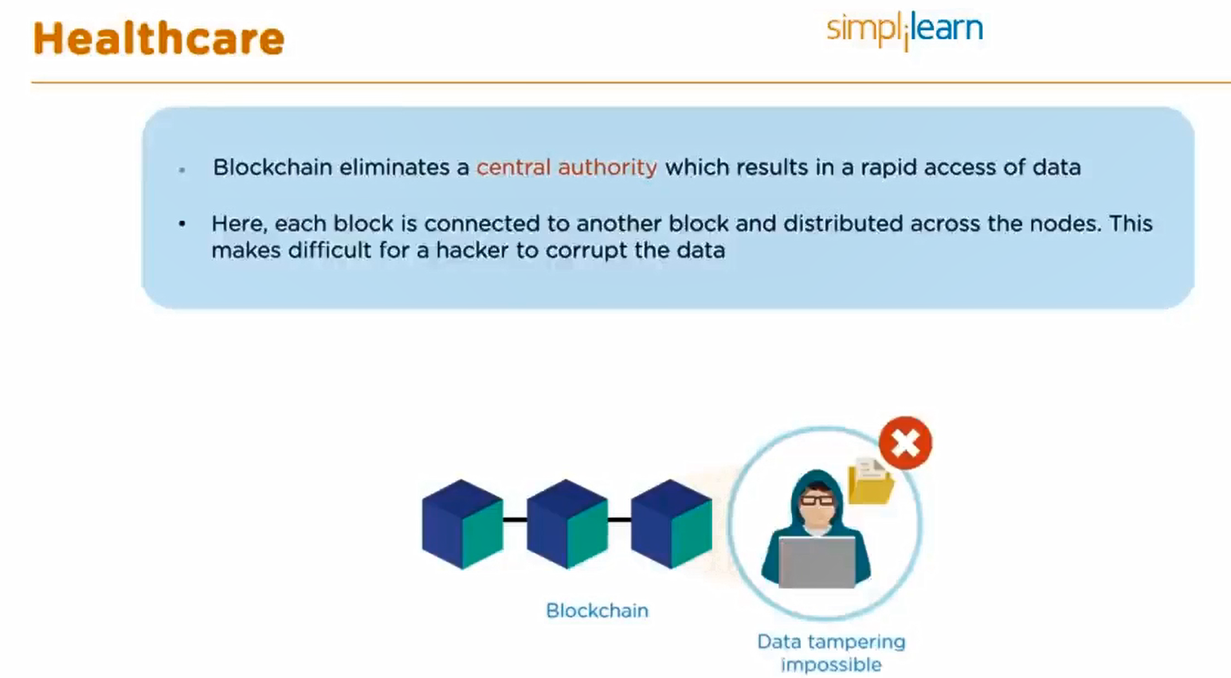

Slide 19
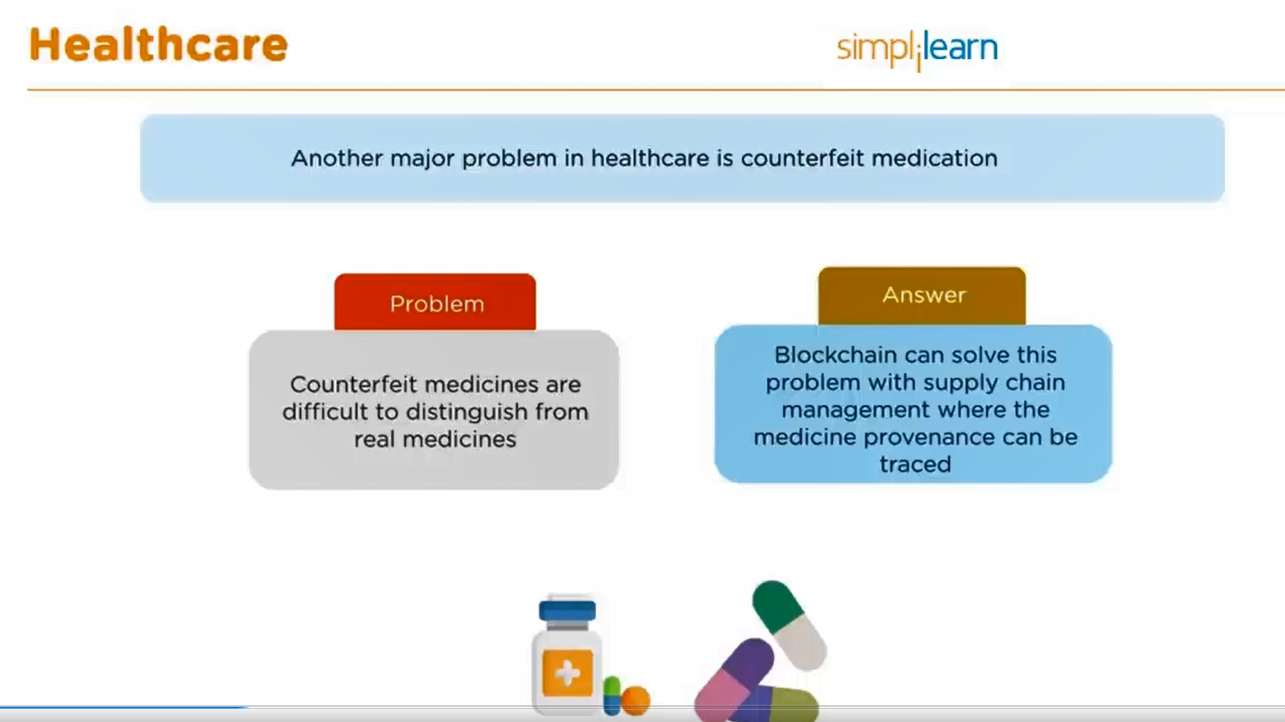

Slide 20
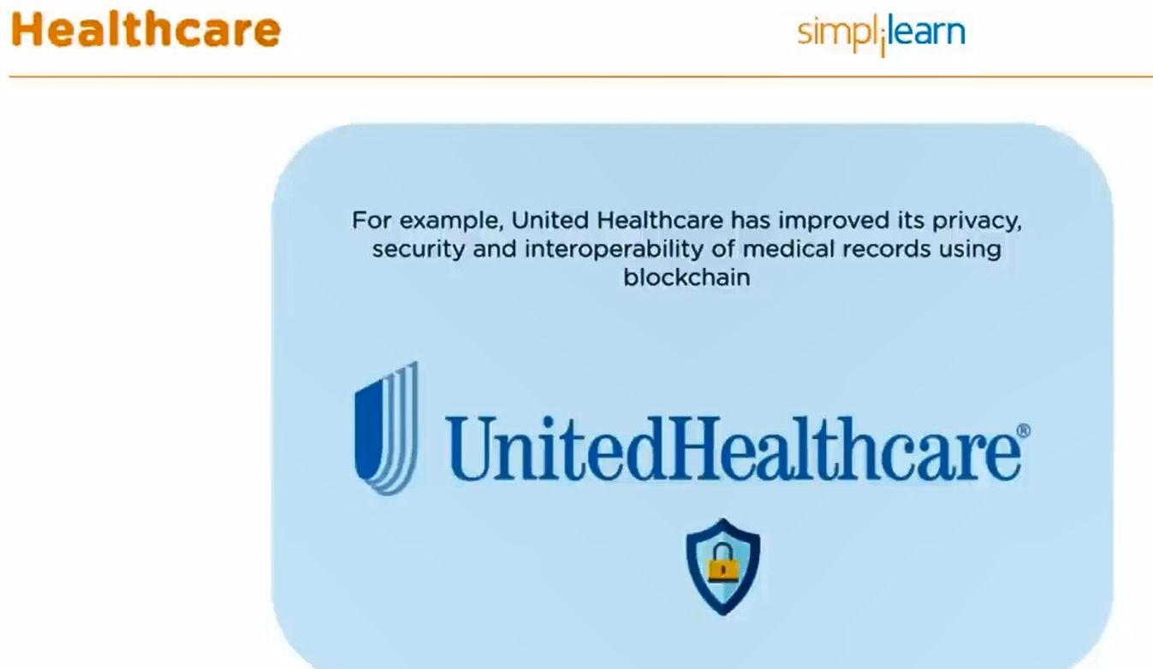

Slide 21
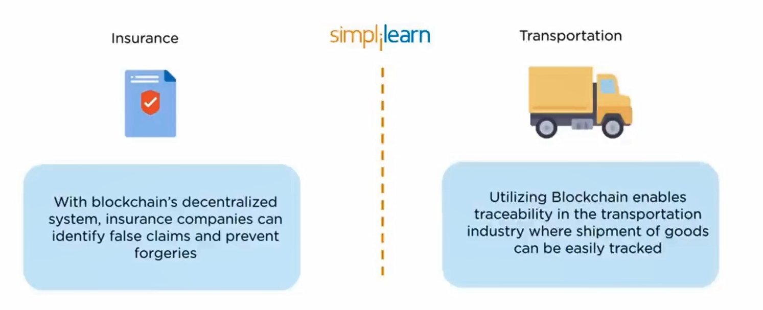

Slide 22
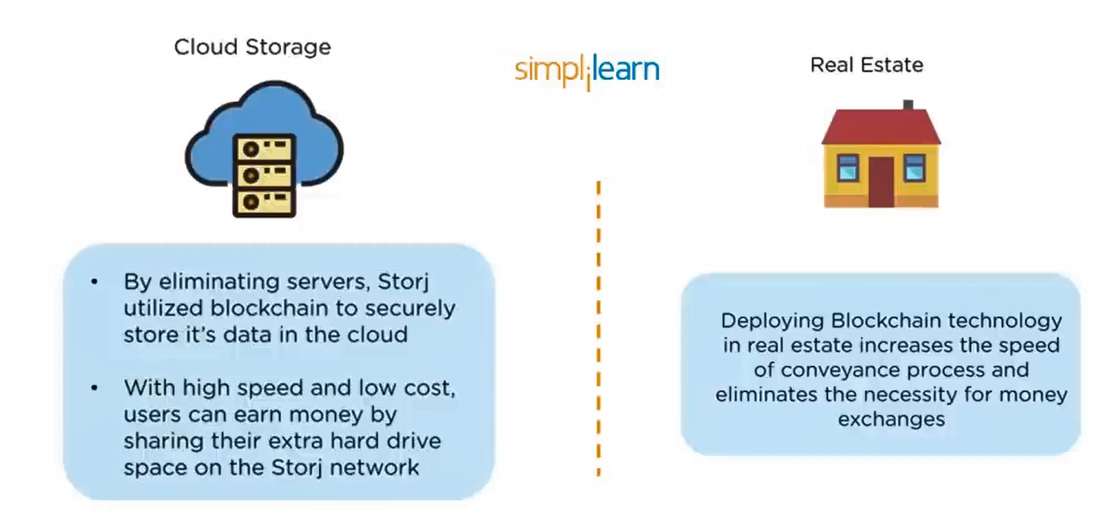

Slide 23
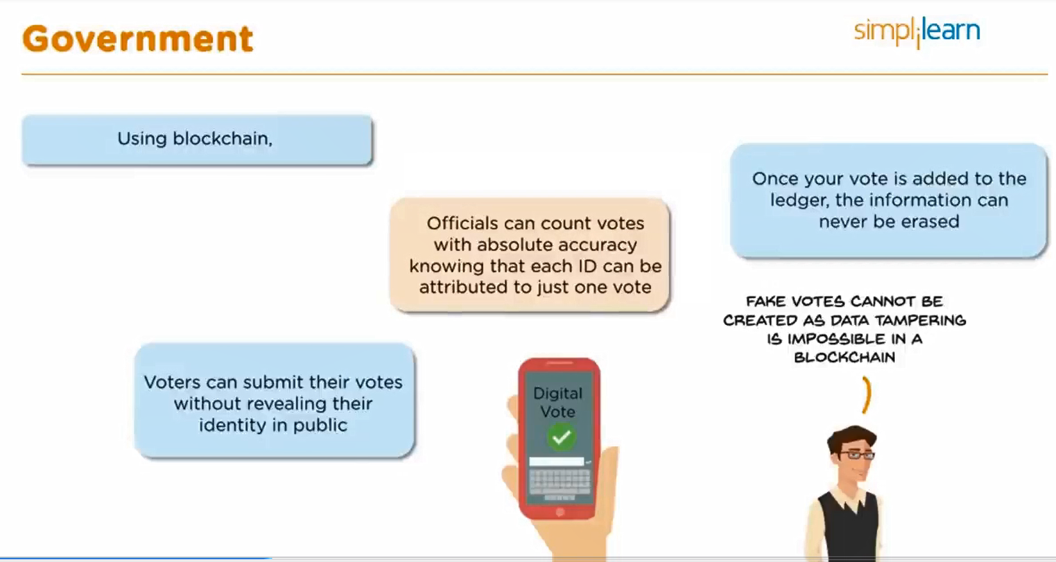

Slide 24
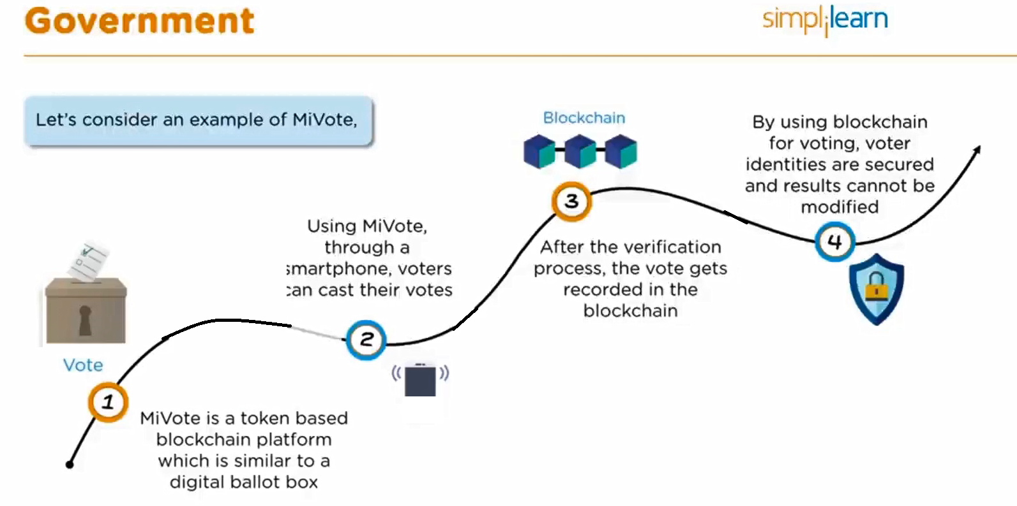

Slide 25
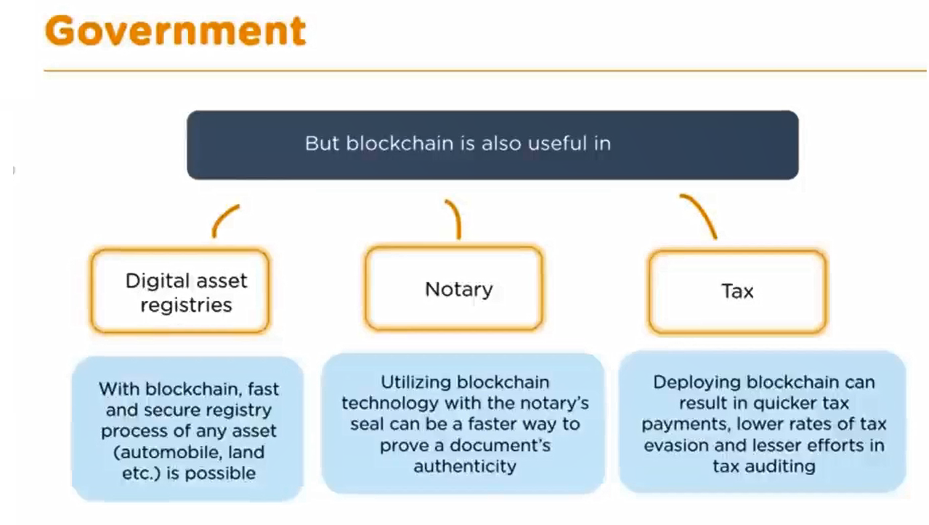

Slide 26
