Slide 1
Bitcoin vs. Ethereum: A Detailed Comparison
FIN451 / MBA651

Slide 2
Bitcoin
Creation: Bitcoin was created by an anonymous person or group known as Satoshi Nakamoto and was released as open-source software in 2009.
Purpose: Bitcoin was designed as a peer-to-peer digital currency to serve as an alternative to traditional fiat currencies.
Its primary purpose is to enable decentralized, secure, and transparent transactions without the need for a central authority, such as a bank or government.
Philosophy: Bitcoin's core philosophy is to provide a decentralized financial system that empowers individuals to have full control over their money.
It is often referred to as "digital gold" because of its deflationary nature (limited supply of 21 million coins) and its role as a store of value.

Slide 3
Ethereum
Creation: Ethereum was proposed in late 2013 by Vitalik Buterin, a young programmer, and development began through a Swiss company, Ethereum Switzerland GmbH, and a Swiss nonprofit foundation, the Ethereum Foundation. It was officially launched in 2015.
Purpose: Ethereum was designed as a platform for decentralized applications (dApps) and smart contracts.
Unlike Bitcoin, which is primarily focused on being a currency, Ethereum allows developers to create and deploy their own decentralized applications on its blockchain.
Philosophy: Ethereum's philosophy is to be a "world computer" that provides a decentralized platform where anyone can build and run applications without censorship, downtime, or third-party interference.
It emphasizes flexibility, innovation, and the creation of a new type of internet, often referred to as Web3.

Slide 4
Blockchain
Blockchain Structure: Bitcoin's blockchain is a simple, linear chain of blocks.
Each block contains a list of transactions and a reference to the previous block, forming a continuous chain.
Consensus Mechanism: Bitcoin uses a Proof of Work (PoW) consensus mechanism, where miners compete to solve complex mathematical puzzles to validate transactions and add them to the blockchain.
This process is resource-intensive and requires significant computational power.
Transaction Speed: Bitcoin's block time is approximately 10 minutes, meaning that a new block is added to the blockchain roughly every 10 minutes.
This results in slower transaction confirmation times compared to other blockchains.
Scalability: Bitcoin's scalability is limited, with the network capable of handling around 7 transactions per second (TPS).
Efforts like the Lightning Network aim to improve scalability by enabling off-chain transactions.

Slide 5
Ethereum
Blockchain Structure: Ethereum's blockchain is similar to Bitcoin's but includes an additional feature called the Ethereum Virtual Machine (EVM).
The EVM allows for the execution of smart contracts, which are self-executing contracts with the terms of the agreement directly written into code.
Consensus Mechanism: Originally, Ethereum also used Proof of Work (PoW), but with the launch of Ethereum 2.0, the network is transitioning to a Proof of Stake (PoS) consensus mechanism.
In PoS, validators are chosen to create new blocks based on the number of coins they hold and are willing to "stake" as collateral.
Transaction Speed: Ethereum's block time is around 12-15 seconds, significantly faster than Bitcoin. This allows for quicker transaction confirmations and a higher transaction throughput.
Scalability: Ethereum's scalability has been a concern, especially with the growth of decentralized applications.
However, Ethereum 2.0 aims to address this issue with features like sharding, which will divide the network into smaller, more manageable parts, allowing for parallel processing and increased TPS.

Slide 6
Bitcoin
Smart Contracts: Bitcoin does support very basic smart contracts using a scripting language called Script, but its capabilities are limited compared to Ethereum.
The most common smart contract-like functionality on Bitcoin is multi-signature transactions, where multiple signatures are required to authorize a transaction.
dApps: Bitcoin was not designed for decentralized applications.
While it can support simple scripts and contracts, it lacks the flexibility and functionality needed for complex dApps.

Slide 7
Ethereum
Smart Contracts: Ethereum was explicitly designed to support smart contracts, which are self-executing contracts that automatically enforce the terms of an agreement.
Smart contracts are written in a programming language called Solidity and run on the Ethereum Virtual Machine (EVM).
dApps: Ethereum is the leading platform for decentralized applications, with thousands of dApps built on its blockchain.
These applications can range from decentralized finance (DeFi) platforms to non-fungible token (NFT) marketplaces, gaming, and beyond.

Slide 8
Bitcoin
Token Supply: Bitcoin has a fixed supply of 21 million coins.
This hard cap is one of the key features that contribute to its value proposition as "digital gold."
Token Distribution: Bitcoins are distributed as rewards to miners who successfully validate transactions and add them to the blockchain.
The reward is halved approximately every four years in an event known as the "halving."
Monetary Policy: Bitcoin's monetary policy is deflationary, meaning that its supply decreases over time as the mining reward is reduced.
This scarcity is a key factor in its value proposition as a store of value.

Slide 9
Ethereum
Token Supply: Ethereum does not have a fixed supply like Bitcoin.
It has an inflationary monetary policy where new Ether (ETH) is continuously created through block rewards to validators.
Token Distribution: Ether is distributed as rewards to miners (in PoW) and validators (in PoS) who help maintain the network.
Unlike Bitcoin, there is no set limit on the total supply of Ether.
Monetary Policy: Ethereum's monetary policy has evolved over time. With the transition to Ethereum 2.0 and the introduction of EIP-1559 (a protocol upgrade), Ethereum has introduced a mechanism to burn a portion of transaction fees, reducing the overall supply and potentially making it deflationary.

Slide 10
Bitcoin
Ecosystem: Bitcoin has a robust ecosystem with a large and active community.
It is widely accepted as a form of payment by merchants and is used by individuals and institutions as a store of value, a hedge against inflation, and a medium of exchange.
Use Cases: Bitcoin's primary use cases are as a digital currency and a store of value.
It is often used for cross-border payments, remittances, and as a hedge against economic instability.
Bitcoin's simplicity and security make it the go-to choice for individuals and institutions looking for a reliable and decentralized form of money.

Slide 11
Ethereum
Ecosystem: Ethereum has a vibrant and diverse ecosystem with a wide range of developers, projects, and users.
It is the leading platform for decentralized finance (DeFi), non-fungible tokens (NFTs), decentralized autonomous organizations (DAOs), and other innovative blockchain applications.
Use Cases: Ethereum's use cases are broader and more varied than Bitcoin's. In addition to being used as a digital currency, Ether is used to pay for transaction fees and computational services on the Ethereum network.
Ethereum's smart contract functionality allows for the creation of decentralized applications across various industries, including finance, gaming, supply chain management, and more.

Slide 12
Bitcoin
Security: Bitcoin is considered the most secure blockchain network due to its large and decentralized mining network.
The Proof of Work consensus mechanism, combined with the network's size, makes it highly resistant to attacks, such as the 51% attack, where an attacker gains control of the majority of the network's hash rate.
Decentralization: Bitcoin is one of the most decentralized blockchains, with thousands of nodes distributed worldwide.
This high level of decentralization contributes to its security and censorship resistance.

Slide 13
Ethereum
Security: Ethereum is also a highly secure blockchain, though it has faced security challenges in the past, particularly with smart contract vulnerabilities.
The transition to Proof of Stake is expected to enhance its security by reducing energy consumption and incentivizing more participants to become validators.
Decentralization: Ethereum is decentralized, but not to the same extent as Bitcoin.
The network's transition to Proof of Stake is designed to further decentralize the network by making it easier for more people to participate in the validation process.

Slide 14
Bitcoin
Energy Consumption: Bitcoin's Proof of Work consensus mechanism is highly energy-intensive, as it requires miners to solve complex puzzles using significant computational power.
This has led to criticism of Bitcoin's environmental impact, as the energy consumption of the network is comparable to that of entire countries.
Environmental Impact: The environmental impact of Bitcoin mining is a significant concern.
Efforts are being made to shift to more sustainable energy sources, but the overall energy consumption remains high.

Slide 15
Ethereum
Energy Consumption: Ethereum's energy consumption has been high due to its Proof of Work consensus mechanism.
However, with the transition to Proof of Stake in Ethereum 2.0, the network's energy consumption is expected to decrease significantly, as PoS requires far less computational power than PoW.
Environmental Impact: The transition to Proof of Stake is seen as a positive step towards reducing Ethereum's environmental impact.
PoS is considered a more sustainable and energy-efficient consensus mechanism, which should alleviate some of the environmental concerns associated with blockchain technology.

Slide 16
Bitcoin
Future Developments: Bitcoin's development is relatively slow and conservative compared to Ethereum.
The Bitcoin community prioritizes security and stability over rapid innovation. Future developments include potential improvements to scalability through the Lightning Network and increased privacy features.
Roadmap: Bitcoin's roadmap focuses on maintaining its role as a secure and decentralized store of value.
While there are ongoing discussions about adding new features, any changes to the protocol are carefully considered and subject to broad consensus within the community.

Slide 17
Ethereum
Future Developments: Ethereum is more experimental and rapidly evolving than Bitcoin.
The transition to Ethereum 2.0 is the most significant development, aiming to improve scalability, security, and sustainability.
Other future developments include enhancements to smart contract functionality and interoperability with other blockchains.
Roadmap: Ethereum's roadmap is ambitious, with a focus on transitioning to Proof of Stake, implementing sharding to improve scalability, and continuing to be the leading platform for decentralized applications.
The community is actively working on improving the network's performance and expanding its use cases.

Slide 18


Slide 19


Slide 20


Slide 21
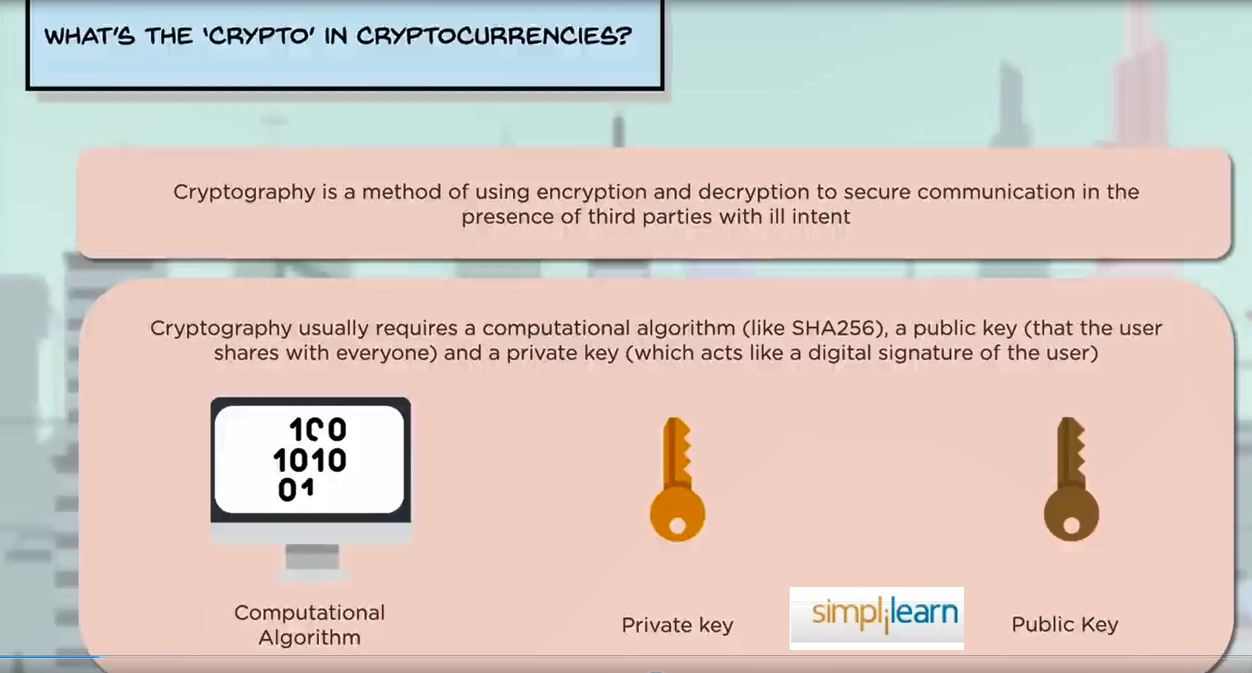

Slide 22
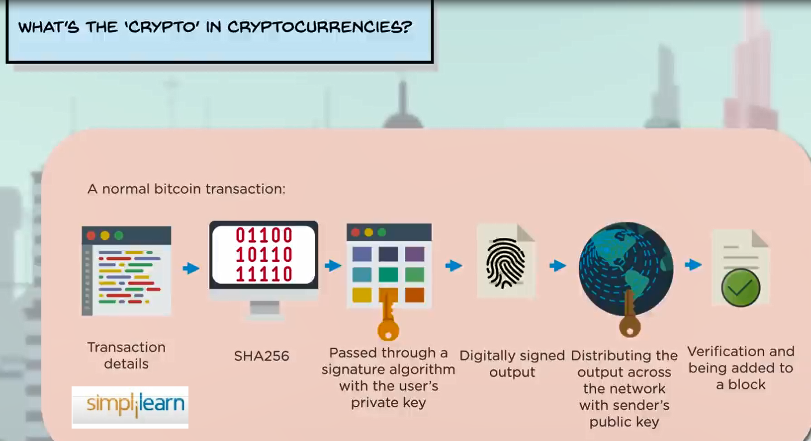

Slide 23
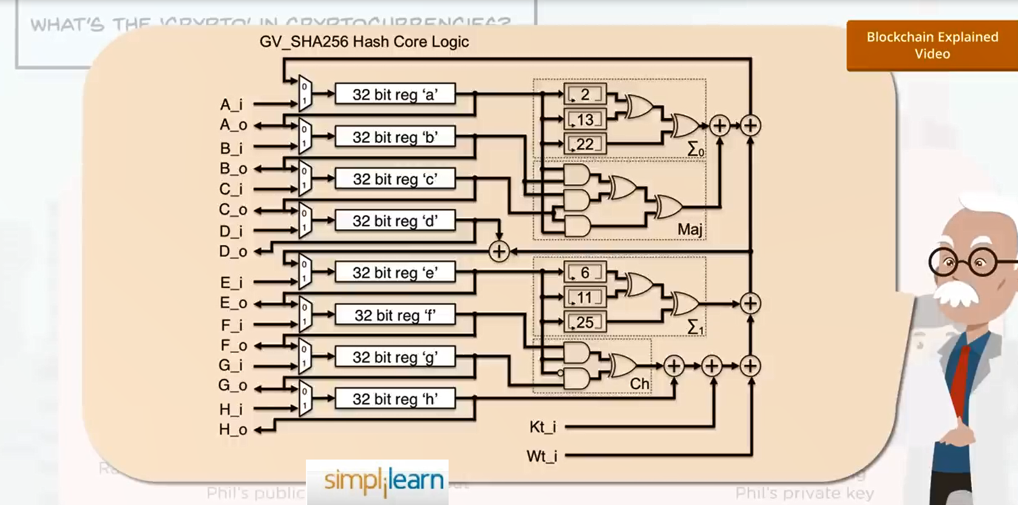

Slide 24


Slide 25
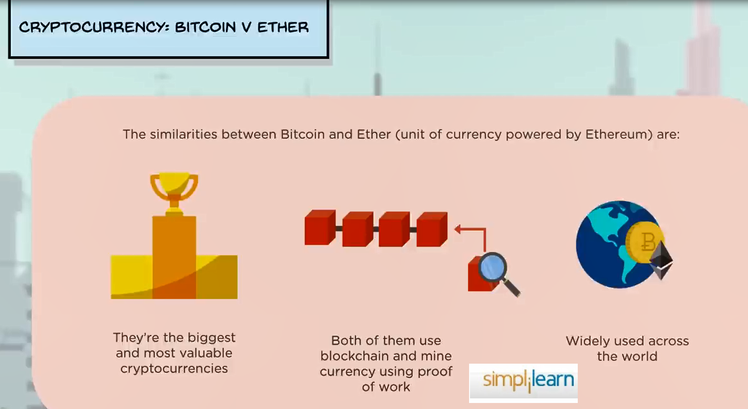

Slide 26
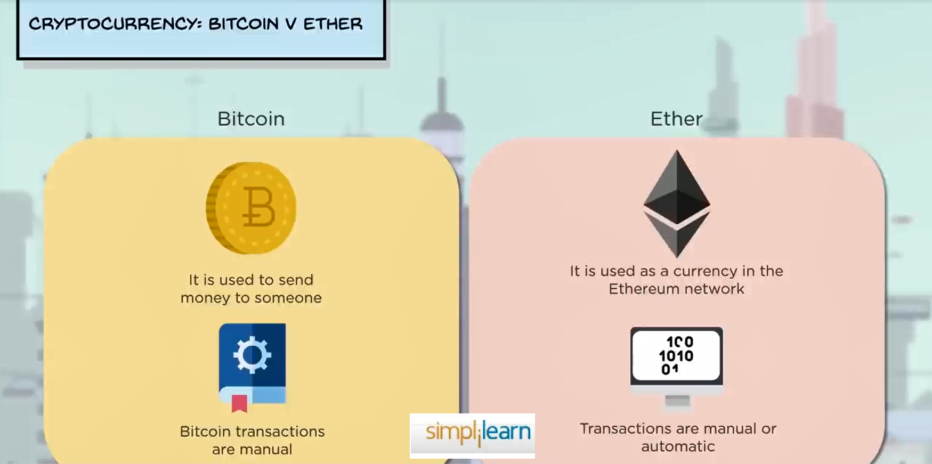

Slide 27
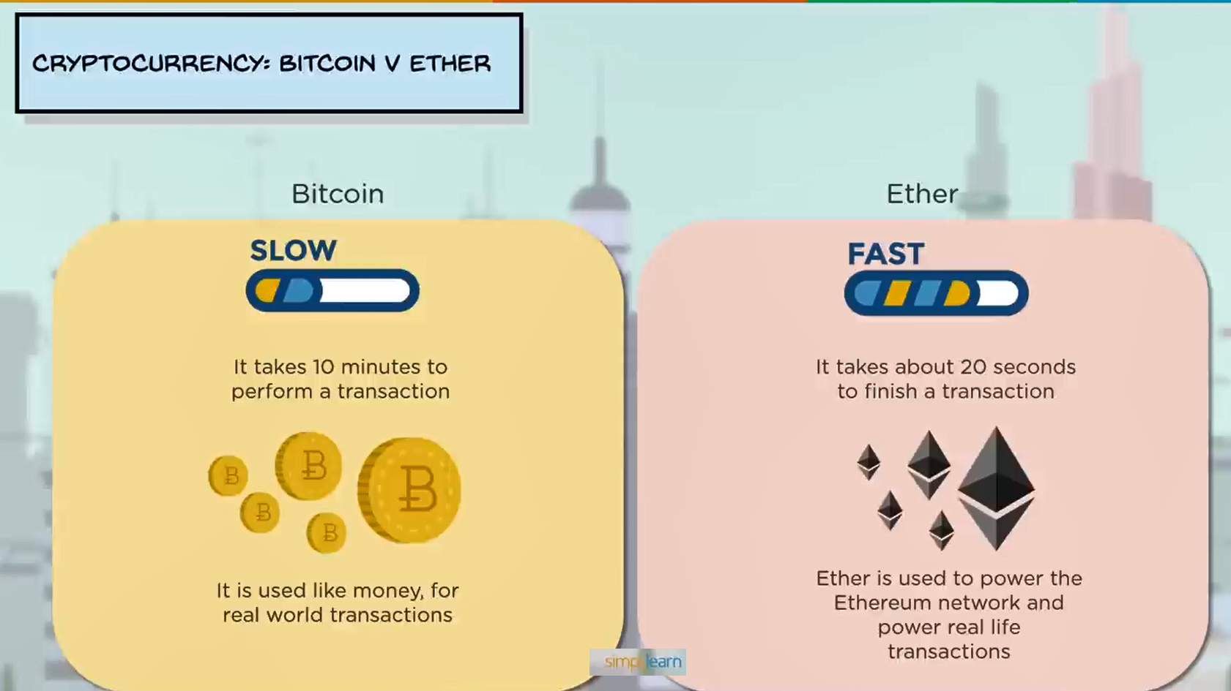

Slide 28
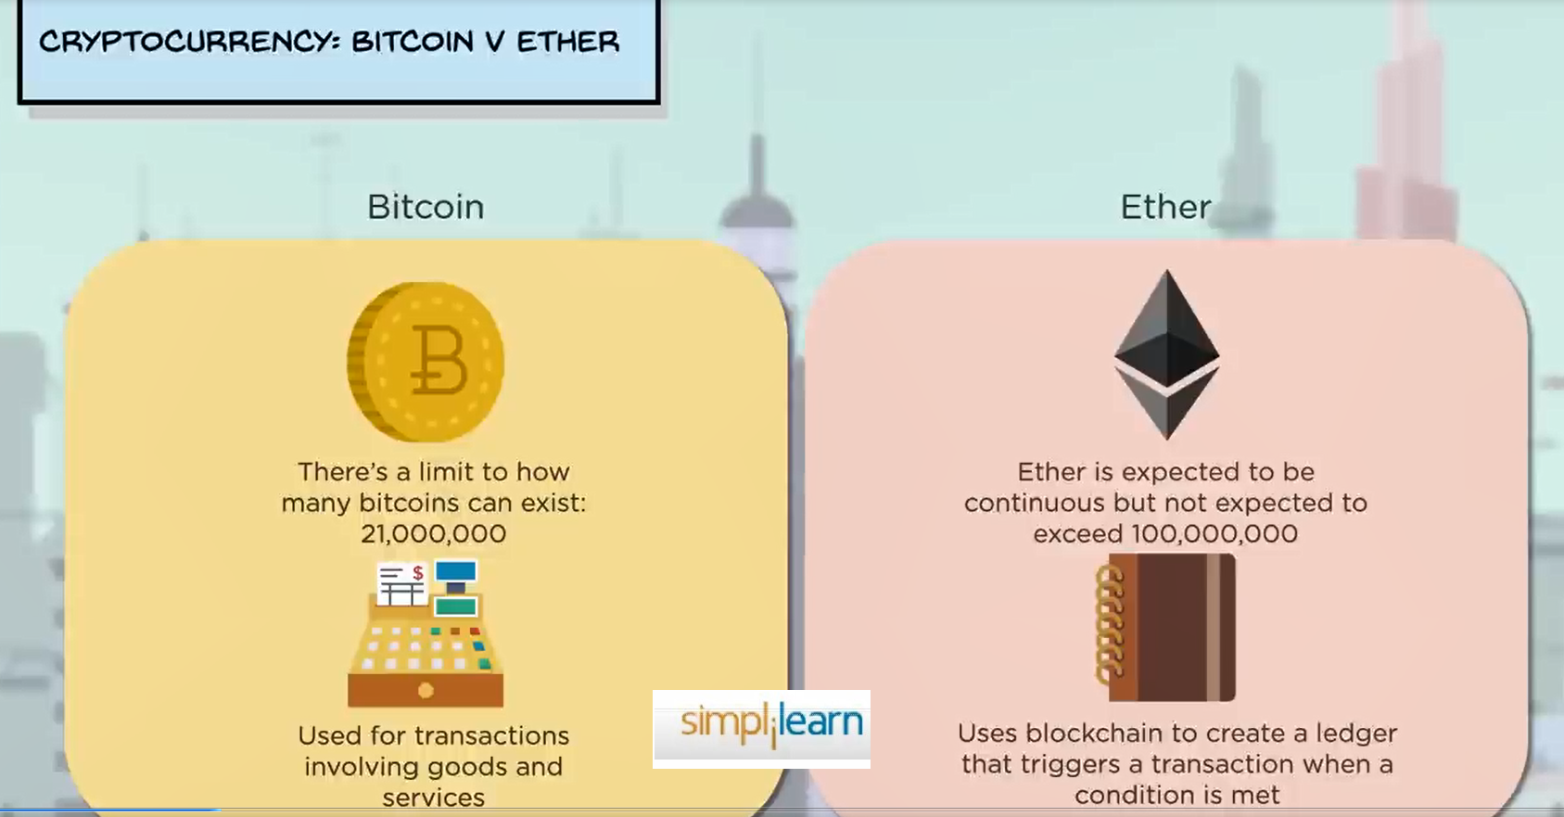

Slide 29
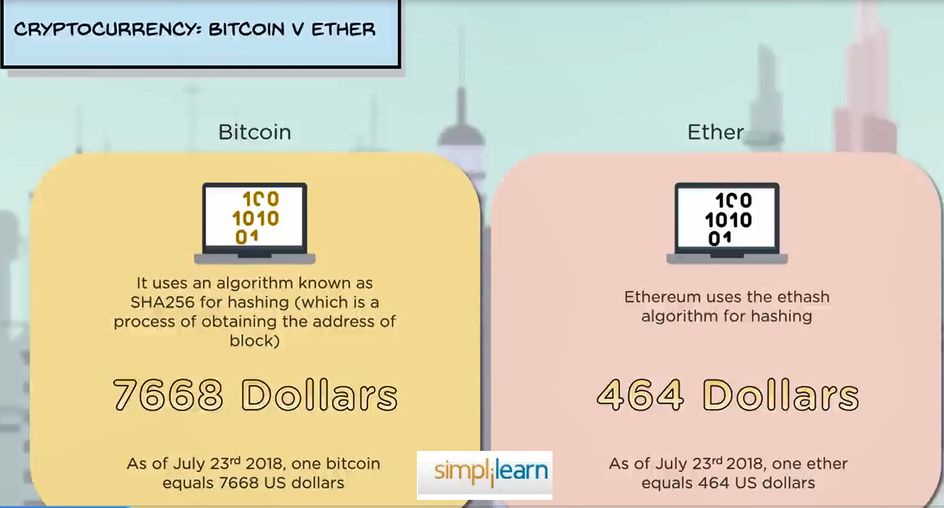

Slide 30


Slide 31
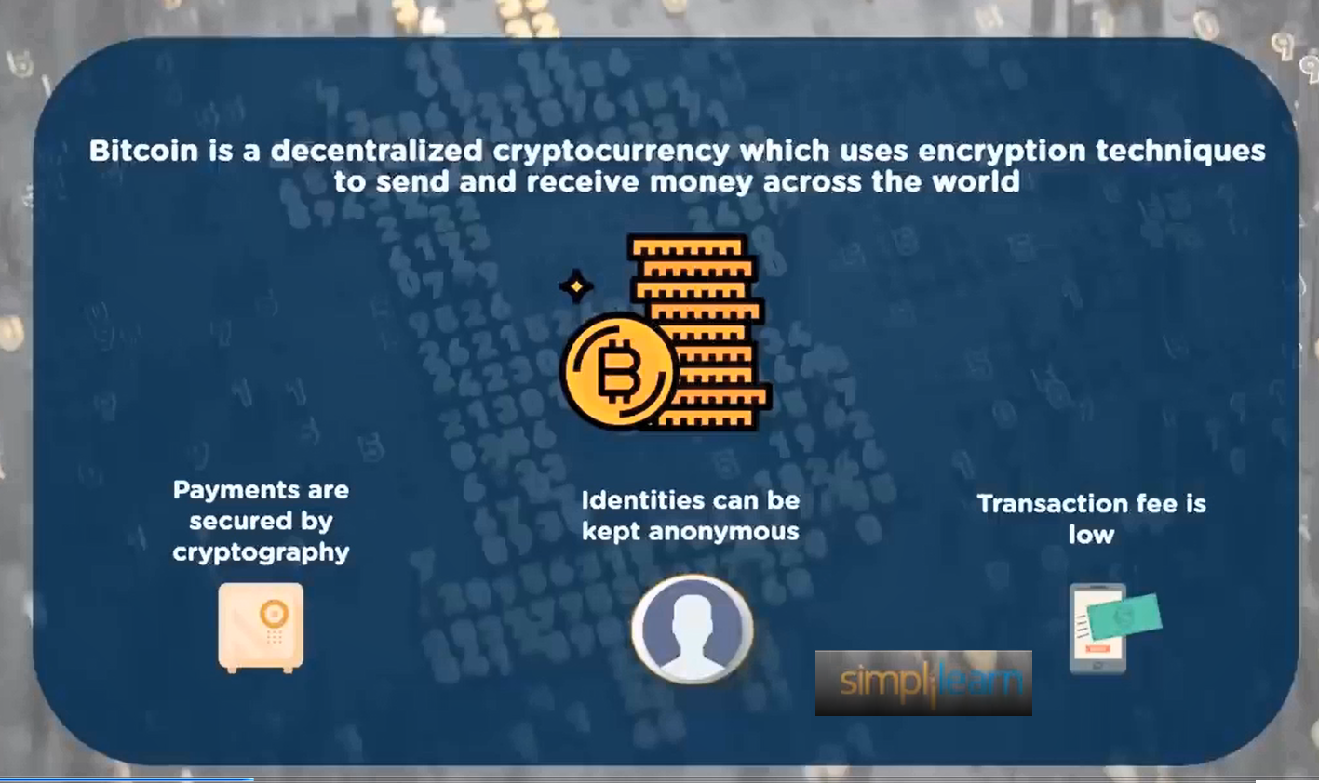

Slide 32
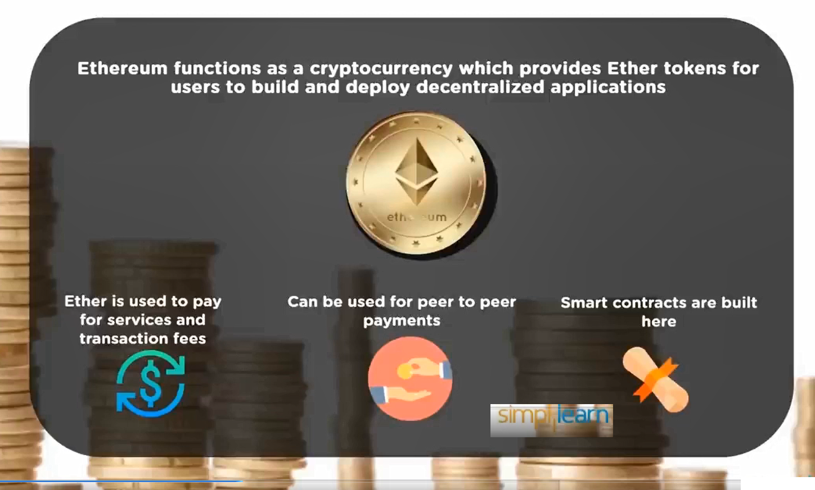

Slide 33
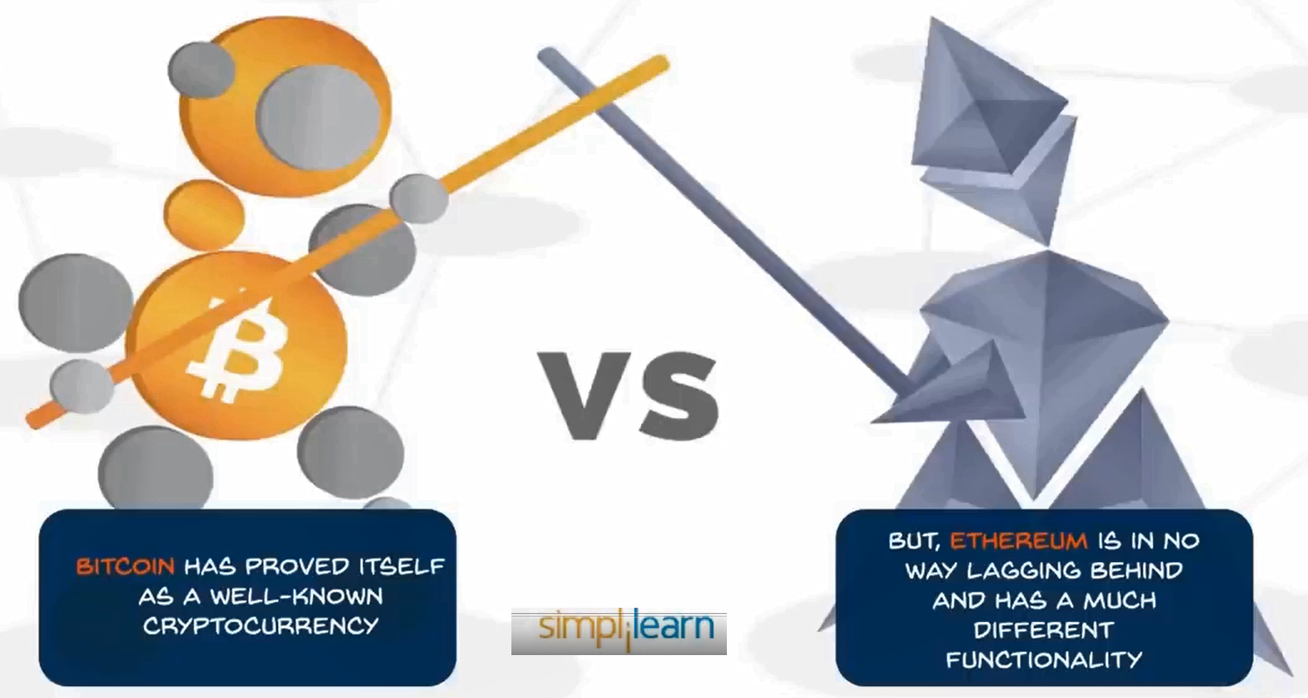

Slide 34
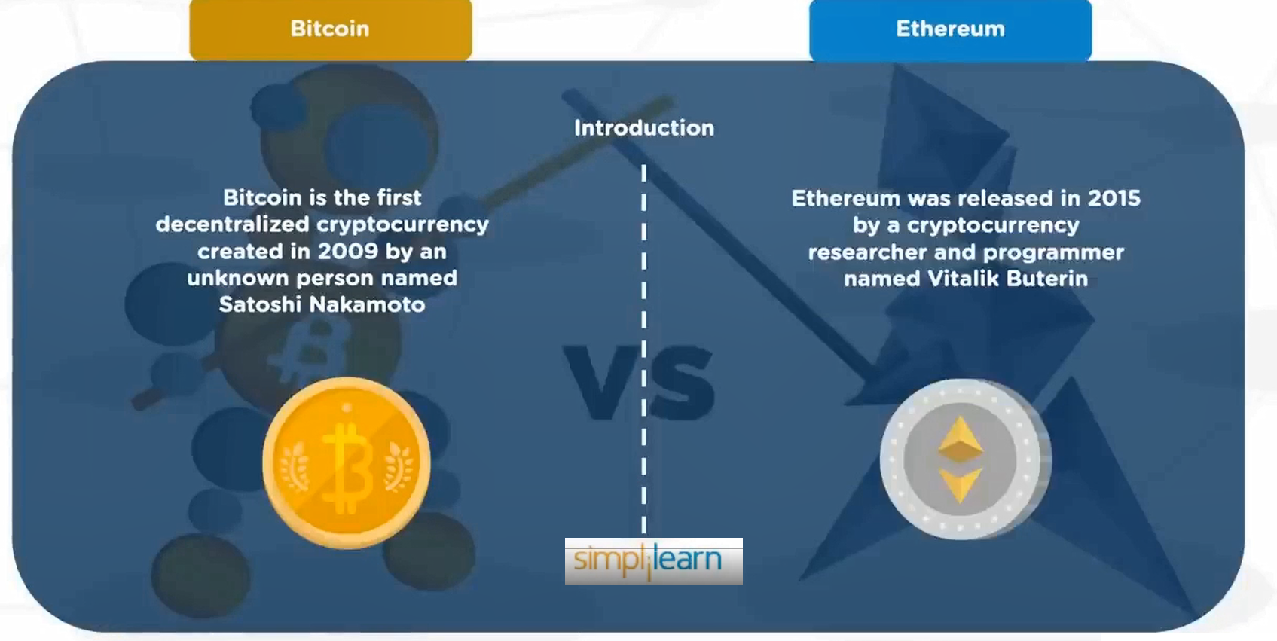

Slide 35
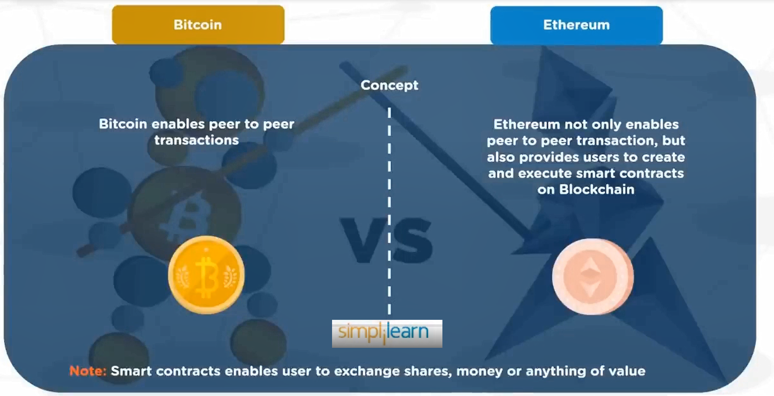

Slide 36
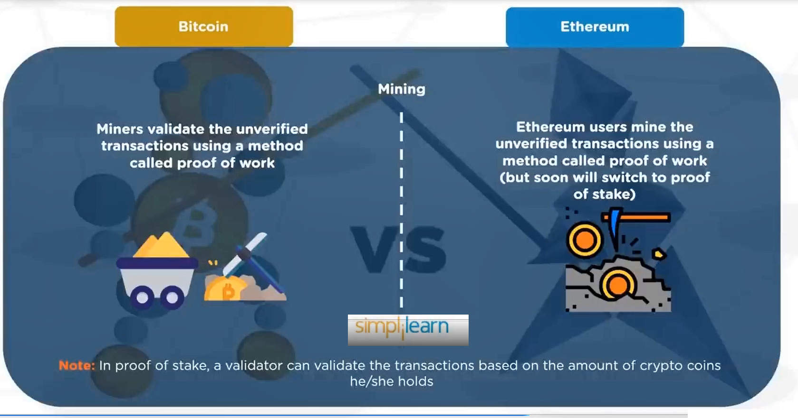

Slide 37
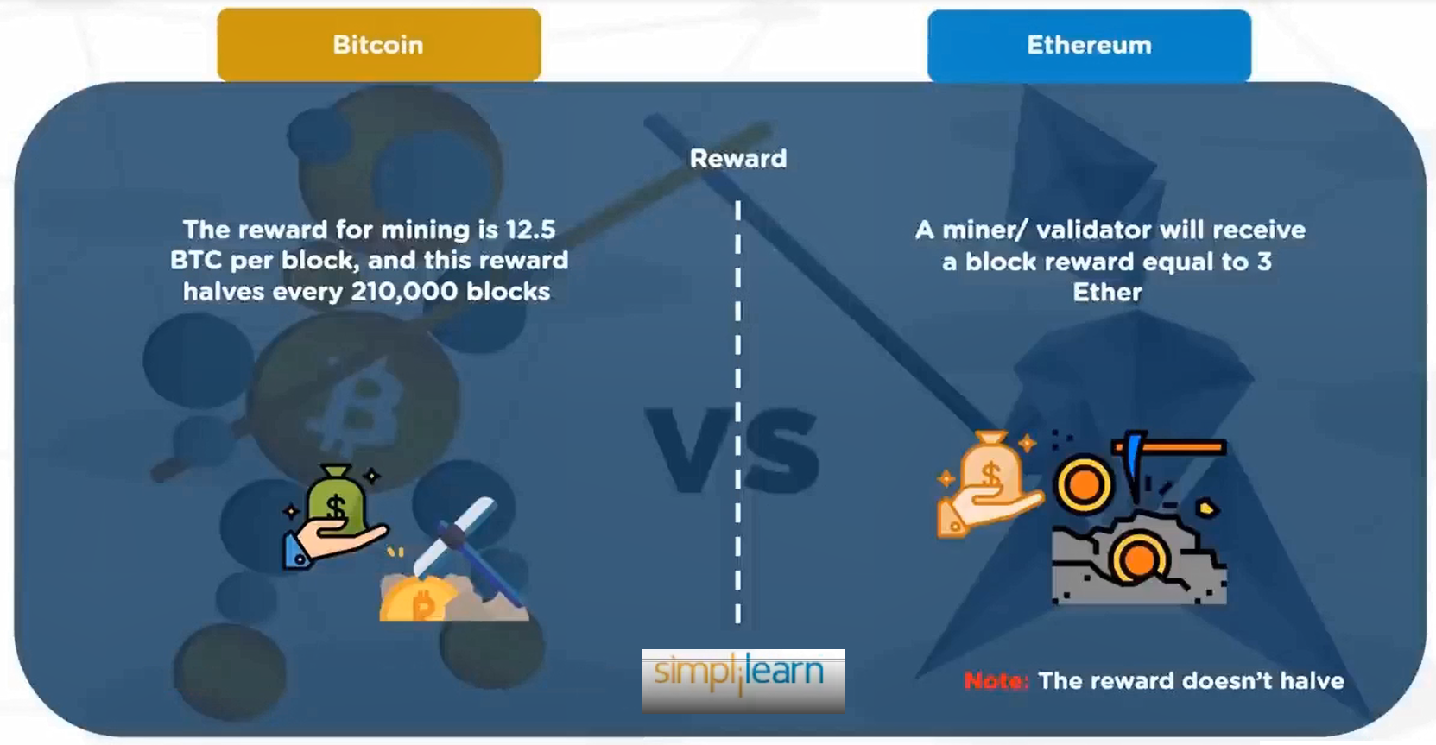

Slide 38
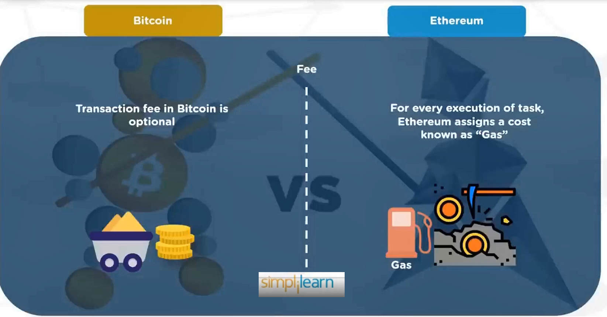

Slide 39
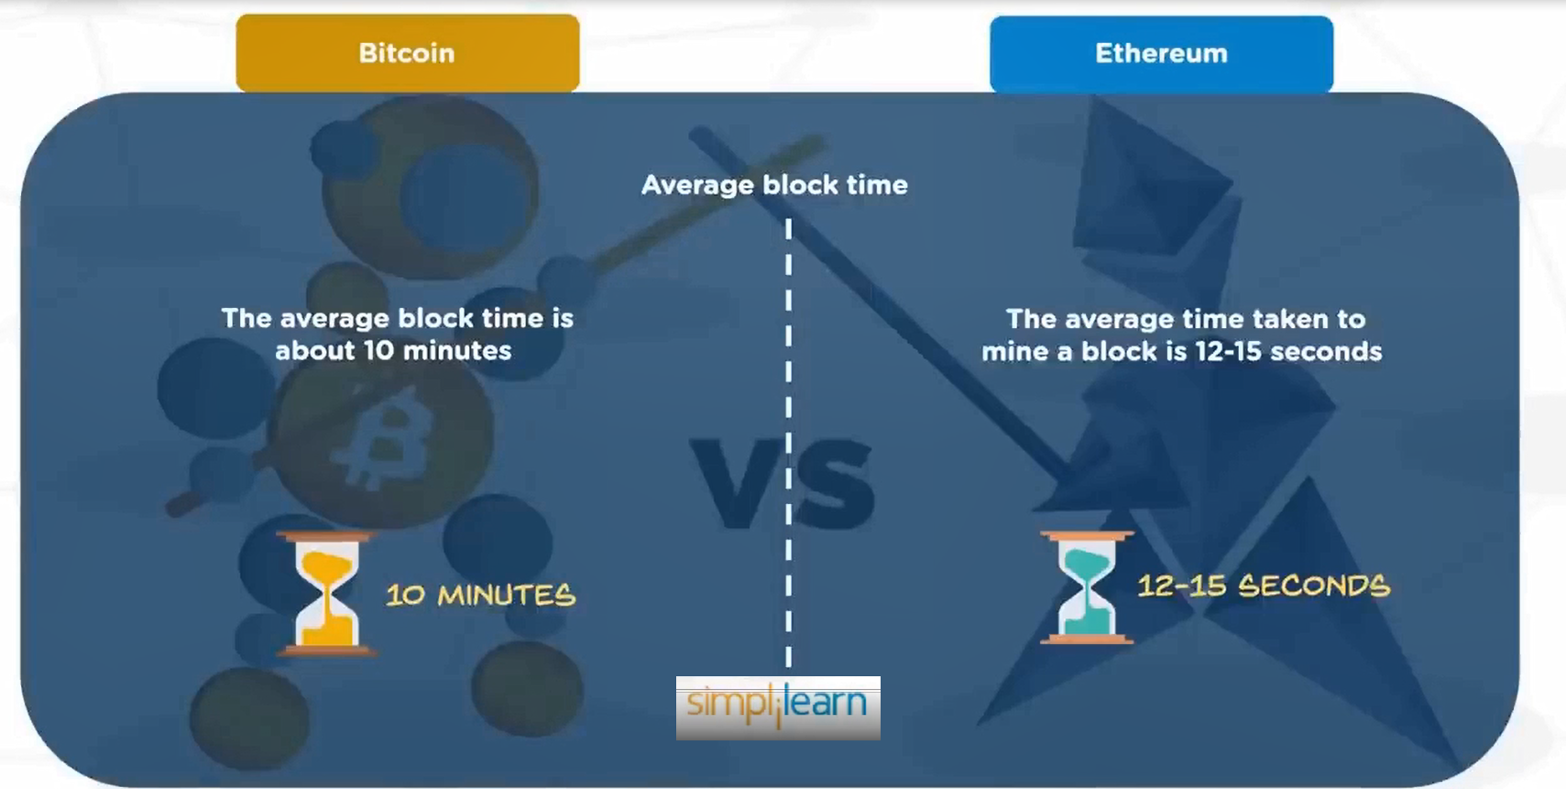

Slide 40
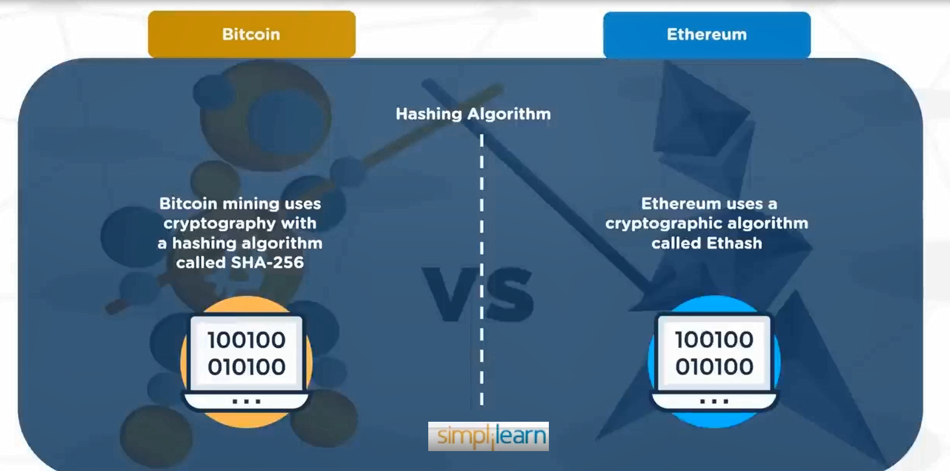

Slide 41
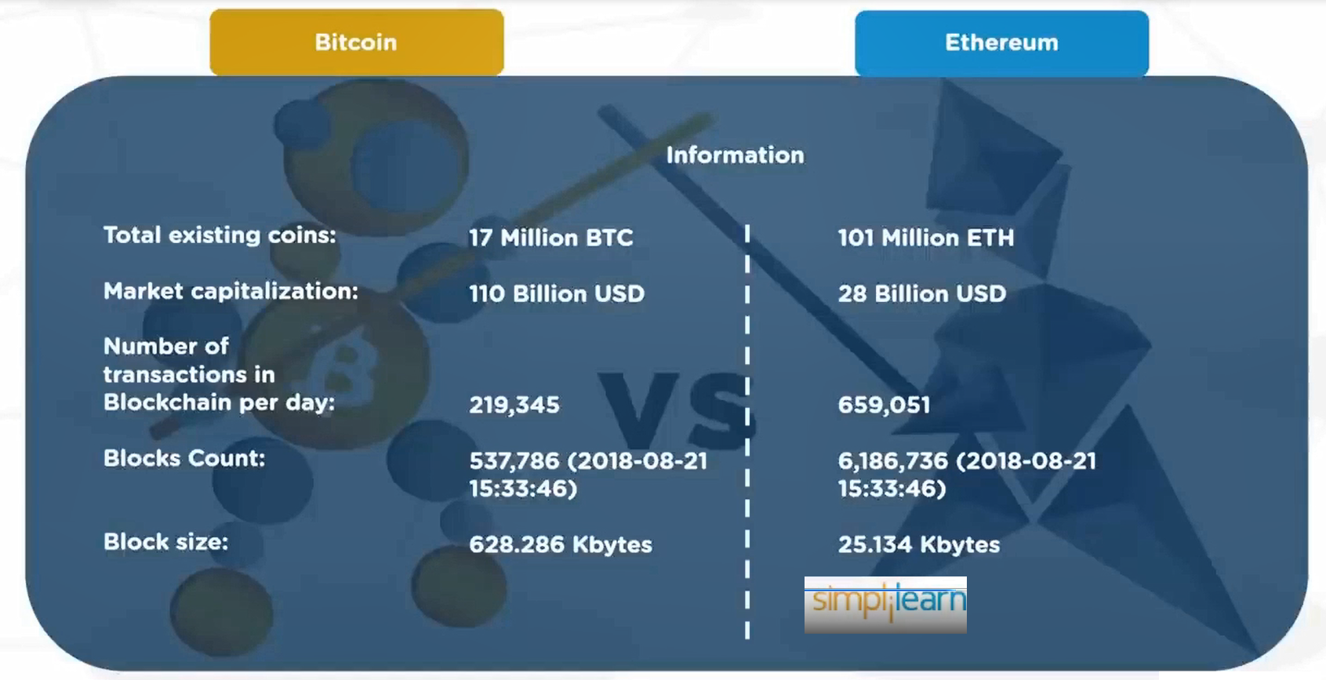

Slide 42
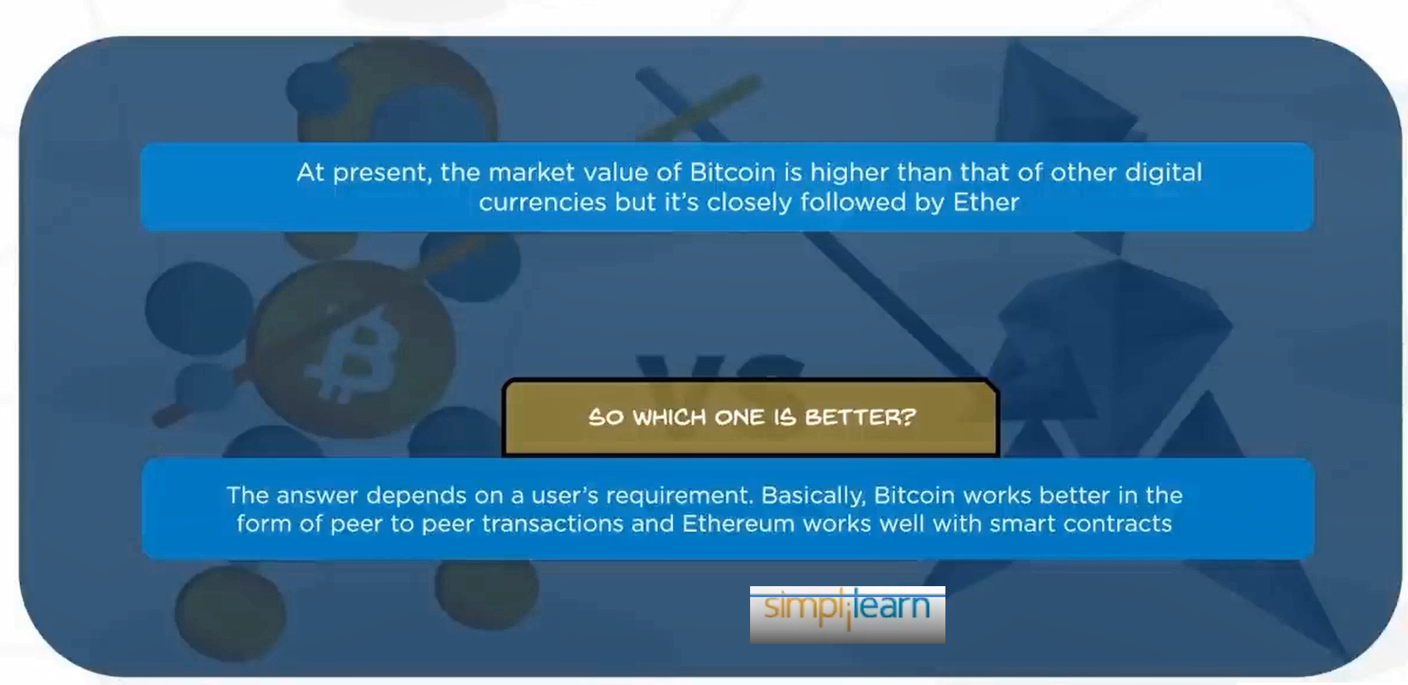

Slide 43
Conclusion
Bitcoin and Ethereum are both revolutionary in their own right, but they serve different purposes and are built on different philosophies.
Bitcoin is primarily a decentralized digital currency and store of value, while Ethereum is a flexible platform for decentralized applications and smart contracts.
Both networks have their strengths and weaknesses, and the choice between them depends on the specific needs and goals of the user.

