Slide 1
Cryptocurrency - Bitcoin

Slide 2
Introduction to Cryptocurrencies
  Definition: Cryptocurrencies are digital or virtual currencies that use cryptography for security and operate on decentralized networks, typically based on blockchain technology.
  Importance: Cryptocurrencies are reshaping the global financial landscape, offering an alternative to traditional financial systems by enabling borderless transactions, reducing transaction fees, and providing privacy.
  Examples: Bitcoin, Ethereum, and thousands of other cryptocurrencies are in circulation, with Bitcoin being the first and most widely recognized.

Slide 3
Introduction to Bitcoin
  Brief History: Bitcoin was introduced in 2009 by an anonymous entity known as Satoshi Nakamoto. It was designed as a decentralized currency to operate without a central authority, enabling peer-to-peer transactions directly between users.
  Blockchain Technology: Bitcoin operates on a public ledger known as the blockchain, which records all transactions across a network of computers.
  Decentralization: Unlike traditional currencies, Bitcoin is not controlled by any government or financial institution.

Slide 4
Understanding Bitcoins
Digital Currency: Bitcoins are purely digital, with no physical counterpart. They exist only as data on the blockchain.
Supply Cap: There will only ever be 21 million bitcoins, which creates scarcity and can influence its value.
Pseudonymous: Transactions are linked to addresses rather than personal identities, providing a level of privacy.
Divisibility: Bitcoin can be divided into smaller units, with the smallest being a satoshi (0.00000001 BTC).

Slide 5
The Purpose of Bitcoin
  Alternative to Fiat Currencies: Bitcoin offers an alternative to traditional currencies, particularly in countries with unstable financial systems.
  Decentralized Transactions: Bitcoin transactions don’t require intermediaries like banks, making transfers faster and cheaper, especially across borders.
  Financial Sovereignty: Users have full control over their funds, without reliance on central authorities.
  Inflation Resistance: Bitcoin's capped supply provides a hedge against inflation, unlike fiat currencies which can be printed in unlimited quantities.

Slide 6
How Bitcoin Operates
  Blockchain: Bitcoin transactions are recorded on a distributed ledger called the blockchain. Each block contains a list of transactions, and once added, it cannot be altered.
  Mining: Miners validate transactions by solving complex mathematical problems, adding new blocks to the blockchain, and are rewarded with newly created bitcoins (block rewards).
  Proof of Work (PoW): Bitcoin uses PoW as its consensus mechanism, ensuring network security by requiring computational effort to create new blocks.
  Public and Private Keys: Bitcoin ownership is secured using cryptographic keys. The public key is like an address that others can send bitcoins to, while the private key allows the owner to spend those bitcoins.

Slide 7
The Bitcoin Ecosystem
  Miners: Individuals or entities who validate transactions and secure the network by adding blocks to the blockchain.
  Nodes: Computers that maintain copies of the blockchain and validate new transactions according to Bitcoin’s rules.
  Exchanges: Platforms where users can buy, sell, or trade bitcoins for other currencies or assets.
  Wallets: Software or hardware that stores private keys, enabling users to manage their bitcoins securely.
  Developers: The community of programmers who contribute to the Bitcoin codebase, improving and maintaining the network.
  Regulators: Government bodies that create laws and regulations impacting the use and trading of Bitcoin.

Slide 8
Practical Applications of Bitcoin
  Remittances: Bitcoin is used to send money across borders quickly and at a lower cost compared to traditional remittance services.
  Investment: Many people buy bitcoins as a store of value, often referred to as "digital gold," due to its limited supply.
  Payments: Increasingly accepted by merchants worldwide, Bitcoin allows for direct purchases of goods and services.
  Decentralized Finance (DeFi): Bitcoin plays a foundational role in the emerging DeFi space, providing decentralized lending, borrowing, and trading opportunities.
  Microtransactions: Bitcoin’s divisibility enables microtransactions, which are especially useful in online tipping and pay-per-use services.

Slide 9
Precursors to Bitcoin
  DigiCash: An early form of digital currency created in the 1990s by David Chaum, which laid the groundwork for digital payments.
  B-Money: Proposed by Wei Dai, B-Money was an early idea for a decentralized digital currency that introduced concepts like proof of work.
  Bit Gold: Developed by Nick Szabo, Bit Gold was a precursor to Bitcoin that proposed a decentralized digital currency with proof-of-work elements.

Slide 10
The Early Days of Bitcoin
  Genesis Block: The first block of the Bitcoin blockchain, mined by Satoshi Nakamoto on January 3, 2009.
  Early Adoption: Initially used by cryptography enthusiasts, Bitcoin gained attention on forums and in early transactions like the famous 10,000 BTC pizza purchase in 2010.
  Mt. Gox Exchange: One of the first Bitcoin exchanges, which became infamous after a massive hack in 2014.

Slide 11
The Evolution of Bitcoin’s Price
  Volatility: Bitcoin’s price has been highly volatile, with significant price swings since its inception.
  Bull and Bear Markets: Notable periods of rapid price increases (bull markets) followed by corrections (bear markets).
  Influencing Factors: Adoption rates, regulatory news, technological developments, and macroeconomic factors influence Bitcoin’s price.

Slide 12
How to Store Bitcoins
  Private Keys: The essential element for accessing and spending bitcoins. Private keys must be stored securely.
  Software Wallets: Applications that store private keys on your computer or mobile device, often with backup and recovery features.
  Hardware Wallets: Physical devices that store private keys offline, providing enhanced security against hacks and malware.

Slide 13
Acquiring and Disposing of Bitcoins
  Exchanges: Online platforms where users can buy and sell bitcoins using fiat currencies or other cryptocurrencies. Examples include Coinbase, Binance, and Kraken.
  Over the Counter (OTC) Brokers: Services that facilitate large-volume trades of bitcoins without affecting the market price, often used by institutional investors.
  LocalBitcoins: A peer-to-peer platform that allows users to buy and sell bitcoins directly with others in their local area, often using cash.

Slide 14
The Mystery of Satoshi Nakamoto
  Pseudonymous Creator: Satoshi Nakamoto is the name used by the unknown person or group who created Bitcoin. Their identity remains one of the biggest mysteries in the crypto world.
  Contributions: Nakamoto authored the Bitcoin whitepaper, developed the initial Bitcoin software, and mined the first bitcoins.
  Disappearance: Nakamoto gradually withdrew from the project in 2010, leaving the development of Bitcoin to the community.

Slide 15
Bitcoin Mining Process
The mining process involves several key steps:
Transaction Collection: Miners collect transactions from the network and organize them into a candidate block. These transactions are typically those that include higher transaction fees, as miners are incentivized to prioritize these transactions.
Hash Calculation: Miners then begin the process of finding a valid hash for the block. A hash is a fixed-length string of characters generated from the block's data using a cryptographic function. The goal is to find a hash that is less than a target value set by the network, which requires finding the correct nonce—a random number added to the block's data.

Slide 16
Bitcoin Mining Process
The mining process involves several key steps:
Proof-of-Work: This step involves intense computational work, as miners try different nonces until they find a valid hash. This process is known as proof-of-work because it demonstrates that the miner has invested significant computational effort.
Block Addition: Once a valid hash is found, the block is added to the blockchain, and the miner is rewarded with new bitcoins and transaction fees. The process then starts over with a new block.

Slide 17
The Economics of Mining
Mining is a competitive and resource-intensive process. As more miners join the network, the difficulty of solving the puzzles increases, requiring more computational power and electricity.
This has led to the development of specialized mining hardware, known as Application-Specific Integrated Circuits (ASICs), which are designed specifically for Bitcoin mining.
The reward for mining a block is halved approximately every four years in an event known as the "halving." This reduces the rate at which new bitcoins are created and contributes to Bitcoin's deflationary nature. Initially, the reward was 50 bitcoins per block; as of 2024, it is 6.25 bitcoins per block.
The increasing difficulty and decreasing rewards mean that mining is no longer profitable for individual miners using standard hardware. Today, mining is typically conducted by large mining farms or pools, where miners combine their computational resources to increase their chances of solving a block and sharing the rewards.

Slide 18
Bitcoin Mining – Environmental Concerns
Bitcoin mining has attracted criticism for its environmental impact due to the large amount of electricity required to power the mining hardware.
This energy consumption has raised concerns about the sustainability of Bitcoin, especially as the network grows.
However, some argue that mining operations are increasingly being powered by renewable energy sources, and efforts are underway to make the process more energy-efficient.

Slide 19
The Proof-of-Work Consensus Mechanism
Proof-of-work (PoW) is the consensus algorithm used by the Bitcoin network to validate transactions and secure the blockchain.
It is a form of cryptographic proof in which one party (the miner) proves to others that a certain amount of computational effort has been expended. This process is fundamental to the security and decentralization of the Bitcoin network.
In the PoW system, miners compete to solve a mathematical puzzle that requires significant computational power.
The first miner to solve the puzzle broadcasts their solution to the network, and if the solution is valid, the miner is allowed to add a new block to the blockchain.
This process ensures that the network reaches consensus on the state of the blockchain, with the longest chain being considered the valid one.

Slide 20
The Role of PoW in Security
PoW plays a crucial role in securing the Bitcoin network. By requiring miners to expend significant computational effort, PoW makes it prohibitively expensive for any single entity to alter the blockchain.
To change a transaction, an attacker would need to redo the PoW for that block and all subsequent blocks, which would require an immense amount of computational power and is therefore practically impossible.
This security feature makes Bitcoin resistant to double-spending attacks and other forms of fraud, as any attempt to alter the blockchain would be immediately apparent and rejected by the network.

Slide 21
Criticisms of PoW
Energy Consumption: PoW requires a vast amount of energy, leading to concerns about its environmental impact. The energy consumption of the Bitcoin network has been compared to that of entire countries, prompting debates about the sustainability of the system.
Centralization of Mining: As mining becomes more resource-intensive, it has become increasingly centralized, with a few large mining pools controlling the majority of the network's hash power. This concentration of power contradicts the decentralized ethos of Bitcoin and raises concerns about the potential for collusion or attacks by these pools.
Scalability Issues: PoW limits the speed at which new blocks can be added to the blockchain, which in turn limits the number of transactions that the network can process. This scalability issue has led to high transaction fees and long confirmation times during periods of high demand.

Slide 22
Alternatives to PoW
In response to the criticisms of PoW, alternative consensus mechanisms have been proposed, such as Proof-of-Stake (PoS), which requires validators to hold a certain amount of cryptocurrency as collateral rather than expending computational power.
However, PoS and other alternatives have their own trade-offs and challenges, and PoW remains the most widely used and proven method for securing decentralized networks.

Slide 23
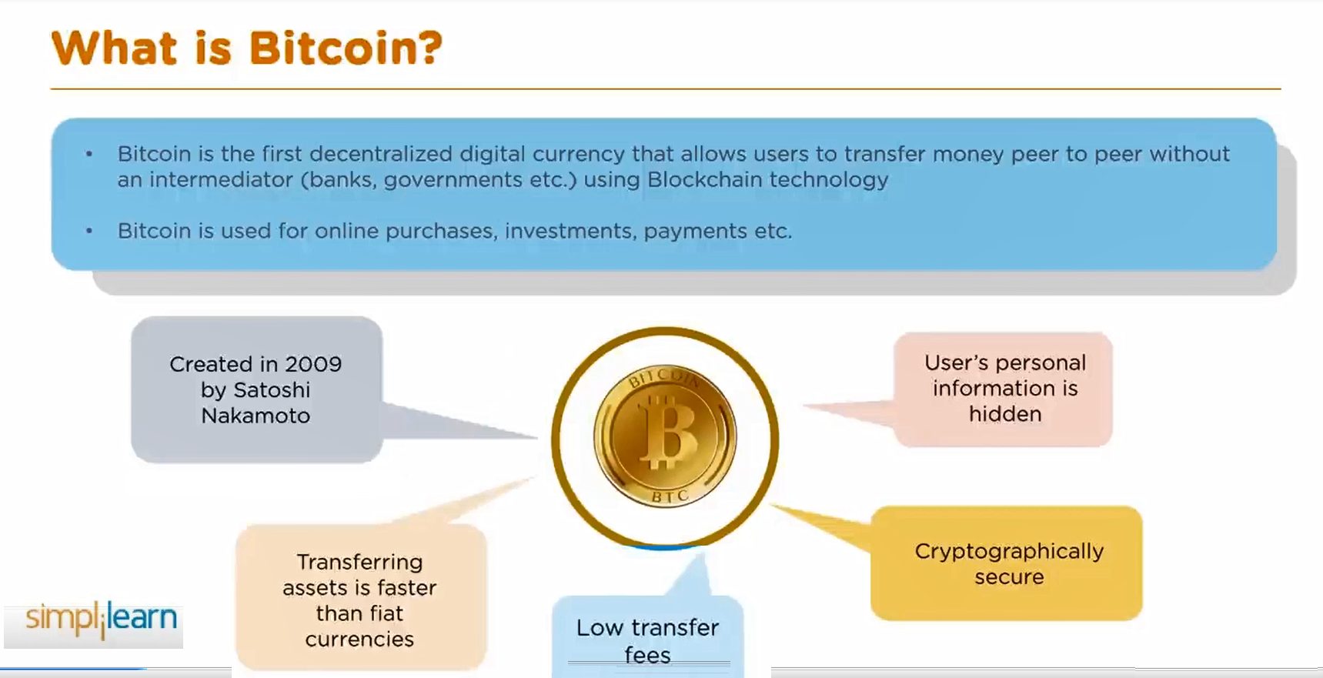
Bitcoin Mining

Slide 24
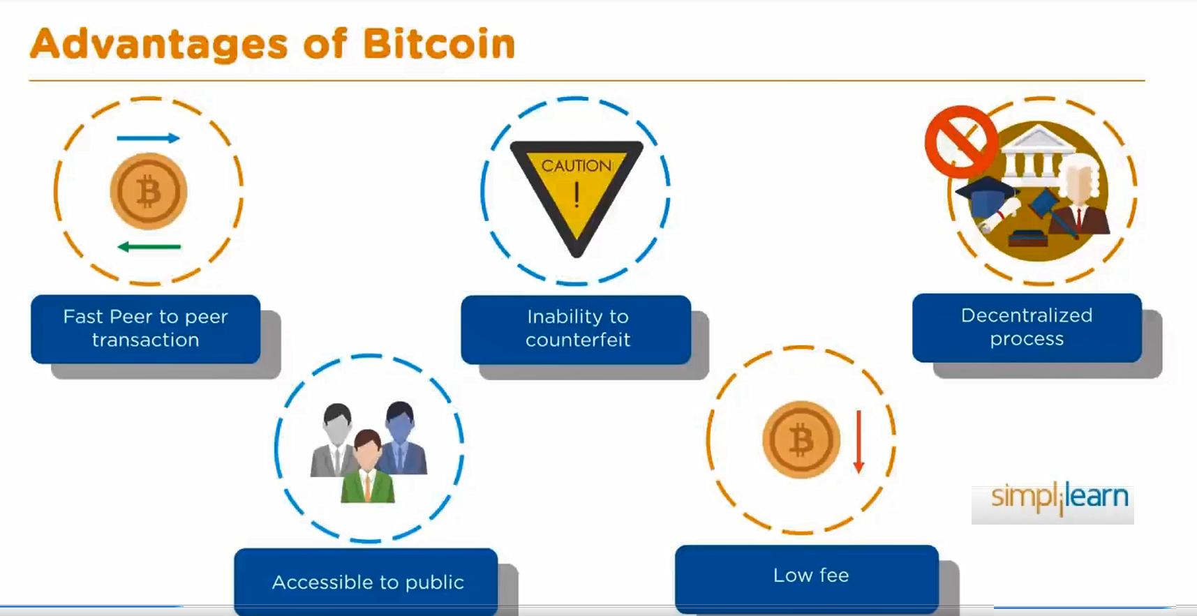
Bitcoin Mining

Slide 25
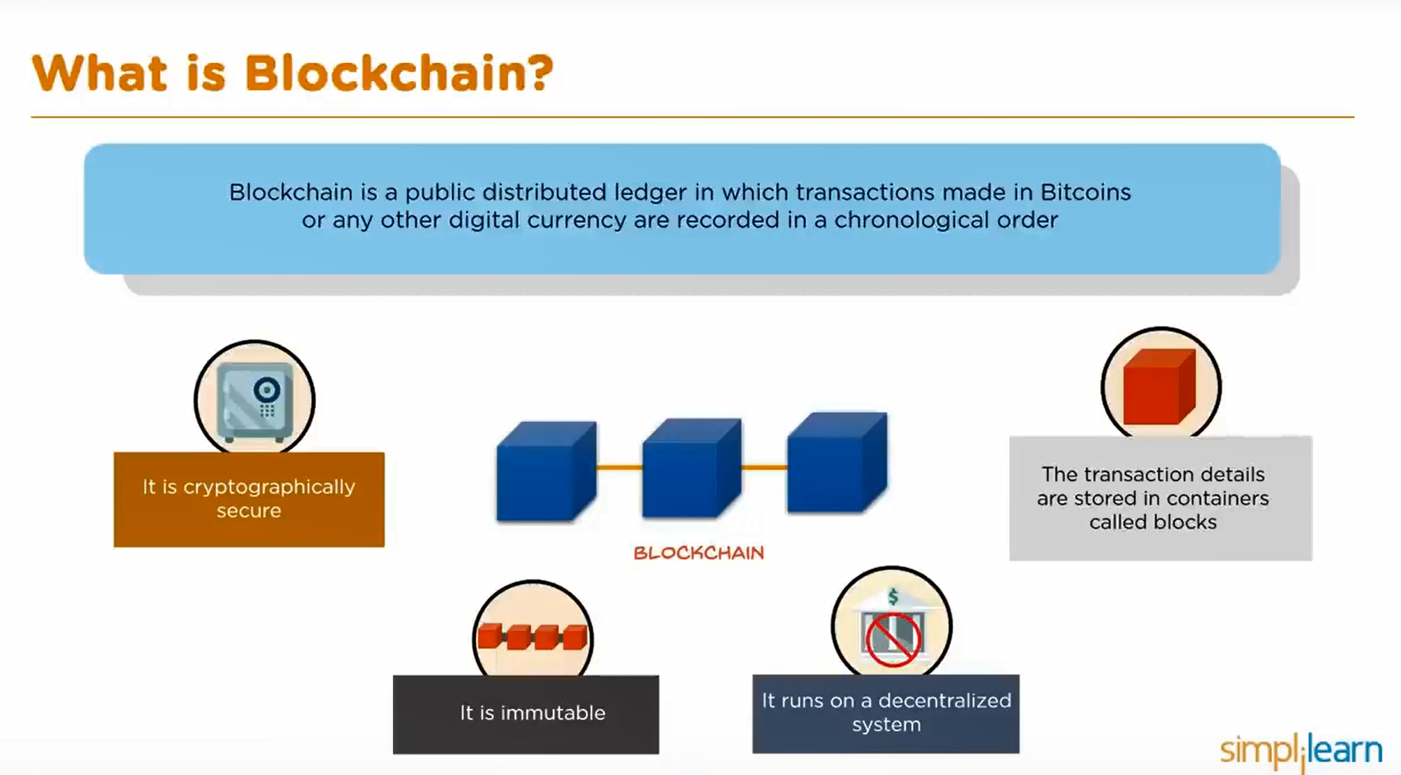
Bitcoin Mining

Slide 26
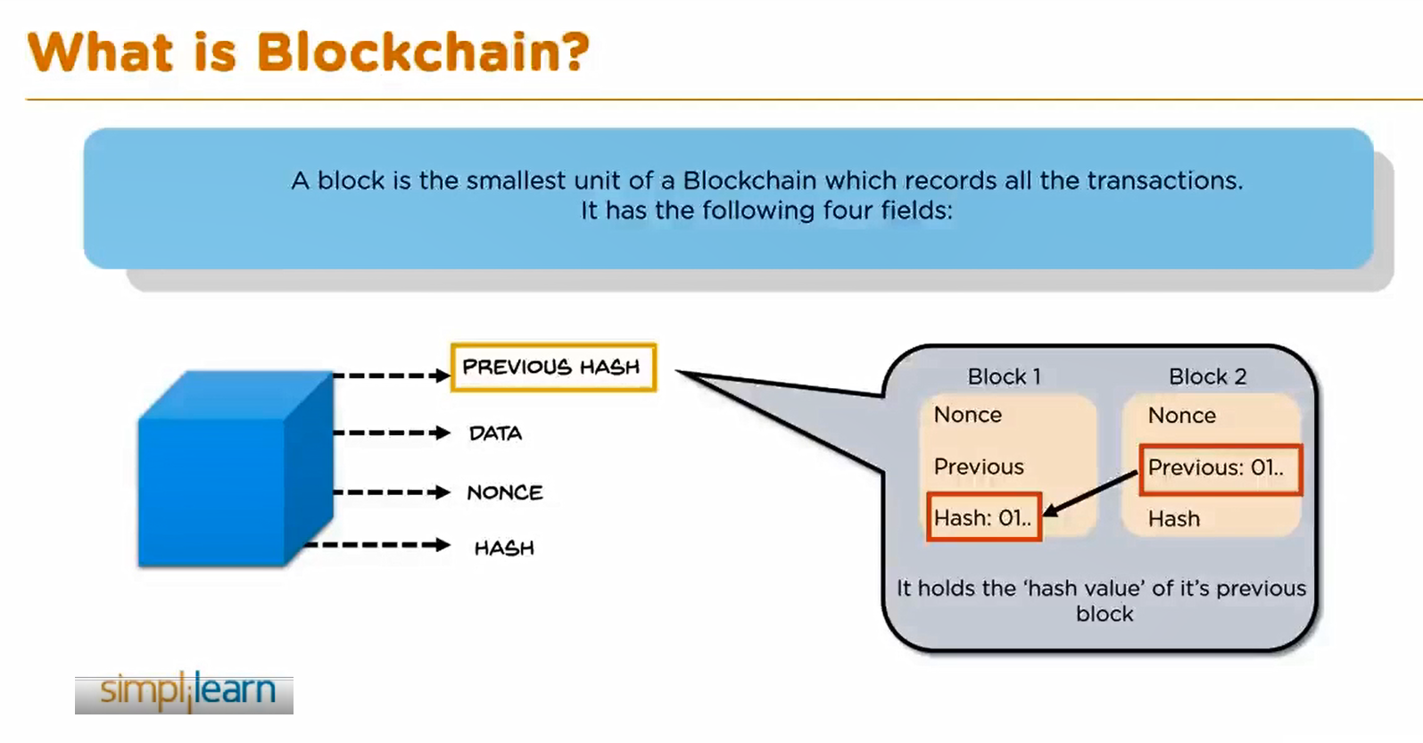
Bitcoin Mining

Slide 27
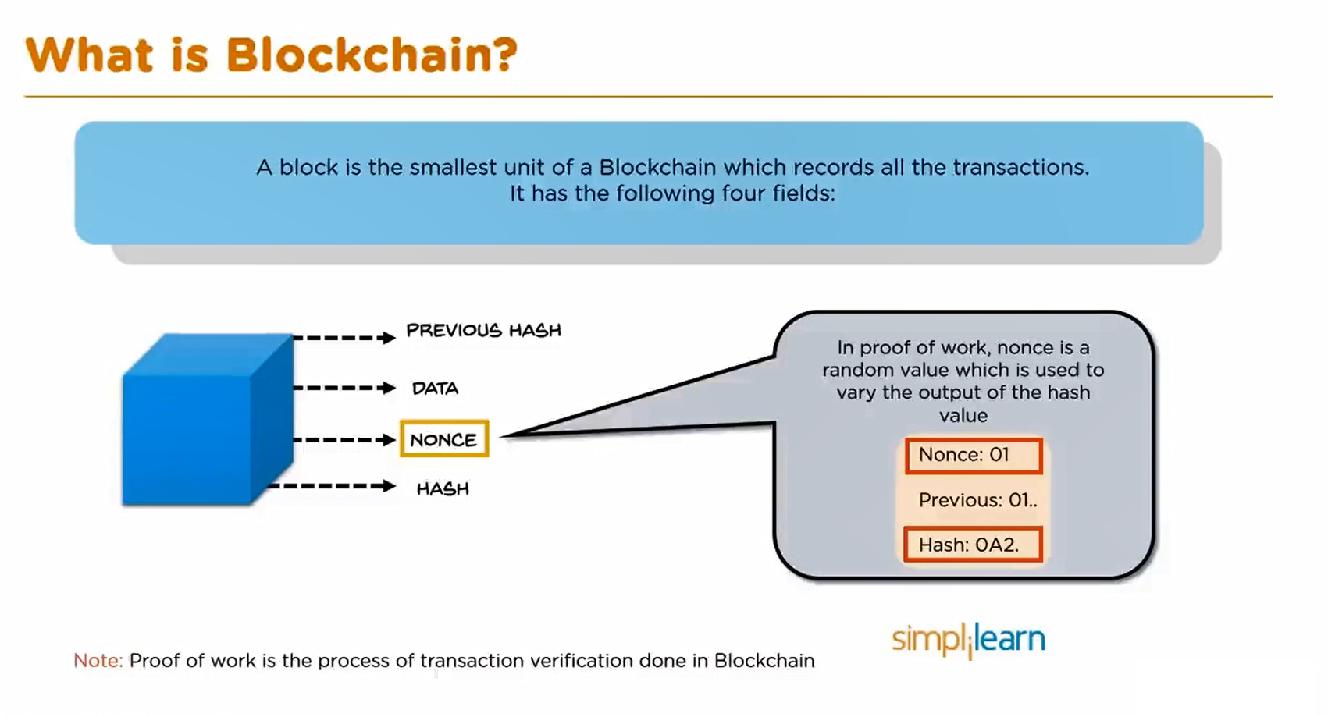
Bitcoin Mining

Slide 28
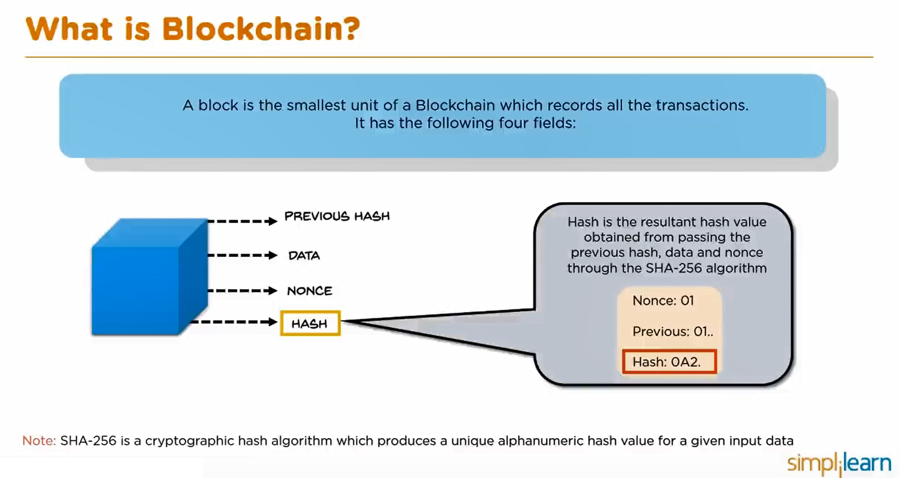
Bitcoin Mining

Slide 29
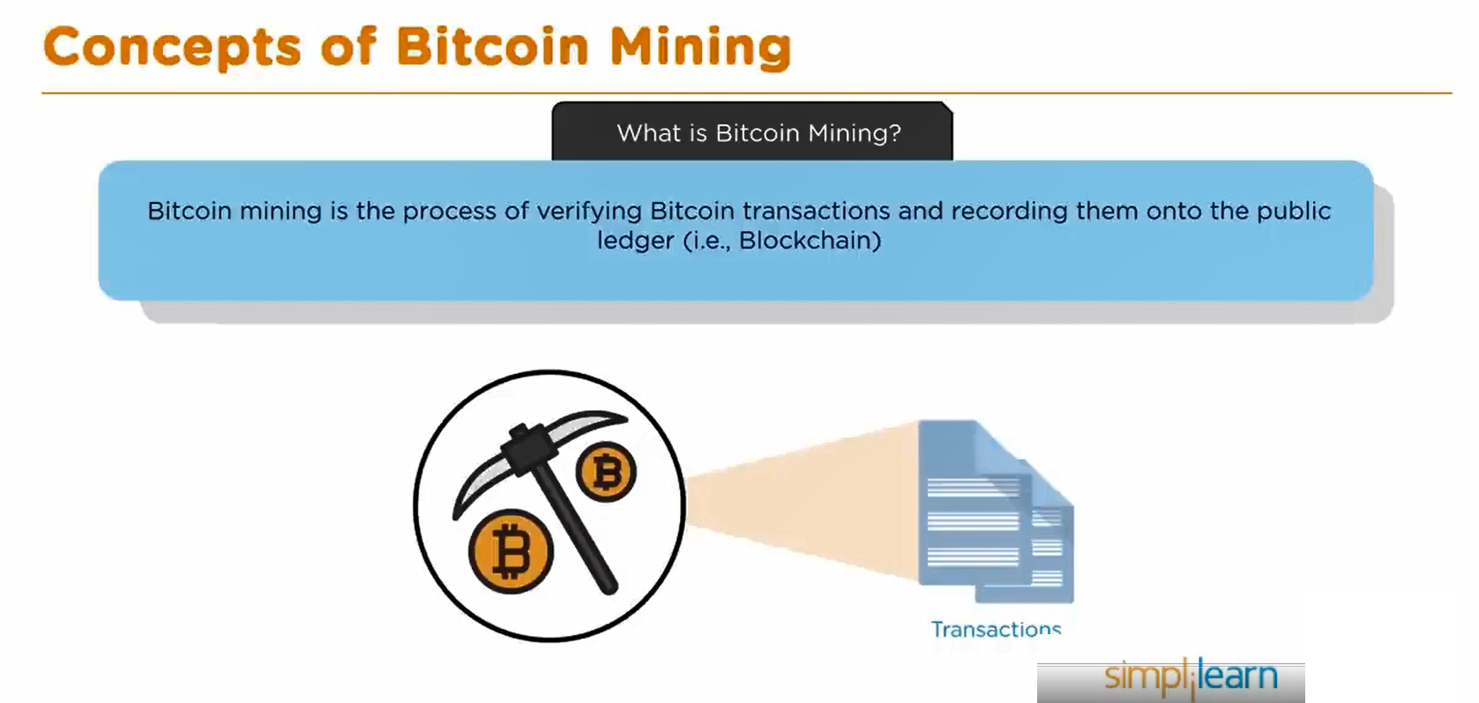
Bitcoin Mining

Slide 30
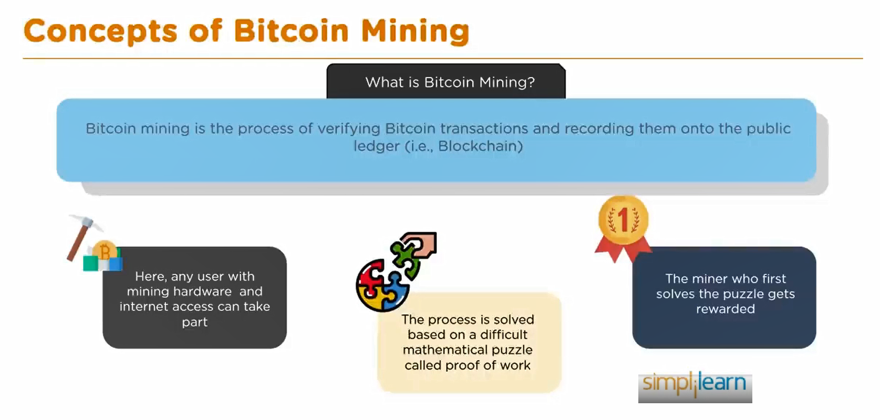
Bitcoin Mining

Slide 31
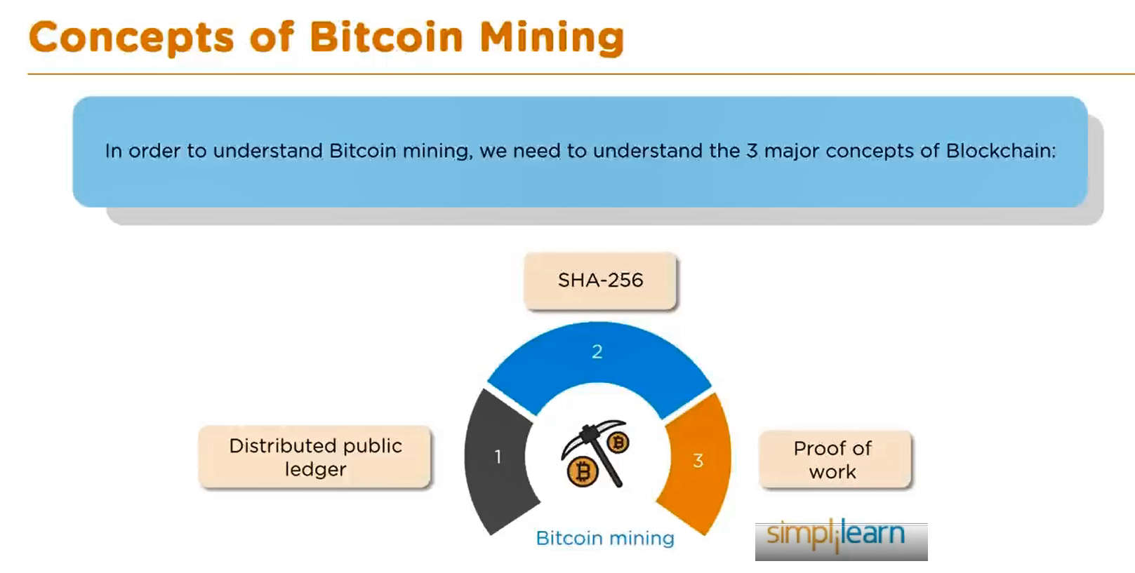
Bitcoin Mining

Slide 32
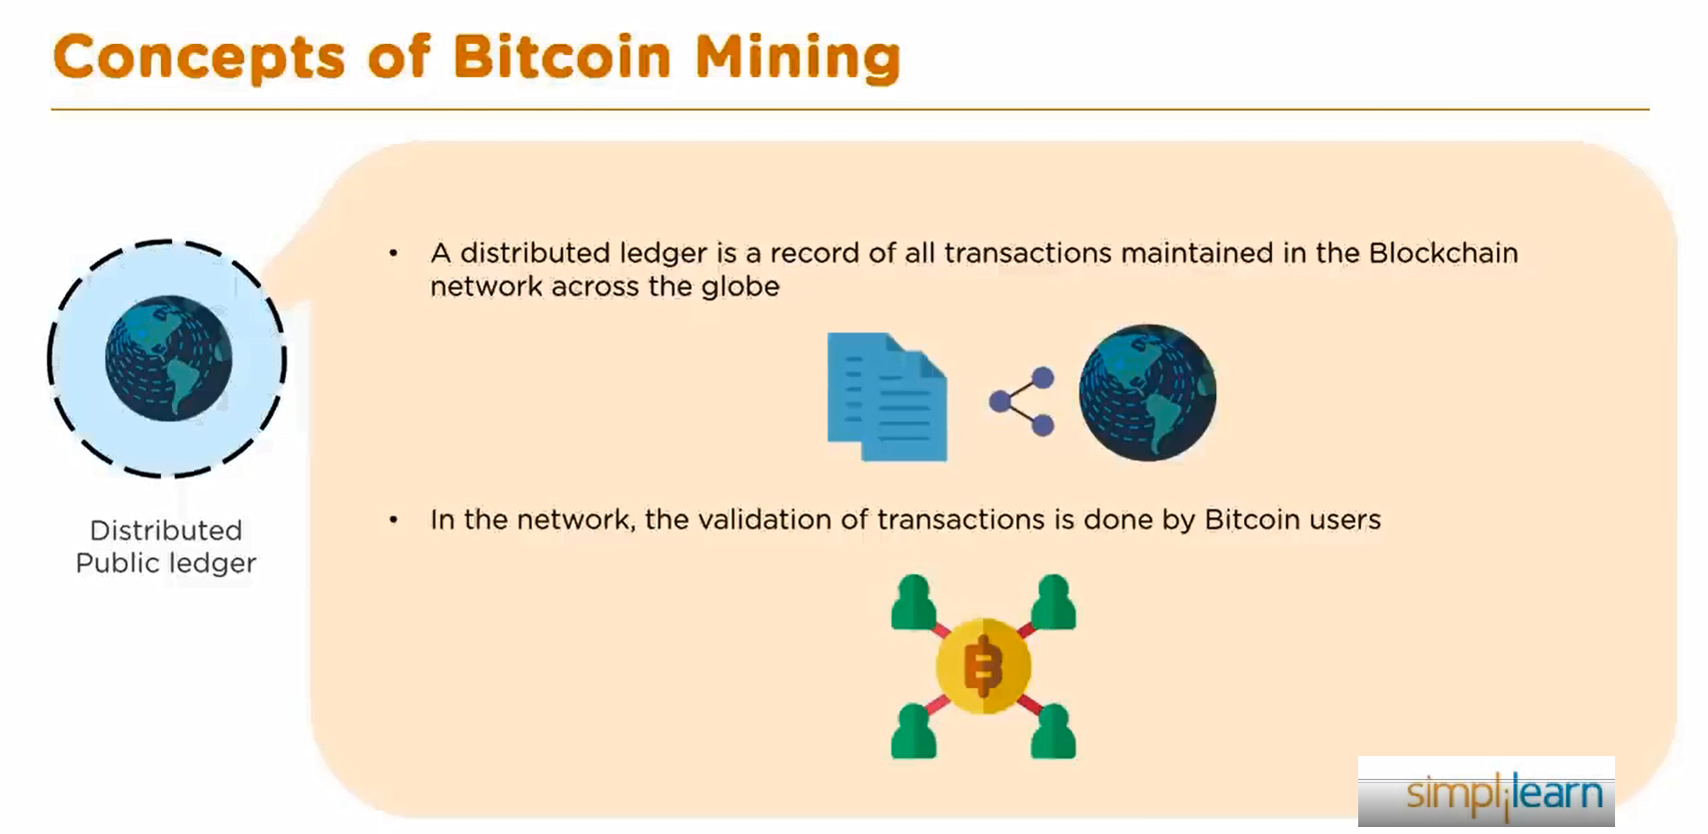
Bitcoin Mining

Slide 33
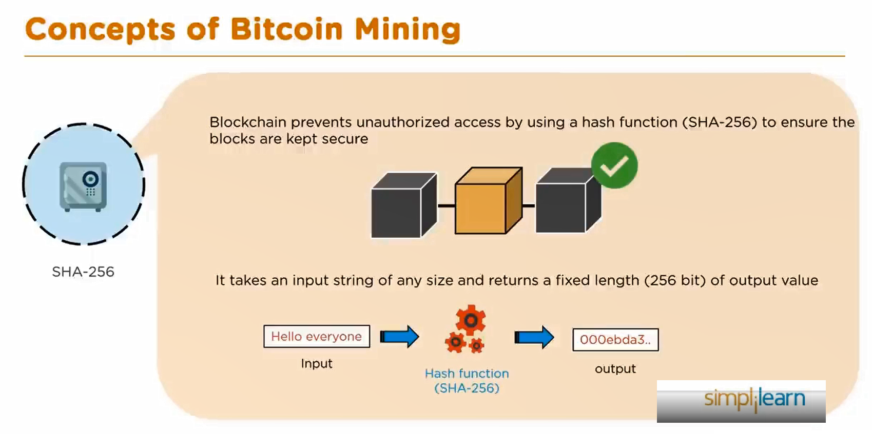
Bitcoin Mining

Slide 34
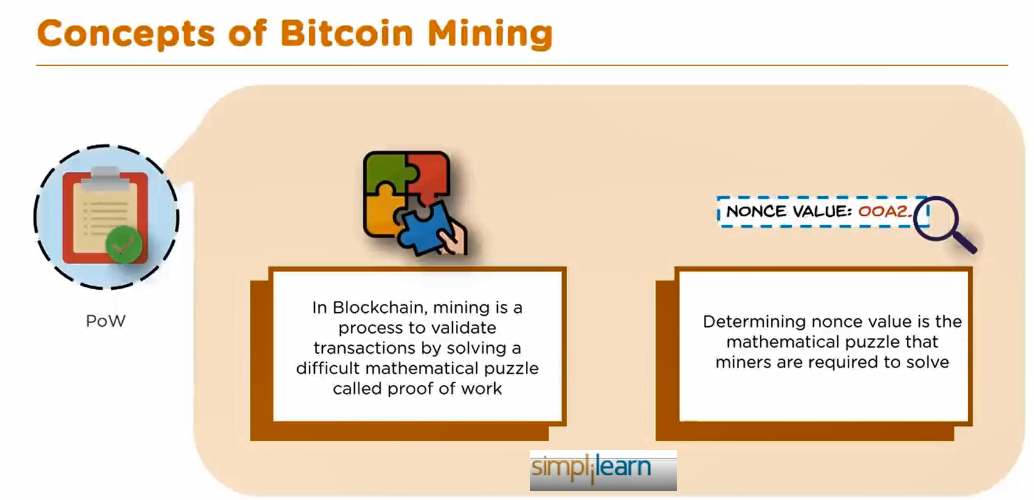
Bitcoin Mining

Slide 35
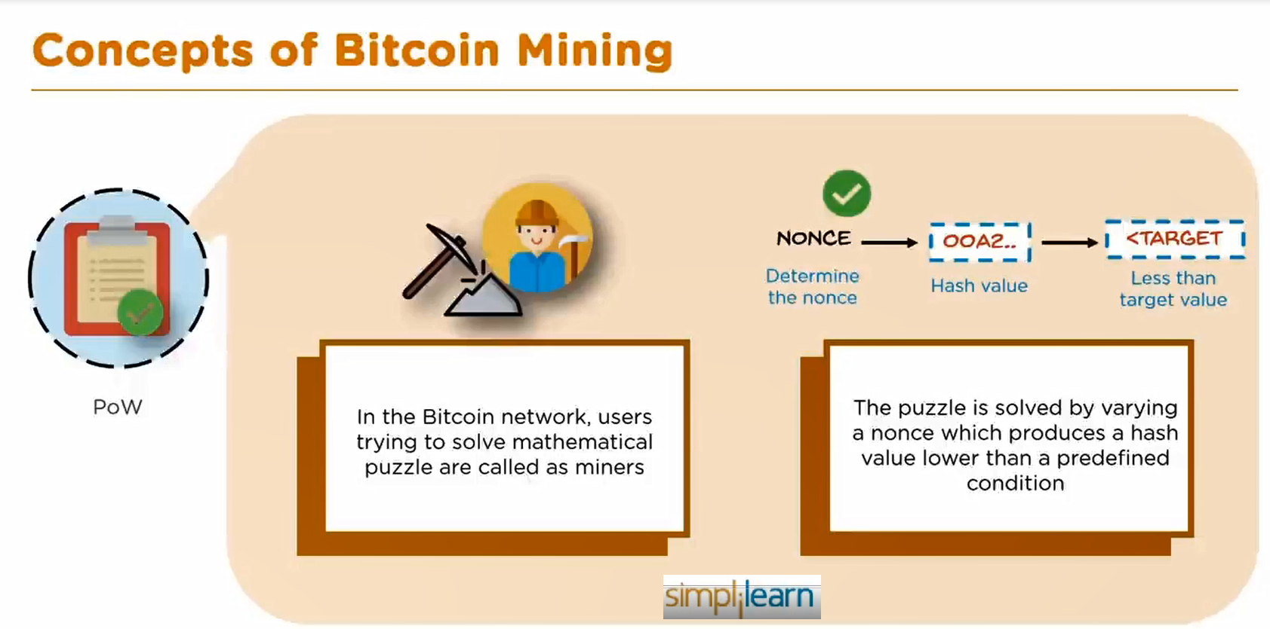
Bitcoin Mining

Slide 36
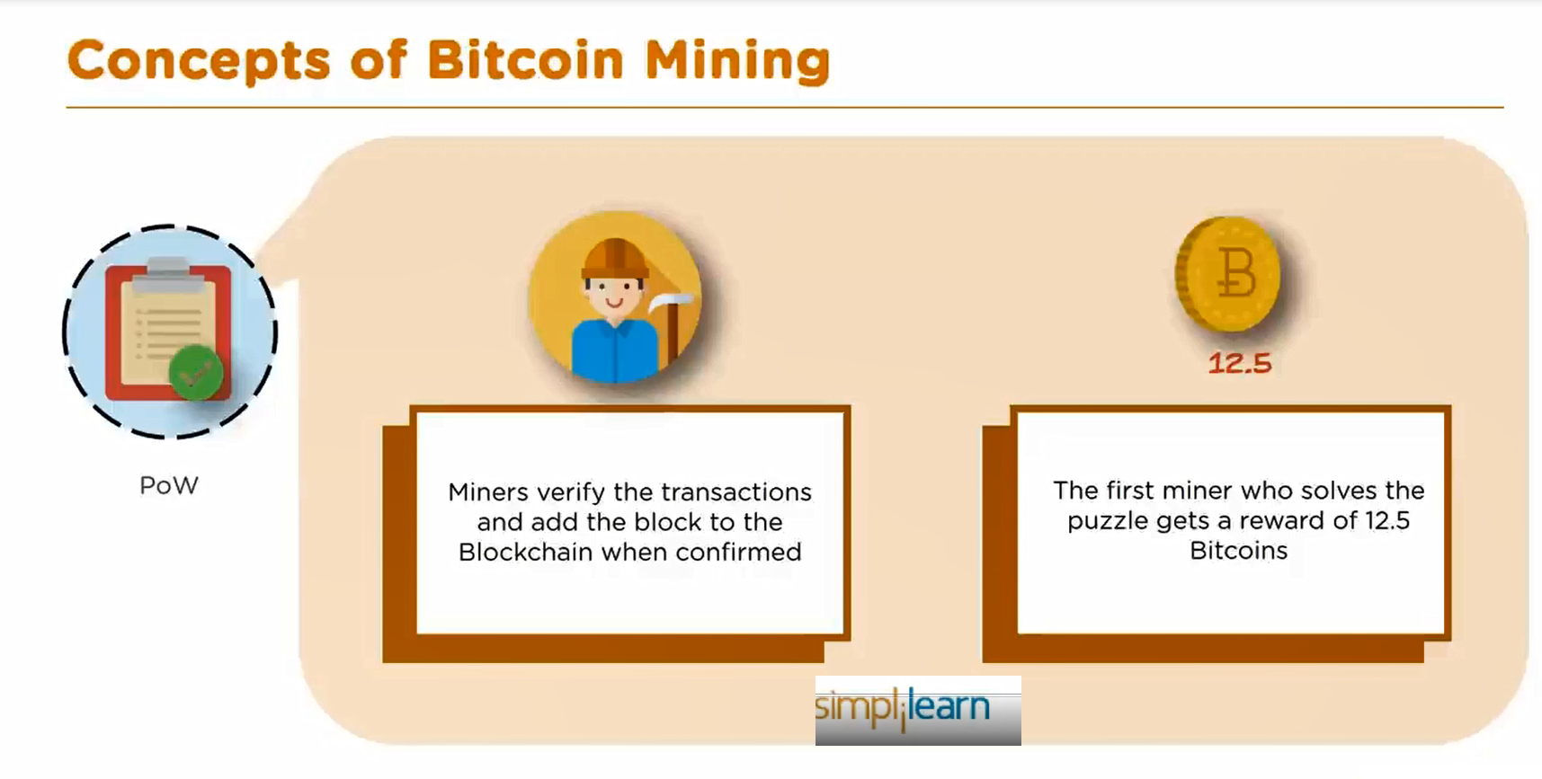
Bitcoin Mining

Slide 37
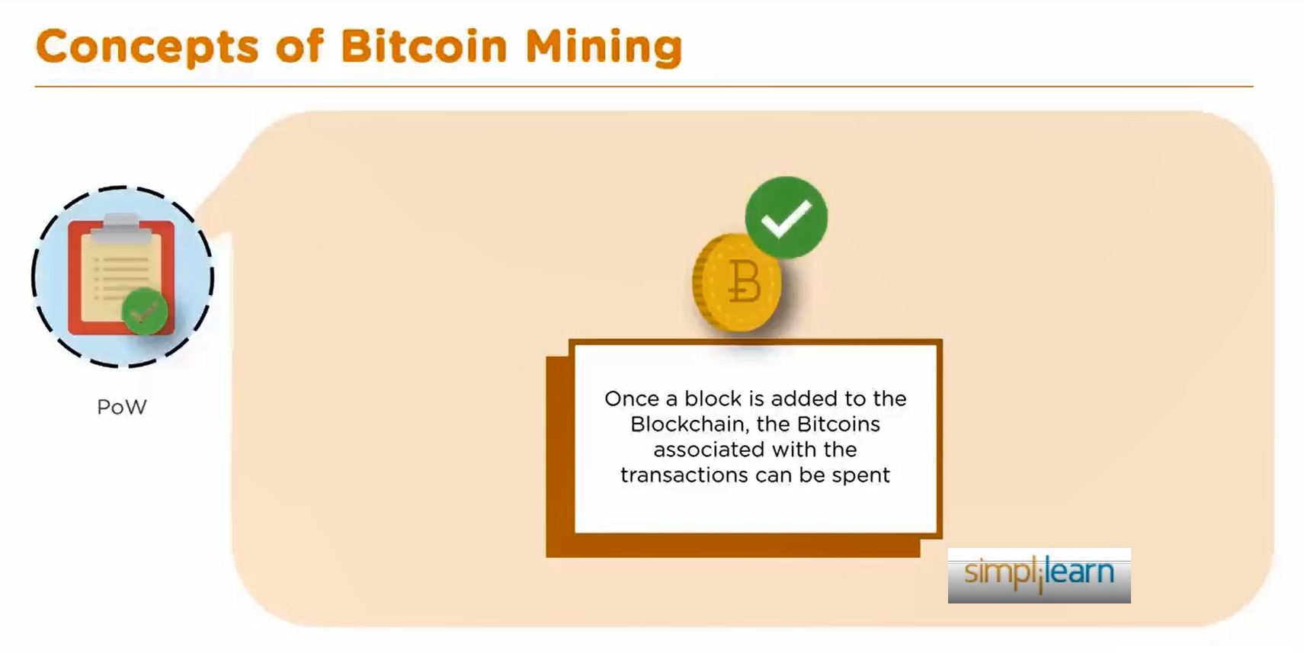
Bitcoin Mining

Slide 38
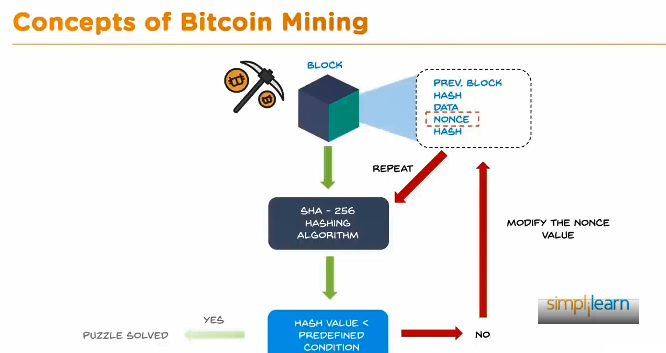
Bitcoin Mining

Slide 39
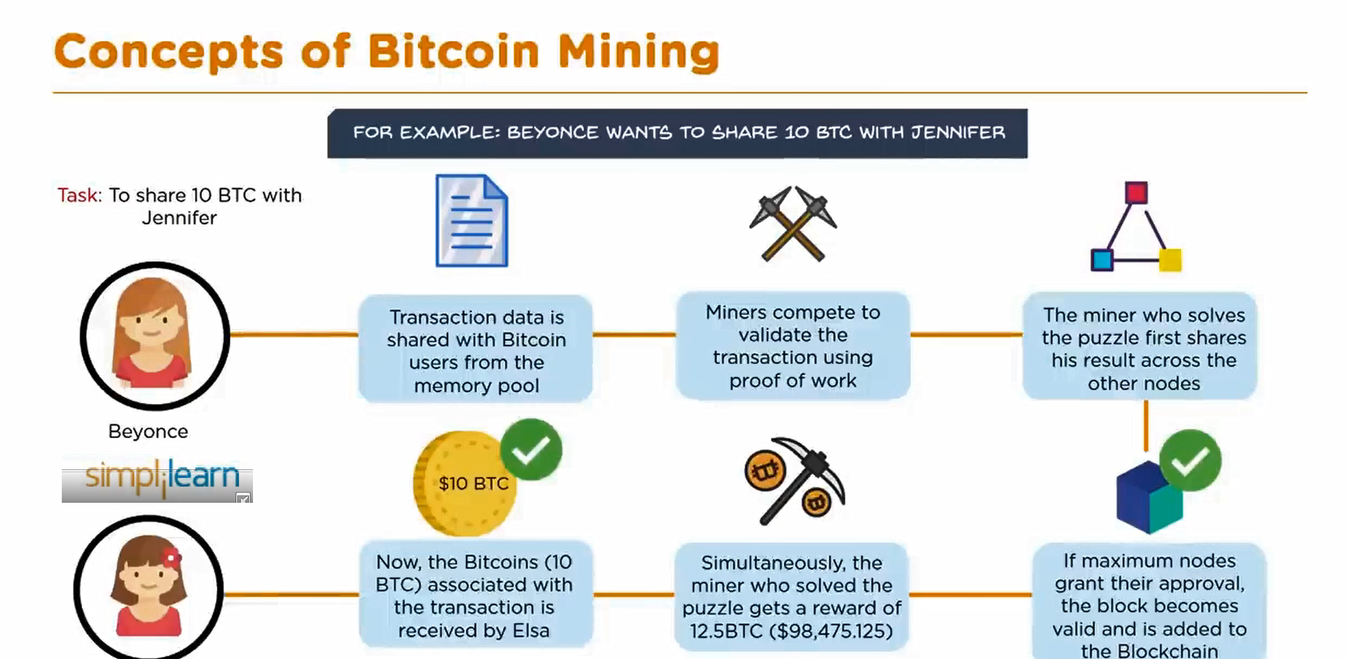
Bitcoin Mining

Slide 40
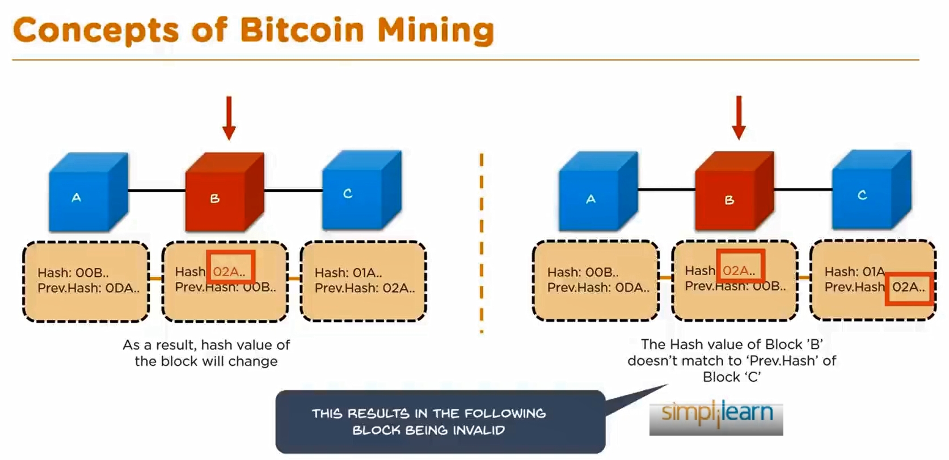
Bitcoin Mining

Slide 41
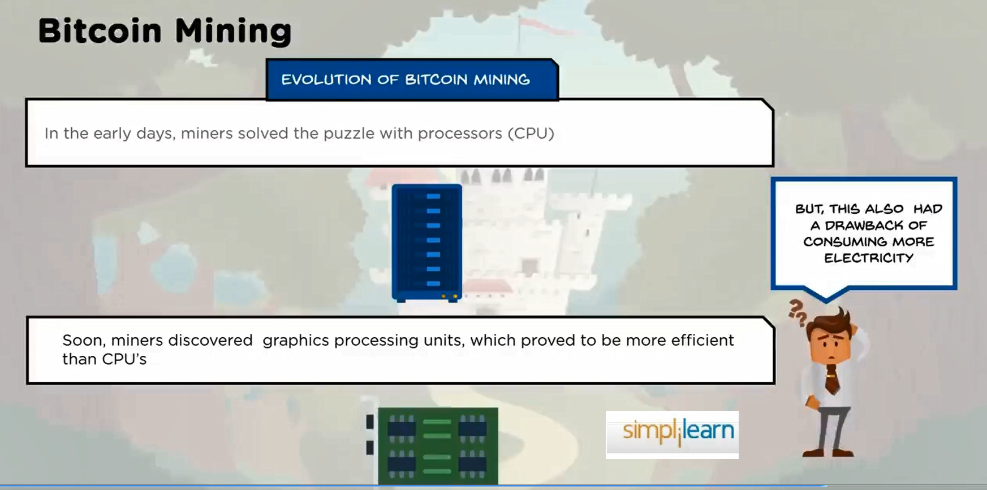
Bitcoin Mining

Slide 42
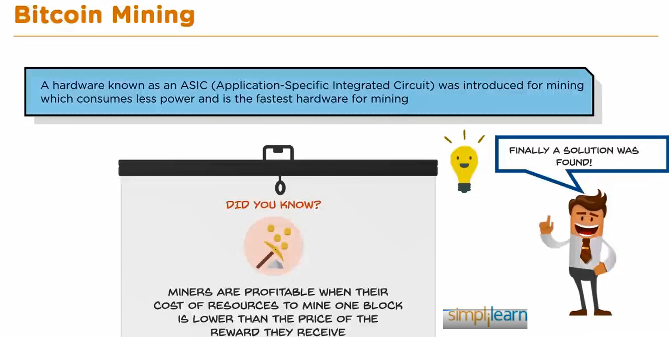
Bitcoin Mining

Slide 43
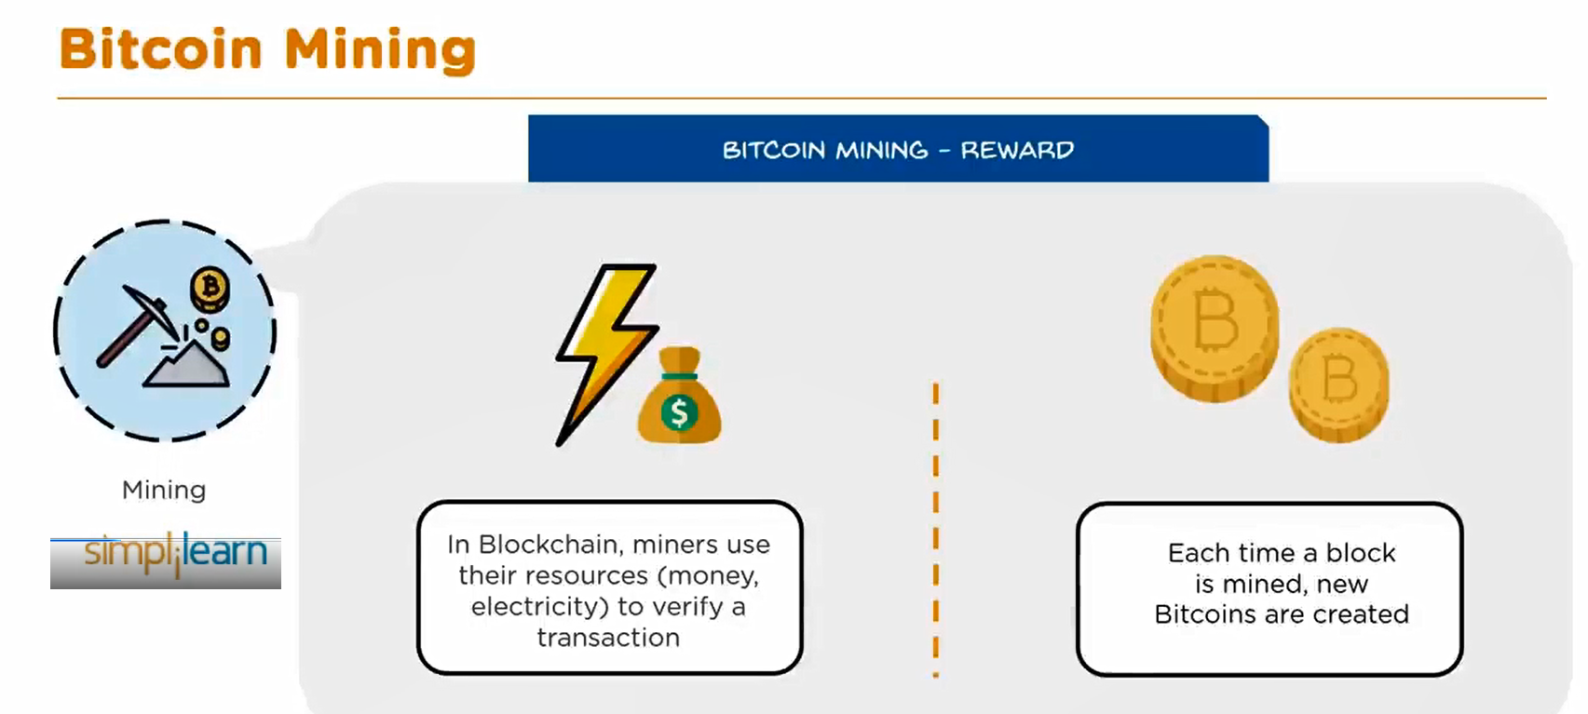
Bitcoin Mining

Slide 44
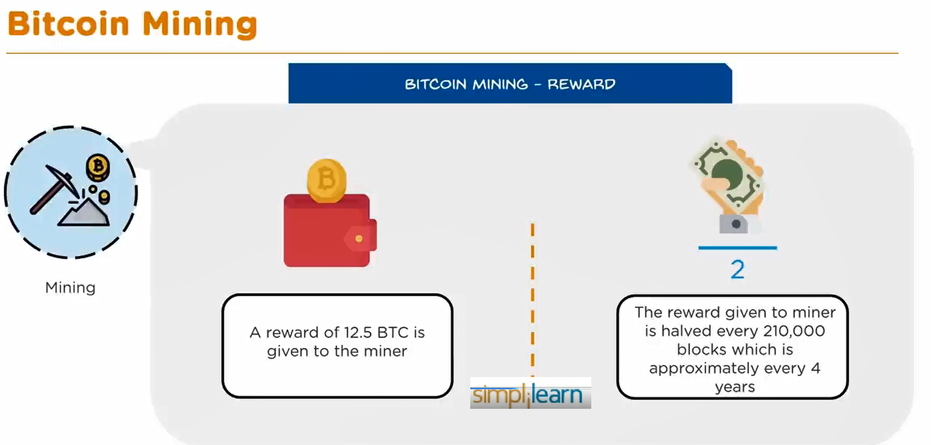
Bitcoin Mining

Slide 45
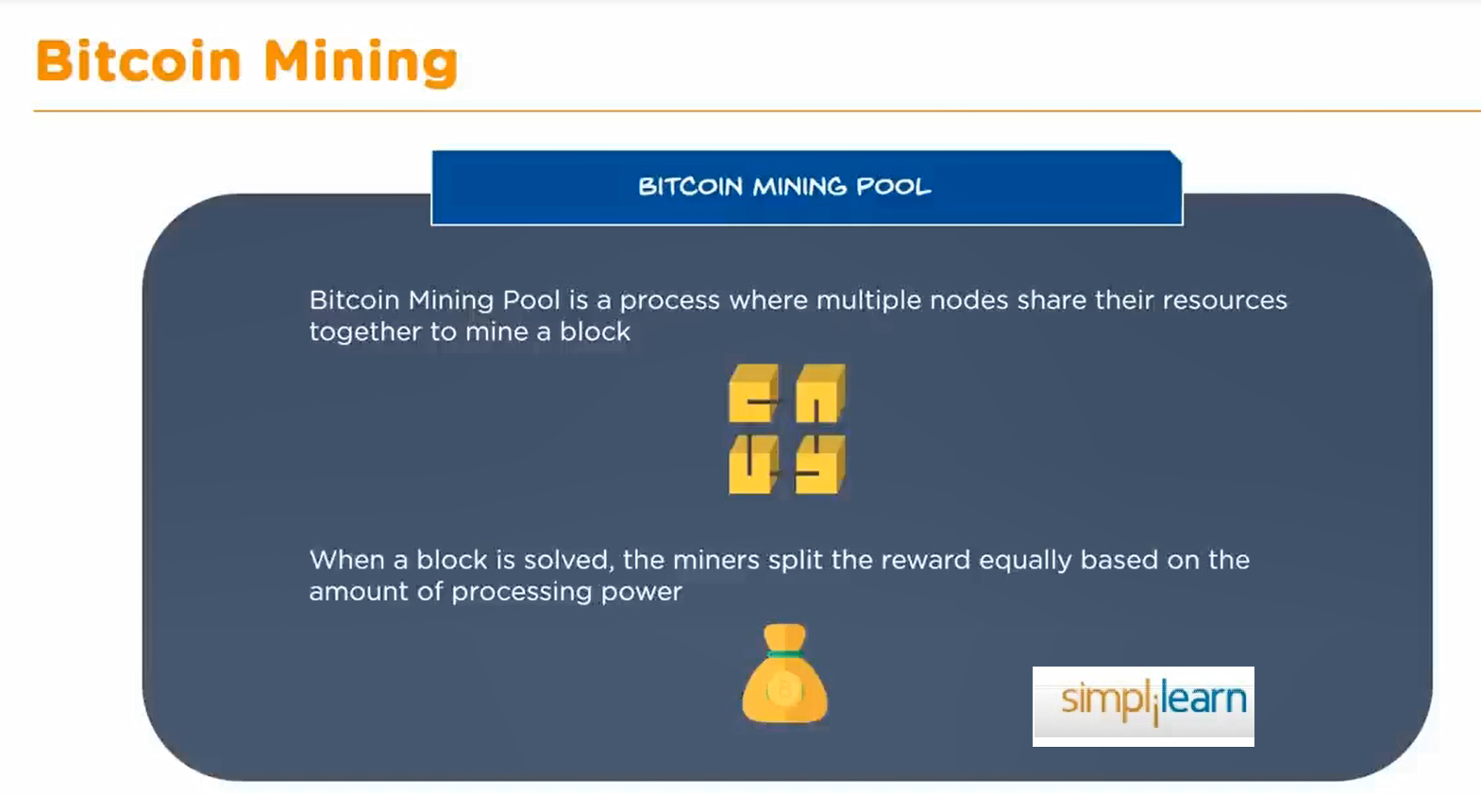
Bitcoin Mining

Slide 46
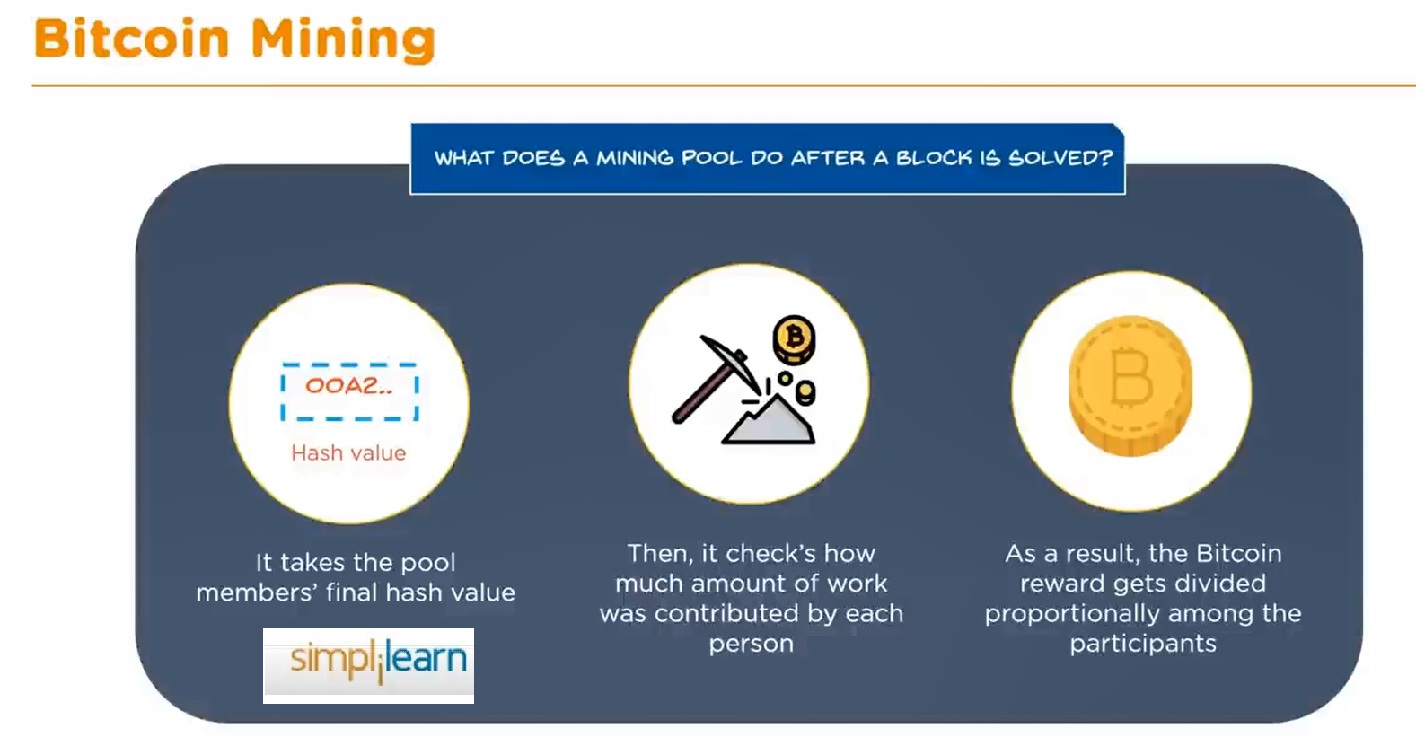
Bitcoin Mining

Slide 47
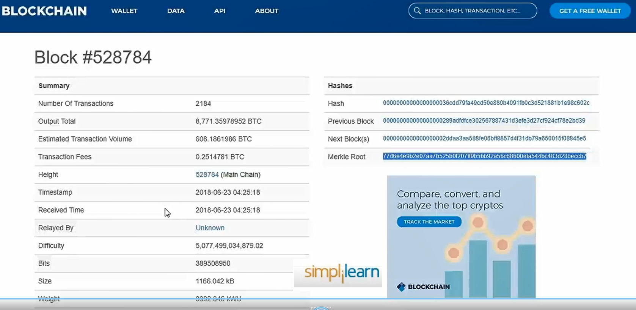
Bitcoin Mining

Slide 48
Bitcoin Wallet
A Bitcoin wallet is a software program or a physical device that allows you to store, send, and receive Bitcoin.
It functions like a digital bank account, but with a few key differences that are important to understand.

Slide 49
Types of Bitcoin Wallets
Software Wallets: These are applications you can download to your computer or smartphone. They are convenient and easy to use.
  Desktop Wallets: Installed on your computer. Examples include Electrum and Bitcoin Core.
  Mobile Wallets: Installed on your smartphone. Examples include Mycelium and Trust Wallet.
Hardware Wallets: Physical devices that store your Bitcoin offline, providing high security against hacking. Examples include Ledger Nano S and Trezor.

Slide 50
Types of Bitcoin Wallets
Web Wallets: Online services where you can access your Bitcoin via a web browser. Examples include Coinbase and Blockchain.com.
Paper Wallets: A physical document containing your Bitcoin private keys and addresses, typically generated by an offline tool.
Cold Wallets: Any Bitcoin wallet that is not connected to the internet, which could be a hardware or paper wallet. Cold wallets are considered more secure than hot wallets (those connected to the internet).

Slide 51
How Bitcoin Wallets Work
A Bitcoin wallet does not store Bitcoin itself; instead, it stores the private keys that allow you to access your Bitcoin on the blockchain.
Private Keys: A private key is a secret code that allows you to access and control your Bitcoin. If someone else gets your private key, they can access your Bitcoin.
Public Keys and Bitcoin Addresses:
A public key is derived from your private key and is used to generate a Bitcoin address, which is like an account number.
This is the address you share with others to receive Bitcoin. The public key and address do not reveal your private key.

Slide 52
Sending and Receiving Bitcoin
Receiving Bitcoin:
To receive Bitcoin, you simply share your Bitcoin address with the sender. The sender inputs this address into their wallet and sends the desired amount of Bitcoin.
Sending Bitcoin:
To send Bitcoin, you need to input the recipient’s Bitcoin address and the amount you wish to send into your wallet, then confirm the transaction with your private key. This transaction is then broadcast to the Bitcoin network for validation.

Slide 53
Security Considerations
Backup Your Wallet: Always back up your wallet. If you lose your wallet, without a backup, your Bitcoin is gone forever.
Use Strong Passwords: Ensure your wallet is protected by a strong password.
Enable Two-Factor Authentication (2FA): For online and mobile wallets, enable 2FA to add an extra layer of security.
Keep Your Private Keys Secure: Never share your private keys. Store them in a secure place, like a hardware wallet or a safely stored paper wallet.

Slide 54
Transaction Fees
When sending Bitcoin, you may need to pay a transaction fee.
This fee goes to the miners who validate transactions on the Bitcoin network. The amount of the fee can affect how quickly your transaction is processed.

Slide 55
Choosing the Right Wallet
For daily transactions: A mobile or web wallet might be convenient.
For long-term storage: A hardware or paper wallet offers the highest level of security.

Slide 56
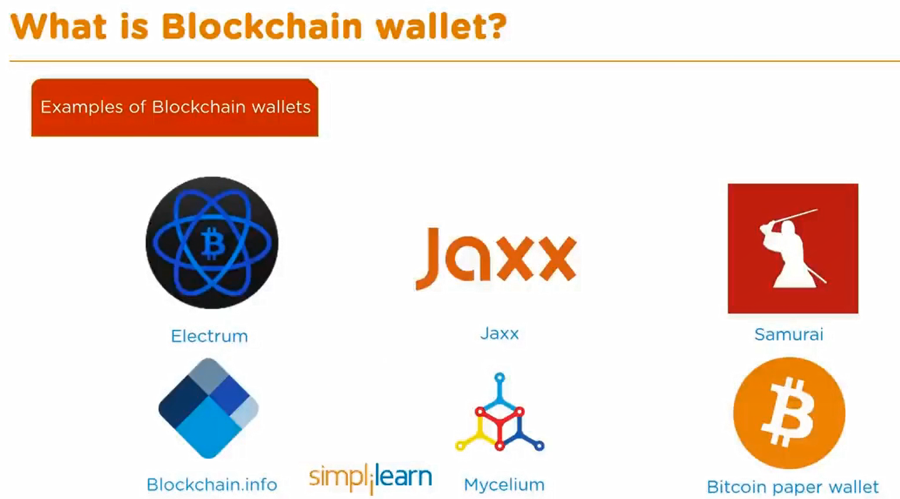

Slide 57
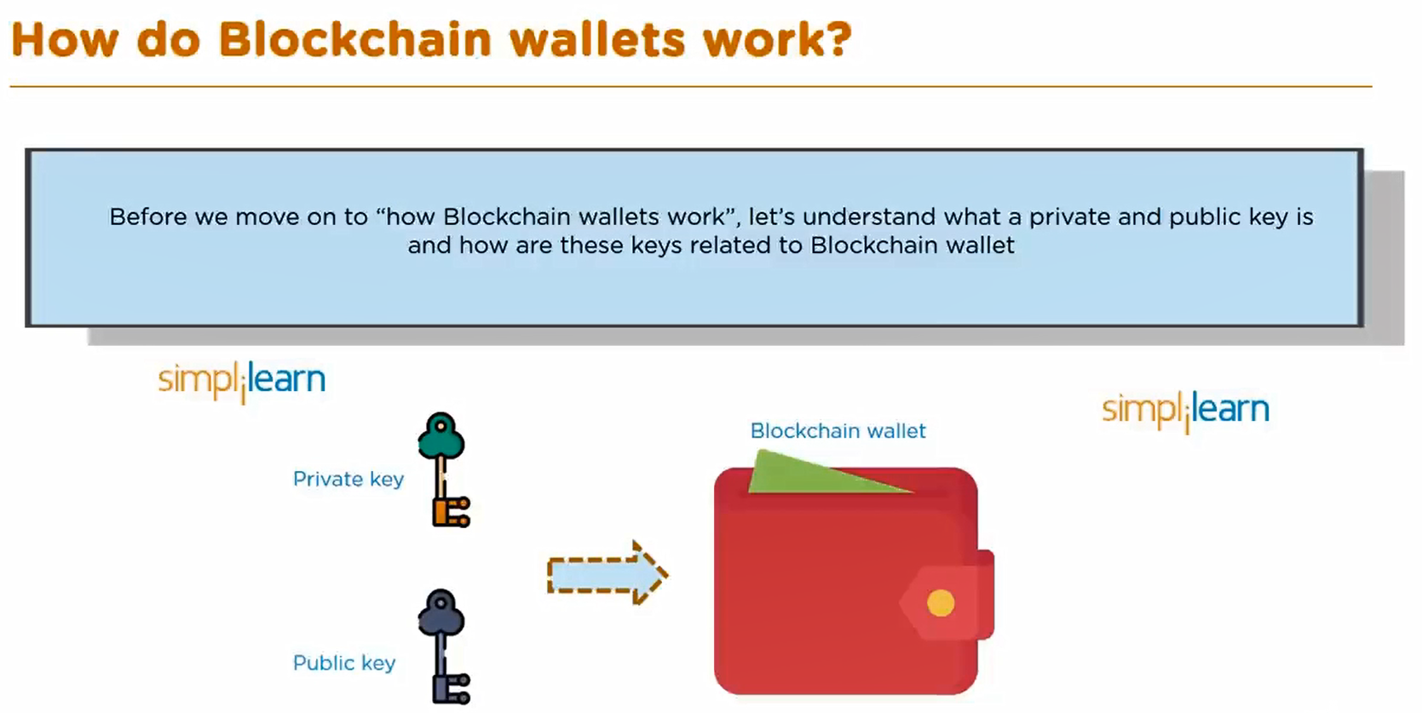

Slide 58
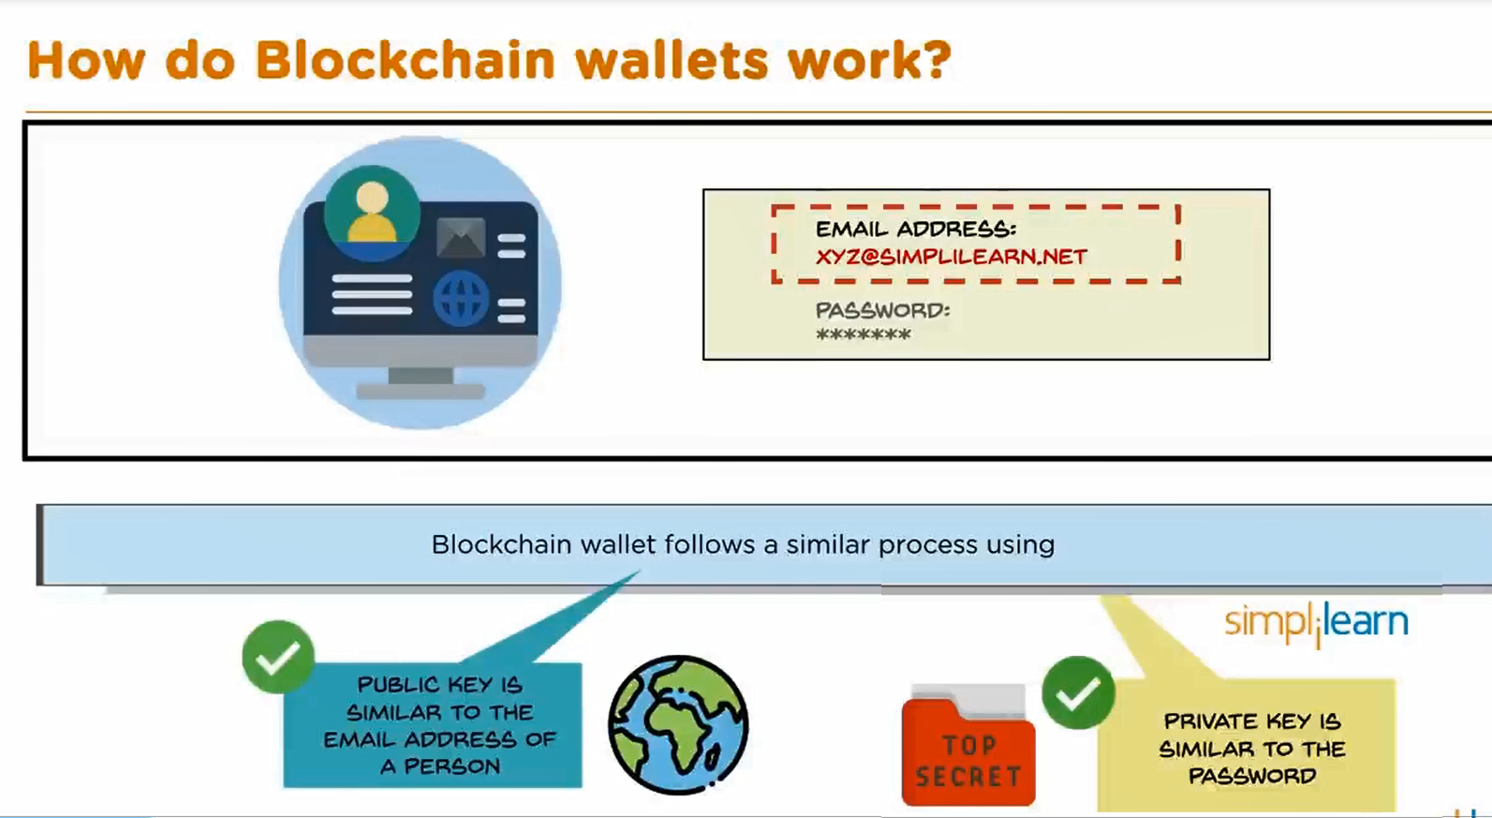

Slide 59
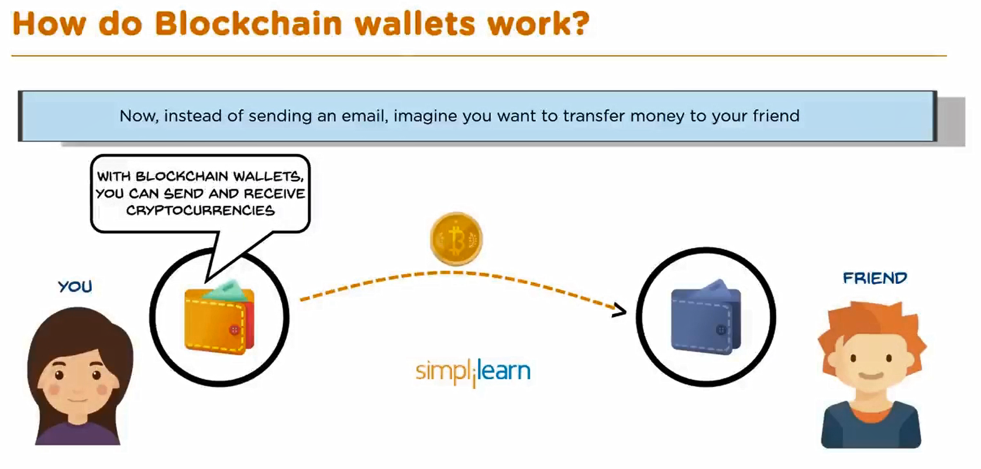

Slide 60
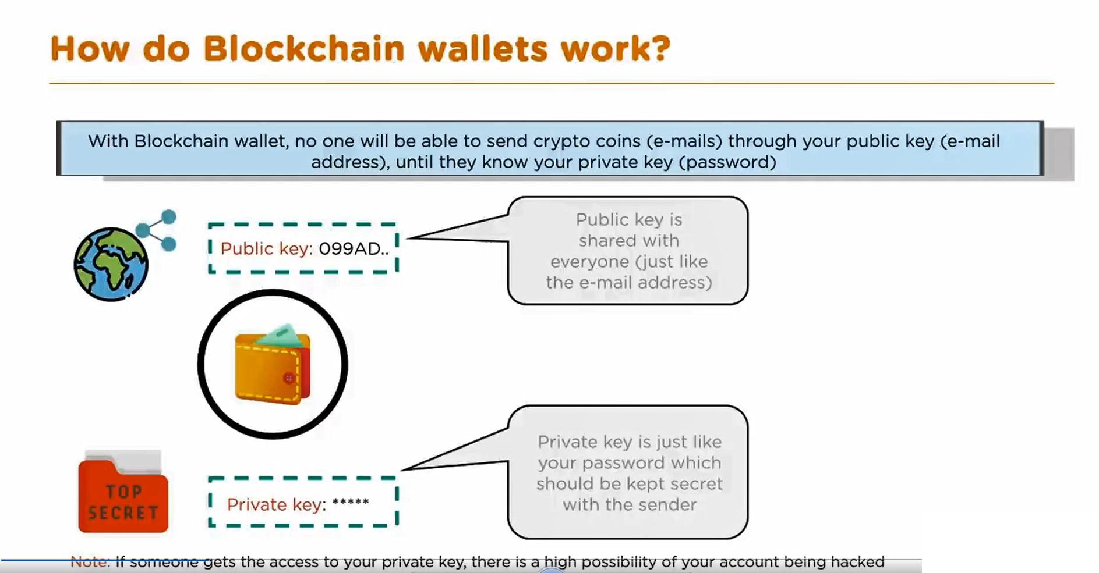

Slide 61
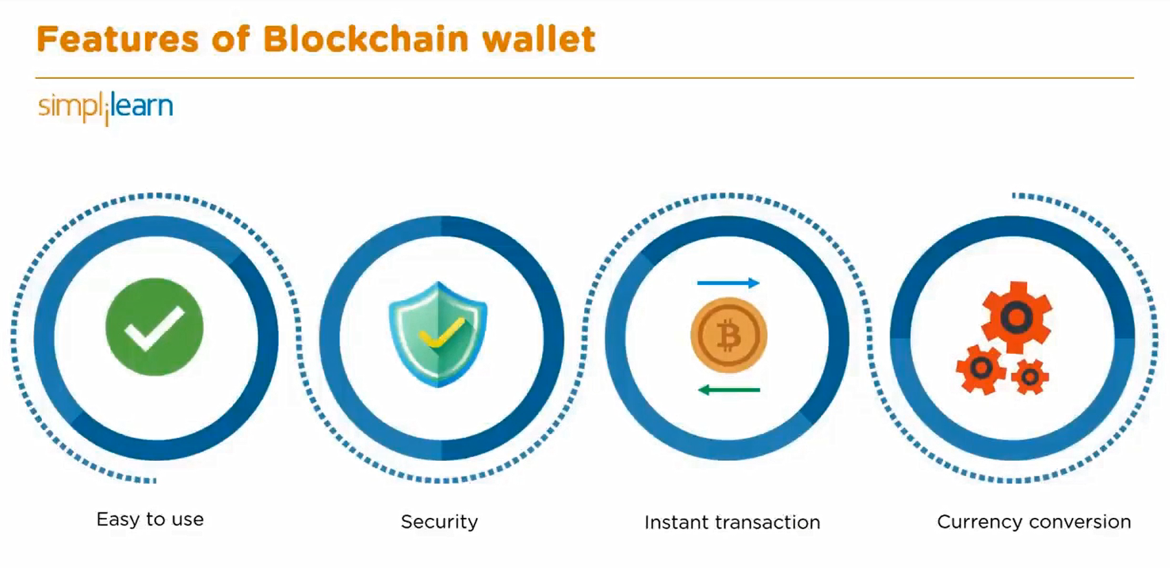

Slide 62
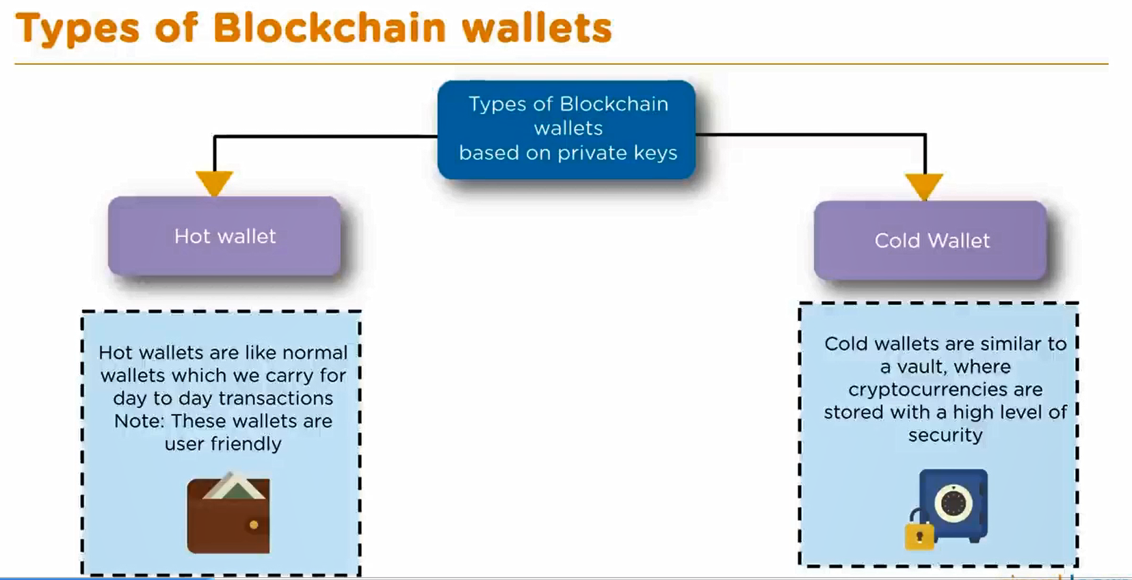

Slide 63
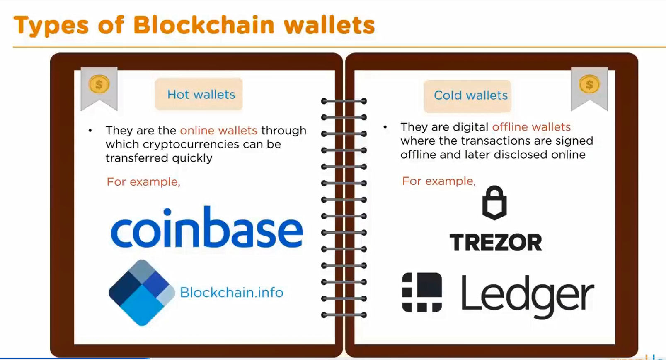

Slide 64
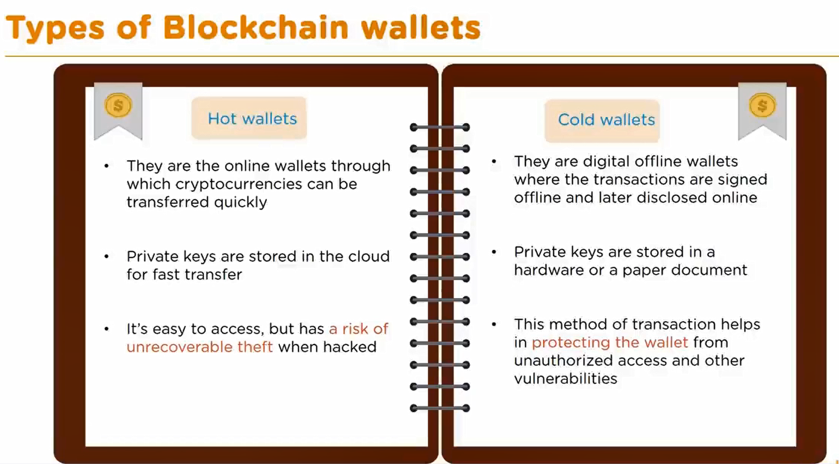

Slide 65
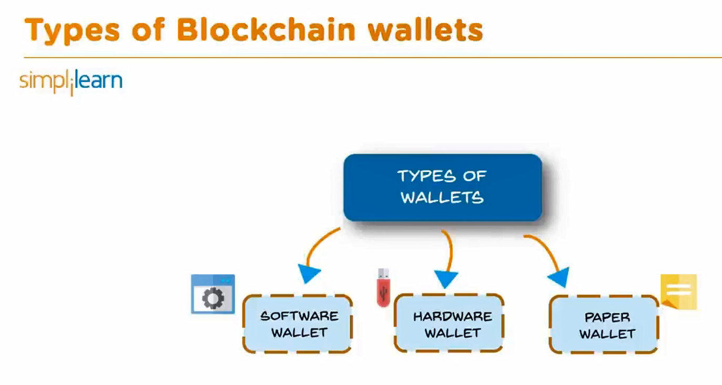

Slide 66
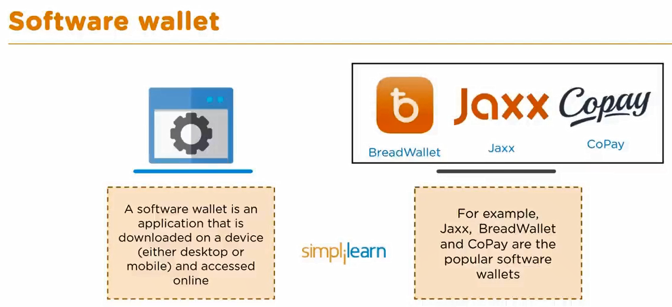

Slide 67
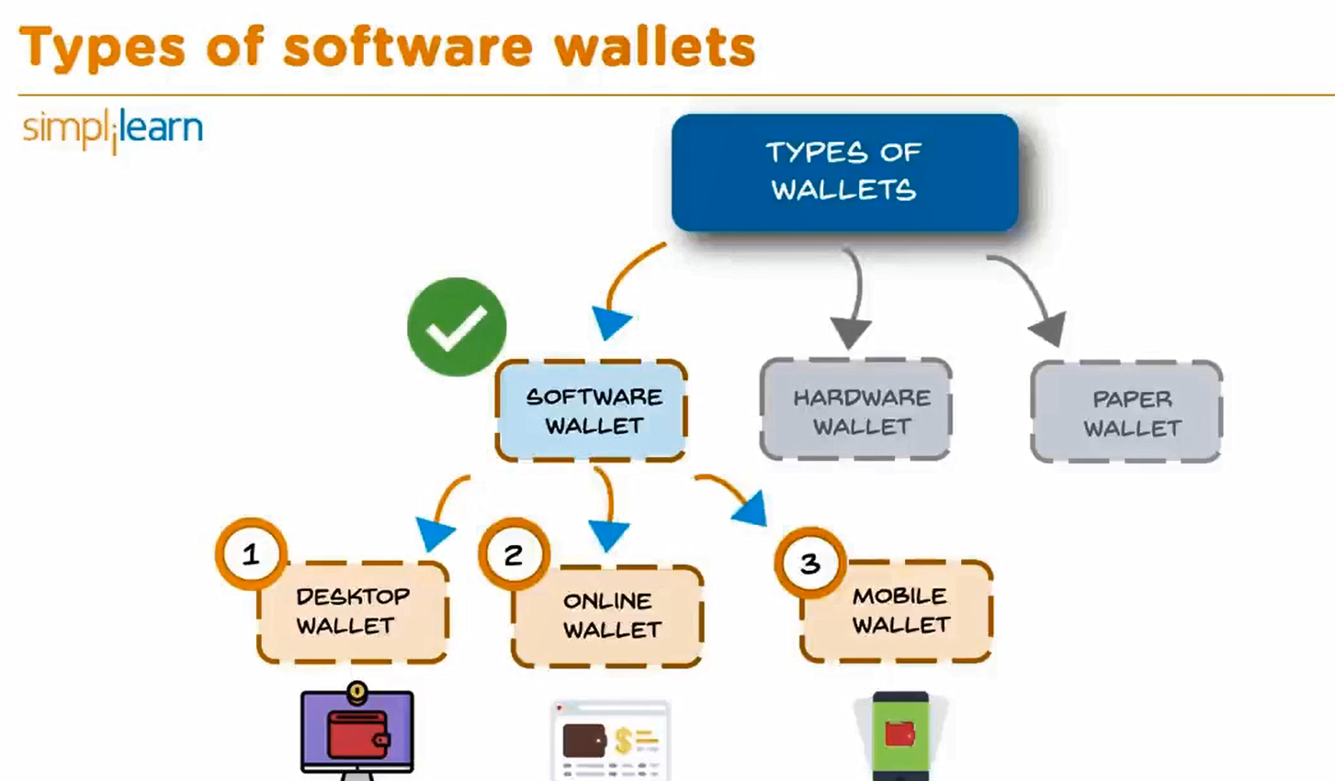

Slide 68
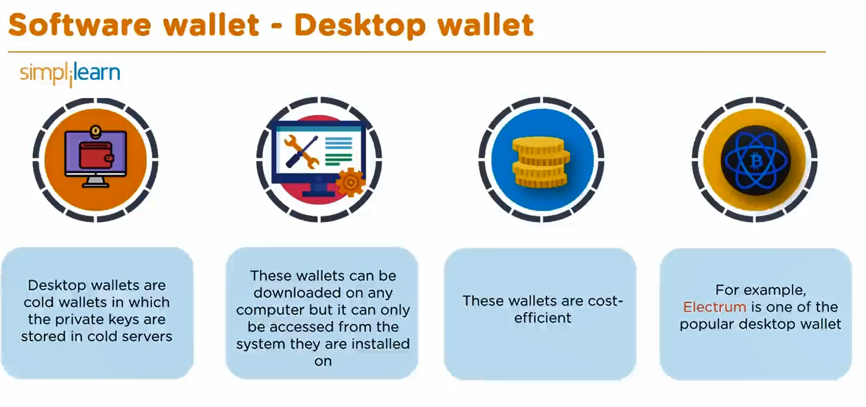

Slide 69
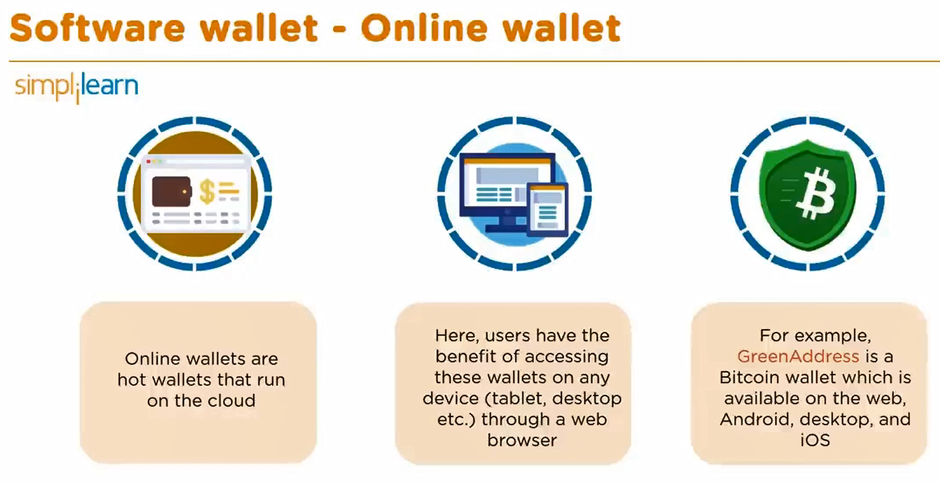

Slide 70
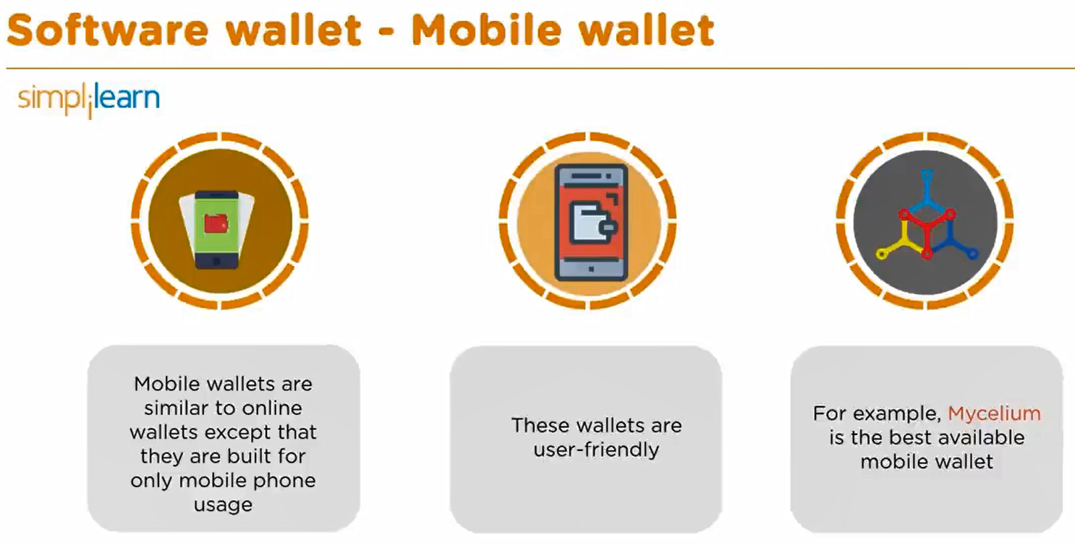

Slide 71
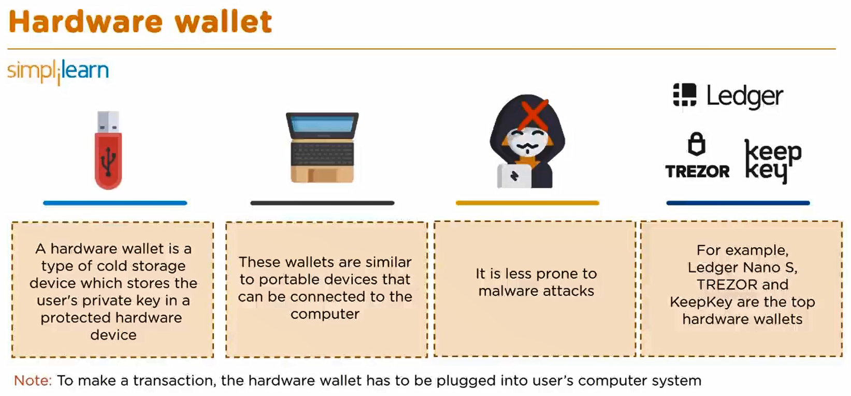

Slide 72
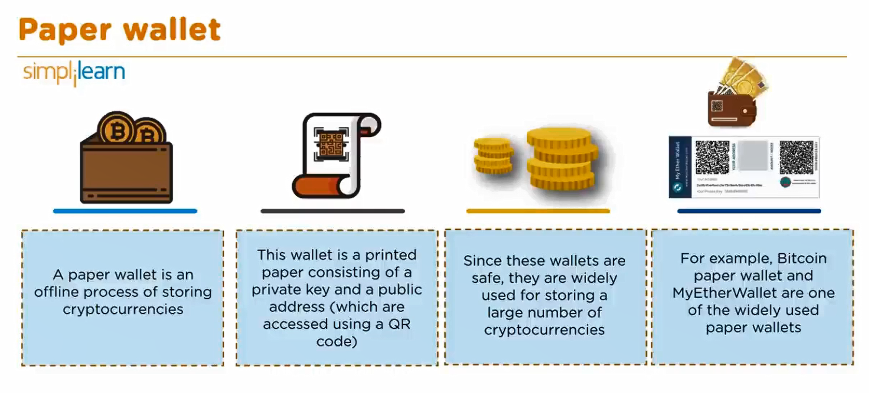

Slide 73
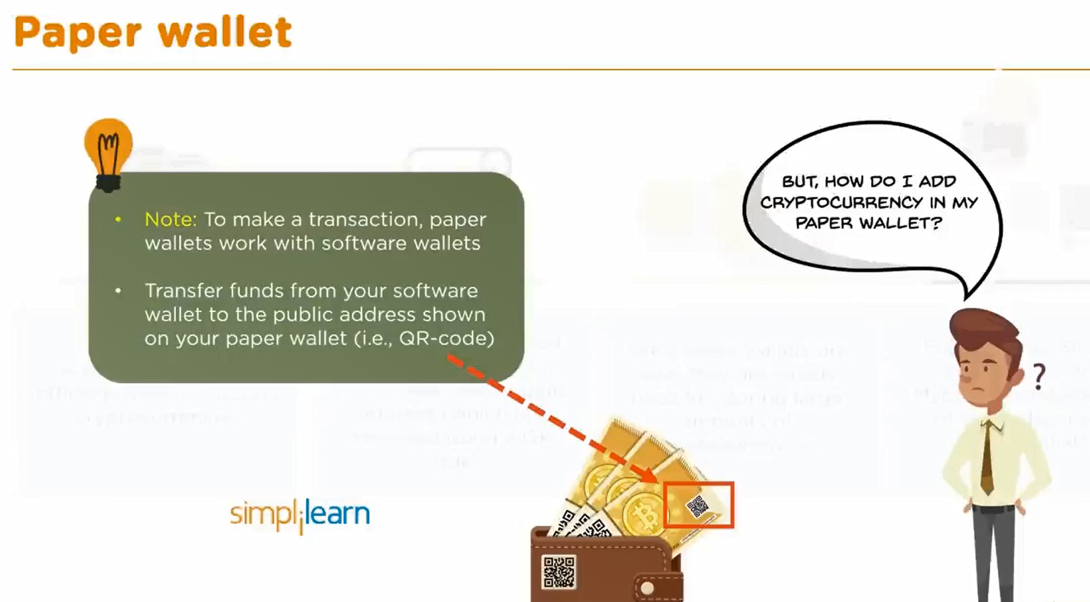

Slide 74
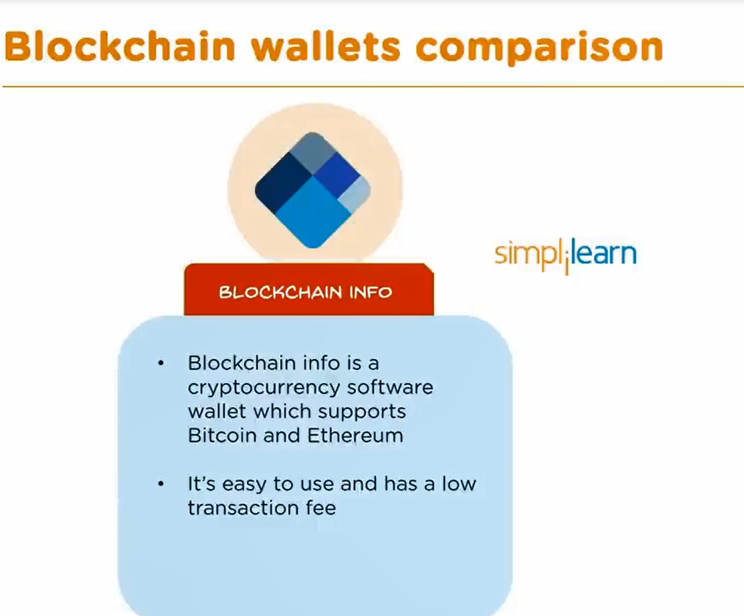

Slide 75
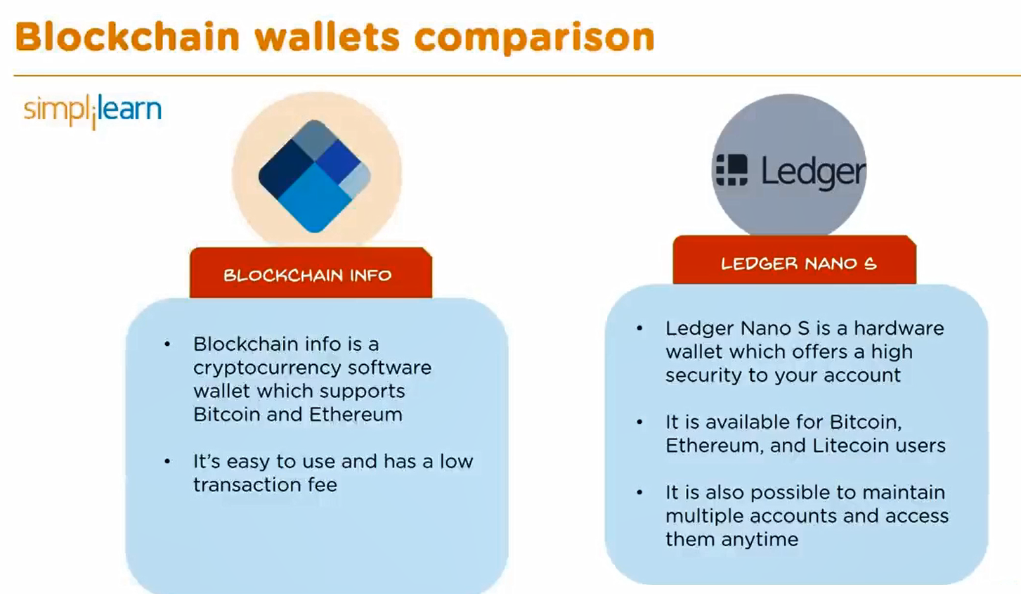

Slide 76
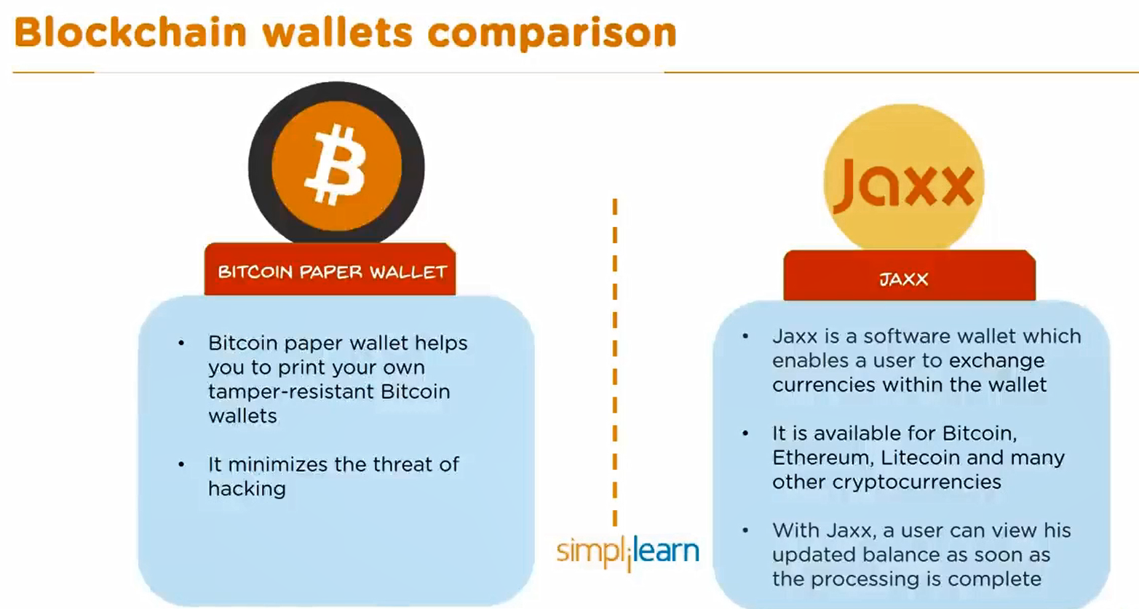

Slide 77
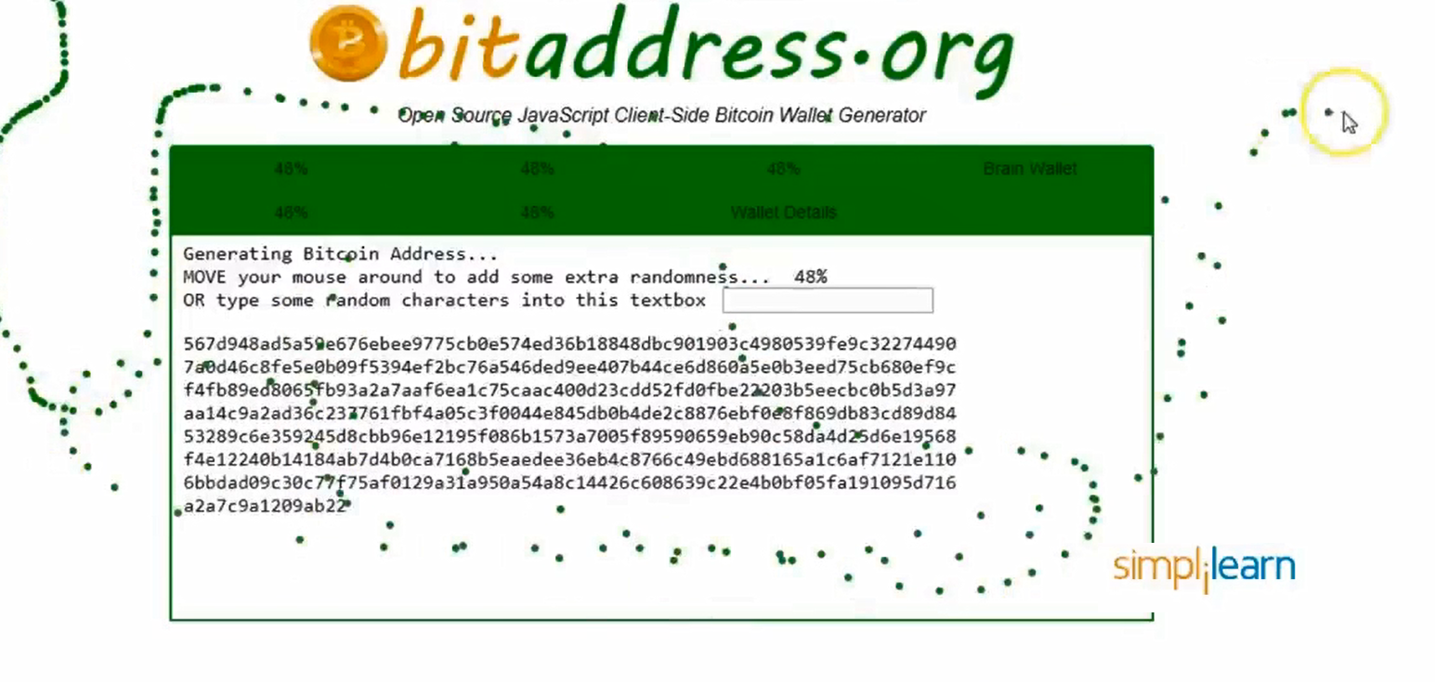

Slide 78
Conclusion
Bitcoin's introduction as the first cryptocurrency has had a profound impact on the financial world, challenging traditional systems and offering a new way to think about money and transactions. Its decentralized nature, combined with the innovative use of blockchain technology, has made it a resilient and secure system that continues to attract attention and adoption worldwide.
Understanding the genesis of Bitcoin, the mechanics of mining, the proof-of-work consensus algorithm, and the intricacies of the Bitcoin network is essential for anyone looking to grasp the broader implications of this groundbreaking technology. As Bitcoin continues to evolve, its role in the future of finance will undoubtedly be a subject of ongoing discussion and exploration.

