Slide 1
Ethereum and Smart Contract
FIN451 / MBA651

Slide 2
What is Ethereum?
Ethereum is a decentralized, open-source blockchain platform that allows developers to build and deploy decentralized applications (dApps).
Launched in 2015 by Vitalik Buterin and a group of co-founders, Ethereum extends the functionality of Bitcoin’s blockchain by enabling not just the transfer of cryptocurrency, but also the execution of smart contracts.

Slide 3
Ethereum’s Purpose
While Bitcoin is primarily designed as a digital currency, Ethereum was created to serve as a platform for decentralized applications (dApps), powered by smart contracts.
Ethereum allows developers to write and deploy smart contracts on its blockchain, making it the first blockchain to support this level of programmability.

Slide 4
Key Components of Ethereum - Ethereum Virtual Machine (EVM)
The Ethereum Virtual Machine (EVM) is the runtime environment for smart contracts on Ethereum.
It is a decentralized computer that executes smart contract code exactly as it is written, across thousands of nodes in the network.
The EVM is what makes Ethereum unique, as it enables developers to create complex, programmable contracts that can run on the blockchain.

Slide 5
Key Components of Ethereum - Ether (ETH)
Ether (ETH) is the native cryptocurrency of the Ethereum network, and it plays a crucial role in the execution of smart contracts.
When a smart contract is executed on Ethereum, it consumes computational resources. These resources are paid for in ETH, through a mechanism called "gas."
Gas is a unit of measurement that dictates the amount of computational work required to execute a transaction or a smart contract. The more complex the smart contract, the more gas it requires, and the more ETH must be paid.

Slide 6
Key Components of Ethereum - Smart Contract
A smart contract is a self-executing contract with the terms of the agreement directly written into lines of code.
This code and the agreements contained within it exist across a distributed, decentralized blockchain network.
Smart contracts automatically execute and enforce the terms of the contract without the need for intermediaries like banks or lawyers.

Slide 7
Key Components of Ethereum - Decentralized Applications (dApps)
Many dApps on Ethereum are powered by smart contracts.
These dApps leverage the Ethereum blockchain’s decentralized nature to offer services like decentralized finance (DeFi), gaming, and more.
For instance, a DeFi application might use a smart contract to automatically lend or borrow cryptocurrency without needing a bank or intermediary.

Slide 8
Key Components of Ethereum - Token Standards (ERC-20, ERC-721)
Ethereum’s smart contract functionality has led to the creation of various token standards, like ERC-20 (for fungible tokens) and ERC-721 (for non-fungible tokens, or NFTs).
These standards define a set of rules for tokens, enabling the creation of digital assets that can be traded, transferred, or used within dApps on the Ethereum network.

Slide 9
Why Ethereum is Important for Smart Contracts:
Pioneering Platform: Ethereum was the first blockchain to enable Turing-complete smart contracts, which means that developers can write code that can perform any computation, given enough resources. This flexibility has made Ethereum the most popular platform for creating and deploying smart contracts.
Community and Ecosystem: Ethereum has a large and active developer community, which has led to the creation of a vast ecosystem of tools, libraries, and frameworks that make it easier to develop, deploy, and interact with smart contracts.
Network Effects: Because Ethereum was the first major platform to support smart contracts, it has benefited from strong network effects. A large number of developers, projects, and users have congregated around Ethereum, further solidifying its position as the leading smart contract platform.

Slide 10
Examples of Smart Contracts on Ethereum
DeFi Protocols: Decentralized finance applications like Uniswap, Aave, and Compound use smart contracts to facilitate trading, lending, and borrowing of cryptocurrencies without the need for a central authority.
NFT Marketplaces: Platforms like OpenSea and Rarible use Ethereum smart contracts to manage the creation, sale, and transfer of non-fungible tokens (NFTs).
Crowdfunding: Platforms like Gitcoin use smart contracts to manage funding for open-source projects, automatically distributing funds based on predefined criteria.

Slide 11
Key Features of Smart Contracts:
Self-Executing: Once the predefined conditions are met, the contract automatically executes the agreed-upon actions.
  For example, if a smart contract is set up to transfer ownership of an asset when payment is received, it will automatically do so when the payment is confirmed on the blockchain.
Immutable: After a smart contract is deployed on the blockchain, it cannot be altered.
  This immutability ensures that the terms agreed upon at the start of the contract cannot be changed, which adds a layer of security and trust.
Transparent: Since smart contracts are stored on a blockchain, they are visible and verifiable by anyone with access to the blockchain.
  This transparency helps in reducing fraud and misunderstandings.

Slide 12
Key Features of Smart Contracts:
Decentralized: Smart contracts operate on decentralized networks, meaning they are not controlled by a single entity.
  This decentralization ensures that the contract’s execution is not dependent on any single party, reducing the risk of manipulation.
Trustless: With smart contracts, there’s no need to trust the other party in the transaction.
  The contract will execute based solely on the code, and there’s no need for intermediaries to enforce the terms.

Slide 13
How Smart Contracts Work:
Code Development: A smart contract is written using a programming language like Solidity (for Ethereum).
  The code specifies the rules and penalties of the agreement and is stored on the blockchain.
Deployment: Once the smart contract is written and tested, it is deployed onto a blockchain like Ethereum.
  This deployment gives the contract a unique address on the blockchain.
Execution: When conditions defined in the contract are met, the contract executes automatically.
  For example, if a smart contract is set up for a crowdfunding campaign, it might release funds to the project creator only if the campaign reaches its funding goal by a specific date.
Final Products: Once executed, the result of the contract (like the transfer of assets or tokens) is recorded on the blockchain, creating a permanent, tamper-proof record of the transaction.

Slide 14
Practical Examples of Smart Contracts:
Financial Transactions: Smart contracts can be used for automated payments, loans, and insurance claims.
  For instance, an insurance company might use a smart contract to automatically pay out claims when certain conditions (like flight delays or cancellations) are met.
Supply Chain Management: In a supply chain, smart contracts can automatically track the movement of goods and release payments when goods are delivered to a specific location.
Real Estate: Smart contracts can automate the process of transferring property ownership once payment is received, reducing the need for intermediaries like real estate agents or escrow services.
Voting Systems: Smart contracts can be used to create transparent and tamper-proof voting systems, ensuring that votes are counted accurately and fairly.

Slide 15
Benefits of Smart Contracts:
Efficiency: By automating processes, smart contracts can reduce the time and cost associated with traditional contract execution.
Security: The cryptographic security of the blockchain ensures that smart contracts are secure from tampering.
Accuracy: Since smart contracts are digital and automated, they reduce the errors that can occur with manually processed contracts.
Trust: The transparency and immutability of smart contracts build trust between parties who may not know each other.

Slide 16
Conclusion
Smart contracts are a powerful tool in the world of blockchain technology, offering automation, security, and trust in executing agreements without the need for third-party intermediaries.
They have a wide range of applications, from financial transactions to complex supply chain logistics, and are poised to revolutionize how contracts are handled in various industries.

Slide 17
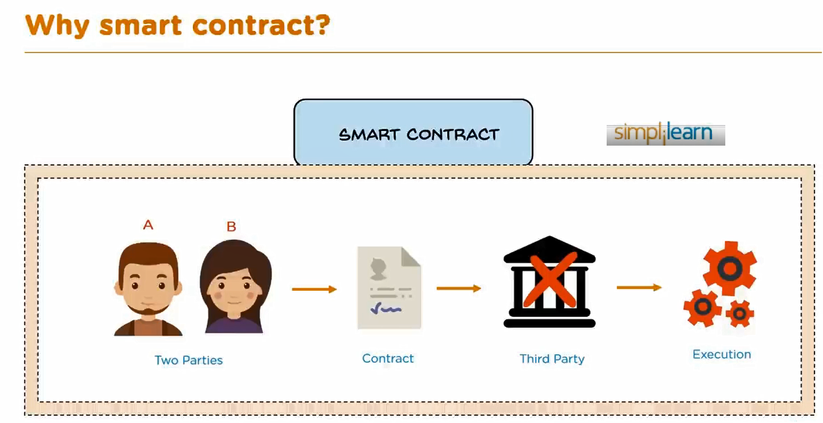

Slide 18
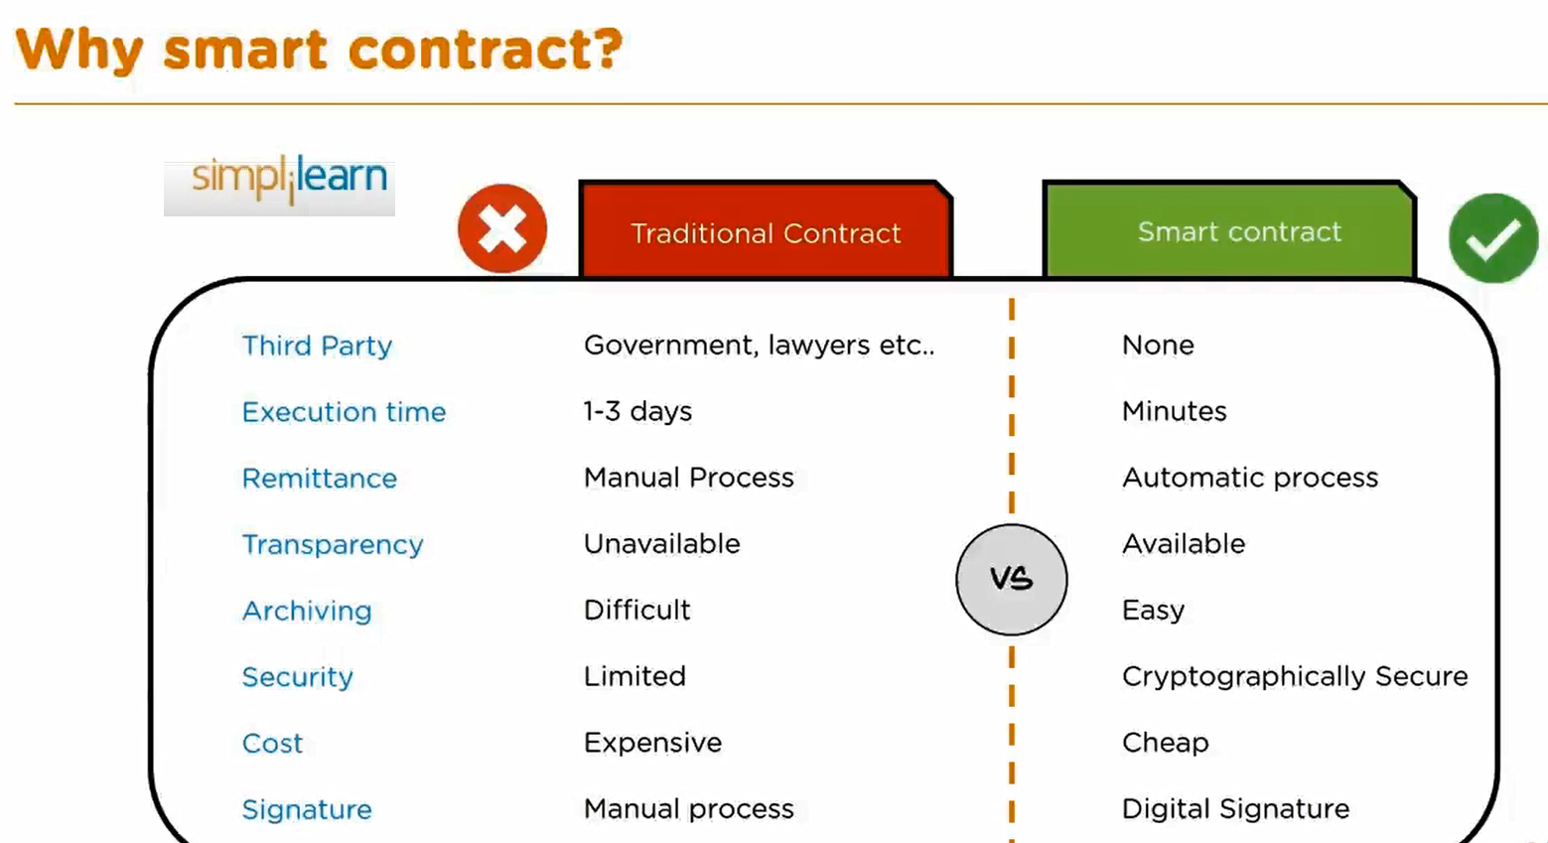

Slide 19
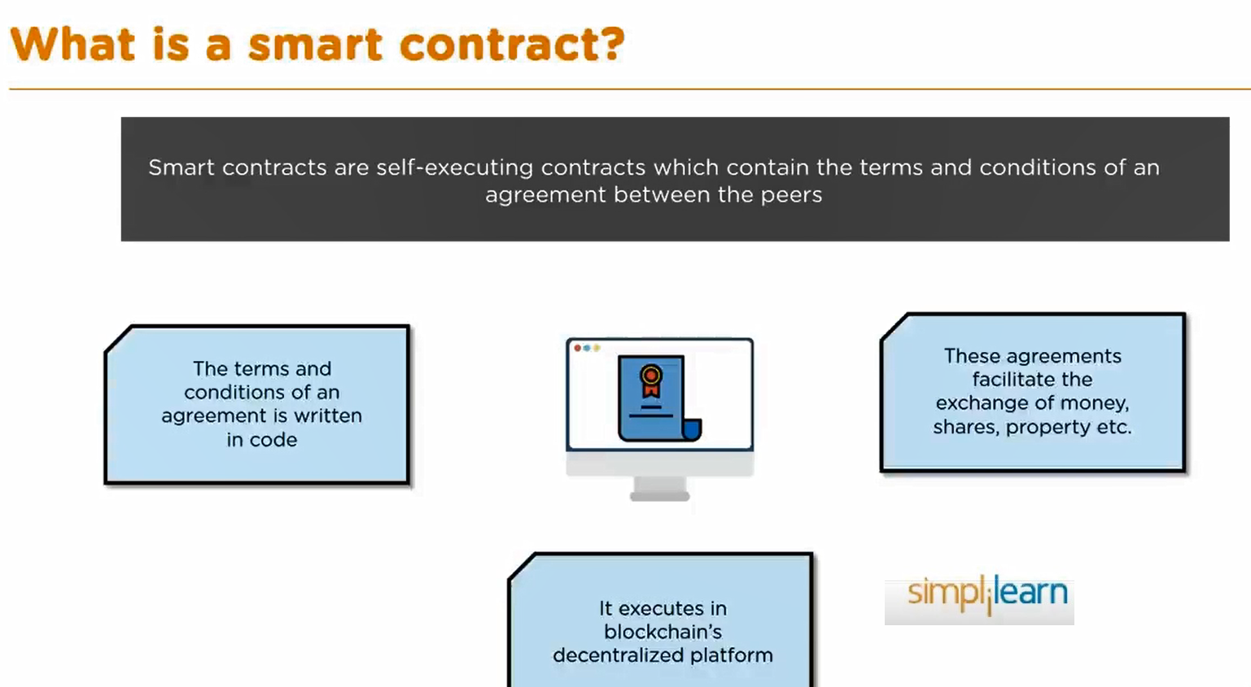

Slide 20
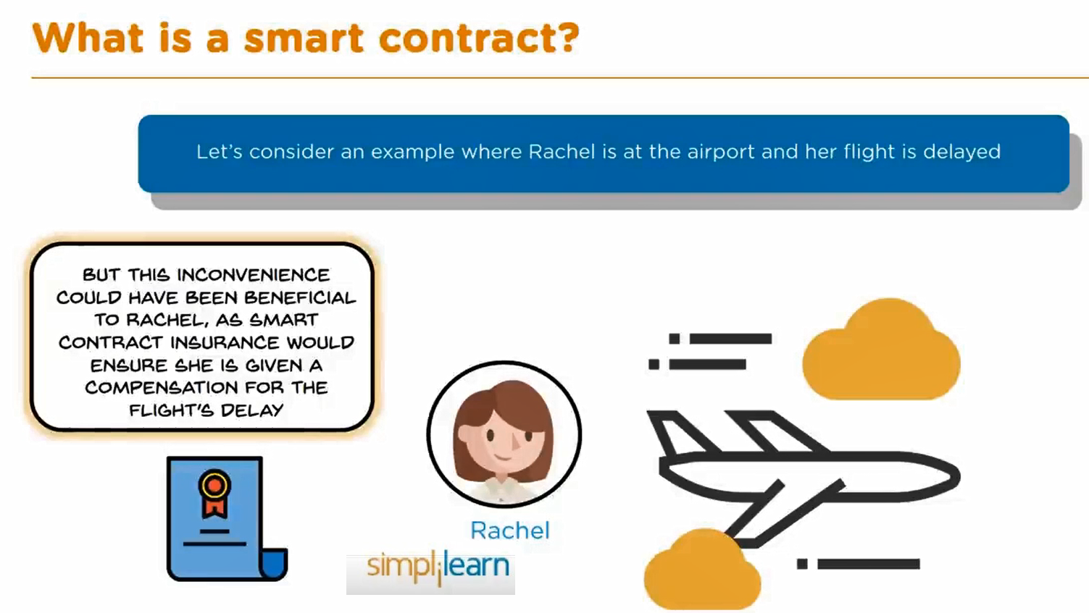

Slide 21
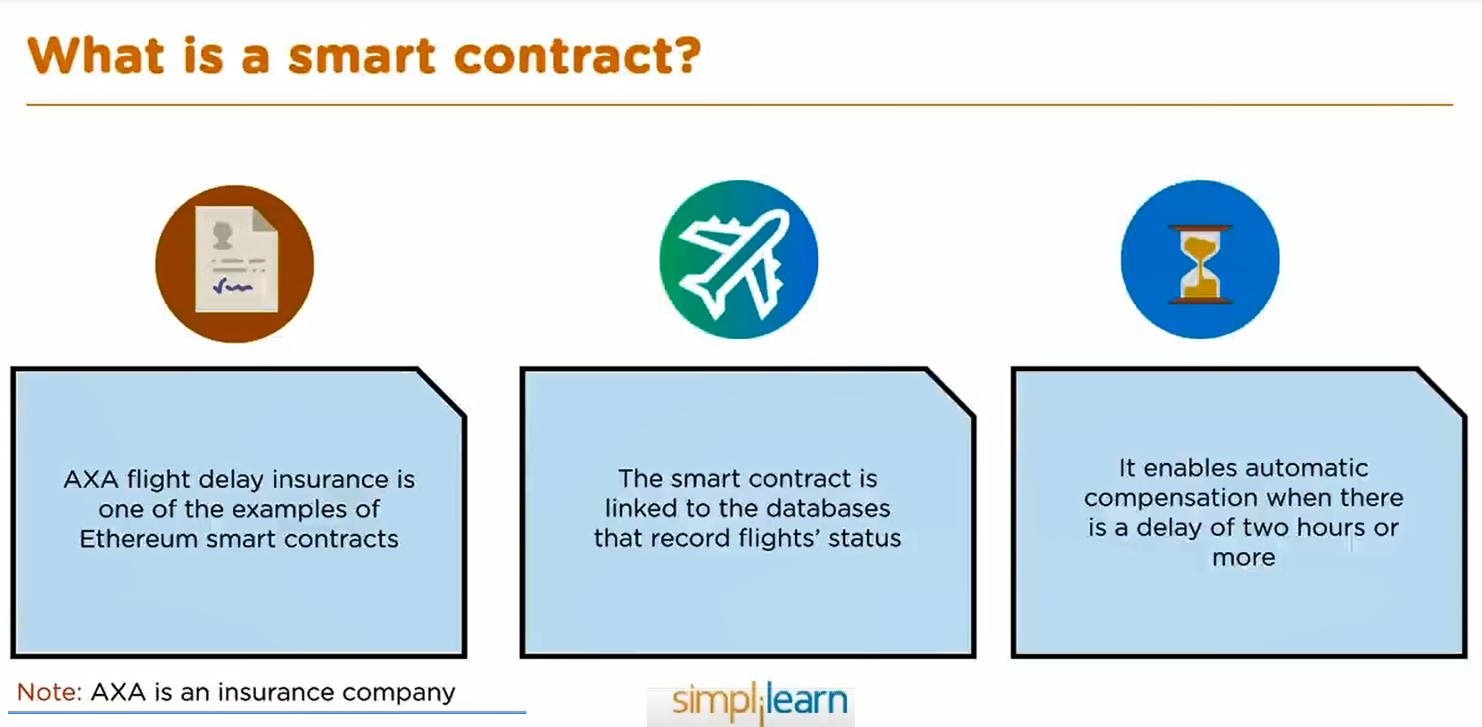

Slide 22
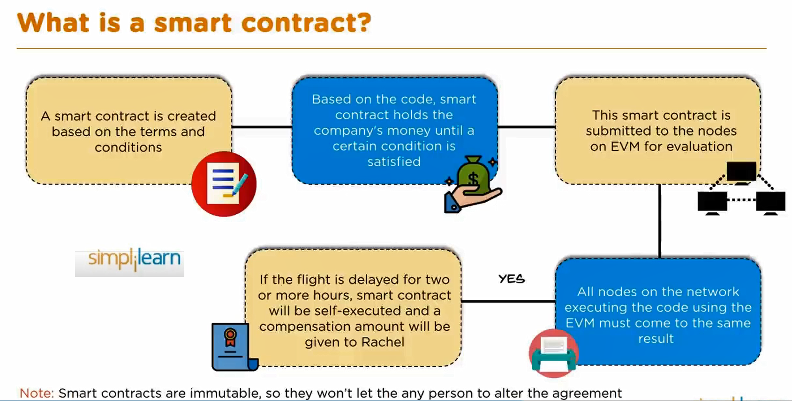

Slide 23
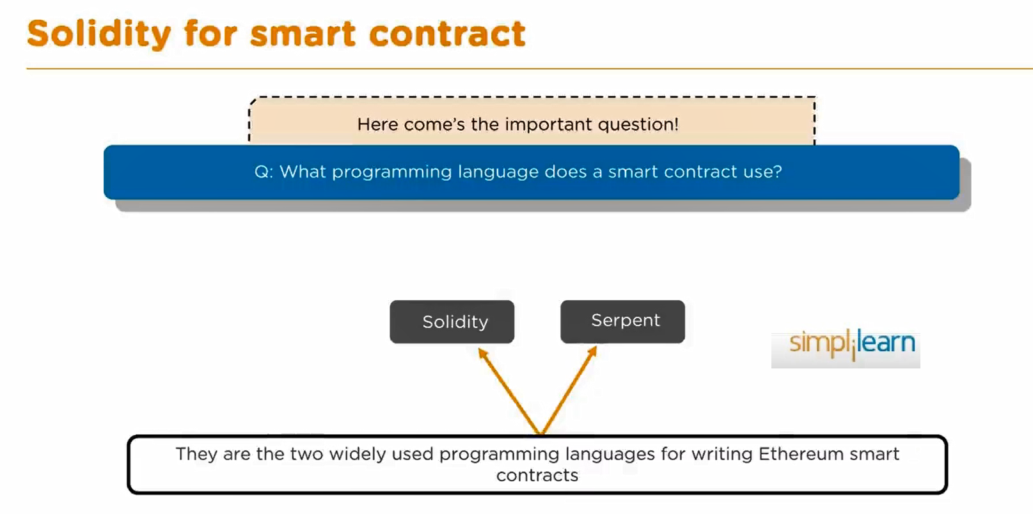

Slide 24
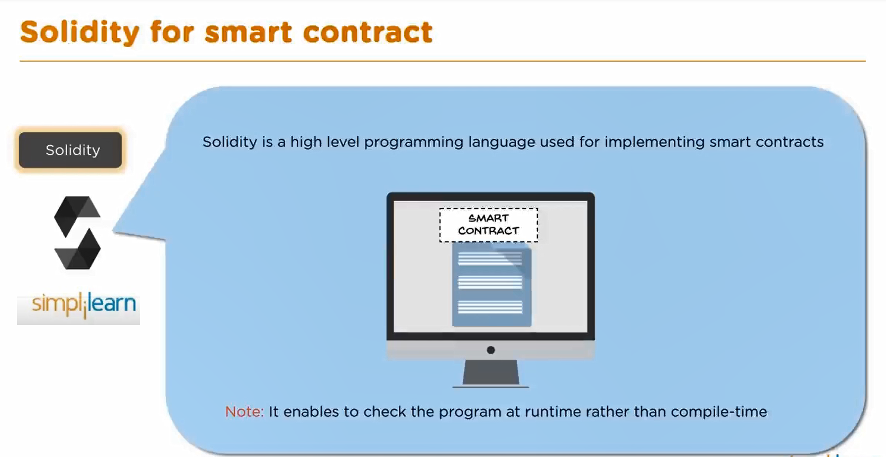

Slide 25
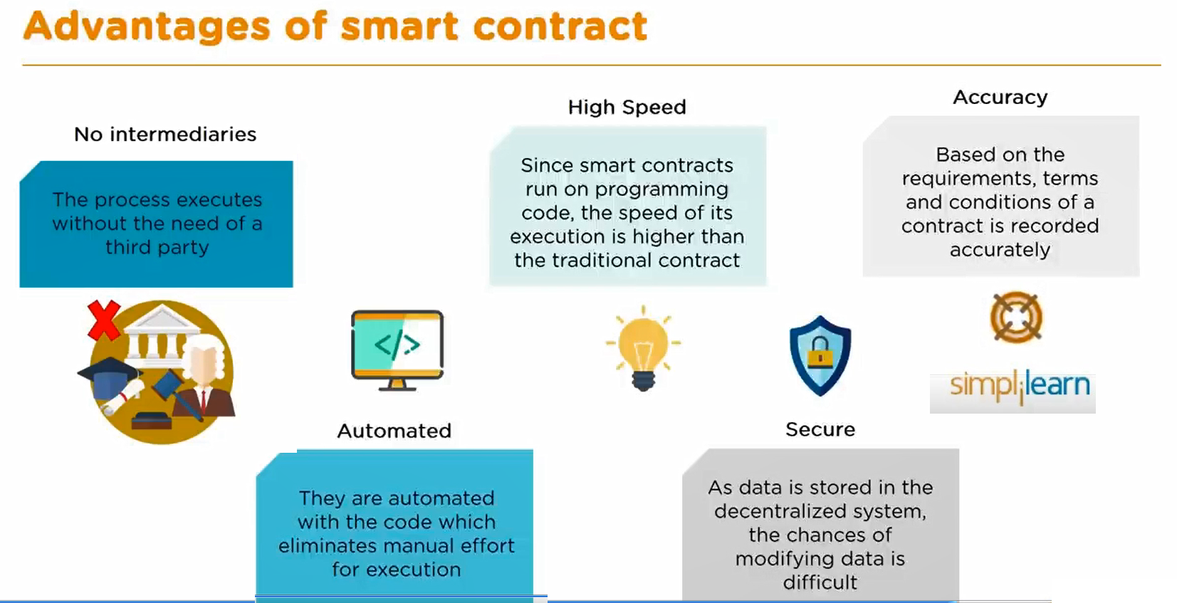

Slide 26
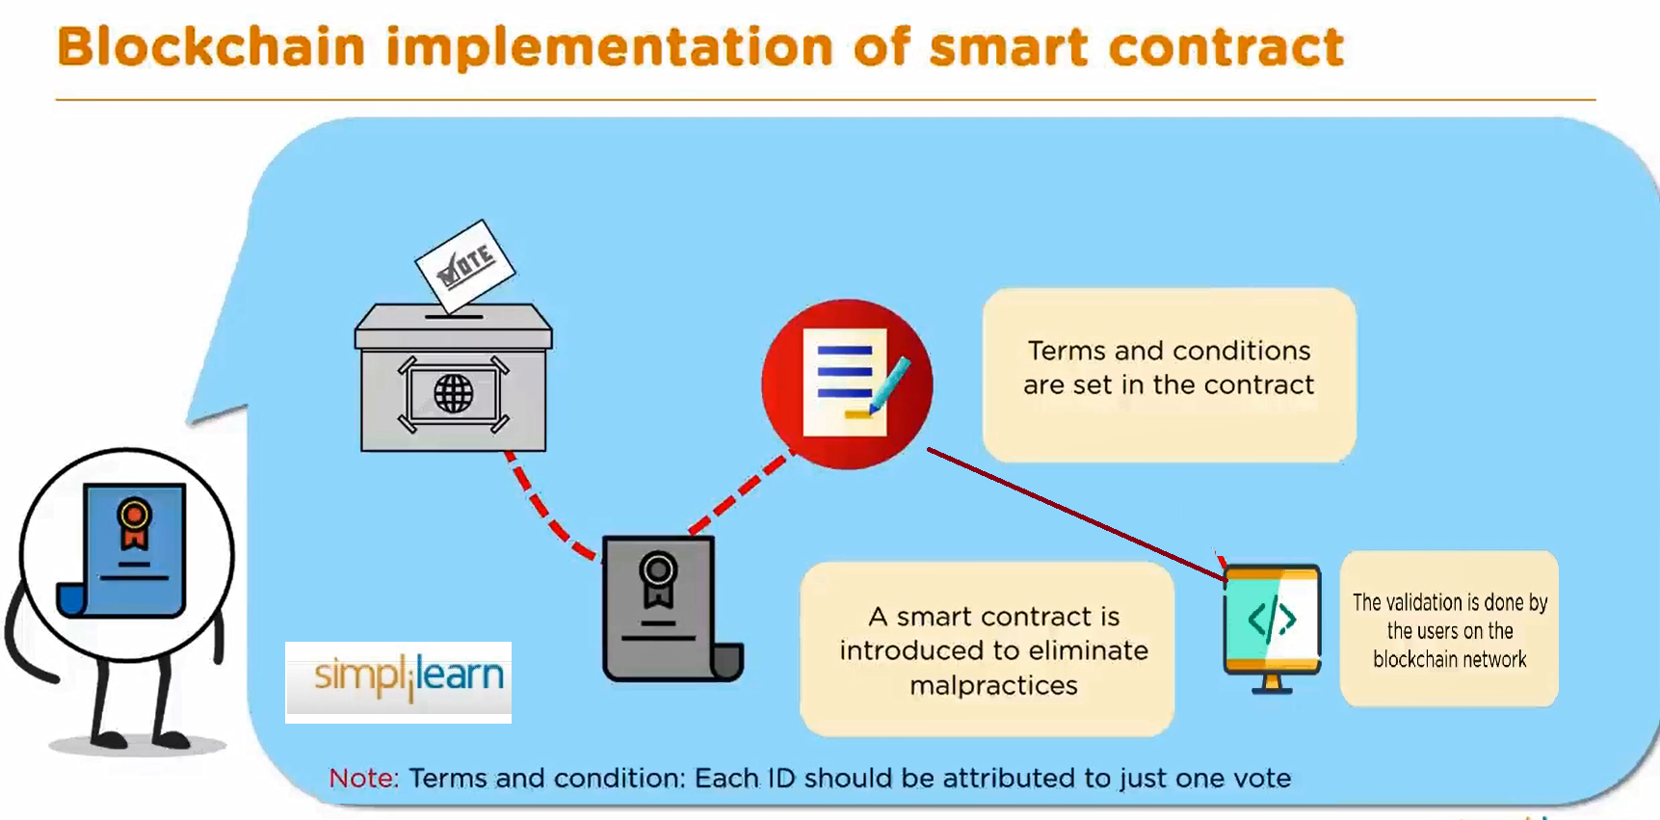

Slide 27
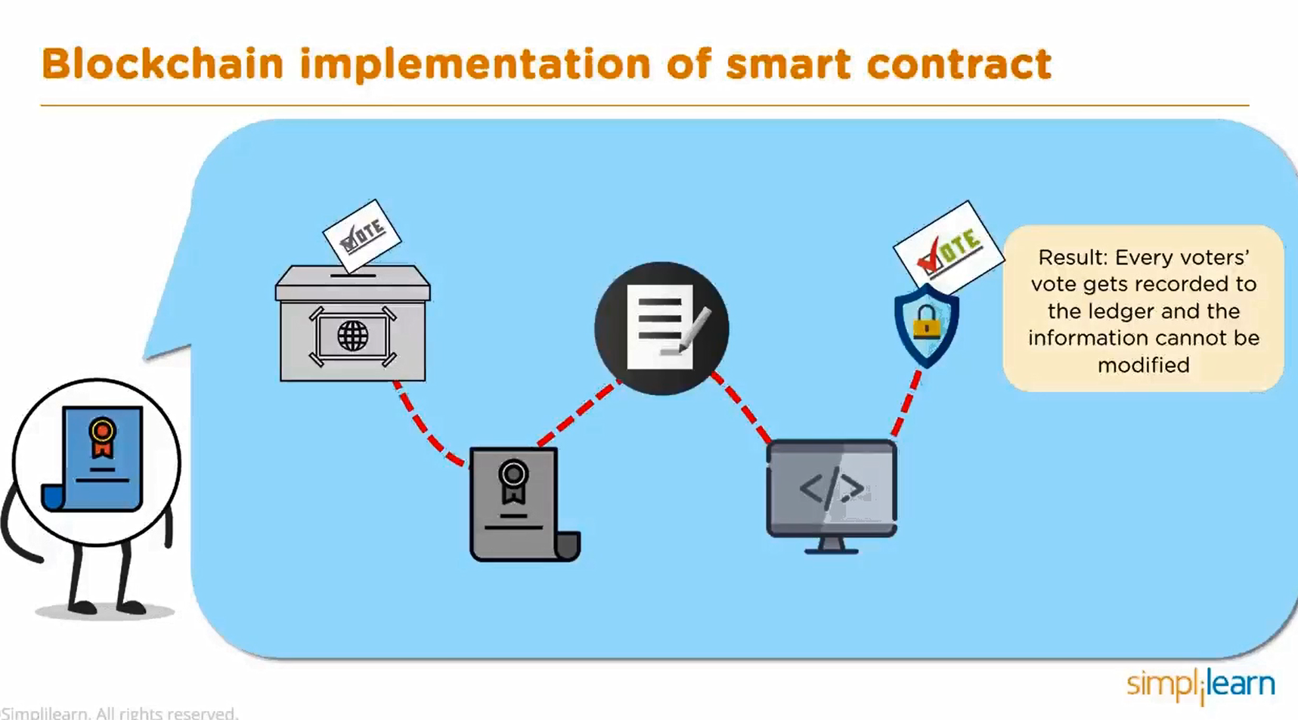

Slide 28
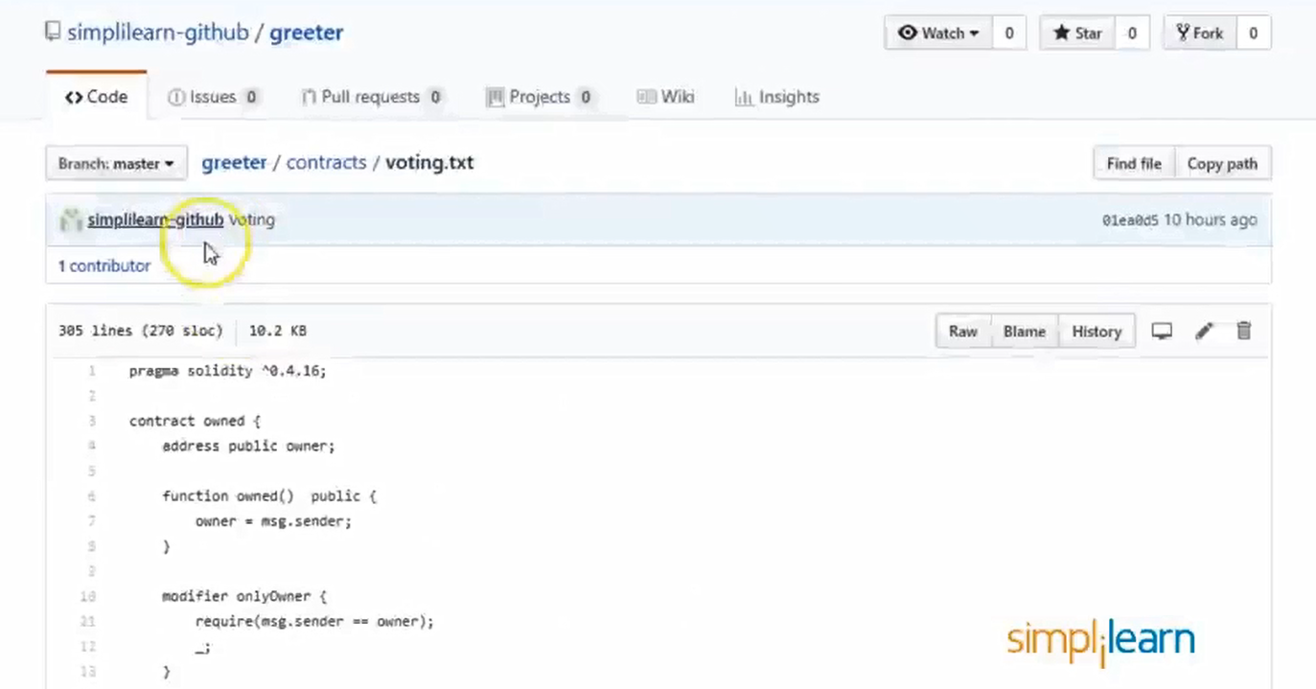

Slide 29
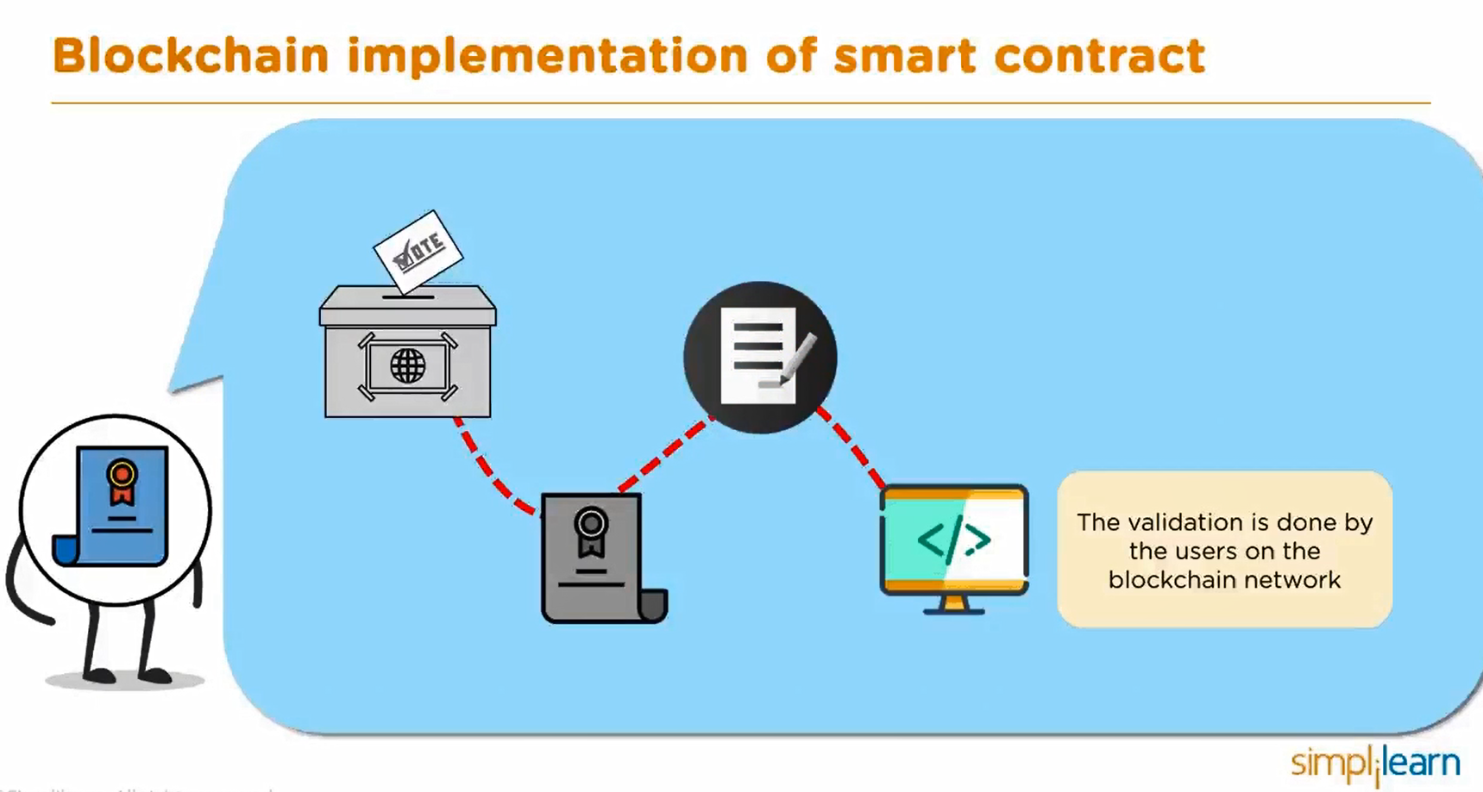

Slide 30
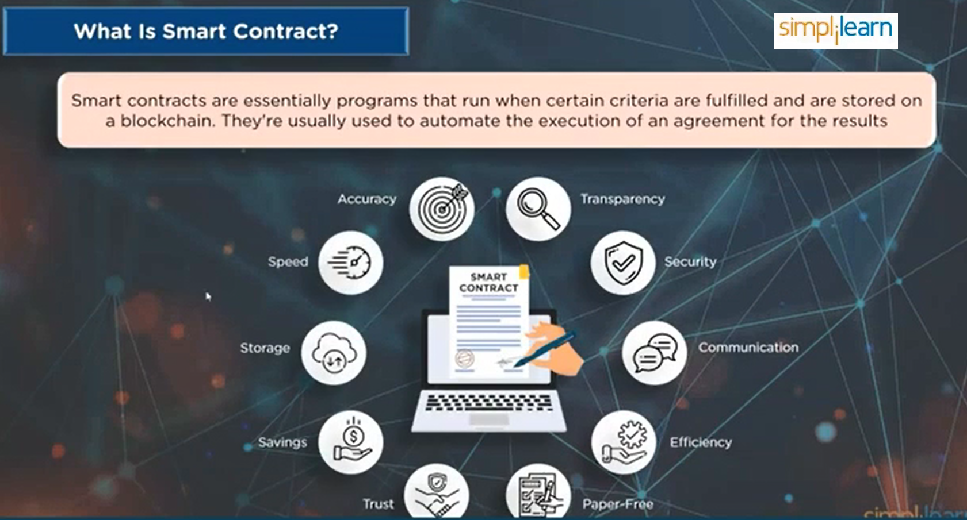

Slide 31
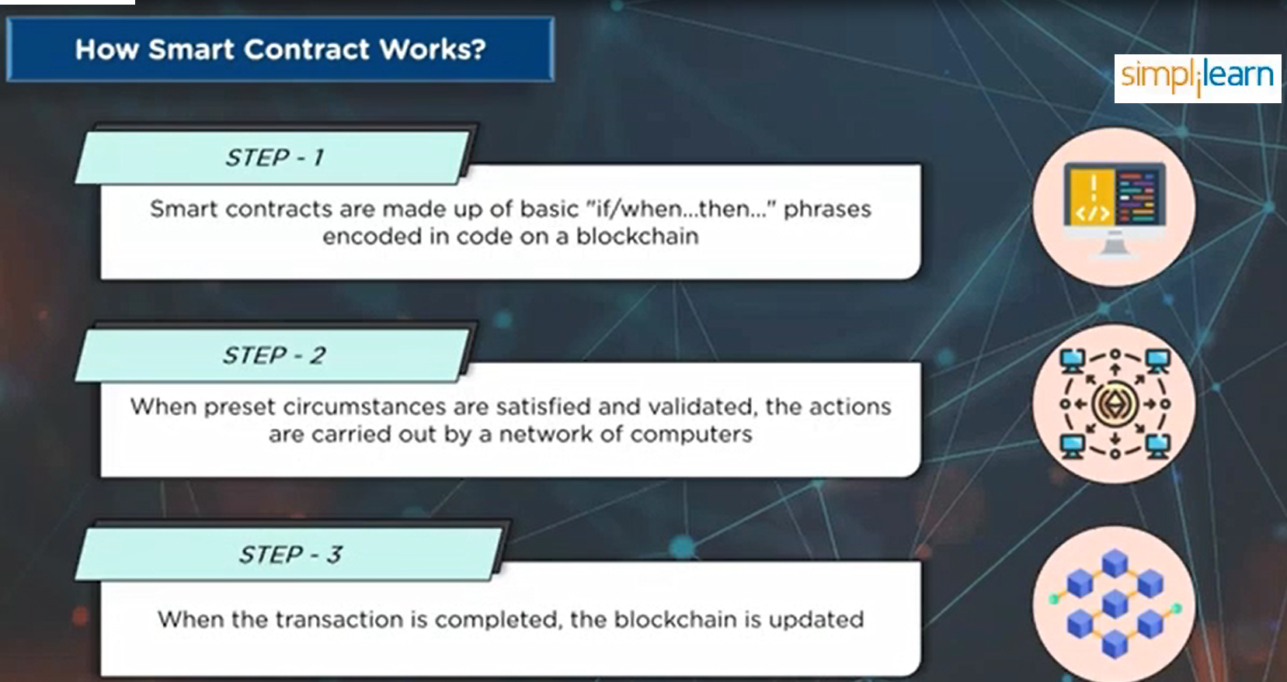

Slide 32
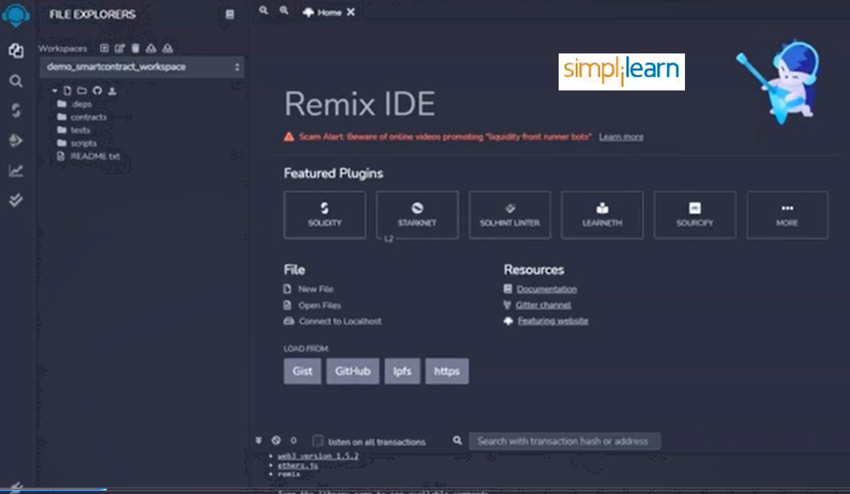

Slide 33
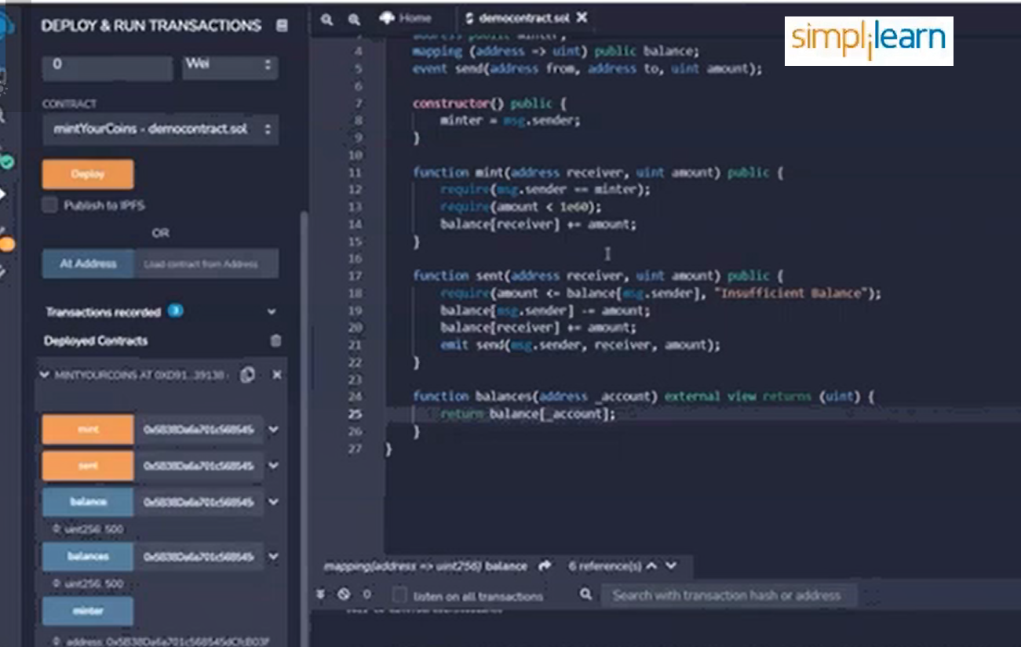

Slide 34
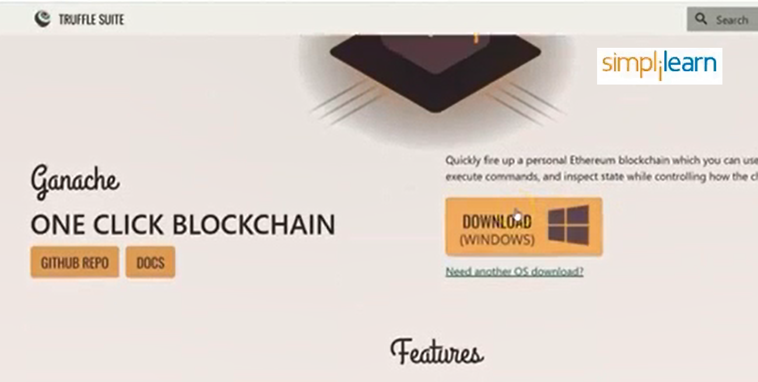

Slide 35


Slide 36
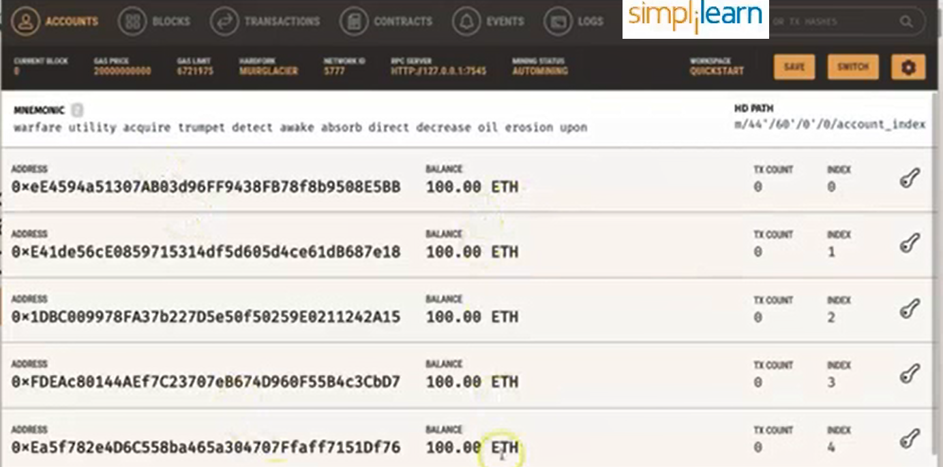

Slide 37
