Slide 1
Using Solidity to Create a Voting Smart Contract
FIN451 / MBA651

Slide 2
What is Solidity?
Solidity is a high-level programming language specifically designed for writing smart contracts on the Ethereum blockchain.
It’s similar in syntax to JavaScript, making it accessible for those familiar with web development. Smart contracts are self-executing contracts where the terms are directly written into code.
They allow for the creation of decentralized applications (DApps) that run exactly as programmed without any possibility of downtime, fraud, or third-party interference.

Slide 3
Example: Voting Smart Contract
Let’s say you want to create a decentralized voting system where people can vote for their favorite candidate in an election.
The contract will count the votes and declare the winner based on the votes received.
Here's a basic outline of how a voting smart contract might look in Solidity:
https://github.com/magfoley/voting-solidity/blob/main/example

Slide 4
Explanation of the Code
Structs and Mappings: The Candidate struct holds the candidate's ID, name, and vote count. We use mappings to store candidates and keep track of whether an address has voted.
Constructor: Initializes the contract by adding two candidates and opening the voting process.
Functions:
addCandidate: Adds a candidate to the election.
vote: Allows a voter to vote for a candidate. It checks that the voter hasn’t voted before and that the candidate ID is valid.
closeVoting: Closes the voting process.
getWinner: Determines and returns the name of the candidate with the most votes.

Slide 5
Deploying the Contract Using Truffle
Step 1: Install Truffle and Initialize a Project
npm install -g truffle
truffle init
Step 2: Write the Contract Place your Voting.sol file in the contracts/ directory.
Step 3: Compile the Contract
truffle compile

Slide 6
Step 4: Deploy the Contract
First, create a 2_deploy_contracts.js file in the migrations/ directory:
const Voting = artifacts.require("Voting");
module.exports = function (deployer) {
deployer.deploy(Voting);
};
Next, deploy the contract
truffle migrate

Slide 7
Step 5: Interact with the Contract Using Truffle Console:
truffle console
Voting.deployed().then(instance => instance.vote(1, {from: accounts[0]}))

Slide 8
Step 6: Create a Frontend
Set up a basic HTML/JavaScript DApp that interacts with your contract using Web3.js.

Slide 9
Using Remix to Deploy Smart Contract
Step 1: Open Remix IDE Visit Remix IDE.
Step 2: Create and Compile the Contract
Create a new file named Voting.sol and paste the Solidity code. Click on the "Solidity Compiler" tab, then click "Compile Voting.sol".
Step 3: Deploy the Contract
Go to the "Deploy & Run Transactions" tab.
Choose "JavaScript VM" in the environment.
Click "Deploy".

Slide 10
Using Remix to Deploy Smart Contract
Step 4: Interact with the Contract You can now interact with your contract directly from Remix. Use the interface to call functions like vote, closeVoting, and getWinner.
Step 5: Setting Up a Simple DApp For deployment and interaction using a web app, you would write a frontend in HTML/JavaScript, connecting it to the Remix-deployed contract using Web3.js.

Slide 11
Detailed Setup of a DApp
Frontend Setup:
HTML: Basic structure and UI elements for voting.
JavaScript: Use Web3.js to interact with the contract.
Web3.js: Connect your frontend to the Ethereum network (you can use MetaMask or Ganache for local testing).
Truffle Setup:
Create a client/ directory for your frontend.
Use Webpack or another bundler to manage your assets.
Connect your contract using Web3.js and interact with it from your JavaScript code.
Remix Setup:
Directly interact with the smart contract using the Remix console.
Deploy the contract on a testnet (like Ropsten) if you want to access it outside of Remix.

Slide 12
Conclusion
By following these steps, you’ll have created, deployed, and interacted with a decentralized voting application using Solidity, Truffle, and Remix.
This provides a practical introduction to building DApps on the Ethereum blockchain, demonstrating the power and flexibility of smart contracts.

Slide 13
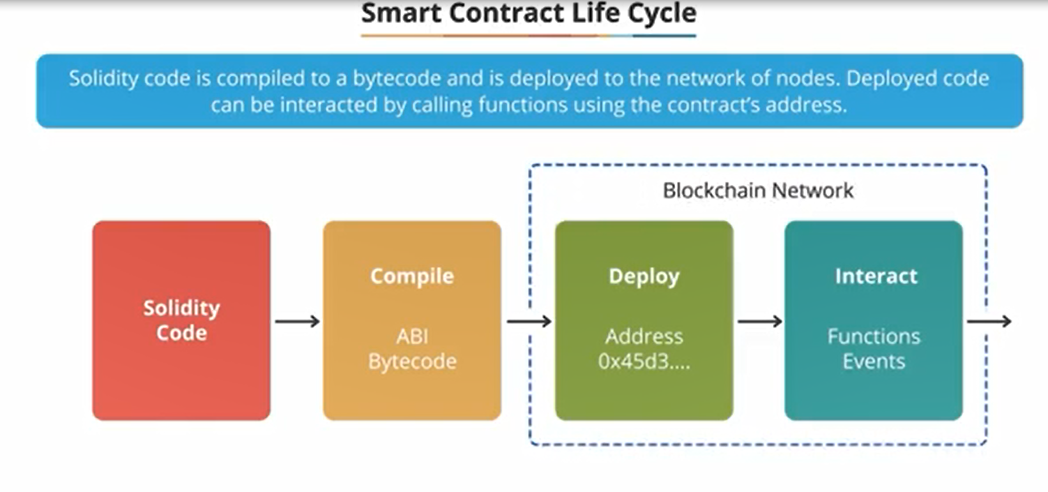

Slide 14
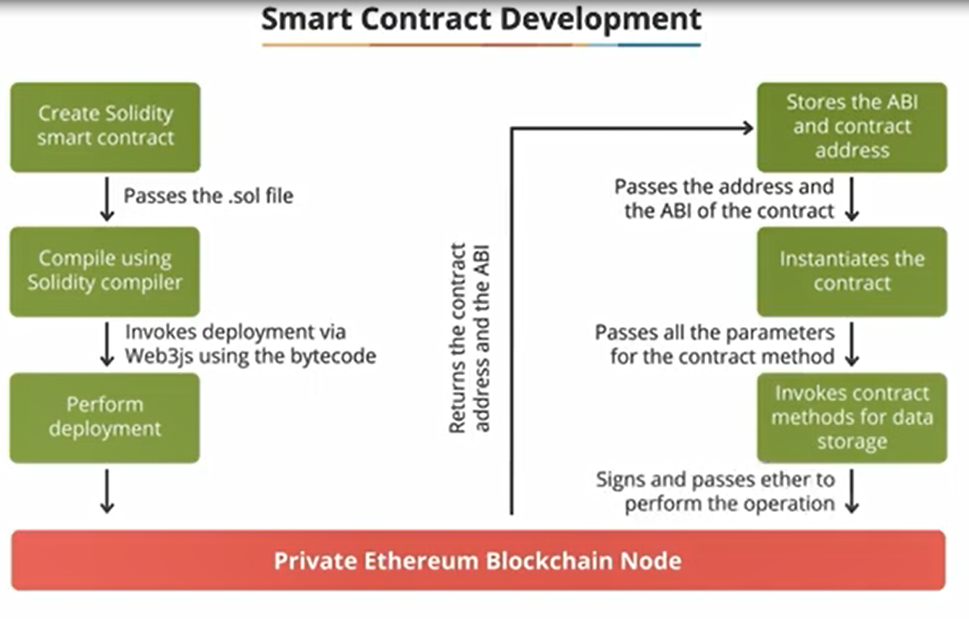

Slide 15
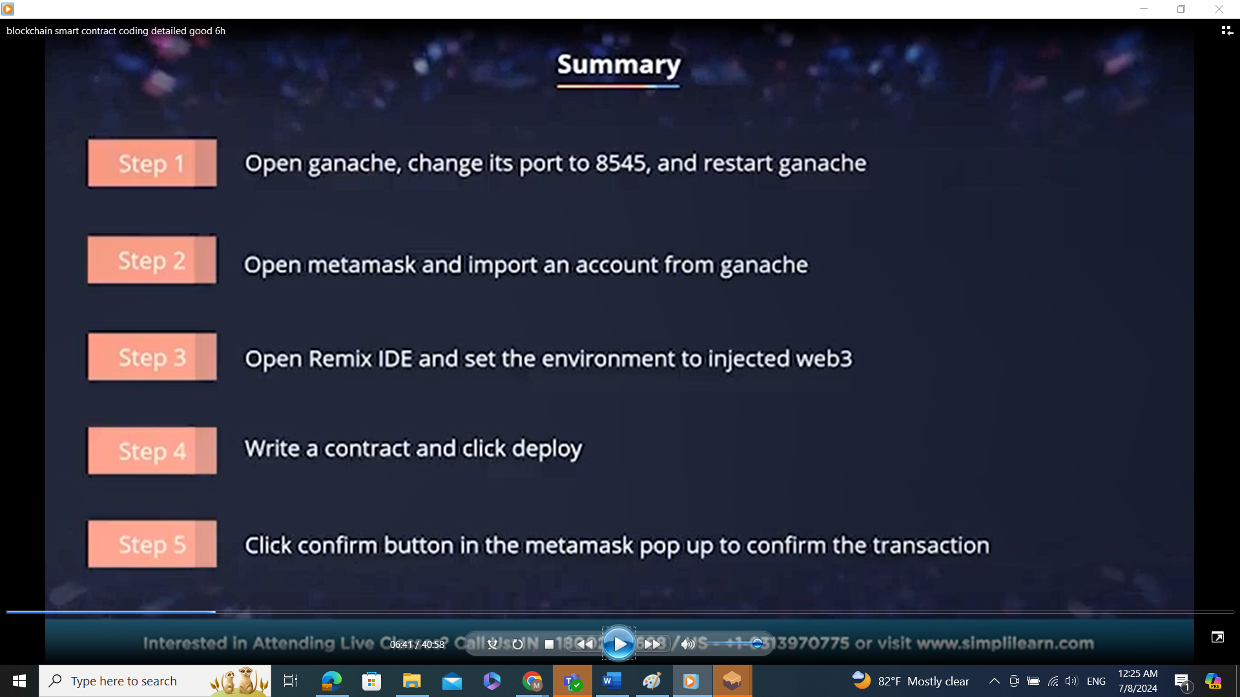

Slide 16
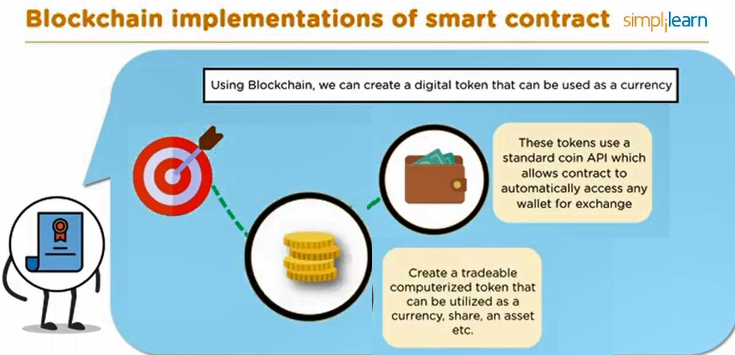

Slide 17
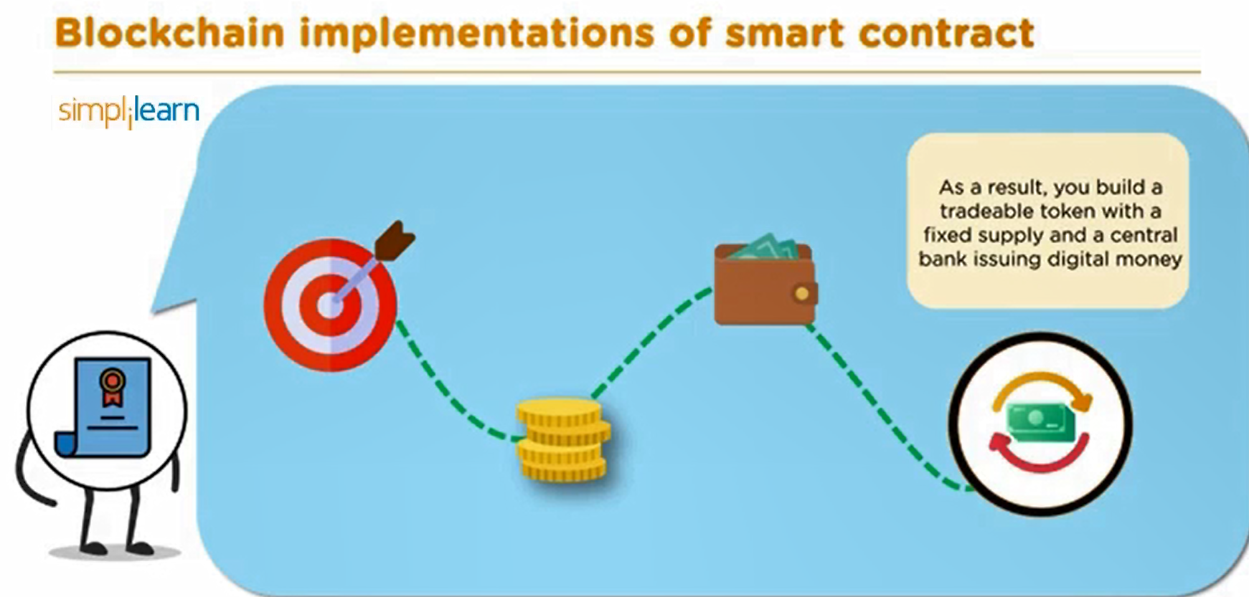

Slide 18
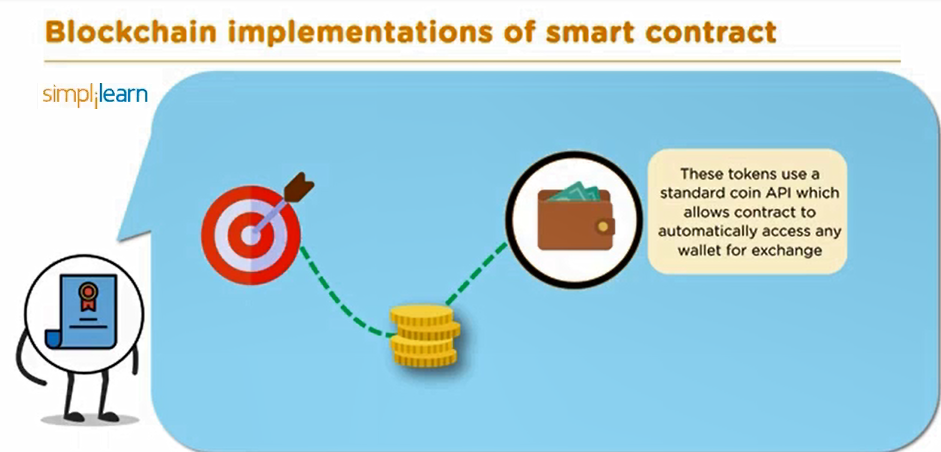

Slide 19
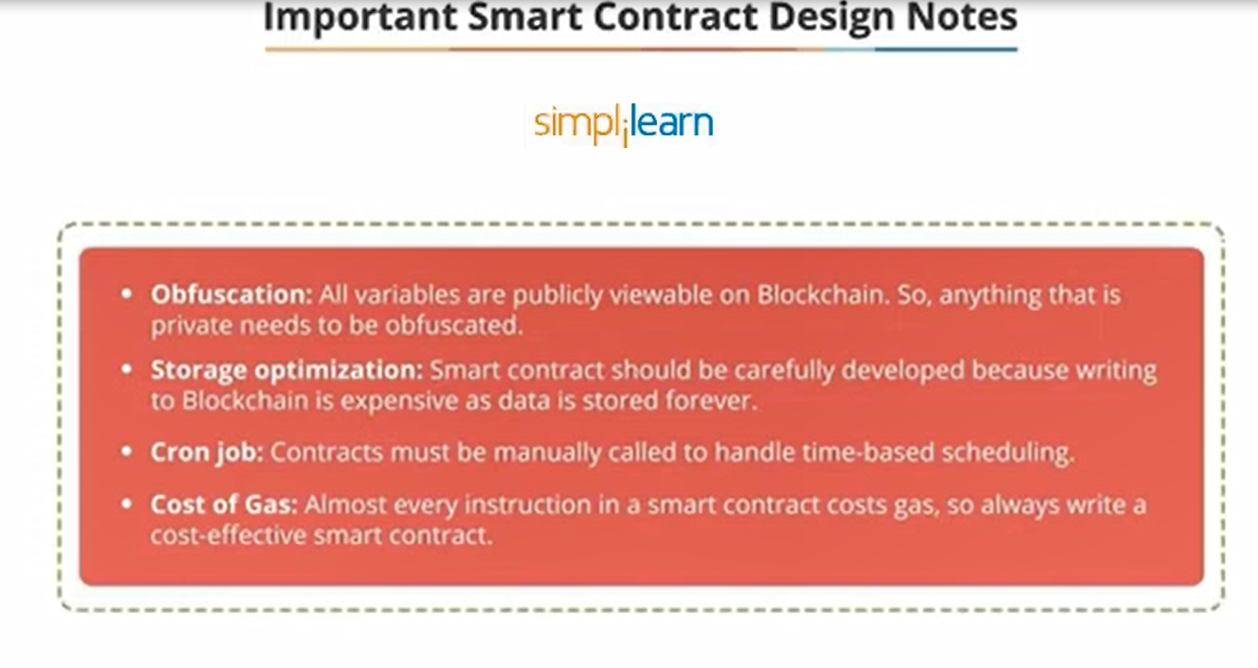

Slide 20
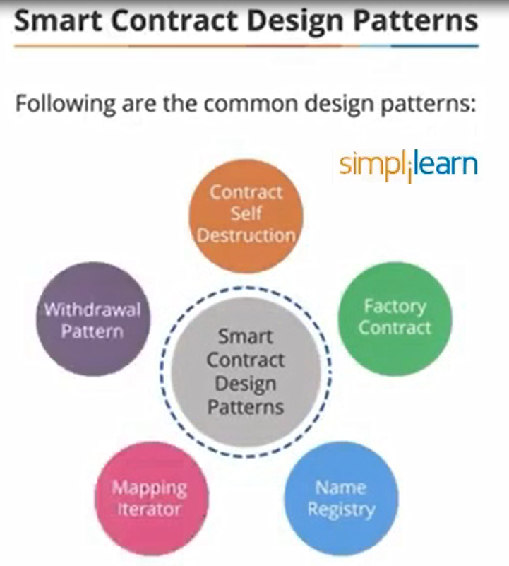

Slide 21
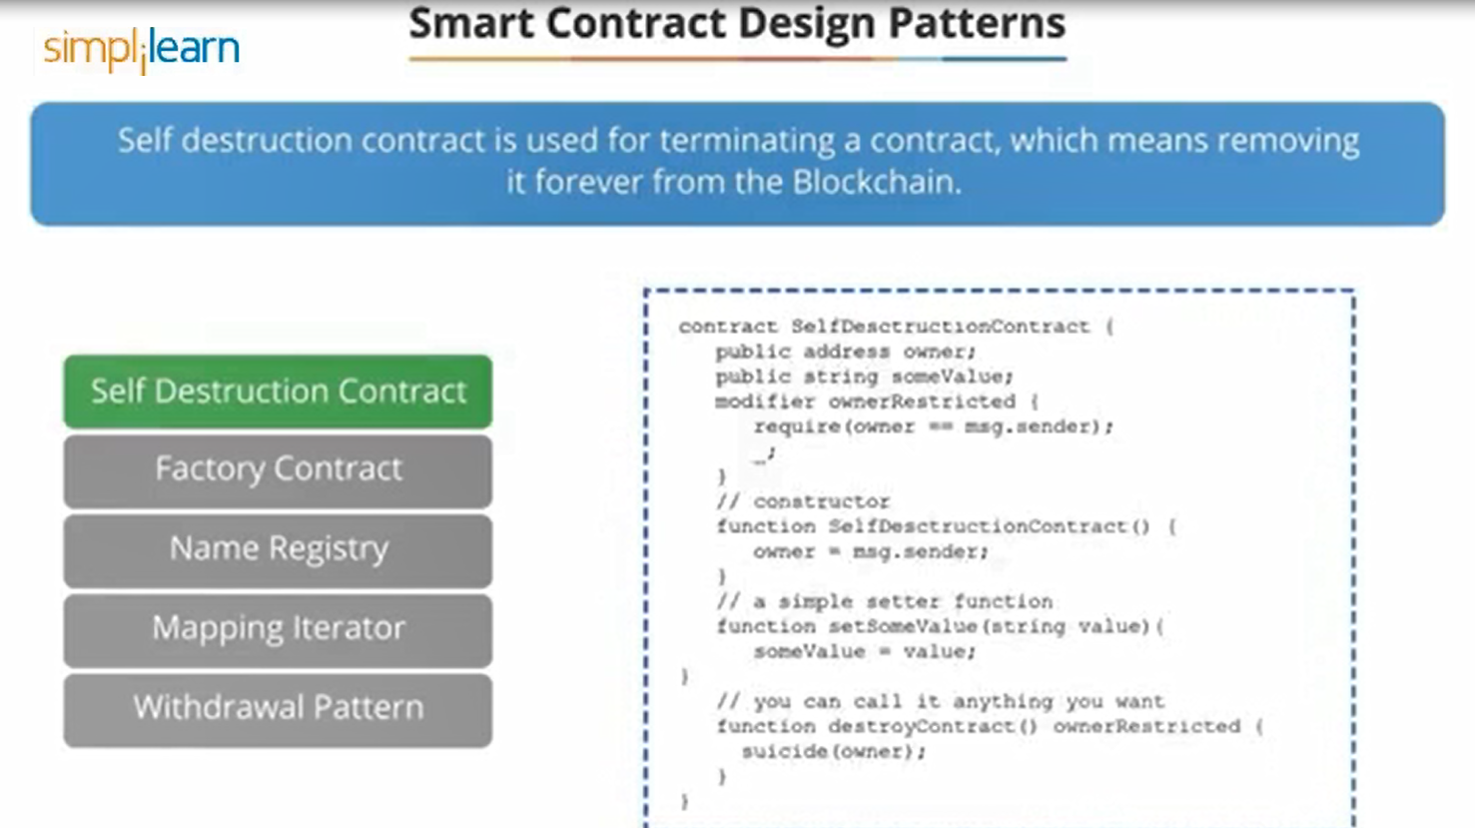

Slide 22
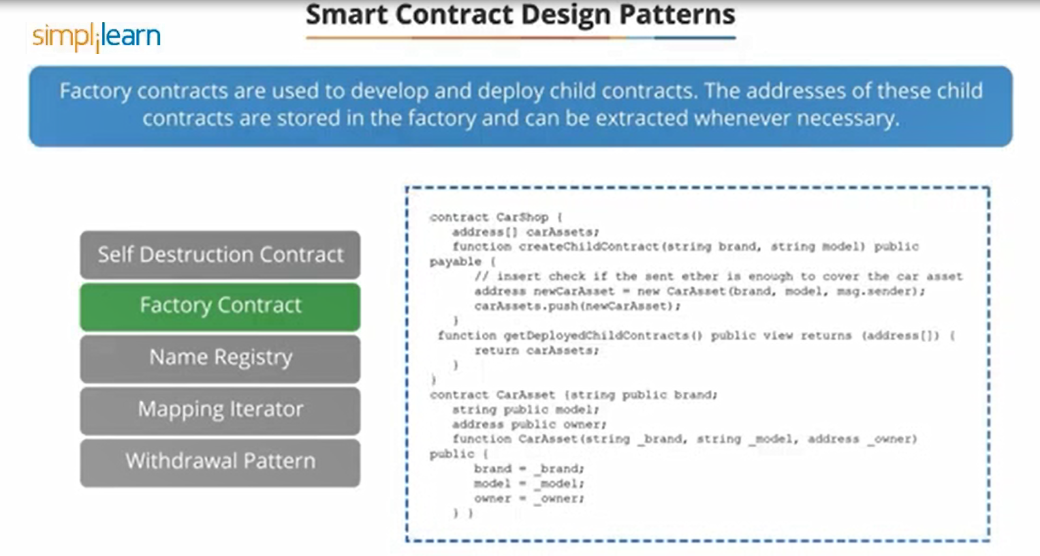
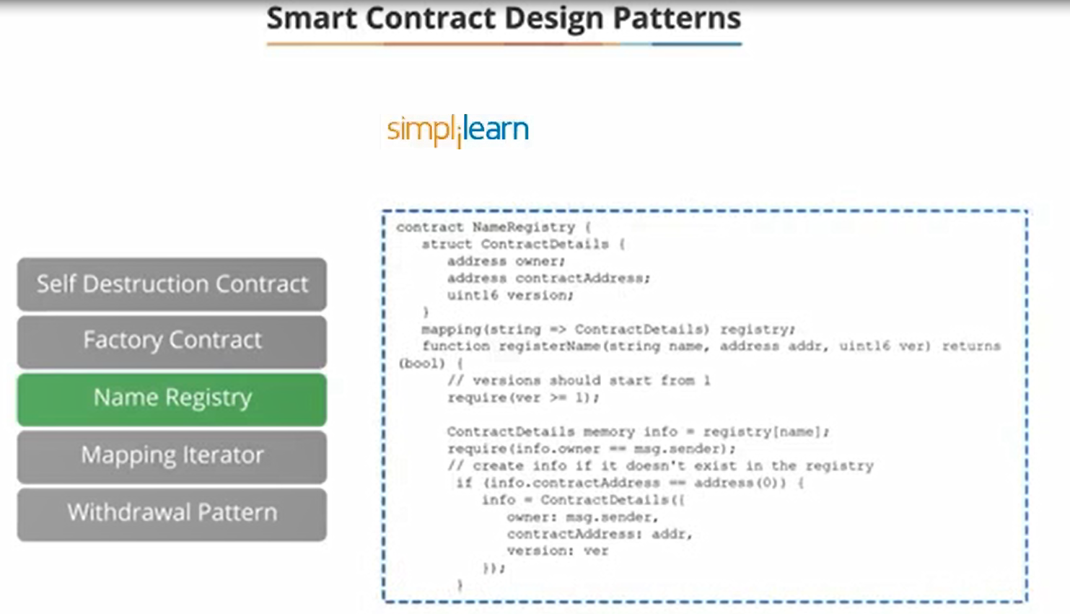

Slide 24
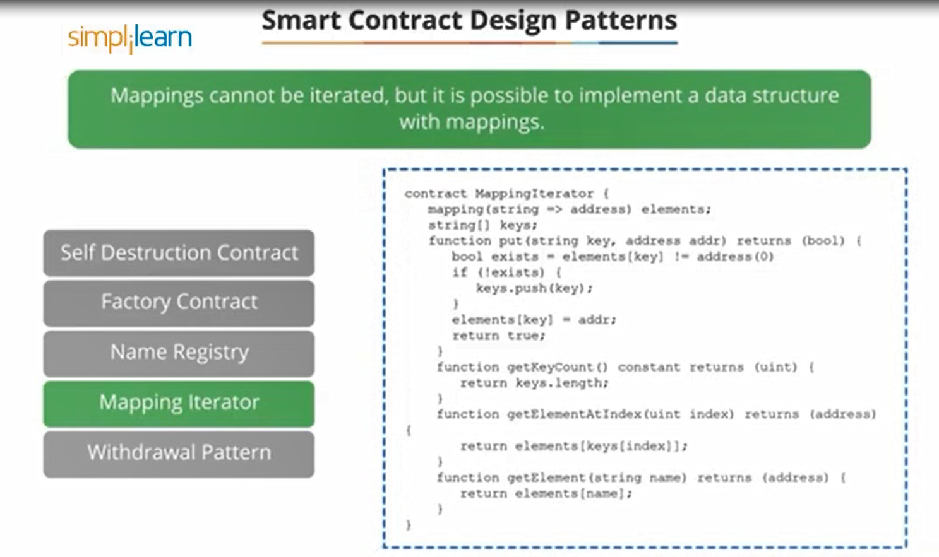

Slide 25
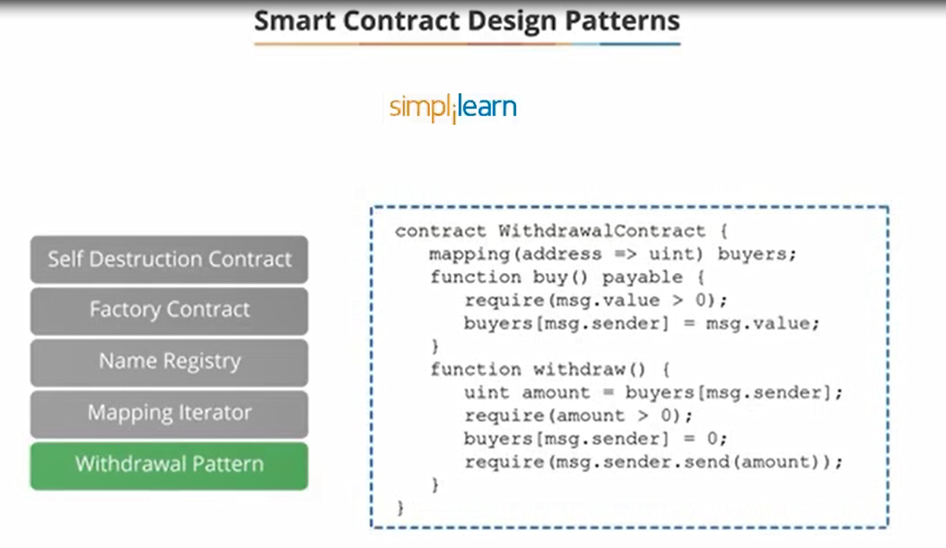

Slide 26
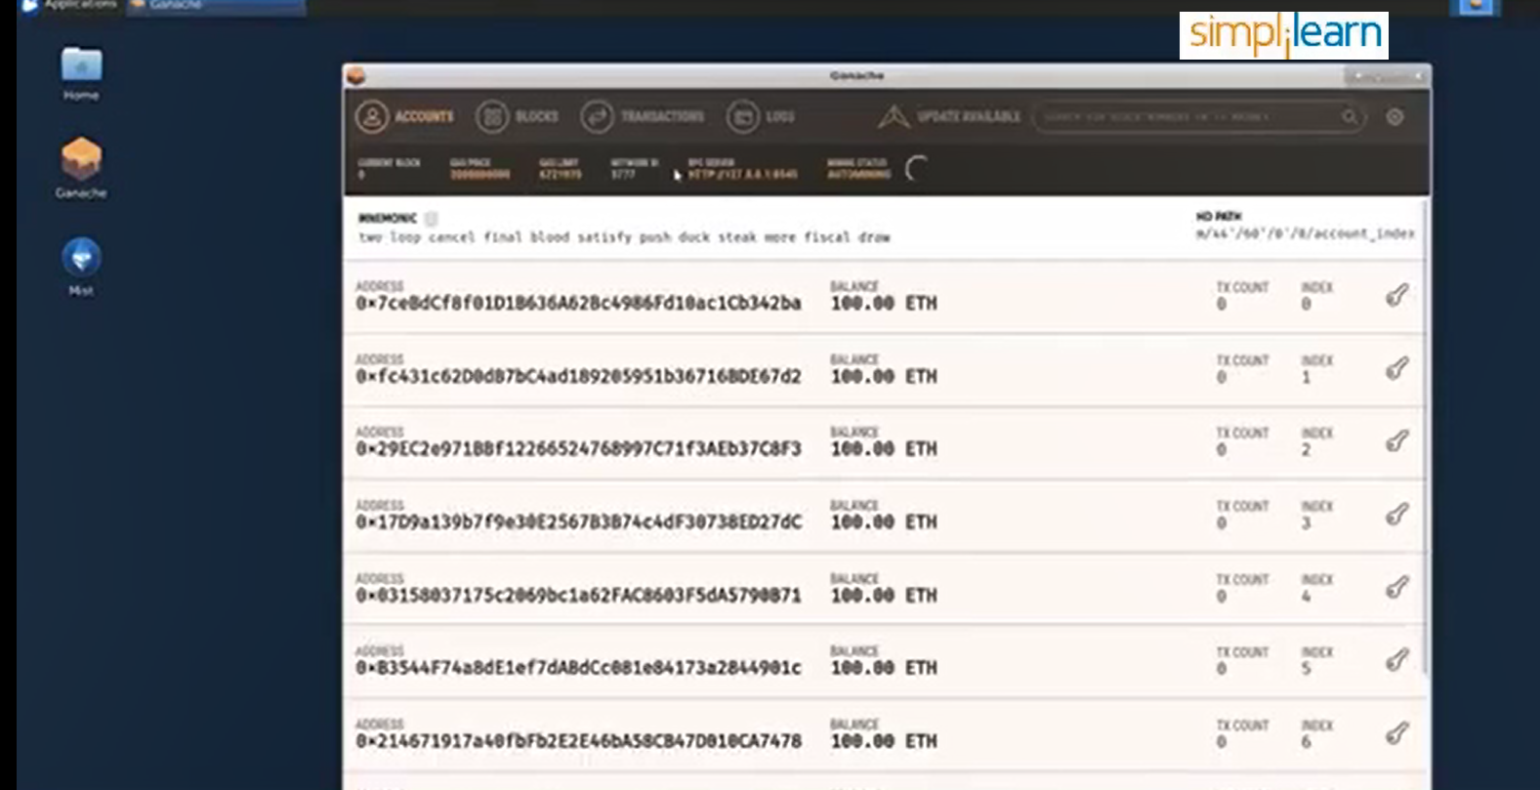
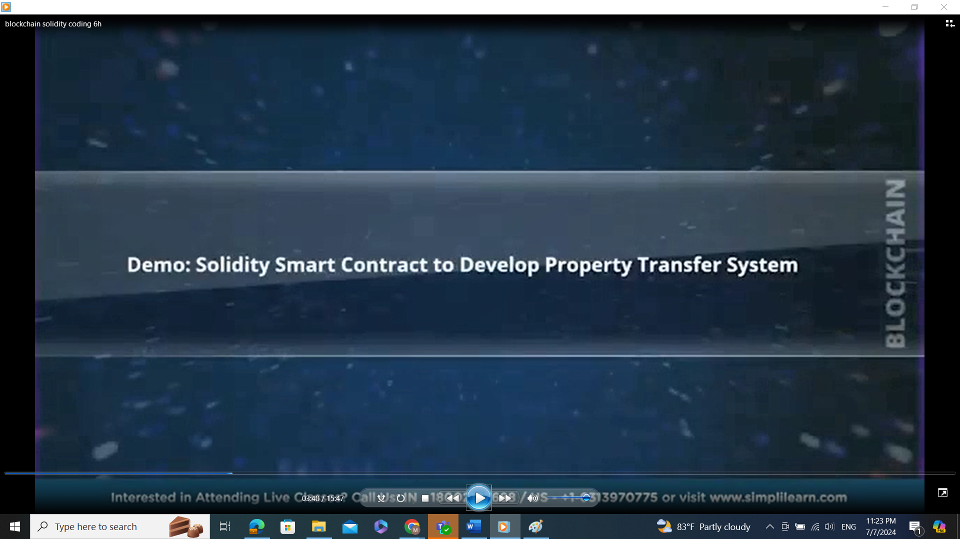

Slide 27
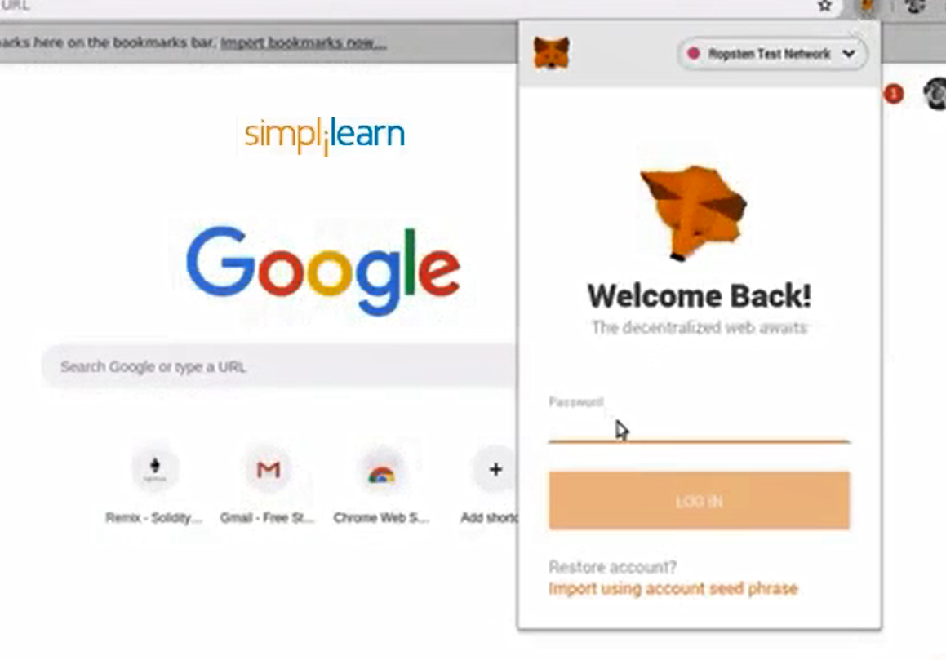

Slide 28
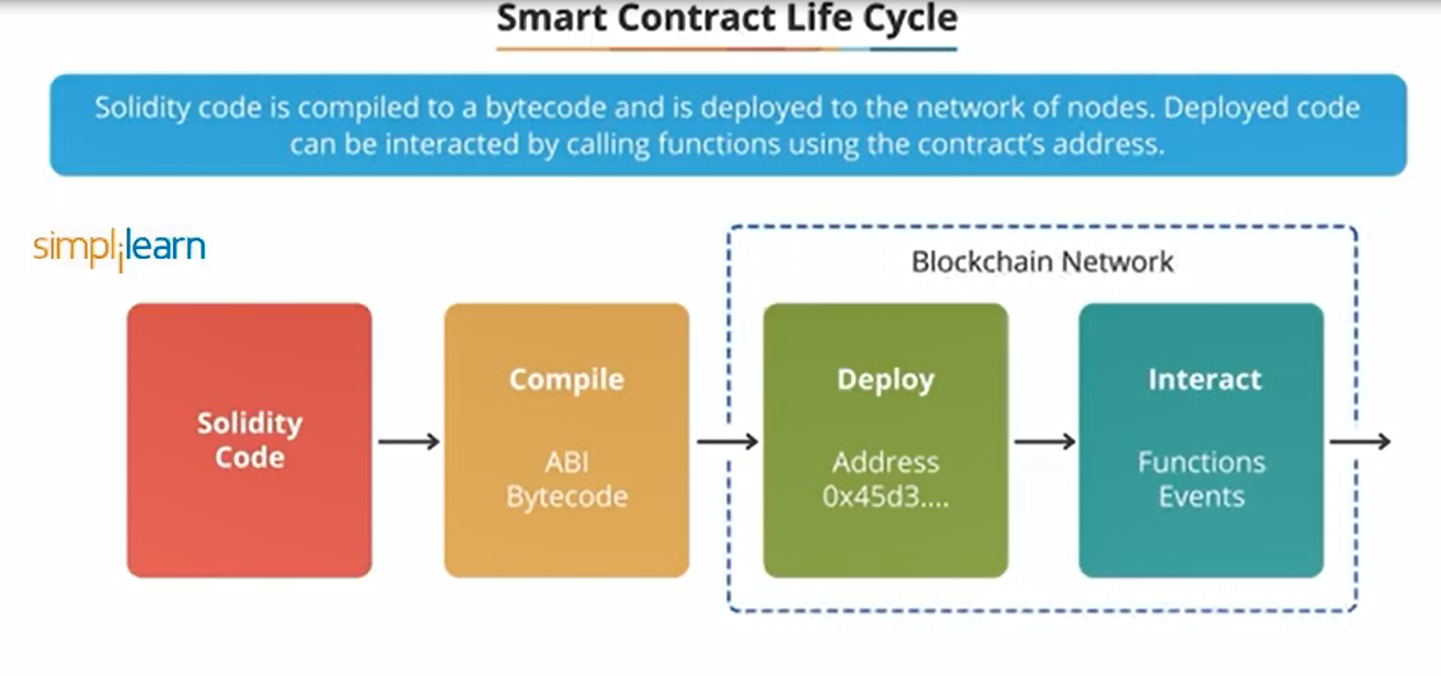

Slide 29
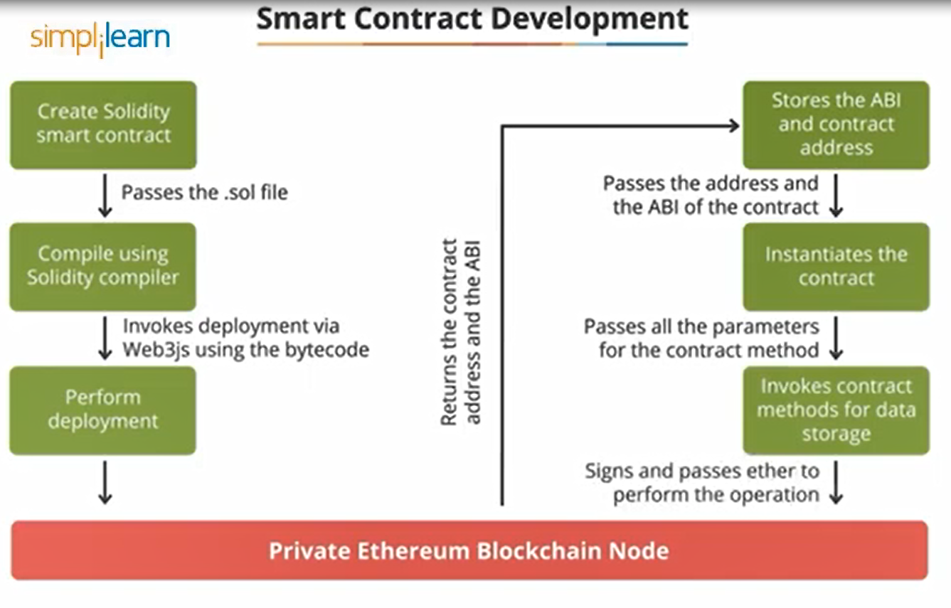

Slide 30
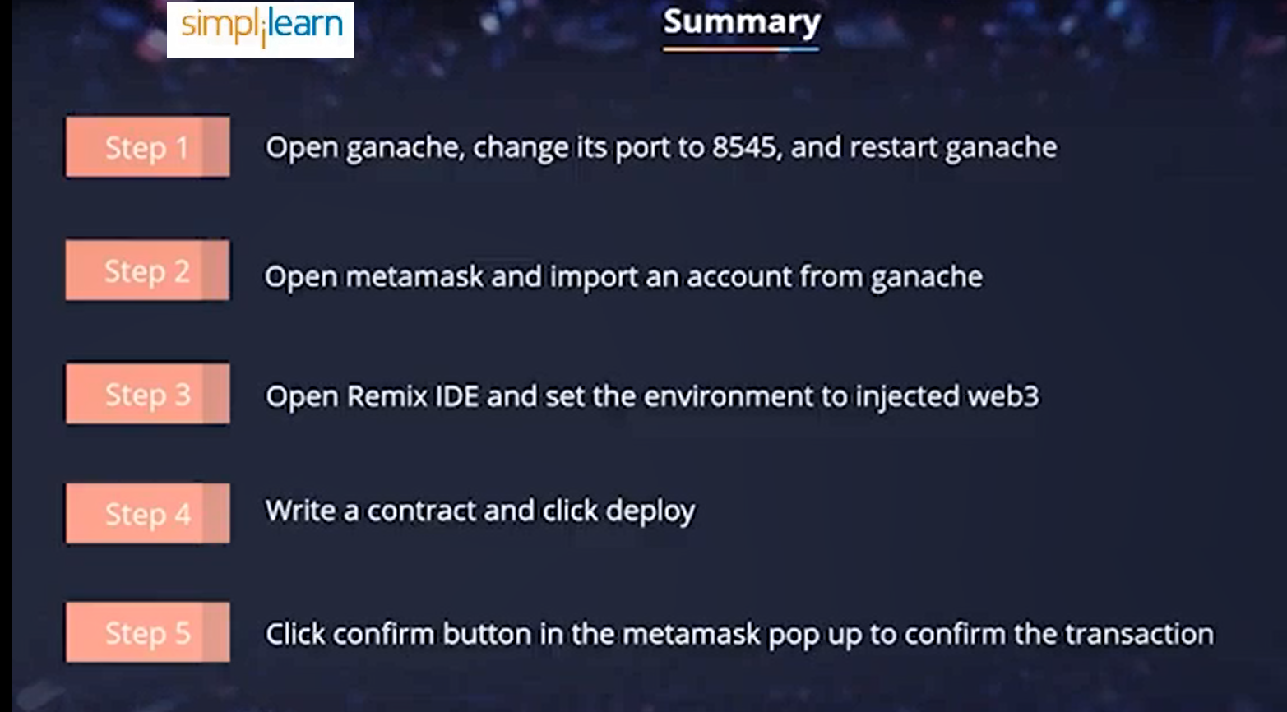

Slide 31
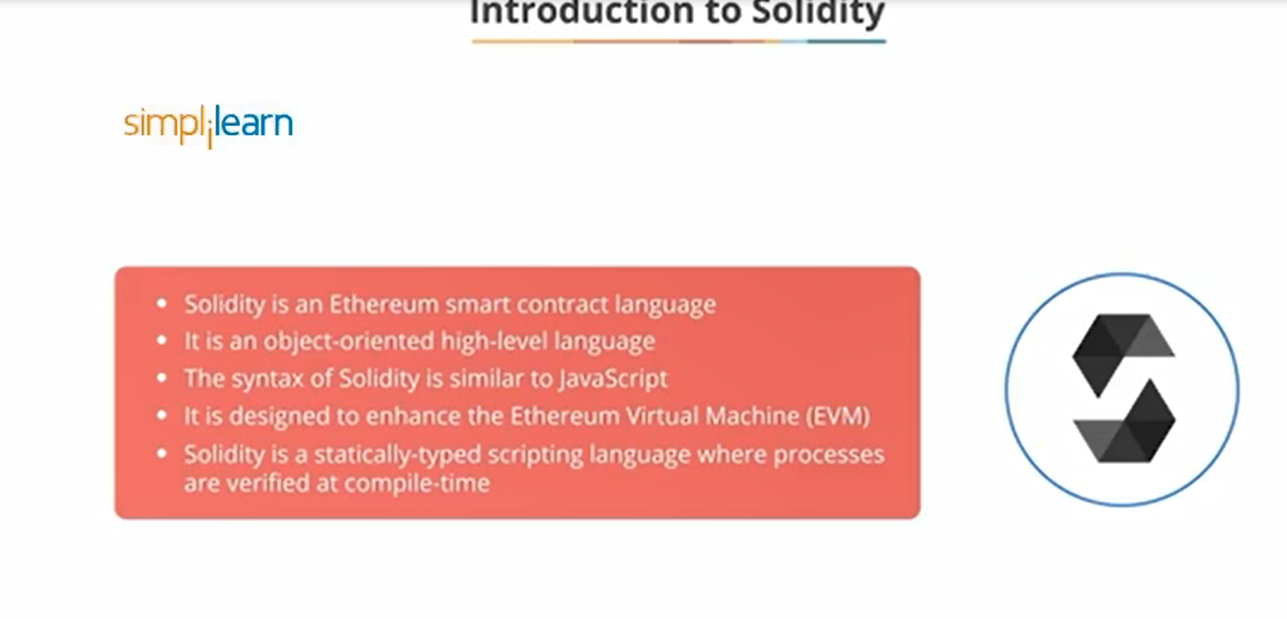

Slide 32
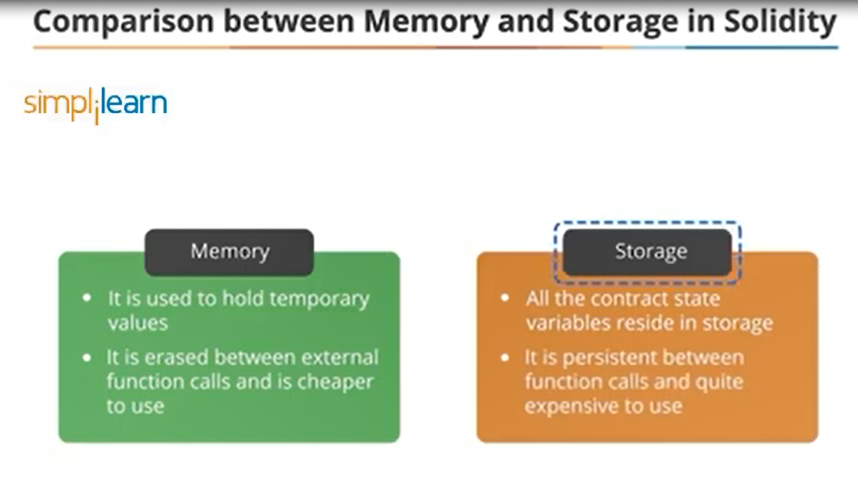

Slide 33
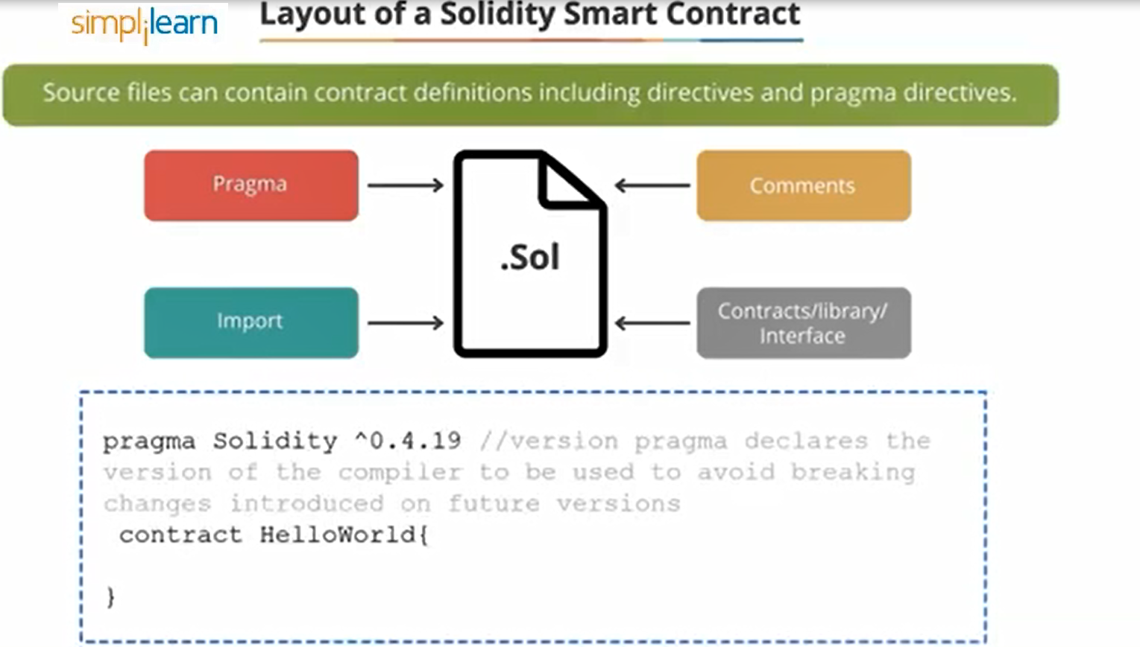

Slide 34
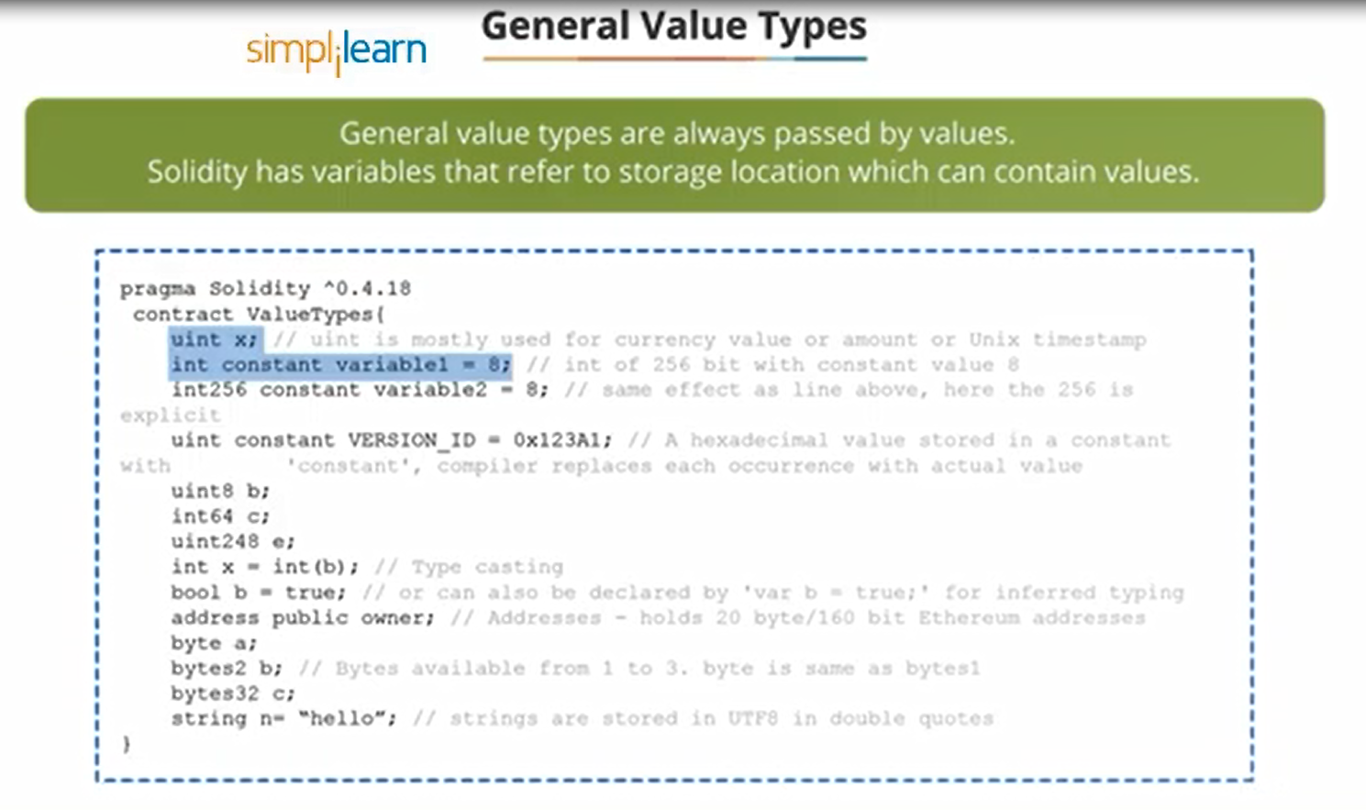

Slide 35
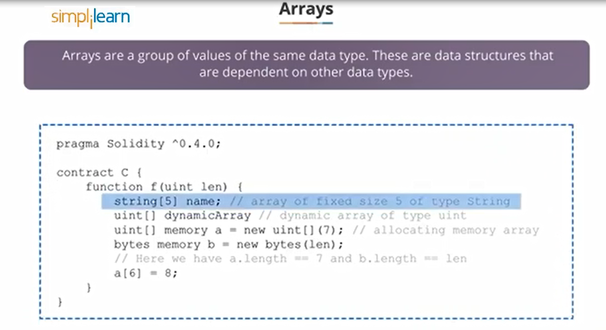

Slide 36
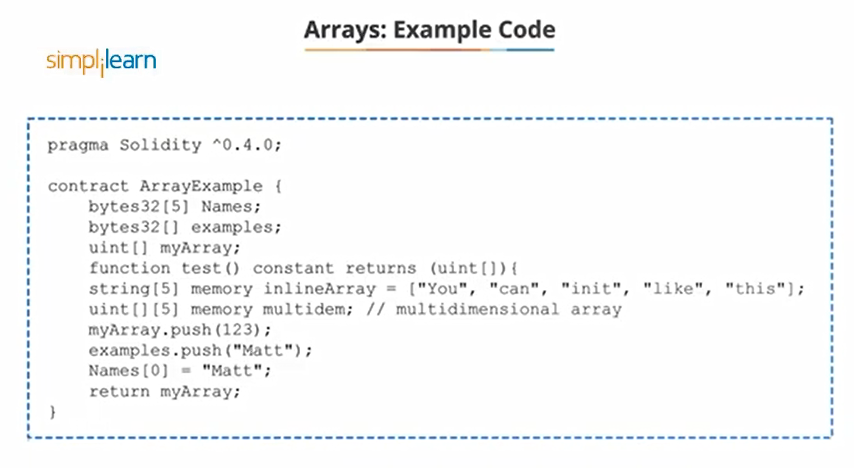

Slide 37
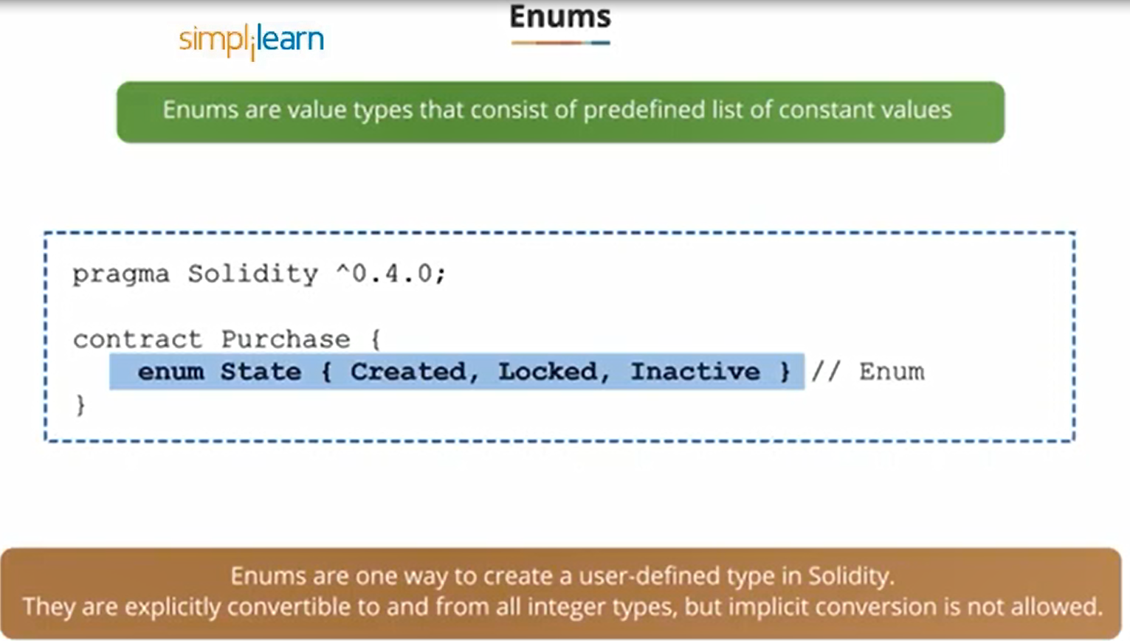

Slide 38
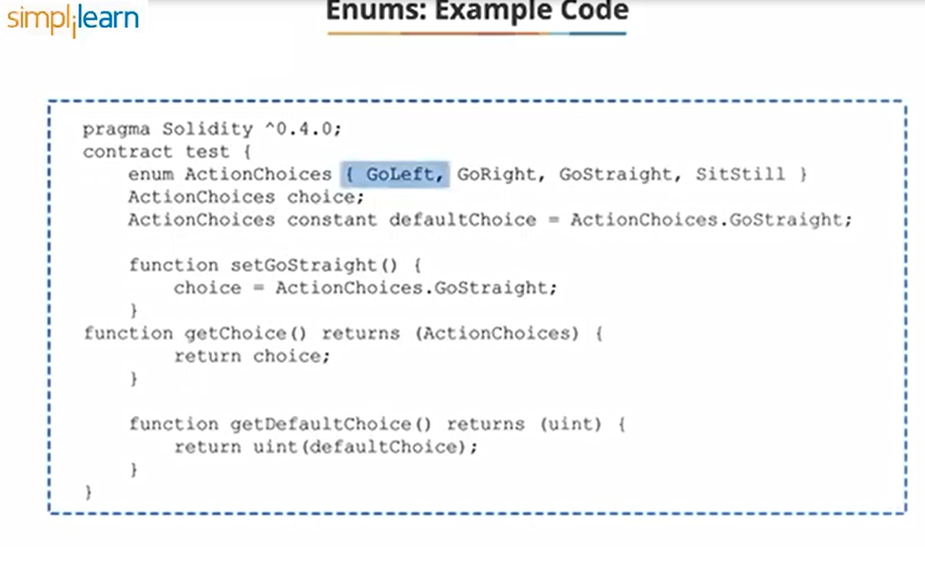

Slide 39
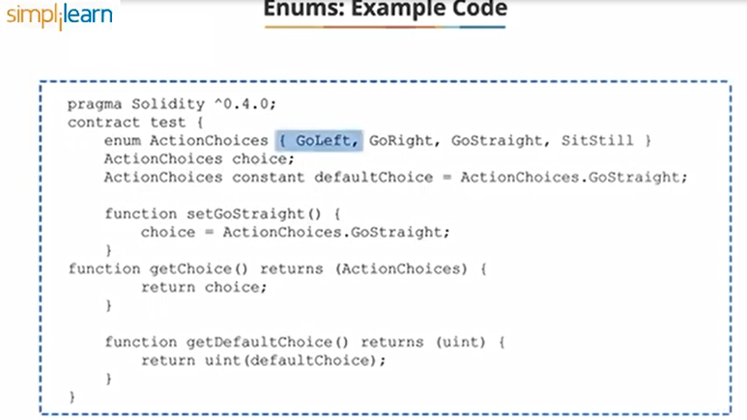

Slide 40
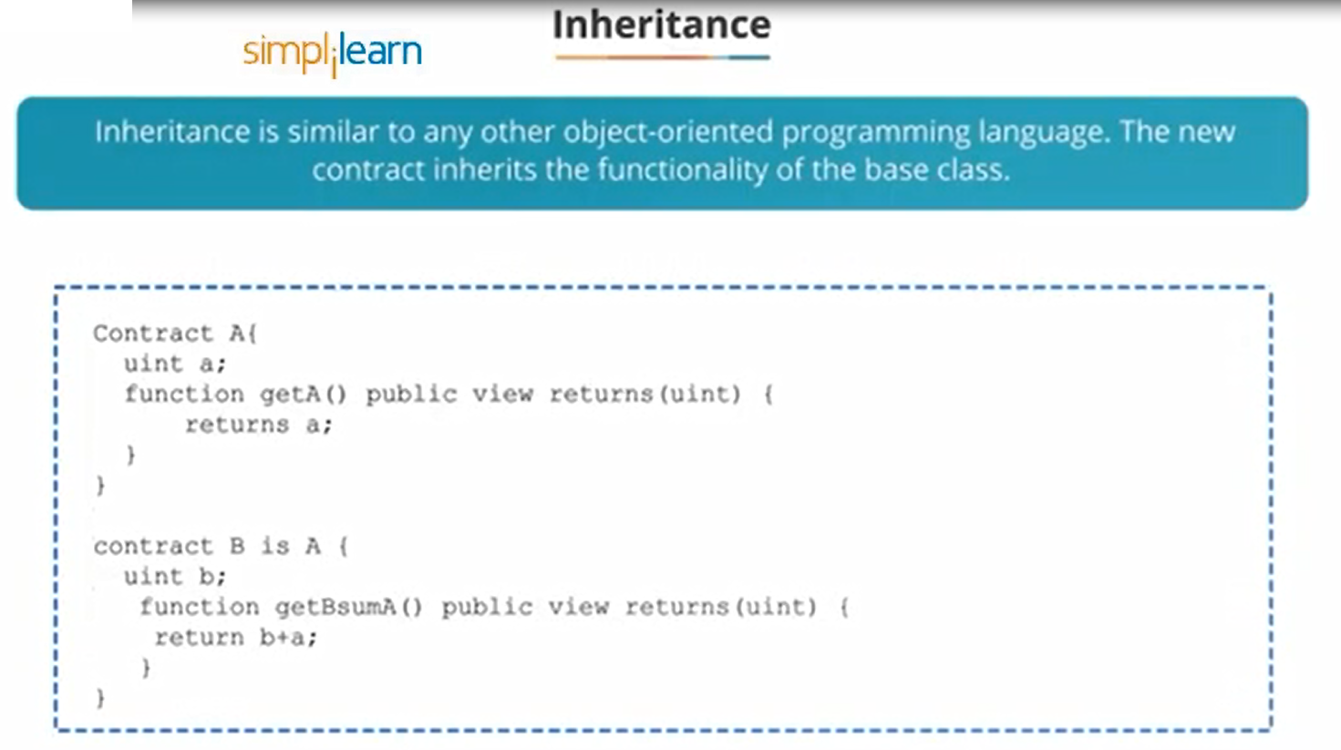

Slide 41
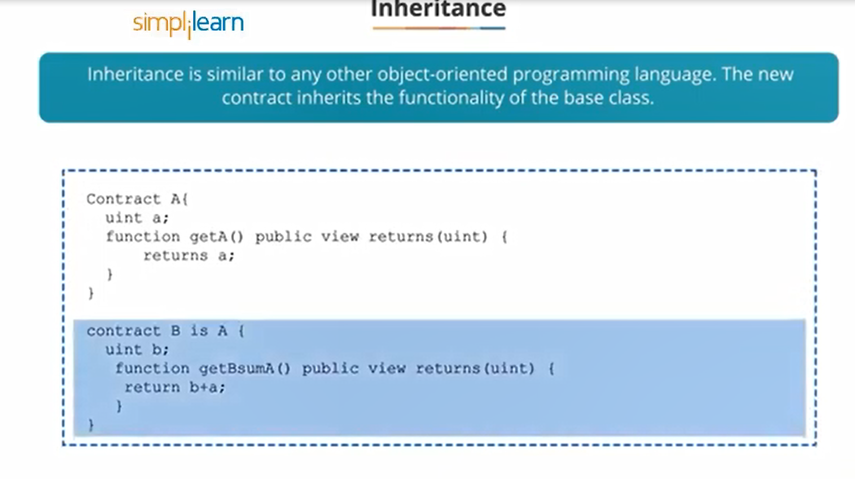

Slide 42
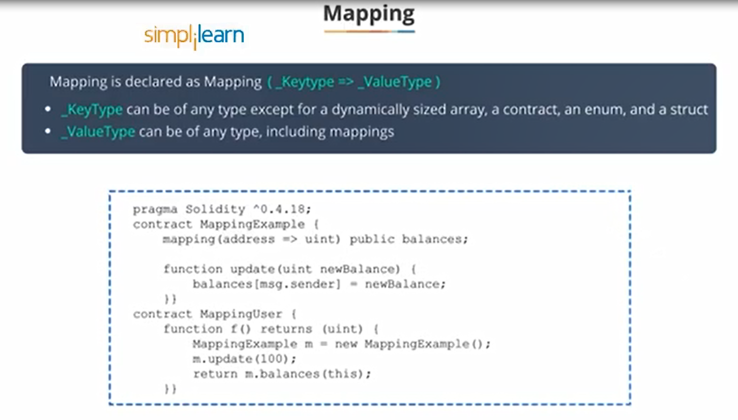

Slide 43
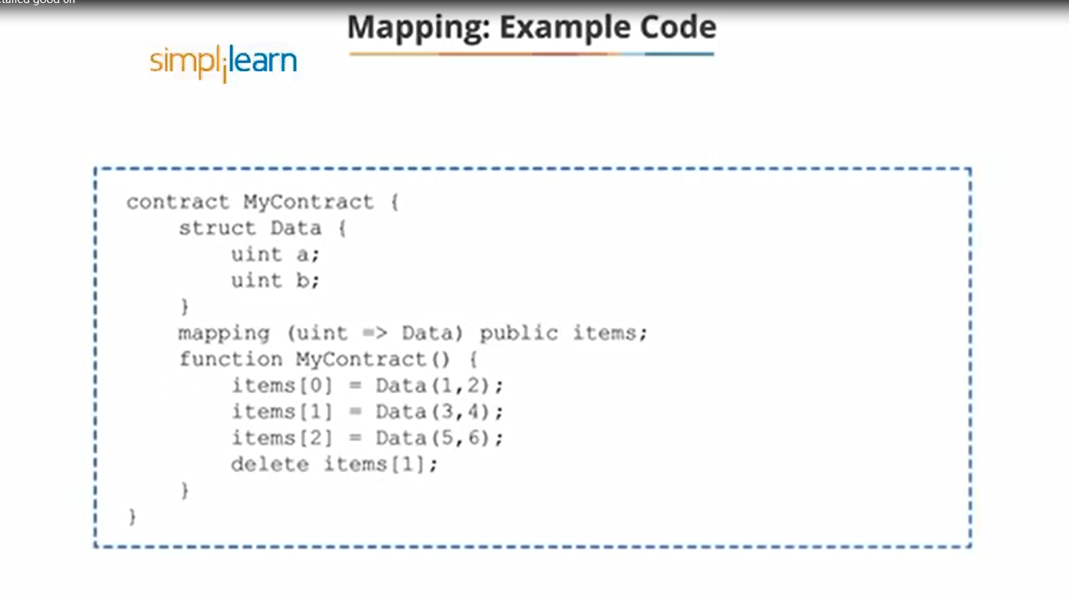

Slide 44
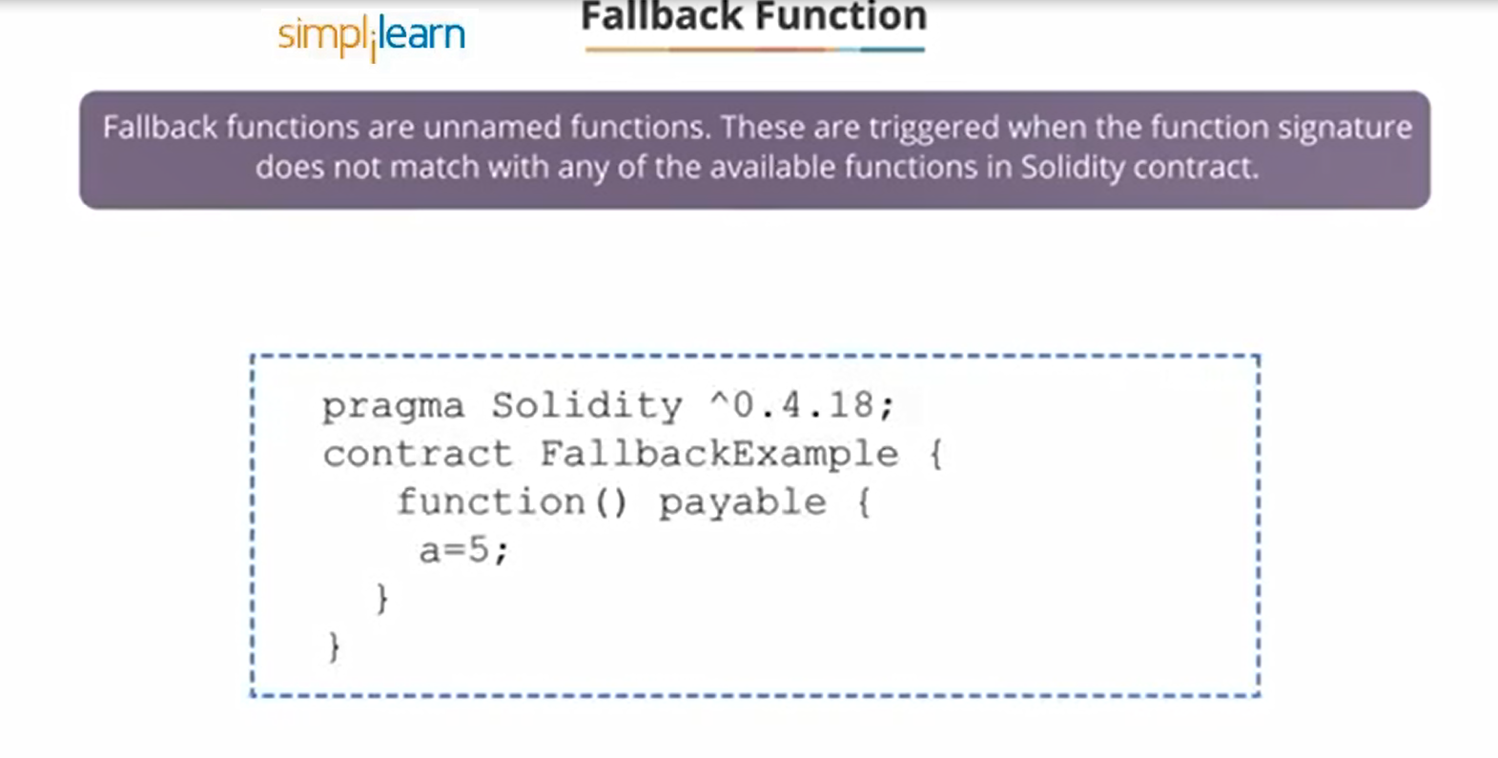

Slide 45
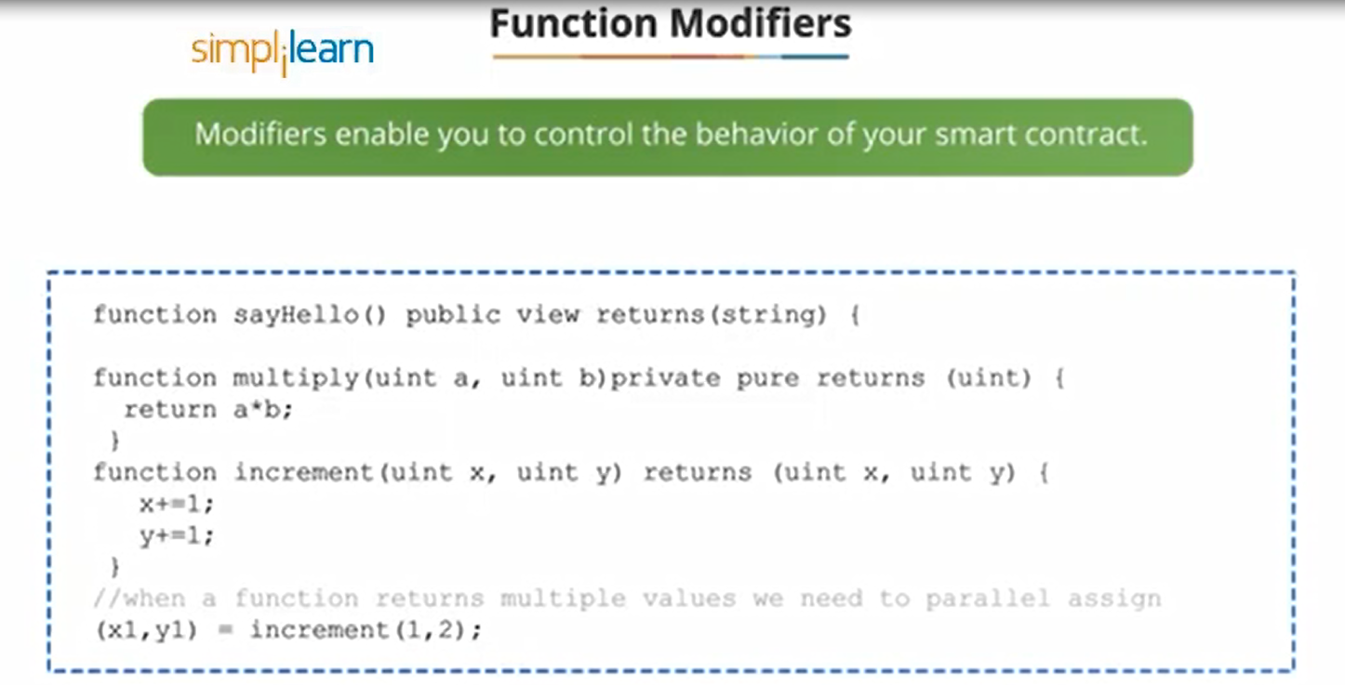

Slide 46
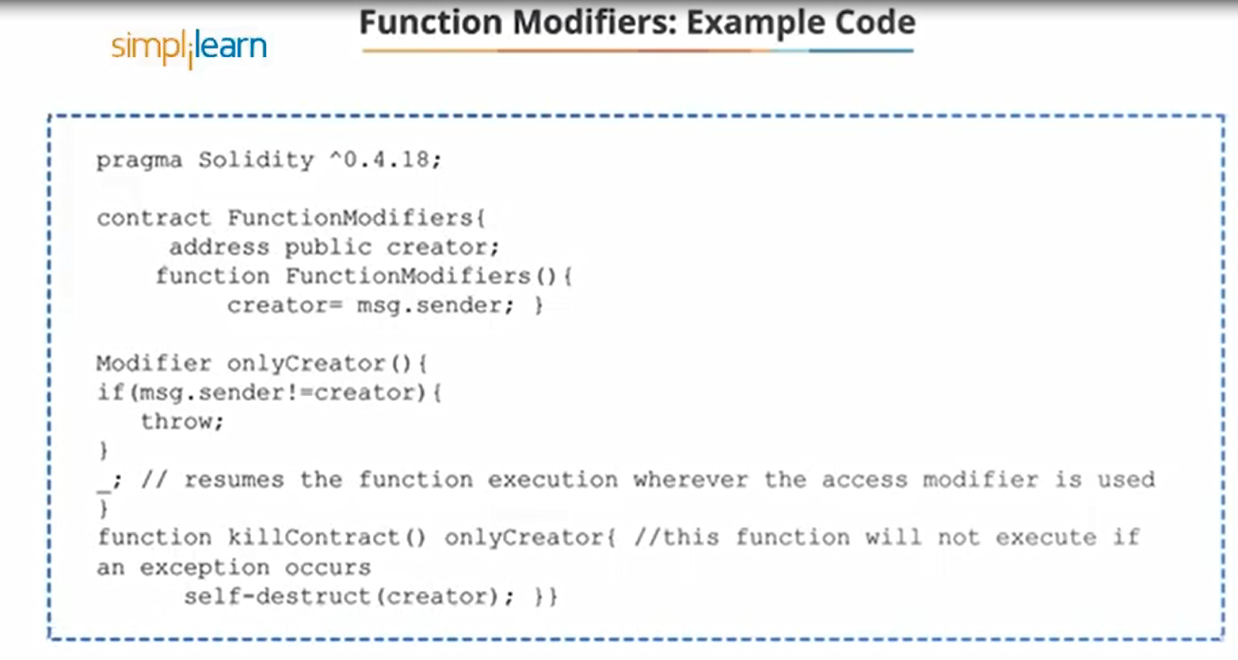

Slide 49
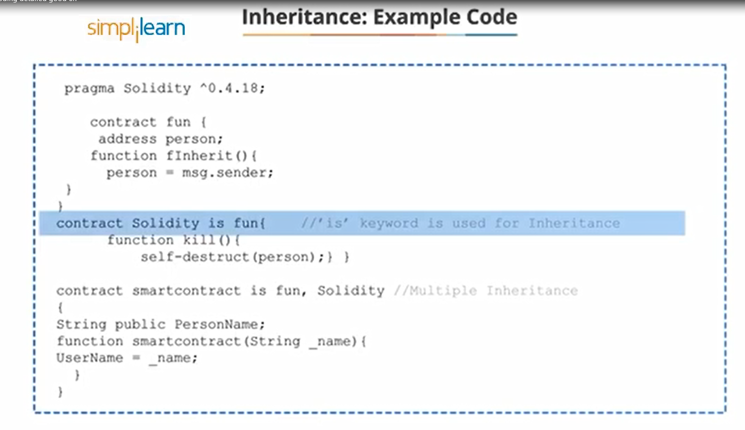

Slide 50
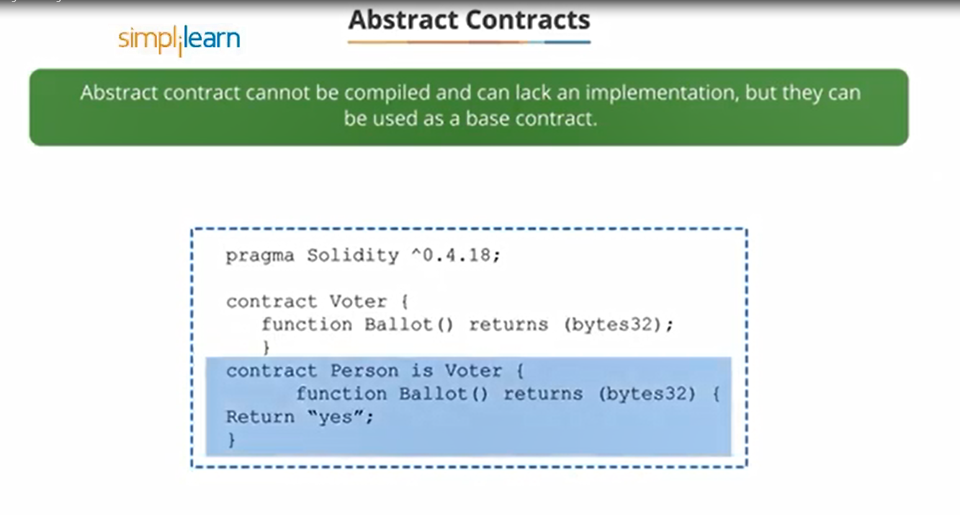

Slide 51
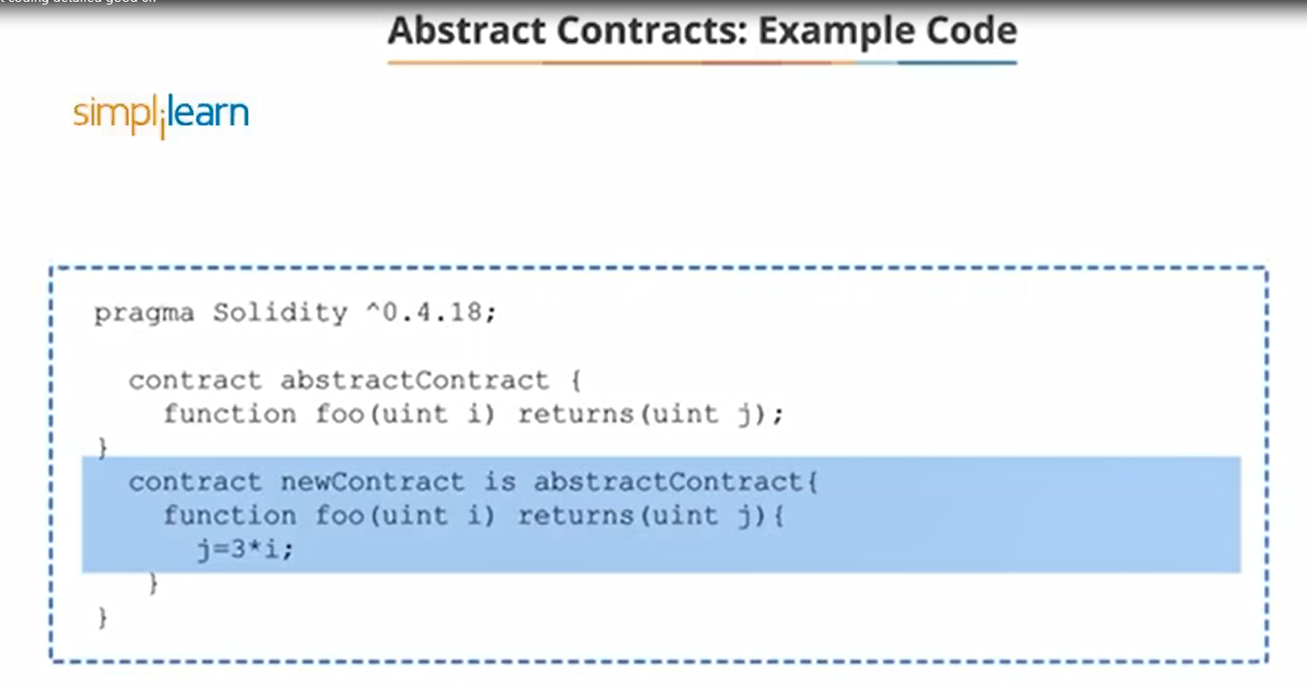

Slide 52
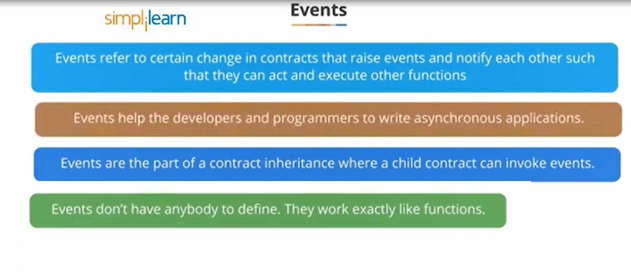

Slide 53
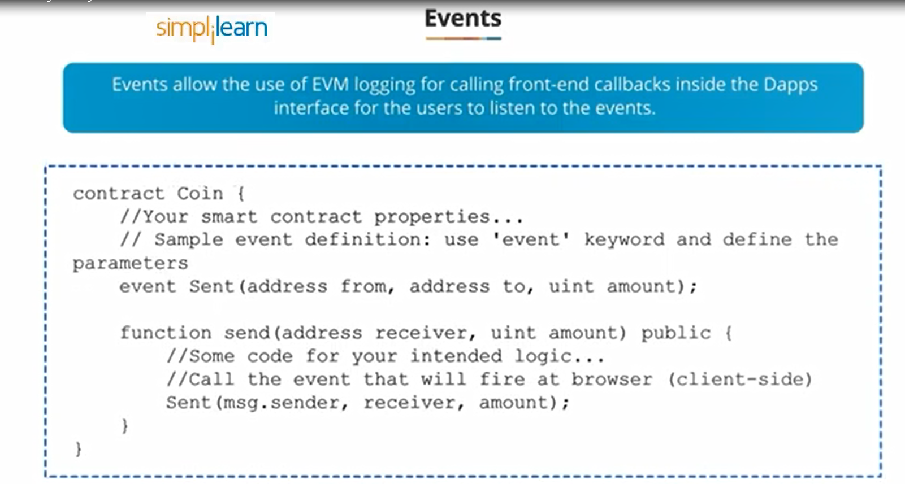

Slide 54
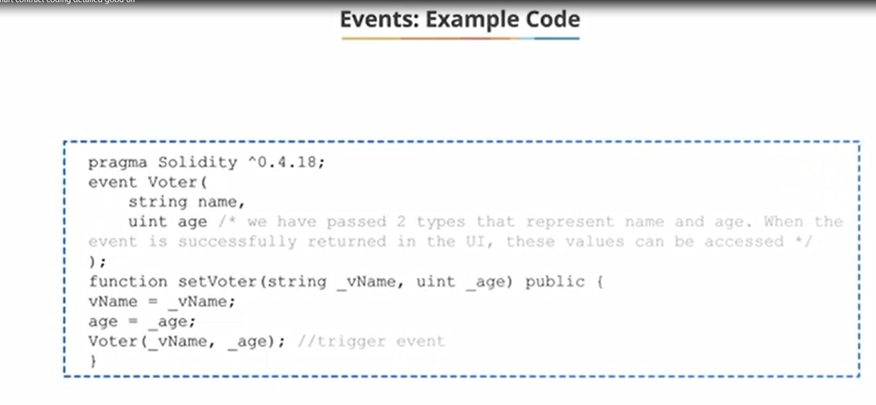

Slide 55
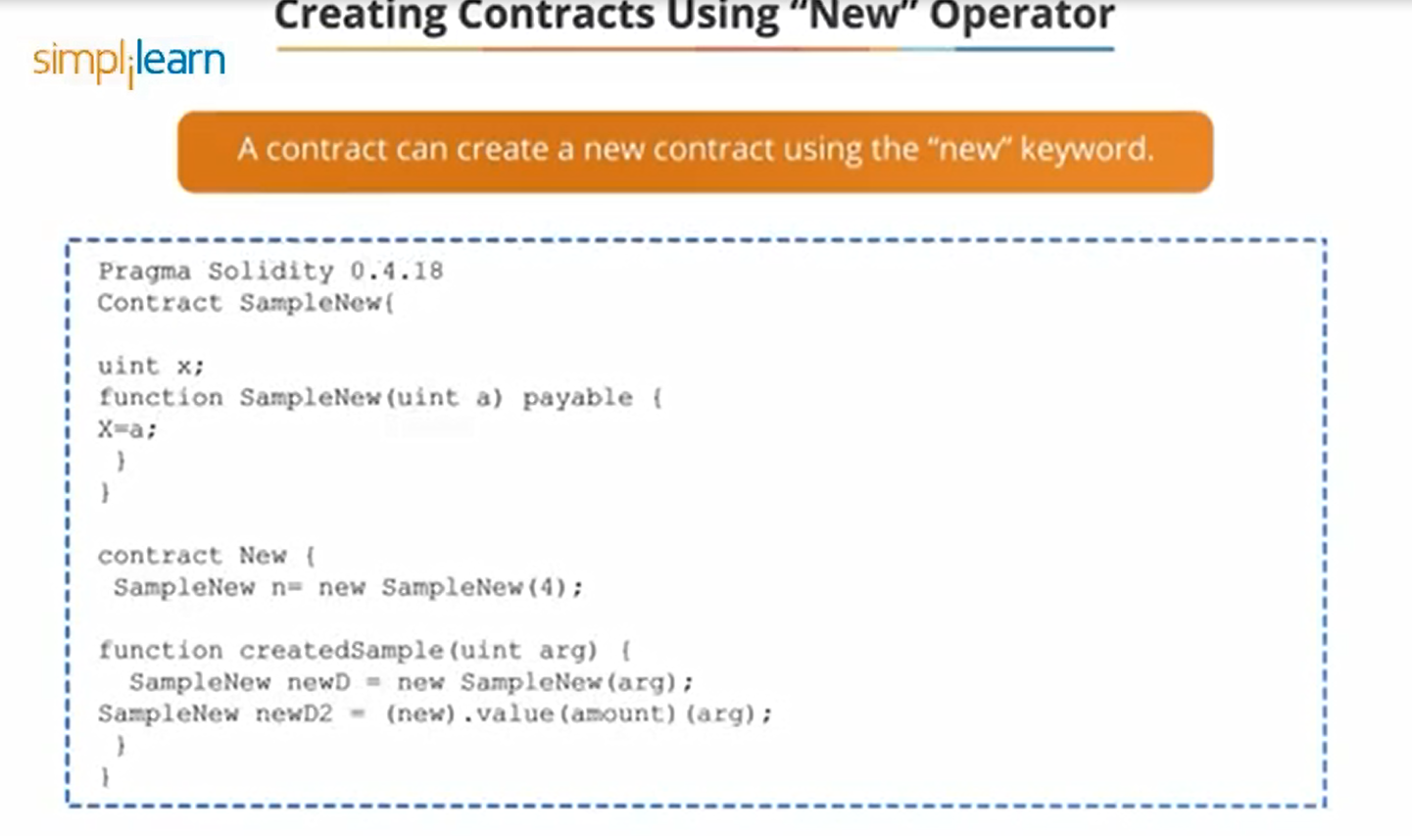

Slide 56
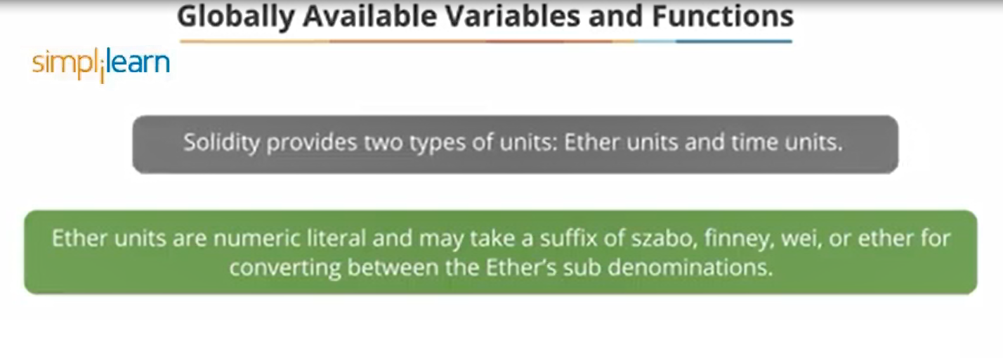

Slide 57
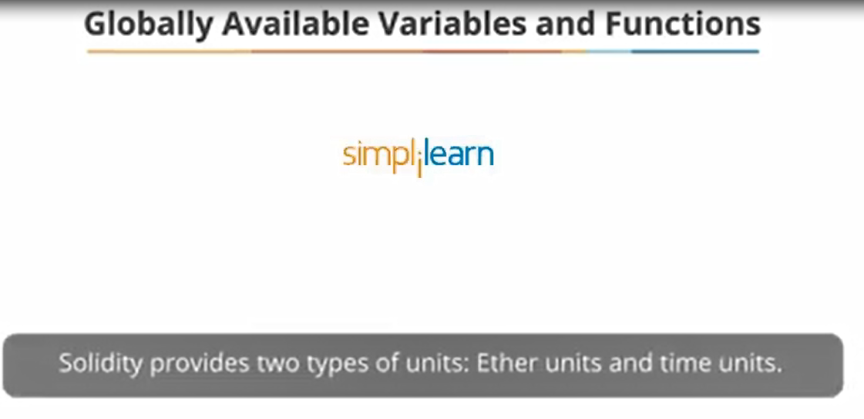

Slide 58
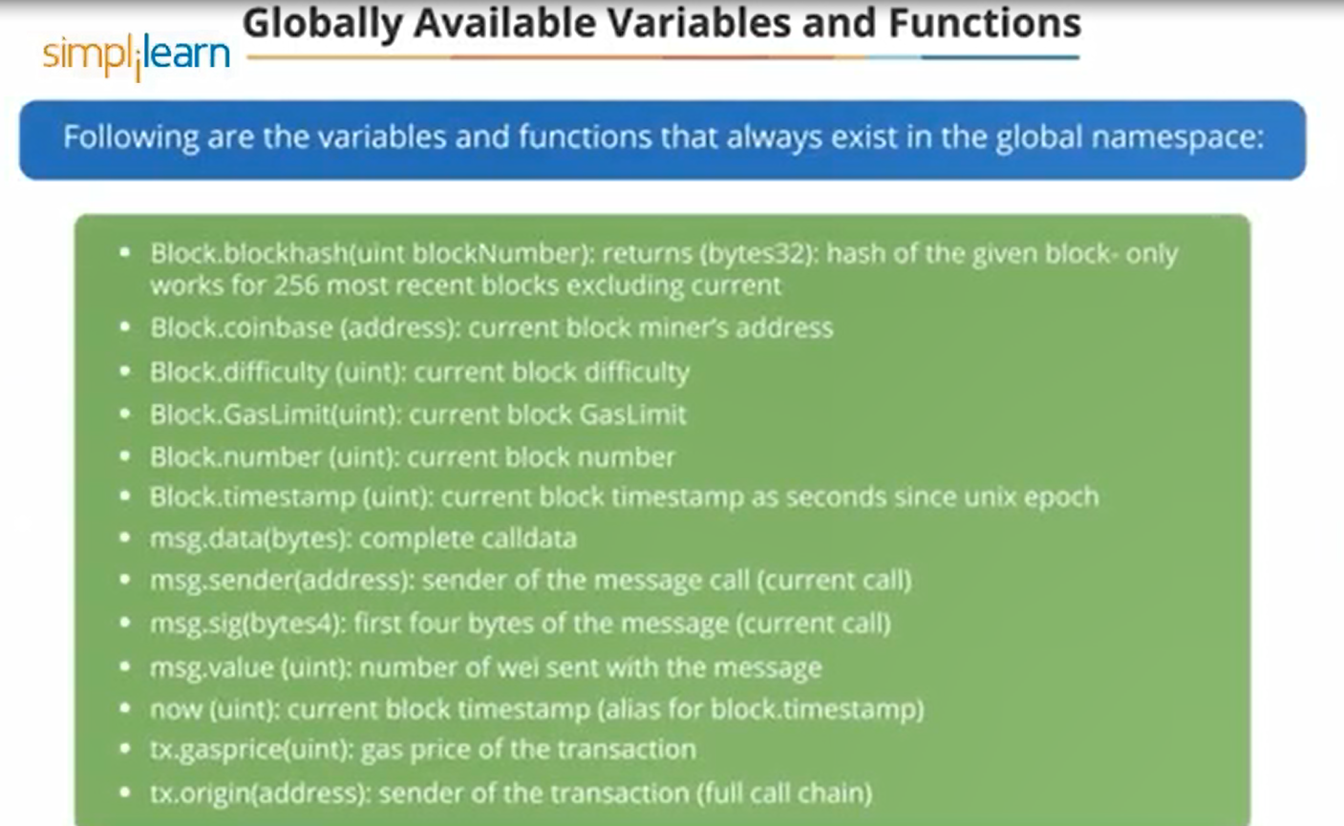

Slide 59
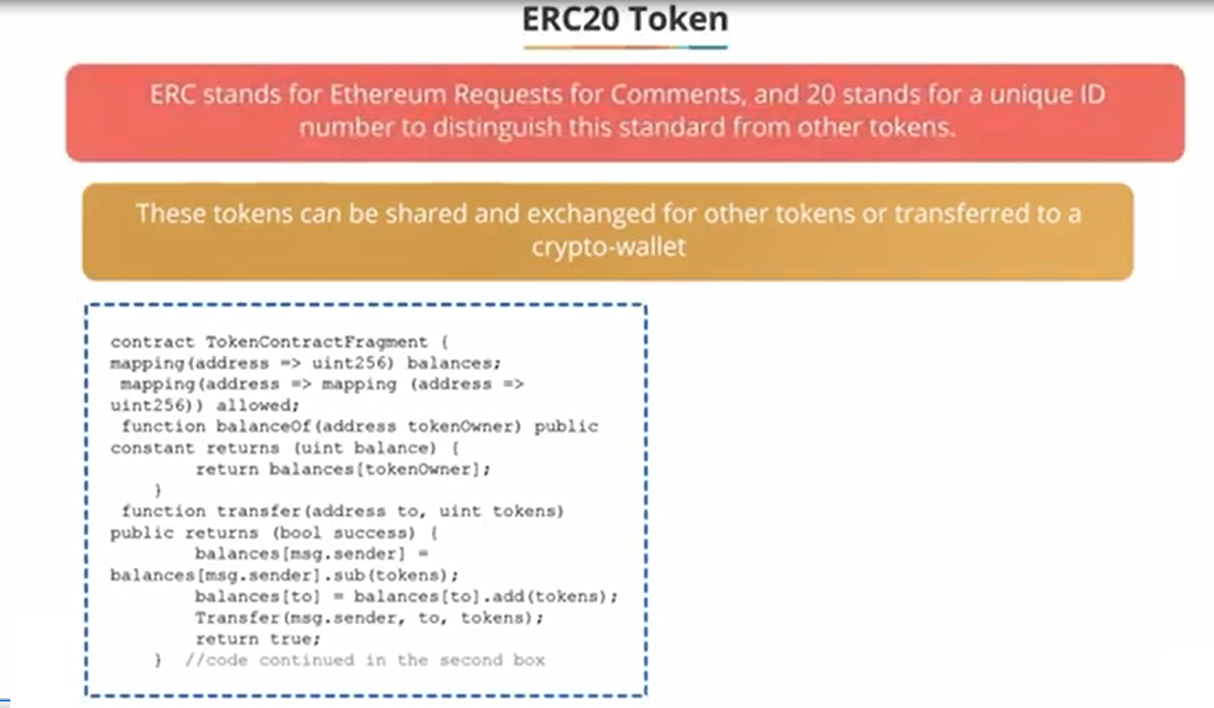

Slide 60
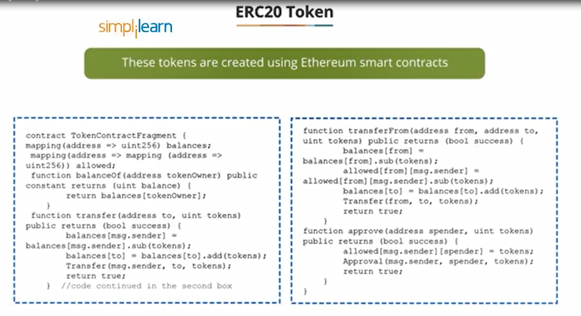

Slide 61
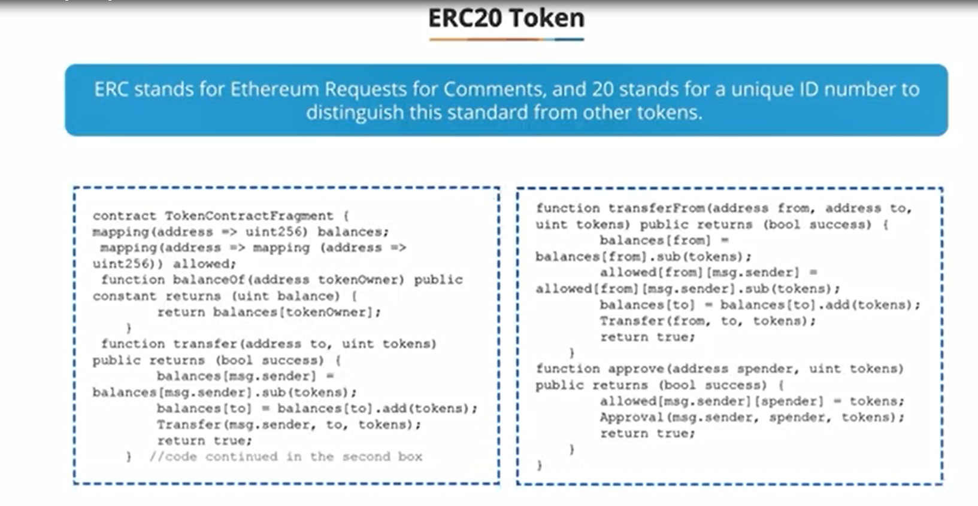

Slide 62
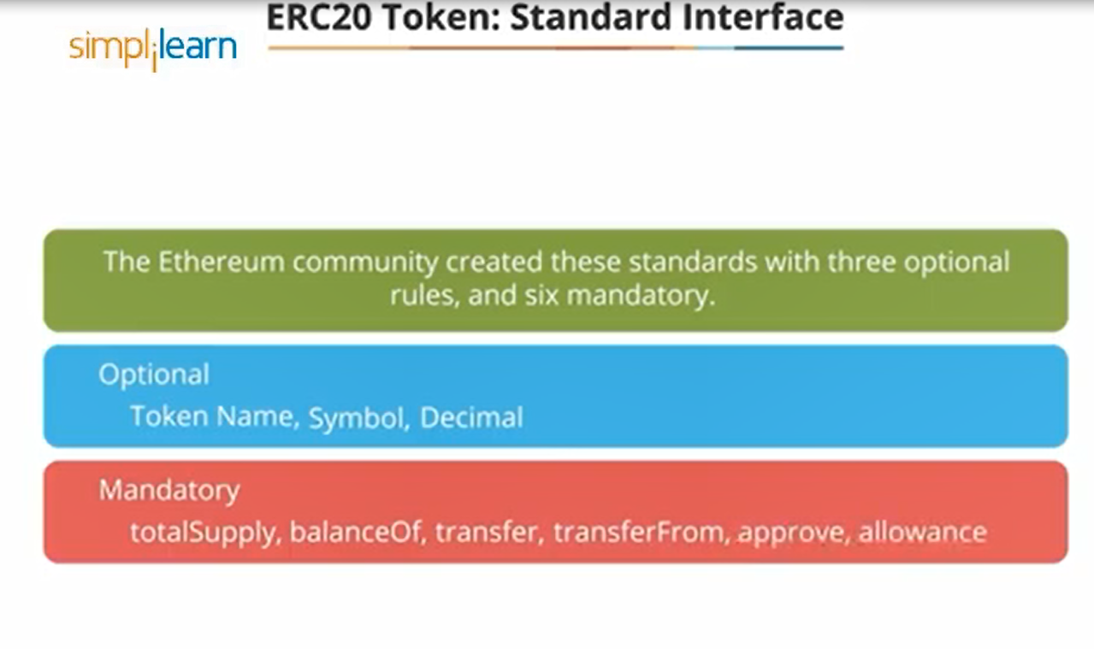

Slide 63
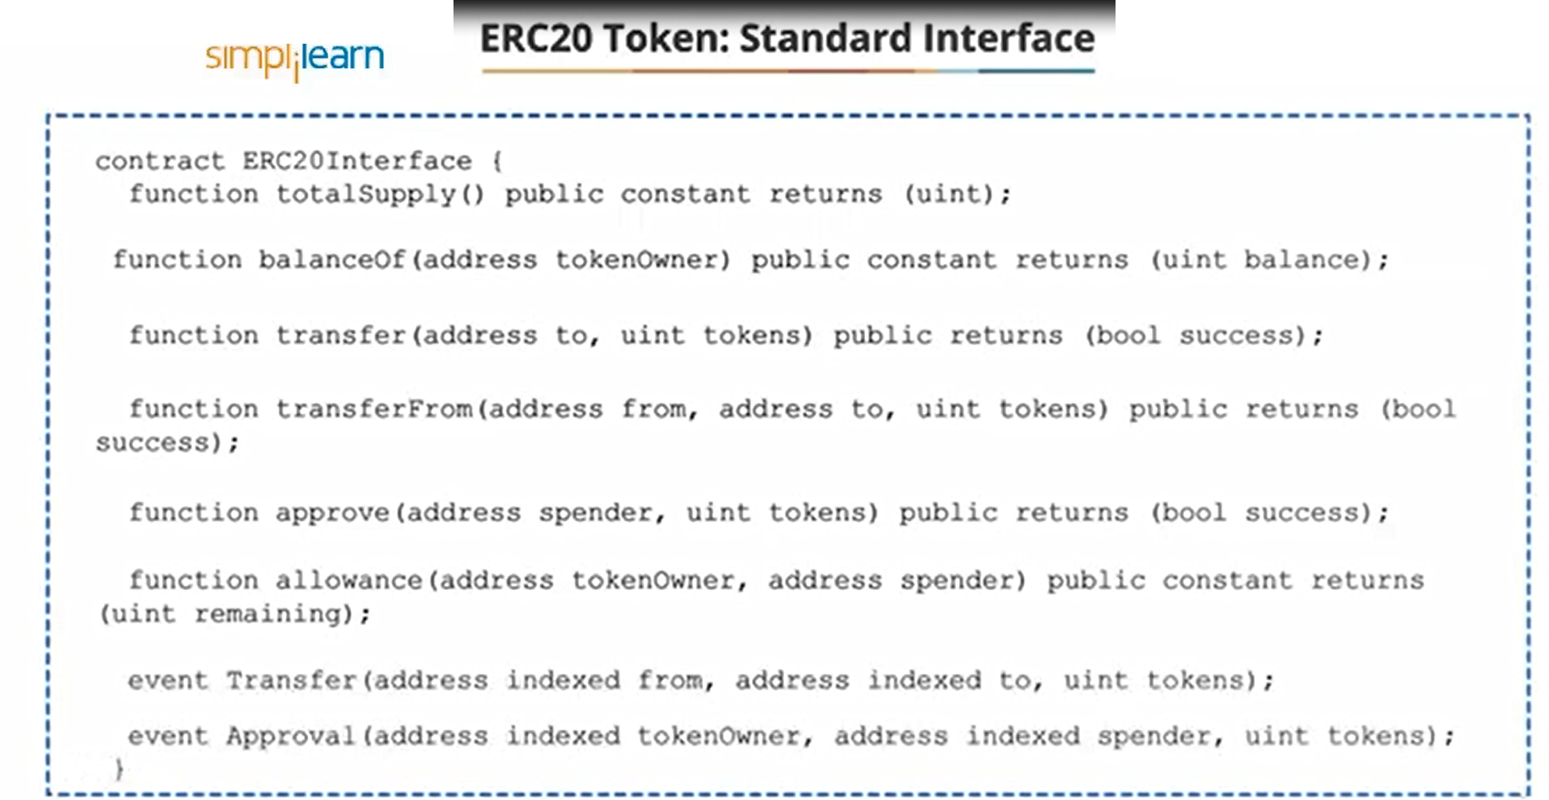

Slide 64


Slide 65


Slide 66


Slide 67


