Slide 1
Chapter 2
Financial Statements, Taxes, and Cash Flow

Slide 2
LEARNING OBJECTIVES
Describe the difference between accounting value (or book value) and market value
Describe the difference between accounting income and cash flow
Describe the difference between average and marginal tax rates
Determine a firm’s cash flow from its financial statements

Slide 3
Chapter Outline
The Balance Sheet
The Income Statement
Taxes
Cash Flow

Slide 4
THE Balance Sheet
The balance sheet is a financial statement showing a firm’s accounting value on a particular date
Organizes and summarizes what a firm owns (assets), what a firm owes (liabilities), and the difference between the two (equity)
Assets are classified as either current or fixed
A fixed asset is one that has a relatively long life
May be tangible (e.g., truck or computer) or intangible (e.g., trademark)
A current asset has a life of less than one year (e.g., inventory, cash, accounts receivable)
Liabilities are the first thing listed on the right side of the balance sheet and are classified are either current or long-term
Current liabilities have a life of less than one year, while long-term liabilities are debts not due in the coming year
Assets = Liabilities + Stockholders’ Equity
Notes:
Section 2.1

Slide 5
THE Balance Sheet
The balance sheet is a financial statement showing a firm’s accounting value on a particular date
Organizes and summarizes what a firm owns (assets), what a firm owes (liabilities), and the difference between the two (equity)
Assets are classified as either current or fixed
A fixed asset is one that has a relatively long life
May be tangible (e.g., truck or computer) or intangible (e.g., patent)
A current asset has a life of less than one year (e.g., inventory, cash, accounts receivable)
Liabilities are the first thing listed on the right side of the balance sheet and are classified are either current or long-term
Current liabilities have a life of less than one year (e.g., accounts payable)
Long-term liabilities are debts not due in the coming year (e.g., a loan the firm will pay off in five years)
Notes:
Section 2.1

Slide 6
THE Balance Sheet (continued)
Shareholders equity (i.e., common equity or owners’ equity) is the difference between the total value of the assets (current and fixed) and the total value of the liabilities (current and long-term)
Balance sheet “balances” because the value of the left side always equals the value of the right side
Value of firm’s assets is equal to the sum of its liabilities and shareholders’ equity
Balance sheet identity, or equation, must hold:
Notes:
The shareholders’ equity feature of the balance sheet is intended to reflect the fact that, if the firm were to sell all its assets and use the money to pay off its debts, then whatever residual value remained would belong to the shareholders.

Slide 7
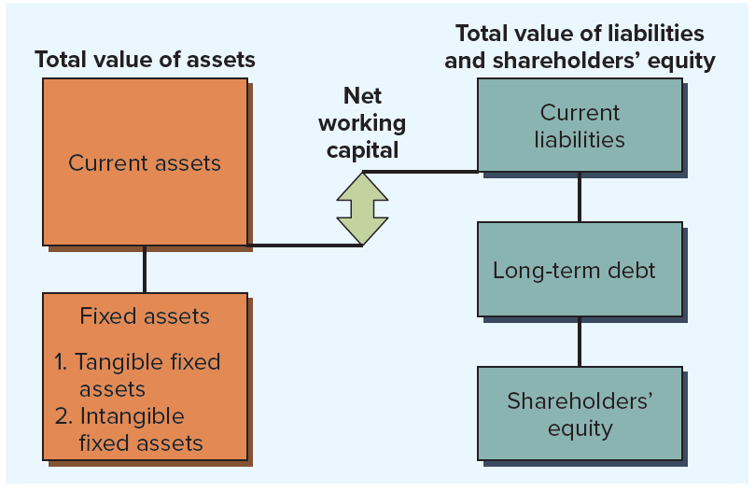
Construction of the balance sheet
Notes:
Figure 2.1 illustrates how the balance sheet is constructed. As shown, the left side lists the assets of the firm, and the right side lists the liabilities and equity.

Slide 8
Net Working Capital
Net working capital is the difference between a firm’s current assets and its current liabilities
Positive when cash that will become available over the next 12 months (i.e., current assets) exceeds cash that must be paid over the same period (i.e., current liabilities)
Usually positive in a healthy firm
Three particularly important things to keep in mind when examining a balance sheet:
Liquidity
Debt versus equity
Market value versus book value

Slide 9
Liquidity and debt versus equity
Liquidity refers to the speed and ease with which an asset can be converted to cash
Two dimensions are ease of conversion versus loss of value
Highly liquid asset is one that can be quickly sold without significant loss of value, while an illiquid asset is one that cannot be quickly converted to cash without a substantial price reduction
Assets are normally listed on the balance sheet in order of decreasing liquidity, with current assets being relatively liquid and fixed assets being relatively illiquid
The more liquid a business, the less likely it is to experience financial distress
If a firm borrows money, it usually gives first claim to the firm’s cash flow to creditors, with equity holders entitled to only the residual value
Use of debt in firm’s capital structure is called financial leverage
Notes:
For example, gold is a relatively liquid asset; a custom manufacturing facility is not.
Emphasize that liquidity is equally concerned with potential loss of value as it is speed of conversion. Any asset can be converted to cash quickly if we cut the price enough.
The COVID-19 pandemic highlighted the importance of liquidity. In late 2019, large tech companies such as Apple and Microsoft were being criticized for their huge cash stockpiles. Such companies looked pretty smart when government-imposed lockdowns in the spring of 2020 sent the economy into a tailspin. Well-known companies such as rental car giant Hertz and retailer J.C. Penney went bankrupt as they ran out of cash and could no longer operate.

Slide 10
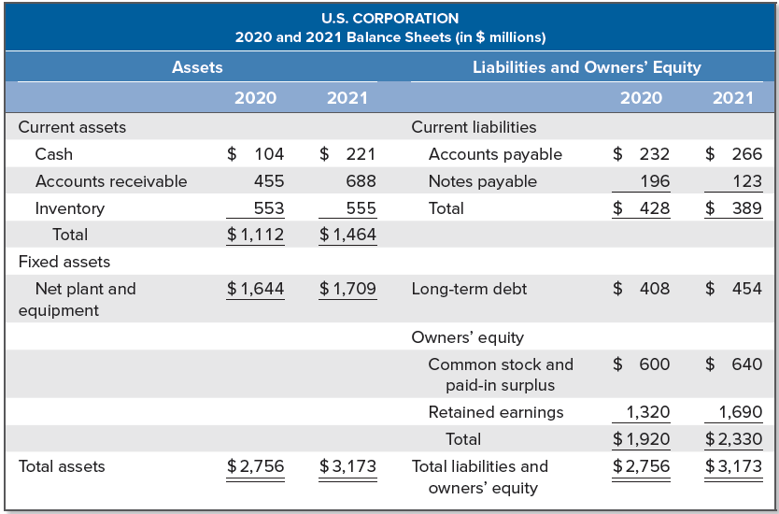
U.S. Corporation 2020 and 2021 balance sheets
Notes:
Table 2.1 shows simplified balance sheets for the fictitious U.S. Corporation.
The assets on the balance sheet are listed in order of the length of time it takes for them to convert to cash in the normal course of business. Similarly, the liabilities are listed in the order in which they would normally be paid.
The structure of the assets for a particular firm reflects the line of business the firm is in, as well as managerial decisions regarding how much cash and inventory to have on hand, the firm’s credit policy, fixed-asset acquisitions, and so on.
The liabilities side of the balance sheet primarily reflects managerial decisions about capital structure and the use of short-term debt.

Slide 11
Market Value versus Book Value
Values on balance sheet for the firm’s assets are book values and generally are not what the assets are actually worth
Under generally accepted accounting principles (GAAP), audited financial statements in the U.S. mostly show assets at historical cost (i.e., assets are “carried on the book” at what the firm paid for them, no matter how long ago they were purchased or how much they are worth today)
No necessary connection between total assets shown on the balance sheet and the value of the firm
For financial managers, accounting value of stock is not especially important; it is the market value that matters
Market value of an asset depends on things like its riskiness and cash flows, neither of which have anything to do with accounting

Slide 12
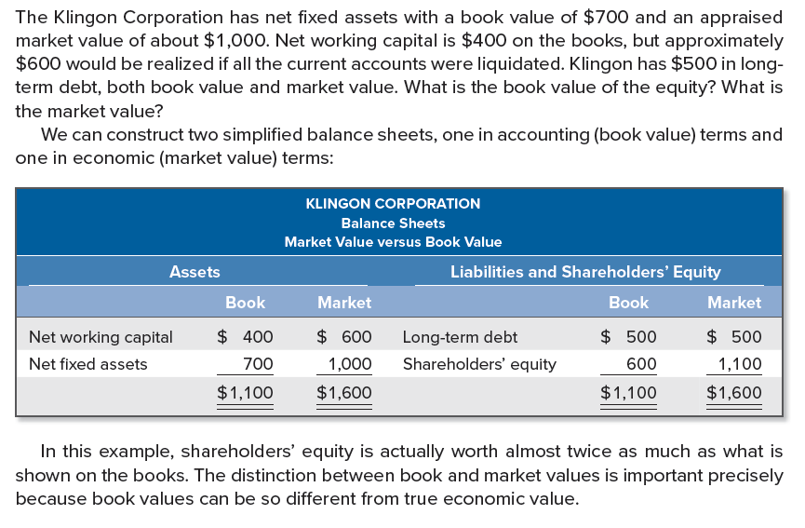
Market Value versus Book Value: an example

Slide 13

THE Income Statement
The income statement is a financial statement summarizing a firm’s performance over a period of time, usually a quarter or a year
Income statement equation is:
First thing reported on income statement would usually be revenue and expenses from the firm’s principal operations
Subsequent parts include, among other things, financing expenses such as interest paid
Taxes are reported separately
Last item is net income (i.e., “the bottom line”)
Notes:
Section 2.2
If you think of the balance sheet as a snapshot, then you can think of the income statement as a video recording covering the period between before and after pictures.
Net income is often expressed on a per-share basis and called earnings per share (EPS).

Slide 14
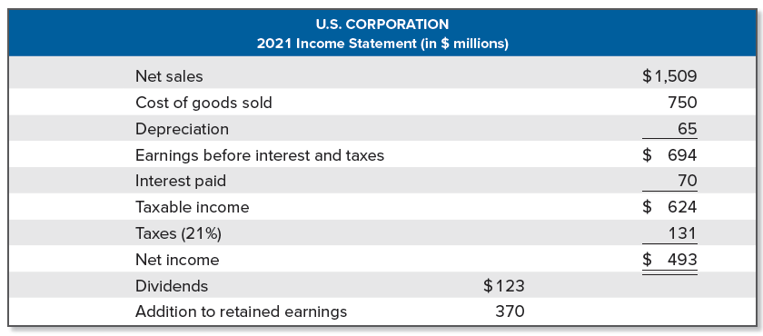
U.S. Corporation: Income Statement
Notes:
Table 2.2 gives a simplified income statement for U.S. Corporation.
As indicated, U.S. Corporation paid cash dividends of $123. The difference between net income and cash dividends, $370, is the addition to retained earnings for the year. This amount is added to the cumulative retained earnings account on the balance sheet. If you look back at the two balance sheets for U.S. Corporation, you’ll see that retained earnings did go up by this amount: $1,320 + 370 = $1,690.

Slide 15
THE Income Statement (continued)
A financial manager should keep three things in mind when looking at an income statement:
GAAP
As a result of the way revenues and expenses are realized, income statement figures may not be representative of actual cash inflows/outflows that occurred during a particular period
Cash versus noncash items
Noncash items are expenses charged against revenues that do not directly affect cash flow, such as depreciation
Crucial to separate cash flows from noncash accounting entries
Time and costs
Product costs include things such as raw materials, direct labor expense, and manufacturing overhead
Period costs are incurred during a particular time period and might be reported as selling, general, and administrative expenses
Notes:
An income statement prepared using GAAP will show revenue when it accrues. This is not necessarily when the cash comes in. The general rule (the recognition or realization principle) is to recognize revenue when the earnings process is virtually complete and the value of an exchange of goods or services is known or can be reliably determined.
Expenses shown on the income statement are based on the matching principle. The basic idea here is to first determine revenues as described previously and then match those revenues with the costs associated with producing them.

Slide 16
Taxes
Taxes can be one of the largest cash outflows a firm experiences
Size of a company’s tax bill is determined by the tax code, an often amended set of rules
Federal corporate tax rates became a flat 21% after the passage of the Tax Cuts and Jobs Act of 2017
Tax rates on other forms of business (e.g., proprietorships, partnerships, and LLCs) did not become flat
Average tax rate is calculated as total taxes paid divided by total taxable income, while the marginal tax rate is the amount of tax payable on the next dollar earned
Notes:
Section 2.3

Slide 17
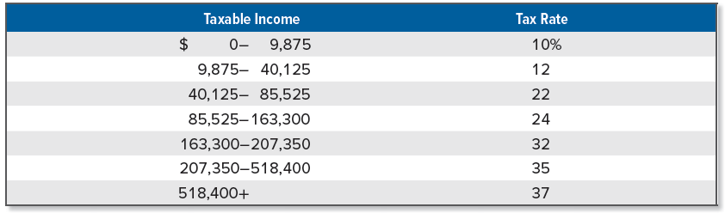
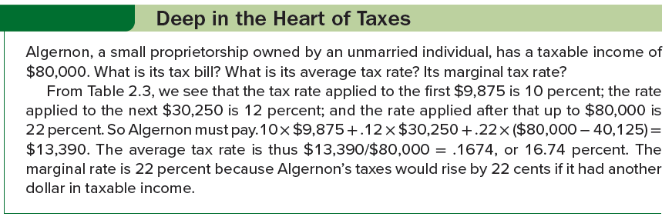
Personal tax rates and an example
Notes:
To illustrate some important points about taxes for such entities, we take a look at personal tax rates in Table 2.3. The percentage tax rates shown in Table 2.3 are all marginal rates. Put another way, the tax rates in Table 2.3 apply to the part of income in the indicated range only, not all income.
Before moving on, we should note that the tax rates we have discussed in this section relate to federal taxes only. Overall tax rates can be higher if state, local, and any other taxes are considered.

Slide 18
Cash Flow
Cash flow means the different between the number of dollars that came in and the number of dollars that went out
No standard financial statement presents this information in the way that we wish
Statement of cash flows is a standard financial accounting statement, but it is concerned with a somewhat different issue
Cash flow identity says the cash flow from the firm’s assets is equal to the cash flow paid to suppliers of capital to the firm:
Cash flow identity reflects the fact that a firm generates cash through its various activities, and that cash is either used to pay creditors or paid out to the owners of the firm
Notes:
Section 2.4

Slide 19
Cash Flow From Assets
Cash flow from assets is the total of cash flow to creditors and cash flow to stockholders, consisting of the following three components:
Operating cash flow refers to cash generated from a firm’s normal business activities
Capital spending refers to the net spending on fixed assets (purchases of fixed assets less sales of fixed assets)
Change in net working capital is measured as the net change in current assets relative to current liabilities for the period being examined and represents the amount spend on net working capital
Cash flow from assets is sometimes called free cash flow, referring to the cash the firm is “free” to distribute to creditors and stockholders because it is not needed for working capital or fixed asset investments

Slide 20
Cash Flow From Assets (Continued)
Operating cash flow is calculated as revenues minus costs and tells us whether a firm’s cash inflows from its business operations are sufficient to cover its everyday cash outflows
Do not include depreciation or interest in the calculation, but be sure to include taxes
Negative operating cash flow is a sign of trouble
Different calculation used for operating cash flow in accounting
Net capital spending (i.e., CAPEX) is money spent on fixed assets less money received from the sale of fixed assets
Could be negative is the firm sells more assets than it purchases
Change in net working capital is found by taking the difference between the beginning and ending net working capital (NWC) figures
Often referred to as the “addition to” NWC
Notes:
For operating cash flow, we don’t want to include depreciation because it’s not a cash outflow, and we don’t want to include interest because it’s a financing expense. We do want to include taxes because taxes are (unfortunately) paid in cash.
There is an unpleasant possibility of confusion when we speak of operating cash flow. In accounting practice, operating cash flow is often defined as net income plus depreciation.

Slide 21
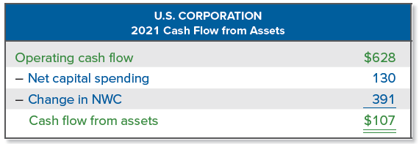
Cash flow from assets (concluded)
Notes:
These figures are calculated using the income statement in Table 2.2 and the balance sheets in Table 2.1.
The total cash flow from assets is given by operating cash flow less the amounts invested in fixed assets and net working capital.

Slide 22
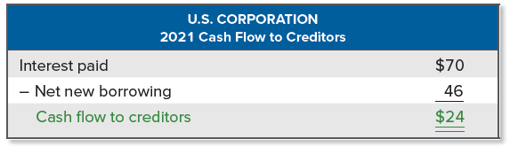
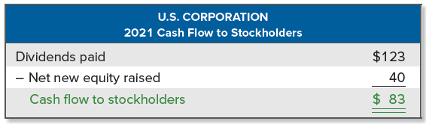
Cash Flow to creditors and stockholders
Cash flow to creditors is calculated as a firm’s interest payments to creditors less net new borrowing
Sometimes called cash flow to bondholders
Cash flow to stockholders is calculated as dividends paid out by a firm less net new equity raised
Notes:
The cash flows to creditors and stockholders represent the net payments to creditors and owners during the year. Their calculation is similar to that of cash flow from assets.
These figures are calculated using the income statement in Table 2.2 and the balance sheets in Table 2.1.

Slide 23
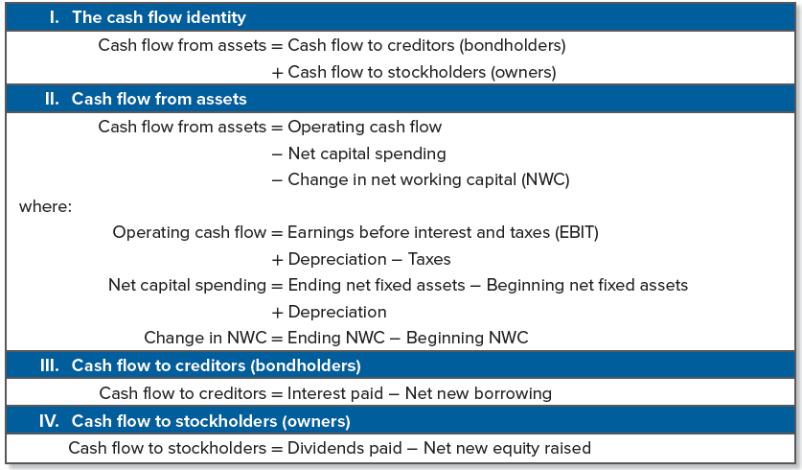
Cash Flow Summary
Notes:
Table 2.4 contains a summary of the various cash flow calculations for future reference.
An extended example at the end of the chapter covers the various cash flow calculations discussed and illustrates a few variations that may arise.

Slide 24
SELECTED CONCEPT QUESTIONS
What is liquidity? Why is it important?
Explain the difference between book value and market value. Which is more important to the financial manager? Why?
What is the income statement equation?
What is the difference between a marginal and an average tax rate?
What is the cash flow identity? Explain what it says.
What are the components of operating cash flow?

Slide 25
END OF CHAPTER
CHAPTER 2

