Slide 1
Chapter 3
WORKING WITH FINANCIAL STATEMENTS

Slide 2
Learning objectives
Standardize financial statements for comparison purposes
Compute and more importantly, interpret some common ratios
Name the determinants of a firm’s profitability
Explain some of the problems and pitfalls in financial statement analysis

Slide 3
Chapter Outline
Cash Flow and Financial Statements: A Closer Look
Standardized Financial Statements
Ratio Analysis
The DuPont Identity
Using Financial Statement Information

Slide 4
CASH FLOW AND FINANCIAL STATEMENTS: A CLOSER LOOK
Activities that bring in cash are called sources of cash, while activities that involve spending cash are called uses of cash
An increase in a left-side (asset) account or a decrease in a right-side (liability or equity) account is a use of cash
  Increase in an asset account means the firm, on a net basis, bought some assets – a use of cash
A decrease in a left-side (asset) account or an increase in a right-side (liability or equity) account is a source of cash
  Decrease in an asset account, on a net basis, means the firm sold some assets (i.e., a net source)
To trace the flow of cash through a firm during the year in a detailed fashion, an income statement is necessary
Notes:
Section 3.1

Slide 5
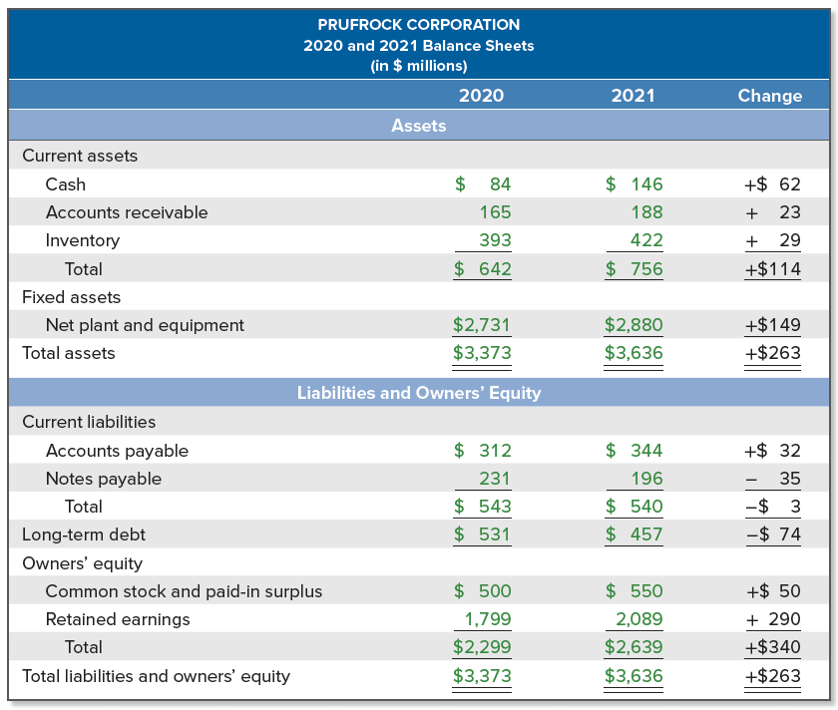
Prufrock corporation:
2020 and 2021 balance sheets
Notes:
To get started, consider the balance sheets for the Prufrock Corporation in Table 3.1.
Quite a few things changed during the year for Prufrock. For example:
Inventory rose by $29. This is a net use of cash because Prufrock effectively paid out $29 to increase inventories.
Accounts payable rose by $32. This is a source of cash because Prufrock effectively has borrowed an additional $32 payable by the end of the year.
Notes payable, on the other hand, went down by $35, so Prufrock effectively paid off $35 worth of short-term debt—a use of cash.

Slide 6
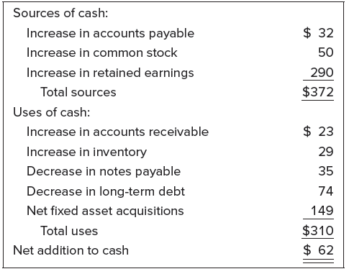
Prufrock corporation: summary of sources and uses of cash
Notes:
We can summarize the sources and uses of cash from the balance sheet as follows:
The net addition to cash is the difference between sources and uses, and our $62 result here agrees with the $62 change shown on the balance sheet.

Slide 7
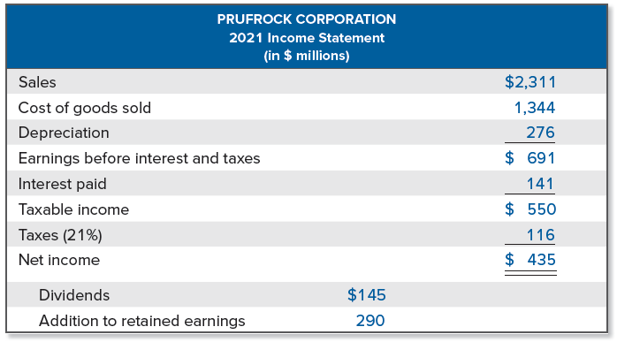
Prufrock corporation:
2021 income statement
Notes:
To further trace the flow of cash through the firm during the year, we need an income statement.
For Prufrock, the results for the year are shown in Table 3.2.
Notice here that the $290 addition to retained earnings we calculated from the balance sheet is the difference between the net income of $435 and the dividends of $145.

Slide 8
The Statement of Cash Flows
Statement of cash flows is a firm’s financial statement that summarizes its sources and uses of cash over a specified period
Exact form differs in detail from one preparer to the next, but the basic idea is to group all changes into three categories:
  Operating activities
  Investment activities
  Financing activities
Standard accounting practices expressly prohibits reporting cash flow per share
  Cash flow is not an alternative to accounting income, so only earnings per share are to be reported

Slide 9
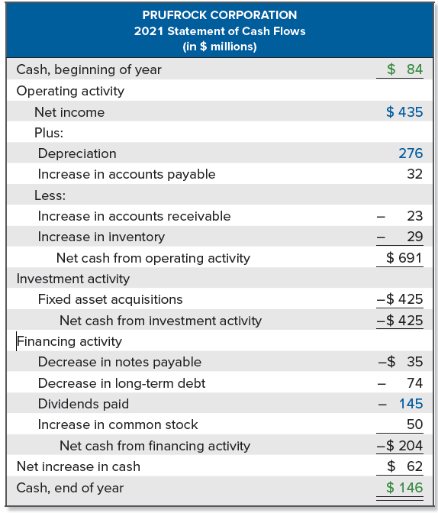
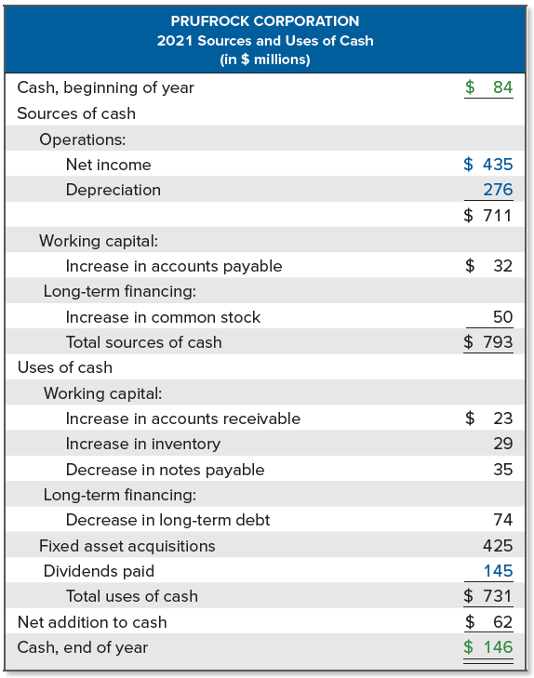
Prufrock corporation:
CASH FLOWS
Notes:
TABLE ON LEFT: We present a statement of cash flows in Table 3.3.
TABLE ON RIGHT: As shown in Table 3.4, it is sometimes useful to present the same information a bit differently. We will call this the “sources and uses of cash” statement. There is no such statement in financial accounting, but this arrangement resembles one used many years ago.
Now that we have the various cash pieces in place, we can get a good idea of what happened during the year.
Prufrock’s major cash outlays were fixed asset acquisitions and cash dividends. It paid for these activities primarily with cash generated from operations.
Prufrock also retired some long-term debt and increased current assets.
Finally, current liabilities were not greatly changed, and a relatively small amount of new equity was sold.

Slide 10
Standardized Financial Statements
Nearly impossible to directly compare the financial statements for two companies because of differences in size
  Similarly challenging to compare financial statements from different points in time for the same company if the company’s size has changed
To make comparisons, standardize the financial statements
  Common-size statements present all items in percentage terms
    Common-size balance sheets typically express each item as a percentage of total assets
    Common-size income statements usually show each item as a percentage of total sales
    Common-size statement of cash flows can be constructed from a “sources and uses of cash” statement, expressing each item as a percentage of total sources (or total uses)
  Common-base year statements (i.e., trend analysis) present all items relative to a certain base year amount
Notes:
Section 3.2
Common-base year statements are often used to investigate trends in the firm’s pattern of operations and, thus, may be referred to as trend analysis.

Slide 11
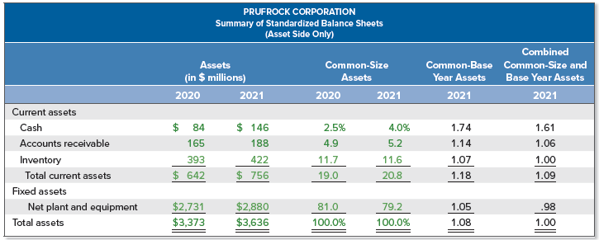
Prufrock corporation: Summary of standardized balance sheets
Notes:
Common-size analysis can be combined with trend analysis. The reason for doing this is that as total assets grow, most of the other accounts must grow as well. By first forming the common-size statements, we eliminate the effect of this overall growth.
Looking at Table 3.7, we see that Prufrock’s accounts receivable were $165, or 4.9 percent of total assets, in 2020. In 2021, they had risen to $188, which was 5.2 percent of total assets. If we do our analysis in terms of dollars, then the 2021 figure would be $188/$165 = 1.14, representing a 14 percent increase in receivables. However, if we work with the common-size statements, then the 2021 figure would be 5.2%/4.9% = 1.06. This tells us accounts receivable, as a percentage of total assets, grew by 6 percent. Roughly speaking, what we see is that of the 14 percent total increase, about 8 percent ( = 14% − 6%) is attributable to growth in total assets.

Slide 12
Ratio Analysis
Another way of avoiding the problems involved in comparing companies of different sizes is to calculate and compare financial ratios
  Financial ratios are relationships determined from a firm’s financial information and used for comparison purposes
Financial ratios are traditionally grouped into the following categories:
  Short-term solvency, or liquidity, ratios
  Long-term solvency, or financial leverage, ratios
  Asset management, or turnover, ratios
  Profitability ratios
  Market value ratios
Different people and different sources seldom compute ratios in the same way, leading to confusion
Notes:
Section 3.3
Lecture Tip: Be sure that your students understand that “real-world” financial statements are not as straightforward as the simplified ones presented in the textbook. Reviewing some financial statements of companies with which they are familiar may help.

Slide 13
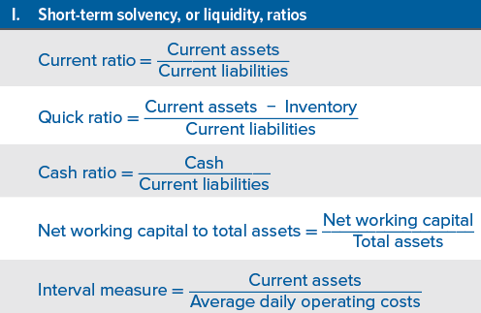
Short-term solvency, or liquidity, RATIOS

Slide 14
Short-term solvency, or liquidity, measures
Current ratio is a measure of short-term liquidity
  To a creditor, the higher this ratio, the better
  To a firm, a high current ratio may indicate an inefficient use of cash and other short-term assets
  Normally expect to see a current ratio of at least 1
Quick (or acid-test) ratio is computed just like the current ratio, except inventory is omitted since it is often the least liquid current asset
  Relatively large inventories are often a sign of short-term trouble
Cash ratio may be of interest to a very short-term creditor
Net working capital to total assets
  Low values might indicate relatively low levels of liquidity
Interval measure indicates how long the business can continue

Slide 15
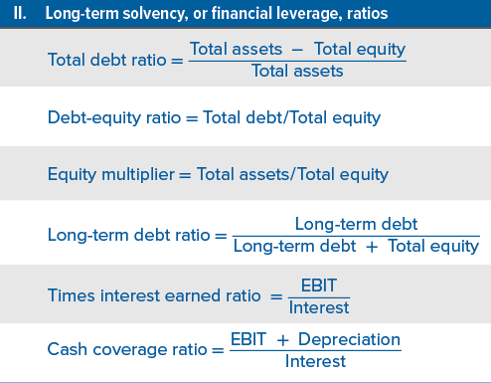
Long-term solvency RATIOS

Slide 16
Long-term solvency measures
Total debt ratio considers all debts of all maturities to all creditors and has two useful variations:
  Debt-equity ratio
  Equity multiplier
Long-term debt ratio is calculated as long-term debt divided by the sum of long-term debt and total equity
Times interest earned (TIE) ratio measures how well a company has its interest obligations covered, and is often called the interest coverage ratio
Cash coverage ratio is a basic measure of the firm’s ability to generate cash from operations and is frequently used as a measure of cash flow available to meet financial obligations
  Calculated similarly to the TIE ratio, except the numerator is EBITD (earnings before interest, taxes, and depreciation) instead of EBIT
Notes:
Regarding the total debt ratio, debt-equity ratio, and equity multiplier, notice that given any one of these three ratios, you can immediately calculate the other two.

Slide 17
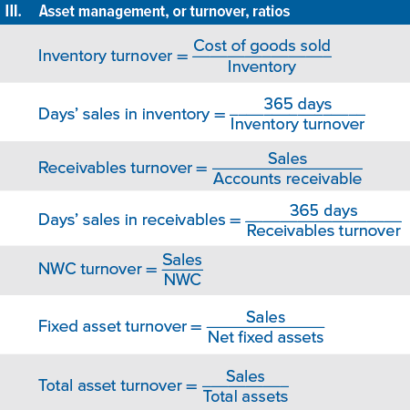
ASSET MANAGEMENT, OR TURNOVER, RATIOS

Slide 18
Asset management, or turnover, measures
Inventory turnover tells us how many times the firm sold off or turned over the entire inventory
  Days’ sales in inventory tells us how many days inventory sits (on average) before it is sold
Receivables turnover shows how many times a firm collects outstanding credit accounts and reloans the money
  Days’ sales in receivables provides the average number of days it takes for a firm to collect on its credit sales
Asset turnover ratios
  NWC turnover measures how much “work” we get out of our working capital
  Fixed asset turnover tells us how much the company generates in sales for every dollar in fixed assets
  Total assets turnover tells us how much the company generates in sales for every dollar in assets
Notes:
The measures in this section are sometimes called asset utilization ratios. The specific ratios we discuss can all be interpreted as measures of turnover. What they are intended to describe is how efficiently or intensively a firm uses its assets to generate sales.

Slide 19
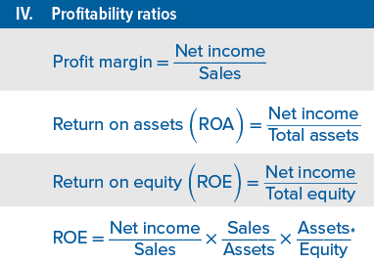
PROFITABILITY RATIOS
Notes:
* The decomposition of ROE is covered in Section 3.4.

Slide 20
PROFITABILITY measures
Profit margin measures how well a company makes money (i.e., how much money it generates in profit for every dollar in sales)
  All other things equal, a relatively high profit margin is desirable
  Significant variation in profit margins across industries
Remember that ROA and ROE are accounting rates of return; as such, they should properly be called return on book assets and return on book equity
  Return on assets (ROA) is a measure of profit per dollar of assets
  Return on equity (ROE) is a measure of how the stockholders fared during the year (i.e., how much money the company generated in profit for every dollar in equity)

Slide 21
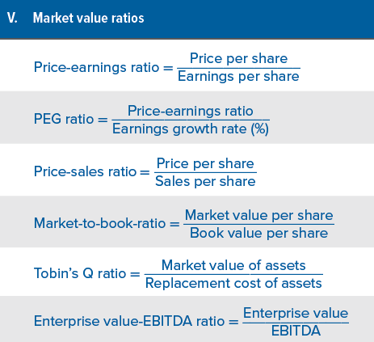
MARKET VALUE RATIOS

Slide 22
Market value measures
Price-earnings (PE) ratio measures how much investors are willing to pay per dollar of current earnings
  Vary significantly across companies, but, in 2020, a typical large company in the U.S. had a PE in the 15-20 range
  Higher PEs are often taken to mean the firm has significant prospects for future growth, but it could also mean a firm had no (or almost no) earnings
Price-sales ratio is useful if PE ratio is not meaningful due (e.g., firm has negative earnings for extended periods)
Market-to-book ratio compares the market value of the firm’s investments to their costs
  Value less than 1 could mean that the firm has not been successful overall in creating value for its stockholders
  Focuses on historical costs, which are less relevant
Notes:
Market value measures are based, in part, on information not necessarily contained in financial statements—the market price per share of stock. Obviously, these measures can be calculated directly only for publicly traded companies.
Because book value per share (the denominator in the market-to-book ratio) is an accounting number, it reflects historical costs.

Slide 23
Market value measures (continued)
Tobin’s Q ratio is superior to the market-to-book ratio because it focuses on what the firm is worth today relative to what it would cost to replace it today
  Firms with high Q ratios tend to be those with attractive investment opportunities or significant competitive advantages (or both)
  Difficult to calculate with accuracy because estimating the replacement cost of a firm’s assets is not an easy task and market values for a firm’s debt are often unobservable
Enterprise value-EBITDA multiple relates the value of all the operating assets (i.e., enterprise value) to a measure of the operating cash flow generated by those assets (EBITDA)
  Enterprise value is an estimate of the market value of the company’s operating assets, which include all assets of the firm except cash
Notes:
It’s not practical to work with the individual assets of a firm in calculating enterprise value because market values would usually not be available. Instead, we can use the right-hand side of the balance sheet and calculate the enterprise value as follows:
Enterprise value = total market value of the stock + book value of all liabilities – cash.

Slide 24

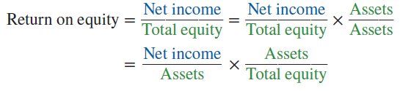

the DuPont Identity
We could multiply ROE by Assets/Assets, which then expresses the ROE as the product of ROA and the equity multiplier:
We can further decompose ROE by multiplying by Sales/Sales:
Notes:
Section 3.4

Slide 25
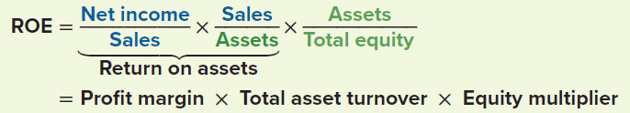
the DuPont Identity (continued)
If we rearrange things a bit, we can partition ROA into its two component parts – profit margin and total asset turnover
The DuPont identity breaks ROE into three parts:
  Operating efficiency, as measured by profit margin
  Asset use efficiency, as measured by total asset turnover
  Financial leverage, as measured by the equity multiplier
Notes:
The decomposition of ROE we’ve discussed is a convenient way of systematically approaching financial statement analysis. If ROE is unsatisfactory by some measure, then the DuPont identity tells you where to start looking for the reasons.

Slide 26
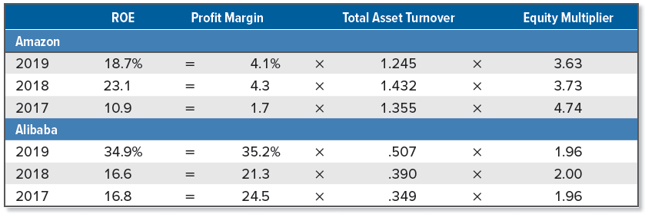
Dupont breakdown: amazon and alibaba
Notes:
The DuPont breakdowns for Amazon and Alibaba are summarized in Table 3.11.
As shown, in 2019, Amazon had an ROE of 18.7 percent, down over 4 percent from the previous year. In contrast, in 2019, Alibaba had an ROE of 34.9 percent, more than double its ROE in 2018 of 16.6 percent. For two of the three years, Alibaba had a higher ROE than Amazon.
A closer inspection of the DuPont breakdown shows the divergence in how these two companies generate their respective ROE. Alibaba has consistently shown a profit margin above 20 percent, while Amazon’s profit margin has been in the low single digits. However, Amazon has a much higher total asset turnover, as a well as an equity multiplier that is twice as large as Alibaba’s.
We can say that Alibaba has an advantage in that its operating efficiency is much higher than that of Amazon, but Amazon has an advantage in its asset utilization.

Slide 27
Using financial statement information
Why evaluate financial statements?
  Internal uses include performance evaluation and planning purposes
  Financial statements are also useful to parties external to the firm:
    Short-term and long-term creditors
    Potential investors
    Suppliers and large customers
    Credit rating agencies
    Competitors
    Potential targets for acquisition
Notes:
Section 3.5
Lecture Tip: Discuss with students that the ratios that are most important to a firm are those that best represent their business. So, whereas inventory turnover may be relevant for a retailer or manufacturer, it is less important for a service firm. The best ratios may be those that are uniquely developed for the business under review.

Slide 28
Choosing a benchmark
How do we choose a benchmark, or a standard of comparison, given we want to evaluate a division or firm based on its financial statements?
  Time trend analysis uses a firm’s historical data as the standard
  Peer group analysis compares firms to their peer group, firms similar in the sense that they compete in the same markets, have similar assets, and operate in similar ways
    One way to identify potential peers is based on standard industrial classification (SIC) codes, four-digit codes established by the U.S. government to classify a firm by its type of business operations
    North American Industry Classification System (NAICS), a new industry classification system initiated in 1997, will eventually replace the older SIC codes

Slide 29
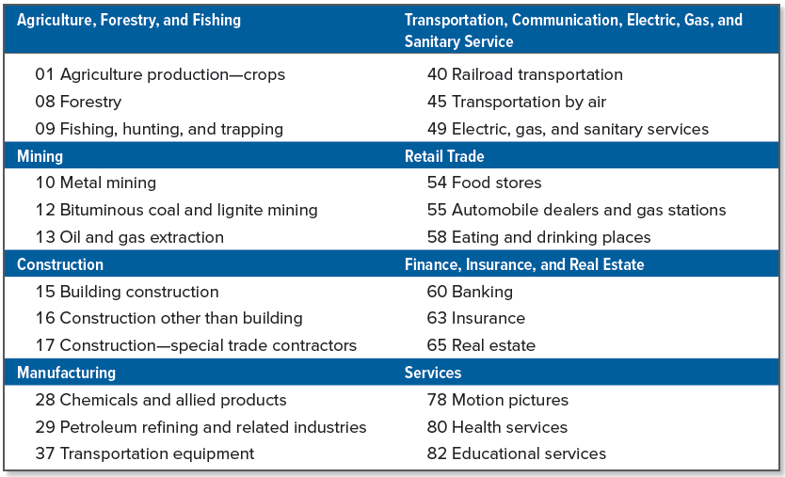
Selected two-digit sic codes
Notes:
Table 3.13 lists selected two-digit codes (the first two digits of the four-digit SIC codes) and the industries they represent.
The first digit in an SIC code establishes the general type of business. For example, firms engaged in finance, insurance, and real estate have SIC codes beginning with 6. Each additional digit narrows down the industry. So, companies with SIC codes beginning with 60 are mostly banks and bank-like businesses; those with codes beginning with 602 are mostly commercial banks; and SIC code 6025 is assigned to national banks that are members of the Federal Reserve system.

Slide 30
Problems with financial statement analysis
No underlying theory exists to help us identify which quantities to look at and to use in establishing benchmarks
Many firms are conglomerates, owning unrelated lines of business, and consolidated financial statements for such firms do not fit any neat industry category
Major competitors and natural peer group members in an industry may be scattered around the globe
  Financial statements from outside the U.S. do not necessarily conform to all GAAP principles
Even companies that are clearly in the same line of business may not be comparable
Different firms use different accounting procedures
Different firms end their fiscal years at different times
Unusual or transient events may affect financial performance

Slide 31
Selected concept questions
What is a source of cash? Give three examples.
Name two types of standardized statements and describe how each is formed.
What are the five groups of ratios? Give two or three examples of each kind.
Return on equity, or ROE, can be express as the product of three ratios. Which three?
What are SIC codes and how might they be useful?
Notes:
Section 3.6

Slide 32
End of Chapter
Chapter 3

