Slide 1
CHAPTER 5
INTRODUCTION TO VALUATION:
THE TIME VALUE OF MONEY
Notes:
The calculator discussed is the TI BA-II+. The slides are easy to modify for whatever calculator you prefer.

Slide 2
Learning objectives
Determine the future value of an investment made today
Determine the present value of cash to be received at a future date
Find the return on an investment
Calculate how long it takes for an investment to reach a desired value

Slide 3
Chapter Outline
Future Value and Compounding
Present Value and Discounting
More about Present and Future Values

Slide 4
introduction
One of the basic problems faced by the financial manager is how to determine the value today of cash flows expected in the future
Time value of money refers to the fact that a dollar in hand today is worth more than a dollar promised at some time in the future

Slide 5
FUTURE VALUE AND COMPOUNDING
Future value refers to the amount an investment is worth after one or more periods
The simplest case is a single-period investment
Suppose you invest $100 in a savings account that pays 10% interest per year. How much will you have in one year?
In general, if you invest for one period at an interest rate of r, your investment will grow to (1 + r) per dollar invested
r = 10%
1 + .10 = 1.1 dollars per dollar invested
$100 x 1.1 = $110
Notes:
Section 5.1

Slide 6
Investing for more than one period
Going back to our $100 investment, what will you have after two years, assuming the interest rate doesn’t change?
$110 x .10 = $11 in interest during the second year
Total = $110 + 11 = $121
$121 is the future value of $100 in two years at 10%
Compounding is the process of accumulating interest on an investment over time to earn more interest
Compounding the interest means earning interest on interest, so we call the result compound interest
With simple interest, interest is earned only on the original principal amount invested
Notes:
This $121 has four parts. The first part is the $100 original principal. The second part is the $10 in interest you earned in the first year, and the third part is another $10 you earned in the second year, for a total of $120. The last $1 you end up with (the fourth part) is interest you earned in the second year on the interest paid in the first year: $10 × .10 = $1.

Slide 7

Future Value: General Formula
The future value of $1 invested for t periods at a rate of r per period is this:
The expression (1 + r)^{t} is sometimes called the future value interest factor (or just future value factor) for $1 invested at r percent for t periods and can be abbreviated FVIF_{r,t}
Going back to our $100 investment, what will you have after five years, assuming the interest rate doesn’t change?
(1 + r)^{t} = (1 + .10)⁵ = 1.1⁵ = 1.6105
Your $100 will thus grow to $100 x 1.6105 = $161.05

Slide 8
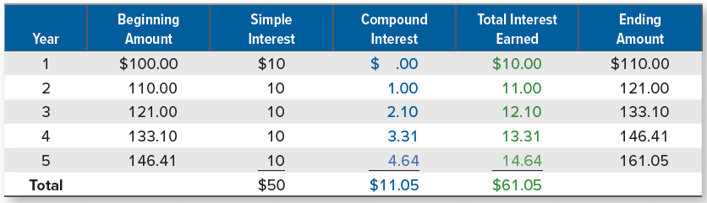
FUTURE VALUE OF $100 AT 10 PERCENT
Notes:
The growth of your $100 each year is illustrated in Table 5.1. As shown, the interest earned in each year is equal to the beginning amount multiplied by the interest rate of 10 percent.
In Table 5.1, notice the total interest you earn is $61.05. Over the five-year span of this investment, the simple interest is $100 × .10 = $10 per year, so you accumulate $50 this way. The other $11.05 is from compounding.

Slide 9
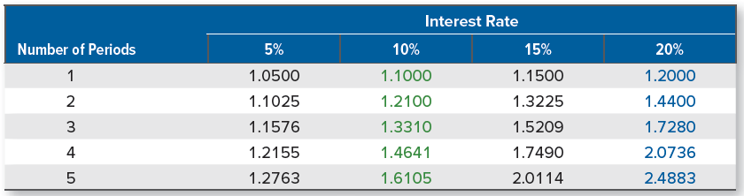
Future value factors
Future values depend critically on the assumed interest rate, particularly for long-lived investments
There are several different ways of doing this:
In our example, we could have multiplied 1.1 by itself five times, but that approach gets very tedious for, say, a 30-year investment
Calculators generally have a key labeled “yx”; you could enter 1.1, press this key, enter 5, and press the “=“ key to get the answer
You could also use a table that contains future value factors for some common interest rates and time periods, such as the one below:
Notes:
Table 5.2 contains some future value factors. Table A.1 in the appendix at the end of the book contains a much larger set. To use the table, find the column that corresponds to 10 percent. Then look down the rows until you come to five periods. You should find the factor that we calculated, 1.6105.
To make sure you are doing the calculations correctly, pick a factor from the table and then calculate it yourself to see that you get the same answer.

Slide 10
Calculator Keys
Keys of particular interest:
FV = future value
PV = present value
I/Y = interest rate (i.e., what we have been calling r)
N = number of periods (i.e., what we have been calling t)
Things you need to do only once:
Make sure your calculator is set to display many decimal places
Set calculator to assume only one payment per period or per year
Make sure your calculator is in “end” mode
Things you need to do every time you work a problem:
Before you start, completely clear out the calculator
Put a negative sign on cash outflows
Enter the rate correctly (i.e., percent form)
Notes:
We are providing information on the Texas Instruments BA-II Plus – other calculators are similar. If you recommend or require a specific calculator other than this one, you may want to make the appropriate changes.
If students are having difficulty getting the correct answer, make sure they have done the following:
Set decimal places to floating point (2nd Format, Dec = 9 enter) or show 4 to 5 decimal places if using an HP
Double check and make sure P/Y = 1
Make sure to clear the TVM registers after finishing a problem (or before starting a problem) It is important to point out that CLR TVM clears the FV, PV, N, I/Y and PMT registers. C/CE and CLR Work DO NOT affect the TVM keys
The remaining slides will work the problems using the notation provided above for calculator keys. The formulas are presented in the notes section.

Slide 11
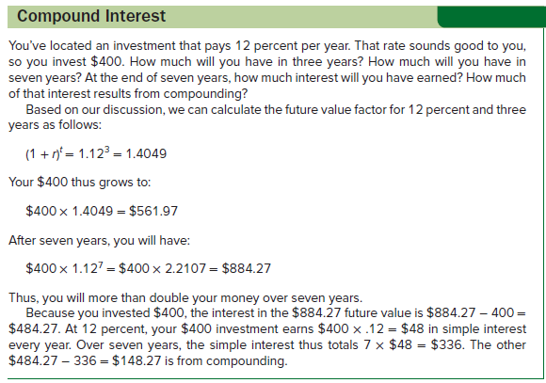
Effect of compounding

Slide 12

Present Value and discounting
Present value is the current value of future cash flows discounted at the appropriate discount rate
Present value is the reverse of future value
Instead of compounding the money forward into the future, we discount it back to the present
To discount is to calculate the present value of some future amount
Present value of $1 to be received in one period if generally given as follows:
Notes:
Section 5.2

Slide 13
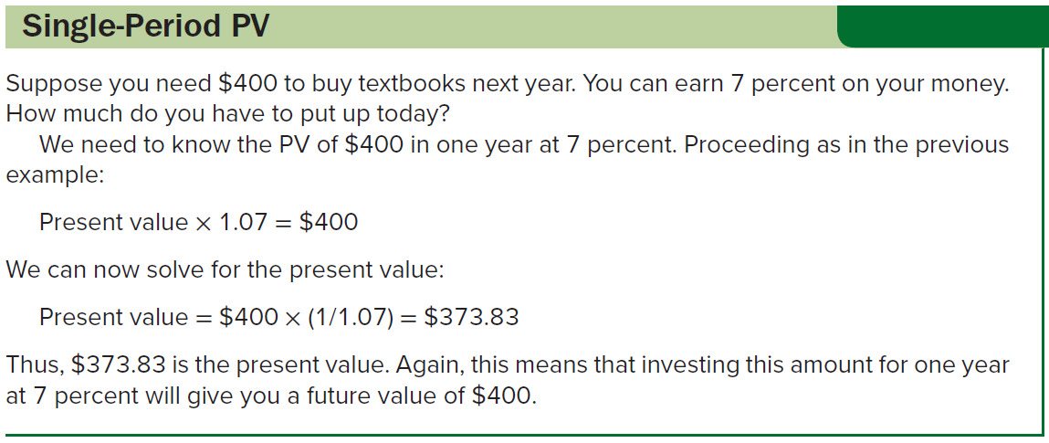
Present Value: THE SINGLE-PERIOD CASE
Notes:
Section 5.2

Slide 14

Present Values for multiple periods
The present value of $1 to be received t periods into the future at a discount rate of r is:
As the length of time until payment grows, present values decline
Present values and discount rates are inversely related
Quantity in brackets, 1/(1 + r)^{t}, is often called a discount factor
Discount rate is the rate used to calculate the present value of future cash flows
Quantity in brackets, 1/(1 + r)^{t}, is called the present value interest factor (or just present value factor) for $1 at r percent for t periods and is sometimes abbreviated PVIF_{r,t}
Calculating the present value of a future cash flow to determine its worth today is called discounted cash flow (DCF) valuation
Notes:
Section 5.2

Slide 15
Present Values for multiple periods (continued)
Suppose you need $1,000 in three years. You can earn 15% on your money. How much do you have to invest today? (In other words, what is the present value of $1,000 in three years at 15%?)
We need to discount $1,000 back three periods at 15%
Discount factor = 1/(1 + .15)³ = 1/1.5209 = .6575
PV = $1,000 x 0.6575 = $657.52
How do we solve this on a financial calculator?
N = 3
I/Y = 15
FV = 1,000
Solve for PV = -657.52
Notes:
Notice that the answer (using the financial calculator) has a negative sign; as we discussed earlier, that’s because it represents an outflow today in exchange for the $1,000 inflow later.
There are tables for present value factors just as there are tables for future value factors, and you use them in the same way (if you use them at all). Table 5.3 contains a small set. A much larger set can be found in Table A.2 in the book’s appendix.
In Table 5.3, the discount factor we just calculated (.6575) can be found by looking down the column labeled “15%” until you come to the third row.

Slide 16

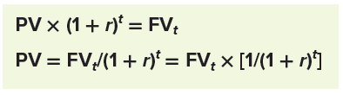
More about present and future values
The present value factor is the reciprocal of (i.e., 1 divided by) the future value factor:
If we let FV_{t} stand for the future value after t periods, the relationship between future value and present value can be written as one of the following:
The (final) result above is called the basic present value equation
Notes:
Section 5.3

Slide 17
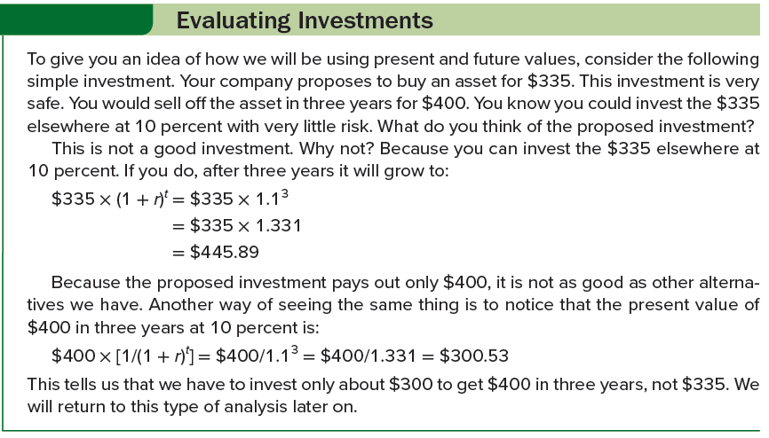
Evaluating investments

Slide 18

Determining the discount rate
We often need to determine what discount rate is implicit in an investment, and we can do so by looking at the basic present value equation:
There are only four parts to this equation: the present value (PV), the future value (FV_{t}), the discount rate (r), and the life of the investment (t)
Given any three of these, we can always find the fourth

Slide 19
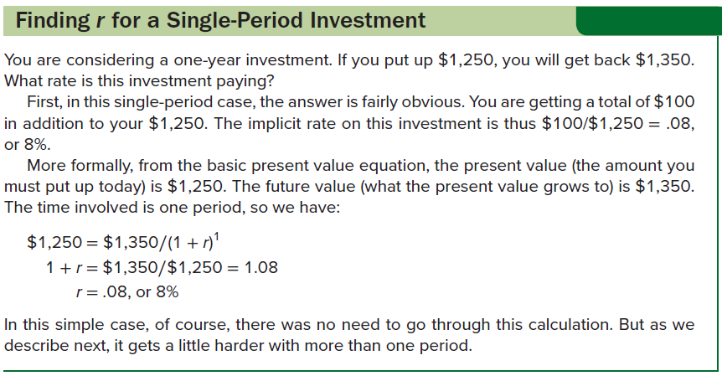
Finding r for a single-period investment

Slide 20


Determining the discount rate: an example
Assume we are offered an investment that costs us $100 and will double our money in eight years. To compare this to other investments, we would like to know what discount rate (i.e., rate of return, or return) is implicit in these numbers.
Here, PV = $100, FV = $200 (double our money), and an 8-year life
To calculate the return, we can write the basic present value equation as:
It could also be written as:
We now need to solve for r, and there are three ways to do this

Slide 21
Determining the discount rate: an example (continued)
Use a financial calculator.
PV = -100, FV = 200, N = 8; Solve for I/Y = 9%
Solve the equation for 1 + r by taking the eighth root of both sides.
Because this is the same thing as raising both sides to the power of ⅛ or .125, this is easy to do with the “y^{x}” key on a calculator.
Just enter 2, then press “y^{x},” enter .125, and press the “=” key. The eighth root should be about 1.09, which implies that r is 9%.
Use a future value table.
The future value factor after eight years is equal to 2.
If you look across the row corresponding to eight periods in Table A.1, you will see that a future value factor of 2 corresponds to the 9% column, again implying that the return here is 9%.
Notes:
In this particular example, there is a useful “back of the envelope” means of solving for r—the Rule of 72.
For reasonable rates of return, the time it takes to double your money is given approximately by 72/r%. In our example, this means that 72/r% = 8 years, implying that r is 9 percent, as we calculated. This rule is fairly accurate for discount rates in the 5 percent to 20 percent range.

Slide 22

Solving for the discount rate
In his will, Benjamin Franklin gave 1,000 pounds sterling to Massachusetts and the city of Boston. He gave a like amount to Pennsylvania and the city of Philadelphia. After some legal wrangling, it was agreed that the money would be paid out in 1990, 200 years after Franklin’s death.
By that time, the Pennsylvania bequest had grown to about $2 million; the Massachusetts bequest had grown to $4.5 million.
If 1,000 pounds sterling was equivalent to $1,000, what rate of return did the two states earn?
For Pennsylvania, FV = $2 million and PV = $1,000. There are 200 years involved, so we need to solve for r in the following:
N = 200, PV = -1,000, FV = 2,000,000; Solve for I/Y = 3.87
Notes:
The Massachusetts money did better; verify that the rate of return in this case was 4.3 percent.

Slide 23
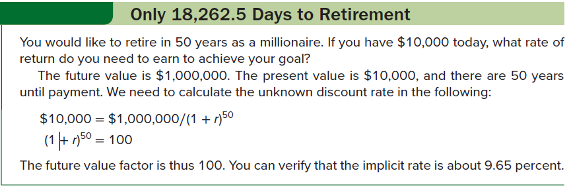
Only 18,262.5 Days to retirement

Slide 24

Finding the number of periods
Suppose we are interested in purchasing an asset that costs $50,000. We currently have $25,000. If we can earn 12 percent on this $25,000, how long until we have the $50,000?
We can again manipulate the basic present value equation to solve for the number of periods:
PV = $25,000, FV = $50,000, and I/Y = 12%
Basic equation takes one of the following forms:
We have a future value factor of 2 for a 12 percent rate, so we now need to solve for t
Per Table A.1, you will see that a future value factor of 1.9738 occurs at six periods; it will thus take about six years
To get an exact answer, we can use our financial calculator
I/Y = 12, PV = -25,000, FV = 50,000; Solve for N = 6.1163

Slide 25
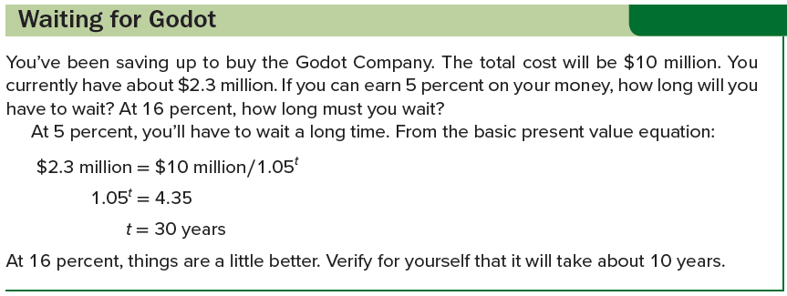
Waiting for godot

Slide 26
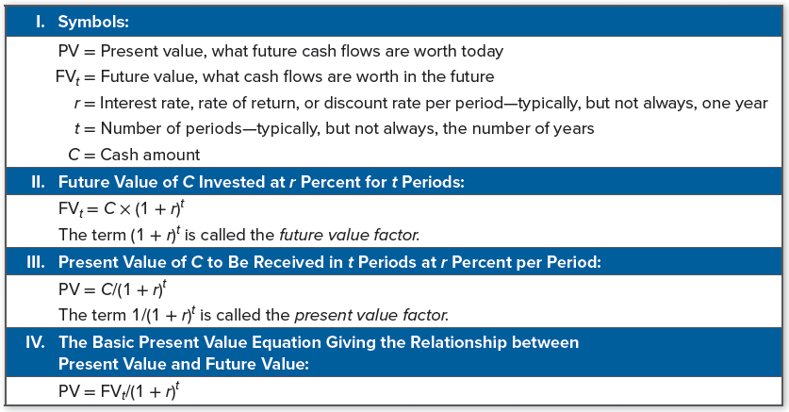
Summary of time value calculations
Notes:
Table 5.4 summarizes present and future value calculations for future reference.

Slide 27
Selected concept questions
What do we mean by the future value of an investment?
What does it mean to compound interest? How does compound interest differ from simple interest?
What do we mean by the present value of an investment?
The process of discounting a future amount back to the present is the opposite of doing what?
What is the basic present value equation?

Slide 28
End of Chapter
Chapter 5

