Slide 1
CHAPTER 6
DISCOUNTED CASH FLOW VALUATION

Slide 2
Learning objectives
Determine the future and present value of investments with multiple cash flows
Explain how loan payments are calculated and how to find the interest rate on a loan
Describe how loans are amortized or paid off
Show how interest rates are quoted (and misquoted)

Slide 3
Chapter Outline
Future and Present Values of Multiple Cash Flows
Valuing Level Cash Flows: Annuities and Perpetuities
Comparing Rates: The Effect of Compounding
Loan Types and Loan Amortization

Slide 4
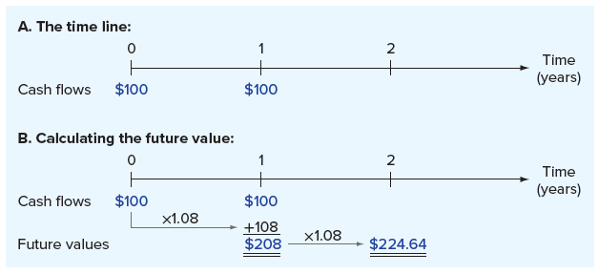
Future value with multiple cash flows
Suppose you deposit $100 today in an account paying 8 percent interest. In one year, you will deposit another $100. How much will you have in two years?
At the end of the first year, you will have $108 plus the second $100 you deposit, for a total of $208. You leave this $208 on deposit at 8 percent for another year. At the end of this second year, it is worth: $208 × 1.08 = $224.64
Notes:
Section 6.1
Here, when we calculated the future value of the two $100 deposits, we calculated the balance as of the beginning of each year and then rolled that amount forward to the next year.
Figure 6.1 is a time line that illustrates the process of calculating the future value of these two $100 deposits. Figures such as this are useful for solving complicated problems. Almost anytime you are having trouble with a present or future value problem, drawing a time line will help you see what is happening.
In the first part of Figure 6.1, we show the cash flows on the time line. The most important thing is that we write them down where they actually occur. Here, the first cash flow occurs today, which we label as Time 0. We therefore put $100 at Time 0 on the time line. The second $100 cash flow occurs one year from today, so we write it down at the point labeled as Time 1. In the second part of Figure 6.1, we calculate the future values one period at a time to come up with the final $224.64.

Slide 5
Future value with multiple cash flows (ALTERNATE SOLUTION)
The first $100 is on deposit for two years at 8 percent, so its future value is:
$100 × 1.08² = $100 × 1.1664 = $116.64
The second $100 is on deposit for one year at 8 percent, and its future value is thus:
$100 × 1.08 = $108
The total future value, as we previously calculated, is equal to the sum of these two future values:
$116.64 + 108 = $224.64
Based on this example, there are two ways to calculate future values for multiple cash flows, both giving the same answer:
Compound the accumulated balance forward one year at a time
Calculate the FV of each cash flow first and then add them up
Notes:
We could have solved the problem on the previous slide in another, quicker way. An alternative solution, where we calculate the FV of each cash flow first and then add them up, is presented on this slide.

Slide 6
Saving up revisited
You think you will be able to deposit $4,000 at the end of each of the next three years in a bank account paying 8 percent interest. You currently have $7,000 in the account. How much will you have in three years? In four years?
At the end of the first year, you will have:
$7,000 × 1.08 + 4,000 = $11,560
At the end of the second year, you will have:
$11,560 × 1.08 + 4,000 = $16,484.80
Repeating this for the third year gives:
$16,484.80 × 1.08 + 4,000 = $21,803.58
Therefore, you will have $21,803.58 in three years. If you leave this on deposit for one more year (and don’t add to it), at the end of the fourth year, you’ll have:
$21,803.58 × 1.08 = $23,547.87
Notes:
This is Example 6.1 in the text.

Slide 7

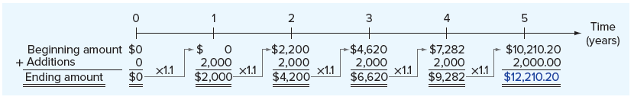
illustrating two different ways of calculating future values
Consider the future value of $2,000 invested at the end of each of the next five years. The current balance is zero, and the rate is 10 percent. The time line is presented below:
Notice that nothing happens until the end of the first year, when we make the first $2,000 investment
If we compound the investment one period at a time, the future value is $12,210.20
Notes:
On the time line, notice that nothing happens until the end of the first year, when we make the first $2,000 investment. This first $2,000 earns interest for the next four (not five) years. Also notice that the last $2,000 is invested at the end of the fifth year, so it earns no interest at all.

Slide 8
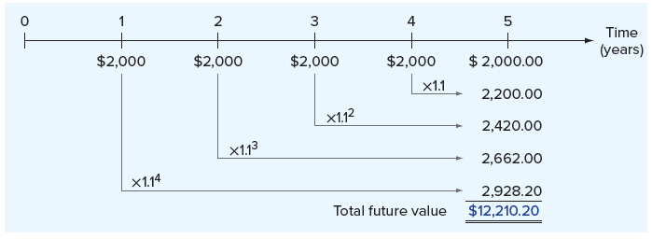
illustrating two different ways of calculating future values (CONTINUED)
We can solve the problem from the previous slide using the second technique, where we calculate the future value of each cash flow first and then add them up
The answer is the same, regardless of the technique used, with the future value being $12,210.20
Notes:
Figure 6.4 goes through the same calculations, but the second technique is used. Naturally, the answer is the same.

Slide 9
present value with multiple cash flows
Suppose you need $1,000 in one year and $2,000 more in two years. If you can earn 9 percent on your money, how much do you have to put up today to exactly cover these amounts in the future? In other words, what is the present value of the two cash flows at 9 percent?
The PV of $2,000 in two years at 9 percent is:
$2,000/1.09² = $1,683.36
The PV of $1,000 in one year at 9 percent is:
$1,000/1.09 = $917.43
Therefore, the total PV is: $1,683.36 + 917.43 = $2,600.79
Notes:
To see why $2,600.79 is the right answer, we can check to see that after the $2,000 is paid out in two years, there is no money left. If we invest $2,600.79 for one year at 9 percent, we will have:
$2,600.79 × 1.09 = $2,834.86
We take out $1,000, leaving $1,834.86. This amount earns 9 percent for another year, leaving us with:
$1,834.86 × 1.09 = $2,000

Slide 10
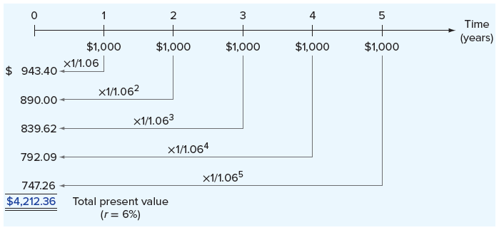
PV with multiple cash flows (CALCULATE PV INDIVIDUALLY AND ADD THEM UP)
As with future values, there are two ways to determine the present value of a series of future cash flows:
Discount back one period at a time
Calculate the present values individually and add them up
Suppose we had an investment that was going to pay $1,000 at the end of every year for the next five years. To find the present value, we could discount each $1,000 back to the present separately and then add them up.
Notes:
Figure 6.5 illustrates this approach for a 6 percent discount rate; as shown, the answer is $4,212.36.

Slide 11
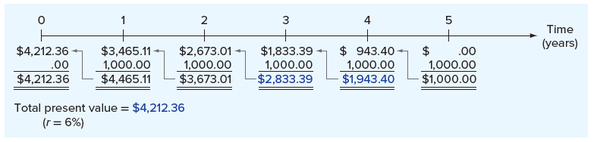
PRESENT value with multiple cash flows (DISCOUNT BACK ONE PERIOD AT A TIME)
Alternatively, we could discount the last cash flow back one period and add it to the next-to-the-last cash flow:
($1,000/1.06) + 1,000 = $943.40 + 1,000 = $1,943.40
We could then discount this amount back one period and add it to the Year 3 cash flow:
($1,943.40/1.06) + 1,000 = $1,833.39 + 1,000 = $2,833.39
Process can be repeated as necessary, as shown below:
Notes:
This process could be repeated as necessary. Figure 6.6 illustrates this approach and the remaining calculations.

Slide 12
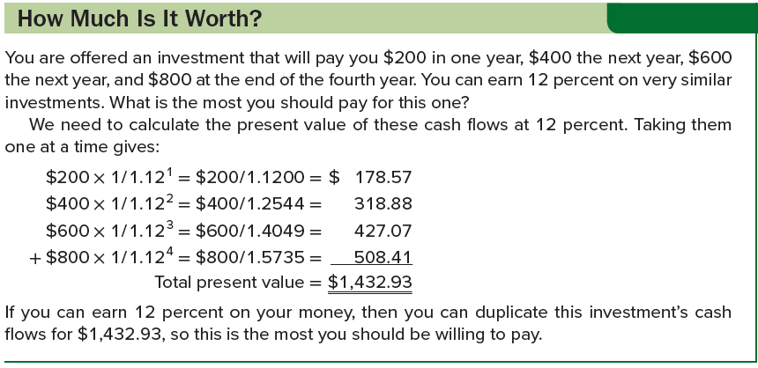
How Much is it worth?

Slide 13
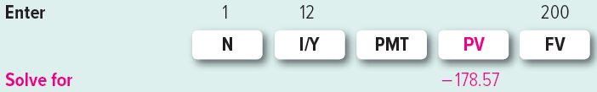

CALCULATE PV WITH MULTIPLE FUTURE CASH FLOWS USING A FINANCIAL CALCULATOR
We will use Example 6.3 (from the previous slide) to illustrate
From Example 6.3, the first cash flow is $200 to be received in one year and the discount rate is 12%, so we do the following:
You could write down the answer (above), but a more efficient method is to store the number in your calculator’s memory
Next, value the second cash flow by changing N to 2 and FV to 400
You save this number (above) by adding it to the one you saved in your first calculation, and so on for the remaining two calculations
Notes:
To begin, of course, we first remember to clear out the calculator!
Emphasize to students that as long as they haven’t changed anything else in moving from the first cash flow to the second, they do not need to reenter I/Y or clear out the calculator.

Slide 14
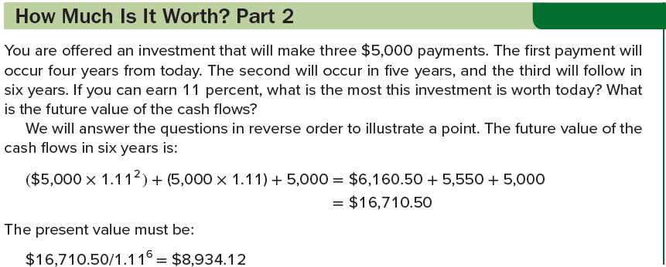
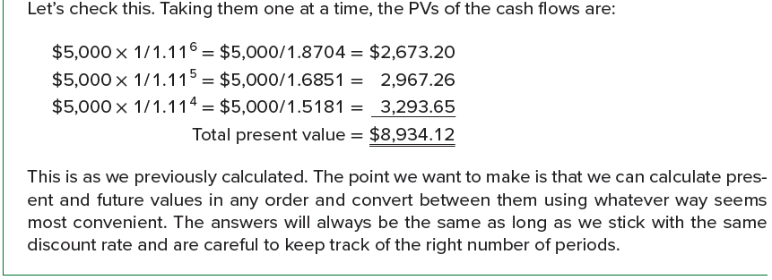
How Much is it worth? Part 2

Slide 15
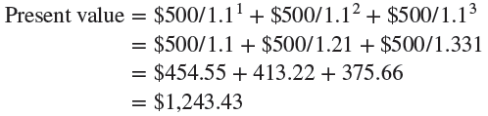
PRESENT VALUE FOR ANNUITY CASH FLOWS
In many situations, multiple cash flows will all be for the same amount (e.g., consumer loans and home mortgages)
An annuity is a level stream of cash flows for a fixed period
Suppose we were examining an asset that promised to pay $500 at the end of each of the next three years. The cash flows from this asset are in the form of a three-year, $500 annuity. If we wanted to earn 10 percent on our money, how much would we offer for this annuity?
One way to solve this problem is to discount each of these $500 payments back to the present at 10% to determine the total PV
Notes:
Section 6.2
This approach works just fine. However, we For example, a typical home mortgage calls for will often encounter situations in which the number of cash flows is quite large. monthly payments over 30 years, for a total of 360 payments. If we were trying to determine the present value of those payments, it would be useful to have a shortcut.

Slide 16
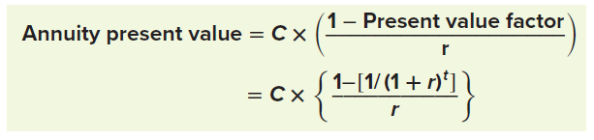
PRESENT VALUE FOR ANNUITY CASH FLOWS (continued)
PV of an annuity of C dollars per period for t periods when the rate of return or interest rate, r, is given by:
Term in parentheses on first line is called the present value interest factor for annuities and abbreviated PVIFA(r, t)
From the example in the previous slide, the usual PV factor is:
Present value factor = 1/1.1³ = 1/1.331 = .751315
To calculate the annuity PV factor, we simply plus this in:
Annuity present value factor = ( 1 − Present value factor ) / r
= ( 1 − .751315 ) / .10
= .248685 / .10 = 2.48685
PV of $500 annuity is therefore: $500 × 2.48685 = $1,243.43
Notes:
Notice this is the same answer we calculated on the previous slide.

Slide 17
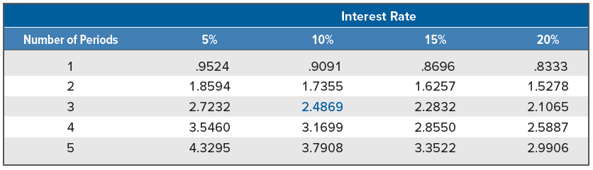
Annuity tables
Just as there are tables for ordinary PV factors, there are tables for annuity factors, as well
To find the annuity PV factor we calculated in the previous slide, look for the row corresponding to three periods and then find the column for 10 percent.
The number you see at that intersection should be 2.4869 (rounded to four decimal places), as we calculated.
Notes:
Table 6.1 contains a few such factors; Table A.3 in the appendix to the book contains a larger set.

Slide 18

Find annuity present values with a financial calculator
To find annuity present values with a financial calculator, we need to use the PMT key
Compared to finding the present value of a single amount, there are two important differences:
We enter the annuity cash flow using the PMT key
We don’t enter anything for the future value (FV)
The problem we have been examining is a three-year, $500 annuity. If the discount rate is 10 percent, we need to do the following (after clearing out the calculator!):
Notes:
As usual, we get a negative sign on the PV.

Slide 19
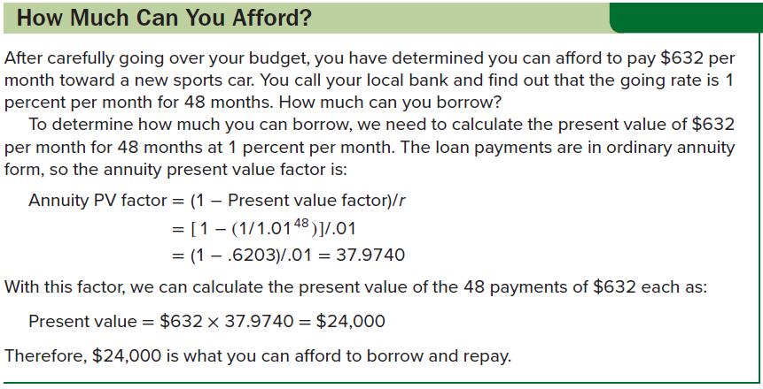
HOW MUCH CAN YOU AFFORD?

Slide 20
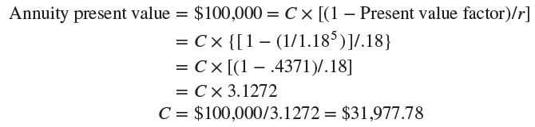
Finding the payment
Suppose you wish to start up a new business that specializes in the latest of health food trends, frozen yak milk. To produce and market your product, the Yakkee Doodle Dandy, you need to borrow $100,000. Because it strikes you as unlikely that this particular fad will be long-lived, you propose to pay off the loan quickly by making five equal annual payments. If the interest rate is 18 percent, what will the payment be?
You will make five payments of just under $32,000 each
Notes:
In this case, we know the present value is $100,000. The interest rate is 18 percent, and there are five years. The payments are all equal, so we need to find the relevant annuity factor and solve for the unknown cash flow.

Slide 21

Finding the payment (continued)
Solving the problem from the previous slide using a financial calculator is quite simple
In our yak milk example, the PV is $100,000, the interest rate is 18 percent, and there are five years
We find the payment as follows:

Slide 22
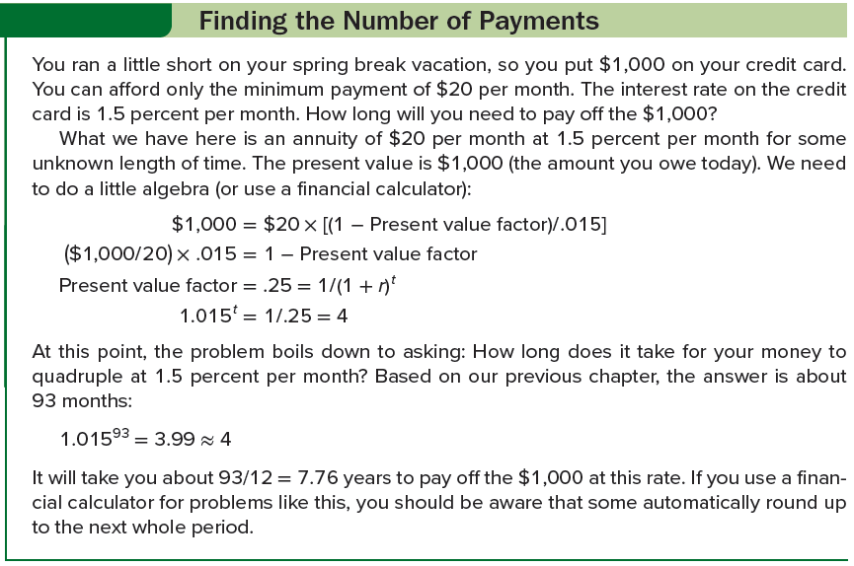
Finding the number of payments

Slide 23

Finding the number of payments (continued)
To solve Example 6.6 (from the previous slide) on a financial calculator, do the following:
Notice that we put a negative sign on the payment you must make, and we have solved for the number of months; You still must divide by 12 to get our answer!
93.11 / 12 = 7.76 years
Some financial calculators won’t report a fractional value for N; they automatically round up to the next whole period
With a spreadsheet, use the function =NPER(rate,pmt,pv,fv)
Be sure to put in a zero for FV (or leave it blank) and to enter −20 as the payment

Slide 24

Finding the rate
An insurance company offers to pay you $1,000 per year for 10 years if you will pay $6,710 up front. What rate is implicit in this 10-year annuity?
As shown above, the annuity factor for 10 periods is equal to 6.71, and we need to solve this equation for the unknown value of r
This is mathematically impossible to do directly; the only way to do it is to use a table or trial and error to find a value for r
Solving with annuity table
If you look across the row corresponding to 10 periods in Table A.3, you will see a factor of 6.7101 for 8%, so the insurance company is offering just about 8%
Notes:
In this case, we know the present value ($6,710), we know the cash flows ($1,000 per year), and we know the life of the investment (10 years).

Slide 25
Finding the rate (continued)
Suppose a relative wants to borrow $3,000. She offers to repay you $1,000 every year for four years. What interest rate are you being offered?
Finding the answer by trial and error
At 10%, the annuity PV factor is: [1 − (1/1.10⁴)] /.10 = 3.16987
PV of the cash flows at 10% is thus: $1,000 × 3.16987 = $3,169.87
Is 10% too high or too low? PVs and discount rates move in opposite directions: Increasing the discount rate lowers the PV and vice versa. PV here is too high, so discount rate is too low.
Let’s try 12%: $1,000 × {[1 − (1/1.12⁴)] / .12} = $3,037.35
We are still a low on the discount rate (because PV is a little high)
Let’s try 13%: $1,000 × {[1 − (1/1.13⁴)] / .13} = $2,974.47
This is less than $3,000, so we now know that the answer is between 12% and 13%, and it looks to be about 12.5%
Notes:
Note that, in step 1, we simply pick 10% as a starting point.
For practice, work at it for a while longer and see if you find that the answer is about 12.59 percent.

Slide 26

Finding the rate (CONCLUDED)
Suppose a relative wants to borrow $3,000. She offers to repay you $1,000 every year for four years. What interest rate are you being offered?
Finding the answer using a financial calculator
Notice that we put a negative sign on the present value
With a spreadsheet, use the function =RATE(nper,pmt,pv,fv);
Be sure to put in a zero for FV (or leave it blank) and to enter 1,000 as the payment and −3,000 as the PV

Slide 27
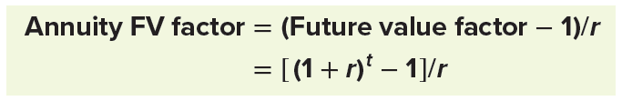
Future value for annuities
Here is the future value factor for an annuity:
Suppose you plan to contribute $2,000 every year to a retirement account paying 8 percent. If you retire in 30 years, how much will you have?
We can calculate the annuity future value factor as:
Annuity FV factor = (Future value factor − 1 ) / r
= ( 1.08³⁰ − 1 ) / .08
= ( 10.0627 − 1 ) / .08
= 113.2832
Future value of this 30-year, $2,000 annuity is thus:
Annuity future value = $2,000 × 113.2832
= $226,566.42
Notes:
The number of years here, t, is 30, and the interest rate, r, is 8 percent.

Slide 28
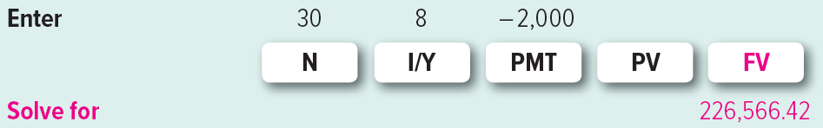
Future value for annuities (continued)
You could solve the problem from the previous slide using a financing calculator by doing the following:
Notice that we put a negative sign on the payment
With a spreadsheet, use the function =FV(rate,nper,pmt,pv)
Be sure to put in a zero for PV (or leave it blank) and to enter −2,000 as the payment

Slide 29
Future value for annuities (CONCLUDED)
Sometimes we need to find the unknown rate, r, in the context of an annuity future value
If you had invested $100 per month in stocks over the 25-year period ended December 1978, your investment would have grown to $76,374. This period had the worst stretch of stock returns of any 25-year period between 1925 and 2019. How bad was it?
To find the implicit rate, r:
$76,374 = $100 × [(Future value factor − 1) / r]
$763.74 = [(1 + r)³⁰⁰ − 1] / r
Because this is the worst period, let’s try 1 percent:
Annuity future value factor = (1.01³⁰⁰ − 1)/.01 = 1,878.85
We see that 1 percent is too high; from here, it’s trial and error!
Notes:
Here we have the cash flows ($100 per month), the future value ($76,374), and the time period (25 years, or 300 months).
See if you agree that r is about .55 percent per month. As you will see later in the chapter, this works out to be about 6.8 percent per year.

Slide 30
A note about annuities due
Ordinary annuities are annuities in which the cash flows occur at the end of each period
An annuity due is an annuity for which the cash flows occur at the beginning of each period
There are several different ways to calculate the value of an annuity due:
With a financial calculator, switch it into “due” or “beginning” mode
Treat number of payments in annuity due as equivalent to number of payments less one in ordinary annuity (i.e., five-year annuity due equals four-year ordinary annuity) and add the cash flow at Time 0
Calculate the PV or FV as though it were an ordinary annuity and then multiply your answer by (1 + r)
Notes:
Almost any type of arrangement in which we have to prepay the same amount each period is an annuity due.
If you switch your calculator into “due” or “beginning” mode, be sure to switch it back when you are done!

Slide 31
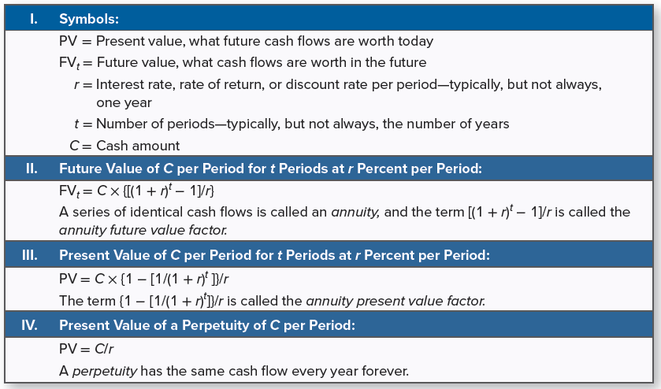
Summary of annuity and perpetuity calculations

Slide 32

perpetuities
Perpetuities are annuities in which the cash flows continue forever
Also referred to as consols, particularly in Canada and the U.K.
Present value of a perpetuity is:
For example, an investment offers a perpetual cash flow of $500 every year. The return you require on such an investment is 8 percent. What is the value of this investment?
The value of this perpetuity is:
Notes:
For future reference, Table 6.2 contains a summary of the annuity and perpetuity basic calculations we have described in this section.

Slide 33
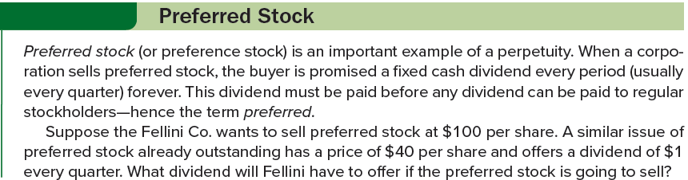
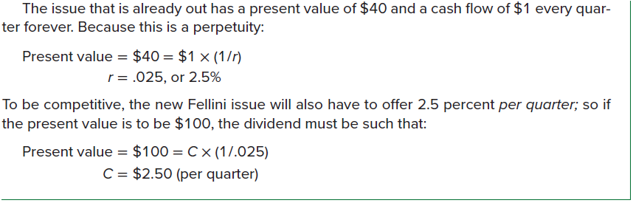
Preferred stock

Slide 34
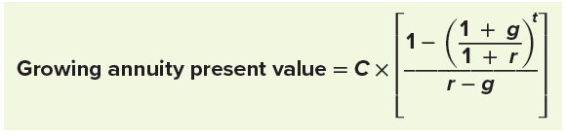
Growing annuities and perpetuities
Annuities commonly have payments that grow over time
Suppose we are looking at a lottery payout over a 20-year period. The first payment, made one year from now, will be $200,000. Every year thereafter, the payment will grow by 5%, so the payment in the second year will be $200,000 × 1.05 = $210,000. The payment in the third year will be $210,000 × 1.05 = $220,500, and so on. What’s the PV if the appropriate discount rate is 11%?
If we use the symbol g to represent the growth rate, we can calculate the value of a growing annuity using a modified version of our regular annuity formula:

Slide 35
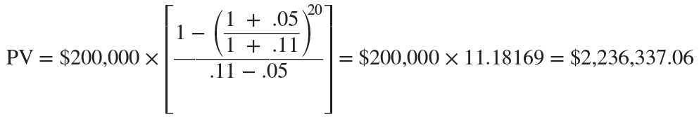

Growing annuities and perpetuities (continued)
Plugging in the numbers from our lottery example (and letting g = .05), we get:
There is also a formula for the PV of a growing perpetuity:
Returning to our lottery example, now suppose the payments continue forever. In this case, the present value is:
Notes:
Before we go on, there is one important item to note in regard to our formulas for growing annuities and perpetuities. In both cases, the cash flow in the formula, C, is the cash flow that is going to occur exactly one period from today.

Slide 36
EFFECTIVE ANNUAL RATES AND COMPOUNDING
Rates are quoted in many ways
If a rate is quoted as 10 percent compounded semiannually, this means the investment actually pays 5 percent every six months
Is 5% every six months the same thing as 10% per year? No!
If you invest $1 at 10% per year, you will have $1.10 at year end
If you invest at 5% every six months, then you’ll have the FV of $1 at 5% for two periods: $1 × 1.052 = $1.1025
In this example, the 10% is a stated, or quoted, interest rate
The 10.25%, which is actually the rate you will earn, is called the effective annual rate (EAR)
Anytime we have compounding during the year, we need to be concerned about what the rate really is
To compare different investments or interest rates, we will always need to convert to effective rates
Notes:
Section 6.3
Sometimes the way a rate is quoted is the result of tradition, and sometimes it’s the result of legislation. Unfortunately, at times, rates are quoted in deliberately deceptive ways to mislead borrowers and investors.

Slide 37
CALCULATING AND COMPARING EFFECTIVE ANNUAL RATES
Suppose you’ve shopped around and found the following rates:
Bank A: 15 percent compounded daily
Bank B: 15.5 percent compounded quarterly
Bank C: 16 percent compounded annually
Which of these is the best if you are thinking of opening a savings account? Which is best if they represent loan rates?
Bank C is offering 16% per year. Because there is no compounding during the year, the EAR is 16%.
Bank B is paying .155/4 = .03875, or 3.875% per quarter. An investment of $1 for four quarters would grow to: $1 × 1.03875⁴ = $1.1642. The EAR, therefore, is 16.42%.
Bank A is compounding every day. The daily interest rate is: .15/365 = .000411, or .0411%. An investment of $1 for 365 periods would grow to: $1 × 1.000411³⁶⁵ = $1.1618 and the EAR is 16.18%
Notes:
You see that we computed the EARs in three steps. We first divided the quoted rate by the number of times that the interest is compounded. We then added 1 to the result and raised it to the power of the number of times the interest is compounded. Finally, we subtracted the 1.

Slide 38

CALCULATING AND COMPARING EFFECTIVE ANNUAL RATES (continued)
The EARs from the previous slide are as follows:
Bank A – 16.18%
Bank B – 16.42%
Bank C – 16.00%
Which rate is best?
For a borrower, Bank C offers the best rate
For a saver, Bank B offers the best rate
EAR may be calculated as follows, where m is the number of times the interest is compounded:
Notes:
This example illustrates two things. First, the highest quoted rate is not necessarily the best. Second, compounding during the year can lead to a significant difference between the quoted rate and the effective rate. Remember that the effective rate is what you actually get or what you pay.

Slide 39
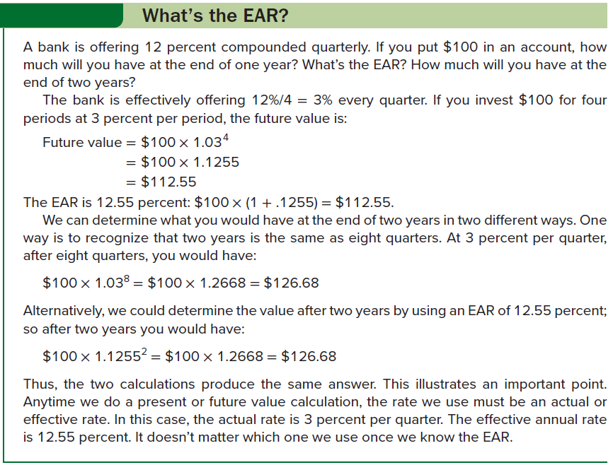
What’s the ear?

Slide 40
Ears and aprs
Truth-in-lending laws in the U.S. require lenders to disclose an APR on virtually all consumer loans
Annual percentage rate (APR) is the interest rate charged per period multiplied by the number of periods per year
Is APR an EAR? In other words, if a bank quotes a car loan at 12% APR, is the consumer actually paying 12% interest? No!
For example, an APR of 12% on a loan calling for monthly payments is really 1% per month
However, the EAR on such a loan is the following:
EAR = [1 + (APR /12)]¹² − 1 = 1.01¹² − 1 = .126825, or 12.6825%
There are also truth-in-saving laws that require banks and other borrowers to quote an “annual percentage yield,” or APY, on things like savings accounts
Unlike APR, an APY is an EAR; rates quoted to borrowers (APRs) and those quoted to savers (APYs) are not computed the same way

Slide 41
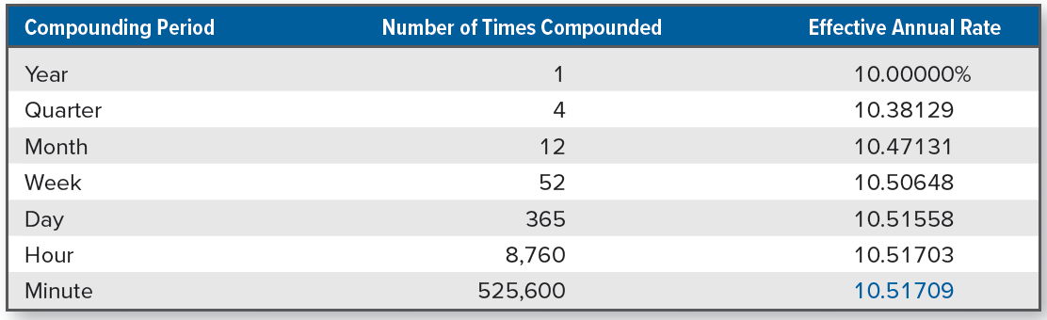

A note about continuous compounding
There is no upper limit to the number of times your money could be compounded during the year
We have seen daily compounding, but compounding (in theory) could occur every hour or minute or second
How high will the EAR get?
There is an upper limit to the EAR
If we let q stand for the quoted rate, then as the number of times interest is compounded gets extremely large, EAR approaches:
Notes:
Table 6.3 illustrates the EARs that result as 10 percent is compounded at shorter and shorter intervals. Notice that the EARs do keep getting larger, but the differences get very small.

Slide 42
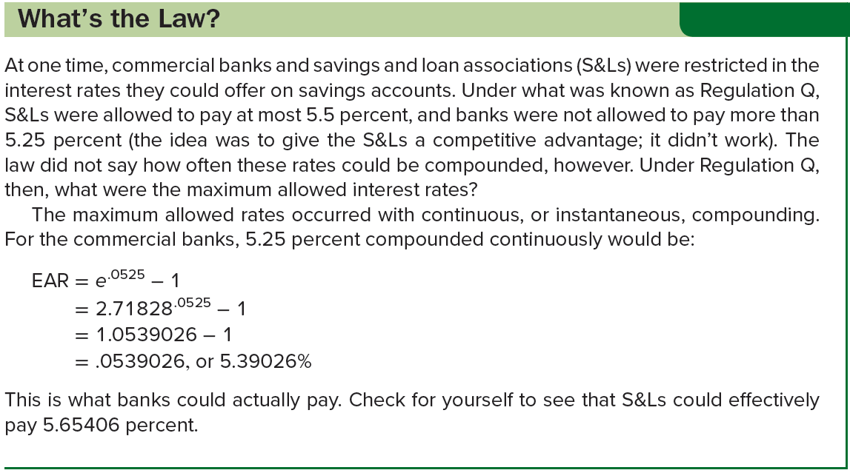
What’s the law?

Slide 43
Loan types and loan amortization: pure discount loans
Pure discount loans are those in which the borrower receives money today and repays a single lump sum at some time in the future
Simplest form of loan
Common when the loan term is short – say a year or less
Suppose a borrower was able to repay $25,000 in five years. If we, acting as the lender, wanted a 12% interest rate on the loan, how much would we be willing to lend? Put another way, what value would we assign today to that $25,000 to be repaid in five years?
Answer is the present value of $25,000 at 12 percent for five years:
Present value = $25,000 / 1.12⁵
= $25,000 / 1.7623
= $14,185.67
Notes:
Section 6.4

Slide 44
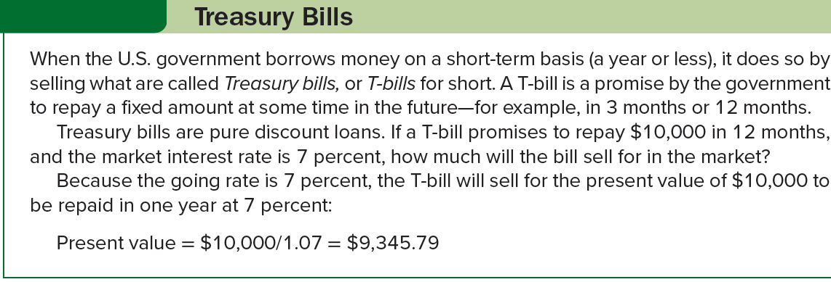
Treasury bills

Slide 45
Loan types and loan amortization: interest only loans
Interest-only loans call for the borrower to pay interest each period and to repay the entire principal (the original loan amount) at some point in the future
Most corporate bonds have general form of an interest-only loan
For example, with a three-year, 10 percent, interest-only loan of $1,000, the borrower would pay $1,000 × .10 = $100 in interest at the end of the first and second years
At the end of the third year, the borrower would return the $1,000 along with another $100 in interest for that year
Likewise, a 50-year interest-only loan would call for the borrower to pay interest every year for the next 50 years and then repay the principal
Notes:
Notice that if there is just one period, a pure discount loan and an interest-only loan are the same thing.

Slide 46
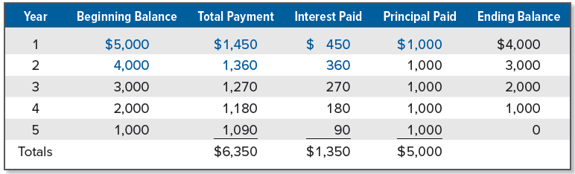
Loan types and loan amortization: amortized loans
If the lender requires the borrower to repay parts of the loan over time, it is an amortized loan; process of providing for a loan to be paid off by making regular principal reductions is called amortizing the loan
Simple way of amortizing a loan is to have the borrower pay the interest each period plus some fixed amount
Suppose a business takes out a $5,000, 5-year loan at 9%. The loan agreement calls for the borrower to pay the interest on the loan balance each year and to reduce the loan balance each year by $1,000. Because the loan amount declines by $1,000 each year, it is fully paid in 5 years.
Notes:
An amortization schedule is provided, showing the total payment in each of the remaining years.
Notice that in each year, the interest paid is given by the beginning balance multiplied by the interest rate. Also notice that the beginning balance is given by the ending balance from the previous year.

Slide 47
Loan types and loan amortization: amortized loans (continued)
Most common way of amortizing a loan is to have the borrower make a single, fixed payment every period
Suppose our five-year, 9 percent, $5,000 loan was amortized this way. How would the amortization schedule look?
We can solve for the payment as follows:
$5,000 = C × {[ 1 − (1 / 1.09⁵)] / .09}
= C × [(1 − .6499) / .09]
This gives us:
C = $5,000 / 3.8897 = $1,285.46
Borrower will therefore make five equal payments of $1,285.46
We will calculate the interest and then subtract it from the total payment to calculate the principal portion in each payment
Interest paid in the first year if $5,000 x .09 = $450
Principal paid in first year = $1,285.46 – 450 = $835.46
Ending loan balance = $5,000 – 835.46 = $4,164.54
Notes:
Almost all consumer loans (such as car loans) and mortgages work this way.

Slide 48
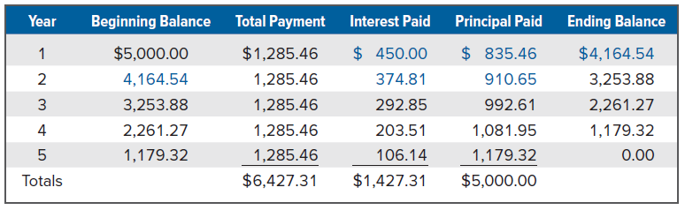
Loan types and loan amortization: amortized loans (concluded)
All remaining calculations are summarized in the following schedule:
Because the loan balance declines to zero, the five equal payments pay off the loan

Slide 49
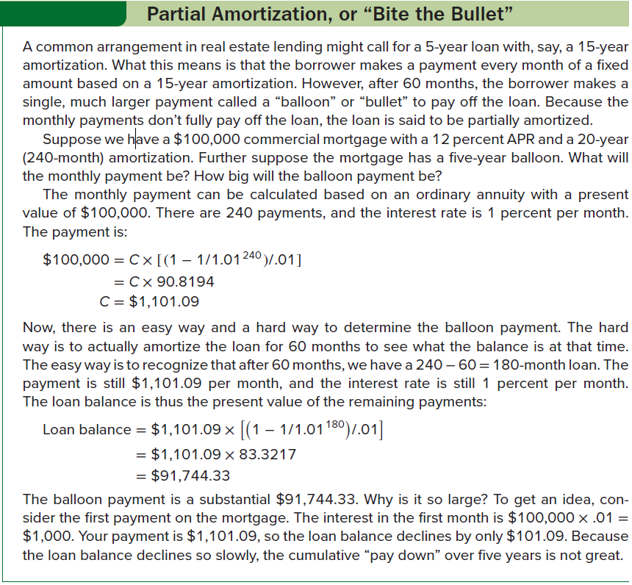
Partial amortization, or “bite the bullet”

Slide 50
Selected concept questions
Describe how to calculate the future value of a series of cash flows.
Describe how to calculate the present value of a series of cash flows.
In general, what is the present value of a perpetuity?
If an interest rate is given as 12 percent compounded daily, what do we call this rate?
What is an APR? What is an EAR? Are they the same thing?
What is a pure discount loan? An interest-only loan?
What does it mean to amortize a loan?

Slide 51
End of Chapter
Chapter 6

