Slide 1
CHAPTER 8
STOCK VALUATION

Slide 2
Learning objectives
Explain how stock prices depend on future dividends and dividend growth
Show how to value stocks using multiples
Lay out the different ways corporate directors are elected to office
Define how the stock markets work

Slide 3
Chapter Outline
Common Stock Valuation
Some Features of Common and Preferred Stocks
The Stock Markets

Slide 4
Common stock valuation
Share of common stock is more difficult to value in practice than a bond for at least three reasons:
  With common stock, not even the promised cash flows are known in advance
  Life of the investment is essentially forever because common stock has no maturity
  No way to easily observe the rate of return that the market requires
Notes:
Section 8.1

Slide 5

Cash flows
Imagine you are considering buying a share of stock today. You plan to sell the stock in one year. You somehow know that the stock will be worth $70 at that time. You predict the stock will also pay a $10 per share dividend at the end of the year. If you require a 25% return on your investment, what is the most you would pay for the stock? In other words, what is the present value of the $10 dividend along with the $70 ending value at 25%?
  Present value = ($10 + 70)/1.25 = $64
Let P₀ be the current price of the stock, and assign P₁ to be the price in one period. If D₁ is the cash dividend paid at the end of the period and R is the required return in the market on this investment , then:
Notes:
Section 8.1
$64 is the value you would assign to the stock today.

Slide 6

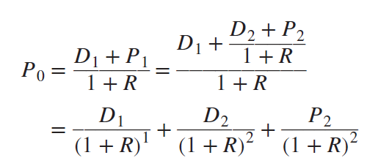
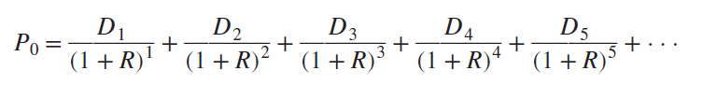
Cash flows
(continued)
Suppose we somehow knew the price in two periods, P₂. Given a predicted dividend in two periods, D₂, the stock price in one period would be:
Substitute this expression for P₁ into our expression for P₀
The price of the stock today is equal to the present value of all of the future dividends
Notes:
We can push the problem of coming up with the stock price off into the future forever. Note that no matter what the stock price is, the present value is essentially zero if we push the sale of the stock far enough away. What we are eventually left with is the result that the current price of the stock can be written as the present value of the dividends beginning in one period and extending out forever.

Slide 7
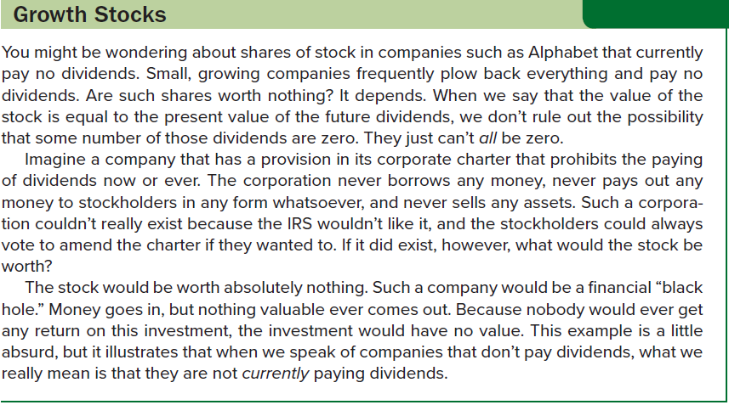
Growth stocks

Slide 8



Zero growth
A share of common stock in a company with a constant dividend is much like a share of preferred stock
Dividend on a share of preferred stock has zero growth and is constant through time; for a zero-growth share of common stock, this implies that:
Value of the stock is:
Stock may be viewed as ordinary perpetuity with cash flow equal to D every period, with the per-share value given by:
  Where R is the required return

Slide 9
Constant growth
Suppose we know that the dividend for some company always grows at a steady rate. Call this growth rate g. If we let D₀ be the dividend just paid, then the next dividend, D₁, is:
    D₁ = D₀ × (1 + g)
The dividend in two periods is:
    D₂ = D₁ × (1 + g)
    = [D₀ × (1 + g )] × (1 + g)
    = D₀ × ( 1 + g )²
We could repeat this process to come up with the dividend at any point in the future
The dividend t periods into the future, D_{t}, is given by:
    D_{t} = D₀ × (1 + g)^{t}
Notes:
The assumption of steady dividend growth might strike you as peculiar. Why would the dividend grow at a constant rate? The reason is that, for many companies, steady growth in dividends is an explicit goal.

Slide 10


Constant growth
(continued)
The dividend growth model determines the current price of a stock as its dividend next period divided by the discount rate less the dividend growth rate, and can be written as follows, so long as the growth rate, g, is less than the discount rate, r:
We can use the dividend growth model to get the stock price at any point in time; in general, the price of the stock as of Time t is:

Slide 11

Constant growth
(concluded)
Suppose D₀ is $2.30, R is 13%, and g is 5%. The price per share in this case is:
    P₀ = D₀ × (1 + g)/(R − g)
    = $2.30 × 1.05/(. 13 − . 05 )
    = $2.415 / .08
    = $30.19
Suppose we are interested in the price of the stock in five years, P₅. We first need the dividend at Time 5, D₅. Because the dividend just paid is $2.30 and the growth rate is 5% per year, D₅ is:
    D₅ = $2.30 × 1.05⁵ = $2.30 × 1.2763 = $2.935
The price of the stock in five years is:

Slide 12
Nonconstant GROWTH
Main reason to consider this case is to allow for “supernormal” growth rates over some finite length of time
  Require dividends start growing at a constant rate sometime in future
Consider the case of a company that is currently not paying dividends. You predict that, in five years, the company will pay a dividend for the first time. The dividend will be $.50 per share. You expect that this dividend will then grow at a rate of 10% per year indefinitely. The required return on companies such as this one is 20%. What is the price of the stock today?
  Find out what it will be worth once dividends are paid; price in four years will be:
    P₄ = D₄ × (1 + g)/(R − g) = D₅/(R − g) = $.50 /( .20 − .10) = $5
  If the stock will be worth $5 in four years, then we can get the current value by discounting this price back four years at 20%:
    P₀ = $5/1.20⁴ = $5/2.0736 = $2.41
Notes:
The stock is worth $2.41 today.

Slide 13
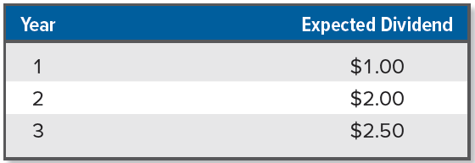
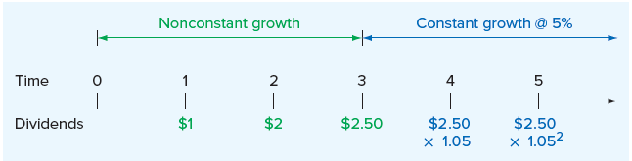
Nonconstant GROWTH
(continued)
Suppose you have come up with the following dividend forecasts for the next three years. After the third year, the dividend will grow at a constant rate of 5% per year. The required return is 10%. What is the value of the stock today?
In dealing with nonconstant growth, a time line can be helpful
Notes:
The problem of nonconstant growth is only slightly more complicated if the dividends are not zero for the first several years.
The important thing to notice is when constant growth starts. As we’ve shown, for this problem, constant growth starts at Time 3. By far the most common mistake in this situation is to incorrectly identify the start of the constant growth phase and, as a result, calculate the future stock price at the wrong time.

Slide 14
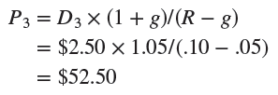
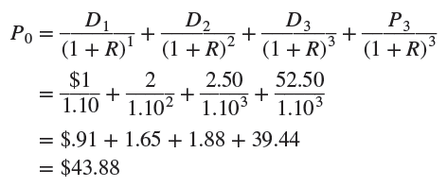
Nonconstant GROWTH
(Concluded)
Value of the stock is the present value of all the future dividends:
  Compute the PV of the stock price three years down the road
  Add in the PV of dividends that will be paid between now and then
Notes:
The value of the stock today is thus $43.88.

Slide 15


Two-stage growth
In this case, the dividend will grow at a rate of g₁ for t years and then grow at a rate of g₂ thereafter, forever
The value of the stock can be written as:
  First term in expression is the PV of a growing annuity
  In first stage, g₁ can be greater than R
  Second part is PV of stock price once second stage begins at Time t
We can calculate P_{t} as follows:
  In this second stage, g₂ must be less than R

Slide 16
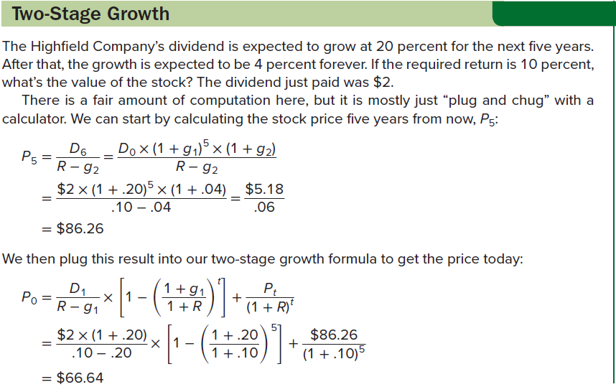

Two-stage growth: an example

Slide 17

Components of the required return
Earlier, we calculated P₀ as: P₀ = D₁/(R − g). If we rearrange this to solve for R, we get:
Total return, R, has two components:
  Dividend yield is a stock’s expected cash dividend divided by its current price (i.e., D₁/P₀)
  Dividend growth rate, g, can be interpreted as the capital gains yield, the rate at which the value of an investment grows
Suppose we observe a stock selling for $20 per share. The next dividend will be $1 per share. You think that the dividend will grow by 10% per year more or less indefinitely. What return does this stock offer if this is correct?
  R = Dividend yield + Capital gains yield
  R = $1/$20 + .10 = .05 + .10 = .15, or 15%

Slide 18
Stock valuation using multiples
Obvious problem with dividend-based approach to stock valuation is that many companies don’t pay dividends
If the company is profitable (i.e., has positive earnings), use the PE ratio, calculated as the ratio of a stock’s price per share to its earnings per share (EPS) over the previous year
  Idea is to have some sort of benchmark PE ratio, which we then multiply by earnings to come up with a price:
  Benchmark PE ratio could come from a variety of sources (e.g., based on similar companies, based on a company’s own historical values)
  PE ratio based on estimated future earnings is a forward PE ratio
Some companies do not pay dividends nor are they profitable
  In this case, use the price-sales ratio, calculated as the price per share on the stock divided by sales per share, or the EV/EBITDA ratio
Notes:
As with any ratio, all three valuation ratios vary based on company age and industry.

Slide 19
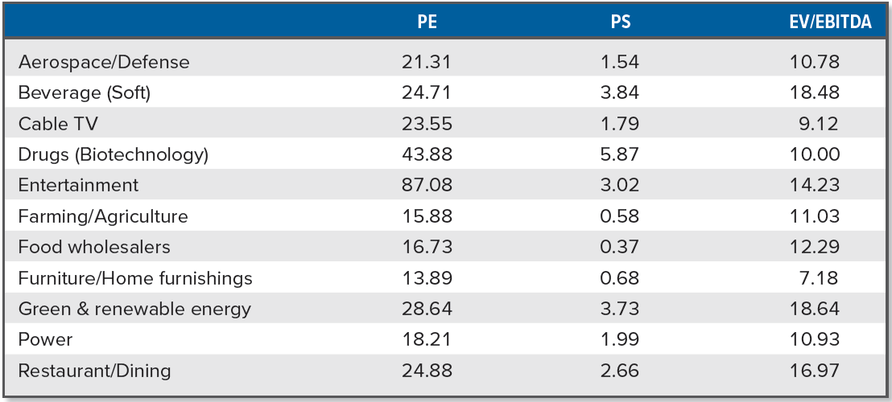
PE, PS, AND EV/EBITDA RATIOS FOR VARIOUS INDUSTRIES
Notes:
Table 8.1 shows the average ratios in different industries. As you can see, significant variation exists between industries, but the difference is not always consistent For example, the PE ratio for the soft drink and cable TV industries are similar, but the price-sales and EV/EBITDA ratios for the soft drink industry are about twice what we see in the cable TV industry.

Slide 20
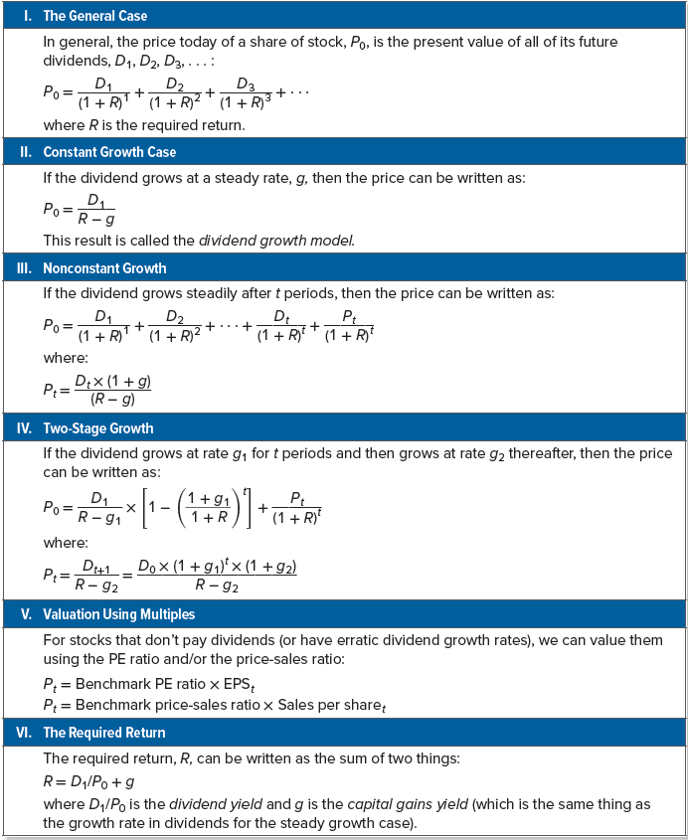
SUMMARY OF STOCK VALUATION
Notes:
For future reference, our discussion of stock valuation techniques is summarized in Table 8.2.

Slide 21
Common stock features: shareholder rights
Common stock is equity without priority for dividends or in bankruptcy
Shareholders elect directors who, in turn, hire managers to carry out their directives
Directors are elected each year at an annual meeting by a vote of the holders of a majority of shares who are present and entitled to vote
  In cumulative voting, a shareholder may cast all votes for one member of the board of directors; all directors are elected at once
  In straight voting, a shareholder may cast all votes for each member of the board of directors; directors are elected one at a time
Many companies have staggered elections for directors (i.e., classified boards), but several have been pressured to declassify
Staggering has two basic effects:
  Makes it more difficult for a minority to elect a director
  Makes takeover attempts less likely to be successful

Slide 22
Common stock features: proxy voting and stock classes
A proxy is a grant of authority by a shareholder allowing another individual to vote his or her shares
Shareholders can come to the annual meeting and vote in person, or they can transfer their right to vote to another party
  Most voting in large public corporations is done by proxy
  If shareholders are not satisfied with management, an “outside” group of shareholders can try to obtain votes via proxy, with the resulting battle called a proxy fight
Some firms have more than one class of common stock
  E.g., Ford Motor Company has Class B common stock, which is not publicly traded
  Primary reason for creating dual or multiple classes of stock has to do with control of the firm
  If multiple classes exist, management can raise equity capital by issuing nonvoting or limited-voting stock while maintaining control

Slide 23
Common stock features: other rights
In addition to the right to vote for directors, shareholders usually have the following rights:
  Right to share proportionally in dividends paid
  Right to share proportionally in assets remaining after liabilities have been paid in a liquidation
  Right to vote on stockholder matters of great importance (e.g., a merger), with voting usually done at the annual meeting or a special meeting
Stockholders sometimes have a preemptive right, the right to share proportionally in any new stock sold
  Purpose is to give stockholders the opportunity to protect their proportionate ownership in the corporation
  Company that wishes to sell stock must first offer it to the existing stockholders before offering it to the general public

Slide 24
Common stock features: dividends
Distinctive feature of corporations is that they have shares of stock on which they are authorized by law to pay dividends to their shareholders
Dividends are payments by a corporation to shareholders, made in either cash or stock
Payment of dividends is at discretion of the board of directors
Important characteristics of dividends include the following:
  Unless a dividend is declared by the board of directors of a corporation, it is not a liability of the corporation. A corporation cannot default on an undeclared dividend. Therefore, corporations cannot become bankrupt because of nonpayment of dividends.
  Payment of dividends by the corporation is not a business expense. Dividends are not deductible for corporate tax purposes.
  Dividends received by individual shareholders are taxable. In 2020, the tax rate was 15 to 20 percent.
Notes:
Regarding the last characteristic of dividends, note that corporations that own stock in other corporations are permitted to exclude 50 percent of the dividend amounts they receive and are taxed on only the remaining 50 percent (the 50 percent exclusion was reduced from 70 percent by the Tax Cuts and Jobs Act of 2017).

Slide 25
preferred stock features: stated value and dividends
Preferred stock has dividend priority over common stock, normally with a fixed dividend rate, sometimes without voting rights
Preferred shares have a stated liquidating value, usually $100 per share, with the cash dividend described in terms of dollars per share
  “$5 preferred” translates into a dividend yield of 5% of stated value
Preferred dividend is not like interest on a bond
  Board of directors may decide not to pay dividends on preferred share, (which may have nothing to do with the current net income of the corporation), in which case:
    Common shareholders must also forgo dividends
    Holders of preferred shares are often granted voting and other rights if preferred dividends have not been paid for some time
Dividends payable on preferred stock are either cumulative or noncumulative, though most are cumulative
Unpaid preferred dividends are not debts of the firm
Notes:
If preferred dividends are cumulative and are not paid in a particular year, they will be carried forward as an arrearage. Usually, both the accumulated (past) preferred dividends and the current preferred dividends must be paid before the common shareholders can receive anything.

Slide 26
preferred stock features: is preferred stock really debt?
Good case can be made that preferred stock is really debt in disguise, a kind of equity bond, for the following reasons:
  Preferred shareholders receive a stated dividend only
  If corporation is liquidated, preferred shareholders get a stated value
  Preferred stocks often carry credit ratings much like those of bonds
  Preferred stock is sometimes convertible into common stock
  Preferred stocks are often callable
  Many issues of preferred stock have obligatory sinking funds, effectively creating a final maturity
In the 1990s, firms began to sell securities that looked a lot like preferred stocks but were treated as debt for tax purposes, making the interest payments tax deductible
  Until 2003, interest payments and dividends were taxed at the same marginal tax rate; when the tax rate on dividend payments was reduced, these instruments were not included

Slide 27
The stock markets: dealers and brokers
Recall the stock market consists of a primary and secondary market
Most securities transactions involve dealers and brokers
  Dealer is an agent who buys and sells securities from inventory
    Stands ready to buy securities from investors wishing to sell them and sell securities to investors wishing to buy them
    The price the dealer is willing to pay is called the bid price
    The price at which the dealer will sell is called the ask price (i.e., asked, offered, or offering price)
    Difference between the bid and ask prices is the spread, the basic source of dealer profits
  Broker is an agent who arranges security transactions among investors
    Does not buy or sell securities for their own accounts, but rather facilitates trades by others
Notes:
In the primary, or new issue, market, shares of stock are first brought to the market and sold to investors. In the secondary market, existing shares are traded among investors. In the primary market, companies sell securities to raise money.
When we speak of used car dealers and real estate brokers, we recognize that the used car dealer maintains an inventory, whereas the real estate broker does not.

Slide 28
Organization of the nyse: members
As of 2006, a member is the owner of a trading license on the NYSE
  NYSE has 1,366 exchange members
  Prior to 2006, exchange members owned “seats” on the exchange, and collectively the members were also the owners
    Seat prices reached a record $4 million in 2005
NYSE became a publicly owned corporation in 2006
  Instead of purchasing seats, exchange members were required to purchase trading licenses, which entitle you to buy and sell securities on the floor of the exchange
In 2007, NYSE merged with Euronext to form NYSE Euronext, becoming the world’s “first global exchange”
In 2008, NYSE Euronext merged with the American Stock Exchange
In 2013, Intercontinental Exchange (ICE) acquired the NYSE
NYSE is a hybrid market, with trading taking place both electronically and face-to-face
Notes:
The New York Stock Exchange, or NYSE, popularly known as the Big Board, celebrated its bicentennial a few years ago. It has occupied its current location on Wall Street since the turn of the twentieth century. Measured in terms of the total value of shares listed, it is the largest stock market in the world.

Slide 29
Organization of the nyse: members (continued)
With electronic trading, orders to buy and orders to sell are submitted to the exchange
  Orders are compared by a computer and whenever there is a match, the orders are executed with no human intervention
  Most trades on the NYSE occur this way
For orders that are not handled electronically, the NYSE relies on its three types of license holders:
  Designated market makers (DMMs) are NYSE members who act as dealers in particular stocks; formerly known as “specialists”
  Floor brokers are NYSE members who execute customer buy and sell orders
  Supplemental liquidity providers (SLPs) are investment firms that are active participants in stocks assigned to them
    Their job is to make a one-sided market (i.e., offering to either buy or sell), and they trade purely for their own accounts
Notes:
In recent years, floor brokers have become less important on the exchange floor because of the efficient Pillar system, which allows orders to be transmitted electronically directly to the DMM. Additionally, the NYSE has an electronic platform called Arca, which accounts for a substantial percentage of all trading on the NYSE, particularly for smaller orders.
Note that a small number of NYSE members are floor traders who independently trade for their own accounts.

Slide 30
Organization of the nyse: floor activity
How does trading take place?
  DDM’s post is a fixed place on the exchange floor where the DMM operates
    DMMs normally operate in front of their posts to monitor and manage trading in the stocks assigned to them
  Floor brokers move between the many workstations lining the walls of the exchange and the exchange floor
    They are receiving customer orders, walking to DMMs’ posts where the orders can be executed, and returning to confirm order executions and receive new customer orders
For a very actively traded stock, there may be many buyers and sellers around the DMM’s post, and most of the trading will be done directly between brokers (i.e., trading in the “crowd”)
  DMM’s responsibility is to maintain order and to make sure that all buyers and sellers receive a fair price
Notes:
Note that colored coats are worn by many of the people on the floor of the exchange. The color of the coat indicates the person’s job or position. Clerks, runners, visitors, exchange officials, and so on wear particular colors to identify themselves.

Slide 31
Nasdaq operations
Introduced in 1971, the Nasdaq market is a computer network of securities dealers and others that disseminates timely security price quotes to computer screens worldwide
  Second largest stock market in the U.S.
  Nasdaq dealers act as market makers for securities listed on Nasdaq, posting bid and ask prices at which they accept sell and buy orders
  Nasdaq market makers trade on an inventory basis, using their inventory as a buffer to absorb buy and sell order imbalances
  Nasdaq features multiple market makers for actively traded stocks
Two key differences between the NYSE and Nasdaq:
  Nasdaq is a computer network and has no physical location where trading takes place
  Nasdaq has a multiple market maker system rather than a DMM system

Slide 32
Nasdaq operations
(continued)
Nasdaq is often referred to as an OTC market, but Nasdaq officials prefer the term OTC not be used when referring to Nasdaq market
  Over-the-counter (OTC) market is a securities market in which trading is almost exclusively done through dealers who buy and sell for their own inventories
Nasdaq network operates with three levels of information access:
  Level 1 is designed to provide a timely, accurate source of price quotations, with prices freely available over the internet
  Level 2 allows users to view price quotes from all Nasdaq market makers, and is not available on the web (sometimes for a small fee)
    Allows access to inside quotes, the highest bid quotes and the lowest ask quotes for a security
  Level 3 is for the use of market makers only, as it allows Nasdaq dealers to enter or change their price quote information

Slide 33
Nasdaq operations
(concluded)
Nasdaq is made up of three separate markets:
  Nasdaq Global Select Market is the market for Nasdaq’s larger and more actively traded securities, listing about 1,400 companies (e.g., Microsoft and Intel)
  Nasdaq Global Market companies are somewhat smaller in size; Nasdaq lists about 810 of these
  Nasdaq Capital Market contains the smallest companies listed on Nasdaq, of which there are about 820 currently listed
In the late 1990s, the Nasdaq system was opened to electronic communication networks (ECNs), websites that allow investors to trade directly with each other
  ECNs act to increase liquidity and competition by essentially allowing individual investors, not just market makers, to enter orders

Slide 34
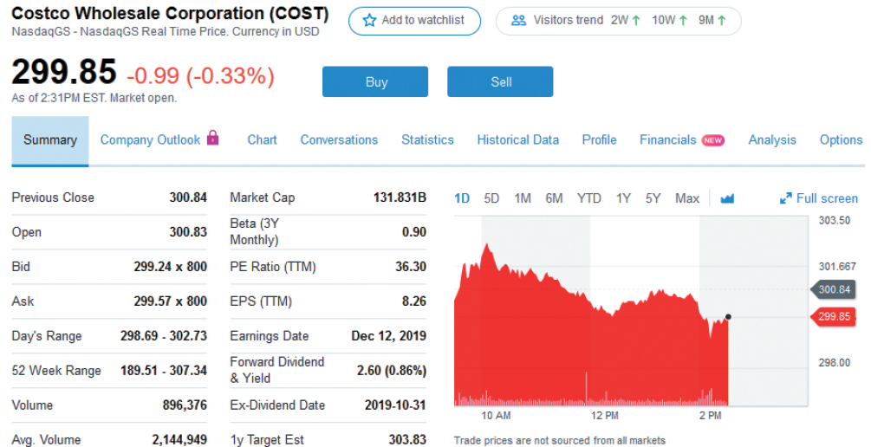
Stock market reporting: costco
Price $299.85 is the real-time price of the last trade
Reported change is from previous day’s closing price
Opening price is first trade of day
Bid and ask prices of $299.24 and $299.57, respectively
Market “depth,” is number of shares sought at bid price and offered at ask price
Volume is number of shares traded today
Market Cap is number of shares outstanding multiplied by current price per share
Yield is reported dividend divided by the previous stock price: $2.60/$300.84 = 0.86%
Notes:
In recent years, the reporting of stock prices and related information has increasingly moved from traditional print media, such as The Wall Street Journal, to various websites.
Note the availability of real-time prices for free is a relatively new development.

Slide 35
Selected concept questions
Does the value of a share of stock depend on how long you expect to keep it?
What is the value of a share of stock when the dividend grows at a constant rate?
What is a proxy?
What rights to stockholders have?
What is the difference between a securities broker and a securities dealer?
How does Nasdaq differ from the NSYE?

Slide 36
End of Chapter
Chapter 8

