Slide 1
CHAPTER 9
NET PRESENT VALUE AND
OTHER INVESTMENT CRITERIA

Slide 2
Learning objectives
Show the reasons why the net present value criterion is the best way to evaluate proposed investments
Discuss the payback rule and some of its shortcomings
Discuss the discounted payback rule and some of its shortcomings
Explain accounting rates of return and some of the problems with them
Present the internal rate of return criterion and its strengths and weaknesses
Calculate the modified internal rate of return
Illustrate the profitability index and its relation to net present value

Slide 3
Chapter Outline
Net Present Value
The Payback Rule
The Discounted Payback
The Average Accounting Return
The Internal Rate of Return
The Profitability Index
The Practice of Capital Budgeting

Slide 4
introduction
Capital budgeting question is probably the most important issue in corporate finance
Process of allocating or budgeting capital is usually more involved than deciding whether to buy a particular fixed asset
  Should we should launch a new product or enter a new market?
Most fundamental decision a business must make concerns its product line
  What services will we offer or what will we sell?
  In what markets will we compete?
  What new products will we introduce?
Notes:
The process of capital budgeting could be given a more descriptive (not to mention impressive) name: strategic asset allocation.

Slide 5
Net Present Value
An investment is worth undertaking if it creates value for its owners
Capital budgeting is all about trying to determine whether a proposed investment or project will be worth more, once it is in place, than it costs
  Net present value is the difference between an investment’s market value and its cost (i.e., a measure of how much value is created or added today by undertaking an investment)
Capital budgeting process can be viewed as a search for investments with positive net present values
  Investment decisions are greatly simplified when there is a market for assets similar to the investment we are considering
  Capital budgeting become more difficult when we cannot observe the market price for at least roughly comparable investments
Notes:
Section 9.1

Slide 6
Estimating Net Present Value
Imagine we are thinking of starting a business to produce and sell a new product—say, organic fertilizer. We can estimate the start-up costs with reasonable accuracy because we know what we will need to buy to begin production. Would this be a good investment?
How should we estimate the value of our fertilizer business?
  Estimate future cash flows we expect the business to product
  Apply basic discounted cash flow procedure to estimate the PV of those cash flows (from step 1)
  Estimate NPV as the difference between the PV of the future cash flows and the cost of the investment
Recall, discounted cash flow (DCF) valuation is the process of valuing an investment by discounting its future cash flows
The task of coming up with the cash flows and the discount rate is much more challenging than the calculations themselves
Remember, NPVs are estimates!
Notes:
Section 9.1

Slide 7
Estimating Net Present Value
(continued)
Suppose we believe cash revenues from our fertilizer business will be $20,000 per year. Cash costs (including taxes) will be $14,000 per year. We will wind down the business in eight years. The plant, property, and equipment will be worth $2,000 as salvage at that time. The project costs $30,000 to launch. We use a 15% discount rate on new projects such as this one. Is this a good investment? If there are 1,000 shares of stock outstanding, what will be the effect on the price per share of taking this investment?
  Present value = $6,000 × [1 − (1/1.15⁸)]/.15 + ($2,000/1. 15⁸)
  = ($6,000 × 4.4873) + ( $2,000/3.0590 )
  = $26,924 + 654
  = $27,578
  NPV = −$30,000 + 27,578 = −$2,422
This is not a good investment! Estimated impact of taking this project is a loss of value of $2,422/1,000 = $2.42 per share
Notes:
Notice that if the NPV is negative, the effect on share value will be unfavorable. If the NPV were positive, the effect would be favorable. As a consequence, all we need to know about a particular proposal for the purpose of making an accept–reject decision is whether the NPV is positive or negative.
In the unlikely event that the net present value turned out to be exactly zero, we would be indifferent between taking the investment and not taking it.

Slide 8
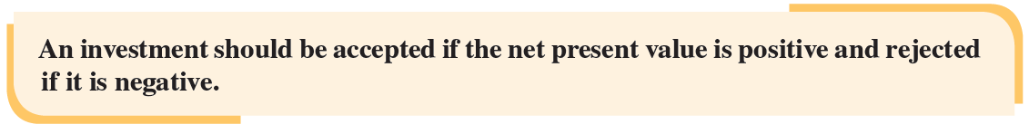
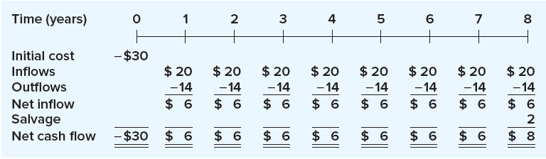
Project cash flows ($000)
Net present value rule:
Cash flows for fertilizer business example (on previous slide):
Notes:
As Figure 9.1 suggests, we effectively have an eight-year annuity of $20,000 − 14,000 = $6,000 per year, along with a single lump sum inflow of $2,000 in eight years.

Slide 9
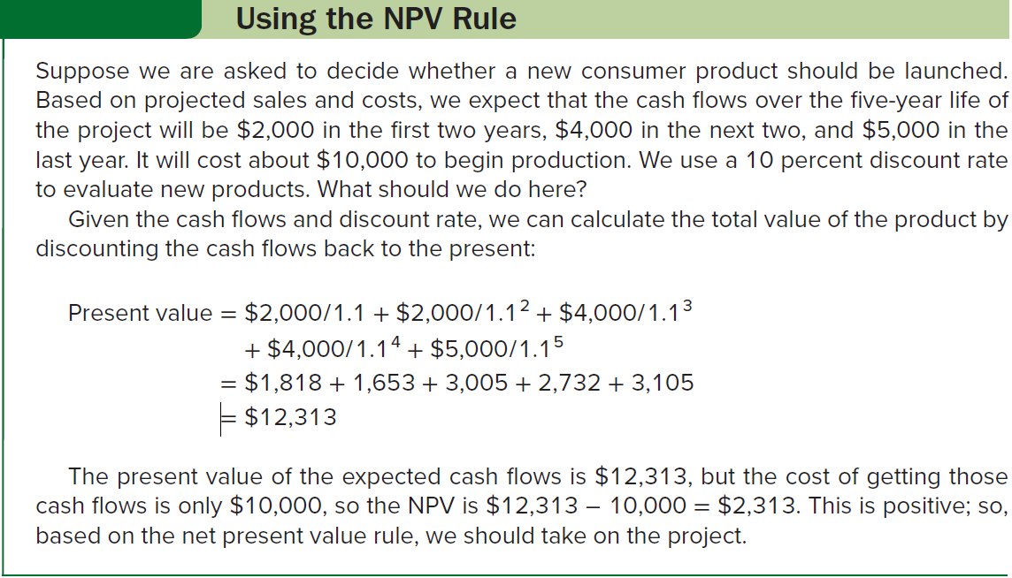
Using the npv rule

Slide 10
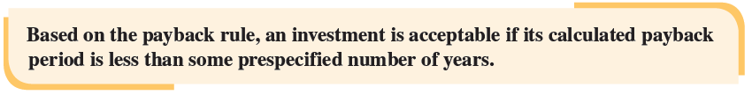
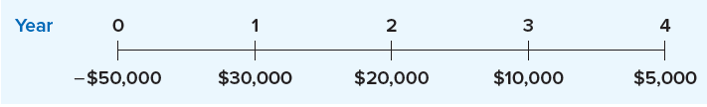
The payback rule
Payback period is the amount of time required for an investment to generate cash flows sufficient to recover its initial cost
Below, find the cash flows from a proposed investment. How many years do we have to wait until the accumulated cash flows from this investment equal or exceed the cost of the investment?
  Initial investment is $50,000
  After the first year, the firm has recovered $30,000, leaving $20,000.
  Cash flow in the second year is exactly $20,000, so payback period for this investment is exactly two years
Notes:
Section 9.2
When the numbers don’t work out exactly, it is customary to work with fractional years.

Slide 11
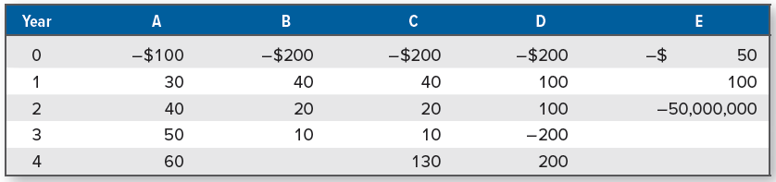
The payback rule
(continued)
Table 9.1, below, illustrates cash flows for five different projects
  Figures shown as Year 0 cash flows are costs of the investments
Note the following:
  Payback for project A is easily calculated as 2.6 years
  Project B never pays back
  Project C has a payback of exactly 4 years
  Project D has two different payback periods – 2 years and 4 years – both of which are correct
  Project E pays back in 6 months

Slide 12
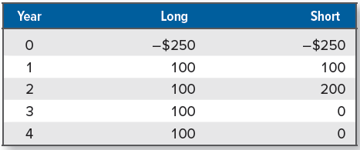
The payback rule: analyzing the rule
When compared to the NPV rule, the payback period rule has some rather severe shortcomings:
  Time value of money is completely ignored
  Payback rule fails to consider any risk differences
  No economic rationale for looking at payback in the first place, so we have no guide for how to pick the cutoff
Suppose we have somehow decided on an appropriate payback period of two years or less. Consider the two investments, Long and Short, in Table 9.2, below. Both projects cost $250.

Slide 13
The payback rule: analyzing the rule (continued)
What is the payback on the two projects?
  The payback on Long is 2 + ($50/$100) = 2.5 years
  The payback on Short is 1 + ($150/$200) = 1.75 years
Is the payback period rule guiding us to the right decisions?
  With a cutoff of two years, the payback period rule dictates that Short is acceptable and Long is not
Suppose we require a 15% return on this type of investment
  NPV (Short) = − $250 + $100/1.15 + $200/1 .15² = − $11.81
  NPV (Long) = − $250 + $100 × {[1 − (1/1 . 15⁴)]/.15} = $35.50
The NPV of Short is negative, while the NPV for Long is positive
Using a payback period rule will tend to bias us toward shorter-term investments

Slide 14
The payback rule: redeeming qualities of the rule
Payback period rule is often used by large and sophisticated companies when they are making relatively minor decisions for the following reasons:
  Many decisions do not warrant detailed analysis because the cost of the analysis would exceed the possible loss from a mistake
  Because it is biased toward short-term projects, it is biased toward liquidity
  Cash flows that are expected to occur later in a project’s life are probably more uncertain, and the payback period rule (in a crude sense) adjusts for the extra riskiness of later cash flows by ignoring them altogether
Notes:
We should note here that some of the apparent simplicity of the payback rule is an illusion. The reason is that we still must come up with the cash flows first, and, as we discussed earlier, this is not at all easy to do. It would probably be more accurate to say that the concept of a payback period is both intuitive and easy to understand.

Slide 15
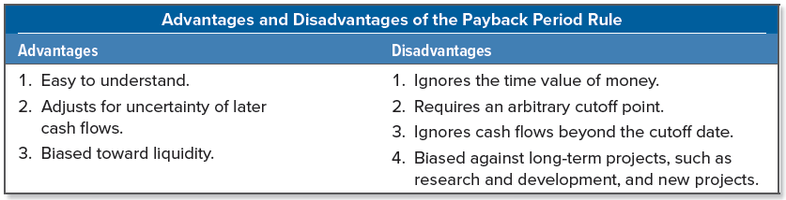
The payback rule: summery of the rule
Payback period is a kind of “break-even” measure
Biggest drawback to the payback period rule is that it doesn’t ask the right question
  Relevant issue is the impact an investment will have on the value of the stock, not how long it takes to recover the initial investment
Because it is so simple, companies often use it as a screen for investment decisions
The following table lists pros and cons of the payback period rule:
Notes:
Because time value is ignored, you can think of the payback period as the length of time it takes to break even in an accounting sense, but not in an economic sense.

Slide 16
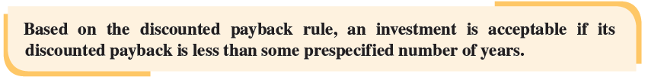
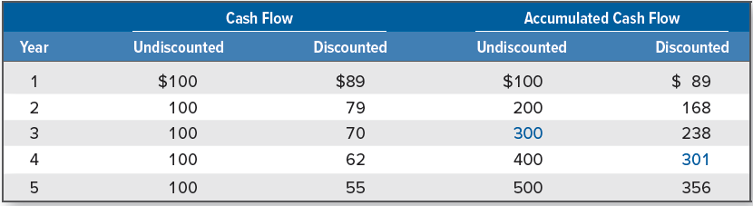
The discounted payback
Discounted payback is the length of time required for an investment’s discounted cash flows to equal its initial cost
Discounted payback rule:
Suppose we require a 12.5% return on new investments. We have an investment that costs $300 and has cash flows of $100 per year for five years. To get the discounted payback, we have to discount each cash flow at 12.5% and then start adding them.
Notes:
Section 9.3
We saw that one shortcoming of the payback period rule was that it ignored time value. The discounted payback period, fixes this particular problem.
In Table 9.3, we have both the discounted and the undiscounted cash flows. Looking at the accumulated cash flows, we see that the regular payback is almost exactly three years (look for the highlighted figure in Year 3). The discounted cash flows total $301 only after four years, so the discounted payback is four years, as shown.

Slide 17
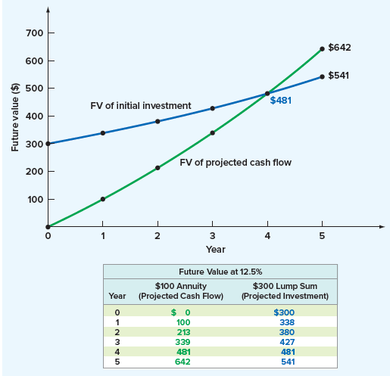
The discounted payback
(continued)
Discounted payback is the time it takes to break even in an economic or financial sense
  In other words, we get our money back, along with interest we could have earned elsewhere, in four years
If a project ever pays back on a discounted basis, then it must have a positive NPV
  If we use discounted payback rule, we won’t accidentally take any projects with negative estimated NPV
Rarely used in practice because it is not any simpler than NPV
Notes:
Figure 9.3 compares the future value of the $300 investment at 12.5 percent to the future value of the $100 annual cash flows at 12.5 percent. Notice that the two lines cross at exactly four years. This tells us that the value of the project’s cash flows catches up and then passes the original investment in four years.

Slide 18
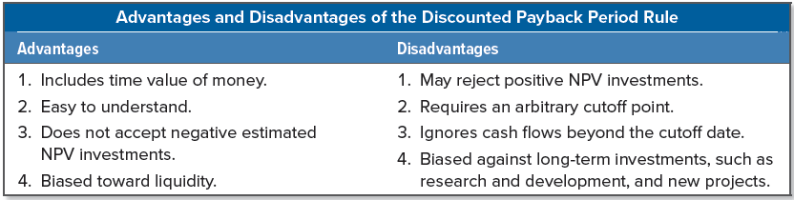
discounted payback Summary
All things considered, the discounted payback is a compromise between a regular payback and NPV, lacking simplicity of the first and conceptual rigor of the second
Advantages and disadvantages of the discounted payback rule are summarized in the following table:

Slide 19
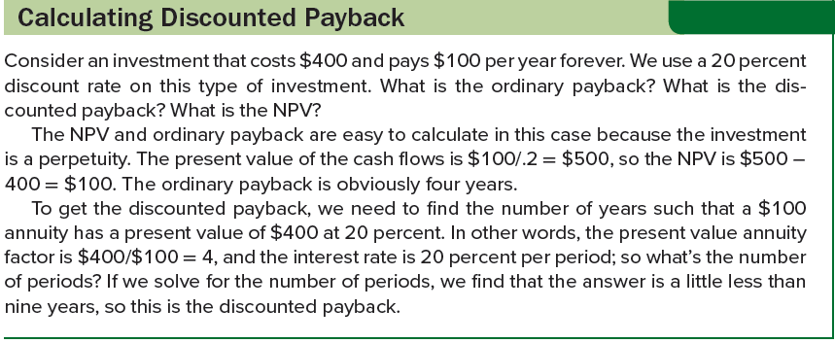
Calculating discounted payback

Slide 20
The average accounting return
Average accounting return (AAR) is an investment’s average net income divided by its average book value
  Different definitions of AAR, but in one form or another, the AAR is always defined as some measure of average accounting profit divided by some measure of average accounting value
Suppose we are deciding whether to open a store in a new shopping mall. The required investment in improvements is $500,000. The store would have a five-year life because everything reverts to the mall owners after that time. The required investment would be 100% depreciated (straight-line) over five years, so the depreciation would be $500,000/5 = $100,000 per year. The tax rate is 25%.
  Table 9.4, on the next slide, contains projected revenues and expenses
  Net income in each year, based on these figures, is also shown
Notes:
Section 9.4

Slide 21
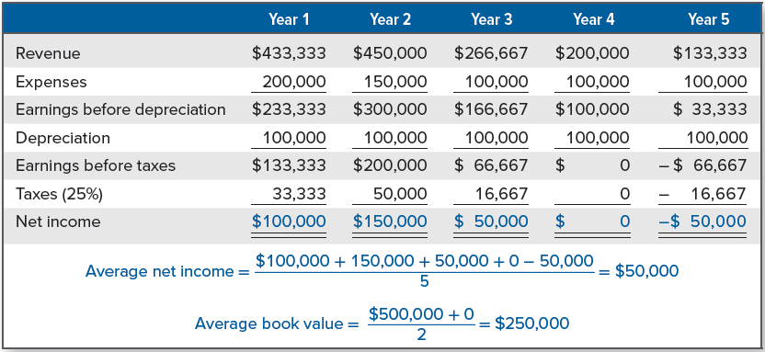
Projected yearly revenue and costs for average accounting return

Slide 22

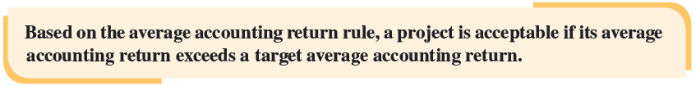
The average accounting return
(continued)
We started out with a book value of $500,000 (the initial cost) and ended up at $0, so the average book value is:
  ($500,000 + 0)/2 = $250,000
Average net income is:
  [$100,000 + 150,000 + 50,000 + 0 + ( − 50,000)]/5 = $50,000
Average accounting return is:
If the firm has a target AAR of less than 20 percent, then this investment is acceptable; otherwise, it is not
Average accounting return rule is:

Slide 23
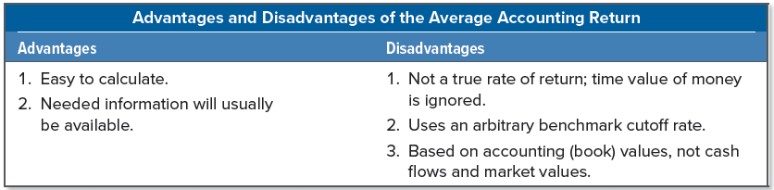
average accounting return summary
Use of this rule has a number of problems
  Chief drawback is that the AAR is not a rate of return in any meaningful economic sense, but rather the ratio of two accounting numbers, and therefore is not comparable to the returns offered in financial markets
    One reason AAR is not a true rate of return is that it ignores time value
  Lacks an objective cutoff period
    Target AAR may be specified by calculating AAR for the firm as a whole and using this as a benchmark
  Does not look at cash flow and market value, but instead focuses on net income and book value, which are poor substitutes
Notes:
Does the AAR have any redeeming features? About the only one is that it almost always can be computed. The reason is that accounting information will almost always be available, both for the project under consideration and for the firm as a whole. We hasten to add that once the accounting information is available, we can always convert it to cash flows, so even this is not a particularly important fact.

Slide 24
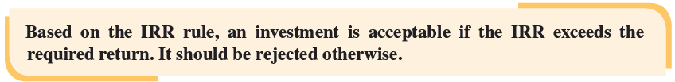
The internal rate of return
Internal rate of return (IRR) is the discount rate that makes the NPV of an investment zero
  Determine single rate of return summarizing the merits of a project
  We want this rate to be an “internal” rate (i.e., it depends only on the cash flows of a particular investment, not on rates offered elsewhere)
Consider a project that costs $100 today and pays $110 in one year. Suppose you were asked, “What is the return on this investment?”
  10% because, for every dollar we put in, we get $1.10 back
Is this project with its 10 percent IRR a good investment?
Notes:
Section 9.5
IRR is the most important alternative to NPV, and the two are closely related.

Slide 25
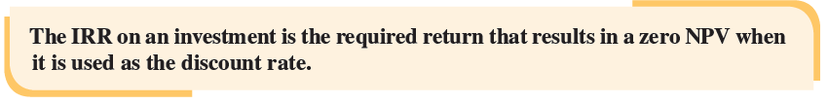
The internal rate of return
(continued)
At a discount rate of R, the NPV is: NPV = −$100 + $110/(1 + R)
Suppose we don’t know the discount rate. We can still ask how high the discount rate would have to be before this project would be deemed unacceptable.
  Recall, this investment is economically a break-even proposition when the NPV is zero because value is neither created nor destroyed
To find the break-even discount rate, we set NPV equal to zero and solve for R:
    NPV = 0 = −$100 + $110/(1 + R)
    $100 = $110/(1 + R)
    1 + R = $110/$100 = 1.1
    R = .10, or 10%

Slide 26

The internal rate of return
(multi-period example)
Suppose you were now looking at an investment that costs $100 and has a cash flow of $60 per year for two years. What is the return on this investment?
Set the NPV equal to zero and solve for the discount rate:
  NPV = 0 = −$100 + $60/(1 + IRR) + $60/(1 + IRR)²
Only way to find IRR in general is by trial and error, either by hand or by calculator
In this case, the cash flows form a two-period, $60 annuity. To find unknown rate, we can try different rates until we get the answer:
  At 0% rate, NPV = $120 − 100 = $20
  At 10% discount rate, NPV = −$100 + $60/1.1 + $60/1.1² = $4.13
  These (and other possibilities) are summarized on the next slide

Slide 27
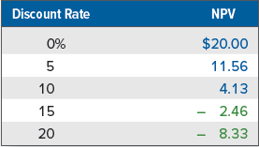
The internal rate of return
(multi-period example Continued)
NPV appears to be zero with a discount rate between 10% and 15%, so the IRR is somewhere in that range
  IRR is about 13.1%
If our required return were less than 13.1%, we would take this investment, but if required return exceeded 13.1%, we would reject it

Slide 28
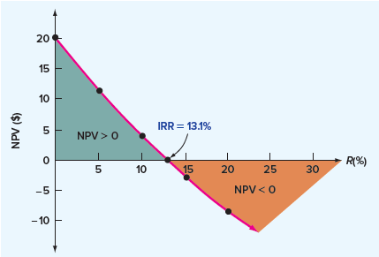
Irr and npv
IRR rule and NPV rule lead to identical decisions if the following conditions are met:
  Project’s cash flows must be conventional
  Project must be independent
Easiest way to illustrate relationship between NPV and IRR is to plot the numbers we calculated for the table on the previous slide
Net present value profile is a graphical representation of relationship between an investment’s NPVs and various discount rates
Notes:
Where will the curve cut through the x-axis? This will occur where the NPV is just equal to zero, so it will happen right at the IRR of 13.1 percent.

Slide 29
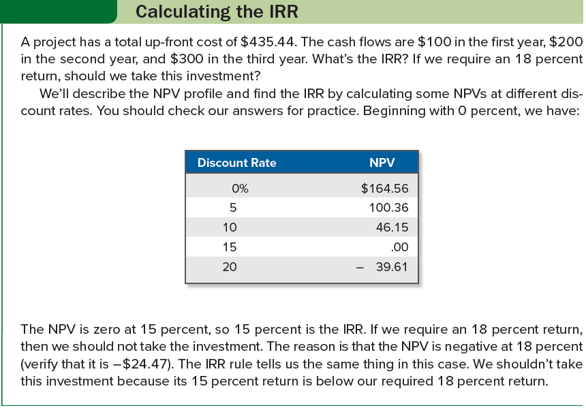
Calculating the irr

Slide 30

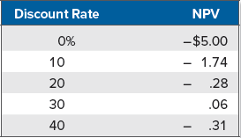
Problems with the irr: nonconventional cash flows
Suppose we have a strip-mining project that requires a $60 investment. Our cash flow in the first year will be $155. In the second year, the mine will be depleted, but we will have to spend $100 to restore the terrain.
The cash flows for this project are shown below:
To find the IRR on this project, calculate the NPV at various rates:
Notes:
The NPV appears to be behaving in a peculiar fashion here. First, as the discount rate increases from 0 percent to 30 percent, the NPV starts out negative and becomes positive. This seems backward because the NPV is rising as the discount rate rises. It then starts getting smaller and becomes negative again.

Slide 31
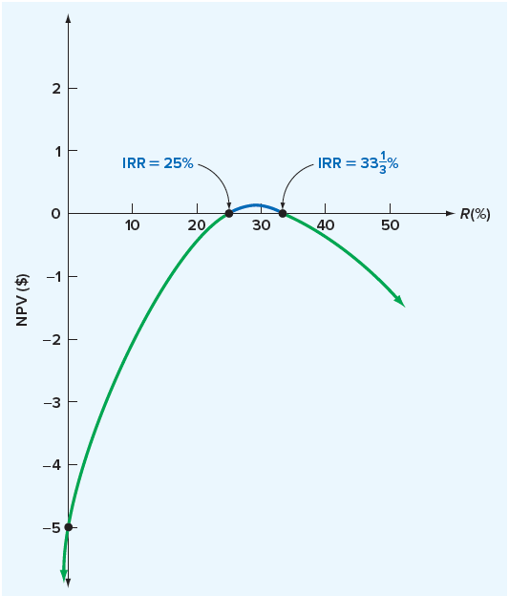
Problems with the irr: nonconventional cash flows (continued)
What’s the IRR? To find out, we draw the NPV profile
  Notice the NPV is zero when the discount rate is 25%, as well as when it is 33.33%
Which of these is correct?
  Both or neither; there is no unambiguously correct answer
Multiple rates of return problem is the possibility that more than one discount rate will make the NPV of an investment zero
We should take this investment only if our required rate of return is between 25% and 33.33%
Notes:
Many financial computer packages (including a best seller for personal computers) aren’t aware of the multiple rates of return problem and just report the first IRR that is found. Others report only the smallest positive IRR, even though this answer is no better than any other.
In our current example, the IRR rule breaks down completely. When the cash flows aren’t conventional, strange things can start to happen to the IRR. However, the NPV rule, as always, works just fine.

Slide 32
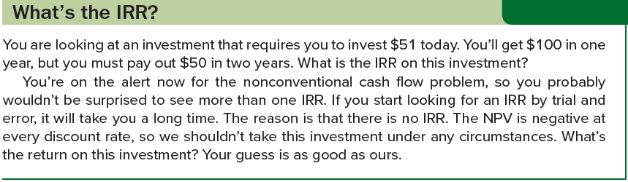
What’s the IRR?

Slide 33
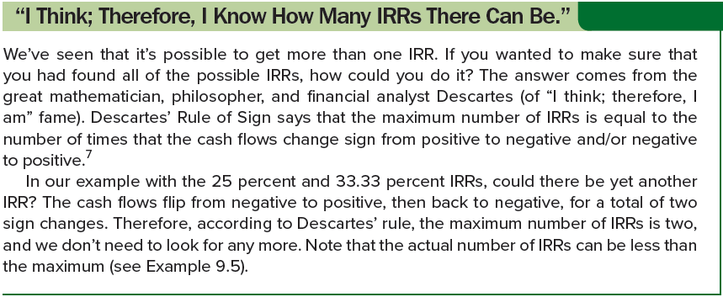
I THINK; THEREFORE, I KNOW

Slide 34
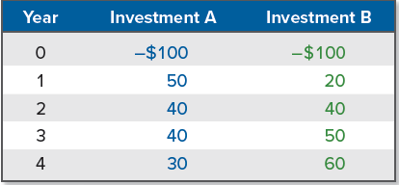
Problems with the irr: mutually exclusive investments
Mutually exclusive investment decisions is a situation in which taking one investment prevents the taking of another
  Two projects that are not mutually exclusive are independent
Given two or more mutually exclusive investments, which one is the best? Can we also say that the best one has the highest return?
  The best one is the one with the largest NPV
  No, we cannot say the best one has the highest return
Consider the following cash flows from two mutually exclusive investments, where the IRR for A is 24% and the IRR for B is 21%:
Notes:
For example, if we own one corner lot, then we can build a gas station or an apartment building, but not both. These are mutually exclusive alternatives.

Slide 35
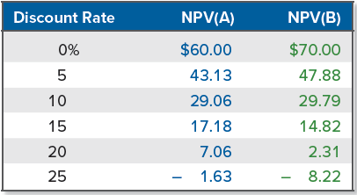
Problems with the irr: mutually exclusive investments (continued)
Simple intuition suggests Investment A is better because of its higher return, but let’s calculate the NPV of these investments for different required returns:
IRR for A (24%) is larger than the IRR for B (21%), but in comparing the NPVs, the higher NPV investment depends on our required return
  If our required return is 10%, B has the higher NPV, but if our required return is 15%, A has the higher NPV
When we have mutually exclusive projects, we shouldn’t rank them based on their returns
  Look at relative NPVs to avoid the possibility of choosing incorrectly

Slide 36
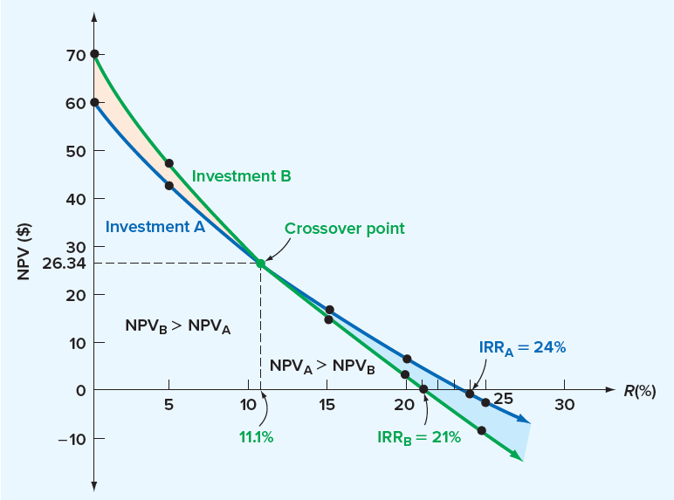
Npv profiles for mutually exclusive investments
Conflict between IRR and NPV for mutually exclusive investments can be illustrated by plotting the investments’ NPV profiles
  NPV profiles cross at about 11.1%
  At any discount rate less than 11.1%, the NPV for B is higher
    In this range, taking B benefits us more than taking A, even though A’s IRR is higher
  At any rate greater than 11.1%, Investment A has the greater NPV

Slide 37
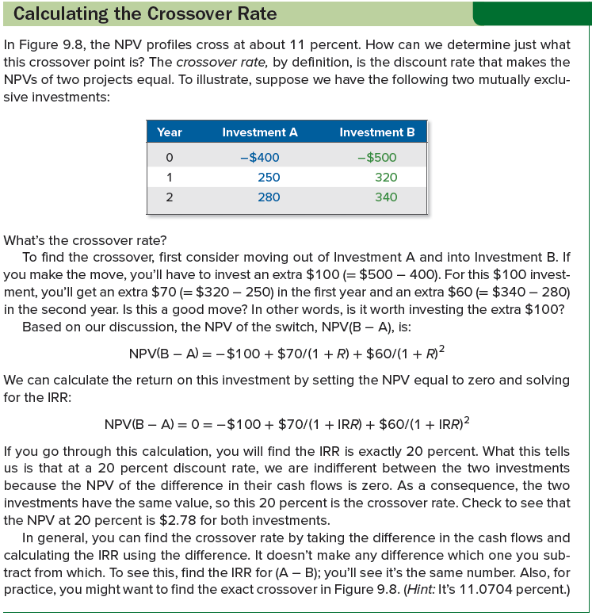
Calculating the crossover rate

Slide 38

Investing or financing?
Consider the following two independent investments:
Company initially pays out cash with Investment A and initially receives cash for Investment B. Suppose the required return for each investment project is 12%. According to the IRR decision rule, which, if either, project should we accept?
  IRR is 30% for both projects, so according to the IRR decision rule, we should accept both projects
However, NPV of B at 12 percent is: $100 – ($130/1.12) = -$16.07
  In this case, the NPV and IRR decision rules disagree
Notes:
Most projects are more like Investment A, projects like Investment B also occur. For example, consider a corporation conducting a seminar where the participants pay in advance. Because large expenses are frequently incurred at the seminar date, cash inflows precede cash outflows.

Slide 39
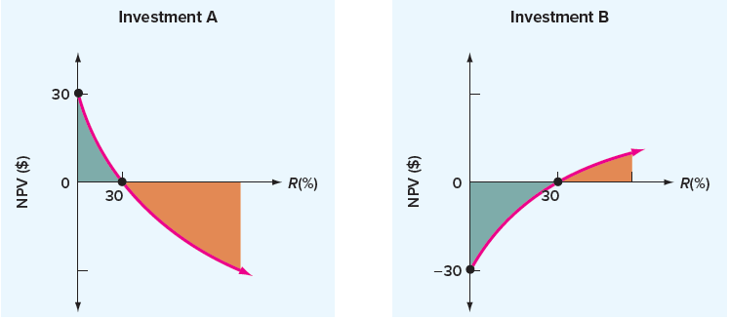
Investing or financing?
(continued)
To see what’s going on, plot the NPV profile for each project
  NPV profile for B is upward sloping; project should be accepted if the required return is greater than 30%
  Investment B has financing type cash flows, whereas Investment A has investing type cash flows
  You should take a project with financing-type cash flows only if it is an inexpensive source of financing (i.e., IRR is lower than required return)
Notes:
When a project has cash flows like Investment B’s, the IRR is really a rate that you are paying, not receiving.

Slide 40
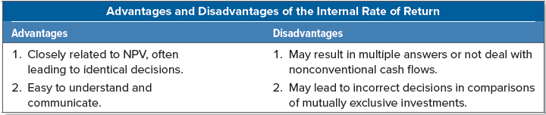
Redeeming qualities of the irr
Despite its flaws, the IRR is very popular in practice—more so than even the NPV
  When analyzing investments, people tend to prefer talking about rates of return rather than dollar values, and the IRR appears to provide a simple way of communicating information about a proposal
  IRR may have a practical advantage over the NPV, as we can still estimate the IRR if we do not know the appropriate discount rate
Advantages and disadvantages of the IRR are summarized as follows:

Slide 41
THE MODIFIED INTERNAL RATE OF RETURN (MIRR)
To address some of the problems that can crop up with the standard IRR, it is often proposed that a modified version be used
  Several different ways to calculate a modified IRR, or MIRR, but basic idea is to modify the cash flows first and then calculate an IRR using the modified cash flows
To illustrate, consider again the cash flows in Figure 9.6, shown below
  As discussed previously, there are two IRRs, 25% and 33.33%
Next, we will calculate three different MIRRs, all of which have the property that only one answer will result, eliminating the multiple IRR problem

Slide 42
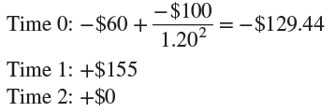
Method 1: the discounting approach
Discount all negative cash flows back to the present at the required return, add them to the initial cost, and then calculate the IRR
  Because only the first modified cash flow is negative, there will be only one IRR
  Discount rate used might be the required return, or it might be some other externally supplied rate
If the required return on the project is 20%, the modified cash flows look like this:
If you calculate the MIRR now, you should get 19.74%

Slide 43
Method 2: the reinvestment approach
Compound all cash flows (positive and negative) except the first out to the end of the project’s life and then calculate the IRR
  Rate we use could be the required return on the project, or it could be a separately specified “reinvestment rate”
Here are the modified cash flows:
  Time 0: − $60
  Time 1: +0
  Time 2: − $100 + ($155 × 1.2) = $86
MIRR on this set of cash flows is 19.72%, a little lower than we got using the discounting approach
Notes:
In a sense, we are “reinvesting” the cash flows and not taking them out of the project until the very end.

Slide 44
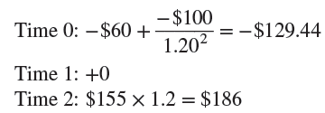
Method 3: the combination approach
Combination approach blends our first two methods
Negative cash flows are discounted back to the present, and positive cash flows are compounded to the end of the project
With the combination approach, the modified cash flows are as follows:
MIRR is 19.87%, the highest of the three methods
Notes:
In practice, different discount or compounding rates might be used, but we will again stick with the project’s required return.

Slide 45
Mirr or irr: which is better?
MIRRs are controversial
  On the bright side, by design, MIRRs don’t suffer from the multiple rate of return problem
  One disadvantage with MIRRs is that there are different ways of calculating them, and there is no clear reason to say one of the three methods is better than any other
Calculating an MIRR requires discounting, compounding, or both:
  If we have the relevant discount rate, why not calculate the NPV and be done with it?
  Because an MIRR depends on an externally supplied discount (or compounding) rate, the answer you get is not truly an “internal” rate of return, which, by definition, depends on only the project’s cash flows
Value of a project does not depend on what the firm does with the cash flows generated by that project
  Generally, no need to consider reinvestment of interim cash flows

Slide 46
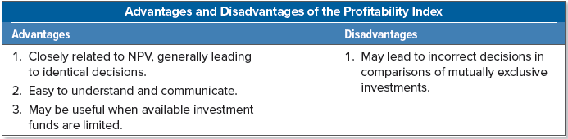
The profitability index
Profitability index (i.e., benefit-cost ratio) is the present value of an investment’s future cash flows divided by its initial cost
  If a project costs $200 and the present value of its future cash flows is $220, the profitability index value would be $220/$200 = 1.1
If a project has a positive NPV, then the present value of the future cash flows must be bigger than the initial investment
  Profitability index will be bigger than 1 for a positive NPV investment and less than 1 for a negative NPV investment
How do we interpret the profitability index?
  A profitability index of 1.1 tells us that, per dollar invested, $1.10 in value or $.10 in NPV results
Notes:
Section 9.6
The profitability index measures “bang for the buck”—that is, the value created per dollar invested. For this reason, it is often proposed as a measure of performance for government or other not-for-profit investments. Also, when capital is scarce, it may make sense to allocate it to projects with the highest PIs.
Overall, there seems to be little reason to rely on the PI instead of the NPV.

Slide 47
The practice of capital budgeting
Given NPV seems to be telling us directly what we want to know, why are there are so many alternative procedures commonly used?
  In light of uncertainty about the future, we can only estimate the NPV, and the true NPV might be quite different
Because the true NPV is unknown, financial managers should seek clues to help in assessing whether the estimated NPV is reliable
  Firms typically use multiple criteria for evaluating a proposal
Large firms often have huge capital budgets
  For 2020, ExxonMobil announced that it expected to have $33 to $35 billion in capital outlays during the year, up from $30 billion in 2019
  About the same time, Chevron announced planned investments of $18 to $20 billion in 2020, similar to the $19.8 billion it spent in 2019
  Other companies with large capital spending budgets were Walmart, which projected capital spending of about $11 billion for 2020, and AT&T, which projected capital spending of about $20 billion for 2020
Notes:
Section 9.7

Slide 48
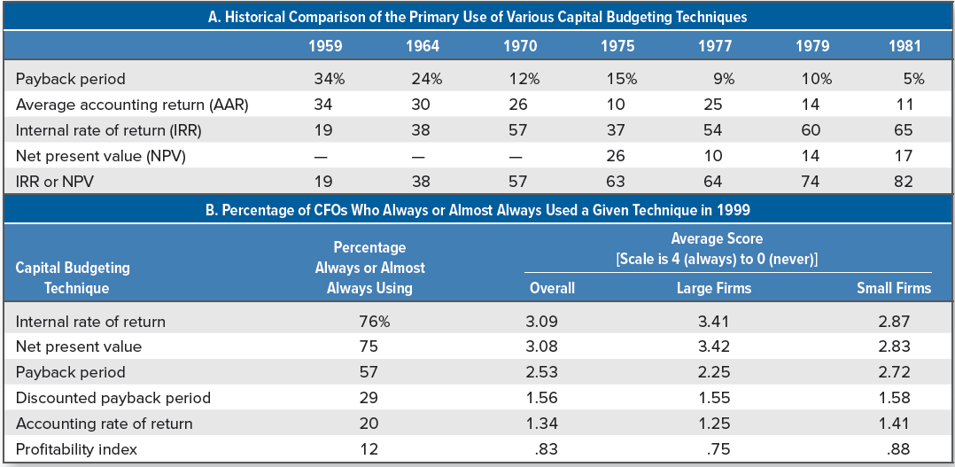
Capital budgeting techniques in practice
Notes:
There have been a number of surveys conducted asking firms what types of investment criteria they actually use. Table 9.6 summarizes the results of several of these.
Panel A of the table is a historical comparison looking at the primary capital budgeting techniques used by large firms through time.
Panel B of Table 9.6 summarizes the results of a 1999 survey of chief financial officers (CFOs) at both large and small firms in the United States.

Slide 49
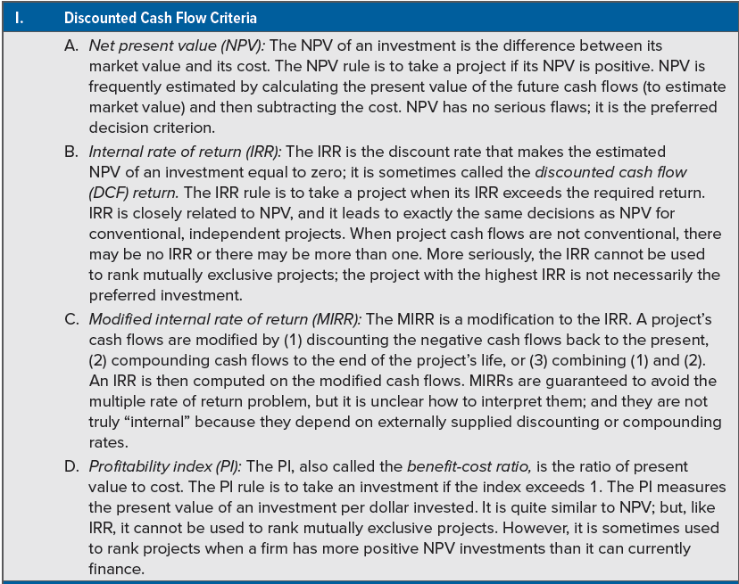
Summary of investment criteria
Notes:
For future reference, the various criteria we have discussed are summarized in Table 9.7.

Slide 50
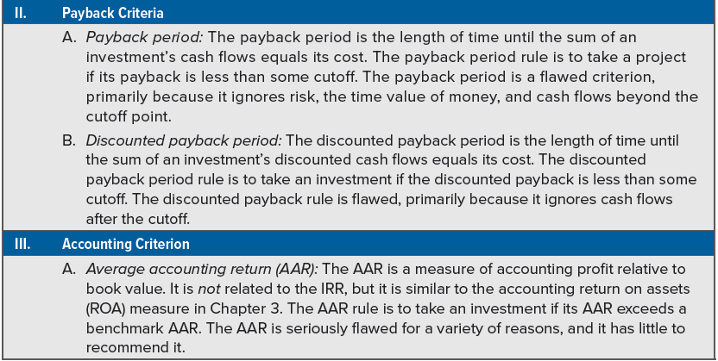
Summary of investment criteria
(continued)
Notes:
For future reference, the various criteria we have discussed are summarized in Table 9.7.

Slide 51
SELECTED CONCEPT QUESTIONS
What is the net present value rule?
In words, what is the payback period? The payback period rule?
What advantage(s) does the discounted payback have over the ordinary payback?
What are the weaknesses of the AAR rule?
Under what circumstances will the IRR and NPV rules lead to the same accept-reject decisions? When might they conflict?
What does the profitability index measure?
What are the most commonly used capital budgeting procedures?
Notes:
Section 9.7

Slide 52
End of Chapter
CHAPTER 9

