Slide 1
CHAPTER 13
RETURN, RISK, AND THE SECURITY MARKET LINE

Slide 2
Learning objectives
Show how to calculate expected returns, variance, and standard deviation
Discuss the impact of diversification
Summarize the systematic risk principle
Describe the security market line and the risk-return trade-off

Slide 3
Chapter Outline
Expected Returns and Variances
Portfolios
Announcements, Surprises, and Expected Returns
Risk: Systematic and Unsystematic
Diversification and Portfolio Risk
Systematic Risk and Beta
The Security Market Line
The SML and the Cost of Capital: A Preview

Slide 4
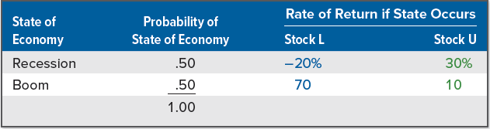
Expected Return
Consider a single period of time—say a year. We have two stocks, L and U, which have the following characteristics:
Stock L is expected to have a return of 25% in the coming year
Stock U is expected to have a return of 20% for the same period
There are two states of the economy, which means that there are only two possible situations, and the two are equally likely to occur:
Economy booms, in which case Stock L will have a 70% return and Stock U will have a 10% return
Economy enters a recession, where Stock L will have a -20% return and Stock U will have a 30% return
Expected return is the return on a risky asset expected in the future
Notes:
Section 13.1

Slide 5
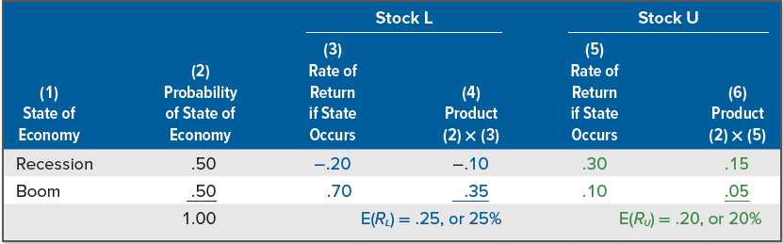
Expected Return (continued)
Expected return on Stock U, E(R_{U}), is 20%, found by:
E(R_{U}) = .50 × 30% + .50 × 10% = 20%
Expected return on Stock L, E(R_{L}), is 25%, found by:
E(R_{L}) = .50 × −20% + .50 × 70% = 25%
The following table illustrates these calculations:

Slide 6
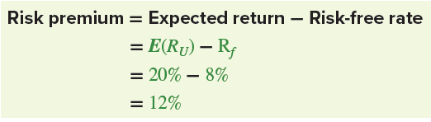
Expected Return (concluded)
Using projected returns, we can calculate the projected, or expected, risk premium as the difference between the expected return on a risky investment and the certain return on a risk-free investment
Suppose risk-free investments are currently offering 8% (i.e., the risk-free rate, which we label as R_{f} , is 8%). Given this, what is the projected risk premium on Stock U? On Stock L?
Expected return on Stock U, E(R_{U}), is 20%; projected risk premium is:
Risk premium on Stock L is 25% - 8% = 17%
In general, the expected return on a security or other asset is equal to the sum of the possible returns multiplied by their probabilities

Slide 7
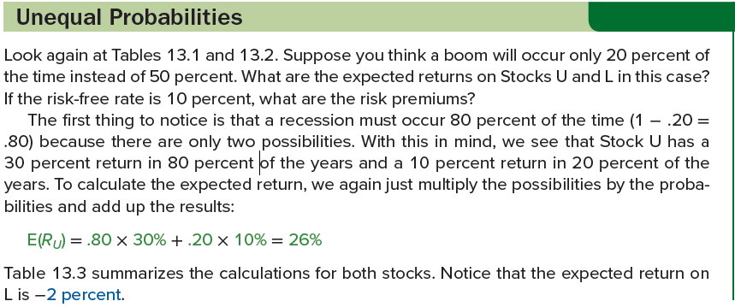
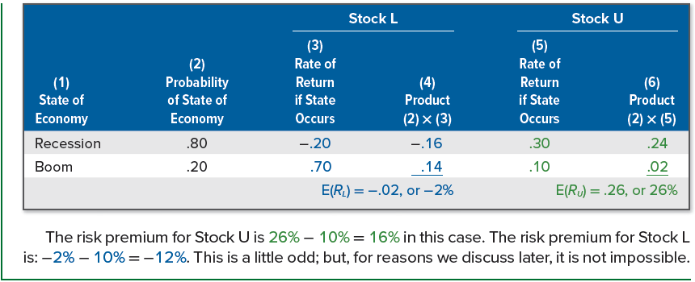
Unequal probabilities

Slide 8
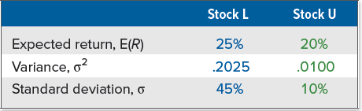
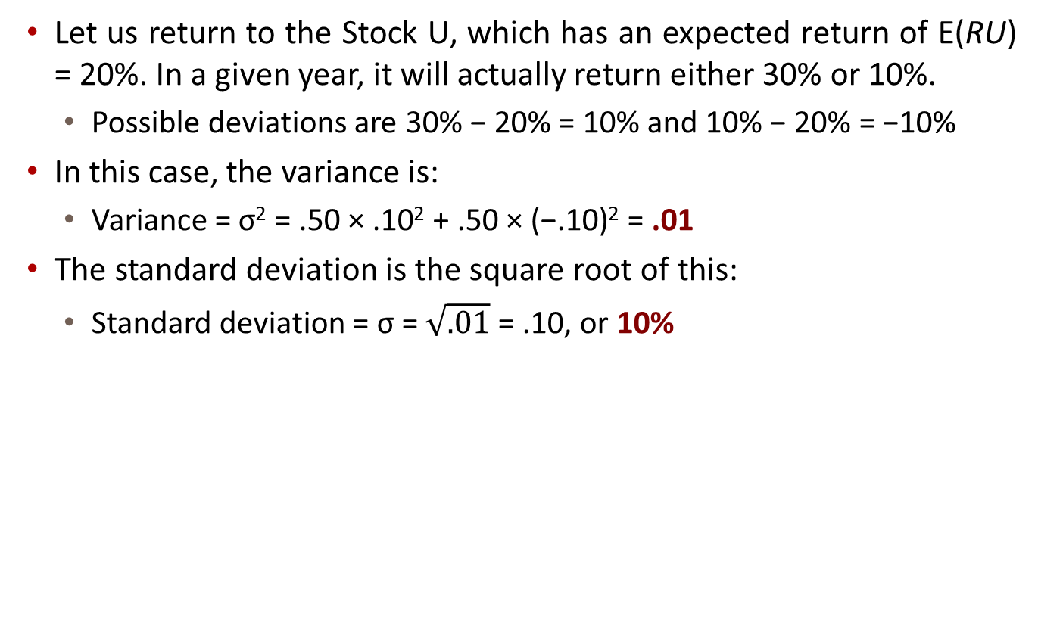
Calculating the variance
Let us return to the Stock U, which has an expected return of E(RU) = 20%. In a given year, it will actually return either 30% or 10%.
Possible deviations are 30% − 20% = 10% and 10% − 20% = −10%
In this case, the variance is:
Variance = σ² = .50 × .10² + .50 × (−.10)² = .01
The standard deviation is the square root of this:
Standard deviation = σ = $\sqrt{.01}$= .10, or 10%
Notes:
To calculate the variances of the returns on our two stocks, we first determine the squared deviations from the expected return. We then multiply each possible squared deviation by its probability. We add these, and the result is the variance. The standard deviation, as always, is the square root of the variance.
Stock L has a higher expected return, but U has less risk. You could get a 70 percent return on your investment in L, but you could also lose 20 percent. Notice that an investment in U will always pay at least 10 percent.

Slide 9
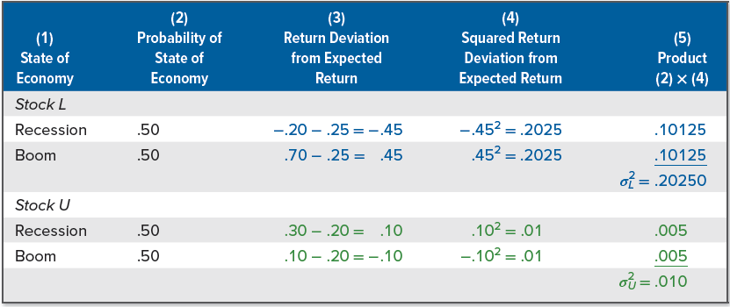
Calculating the variance (continued)
The way we have calculated expected returns and variances here is somewhat different from the way we did it in the last chapter
If examining actual historical returns, we estimate the average return and the variance based on some actual events
Here, we have projected future returns and their associated probabilities, so this is the information with which we must work

Slide 10
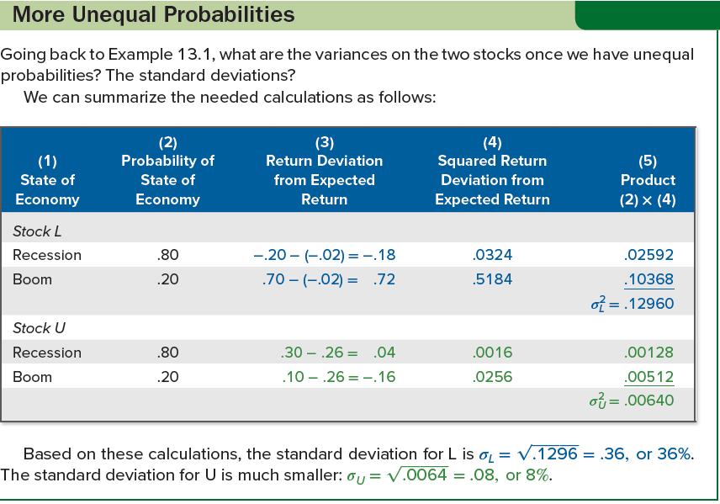
More unequal probabilities

Slide 11
portfolios
A portfolio is a group of assets such as stocks and bonds held by an investor
Portfolio weights are percentages of a portfolio’s total value invested in a particular asset
If we have $50 in one asset and $150 in another, our total portfolio is worth $200
Percentage of our portfolio in the first asset is $50/$200 = .25.
Percentage of our portfolio in the second asset is $150/$200 = .75
Our portfolio weights are .25 and .75
Notes:
Section 13.2

Slide 12
Portfolio expected returns
Let’s go back to Stocks L and U. You put half your money in each. What is the pattern of returns on this portfolio? Expected return?
Suppose the economy enters a recession, in which case half your money (the half in L) loses 20% and the other half (the half in U) gains 30%
In a recession, portfolio return is: R_{P} = .50 × −20% + .50 × 30% = 5%
In a boom, portfolio return is: R_{P} = .50 × 70% + .50 × 10% = 40%
Thus, expected return on your portfolio, E(R_{P}), is 22.5%
We can calculate the expected return more directly:
E(R_{P}) = .50 × E(R_{L}) + .50 × E(R_{U})
= .50 × 25% + .50 × 20%
= 22.5%
If we have n assets in our portfolio, where n is any number, and xi stands for the percentage of our money in Asset i, expected return is:

Slide 13
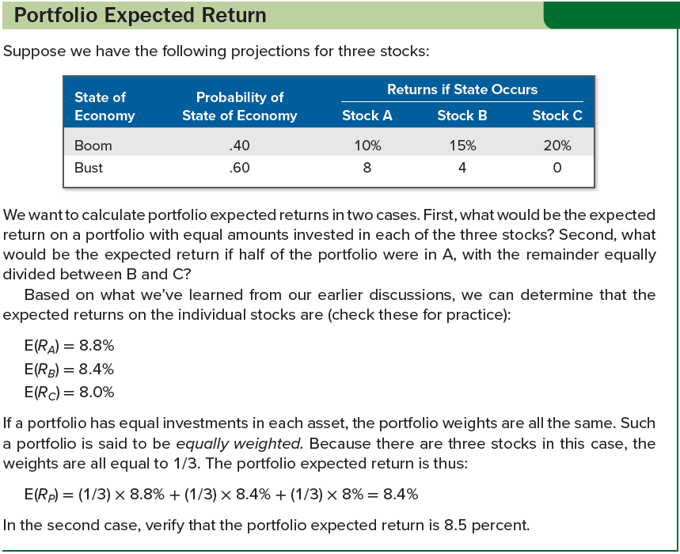
Portfolio expected return

Slide 14
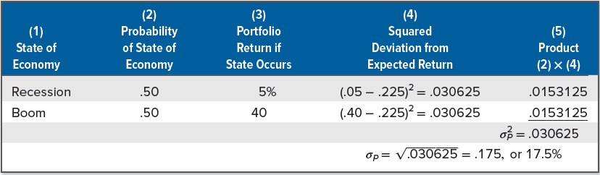
Portfolio variance
Variance on a portfolio is not generally a simple combination of the variances of the assets in the portfolio
What is the standard deviation of returns on the portfolio?
Suppose we put 2/11 (about 18%) in L and the other 9/11 (about 82%) in U. If a recession occurs, this portfolio will have a return of:
R_{P} = (2/11) × −20% + (9/11) × 30% = 20.91%
If a boom occurs, this portfolio will have a return of:
R_{P} = (2/11) × 70% + (9/11) × 10% = 20.91%
Clearly, this portfolio would have a zero variance
Notes:
Simple intuition might suggest that because half of the money has a standard deviation of 45 percent and the other half has a standard deviation of 10 percent, the portfolio’s standard deviation might be calculated as: .50 × 45% + .50 × 10% = 27.5%
Unfortunately, this approach is completely incorrect!

Slide 15
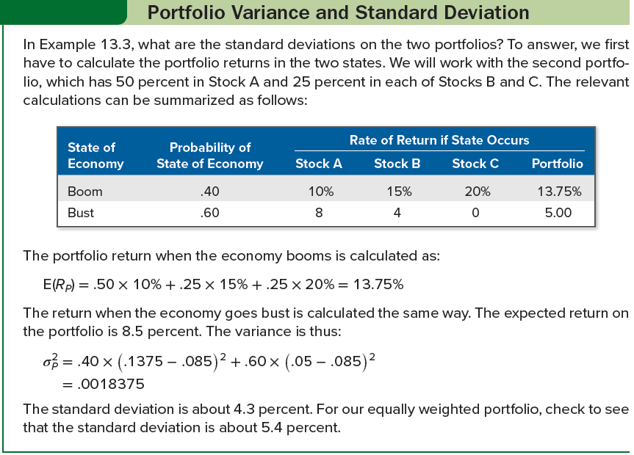
Portfolio variance and Standard deviation

Slide 16

Expected and unexpected returns
Consider the return on the stock of a company called Flyers. What will determine this stock’s return in, say, the coming year?
Return on stock traded in financial market is made up of two parts:
The normal, or expected, return from the stock is the part of the return that shareholders in the market predict or expect
The uncertain, or risky, part is the portion that comes from unexpected information revealed within the year
Return on Flyers stock in the coming year would be:
R stands for the actual total return in the year
E(R) stands for the expected part of the return
U stands for the unexpected part of the return
Notes:
Section 13.3
What this formula says is that the actual return, R, differs from the expected return, E(R), because of surprises that occur during the year. In any given year, the unexpected return will be positive or negative; but, through time, the average value of U will be zero. This means that, on average, the actual return equals the expected return.

Slide 17

Announcements and news
Suppose Flyers’s business is such that the company prospers when GDP grows at a relatively high rate and suffers when GDP is relatively stagnant. When the government actually announces GDP figures for the year, what will happen to the value of Flyers’s stock?
Answer depends on what figure is released
Answer also depends on what shareholders forecast GDP to be
Suppose shareholders forecast GDP to increase by 0.5%, but the government announces that the actual GDP increase during the year has been 1.5%
Difference between actual result and forecast, 1% in this example, is sometimes called the innovation or the surprise
An announcement can be broken into two parts: the anticipated, or expected, part and the surprise, or innovation:
Notes:
The expected part of any announcement is the part of the information that the market uses to form the expectation, E(R), of the return on the stock. The surprise is the news that influences the unanticipated return on the stock, U.
Henceforth, when we speak of news, we will mean the surprise part of an announcement and not the portion that the market has expected and therefore already discounted.

Slide 18
Systematic and unsystematic risk
Systematic risk (i.e., market risk) influences many assets (e.g., uncertainties about general economic conditions, such as GDP, interest rates, or inflation)
Unsystematic risk (i.e., unique or asset-specific risk) is a risk that affects at most a small number of assets (e.g., the announcement of an oil strike by a company)
Actual return broken down into its expected and surprise components:
R = E(R) + U
Total surprise component has systematic and unsystematic component:
We can rewrite the formula for the total return, allowing ϵ to stand for the unsystematic portion and m to stand for the systematic part:
R = E(R) + U
= E(R) + m + ϵ
Notes:
Section 13.4
The distinction between a systematic risk and an unsystematic risk is never really as exact as we make it out to be. Even the most narrow and peculiar bit of news about a company ripples through the economy. This is true because every enterprise, no matter how tiny, is a part of the economy.

Slide 19
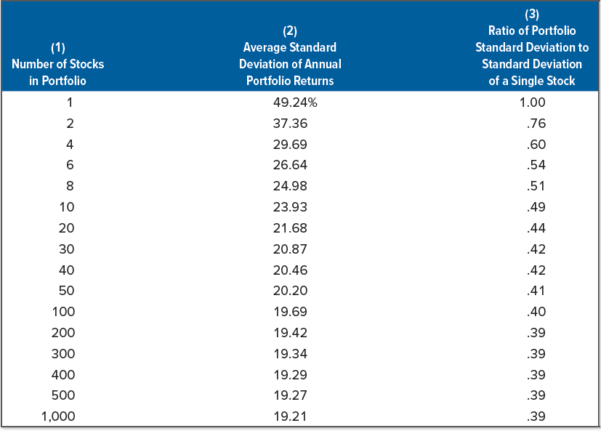
Effect of diversification: another lesson from market history
Table 13.7 illustrates typical average annual standard deviations for equally weighted portfolios that contain different numbers of randomly selected NYSE securities
Standard deviation for “portfolio” of one security is 49%, meaning if you randomly selected a single NYSE stock and put all your money into it, your standard deviation of return would typically be a substantial 49% per year
Note the standard deviation declines as the number of securities is increased
Notes:
Section 13.5

Slide 20
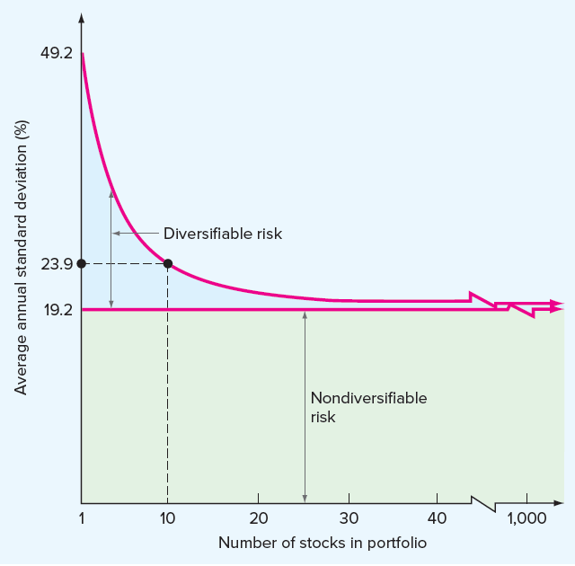
The principle of diversification
Figure 13.1 plots the standard deviation of return versus the number of stocks in the portfolio
Notice the benefit in terms of risk reduction from adding securities drops off as we add more and more
Key points:
Principle of diversification implies some of the riskiness with individual assets can be eliminated by forming portfolios
There is a minimum level of risk that cannot be eliminated by diversifying (i.e., nondiversifiable risk)
Notes:
Taken together, these two key points are another important lesson from capital market history: Diversification reduces risk, but only up to a point. Put another way, some risk is diversifiable and some is not.

Slide 21
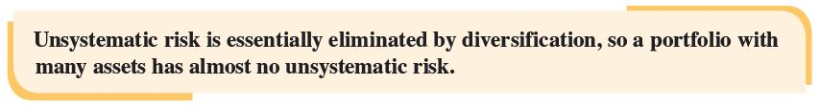
Diversification and unsystematic risk
Some of the risk associated with individual assets can be diversified away and some cannot. Why is this so?
If we held only a single stock, the value of our investment would fluctuate because of company-specific events
If we hold a large portfolio, some of the stocks in the portfolio will go up in value because of positive company-specific events and some will go down in value because of negative events
Net effect on the overall value of the portfolio will be relatively small because these effects will tend to cancel each other out
When we combine assets into portfolios, the unique, or unsystematic, events—both positive and negative—tend to “wash out” once we have more than just a few assets

Slide 22

Diversification and systematic risk
If unsystematic risk can be eliminated by diversification, is the same true for systematic risk?
No, a systematic risk affects almost all assets to some degree, so no matter how many assets we put into a portfolio, the systematic risk doesn’t go away
The total risk of an investment, as measured by the standard deviation of its return, can be written as:
Systematic risk is also called nondiversifiable risk or market risk
Unsystematic risk is also called diversifiable risk, unique risk, or asset-specific risk
Notes:
For a well-diversified portfolio, the unsystematic risk is negligible. For such a portfolio, essentially all of the risk is systematic.

Slide 23
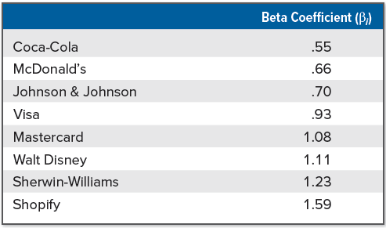
The systematic risk principle
Systematic risk principle states the expected return on a risky asset depends only on that asset’s systematic risk
Only the systematic portion of total risk is relevant in determining the expected return (and the risk premium) on that asset
Level of systematic risk is measured using the beta coefficient, β
An average asset has a beta of 1.0 relative to itself; an asset with a beta of .50 has half as much systematic risk as an average asset; an asset with a beta of 2.0 has twice as much
Notes:
Section 13.6
Table 13.8 contains the estimated beta coefficients for the stocks of some well-known companies. The range of betas in Table 13.8 is typical for stocks of large U.S. corporations. Betas outside this range occur, but they are less common.
One cautionary note is in order: Not all betas are created equal. Different providers use somewhat different methods for estimating betas, and significant differences sometimes occur.

Slide 24
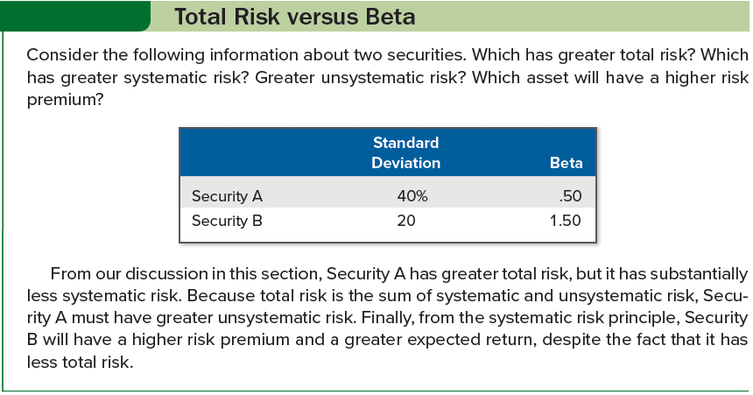
Total risk versus beta

Slide 25
Portfolio betas
A portfolio beta can be calculated just like a portfolio expected return
If we had many assets in a portfolio, we would multiply each asset’s beta by its portfolio weight and then add the results to get the portfolio’s beta
Using Table 13.8, suppose you put half of your money in Shopify and half in Coca-Cola. What would the beta of this combination be?
Because Shopify has a beta of 1.59 and Coca-Cola has a beta of .55, the portfolio’s beta, β_{P}, would be:
β_{P} = .50 × β_{Shopify} + .50 × β_{Coca-Cola} = .50 × 1.59 + .50 × .55 = 1.07

Slide 26
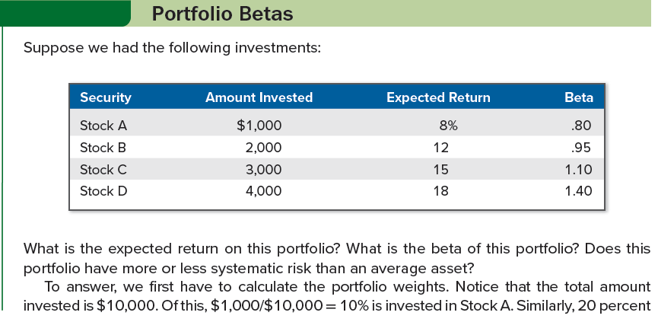
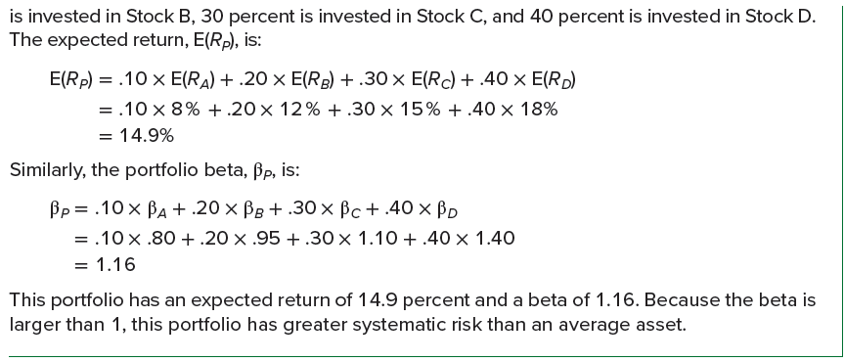
Portfolio betas: an example

Slide 27
Beta and the risk premium
Suppose Asset A has an expected return of E(R_{A}) = 20% and a beta of β_{A} = 1.6. Furthermore, suppose that the risk-free rate is R_{f} = 8%.
Consider a portfolio made up of Asset A and a risk-free asset. If 25% of the portfolio is invested in Asset A, then the expected return is:
E(R_{P}) = .25 × E(R_{A}) + (1 − .25) × R_{f}
= .25 × 20 % + .75 × 8%
= 11%
The beta on the portfolio, β_{P}, would be:
β_{P} = .25 × β_{A} + (1 − .25) × 0
= .25 × 1.6
= .40
Notes:
Section 13.7
Notice that a risk-free asset, by definition, has no systematic risk (or unsystematic risk), so a risk-free asset has a beta of zero.

Slide 28
Beta and the risk premium (continued)
Is it possible for the percentage invested in Asset A to exceed 100%?
Yes, this happens if the investor borrows at the risk-free rate
Suppose an investor has $100 and borrows an additional $50 at 8 percent, the risk-free rate. The total investment in Asset A would be $150, or 150 percent of the investor’s wealth.
The expected return in this case would be:
E(R_{P}) = 1.50 × E(R_{A}) + (1 − 1.50) × R_{f}
= 1.50 × 20% − .50 × 8%
= 26%
The beta on the portfolio would be:
β_{P} = 1.50 × β_{A} + (1 − 1.50) × 0
= 1.50 × 1.6
= 2.4

Slide 29
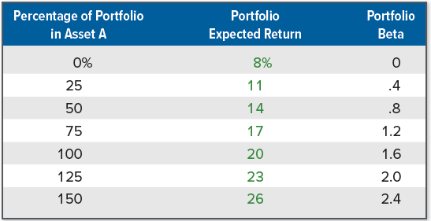
Beta and the risk premium (concluded)
Other possibilities for Asset A may be calculated as follows:

Slide 30
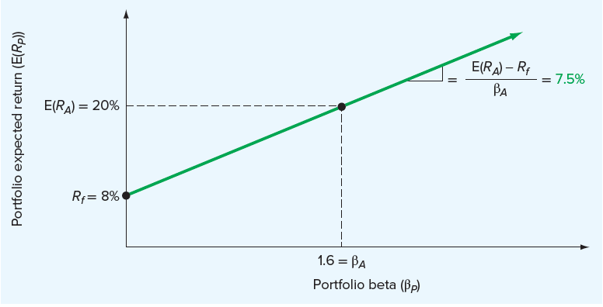
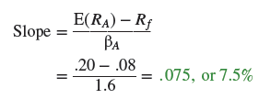
The Reward-to-risk ratio
Expected returns from the previous slide are plotted against portfolio betas in the graph below
Notice all combination fall on a straight line. What is the slope of the straight line?
Slope of line is risk premium on Asset A, E(R_{A}) − R_{f} , divided by Asset A’s beta, β_{A}:
Notes:
As always, the slope of a straight line is equal to “the rise over the run.” In this case, as we move out of the risk-free asset into Asset A, the beta increases from zero to 1.6 (a “run” of 1.6). At the same time, the expected return goes from 8 percent to 20 percent, a “rise” of 12 percent. The slope of the line is thus 12%/1.6 = 7.5%.
Asset A has a risk premium of 7.5 percent per “unit” of systematic risk.

Slide 31
The basic argument
Suppose we consider a second asset, Asset B. This asset has a beta of 1.2 and an expected return of 16%. Which investment is better, Asset A or Asset B?
To begin, calculate different combinations of expected returns and betas for portfolios of Asset B and a risk-free asset, just as we did for Asset A
For example, if we put 25% in Asset B and the remaining 75% in the risk-free asset, the portfolio’s expected return will be:
E(R_{P}) = .25 × E(R_{B}) + (1 − .25) × R_{f}
= .25 × 16 % + .75 × 8%
= 10%
Similarly, the beta on the portfolio, β_{P}, will be:
β_{P} = .25 × β_{B} + (1 − .25) × 0
= .25 × 1.2
= .30

Slide 32
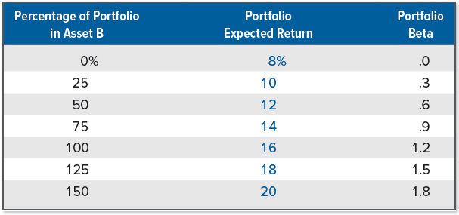
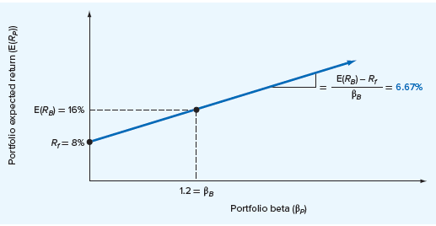
The basic argument (continued)
Other possibilities for Asset B may be calculated as follows:
Plotting these combinations results in a straight line, as with Asset A:

Slide 33
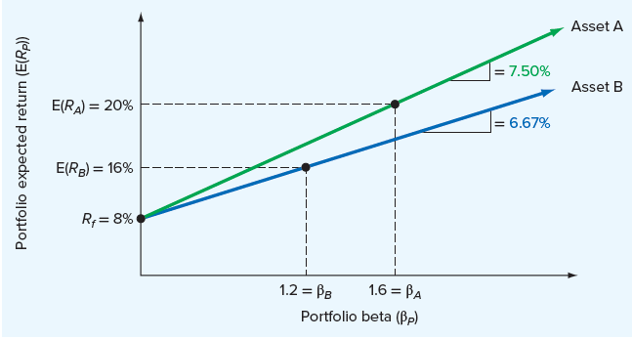
The basic argument (concluded)
The figure below compares the results for Assets A and B
Note the line describing the combinations of expected returns and betas for Asset A is higher than the one for Asset B
Implies that for any given level of systematic risk (as measured by β), some combination of Asset A and the risk-free asset always offers a larger return
Notes:
Another way of seeing that A offers a superior return for its level of risk is to note that the slope of our line for Asset B is:
Slope = (.16 - .08) / 1.2 – 6.67%, whereas the slope for A was 7.5%.
Thus, Asset B has a reward-to-risk ratio of 6.67 percent, which is less than the 7.5 percent offered by Asset A.

Slide 34

The fundamental result
Situation we have described for Assets A and B could not persist in a well-organized, active market, because investors would be attracted to Asset A and away from Asset B
Asset A’s price would rise and Asset B’s price would fall
Because prices and returns move in opposite directions, A’s expected return would decline and B’s would rise
Buying and selling would continue until the two assets plotted on exactly the same line, which means they would offer the same reward for bearing risk
In an active, competitive market, we must have the situation that:
No matter how many assets we have, the reward-to-risk ratio must be the same for all assets in the market
Notes:
This result is really not so surprising. What it says is that, for example, if one asset has twice as much systematic risk as another asset, its risk premium will be twice as large.

Slide 35
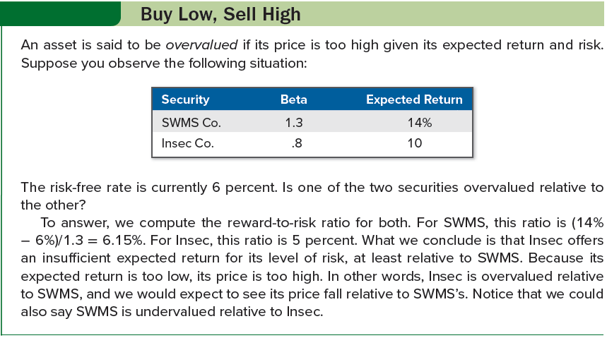
Buy low, sell high

Slide 36

The security market line
The security market line (SML) is a positively sloped, straight line displaying the relationship between expected return and beta
Suppose we consider a portfolio made up of all the assets in the market (i.e., a market portfolio), with the expected return on this market portfolio denoted as E(R_{M})
Because all the assets in the market must plot on the SML, so must a market portfolio made up of those assets
Because the market portfolio is representative of all assets in the market, it must have average systematic risk (i.e., a beta of 1)
We could express the slope of the SML as:
Market risk premium is the slope of the SML, the term E(R_{M}) - R_{f}
Notes:
After NPV, the SML is arguably the most important concept in modern finance.

Slide 37

The capital asset pricing model
Capital asset pricing model (CAPM) is the equation of the SML showing the relationship between expected return and beta
Let E(R_{i}) and β_{i} stand for the expected return and beta, respectively, on any asset in the market, and the following equation is the CAPM:
CAPM shows the expected return for a particular asset depends on three things:
Pure time value of money: As measured by risk-free rate, R_{f}, this is the reward for waiting for your money, without taking any risk
Reward for bearing systematic risk: As measured by the market risk premium, E(R_{M}) − R_{f}, this is the reward offered for bearing an average amount of systematic risk in addition to waiting
Amount of systematic risk: As measured by β_{i}, this is the amount of systematic risk present in a particular asset or portfolio, relative to that in an average asset
Notes:
By the way, the CAPM works for portfolios of assets just as it does for individual assets.

Slide 38
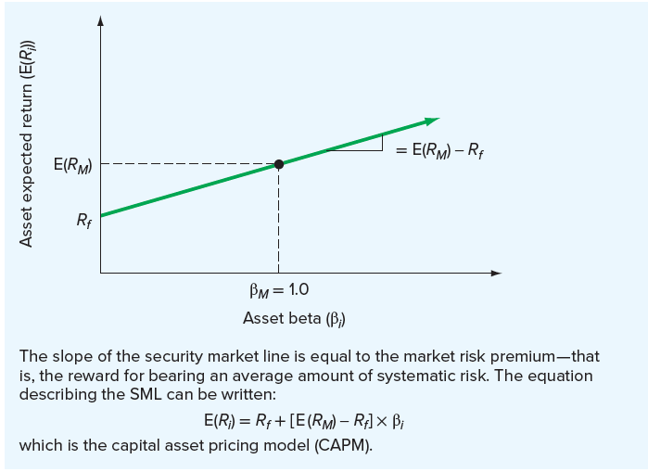
The capital asset pricing model (continued)
Notes:
Figure 13.4 summarizes our discussion of the SML and the CAPM. As before, we plot expected return against beta. Now we recognize that, based on the CAPM, the slope of the SML is equal to the market risk premium, E(R_{M}) − R_{f}.
The distance between a portfolio’s actual return and the SML is often called alpha.

Slide 39
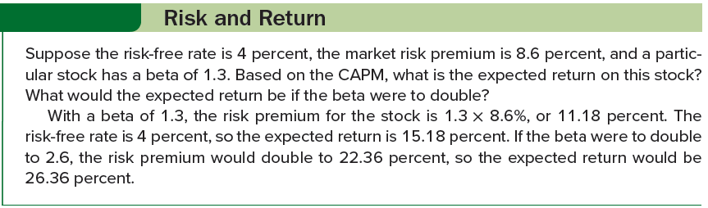
Risk and return

Slide 40
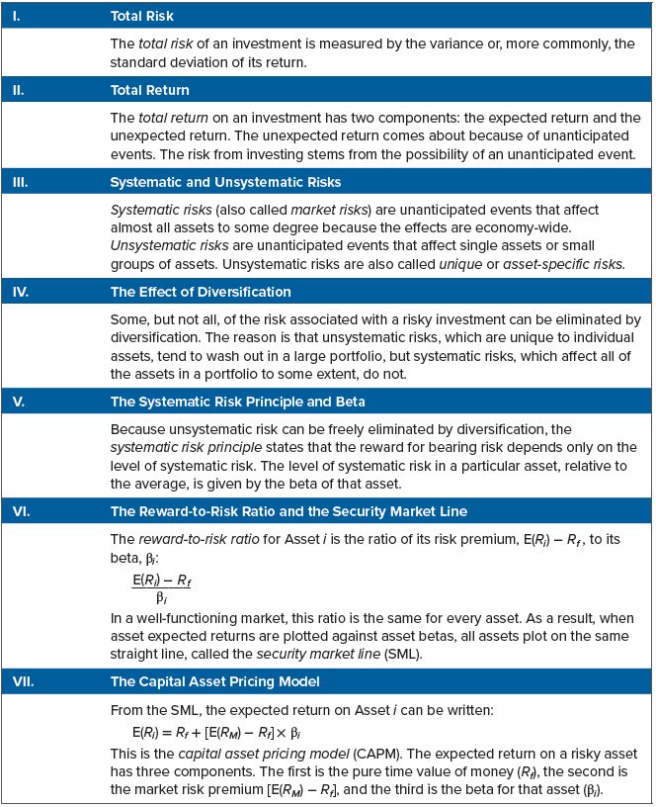
Summary of Risk and return
Notes:
For future reference, Table 13.9 summarizes the various concepts in the order in which we discussed them.

Slide 41
The sml and the cost of capital: a preview
Security market line tells us the reward for bearing risk in financial markets
Only way to benefit our shareholders is by finding investments with expected returns that are superior to what the financial markets offer for the same risk; such an investment will have a positive NPV
To determine whether an investment has a positive NPV, we compare the expected return on that new investment to what the financial market offers on an investment with the same beta
Appropriate discount rate on a new project is the minimum expected rate of return an investment must offer to be attractive (i.e., the cost of capital)
By saying an investment is attractive if its expected return exceeds what is offered in financial markets for investments of the same risk, we are effectively using the internal rate of return (IRR) criterion
Notes:
Section 13.8

Slide 42
SELECTED CONCEPT QUESTIONS
How do we calculate the expected return on a security?
Is there a simple relationship between the standard deviation on a portfolio and the standard deviations of the assets in the portfolio?
What are the two basic parts of a return?
What is the distinction between the two types of risk?
What happens to the standard deviation of return for a portfolio if we increase the number of securities in the portfolio?
True or false: The expected return on a risky asset depends on that asset’s total risk. Explain.
What is the security market line? Why must all assets plot directly on the SML in a well-functioning market?
If an investment has a positive NPV, would it plot above or below the SML? Why?

Slide 43
End of Chapter
Chapter 13

