Slide 1
CHAPTER 14
COST OF CAPITAL

Slide 2
Learning obejectives
Determine a firm’s cost of equity capital
Determine a firm’s cost of debt
Determine a firm’s overall cost of capital and how to use it to value a company
Explain how to correctly include flotation costs in capital budgeting projects
Describe some of the pitfalls associated with a firm’s overall cost of capital and what to do about them

Slide 3
Chapter Outline
The Cost of Capital: Some Preliminaries
The Cost of Equity
The Costs of Debt and Preferred Stock
The Weighted Average Cost of Capital
Divisional and Project Costs of Capital
Company Valuation with the WACC
Flotation Costs and the Weighted Average Cost of Capital

Slide 4
Required return versus cost of capital
The terms required return, appropriate discount rate, and cost of capital essentially mean the same thing:
If the required return on an investment is 10%, we mean the investment will have a positive NPV only if its return exceeds 10%
Also, the firm must earn 10% on the investment to compensate investors for the use of the capital needed to finance the project
Furthermore, 10% is the cost of capital associated with the investment
Cost of capital associated with an investment depends on the risk of that investment, not how and where the capital is raised
Notes:
Section 14.1
We will henceforth use the terms required return, appropriate discount rate, and cost of capital more or less interchangeably.

Slide 5
Financial policy and cost of capital
The particular mixture of debt and equity a firm chooses to employ—its capital structure—is a managerial variable
In this chapter, we will assume the firm has a fixed debt-equity ratio that it maintains
This ratio reflects the firm’s target capital structure
Recall, a firm’s overall cost of capital will reflect the required return on the firm’s assets as a whole
Thus, a firm’s cost of capital will reflect both its cost of debt capital and its cost of equity capital

Slide 6


The cost of equity: dividend growth model approach
Cost of equity is the return that equity investors require on their investment in the firm
No way to directly observe the return the firm’s equity investors require, so we must estimate the firm’s overall cost of equity
Dividend growth model approach is the easiest way to estimate the cost of equity capital
If we assume the firm’s dividend will grow at a constant rate, g, allow D₀ to represent the dividend just paid and D₁ to represent the next period’s projected dividend, the price per share of the stock, P₀, can be written as:
We can rearrange this to solve for R_{E}, the required return on the stock (i.e., firm’s cost of equity capital), as follows:
Notes:
Section 14.2
This section discusses two approaches to determining the cost of equity: the dividend growth model approach and the security market line (SML) approach.
Recall, the dividend growth model was developed in Chapter 8.

Slide 7
dividend growth model approach
We need three pieces of information to estimate R_{E}:
P₀ and D₀ can be observed directly for publicly traded, dividend-paying firms
g must be estimated
Suppose Greater States Public Service, a large public utility, paid a dividend of $4 per share last year. The stock currently sells for $60 per share. You estimate that the dividend will grow steadily at a rate of 6% per year into the indefinite future. What is the cost of equity capital for Greater States?
We can calculate the expected dividend for the coming year, D₁, is:
D₁ = D₀ × (1 + g)
= $4 × 1.06 = $4.24
Given this, the cost of equity, R_{E}, is:
R_{E} = D₁/P₀ + g
= $4.24/$60 + .06 = .1307, or 13.07%

Slide 8
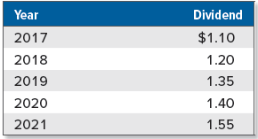
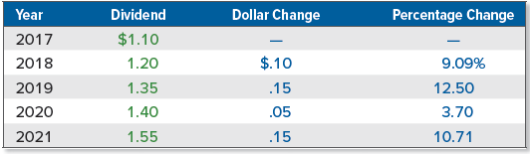
dividend growth model approach: estimating the growth rate
To estimate the growth rate, we can use historical growth rates or analysts’ forecasts of future growth rates
Suppose we observe the following for some company:
We can calculate the percentage change in the dividend per year and then average the four growth rates to derive an estimate for g, (.0909 + .1250 + .0370 + .1071)/4 = .09, or 9%:
Notes:
Analysts’ forecasts are available from a variety of sources. Naturally, different sources will have different estimates, so one approach might be to obtain multiple estimates and then average them. Alternatively, we might observe dividends for the previous, say, five years, calculate the year-to-year growth rates, and average them.
Notice that we calculated the change in the dividend on a year-to-year basis and then expressed the change as a percentage. In 2018 for example, the dividend rose from $1.10 to $1.20, an increase of $.10. This represents a $.10/$1.10 = .0909, or 9.09% increase.
We also could calculate a geometric growth rate of the four-year period, 8.95%.

Slide 9
dividend growth model approach: advantages and disadvantages
Primary advantage of dividend growth model is its simplicity
Several associated practical problems and disadvantages:
Applicable only to firms that pay dividends, and even for those companies that pay dividends, a key underlying assumption is that the dividend grows at constant rate
Estimated cost of equity is very sensitive to estimated growth rate
Does not explicitly consider risk

Slide 10

The sml approach
Recall, the required or expected return on a risky investment depends on three things:
Risk-free rate, R_{f}
Market risk premium, E(R_{M}) − R_{f}
Systematic risk of the asset relative to the average, which we called its beta coefficient, β
Using SML, we can write the expected return on the company’s equity, E(R_{E}), as follows, where β_{E} is the estimated beta:
E(R_{E}) = R_{f} + β_{E} × [E(R_{M}) − R_{f}]
Dropping the Es denoting expectations, the required return form the SML, R_{E}, can be written as:

Slide 11
Implementing The sml approach
To use the SML approach, we need the following:
A risk-free rate, R_{f}
U.S. T-bills were paying about 1.53% as this chapter was being written, so we will use this as our risk-free rate
An estimate of the market risk premium, E(R_{M}) − R_{f}
Recall from Chapter 12 that one estimate of the market risk premium (based on large common stocks) is about 7%
An estimate of the relevant beta, β_{E}
Beta coefficients for publicly traded companies are widely available
In Chapter 13, we saw Walt Disney had an estimated beta of 1.11 (Table 13.8). We could estimate Walt Disney’s cost of equity as:
R_{Walt Disney} = R_{f} + β_{Walt Disney} × (R_{M} − R_{f})
= .0153 + 1.11 × .07
= .0930, or 9.30%

Slide 12
Advantages and disadvantages of The sml approach
SML approach has two primary advantages:
It explicitly adjusts for risk
It is applicable to companies other than just those with steady dividend growth
Disadvantages include the following:
SML approach requires that two things be estimated (the market risk premium and the beta coefficient) and if those estimates are poor, the resulting cost of equity will be inaccurate
As with the dividend growth model, we essentially rely on the past to predict the future when we use the SML approach
Notes:
In the best of all worlds, both approaches (the dividend growth model and the SML) are applicable and the two result in similar answers. If this happens, we might have some confidence in our estimates. We might also wish to compare the results to those for other similar companies as a reality check.

Slide 13
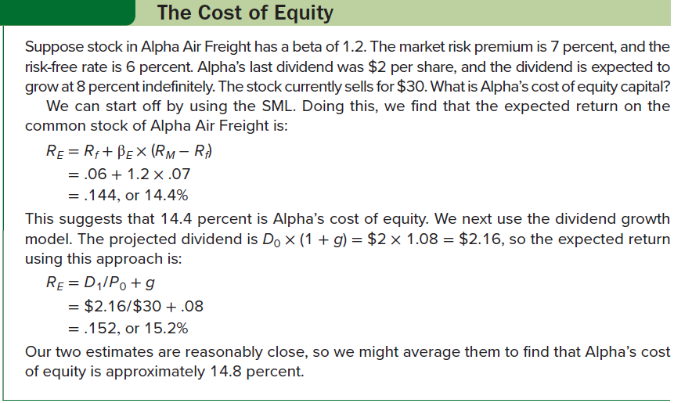
The cost of equity

Slide 14
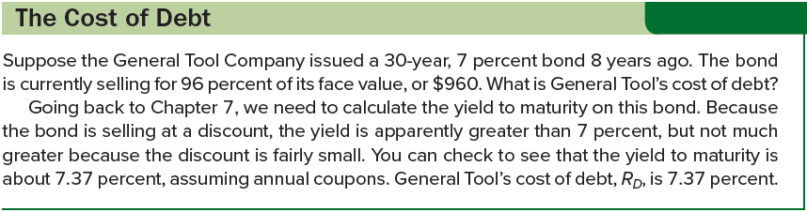
The cost of debt
Cost of debt is the return that lenders require on the firm’s debt
No need to estimate a beta for the debt because the cost of debt can normally be observed either directly or indirectly:
Cost of debt, R_{D}, is interest rate firm must pay on new borrowing, and we can observe interest rates in the financial markets
Note the coupon rate on the firm’s outstanding debt is irrelevant, as this rate tells us what the firm’s cost of debt was back when the bonds were issues, not what the cost of debt is today
Notes:
Section 14.3

Slide 15

The cost of preferred stock
Preferred stock has a fixed dividend paid every period forever, so a share of preferred stock is essentially a perpetuity. The cost of preferred stock, R_{P}, is thus:
D is the fixed dividend
P₀ is the current price per share of the preferred stock
Cost of preferred stock is equal to the dividend yield on the preferred stock
Preferred stocks are rated in much the same way as bonds, so the cost of preferred stock can be estimated by observing the required returns on other, similarly rated shares of preferred stock

Slide 16
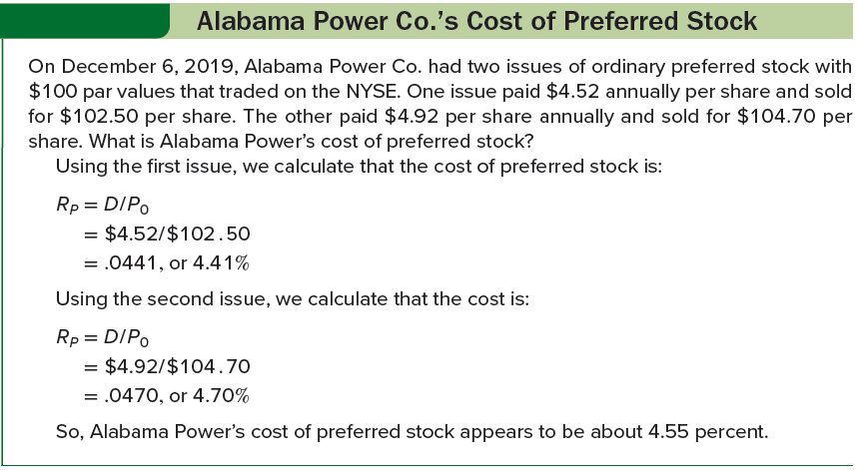
Alabama power co.’s cost of preferred stock

Slide 17


The weighted average cost of capital
Use E to represent market value of firm’s equity, calculated by multiplying number of shares outstanding and price per share
Use D to represent market value of firm’s debt, calculated by multiplying market price of single bond and bonds outstanding
If there are multiple bonds issues, repeat this calculation of D for each and then add up the results
If there is debt that is not publicly traded, observe the yield on similar publicly traded debt and then estimate the market value of the privately held debt using this yield as the discount rate
Use V to represent combined market value of the debt and equity:
Dividing both sides by V, we can calculate percentages of the total capital represented by the debt and equity (i.e., capital structure weights), which can be interpreted just like portfolio weights:
Notes:
Section 14.4
For short-term debt, the book (accounting) values and market values should be somewhat similar, so we might use the book values as estimates of the market value
For example, if the total market value of a company’s stock were calculated as $200 million and the total market value of the company’s debt were calculated as $50 million, then the combined value would be $250 million. Of this total, E/V = $200 million/$250 million = .80, so 80 percent of the firm’s financing would be equity and the remaining 20 percent would be debt.

Slide 18
Taxes and the weighted average cost of capital
Recall the interest paid by a corporation is deductible for tax purposes, but payments to stockholders, such as dividends, are not
In determining an aftertax discount rate, we need to distinguish between the pretax and the aftertax cost of debt
Suppose a firm borrows $1 million at 9% interest. The corporate tax rate is 21%. What is the aftertax interest rate on this loan?
Total interest bill will be $90,000 per year, but this amount is tax deductible, so the $90,000 interest reduces the firm’s tax bill by .21 × $90,000 = $18,900
Aftertax interest bill is $90,000 − 18,900 = $71,100
Aftertax interest rate is $71,100/$1 million = .0711, or 7.11%
Generally, aftertax interest rate equals pretax rate multiplied by 1 minus tax rate
If we use the symbol T_{C} to stand for the corporate tax rate, then the aftertax rate can be written as R_{D} × (1 − T_{C})
Notes:
Using the numbers from the preceding paragraph, we find that the aftertax interest rate is 9% × (1 − .21) = 7.11%.

Slide 19

Taxes and the weighted average cost of capital (continued)
To calculate the firm’s overall cost of capital, we multiply the capital structure weights by the associated costs and add them up, with the total being the weighted average cost of capital (WACC):
WACC has straightforward interpretation:
It is the overall return the firm must earn on its existing assets to maintain the value of its stock
It is also the required return on any investments by the firm that have essentially the same risks as existing operations
If a firm uses preferred stock in its capital structure, and we define P/V as the percentage of the firm’s financing that comes from preferred stock and R_{P} as the cost of preferred stock, the WACC is:
Notes:
The Tax Cuts and Jobs Act of 2017 placed limitations on the amount of interest that can be deducted in certain situations. Throughout this chapter, we will assume all interest can be deducted. We will discuss this issue in greater detail in a subsequent chapter.

Slide 20
The warehouse problem
Suppose you have just become the president of a large company, and the first decision you face is whether to go ahead with a plan to renovate the company’s warehouse distribution system. The plan will cost the company $50 million, and it is expected to save $12 million per year after taxes over the next six years.
Need to find an alternative in the financial markets that is comparable to warehouse renovation (i.e., has same level of risk)
Suppose the firm has a target debt-equity ratio of 1/3, which implies that E/V is .75 and D/V is .25. The cost of debt is 10%, and the cost of equity is 20%. Assuming a 21% tax rate, the WACC will be:
WACC = (E/V) × R_{E} + (D/V) × R_{D} × (1 − T_{C})
= .75 × . 20 + .25 × . 10 × ( 1 − .21)
= .1698, or 16.98%

Slide 21
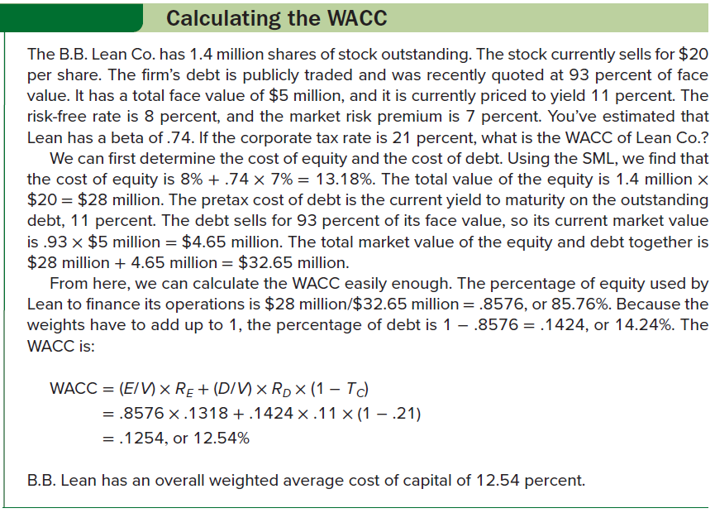
Calculating the wacc

Slide 22

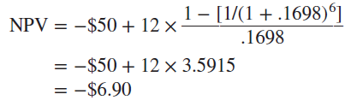
The warehouse problem (continued)
Warehouse project has a cost of $50 million and expected aftertax cash flows (the cost savings) of $12 million per year for six years.
The NPV (in millions) is:
Because cash flows are in the form of an ordinary annuity, we can calculate NPV using 16.98% (the WACC) as the discount rate:
Should the firm take on the warehouse renovation?
No; the project has a negative NPV using the firm’s WACC

Slide 23
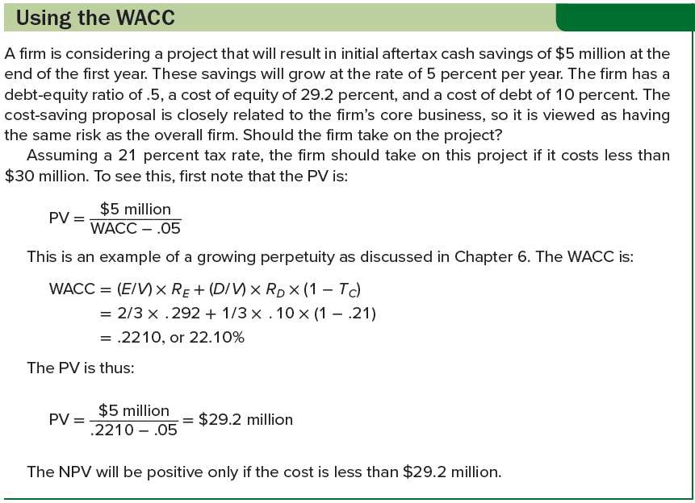
using the wacc

Slide 24
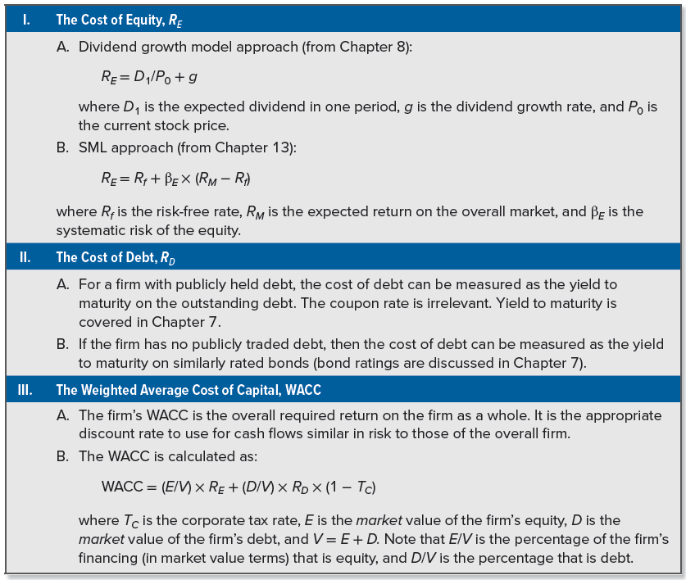
Summary of capital cost calculations

Slide 25
Performance evaluation
Performance evaluation is another use of the WACC
Best-known approach in this area is the economic value added (EVA) method
Others include market value added (MVA) and shareholder value added (SVA)
Suppose we have $100 million in capital (debt and equity) tied up in our firm, and our overall WACC is 12%. If we multiply these together, we get $12 million. If our cash flow from assets is less than this, we are, on an overall basis, destroying value; if cash flow from assets exceeds $12 million, we are creating value
Evaluation strategies suffer to a certain extent from problems with implementation (e.g., many companies make extensive use of book values for debt and equity in computing cost of capital)

Slide 26
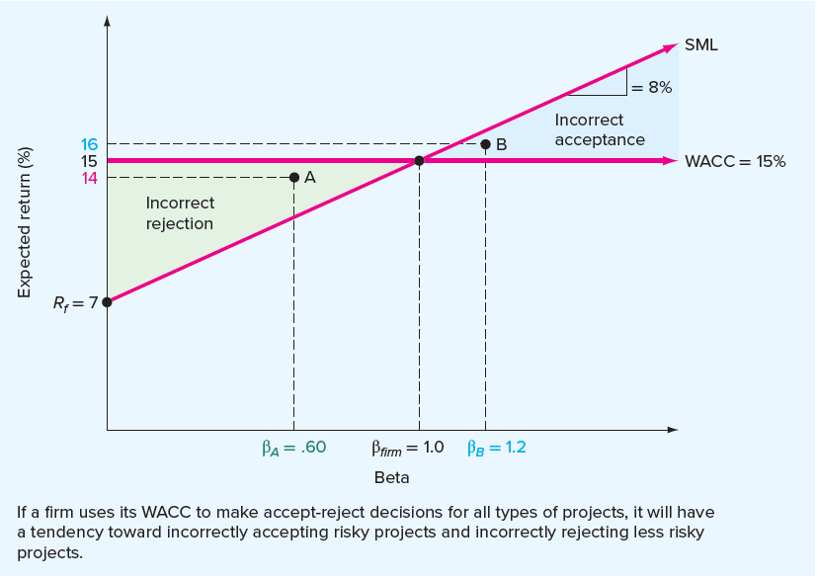
The sml and the wacc
Using WACC could lead to poor decisions when evaluating investments with risks that are substantially different from those of the overall firm
In the graph, we have plotted an SML corresponding to a risk-free rate of 7% and a market risk premium of 8%
Consider an all-equity company with a beta of 1
WACC and cost of equity are equal to 15% for this company because there is no debt
Notes:
Section 14.5

Slide 27
The sml and the wacc (continued)
Suppose our firm uses its WACC to evaluate all investments (i.e., any investment with a return of greater than 15% will be accepted and any investment with a return of less than 15% will be rejected)
Recall that a desirable investment is one that plots above the SML
Consider Point A. This project has a beta of β_{A} = .60, as compared to the firm’s beta of 1.0. It has an expected return of 14%. Is this a desirable investment? Yes, because its required return is only:
Required return = R_{f} + β_{A} × (R_{M} − R_{f})
= .07 + .60 × .08
= .118, or 11.8%
If we use the WACC as a cutoff, this project will be rejected because its return is less than 15%
A firm that uses its WACC as a cutoff will tend to reject profitable projects with risks less than those of the overall firm

Slide 28
The sml and the wacc (concluded)
Consider Point B. This project has a beta of β_{B} = 1.2. It offers a 16% return, which exceeds the firm’s cost of capital
This is not a good investment because, given its level of systematic risk, its return is inadequate
If we use the WACC to evaluate this investment, it will appear to be attractive
If we use the WACC as a cutoff, we will tend to make unprofitable investments with risks greater than those of the overall firm
Through time, a firm that uses its WACC to evaluate all projects will tend to both accept unprofitable investments and become increasingly risky

Slide 29
Divisional cost of capital
Same type of problem with the WACC can arise in a corporation with more than one line of business
Imagine a corporation that has two divisions: a regulated electric company and an electronics manufacturing operation
Electricity operation has relatively low risk
Electronics manufacturing has relatively high risk
Firm’s overall cost of capital is really a mixture of two different costs of capital, one for each division
If the two divisions were competing for resources, and the firm used a single WACC as a cutoff, which division would tend to be awarded greater funds for investment?
Riskier division would tend to have greater returns (ignoring the greater risk), so it would tend to be the “winner”
Less glamorous operation might have great profit potential that would end up being ignored

Slide 30
The pure play approach
Using the firm’s WACC inappropriately can lead to problems, so how can we come up with the appropriate discount rates in such circumstances?
Examine other investments outside the firm that are in the same risk class as the one being considered, and use the market-required return on these investments as the discount rate
Pure play approach is the use of WACC that is unique to a particular project, based on companies in similar lines of business
Going back to our electricity division, suppose we wanted to find a discount rate to use for that division:
We could identify several other electric companies that have publicly traded securities
We may find a typical electric company has a beta of .80, AA-rated debt, and a capital structure that is about 50% debt and 50% equity
Using this information, we could develop a WACC for a typical electric company and use this as our discount rate

Slide 31
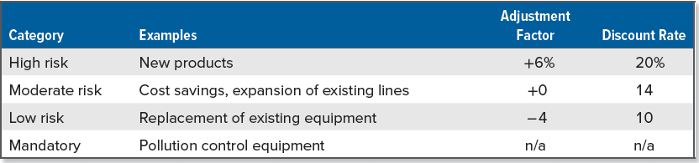
The subjective approach
Due to the challenges that exist in objectively establishing discount rates for individual projects, firms often adopt an approach that involves making subjective adjustments to the overall WACC
Suppose a firm has an overall WACC of 14%, and it places all proposed projects into four categories as follows:
Effect of this partitioning is to assume all projects either fall into one of three risk classes or else are mandatory, in which case the cost of capital is irrelevant because the project must be taken
Notes:
With the subjective approach, the firm’s WACC may change through time as economic conditions change. As this happens, the discount rates for the different types of projects will also change.

Slide 32
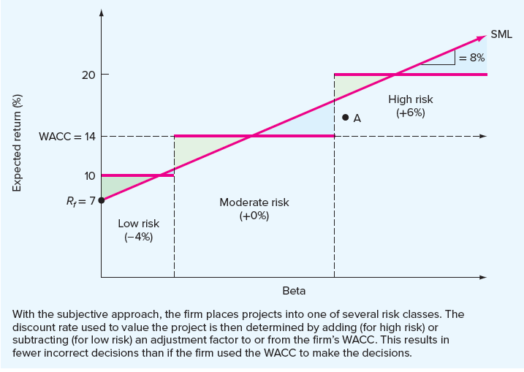
The subjective approach (continued)
Within each risk class, some projects will presumably have more risk than others, and the danger of making incorrect decisions still exists
Project labeled A would be accepted if the WACC were used, but it is rejected once it is classified as a high-risk investment
Some risk adjustment, even if it is subjective, is probably better than no risk adjustment

Slide 33

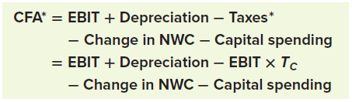

Company valuation with the wacc
To calculate cash flow from assets, first calculate what the firm’s tax bill would have been if it had not used debt financing
Multiply earnings before interest and taxes (EBIT) by firm’s tax rate (T_{C}) to get “would-have-been” tax bill, called “adjusted” taxes, Taxes*:
Next, calculate cash flow from assets, using adjusted taxes
Call this “adjusted” cash flow from assets, CFA*, calculated as:
CFA* calculation could be simplified by writing it as:
Notes:
Section 14.6
When we look at an entire company, we will often see an interest deduction because the company has borrowed money. But as we have consistently emphasized, interest paid is a financing cost, not an operating cost. However, because interest paid is a tax deductible expense, a company’s tax bill is lower than it would have been had the company not used debt financing.

Slide 34
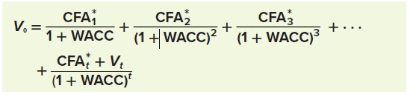

Company valuation with the wacc (continued)
Suppose you project CFA* for the coming year as CFA₁* = $120 million. You think this amount will grow indefinitely at g = 5% per year. You’ve estimated the firm’s WACC to be 9%, so the value of the firm today (V₀) is:
In the case of nonconstant growth, assume constant growth begins at Time t in the future and write the value of the firm today as:
V_{t} is the value of the firm at Time t, which can be calculated using the growing perpetuity formula:
Notes:
In sum, valuing a firm is no different from valuing a project, except for the fact that we have to adjust the taxes to remove the effect of any debt financing.
Notice that the tricky part is that to get the value at Time t, we have to use the cash flow that occurs at the end of that period at Time t + 1. Also, the value of the firm in the future, V_{t}, is often referred to as the “terminal value.”

Slide 35
Flotation costs: the basic approach
If a company accepts a new project, it may be required to issue, or float, new bonds and stocks (i.e., the firm will incur flotation costs)
The Spatt Company, an all-equity firm, has a cost of equity of 20%. Because this firm is 100% equity, its WACC and its cost of equity are the same. Spatt is contemplating a large-scale, $100 million expansion of its existing operations. The expansion would be funded by selling new stock. Spatt believes its flotation costs will run 10% of the amount issued, meaning the proceeds from the equity sale will be only 90% of the amount sold. When flotation costs are considered, what is the cost of the expansion?
Spatt needs to sell enough equity to raise $100 million after covering the flotation costs. In other words:
$100 million = (1 − .10) × Amount raised
Amount raised = $100 million/.90 = $111.11 million
Spatt’s flotation costs are $11.11 million, and the true cost of the expansion is $111.11 million once flotation costs are included
Notes:
Section 14.7
Sometimes it is suggested that the firm’s WACC should be adjusted upward to reflect flotation costs. This is really not the best approach because, once again, the required return on an investment depends on the risk of the investment, not the source of the funds.

Slide 36

The basic approach
Suppose Spatt’s target capital structure is 60% equity, 40% debt. The flotation costs associated with equity are still 10%, but the flotation costs for debt are 5%.
Weighted average flotation cost, f_{A}, may be calculated by multiplying the equity flotation cost, f_{E}, by the percentage of equity (E/V) and the debt flotation cost, f_{D}, by the percentage of debt (D/V) and then adding the two together:
For every dollar in outside financing needed for new projects, the firm must actually raise $1/(1 − .08) = $1.087
The project cost is $100 million when we ignore flotation costs, but if we include them, the true cost is:
$100 million/(1 − f_{A}) = $100 million/.92 = $108.7 million
Notes:
In taking issue costs into account, the firm must be careful not to use the wrong weights. The firm should use the target weights, even if it can finance the entire cost of the project with either debt or equity.

Slide 37
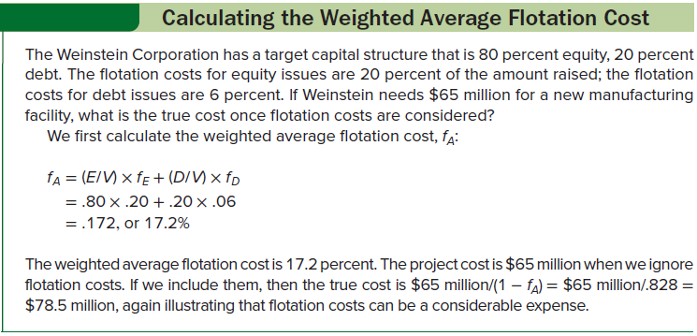
Calculating the weighted average flotation cost

Slide 38
Flotation costs and npv
Suppose the Tripleday Printing Company is currently at its target debt-equity ratio of 100%. It is considering building a new $500,000 printing plant in Kansas. This new plant is expected to generate aftertax cash flows of $73,150 per year forever. The tax rate is 21%.
There are two financing options:
A $500,000 new issue of common stock: The issuance costs of the new common stock would be about 10% of the amount raised. The required return on the company’s new equity is 20%.
A $500,000 issue of 30-year bonds: The issuance costs of the new debt would be 2% of proceeds. The company can raise new debt at 10%.
What is the NPV of the new printing plant?

Slide 39
Flotation costs and npv (continued)
Printing is the company’s main line of business, so the company’s WACC should be used to value the new printing plant:
WACC = (E/V) × R_{E} + (D/V) × R_{D} × (1 − T_{C})
= .50 × .20 + .50 × .10 × (1 − .21) = .1395, or 13.95%
Because cash flows are $73,150 per year forever, the PV is:
PV = $73,150 / .1395 = $524,373
Ignoring flotation costs, the project should be accepted:
NPV = $524,373 − 500,000 = $24,373
Including flotation costs, the weighted average flotation cost, f_{A}, is:
f_{A} = (E/V) × f_{E} + (D/V) × f_{D}
= .50 × .10 + .50 × .02 = .06, or 6%
The true cost, once we include flotation costs, is:
$500,000/(1− f_{A}) = $500,000/.94 = $531,915
Including floatation costs, the project should be rejected:
NPV = $524,373 − 531,915 = −$7,542

Slide 40
Internal equity and flotation costs
Most firms rarely sell equity at all
Their internally generated cash flow is sufficient to cover the equity portion of their capital spending, so only the debt portion must be raised externally
Use of internal equity doesn’t change our approach
Assign a value of zero to the flotation cost of equity because there is no such cost
In the Tripleday example, the weighted average flotation cost would therefore be:
f_{A} = (E/V) × f_{E} + (D/V) × f_{D}
= .50 × 0 + .50 × .02
= .01, or 1%
Notes:
Our discussion of flotation costs to this point implicitly assumes that firms always have to raise the capital needed for new investments.
Notice that whether equity is generated internally or externally makes a big difference because external equity has a relatively high flotation cost.

Slide 41
Selected concept questions
What is the primary determinant of the cost of capital for an investment?
What are two approaches to estimating the cost of equity capital?
Why is the coupon rate a bad estimate of a firm’s cost of debt?
Under what conditions is it correct to use the WACC to determine NPV?
What are the likely consequences if a firm uses its WACC to evaluate all proposed investments?
Why do you think we might prefer to use a ratio when calculating the terminal value when we do a firm valuation?
What are flotation costs?

Slide 42
End of Chapter
Chapter 14

