Slide 1
Microeconomcis Using Stata
Chapter 3
Notes

Slide 2
Data and Focus
Medical expenditure of people over 65 from MEPS
Research question: the impact of insurance on medical expenditure
Control for factors such as
Age
Race
Sex
Education
Income
Location
Health status etc

Slide 3
Univariate Analysis
describe command
List various features of the variables
storage display value
variable name type format label variable label
totexp double %12.0g Total medical expenditure
ltotexp float %9.0g ln(totexp) if totexp > 0
posexp float %9.0g =1 if total expenditure > 0
suppins float %9.0g =1 if has supp priv insurance
phylim double %12.0g =1 if has functional limitation
actlim double %12.0g =1 if has activity limitation
totchr double %12.0g # of chronic problems
age double %12.0g Age
female double %12.0g =1 if female
income double %12.0g annual household income/1000
https://www.stata.com/manuals13/u12.pdf

Slide 4
Univariate Analysis
summarize command and outreg (check the do file)
Show univariate analysis results
Variable | Obs Mean Std. Dev. Min Max
-------------+---------------------------------------------------------
totexp | 3,064 7030.889 11852.75 0 125610
ltotexp | 2,955 8.059866 1.367592 1.098612 11.74094
posexp | 3,064 .9644256 .1852568 0 1
suppins | 3,064 .5812663 .4934321 0 1
phylim | 3,064 .4255875 .4945125 0 1
-------------+---------------------------------------------------------
actlim | 3,064 .2836162 .4508263 0 1
totchr | 3,064 1.754243 1.307197 0 7
age | 3,064 74.17167 6.372938 65 90
female | 3,064 .5796345 .4936982 0 1
income | 3,064 22.47472 22.53491 -1 312.46
https://www.stata.com/manuals13/rsummarize.pdf

Slide 5
Frequency Check
tabulate command
show the frequency of certain features
tabulate income if income <= 0.3
annual |
household |
income/1000 | Freq. Percent Cum.
------------+-----------------------------------
-1 | 1 1.04 1.04
0 | 87 90.63 91.67
.023 | 1 1.04 92.71
.069 | 1 1.04 93.75
.07 | 1 1.04 94.79
.1 | 2 2.08 96.88
.12 | 1 1.04 97.92
.2 | 1 1.04 98.96
.25 | 1 1.04 100.00
------------+-----------------------------------
Total | 96 100.00

Slide 6
Two way table
tabulate command
show the frequency of certain features
tabulate female suppins, row col chi2
| =1 if has supp priv
=1 if | insurance
female | 0 1 | Total
-----------+----------------------+----------
0 | 488 800 | 1,288
| 37.89 62.11 | 100.00
| 38.04 44.92 | 42.04
-----------+----------------------+----------
1 | 795 981 | 1,776
| 44.76 55.24 | 100.00
| 61.96 55.08 | 57.96
-----------+----------------------+----------
Total | 1,283 1,781 | 3,064
| 41.87 58.13 | 100.00
| 100.00 100.00 | 100.00
Pearson chi2(1) = 14.4991 Pr = 0.000

Slide 7
Three way table
table female totchr suppins
Check do file for results

Slide 8
Table command with content
table female suppins, contents(N totchr mean totchr)
------------------------------------
| =1 if has supp priv
=1 if | insurance
female | 0 1
----------+-------------------------
0 | 488 800
| 1.530737705 1.73875
|
1 | 795 981
| 1.803773585 1.837920489

Slide 9
Two sample t test
This is a hypothesis test
Does the expenditures equal between man and woman?
ttest ltotexp, by (female) unequal
Two-sample t test with unequal variances
------------------------------------------------------------------------------
Group | Obs Mean Std. Err. Std. Dev. [95% Conf. Interval]
---------+--------------------------------------------------------------------
0 | 1,229 8.069327 .0405719 1.422333 7.989729 8.148925
1 | 1,726 8.05313 .031956 1.327615 7.990453 8.115806
---------+--------------------------------------------------------------------
combined | 2,955 8.059866 .0251581 1.367592 8.010537 8.109196
---------+--------------------------------------------------------------------
diff | .0161972 .0516455 -.0850746 .1174691
------------------------------------------------------------------------------
diff = mean(0) - mean(1) t = 0.3136
Ho: diff = 0 Satterthwaite's degrees of freedom = 2530.85
Ha: diff < 0 Ha: diff != 0 Ha: diff > 0
Pr(T < t) = 0.6231 Pr(|T| > |t|) = 0.7538 Pr(T > t) = 0.3769

Slide 10
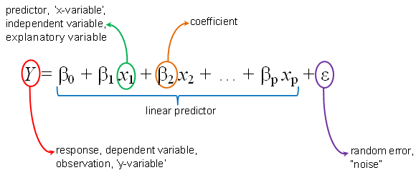
What is beta?
b = (X'X)⁻¹X'y

Slide 11
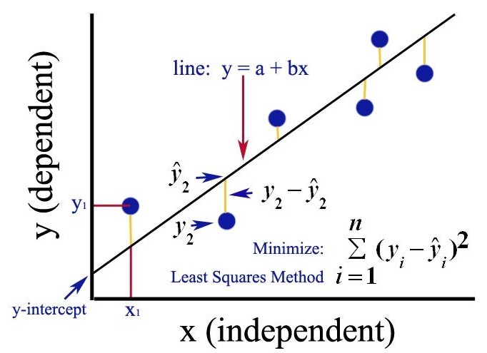

Slide 12
Correlation Matrix
correlate ltotexp suppins phylim actlim totchr age female income
(obs=2,955)
| ltotexp suppins phylim actlim totchr age female income
-------------+------------------------------------------------------------------------
ltotexp | 1.0000
suppins | 0.0941 1.0000
phylim | 0.2924 -0.0243 1.0000
actlim | 0.2888 -0.0675 0.5904 1.0000
totchr | 0.4283 0.0124 0.3334 0.3260 1.0000
age | 0.0858 -0.1226 0.2538 0.2394 0.0904 1.0000
female | -0.0058 -0.0796 0.0943 0.0499 0.0557 0.0774 1.0000
income | 0.0023 0.1943 -0.1142 -0.1483 -0.0816 -0.1542 -0.1312 1.000

Slide 13
OLS regression
regress ltotexp suppins phylim actlim totchr age female income, vce(robust)
Linear regression Number of obs = 2,955
F(7, 2947) = 126.97
Prob > F = 0.0000
R-squared = 0.2289
Root MSE = 1.2023
------------------------------------------------------------------------------
| Robust
ltotexp | Coef. Std. Err. t P>|t| [95% Conf. Interval]
-------------+----------------------------------------------------------------
suppins | .2556428 .0465982 5.49 0.000 .1642744 .3470112
phylim | .3020598 .057705 5.23 0.000 .1889136 .415206
actlim | .3560054 .0634066 5.61 0.000 .2316797 .4803311
totchr | .3758201 .0187185 20.08 0.000 .3391175 .4125228
age | .0038016 .0037028 1.03 0.305 -.0034587 .011062
female | -.0843275 .045654 -1.85 0.065 -.1738444 .0051894
income | .0025498 .0010468 2.44 0.015 .0004973 .0046023
_cons | 6.703737 .2825751 23.72 0.000 6.149673 7.257802
------------------------------------------------------------------------------

Slide 14
Hypothesis Test
test phylim = actlim
Results:
( 1) phylim - actlim = 0
F( 1, 2947) = 0.27
Prob > F = 0.6054
What is hypothesis test?

Slide 15
Heteroskedasticity
quietly regress ltotexp suppins phylim actlim totchr age female income
. estat hettest, iid
Breusch-Pagan / Cook-Weisberg test for heteroskedasticity
Ho: Constant variance
Variables: fitted values of ltotexp
chi2(1) = 32.87
Prob > chi2 = 0.0000
estat hettest suppins phylim actlim totchr age female income, iid
Breusch-Pagan / Cook-Weisberg test for heteroskedasticity
Ho: Constant variance
Variables: suppins phylim actlim totchr age female income
chi2(7) = 93.13
Prob > chi2 = 0.0000

Slide 16
Marginal Effect I
margins, dydx(income)
Average marginal effects Number of obs = 3,064
Model VCE : Robust
Expression : Linear prediction, predict()
dy/dx w.r.t. : income
------------------------------------------------------------------------------
| Delta-method
| dy/dx Std. Err. t P>|t| [95% Conf. Interval]
-------------+----------------------------------------------------------------
income | 3.893248 8.387865 0.46 0.643 -12.55321 20.33971

Slide 17
Marginal Effect II - Elasticity
margins, eyex(totchr) atmean
Conditional marginal effects Number of obs = 3,064
Model VCE : Robust
Expression : Linear prediction, predict()
ey/ex w.r.t. : totchr
at : suppins = .5812663 (mean)
phylim = .4255875 (mean)
actlim = .2836162 (mean)
totchr = 1.754243 (mean)
age = 74.17167 (mean)
female = .5796345 (mean)
income = 22.47472 (mean)
------------------------------------------------------------------------------
| Delta-method
| ey/ex Std. Err. t P>|t| [95% Conf. Interval]
-------------+----------------------------------------------------------------
totchr | .4839724 .0433653 11.16 0.000 .3989444 .5690005
------------------------------------------------------------------------------

