Slide 1
Chapter 3 –
Class Documents

Slide 2
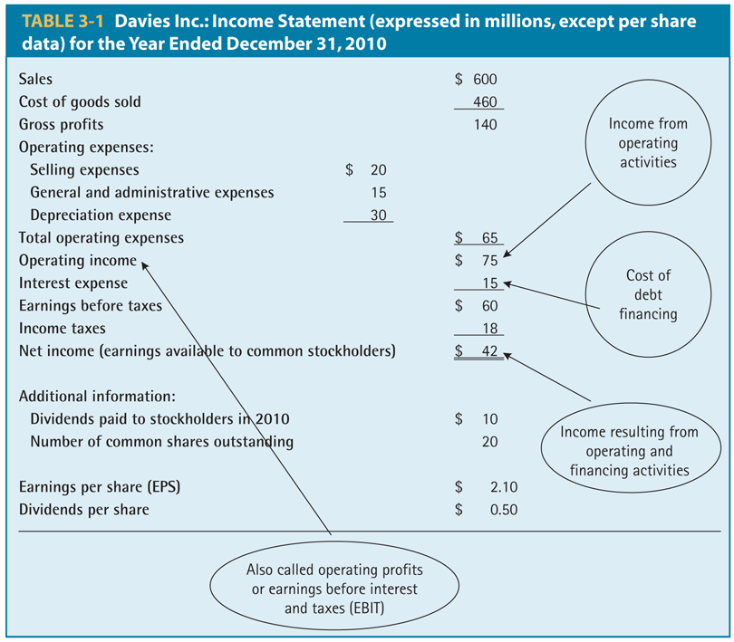
Table 3-1

Slide 3
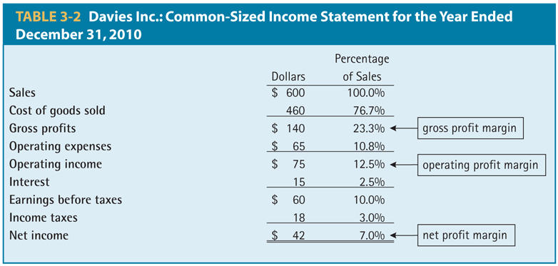
Table 3-2

Slide 4
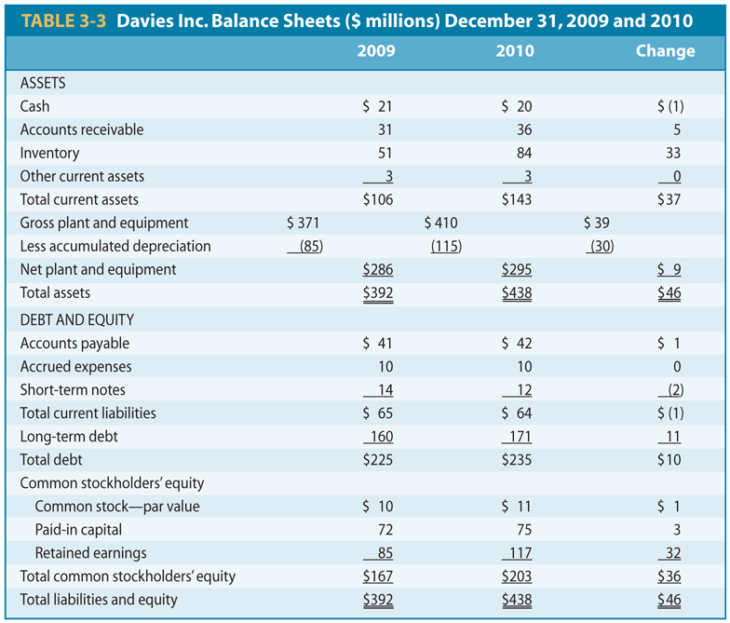
Table 3-3

Slide 5
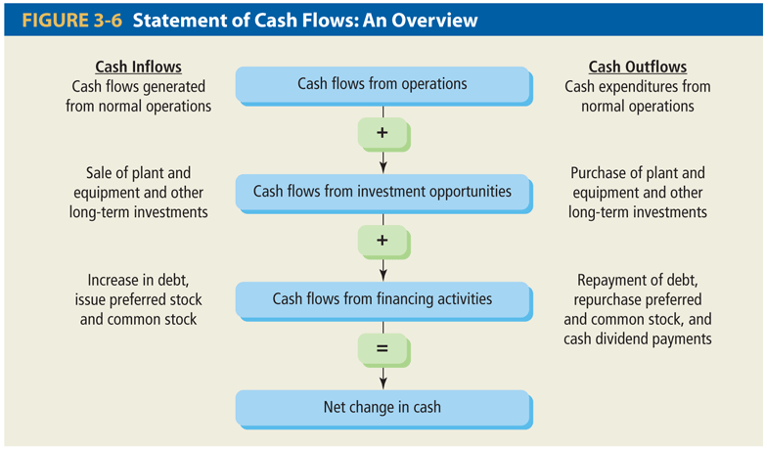
Figure 3-6
How to measure a firm’s cash flows

Slide 6
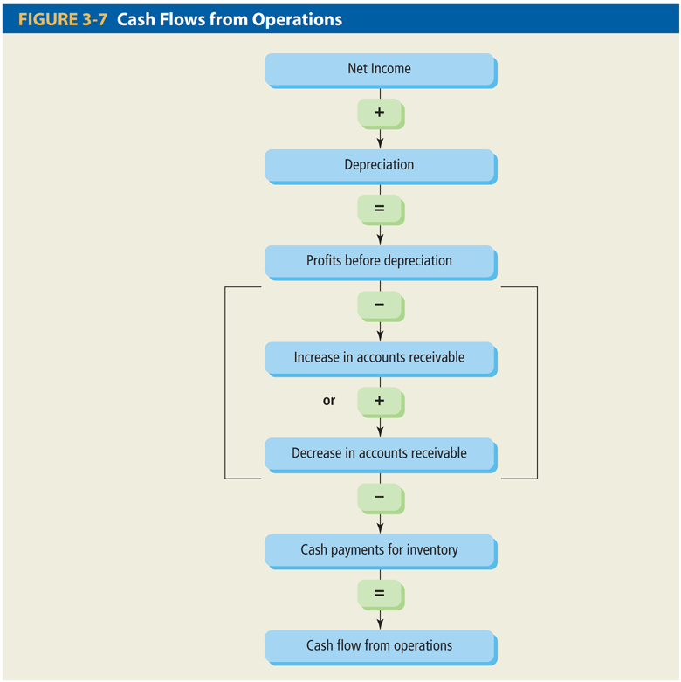
Figure 3-7

Slide 7
Sample Statement of Cash Flows
Cash, beginning of year |  | Financing Activity
Operating Activity |  | Decrease in Notes Payable
Net Income |  | Decrease in LT Debt
Plus: Depreciation |  | Decrease in C/S (minus RE)
Decrease in A/R |  | Dividends Paid
Decrease in Inventory |  | Net Cash from Financing
Increase in A/P
Increase in Other CL |  | Net Increase in Cash
Less: Increase in other CA
Net Cash from Operations |  | Cash End of Year
Investment Activity
Sale of Fixed Assets
Net Cash from Investments

Slide 8
Sample Balance Sheet
 | 2009 | 2008 |  | 2009 | 2008
Cash | 696 | 58 | A/P | 307 | 303
A/R | 956 | 992 | N/P | 26 | 119
Inventory | 301 | 361 | Other CL | 1,662 | 1,353
Other CA | 303 | 264 | Total CL | 1,995 | 1,775
Total CA | 2,256 | 1,675 | LT Debt | 843 | 1,091
Net FA | 3,138 | 3,358 | C/S | 2,556 | 2,167
Total Assets | 5,394 | 5,033 | Total Liab. & Equity | 5,394 | 5,033
Numbers in millions of dollars
3-8
Notes:
Students need to understand: increase in the cash account is a use of funds and vice versa.

Slide 9
Sample Income Statement
Revenues | 5,000
Cost of Goods Sold | (2,006)
Expenses | (1,740)
Depreciation | (116)
EBIT | 1,138
Interest Expense | (7)
Taxable Income | 1,131
Taxes | (442)
Net Income | 689
EPS | 3.61
Dividends per share | 1.08
Numbers in millions of dollars, except EPS & DPS
3-9
Notes:
The net income figure and EPS are based on income from continuing operations. There are 190.9 million shares outstanding.
So EPS (earning per share) = 689 million / 190.9 million shares = $3.61 /share.
So, Dividend paid = 206.172 million (=1.08 * 190.9 million)
So RE=NI – Dividend paid = 689million – 206.172 million= 482.828million

Slide 10
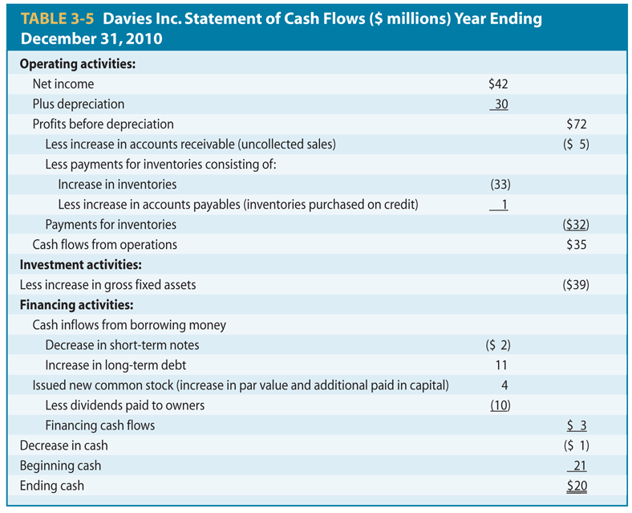
Table 3-5

Slide 11
In Class Exercise - I
48. Wise's Corner Grocer had the following current account values. What effect did the change in net working capital have on the firm's cash flows for 2009?
2008 2009
Cash 87 112
AR 309 321
Inventory 919 868
AP 617 714
A. net use of cash of $37
B. net use of cash of $83
C. net source of cash of $83
D. net source of cash of $111
E. net source of cash of $135
Notes:
11

Slide 12
In Class Exercise - II
During the year, Kitchen Supply increased its accounts receivable by $130, decreased its inventory by $75, and decreased its accounts payable by $40. How did these three accounts affect the firm's cash flows for the year?
A. $245 use of cash
B. $165 use of cash
C. $95 use of cash
D. $95 source of cash
E. $165 source of cash
Notes:
12

Slide 13
In Class Exercise - III
A firm generated net income of $878. The depreciation expense was $47 and dividends were paid in the amount of $25. Accounts payables decreased by $13, accounts receivables increased by $22, inventory decreased by $14, and net fixed assets decreased by $8. There was no interest expense. What was the net cash flow from operating activity?
A. $876
B. $902
C. $904
D. $922
E. $930
Notes:
13

