Slide 1
Ch. 8: Stock market
Ashley Johnson
Hunter Forbes

Slide 2
Learning objectives
Characteristics of Common Stock
Measure of the Level of the Stock Market
Valuation of Stocks
Investing in Stocks for the Long Run
The Stock Markets Role in the Economy

Slide 3
Overview of chapter 8
Stocks play a prominent role in our financial/ economic lives.
Firms deemed most valuable in market are the ones that will be able to obtain financing for growth.
Besides recessions/crashes, stock prices tend to rise even adjusting for inflation.
Goal of presentation: to try to make sense of the stock market, and explain why things go awry.

Slide 4
*The essential characteristics of common stock
Common stock: owning shares of a firm.
Began in the 16th Century.
Ownership of Common Stock Convey Number of Rights:
Stockholder is entitled to participate in profits of the enterprise
Stockholders are merely residual claimant, they get leftovers after creditors get paid.
Limited Liability: The shareholders are not personally responsible for the debts of a company. Only the assets of the business is at risk.
Shareholders can vote at annual meetings

Slide 5
TWO IMPORTANT CHARACTERISTICS
Shares issued into small denomination and could buy as little or as much as wanted.
Shares were transferable, meaning owners could sell to someone else

Slide 6
*Measuring level of the stock market
Stock market indexes: are designed to give a sense of the extent to which things are going up or down.
Two Main Ideas:
Dow Dow Jones Industrial Average
Best known
Index is based on 30 of the largest companies in the U.S.
Price weighted average: gives greater weight to higher prices shares
The company, GE, is only one of the original 11 still in it.
Standard and poor’s 500 index (S/P 500)
Based off of 500 firms opposed to 30.
Largest firms in the U.S economy
Value-weighted index

Slide 7
*The different ways of valuing stock
Chartists: Predict changes in stock prices by looking at patterns in its price movements.
Behavioralists: Estimate the value of stock based on their perception of investor psychology and behavior.
Fundamentalists: believe that the value of a firms stock depends on both its current assets and on estimates of its future profitability.

Slide 8
Fundamental value and the dividend- discount model
Fundamental value of a stock is based on the timing and the uncertainty it brings.
With stocks, payments are usually in the form of Dividends.
Equation for price today: a sum of future dividends and future price.
P_{TODAY} = D_{NEXTYEAR} + D_{IN2YEARS} + . . . + D_{nYEARSFROMNOW} + P_{nYEARSFROMNOW}
(1+ i) (1+i)² (1+i)^{n} (1+i)^{n}

Slide 9
So how do we know what “d” is going to be in years to come?
We have to make the assumption that grow late is constant (g). Which leads us to the following equation:
D_{nYEARSFROMNOW} = D_{TODAY} (1+g)^{n}
…

Slide 10
HOWEVER...
We cannot solve the original equation without knowing what “P_{nYEARSFROMNOW}” is.
We can solve this problem by assuming a firm pays dividends forever. This assumption turns stock into something like a “console”, it never repays the principal.
This allows us to finally simplify the equation into:
P_{TODAY} = D_{TODAY} (1+g)
(i-g)

Slide 11
*RISK AND THE VALUE OF STOCK
Stockholders require compensation for the risk they face. The higher the risk, the greater the compensation.
Since the future sales price is unknown, the investor will require compensation in form of “risk premium”.
This “risk premium” added with “risk-free interest rate” is seen as required return… AKA the interest rate.
This changes the previous equation to:
P_{TODAY} = D_{TODAY} (1+g)
(rf – rp – g)

Slide 12
Dividend-discount model video
https://www.youtube.com/watch?v=TlH3_iOHX3s

Slide 13
The theory of efficient markets
The notion that the prices of all financial instruments, including sticks, reflect all available information.
As a result: markets adjust immediately and continuously to change in fundamental values.
This theory implies that stocks are unpredictable.
If they weren’t, you could easily forecast what will rise and get rich quick.

Slide 14
*Why invest in the long run?
Long-term: more than 10 years of investment. Over long-term time periods, stocks offer more potential rewards.
Even though investing stock is risky, investing for a long period of time will give you the ability to recover from any loss.
Investing in stocks = less risky than bonds.

Slide 15
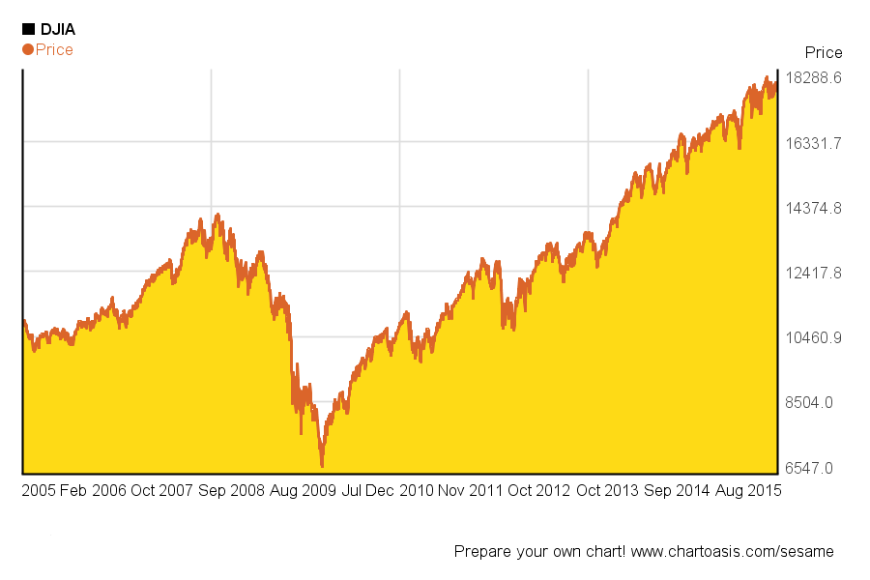
For example:
Stock market: Dow Jones 10 year chart
This graph includes the financial crisis. Today, it is 3000 points above the pre-crisis peak (17800 vs. 14400).
Notice that since 2009, the market started to grow rapidly.

Slide 16
*the stock market’s role in the economy
The stock market plays a crucial role in every modern capitalist economy.
While many economists believe that markets are reasonably efficient and that prices reflect fundamental values, it is possible that shifts in investors psychology may distort price.
This can be caused by both Euphoria and depression

Slide 17
Euphoria and Depression are both contagious.
When investors become exuberant about the markets future prospects, regardless of evidence, prices will rise.
This mass enthusiasm creates “Bubbles”.
Bubbles: are persistent gaps between actual stick prices and those warranted by fundamentalists.
Eventually, these bubbles burst, creating crashes.

Slide 18
The consequences of these bubbles are not innocuous.
Firms that are not objects of this business euphoria have a more difficult time raising finances, so they invest too little.
These companies find it almost impossible to obtain financing for new projects after the bubble bursts.

Slide 19
Bubbles are equally damaging to consumer behavior.
When a Bubble is building, people think they are wealthier than they truly are. Then they start to buy things they cannot afford.
When bubble bursts, people are forced to reevaluate wealth. Firms that got all their business from these people suffer from lack of business when this happens.

Slide 20
Lastly, large market swings alter economic prospect even when they are grounded in fundamentalists. In the recent financial crisis, the disruption of liquidity and credit undermined profit prospects for many companies.

Slide 21
questions
1. What is common stock?
2. Why should you invest in stock for a long period of time vs. a short period of time?
3. When investors become exuberant about the markets future prospects, regardless of evidence, what will happen?
4. What happens when a bubble is building?
5. Can shareholders vote in annual meetings?
6. Stockholders do not require compensation for the risk they face. The higher the risk, the lower the compensation. True or false?
7. Who can invest in stock?

Slide 22
Answers
1. What is common stock?
Owning shares of a firm.
2. Why should you invest in stock for a long period of time vs. a short period of time?
Over long periods of time stocks offer more potential rewards.
3. When investors become exuberant about the markets future prospects, regardless of evidence, what will happen?
Prices will rise.
4. What happens when a bubble is building?
People think they are wealthier than they really are, and they start to buy things they cannot afford.

Slide 23
Answers
5. Can shareholders vote in annual meetings?
Yes.
6. Stockholders do not require compensation for the risk they face. The higher the risk, the lower the compensation. True or false?
False.
Correct answer: Stockholders require compensation for the risk they face. The higher the risk, the greater the compensation.
7. Who can invest in stock?
Anyone

