Slide 1
Market Observations as Seen Through the Eyes of a 43 Year Wall Street Executive
Presented by Sam Peluso
Retired Merrill Lynch Executive

Slide 2
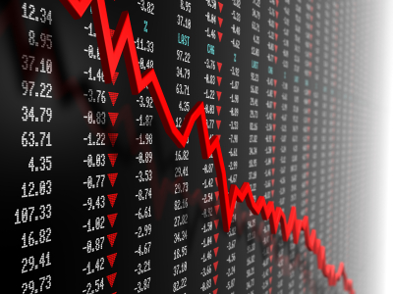
Where Are We Today ?
Just Went Through An Unprecedented Worldwide Economic Meltdown
The Response Was Unprecedented As Well
Yet Still Close to Record Equity Levels And All Time Record Low Interests Rates
So Why ? “Thank You Fed”

Slide 3
Federal Reserve Bank
Primary Role vis a vis the Banking System
Fiscal---Monetary Policy
Past Decisions –
Bail Outs “FAT CATS” vs. “ALLEY CATS”
Q E Bond Buying
Current Thinking- Inflation vs. Employment
Future Plans- Time To Take Off The Training Wheels End Bond Buying Program And Allow Fed Funds To Trade Freely

Slide 4
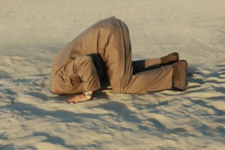
How Prepared are Investors for the Fed’s Announced Future Moves?
Have I missed it?
Afraid to get in and afraid to get out.

Slide 5
Current Environment- Equities
Is It Overbought ?
2008/2009 Melt Down
Are Portfolios Under Invested ?
RSI- Relative Strength Index

Slide 7
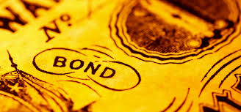
Current Bond Market Environment- Fixed Income
Too Expensive---Fed Funds @ 0% to .12 Basis Points
2008 Fed Funds
Future Losses---If Interest Rates Rise
2yr-10 yr-30yr.

Slide 8
What is Your Portfolio Telling You?
Are You Over/Under Invested In Stocks vs. Bonds?
Over Exposed In One Industry Or One Country?
Does One Security Represent More Than 25% Of The Portfolio?
Are You Satisfied With Your Cash Holdings?

Slide 9
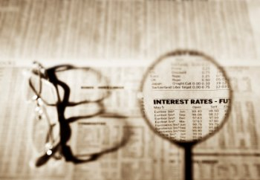
Now What ?
Should We Buy, Hold Or Sell ?
Need a Professional, Comprehensive Investment Plan!
Your Current Needs
Short/Long Term Investments

Slide 10
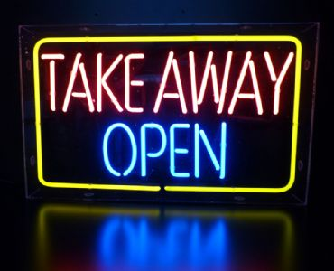
Take Aways
Seek Help For A Comprehensive Investment Plan.
Don’t Be “Overly” Concerned By Any One Particular Environment, There Will Always Be Reasons to Sit On The Sidelines.
Don’t “Buy and Forget” Your Portfolio! -Rebalance!
Think Liquidity.
Don’t Forget to “Pay Yourself First!”

Slide 11
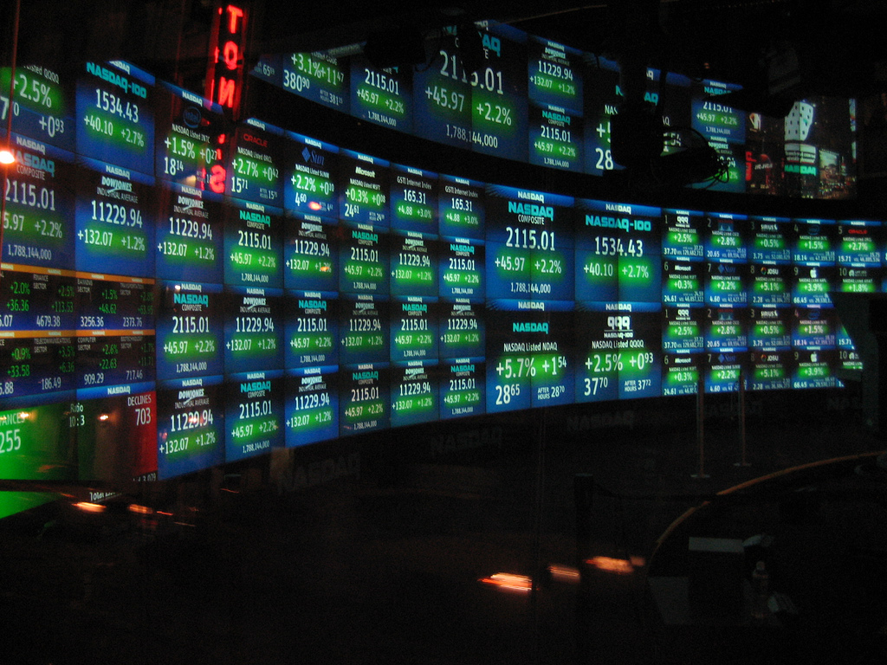
Today’s Wall Street
It Continues to Consolidate
Learned and Still Learning Hard Lessons
HR and Legal/Compliance Call Shots
Fewer Employees
More Service Oriented-Better Educated

Slide 12
Today’s Wall Street
More Government Restrictions
Under Federal Reserve Control
Tarnished Reputation
US Not the Only Market
Can't be All Things to All People

