Slide 2
Satoshi Nakamoto
2008 August website
A Peer-to-Peer Electronic Cash System
2009 Open-source software
21 Million Bitcoin

Slide 4
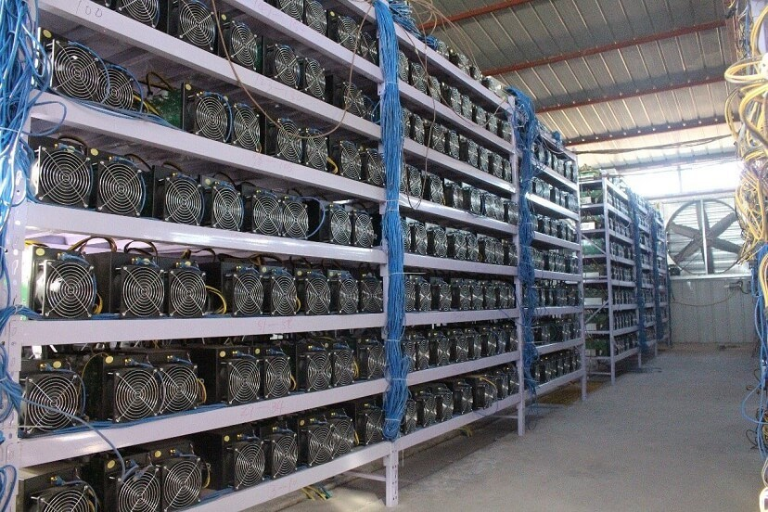

Slide 5
